Slide 1
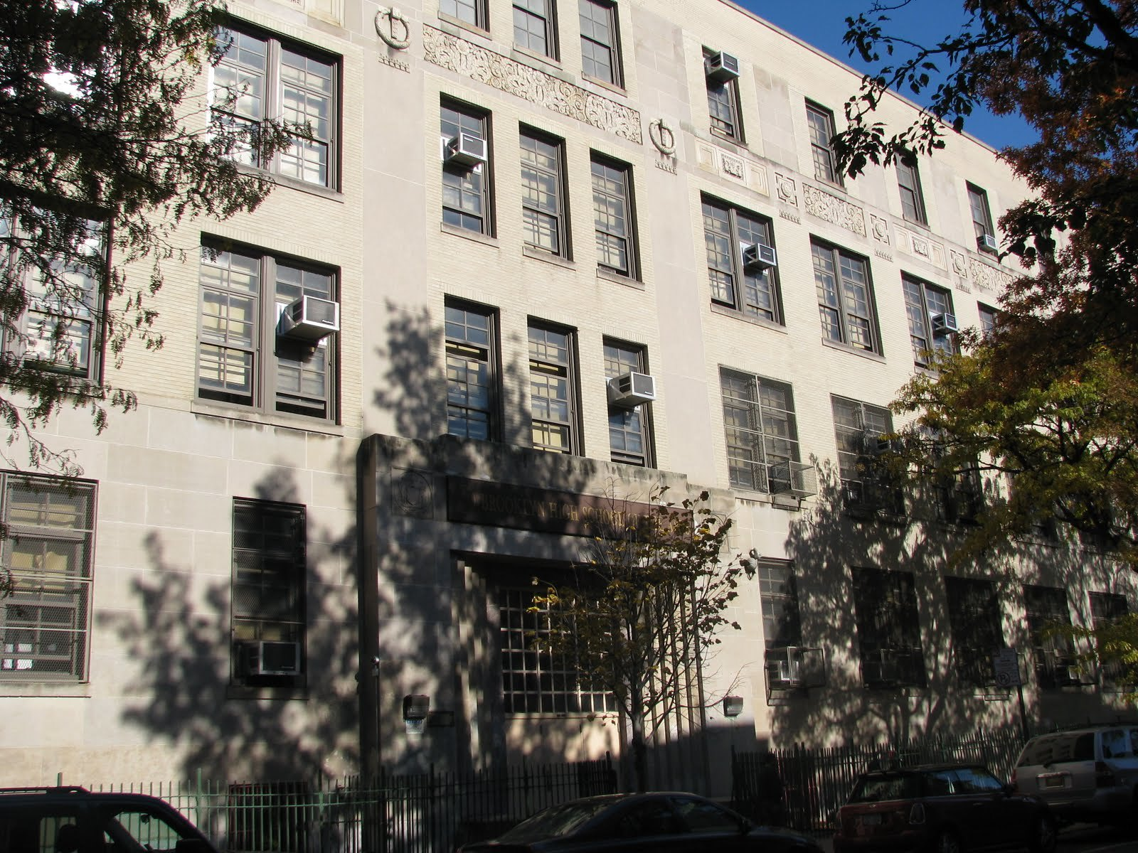

MS447 The Exploratory School

Slide 2
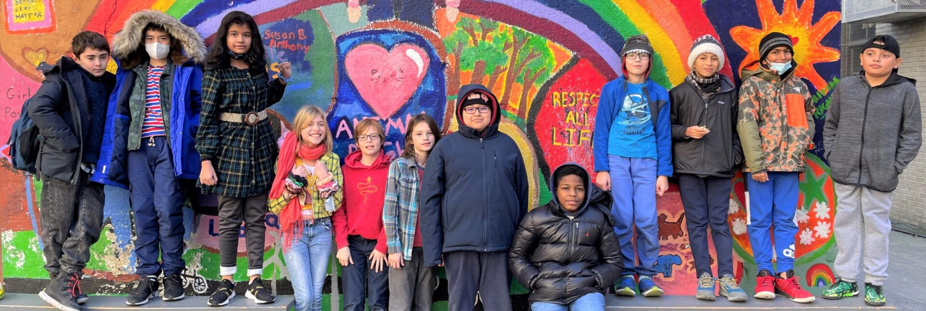
The Basics…
Rigorous and nurturing academic environment
Approximately 530 students
6 classes per grade
Integrated Co-teaching Classes on all grades
3-year advisory program
Busing for 6th Graders
Competency-based education

Slide 3
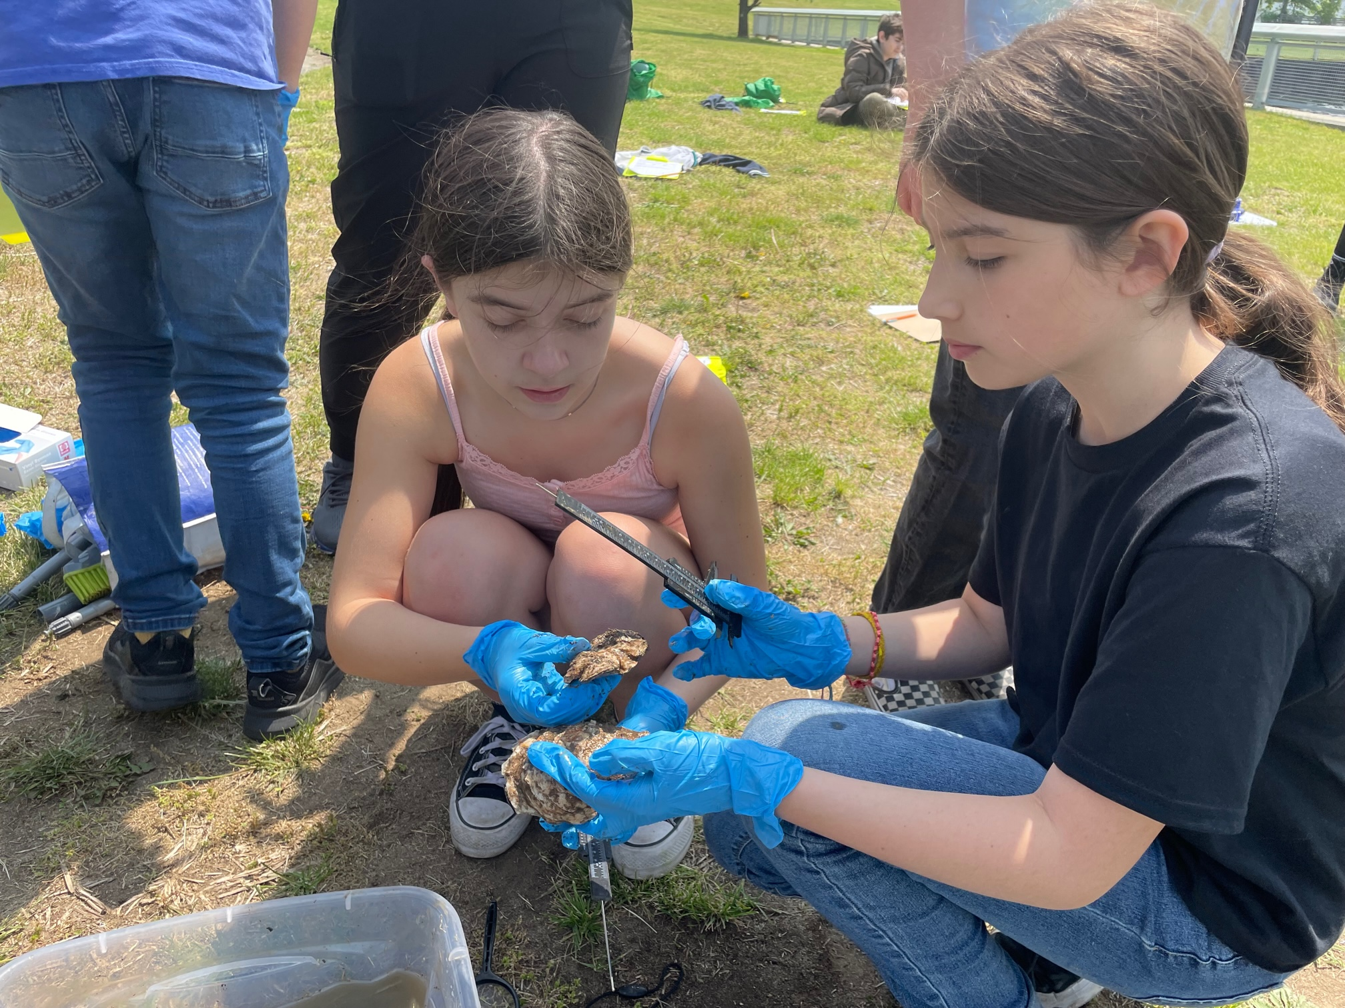
In our community…
We act with INTEGRITY
We work for JUSTICE & EQUITY
We listen and learn with CURIOSITY & JOY
We take RESPONSIBILITY
We all BELONG here!

Slide 4
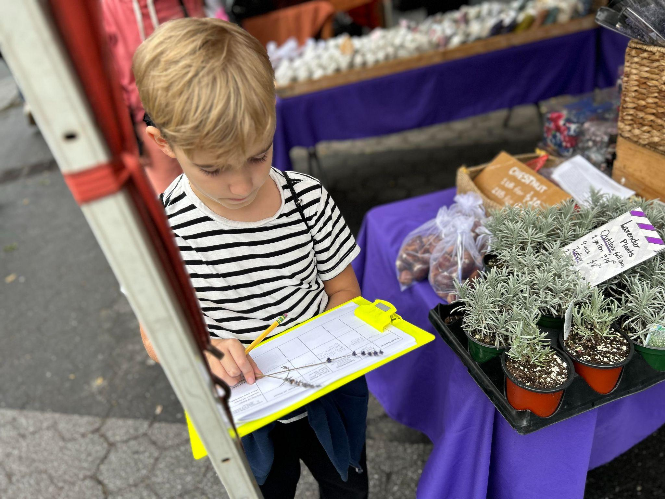
What we do…
Learning through Inquiry-Based Experiences: Opportunities that empower students to question, explore and make sense of the world around them.
Collaboration and Partnership: Between students, teachers, families, and our city
Education of the Whole Child: Students as citizens who are self aware, socially aware, and environmentally aware, and act as responsible members of our community.

Slide 5
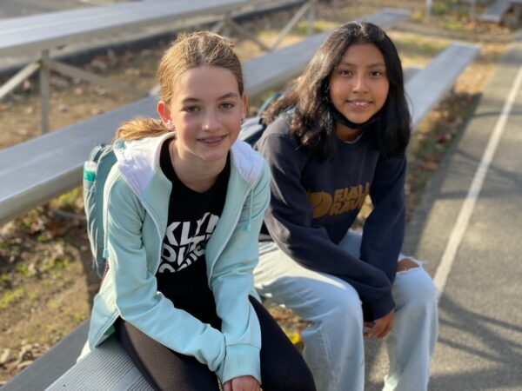
Pack Advisory
Community-building circle structure
Empathetic listening
Self-awareness, self-management
Social awareness
Relationship skills
Responsible decision making
Race and Identity
Organization

Slide 6
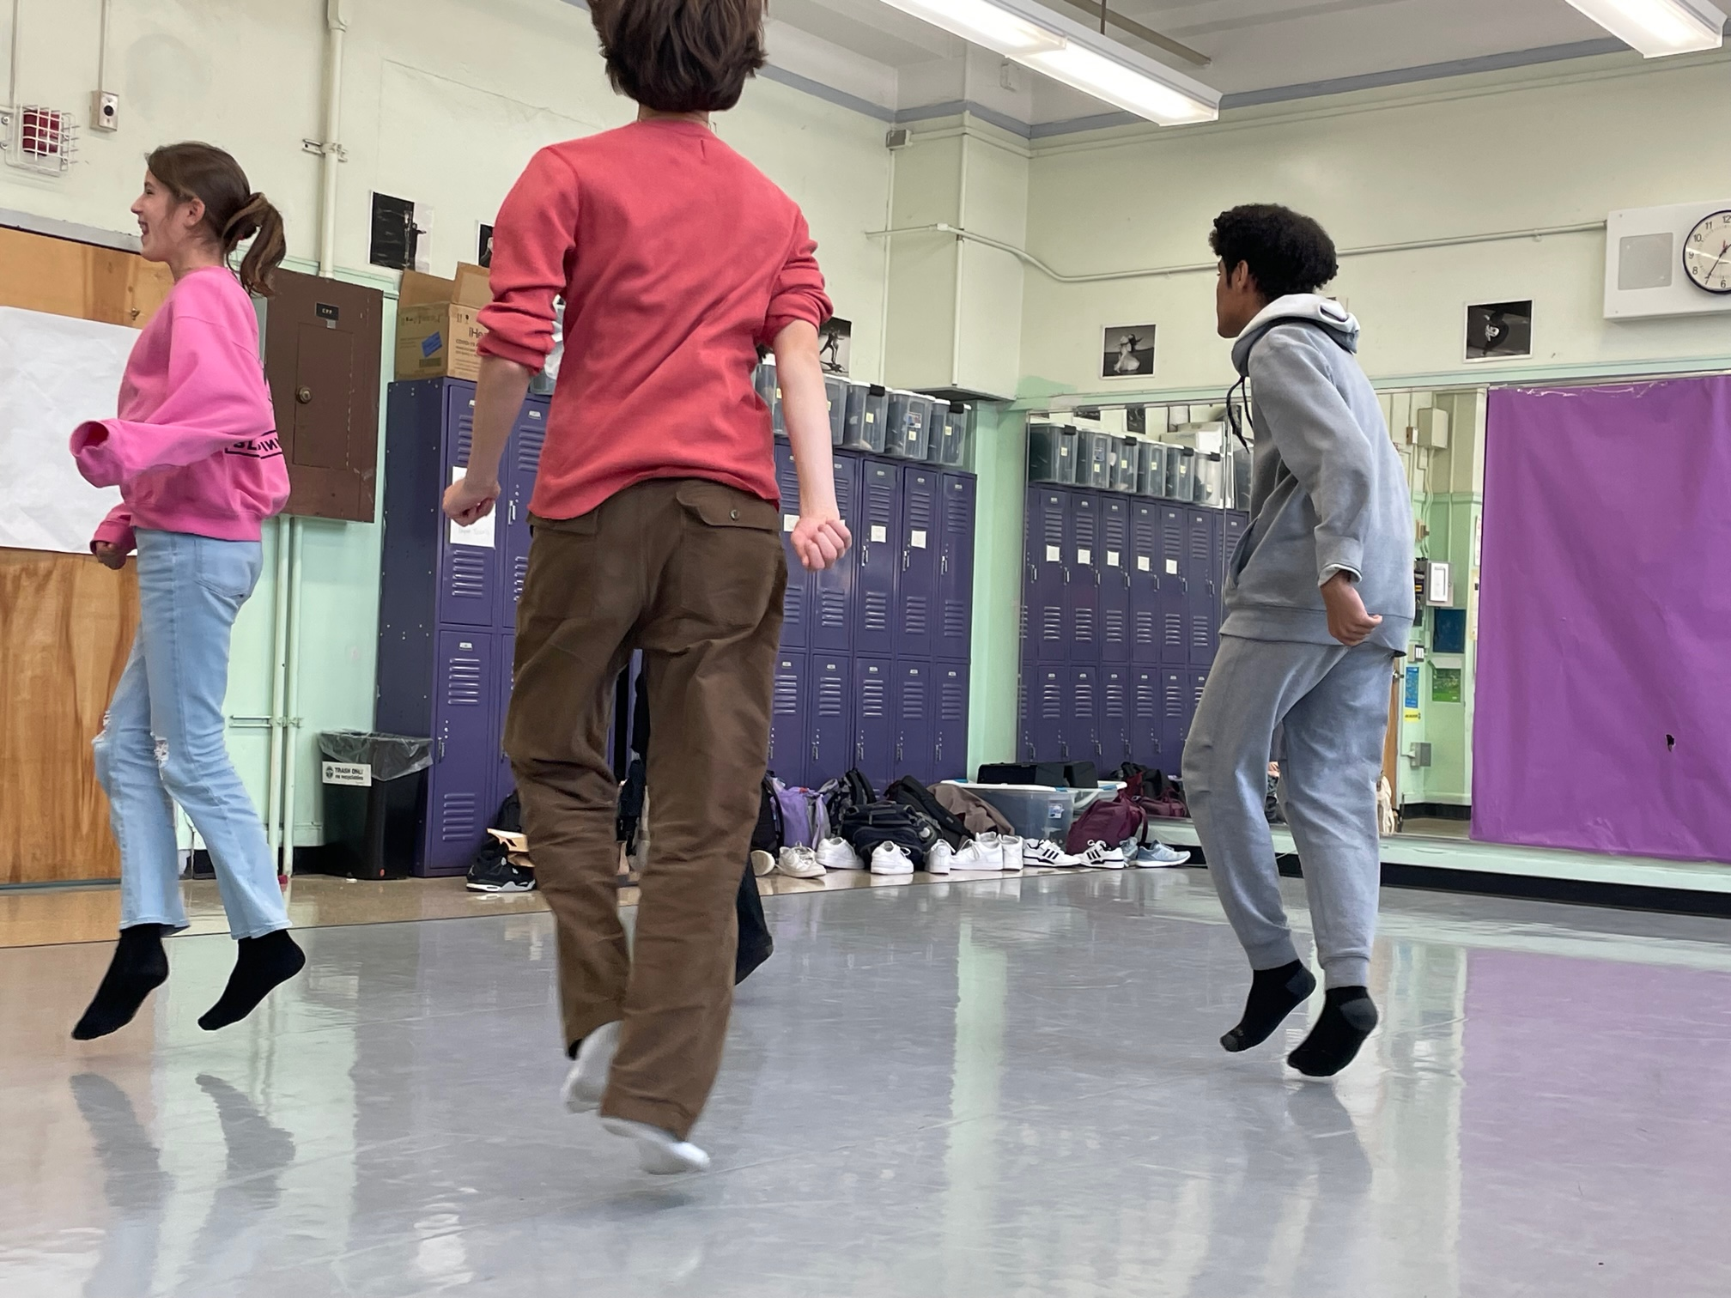
Social Emotional Learning
Conflict resolution
Student Equity Team
Student Council
Peace and Diversity Conference
Restorative approaches to discipline
Lunch Clubs and Recreation
Strong Support Staff

Slide 7
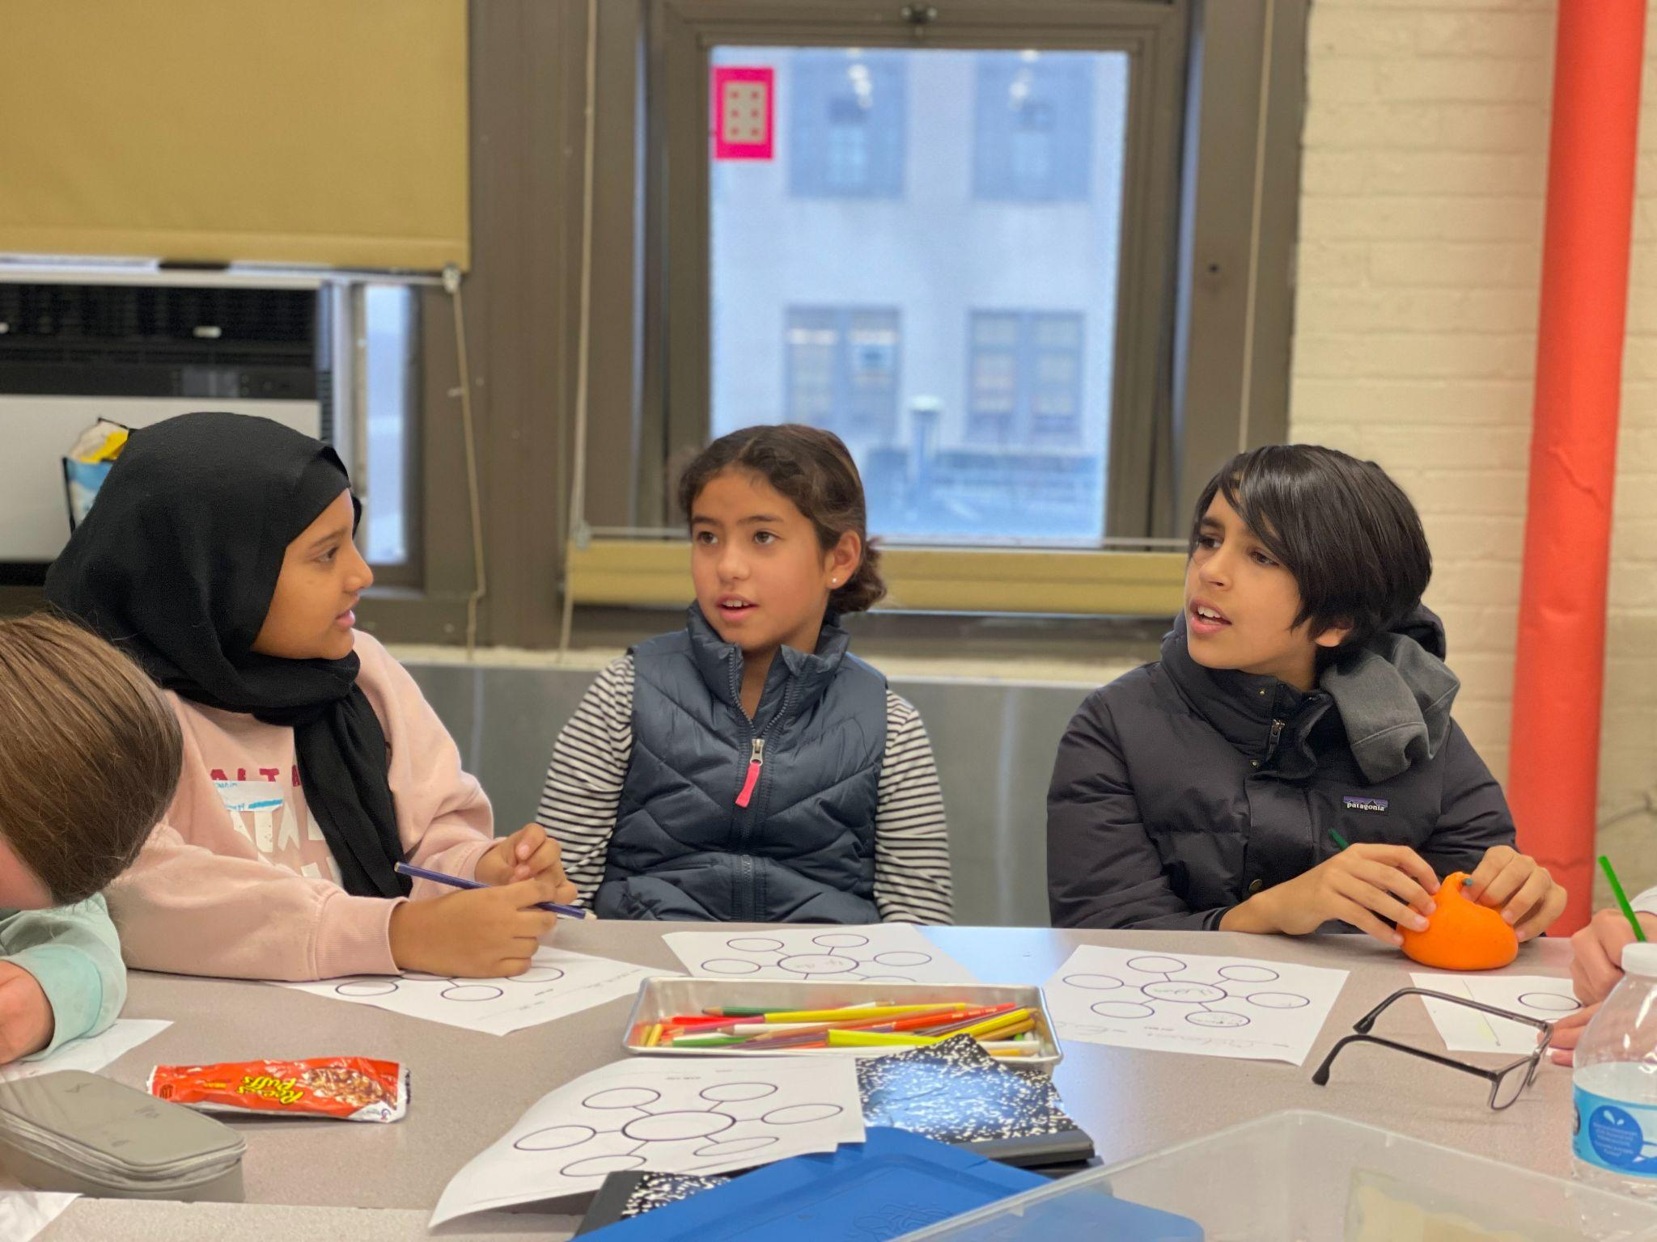
Special Education, ENL, Academic Intervention Services, & Student Support
Integrated Co-Teaching (ICT) inclusion program
ASD Nest Program
SETSS
Speech, OT, and PT
ESL services
Lab periods (Literacy and Math) for small group targeted instruction and academic intervention
Counselors on all three grades
Office Hours with teachers

Slide 8
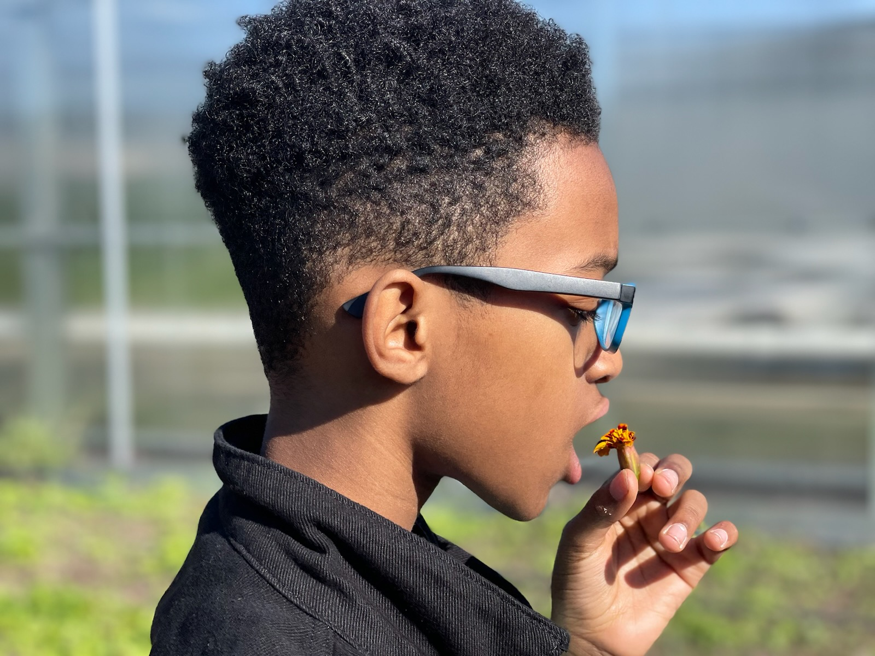
Exploration Program
Interdisciplinary units focused around a central theme
Taught onsite & offsite by a core six-teacher team
Collaborations with NYC cultural institutions
Each unit ends with an Exposition for friends & family
Exploration Units of Study:
6th Grade: Food for Thought, Water Stewardship
7th Grade: Art for Planet Earth, Gowanus Blue
8th Grade: Mini Passion Project; Inventions and Systems for a Better World, Forensic Science and the Carceral System

Slide 9
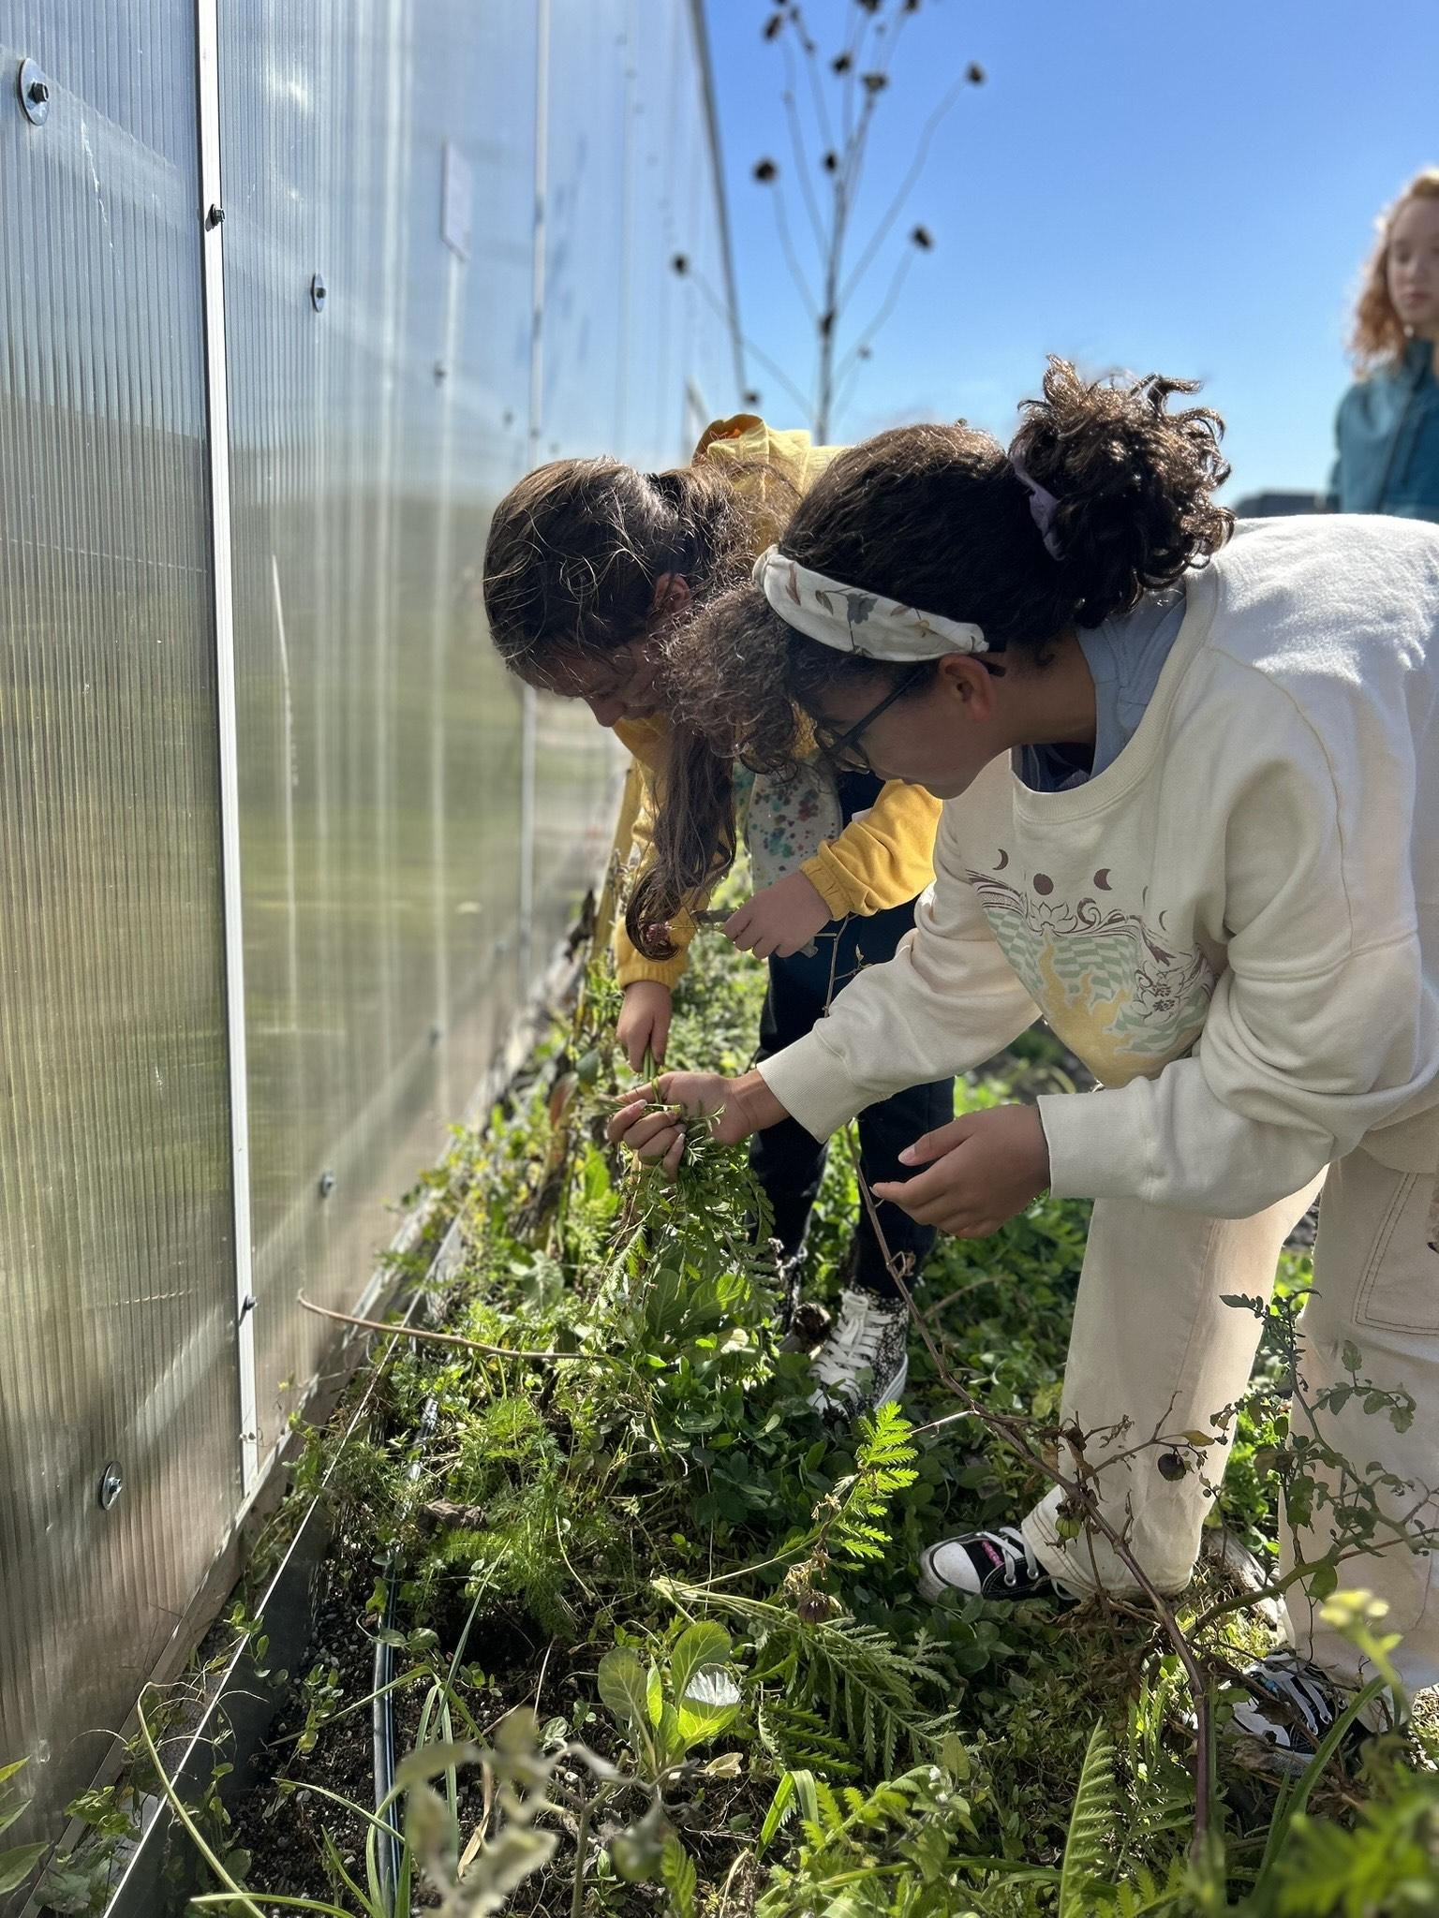
Some of Our Destinations and Collaborations…
Brooklyn Botanic Garden
Sloop Clearwater
The Innocence Project
Center for Architecture Foundation
Dolan DNA Learning Center
Gowanus Canal Conservancy
NYC Mayor's Office of Sustainability
Queens Museum of Art
NY Hall of Science
Taste Buds Kitchen

Slide 10
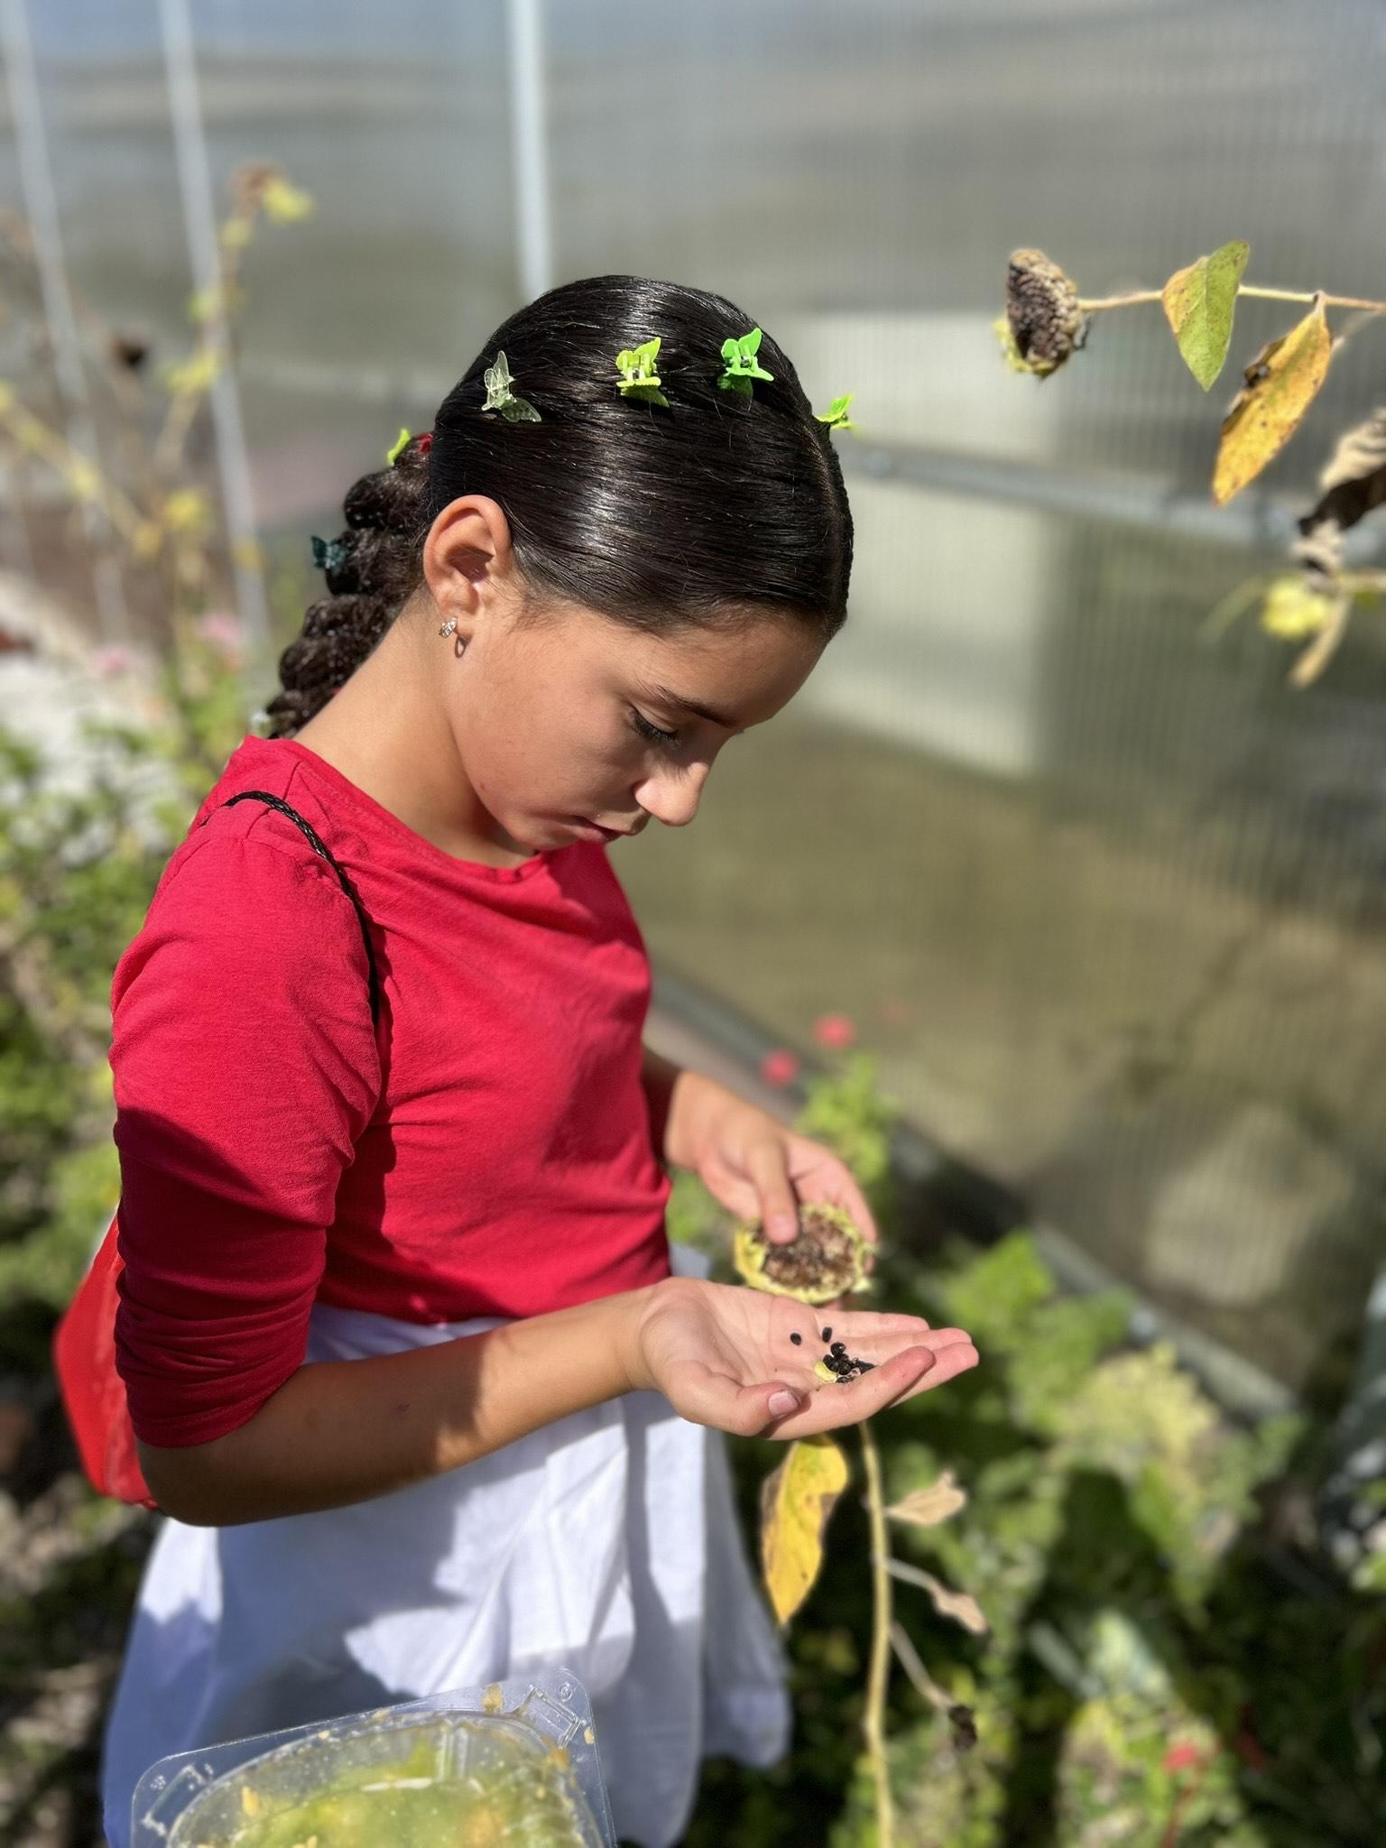
…And Some More
Paley Center for Media
Brooklyn Grange Rooftop Farm
Museum of Natural History – Sackler Lab
Frick Collection
Jamaica Bay Wildlife Refuge
Liberty Science Center
Metropolitan Museum of Art
NYC Greenmarkets
Museum of Tolerance
Oyster Farming in Red Hook
Prospect Park
One World Trade Center

Slide 11
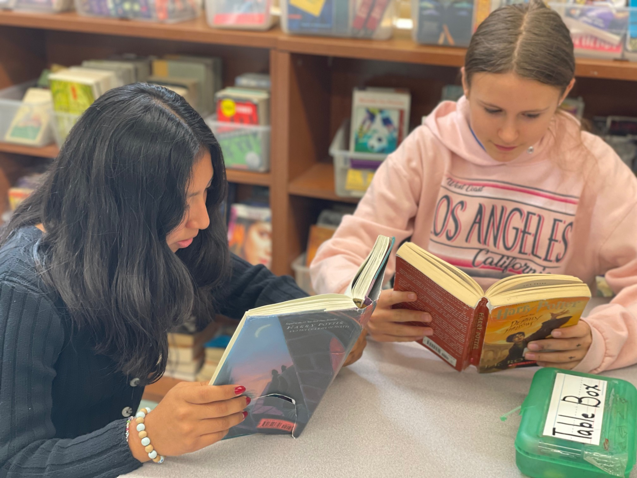
English Language Arts
We follow a comprehensive literacy (reading, writing, word study) curriculum in English Language Arts
Reading and writing across all subjects
Daily instruction reflects a cooperative spirit in which students engage with one another to ask big questions, make meaning, synthesize, apply, and share their learning
Emphasis on student voice

Slide 12
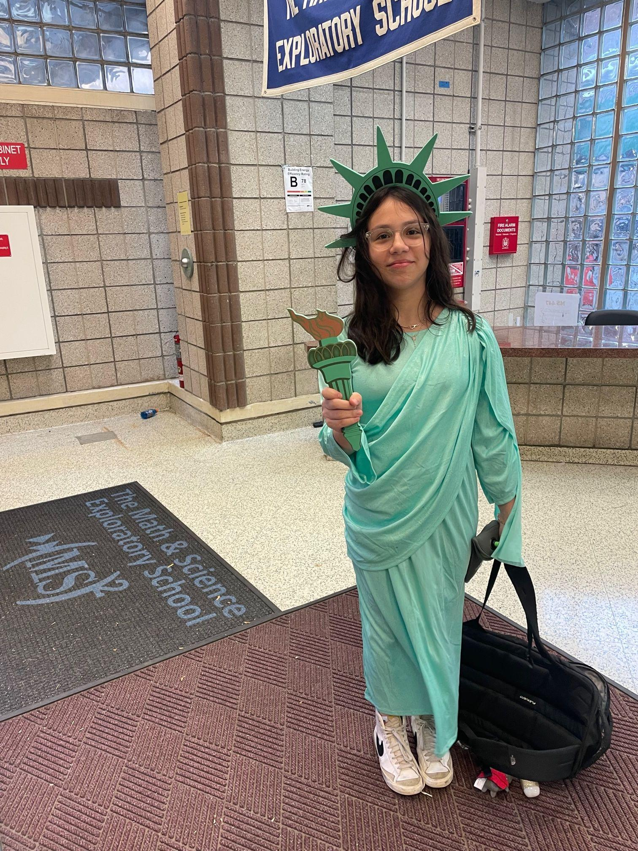
Social Studies
6th Grade: Ancient civilization and non-Western countries
7th & 8th Grades: US History
Collaborations: Facing History and Ourselves, Constitution Works

Slide 13
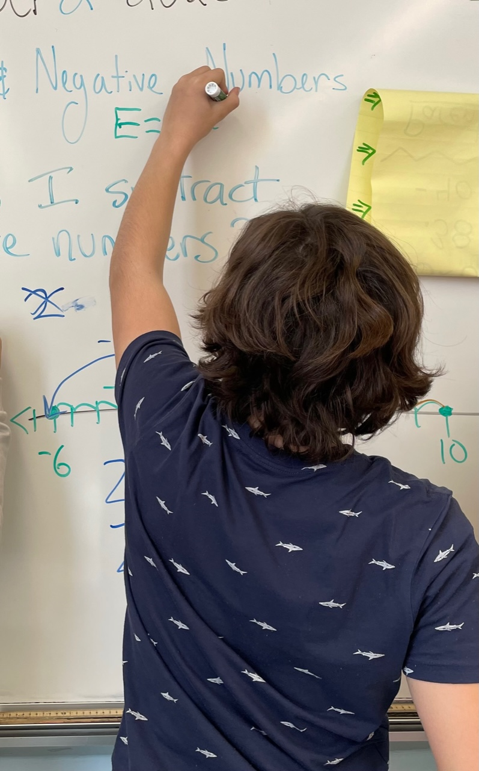
Mathematics
Illustrative Math curriculum - inquiry based
Development of deep understanding of mathematical processes through problem-solving, conversation, and routine skills practice.
Algebra 1 Regents exam at the end of 8th grade.

Slide 14
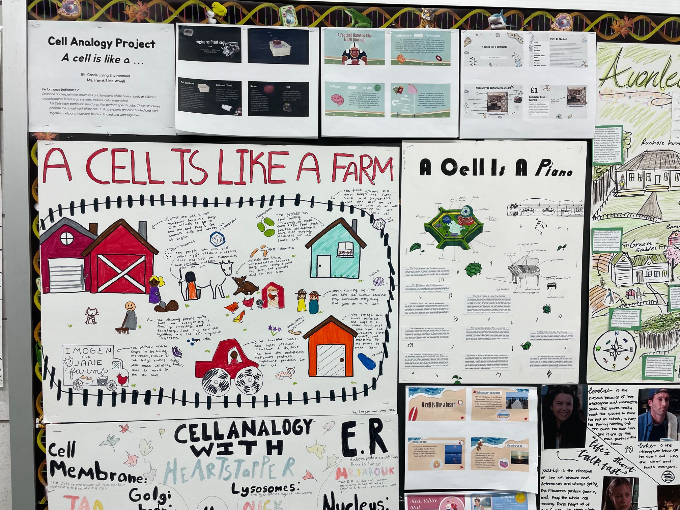
Science
Earth Science, Physical Science, Life Science
Inquiry-based lessons and projects
Long-term investigations
Emphasis on four modes of investigation
  Controlled experiments
  Secondary research
  Field study
  Exploring working model/systems
Biology Regents for all students in 8th grade
Urban Advantage School

Slide 15
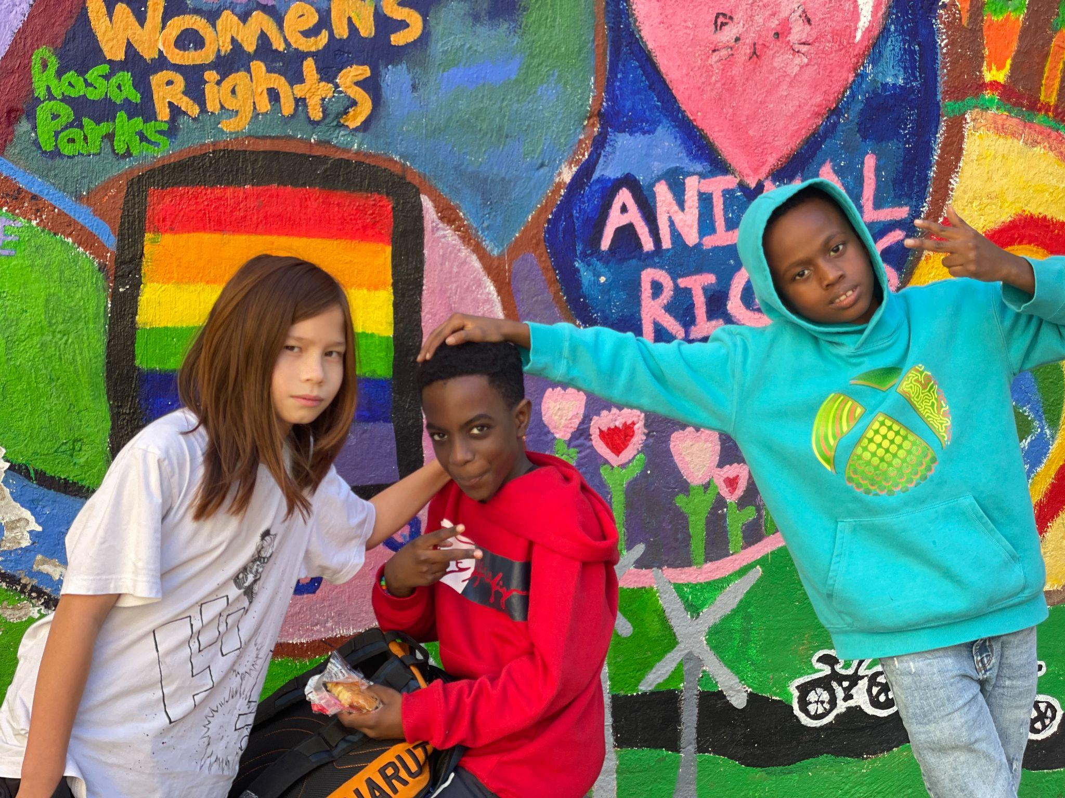
Foreign Language
Spanish, Grade 8
Focus on grammar, reading, writing, and speaking/conversation
Spanish Proficiency Exam offered (TBD)

Slide 16
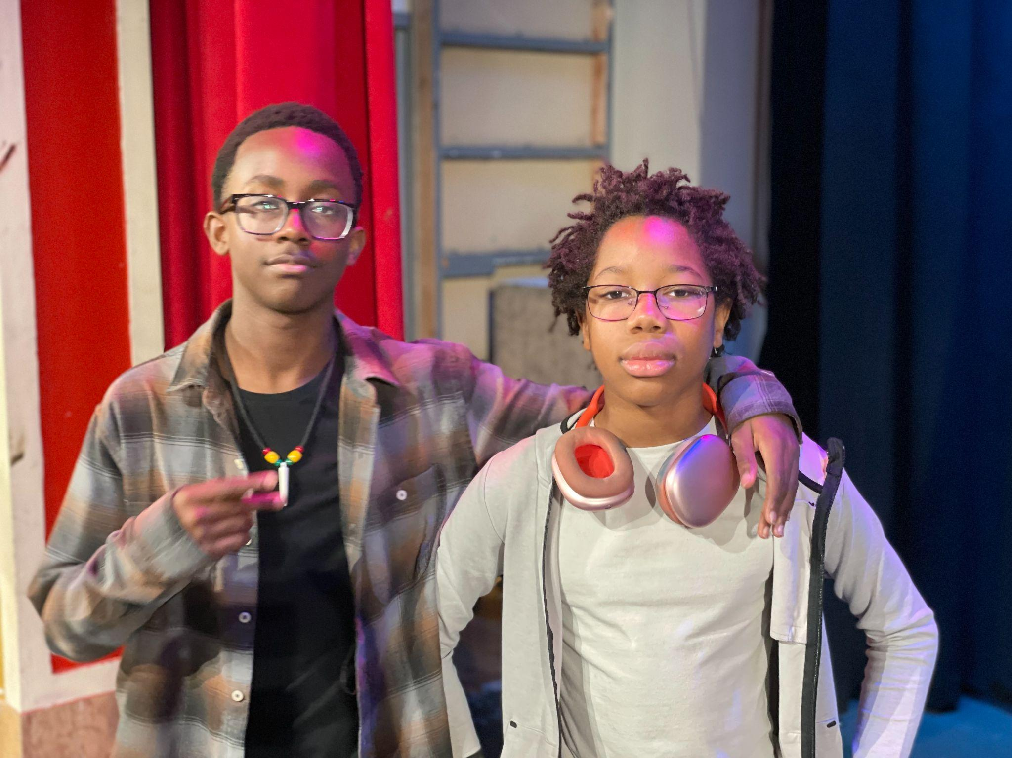
Arts and Technology
All students Grades 6-8 Participate in Studio Art, Performance Art, or Technology
Talent choices:
Dance
Instrumental Music
Theater
Studio Art
Technology

Slide 17
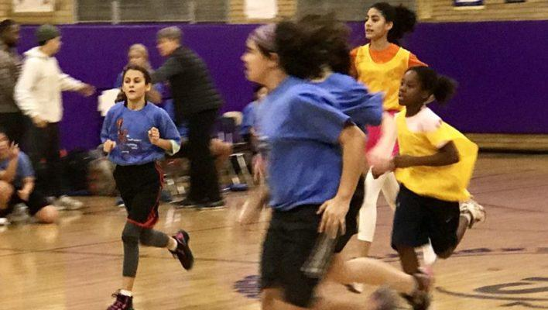
Physical Education and Health
Two or three P.E. periods per week
Sports and Games/Team building
Fitness/Healthy Living
Additional Health class in 6th and
7th Grade
Recess Sports
Morning gym program

Slide 18
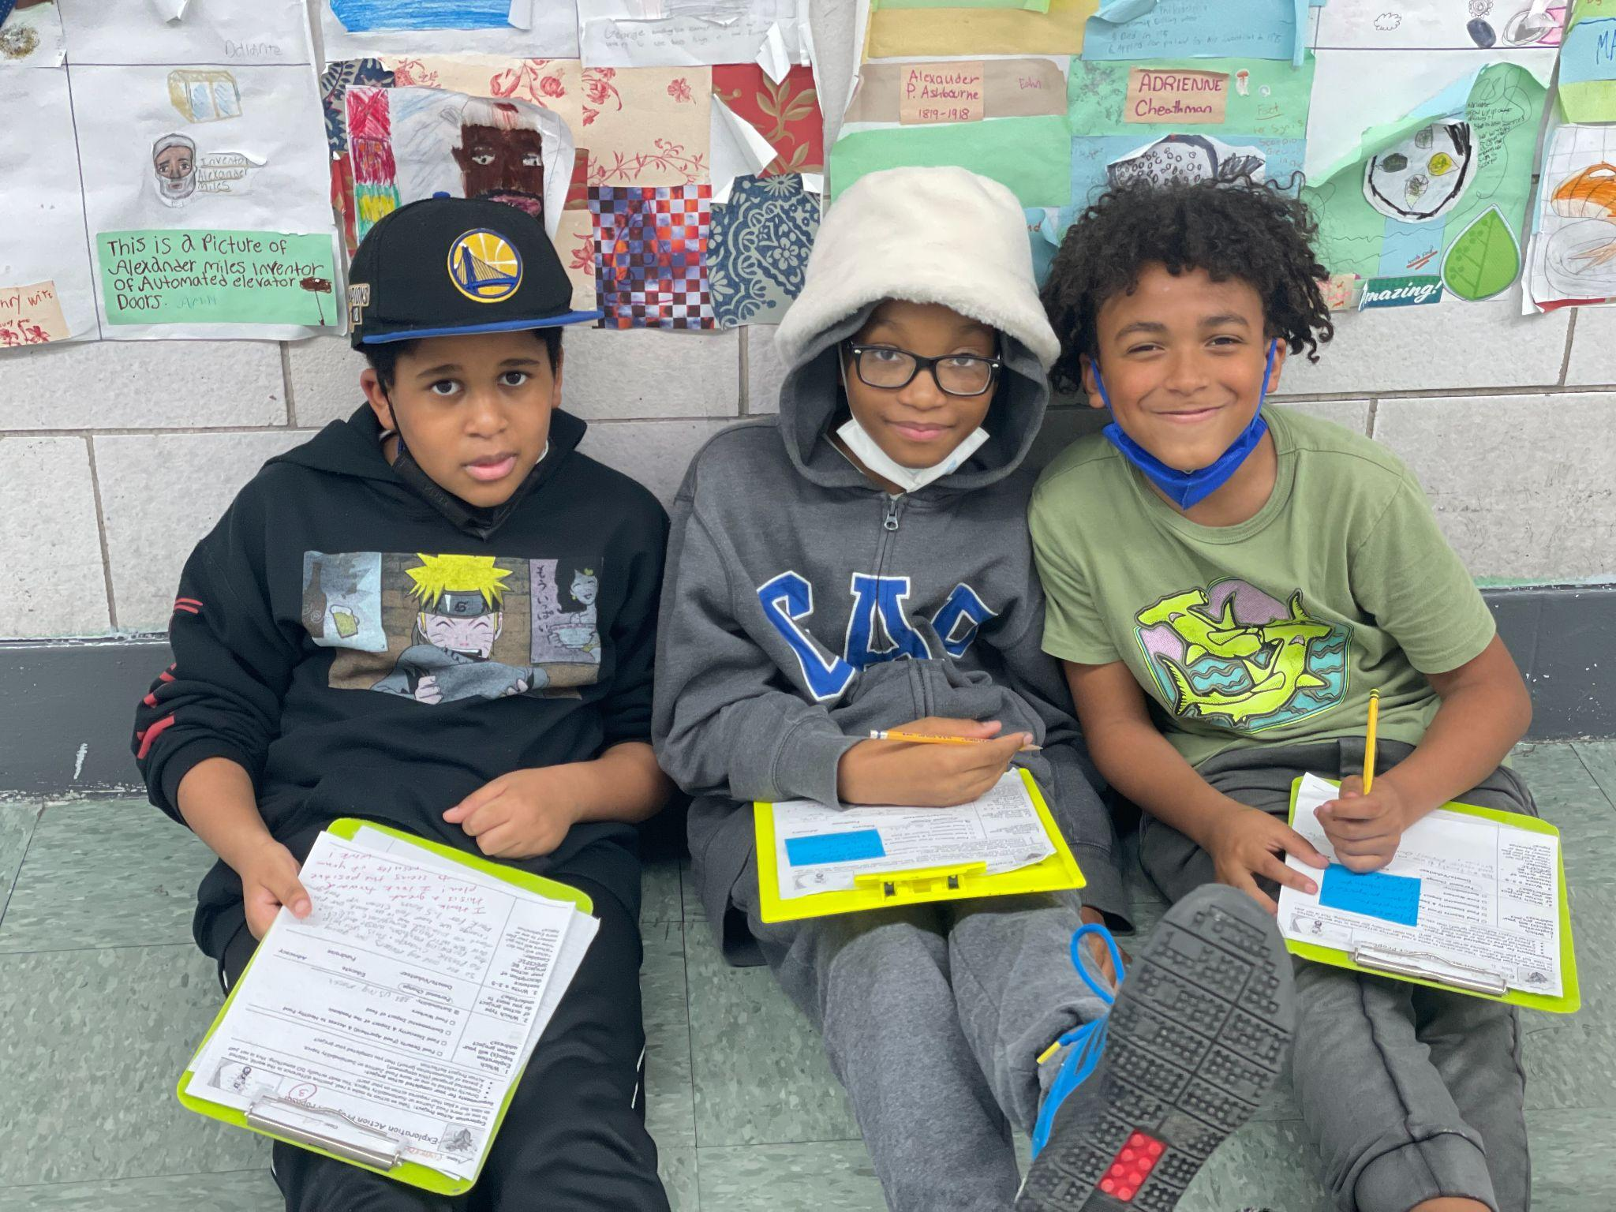
Competency-Based Education
Competency based education provides built-in, specific, and ongoing feedback to students
Opportunities for revision and goal-setting
Habits of Work
Student-Led Conferences

Slide 19
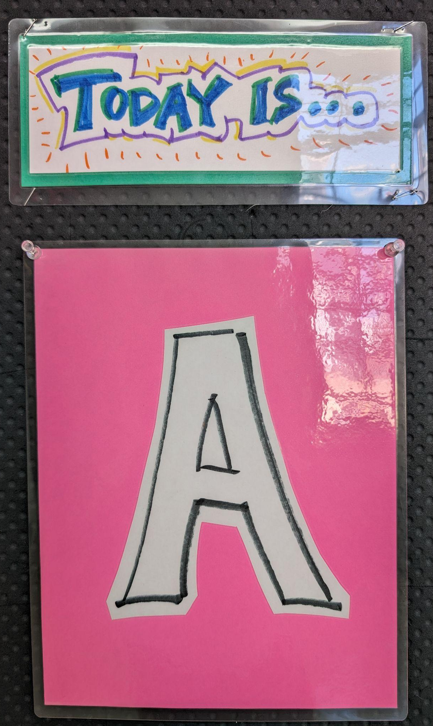
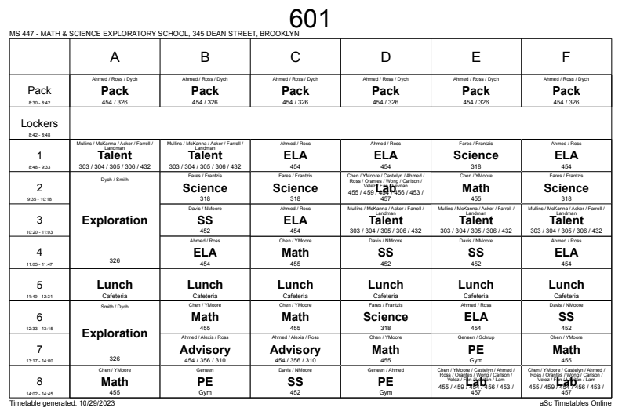
6-Day Schedule (A-F)

Slide 20
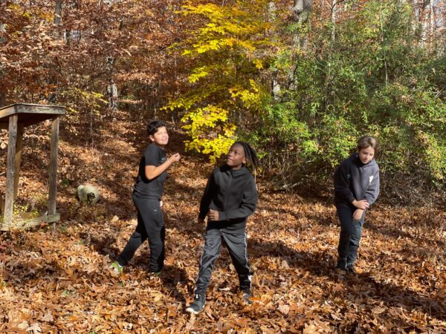
6th Grade Camp Trip
Two days, one night
Community building
Outdoor learning
New friends!

Slide 21
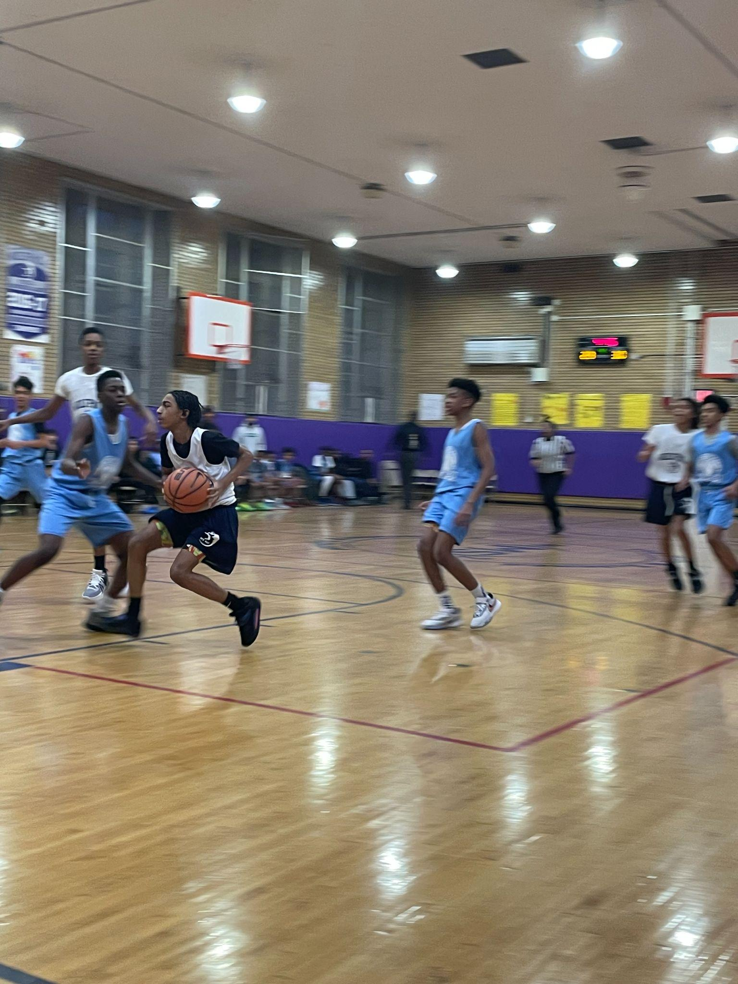
After School Programs
Free, full-time after school program (SONYC)
In partnership with LeAP
Robotics, Fine Arts, Dance, Basketball, Flag Football, Soccer, Volleyball, Spoken Word/Creative Writing, Photography, Film Production, Cartooning, Theater, Songwriting, Games Factory, Vocals, Life Skills and Leadership, Homework Help, Newspaper, Student Council, GSA, Debate Team, and more…

Slide 22
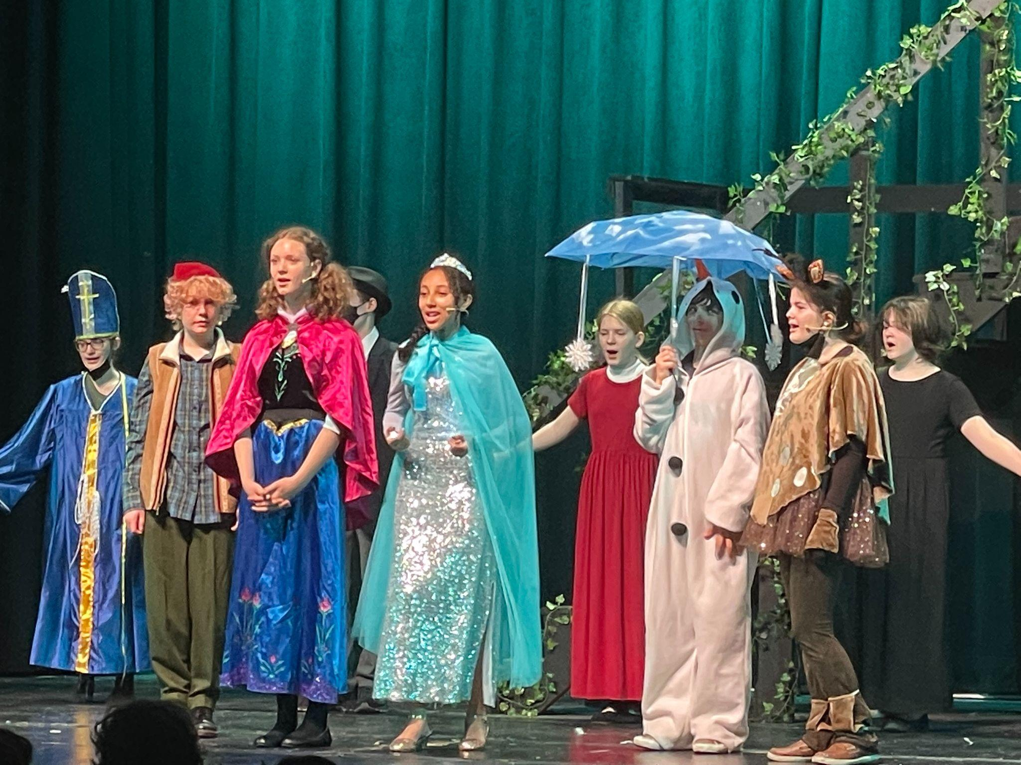
Learn more…
Visit our website: ms447.org
Check out our admissions materials
Contact our Parent Coordinator, Amy Sirot asirot@ms447.org

