Slide 1







General Information
Hera Yoon
hyoon@ms447.org

Slide 2


The Exploratory School
Curriculum Night
Grade 8
2025-2026
Welcome!
We will begin at 5:45 pm

Slide 3
Grade 8 Admin
Hera Yoon
Hyoon@ms447.org
Up Next:
Related Services

Slide 4


Related Services
Jessica Saunders (IEP Coordinator)
Zoe Parker (School Psychologist)
Stacey Billups (Social Worker)
Paula Bentsianova (SLP)
Marina Dimitrova (SLP)
Jane Baraz (SLP)
Nat Hookway (OT)
Up Next:
Social Worker/ Guidance Counselor

Slide 5
IEP Coordinator
Work with SETSS/ICT teachers and Related Service Providers to develop annual IEPs that “meet the child where they are at”
Meet with ICT grade teams weekly to discuss observations and make whole-grade shifts to support the child (academic, executive functioning, self-regulation)
IEP goals monitoring via data across the year
ICT/Nest Coach to support students and teachers/providers with the home/school connection

Slide 6
Speech-Language Therapy
Speech & Language
Comprehension
  Reading
  Listening
Expression
  Written
  Spoken
Articulation
Fluency (Stuttering)
Pragmatic Language/Social Development Intervention (including NYU Nest Support Project)
Perspective Taking
Peer Engagement
Problem Solving
Up Next:
Social Worker/ Guidance Counselor
Pbentsianova@ms447.org-Mdimitova@ms447.org-Jbaraz@ms447.org

Slide 7
School Counselor
Star Corvinelli
Contact: scorvinelli@ms447.org
Up Next: Exploration

Slide 8
High School Application Timeline & Important Information:
Look out for High School emails from Star, all posted on www.ms447.org
Students can attend Star’s lunchtime office hours to ask any questions about their application.
Essay writing session: Students will work on an essay in lab that can be used for the Common Application essay.
Start touring schools (if possible): Use resources like NYC Sift for up-to-date open house information.
Explore the High School Directory on myschools.
Upcoming High School Events
Welcome letters for MySchools are expected to be released the week of September 22nd.
October 7, 2025: MS 447 High School Zoom Meeting (date confirmation pending).
Tuesday, October 7, 2025: High School Application, LaGuardia Application, and Specialized High School Admissions Test (SHSAT) registration opens
Friday, October 31, 2025 SHSAT registration closes
Wednesday, November 12, 2025: SHSAT administered for interested students at MS 447
Wednesday, December 3, 2025 High School & LaGuardia applications close
Thursday, March 5, 2026: High School offer release
Please note these dates are subject to change.

Slide 9
Exploration
Dave Grosshandler
Joy Canning
Matt McGaley
Teri Yoshiuchi
Theila Smith
William Dych
Up Next:
Science

Slide 10

Expo Values
Exploration inspires students to discover the interconnectedness of the world around them, activating their roles as contributing members to their local and global community.

Slide 11
Exploration core learning values:
Expo is…
Experiential
Project-based
Collaborative & Community-Centered
Interdisciplinary
Socially Conscious & Culturally Sustaining

Slide 12
Units of Study
Grade 6 | Grade 7 | Grade 8
Food for Thought | Art for Social Change | Memorializing Movements for Justice
Water Stewardship | Green Infrastructure & Design | My Brooklyn Story
 |  | Passion projects

Slide 13
Teacher Contact
Our Office Hours schedule is:
Tuesday | Wednesday | Thursday
Matthew McGaley (Mr McGaley) mmcgaley@ms447.org | William Dych (Will/Mr Dych) wdych@ms447.org | Theila Smith (Ms Smith) tsmith@ms447.org
Dave Grosshandler (Dave/Mr G) dgrosshandler@ms447.org | Teri Yoshiuchi (Mr Yoshi) tyoshiuchi@ms447.org
 | Joy Canning (Joy/Ms Joy) jcanning@ms447.org

Slide 14
Would you like to chaperone an Expo trip?
Sign up on Konstella
To request an invitation, email TechnologyMS447@gmail.com.

Slide 15
Call for Experts
Are you interested in a particular topic?
Are you an expert or a hobbyist who wants to share your skill and knowledge with middle school students?
Please email us, we are constantly looking for experts to be guest speakers or to workshop a skill.

Slide 16
Thank you!
Up Next:
Science

Slide 17
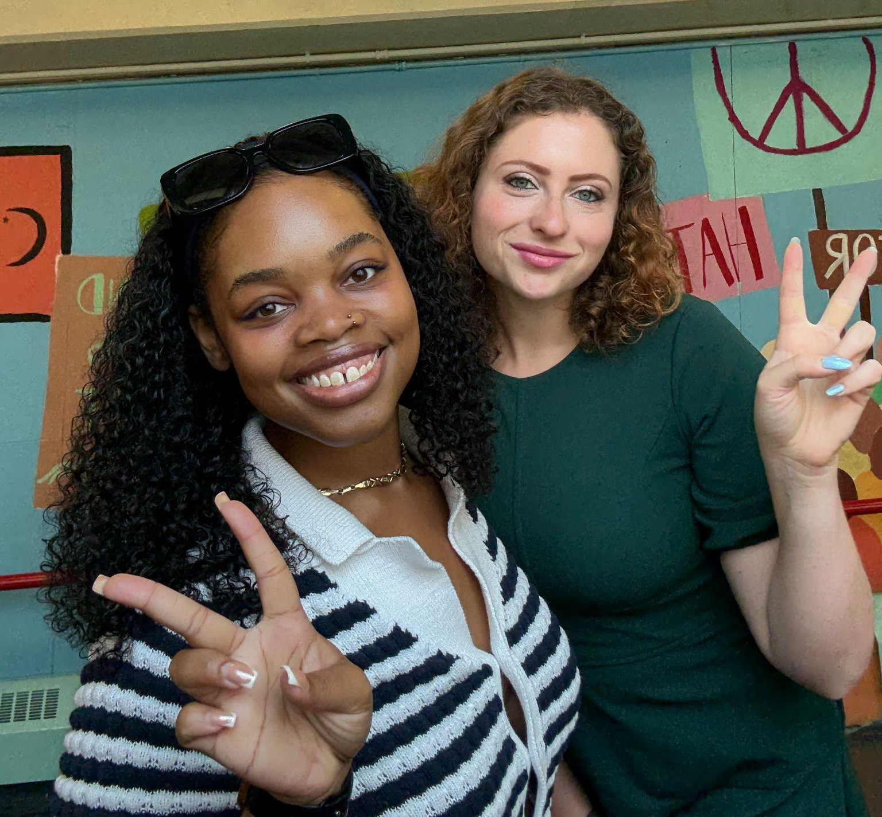




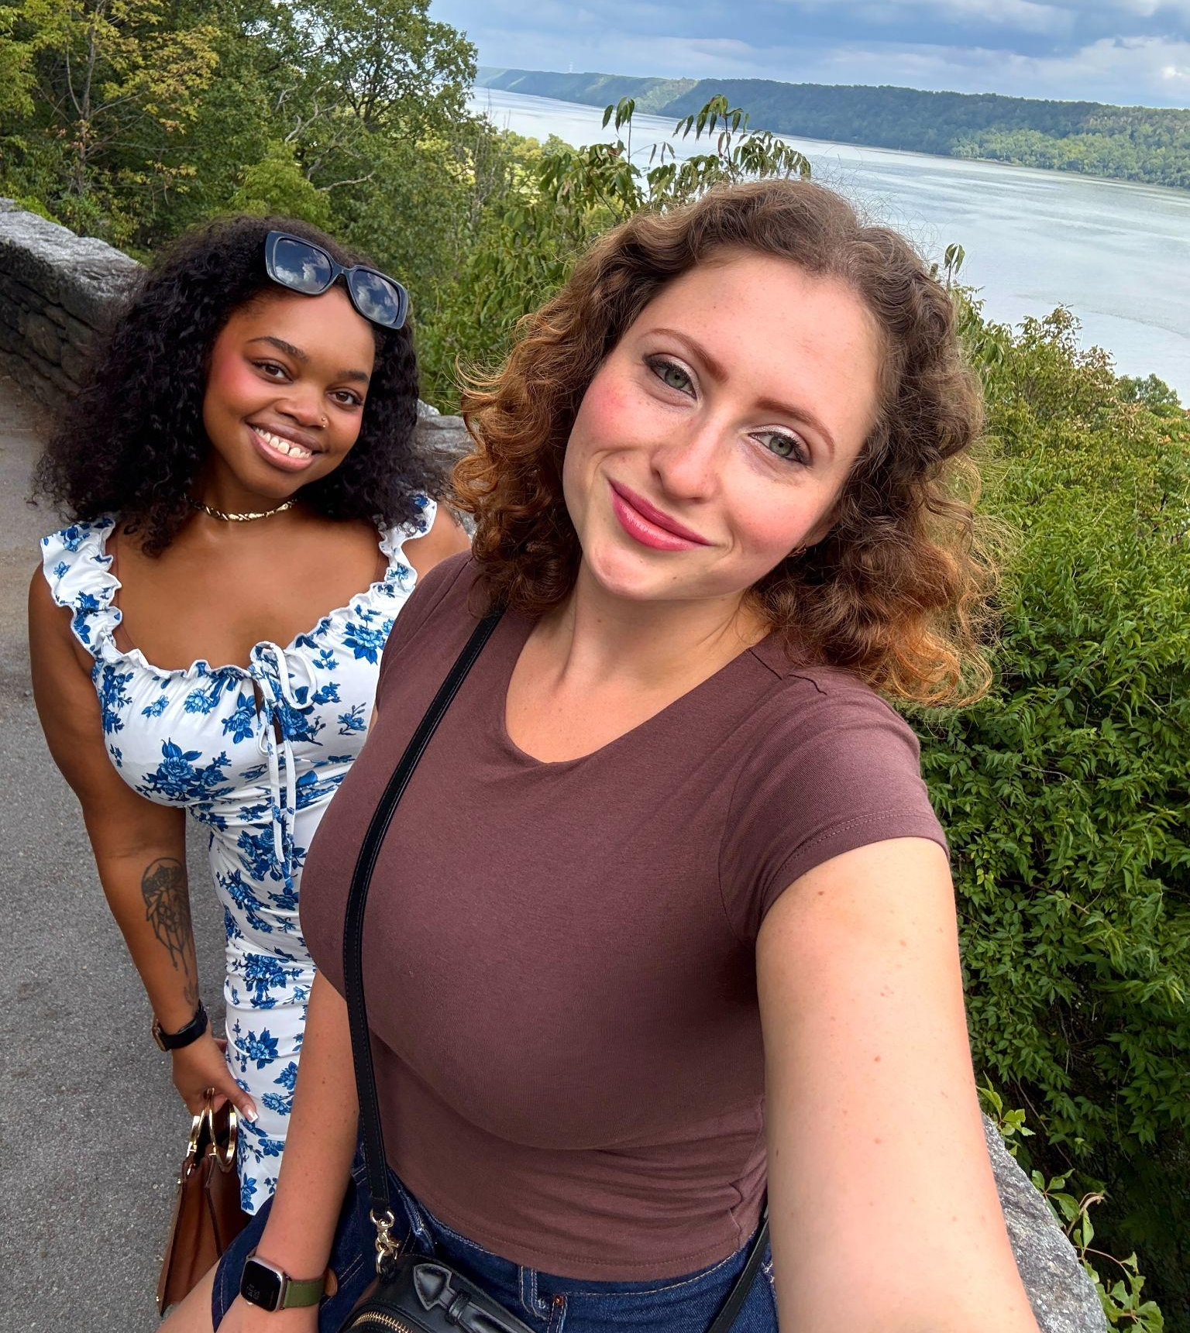


Welcome!
Biology
Curriculum Night at M. S. 447
Ms. Atwell & Ms. Freynk

Slide 18






Biology Overview
Biology is a regents course that consists of studying life from its smallest parts, cells, to the largest part, the environment.The Biology curriculum aims to give an understanding of living things and the world around us. This course was designed to fulfill high school credit while still in middle school. It is inquiry-based with hands-on activities planned. Students will design and carry out controlled experiments on different concepts learned in class.

Slide 19

Biology
Units
Unit 0: Introductions & Experimental Design
Unit 1: Homeostasis: Energy, Respiration,
Circulation, Water Balance
Unit 2: Immune System & Antibiotic Resistance
Unit 3: Digestion, Enzymes & Inheritance
Unit 4: Reproduction, Genetics &
Natural Selection
New Visions Biology Curriculum
Unit 5: Ecosystems and Ecology
Unit 6: Human Impacts on the Environment
Review for Regents

Slide 20


Regents
Requirements
Students are required to complete 1200 minutes of laboratory experiences with satisfactory lab reports. Those not meeting regent requirements will be deemed ineligible to take the NYS regents in June.
State Labs will be completed with Expo teachers during weekly Science Lab period.

Slide 21
New Regents Exam Structure
Old Test | New Test
85- 86 questions First half multiple choice, second half short response. More simple recall/ memory questions Shorter readings, more direct questions One question required making a graph | 9-11 clusters with a total of 45-55 questions Less questions, but more reading! New format in “clusters” Focused on real world application and models- lots of graphs and figures. More advanced vocabulary Approximately 60 percent of each test will be comprised of multiple-choice questions, while approximately 40 percent will be short-response questions.
More information about new curriculum: https://www.nysed.gov/state-assessment/life-science-biology

Slide 22



Absence
Student out sick, what to do?
Students should email both teachers to learn more about what occurred during that class.
Students MUST come to the next office hours to catch up on missing work.
Check Google Classroom for an assignments or homework posted.

Slide 23




Homework Policy
HW is assigned every Monday and due the following Monday.
Any homework or classwork will not be accepted two weeks past the due date.
Missing Labs will be accepted until two weeks prior to the day of the Regents.
HW help is offered during office hours:
  Wednesdays and Thursdays from 3:00-3:40 pm in Room 310

Slide 24
Contact Information
1.
2.
Ms. Freynk
bfreynk@ms447.org
Ms. Atwell
gatwell@ms447.org

Slide 25
Restorative Justice
Sameera Abadi
sabadi@ms447.org
Dallas Alexis
dalexis@ms447.org
Up Next: Math

Slide 26
Math
Marcelle Good (802/4/6)
Onika Joseph (802/4/6)
Christina Quesada (801/3/5)
Katherine Schrup (801/3/5)
Up Next:
Social Studies

Slide 27
Our Curriculum
All 8th graders will be taking a Regents Algebra I course. This means that students will have the option to take the Regents at the end of the school year and to earn high school credit for the course. The exam will take place June 17th. As a math team, we are continuing to use the Illustrative Math (IM) curriculum. Below are some of the topics that we will be covering:
One-variable Statistics
Linear Equations and Systems
Two-variable Statistics
Linear Inequalities
Functions
Exponential Functions
Introduction to Quadratic Functions
Quadratic Equations

Slide 28
Calculators
In Algebra I, we will be using a TI-84 calculator. Each student will be provided with a calculator to use during the classroom period and in office hours if needed.
We do not ask that families purchase the calculator for at home use, however, this calculator may also be used throughout high school.
There are various great apps that students can use that mimic the functions of a TI-84.
One that we recommend is “Calculate 84”, which can be found both in the app store and google play.

Slide 29
Homework
Regular practice is an important part of getting better at math!
Beginning in October, students will be assigned homework once per cycle
Students can and should attend office hours for support with homework as they need it.

Slide 30
Contact Information
801, 803, 805, please contact:
Christina Quesada(cquesada@ms447.org)
Katherine Schrup (kschrup@ms447.org)
802, 804, 806, please contact:
Marcelle Good (mgood@ms447.org)
Onika Joseph (ojoseph@ms447.org)
Up Next:
Social Studies

Slide 31
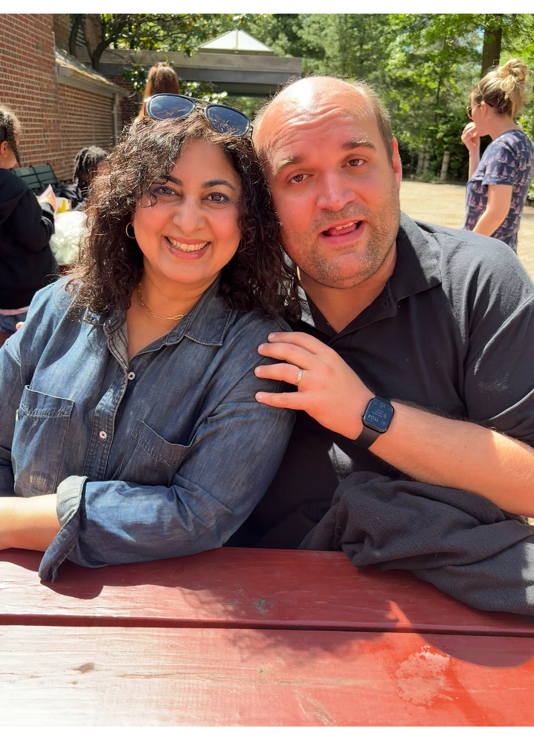

Social Studies
Your teachers:
John Hagan
Jennifer Dhillon
Up Next: Talent

Slide 32


Our Philosophy
Students at this age are ready to tackle moral and ethical questions. They deeply care about fairness and justice. All we have to do is give them the tools to make informed judgments. | American history is hard. If you’re not wrestling with complexity and struggling with how troubling it is, then you’re not really learning it.

Slide 33

Our Curriculum
Content
*8th Grade Social Studies covers American History from the Civil War until the present.
Skills
*Interpreting and analyzing historical documents
*Drawing conclusions, making inferences, and wrestling with moral complexity
*Public Speaking and Presenting

Slide 34

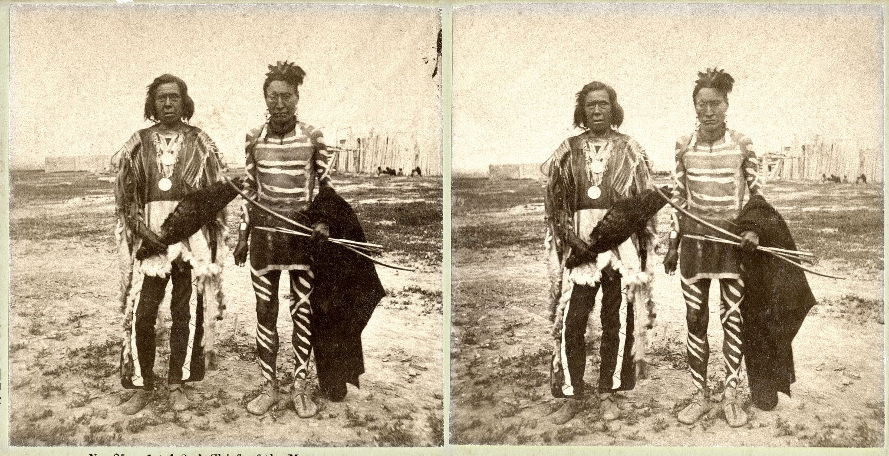

Units of Study
Unit 1: Reconstruction, 1863-1877
Unit 2: A Changing Society, 1860-1920 (Industrialization, etc)
Unit 3: Immigration in U.S. History, 1865-present
Unit 4: Indigenous History, 1865-present
Unit 5: U.S. Imperialism, 1898-present
Unit 6: The World Wars and Holocaust, 1914-1945
Unit 7: The Cold War, 1945-1991
Unit 8: The Fight For Equality, 1865-present

Slide 35

Current Events
If major news stories occur, we will take the time to talk about them.

Slide 36


Office Hours
Tues: Ms Dhillon
Thurs: Mr Hagan
Contact Information: jdhillon@ms447.org
jhagan@ms447.org
If absent or need to review/finish work, every lesson every day is posted on Google Classroom with videos/documents etc. For major projects, we will email with each part and its due dates. Again all material will be be posted on Google Classroom. Please check in with your child.

Slide 37
Any questions?
Thank you for joining us
Up Next: Talent

Slide 38
Talent
Shari Acker (Theater),
Julia Farrell (Dance),
Kristel McKanna (Art)
Kim Landman (Tech),
William Mullins (Music)
Up Next:
Physical Education

Slide 39
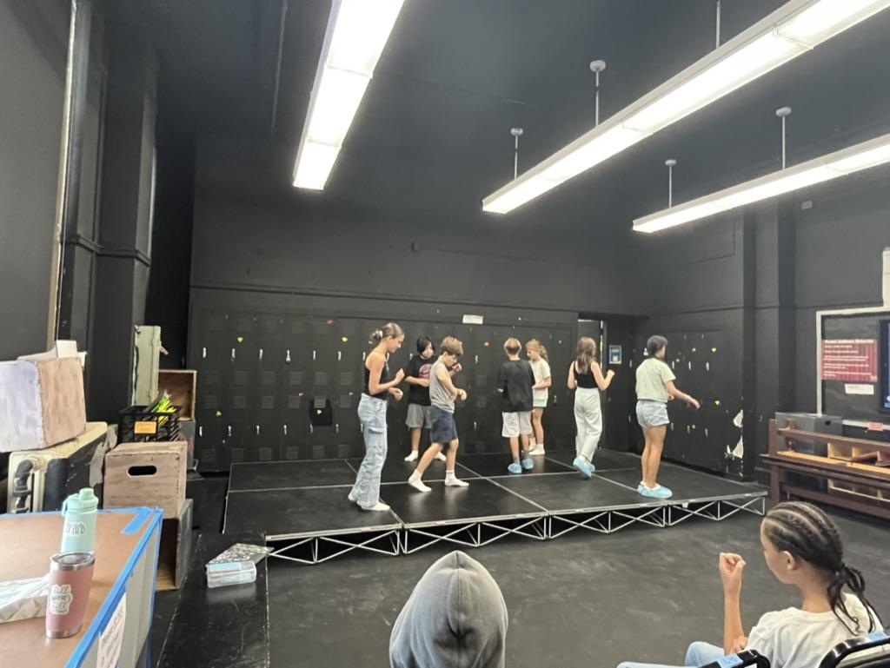
Theater
Shari Acker • Sacker@ms447.org
Office hours on Thursdays
Lunch Club on B Days
Units of Study
Monologue Performance
Scene Study
Playwriting
Advanced Improvisation

Slide 40
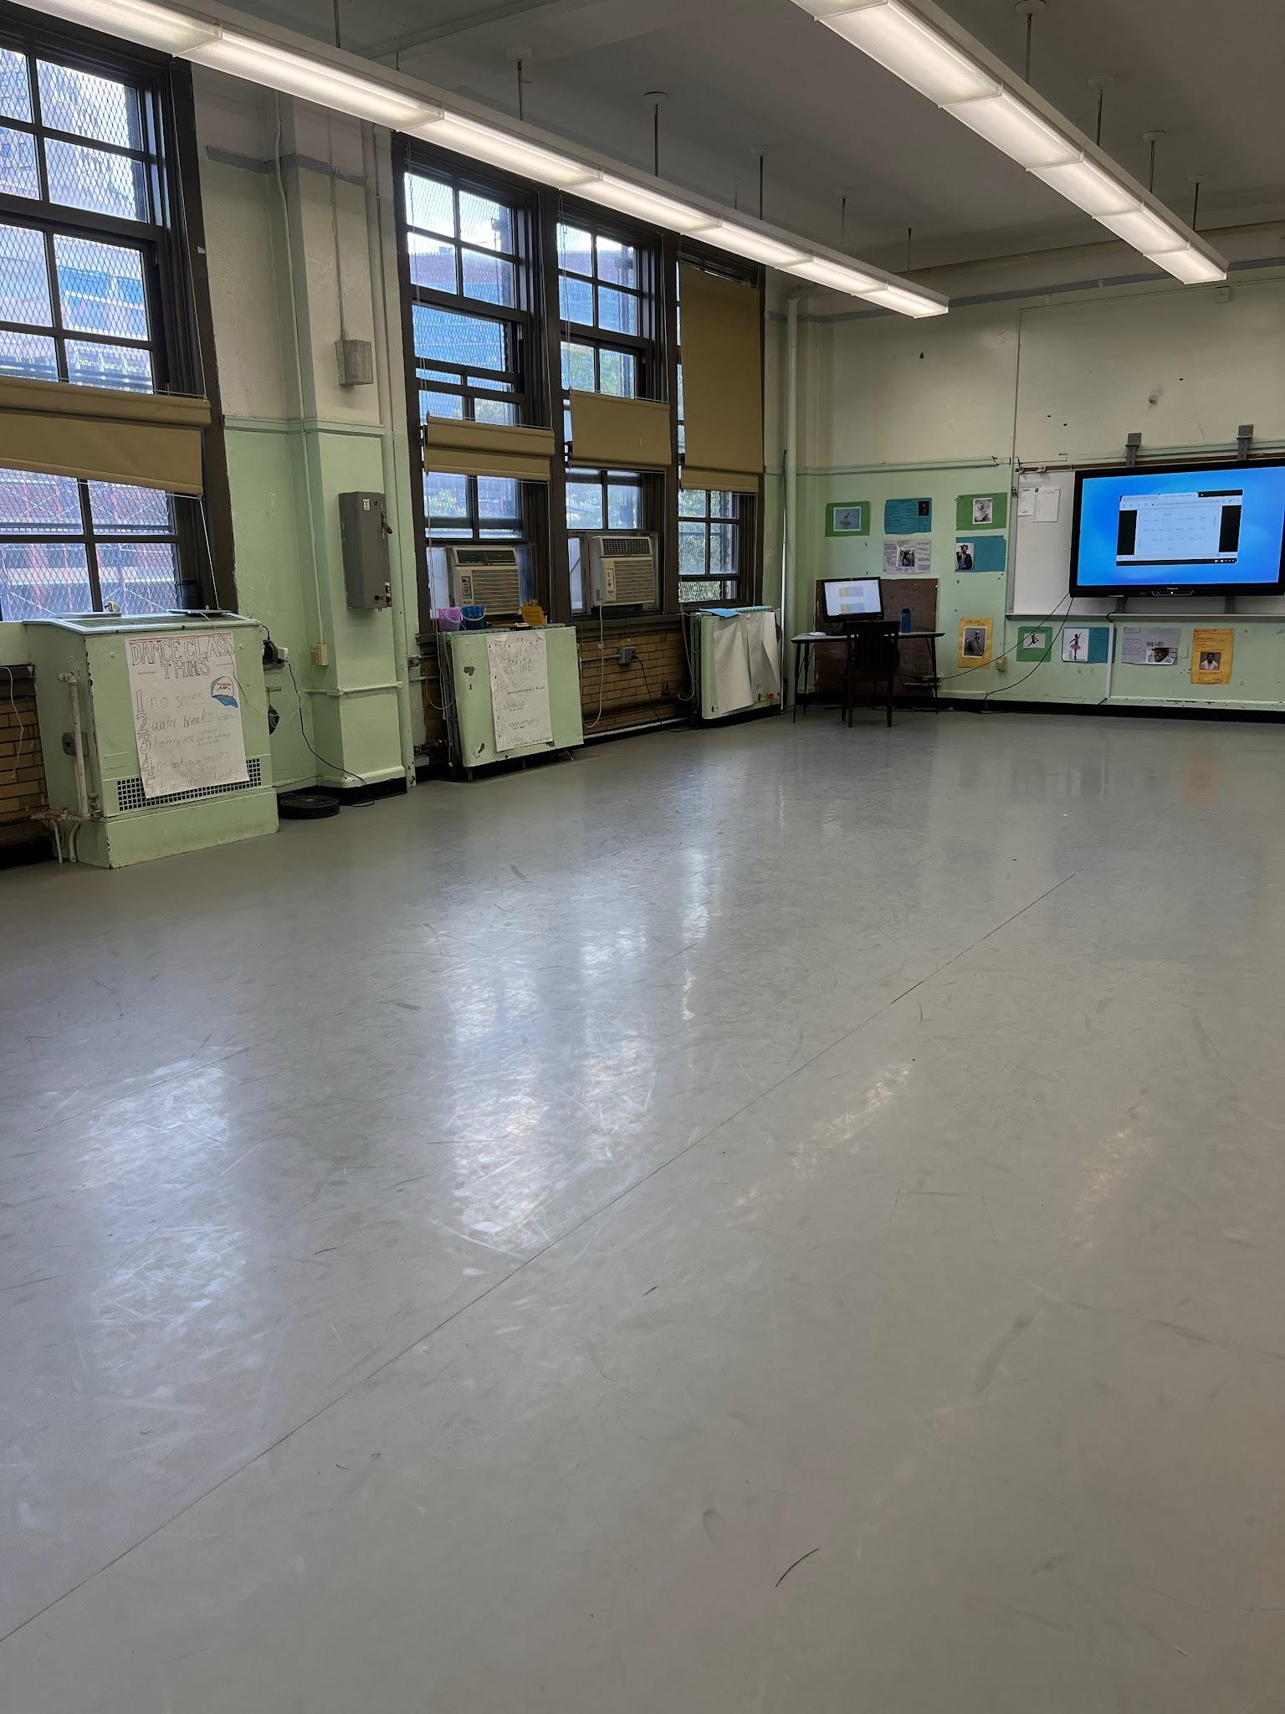
Dance
Julia Farrell

Slide 41
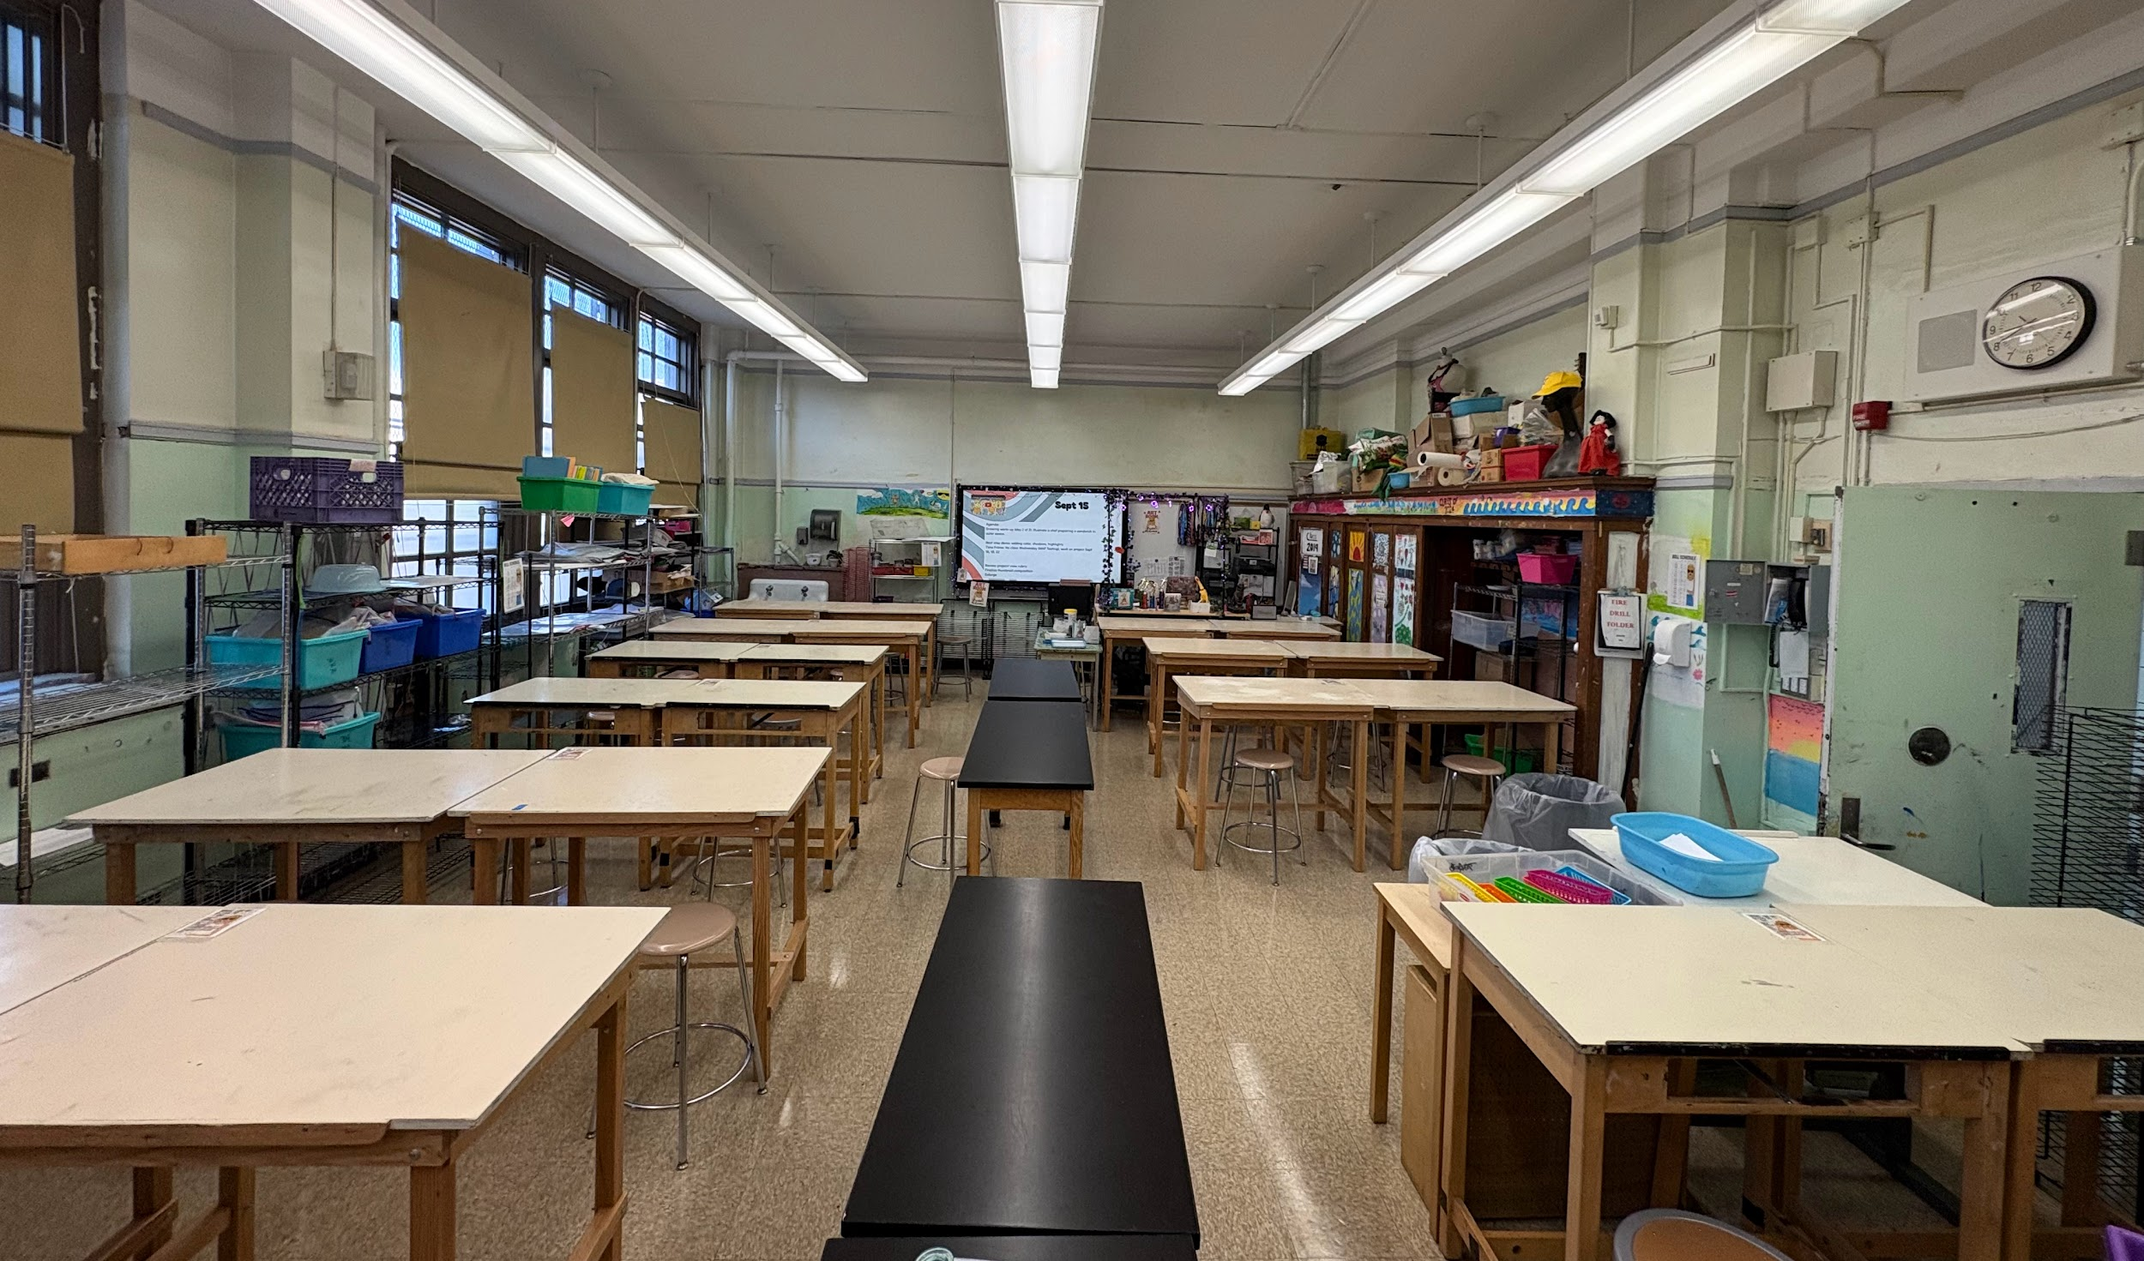
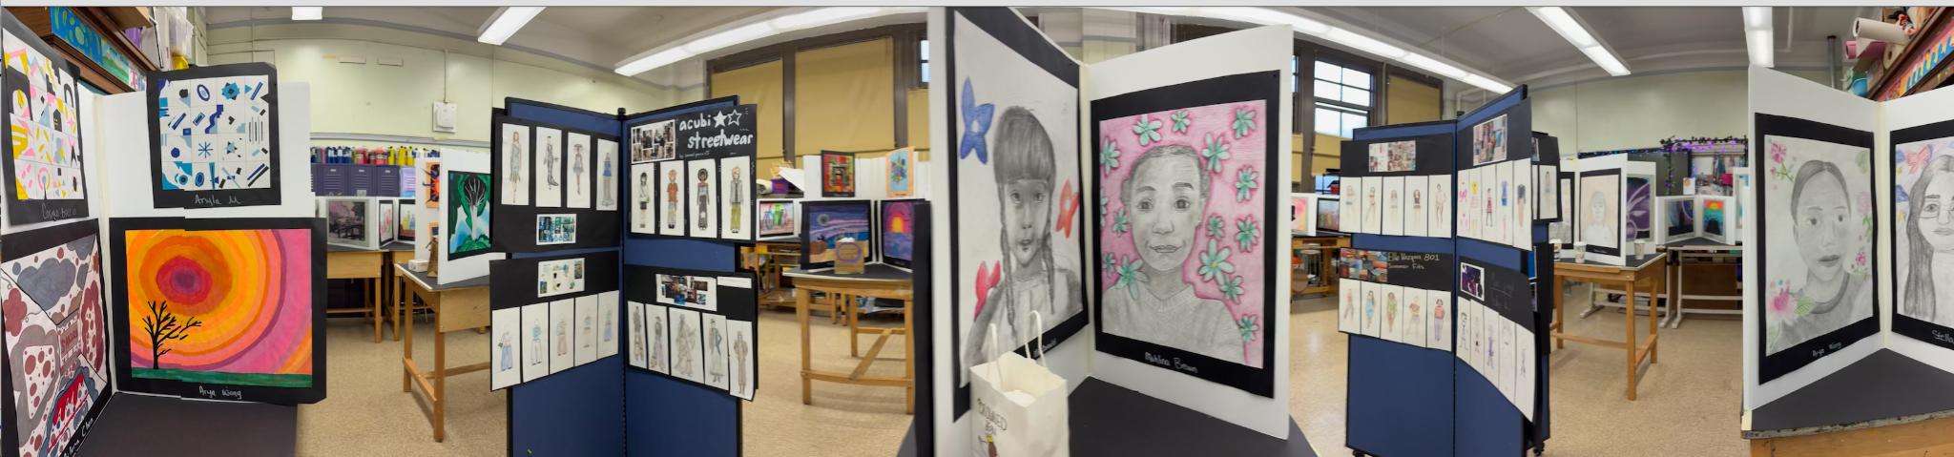
Visual Art
Kristel McKanna
kmckanna@ms447.org
Units:
Observation Drawing
Abstraction
Painting
Collage
Design
Sculpture
Printmaking
Lunch Club:
F days
Office Hours:
Thursday

Slide 42
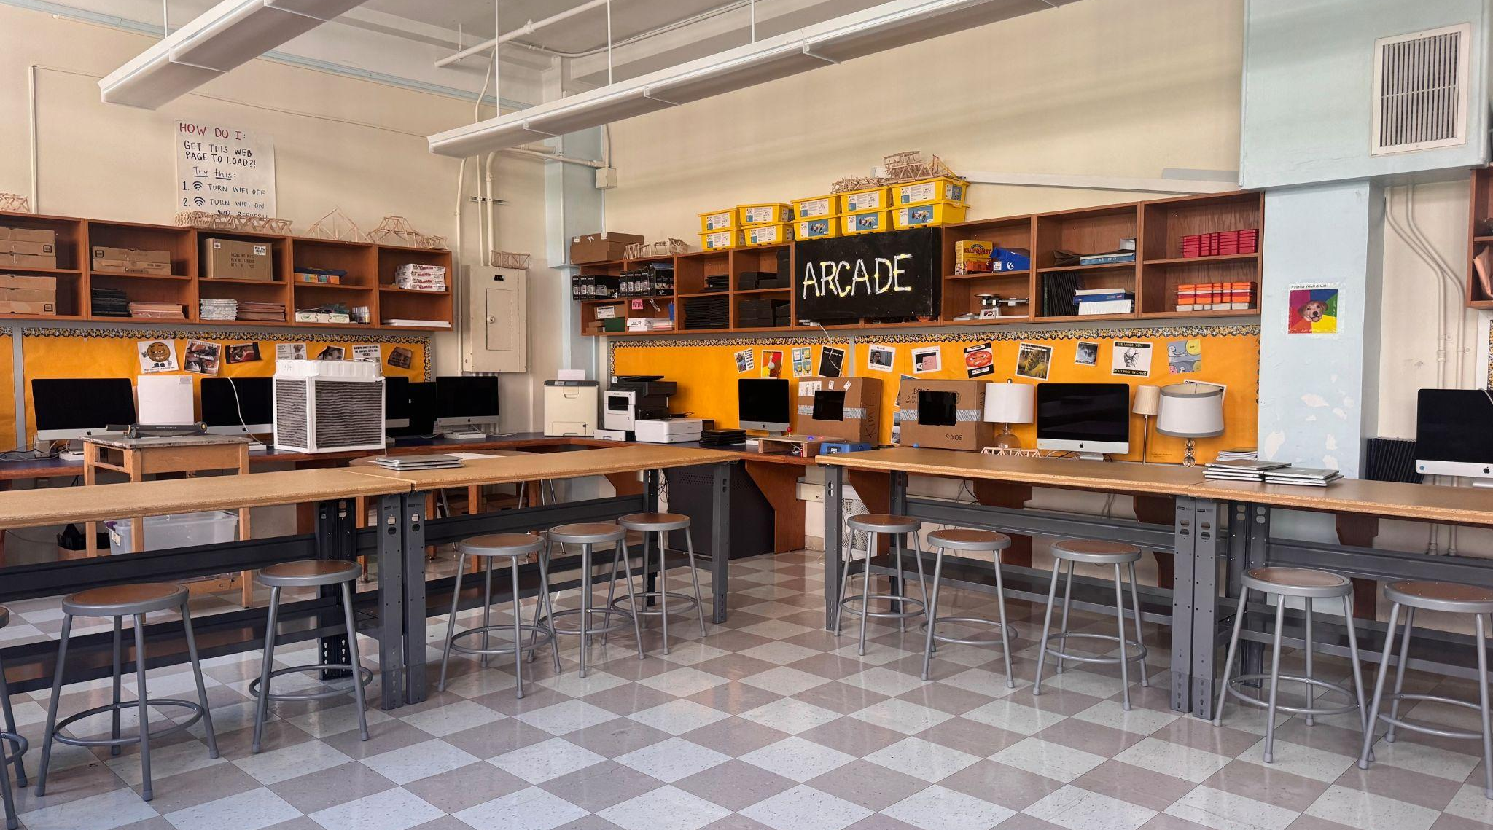
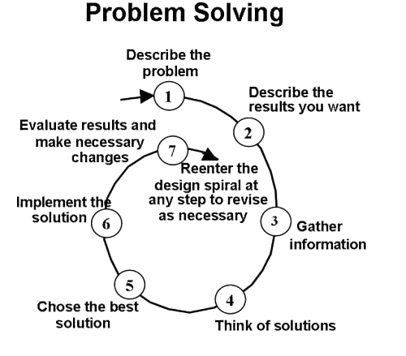
Tech Kim Landman
klandman@ms447.org Office Hours: Thursdays
Tech at 447:
Focus on problem solving using a circular process
Emphasis on using technology as a creative tool via projects and hands-on activities
Each unit dedicated to a distinct type of media
Students take ownership over learning based on their individual interests and passions

Slide 43
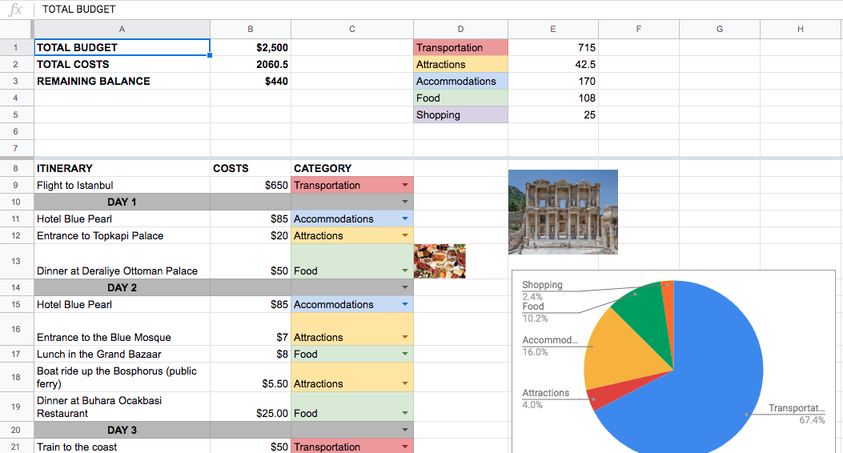

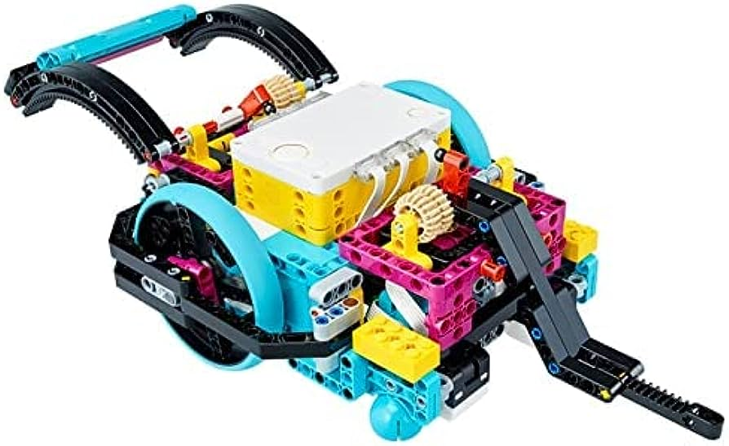

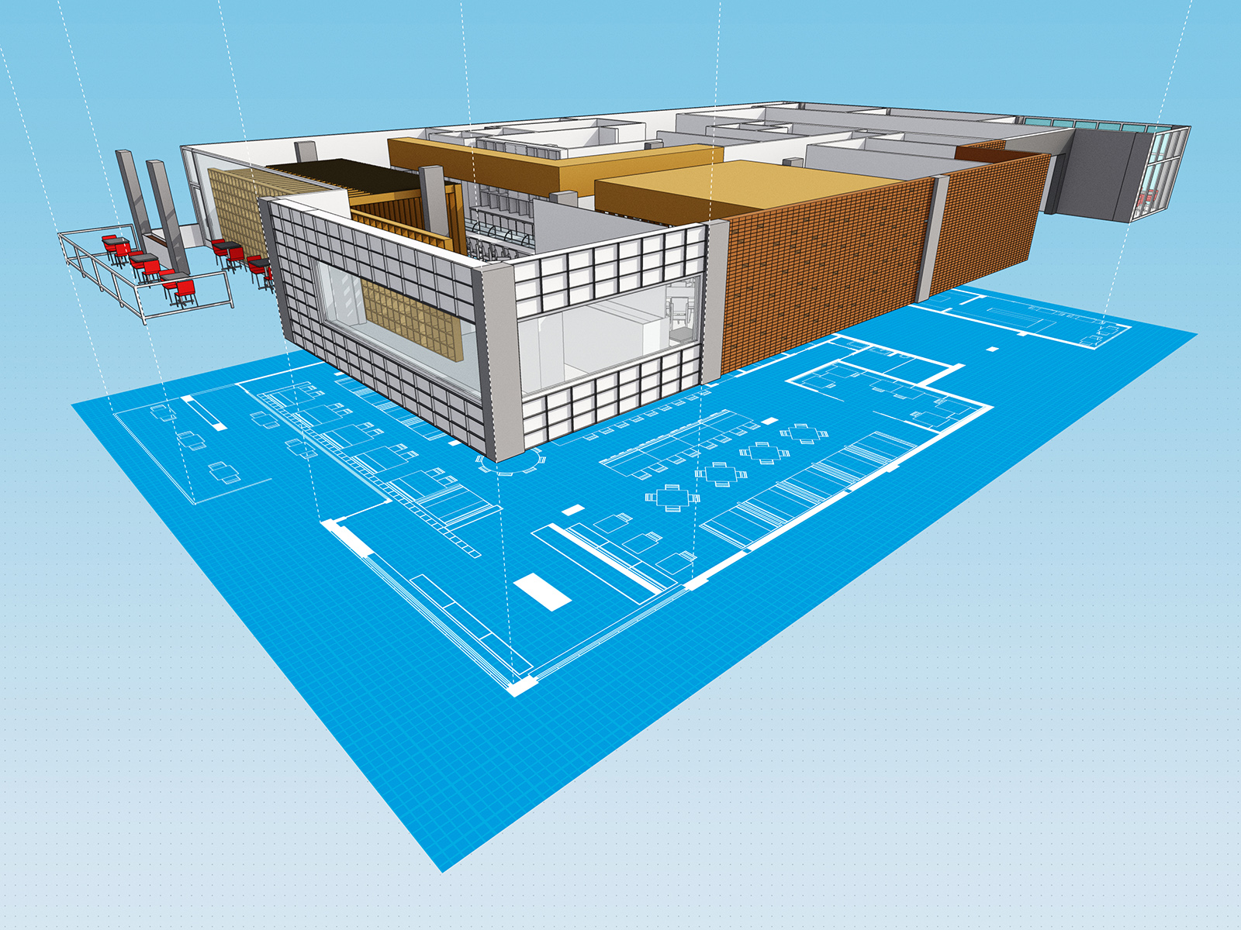

Tech Kim Landman
klandman@ms447.org Office Hours: Thursdays
Spreadsheeting
Javascript
Robotics
Physical Computing
Computer Aided Design
AI

Slide 44
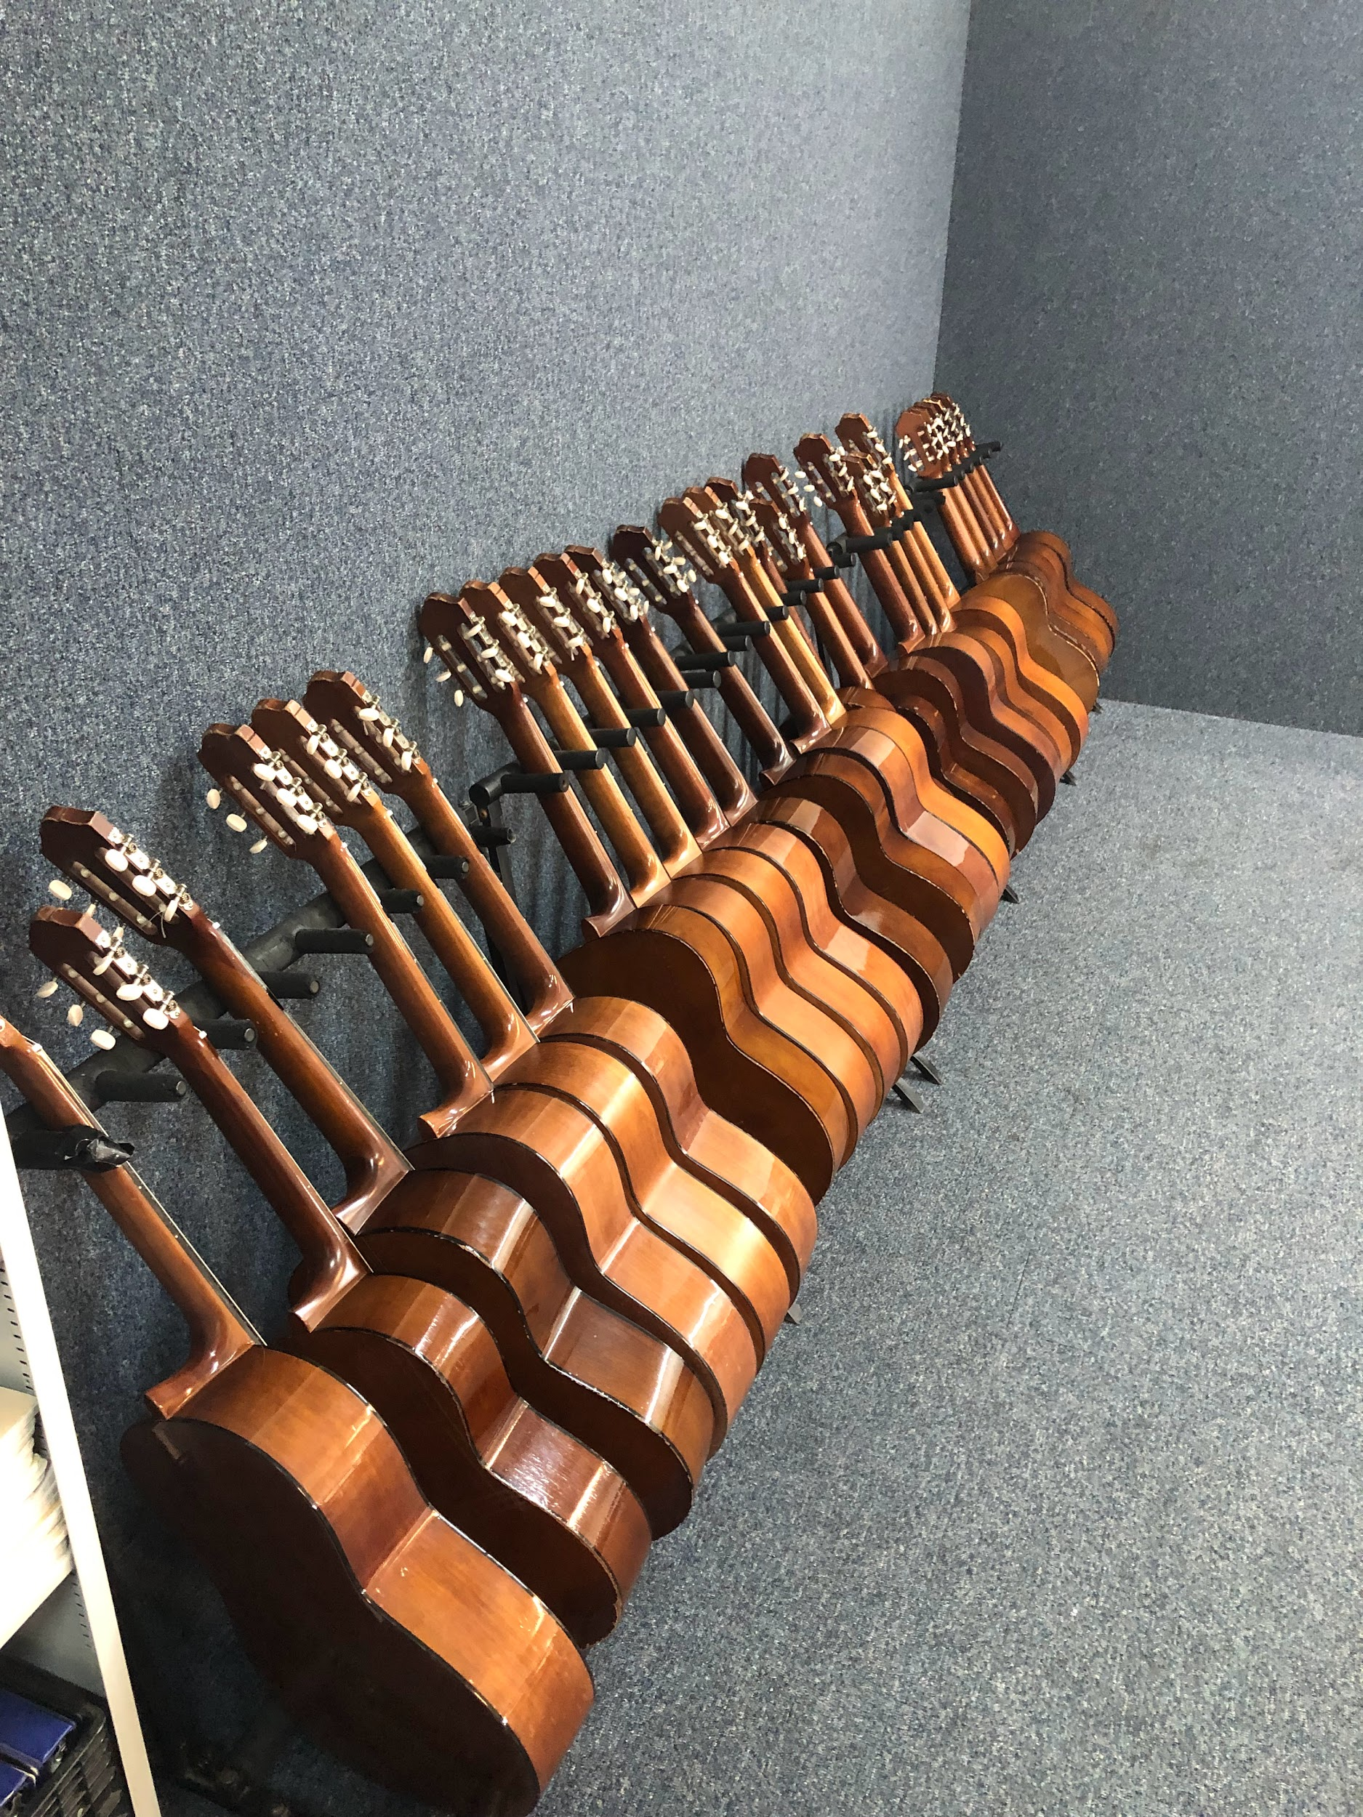
Music
William Mullins
Modern Band II
Lunch Club D Day
Office hours Wednesday
Email: Wmullins@ms447.org

Slide 45
Physical Education
Mr Geneen and Ms Becker
dgeneen@ms447.org
nbecker@ms447.org
Up Next: Spanish

Slide 46
PE Units
Team handball
Basketball
Soccer
Volleyball
Fitness training

Slide 47
Expectations
Have fun
Positive attitude
Come prepared
Be kind
Respect each other
Be safe
Up Next:
Physical Education

Slide 48
Spanish
Giana Russo &
Mark Griffith
Up Next: AIS/ENL

Slide 49
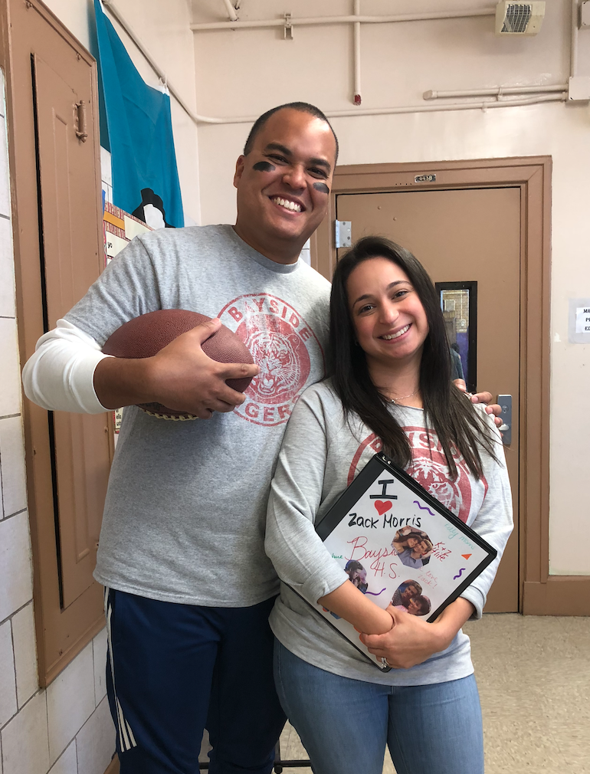
Introduction
Mark Griffith
Giana Russo
mgriffith@ms447.org
grusso@ms447.org
Office Hours:
Thursday
Office Hours:
Wednesday

Slide 50
What can your students expect?
Our introductory Spanish course will help build a strong foundational understanding of the language.
Goal → not only learn Spanish, but also to acquire it in a more natural and fluid way.
Class time → reading, listening and writing with some emphasis on speaking as well as grammar structures.
Our class is very dependent on active in-class engagement and participation
Interactive Notebook & Notebook checks

Slide 51
Units of Study
Unit 1
Unit 3
The basics:
Cognates, letter sounds, geography, numbers, weather, the calendar.
Food:
Continue with conjugations and introduce irregular verbs, express likes & dislikes,
Unit 2
Unit 4
Family / Clothing:
This is where we begin learning verb conjugations, subject pronouns, agreement between nouns and adjectives.
School:
Express preferences related to school.
* Each unit will contain cultural lessons as well.

Slide 52
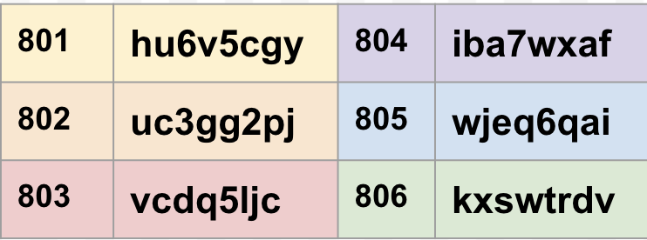
Please ensure your student is linked to Google Classroom for Spanish class.
Up Next: AIS/ENL

Slide 53
AIS / SETSS
Jenn Carlson jcarlson@ms447.org
Tiffani Velez tvelez@ms447.org
Up Next: ELA

Slide 54
AIS
Academic Intervention
LAB periods
Literacy evidence-based instruction and interventions
SE Intervention Teacher

Slide 55
SETSS
Special Education Teacher Support Services
Legally mandated- Individualized Education Plan
Supports IEP goals through:
  Direct push in- in classroom, adapted content
  Direct pull out (Resource Room)- supplemental instruction to address specific, targeted skills
  Indirect consultation- with General Education teacher to adapt content/ instruction
SETSS is delivered a minimum of 3 hours per week (4 periods per cycle)
Up Next: ELA

Slide 56
Questions?
Jenn Carlson jcarlson@ms447.org
Tiffani Velez tvelez@ms447.org
Up Next: ELA

Slide 57
ELA
Nadin Ahmed (801/3/5)
Glenda Hernandez (802/4/6)
Eta Oyarijivbie (801/3/5)
Christine Willis (802/4/6)
Up Next: Closing

Slide 58

8th Grade ELA Overview
This course will combine INQUIRY, RESEARCH, and PRACTICE to explore inner worlds, texts, and writing processes. 8th grade students will dive deeply into common core aligned skills through reading literature, consuming contemporary media, and meaningful group work to improve both their written and verbal communication skills. The year long inquiry around identity combines three creative units along with three analytical units.
We’d LOVE to have you join our class if your profession aligns with our unit of studies.
We love to add and share our real life skills to the curriculum.
Notes:
Nadin

Slide 59




Year Long Investigation Overarching Questions
How does my identity shape my perceptions of the world?
Notes:
Eta- Independent reading books, classroom libraries

Slide 60

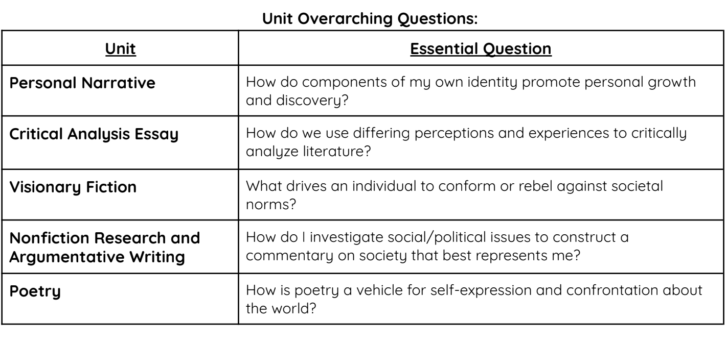
Unit List & Essential Questions
Notes:
Christine- Mention syllabus sent home and has all procedures and expectations

Slide 61
Office Hours:
Tuesdays - Ms. Willis, Ms. Oyarijivbie
Wednesdays - Ms. Hernandez
Thursdays - Ms. Ahmed
Please feel free to reach out to us if you have any questions or concerns!
nahmed@ms447.org
cwillis@ms447.org
ghernandez@ms447.org
eoyarij@ms447.org
Notes:
Glenda

Slide 62

Thanks!
See you for Student Led Conferences on November 13th.
Visit our website:
www.ms447.org

