Slide 1

Grade 7 Curriculum Night
Welcome!
We will begin at 5:40pm

Slide 2
GRADE 7 ADMINISTRATOR
CHRIStine VISSa
CVISSA@MS447.ORG
Next Up:
Social Worker

Slide 3
Social Worker
STACEY BILLUPS
Next Up: Talent

Slide 4
Talent
Shari Acker (Theater),
Julia Farrell (Dance),
Kristel McKanna (Art)
Kim Landman (Tech),
William Mullins (Music)
Next Up: Restorative Justice Team

Slide 5
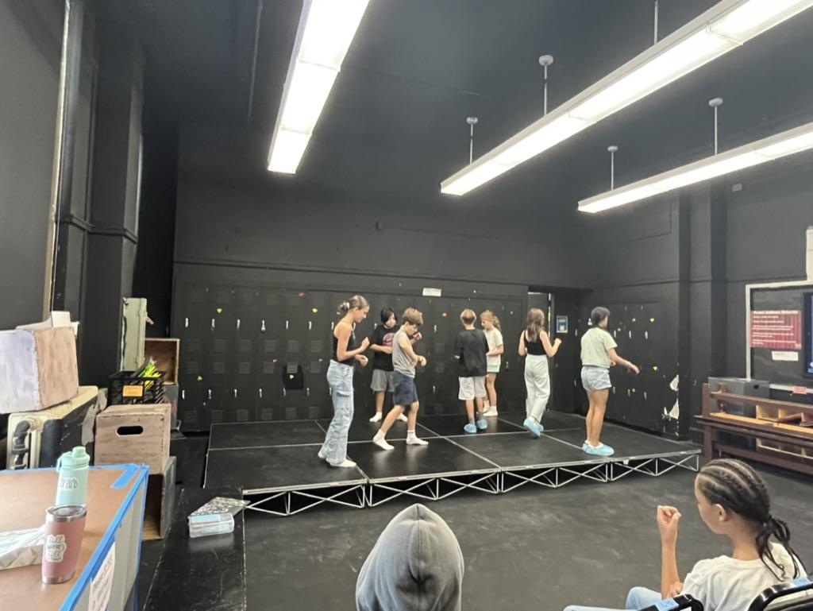
Theater
Shari Acker • Sacker@ms447.org
Office hours on Thursdays
Lunch Club on C Days
Units of Study
Improvisation
Play Production
Playwriting

Slide 6
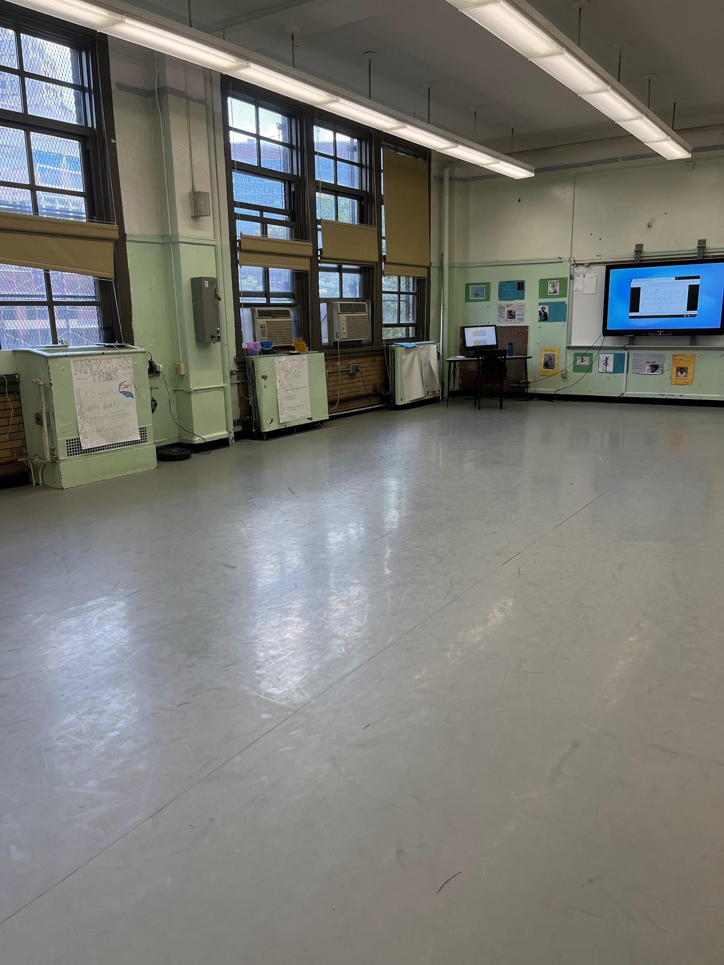
Dance
Julia Farrell

Slide 7
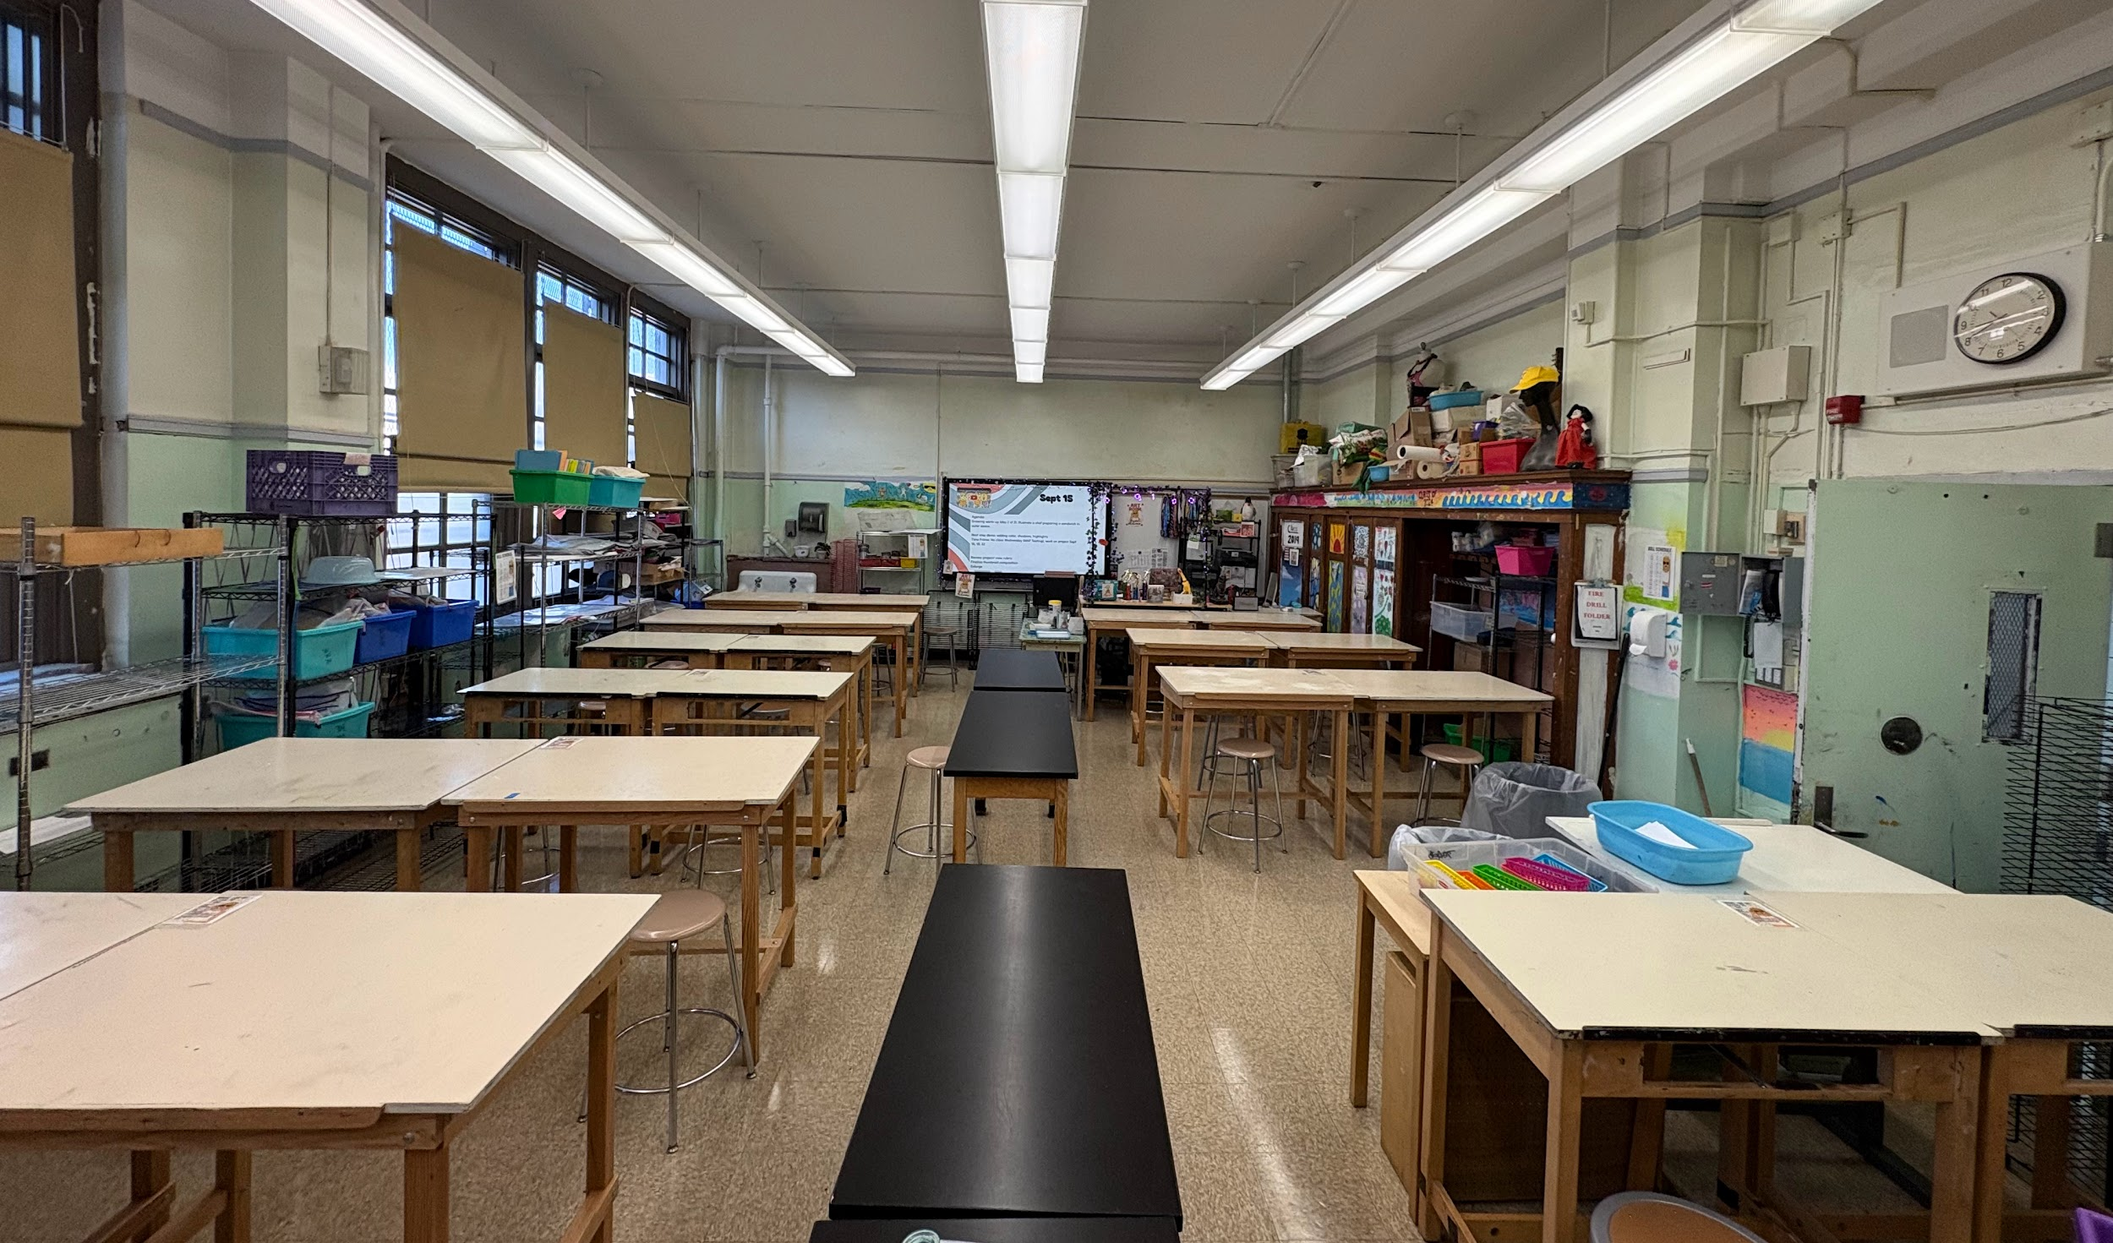
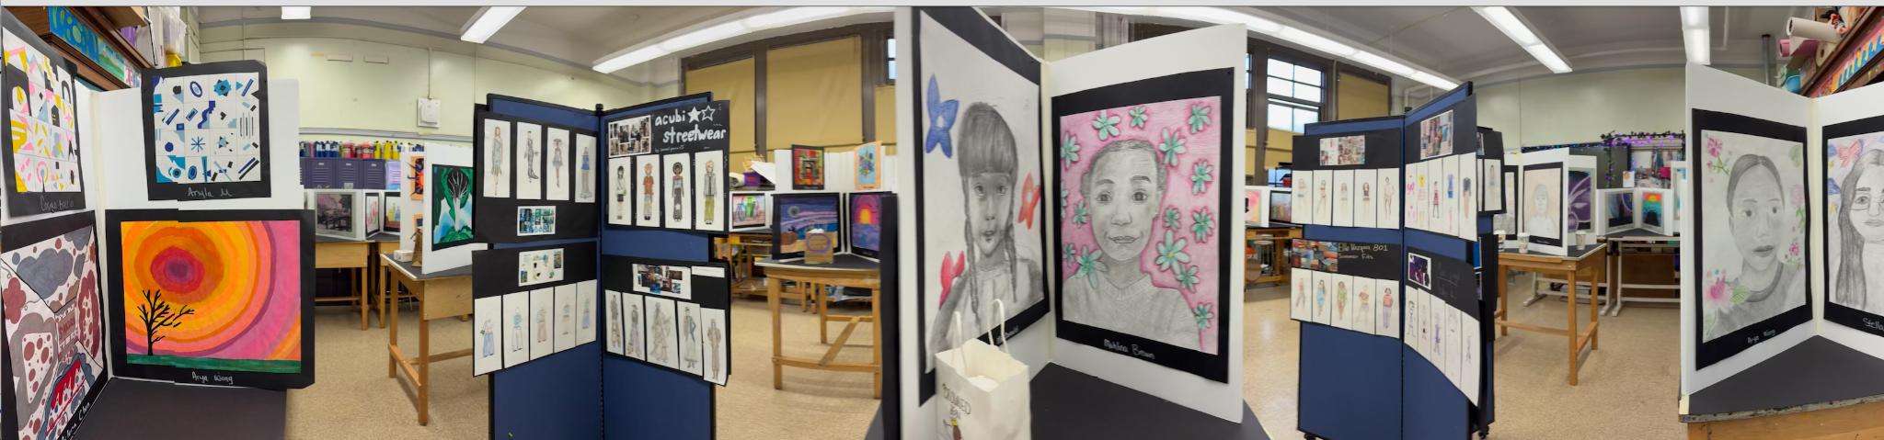
Visual Art
Kristel McKanna
kmckanna@ms447.org
Units:
Observation Drawing
Abstraction
Painting
Collage
Design
Sculpture
Printmaking
Lunch Clubs:
C days
Office Hours:
Thursday

Slide 8
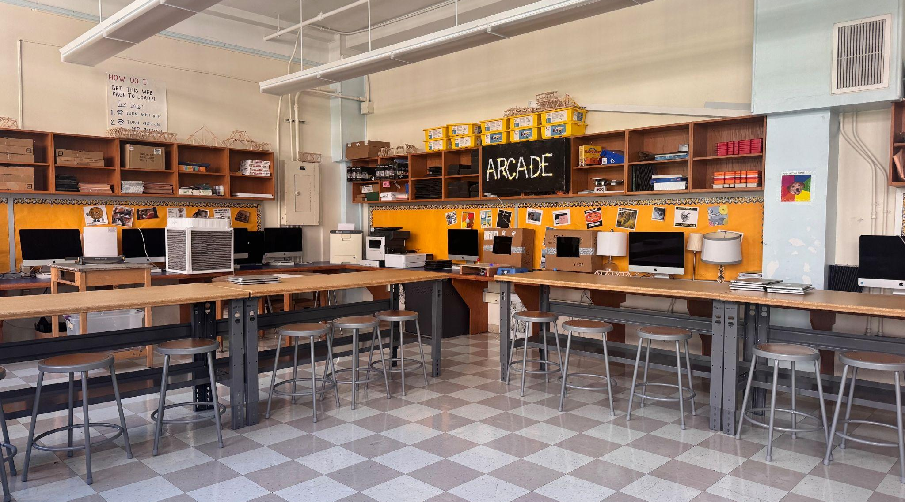
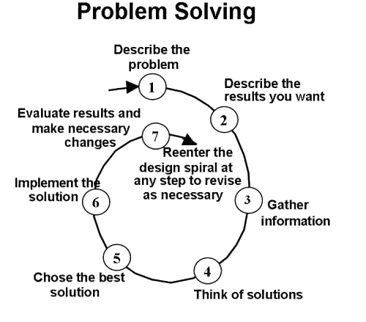
Tech Kim Landman
klandman@ms447.org Office Hours: Thursdays
Tech at 447:
Focus on problem solving using a circular process
Emphasis on using technology as a creative tool via projects and hands-on activities
Each unit dedicated to a distinct type of media
Students take ownership over learning based on their individual interests and passions

Slide 9


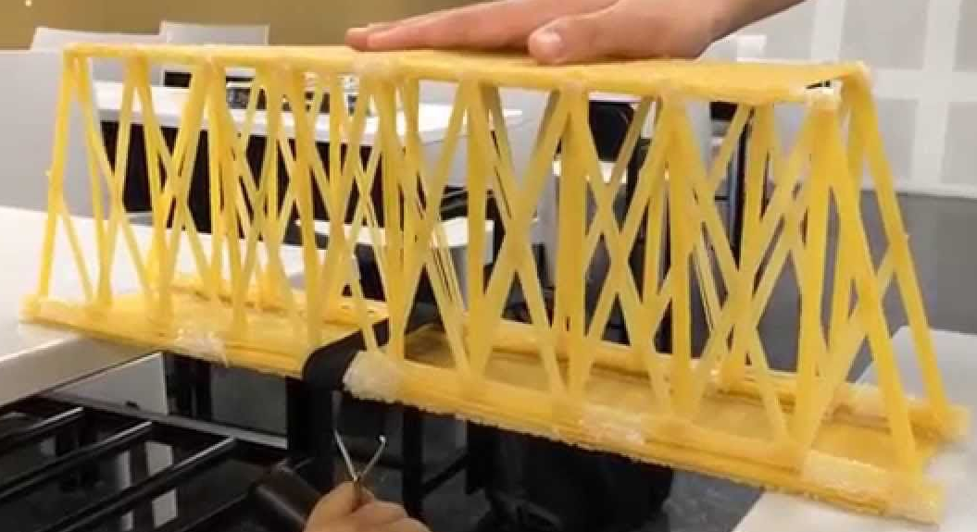
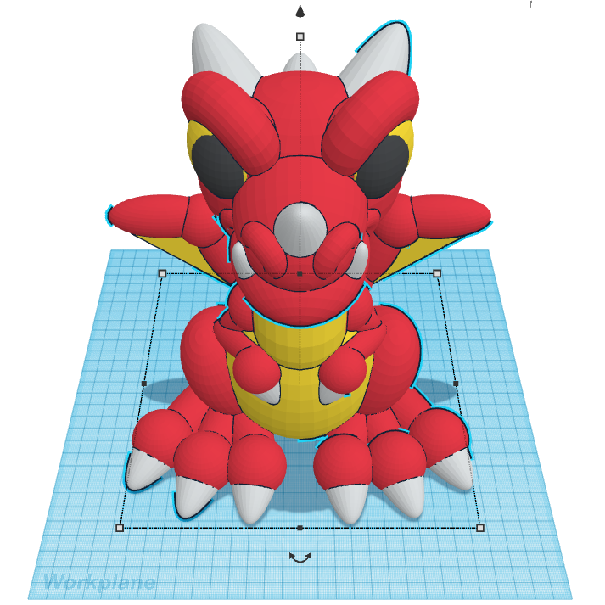


Tech Kim Landman
klandman@ms447.org Office Hours: Thursdays
Web Design
Game Design
Physical Engineering
Computer Modeling
Digital Art
App Design

Slide 10
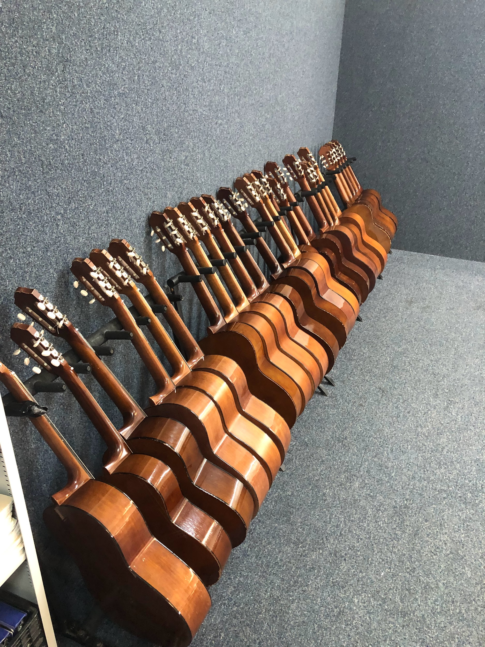
Music
William Mullins
Modern Band I
Lunch Club D Day
Office hours Wednesday
Email: Wmullins@ms447.org

Slide 11
RestorativE Justice Team
Sameera Abadi
sabadi@ms447.org
Dallas Alexis
dalexis@ms447.org
Next Up:
AIS/ENL

Slide 12
AIS/SETSS
Jenn Carlson jcarlson@ms447.org
Tiffani Velez tvelez@ms447.org
Next Up:
Related Services

Slide 13
AIS
Academic Intervention
LAB periods
Literacy evidence-based instruction and interventions

Slide 14
SETSS
Special Education Teacher Support Services
Legally mandated- Individualized Education Plan
Supports IEP goals through:
  Direct push in- in classroom, adapted content
  Direct pull out (Resource Room)- supplemental instruction to address specific, targeted skills
  Indirect consultation- with General Education teacher to adapt content/ instruction
SETSS is delivered a minimum of 3 hours per week (4 periods per cycle)

Slide 15
RELATED SERVICES
Jessica Saunders (IEP Coordinator)
Zoe Parker (School Psychologist)
Stacey Billups (Social Worker)
Paula Sentsianova (SLP)
Marina Dimitrova (SLP)
Jane Baraz (SLP)
Nat Hookway (OT)
Next Up:
Physical Education

Slide 16
IEP Coordinator
Work with SETSS/ICT teachers and Related Service Providers to develop annual IEPs that “meet the child where they are at”
Meet with ICT grade teams weekly to discuss observations and make whole-grade shifts to support the child (academic, executive functioning, self-regulation)
IEP goals monitoring via data across the year
ICT/Nest Coach to support students and teachers/providers with the home/school connection

Slide 17
Speech-Language Therapy
Speech & Language
Comprehension
  Reading
  Listening
Expression
  Written
  Spoken
Articulation
Fluency (Stuttering)
Pragmatic Language/Social Development Intervention (including NYU Nest Support Project)
Perspective Taking
Peer Engagement
Problem Solving
Pbentsianova@ms447.org-Mdimitova@ms447.org-Jbaraz@ms447.org

Slide 18
PHYSICAL EDUCATION
Mr Geneen and Ms Becker
dgeneen@ms447.org
nbecker@ms447.org
Next Up: Health

Slide 19
Physical Education Units
Team handball
Basketball
Soccer
Volleyball
Fitness training

Slide 20
Expectations
Have fun
Positive attitude
Come prepared
Be kind
Respect each other
Be safe

Slide 21
Health
Ms Becker
nbecker@ms447.org
Next Up: Math

Slide 22
Health education Units
Fitness/nutrition
Eating disorders/body image
Tobacco, vaping and alcohol awareness
Substance abuse
Mental health
Sexual Health/puberty

Slide 23
Expectations
Come prepared (pencil and binder)
Participate
Take notes
Be respectful and kind
Come on time

Slide 24
Math
Marco Gambino (702, 4, 6)
Tony Joga (702, 4, 6)
Kora Wilson (701, 3, 5)
Liza Zaretsky (701, 3, 5)
Next Up:
Exploration

Slide 25
Math Units
Scale Drawings
Introducing Proportional Relationships
Proportional Relationships and Percentages
Rational Number Arithmetic
Expressions, Equations & Inequalities
Probability & Sampling
Measuring Circles
Angles, Triangles and Prisms

Slide 26
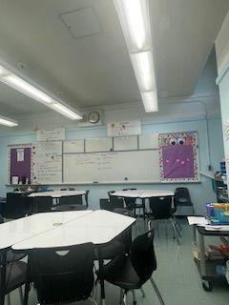
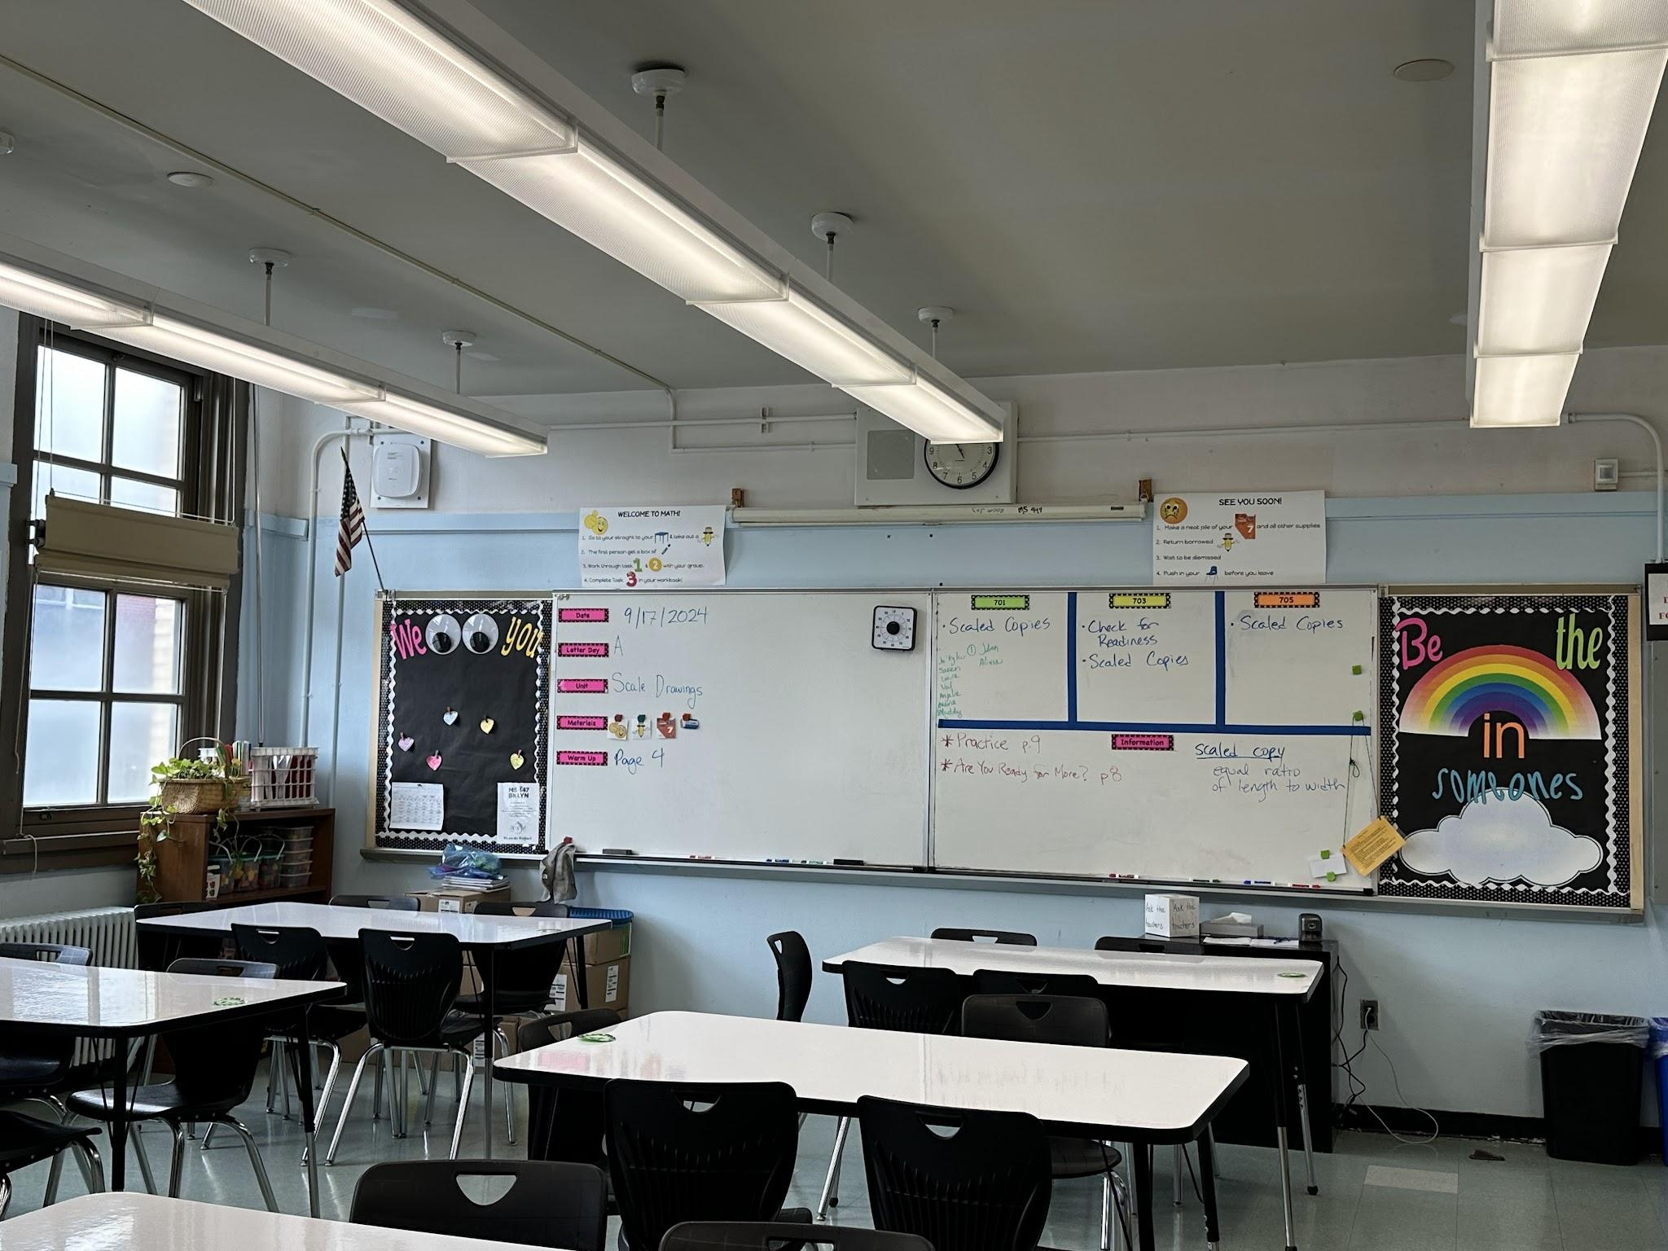
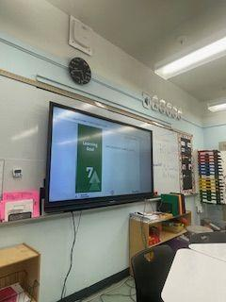
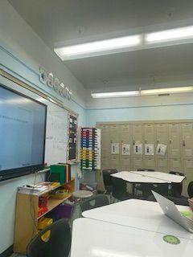
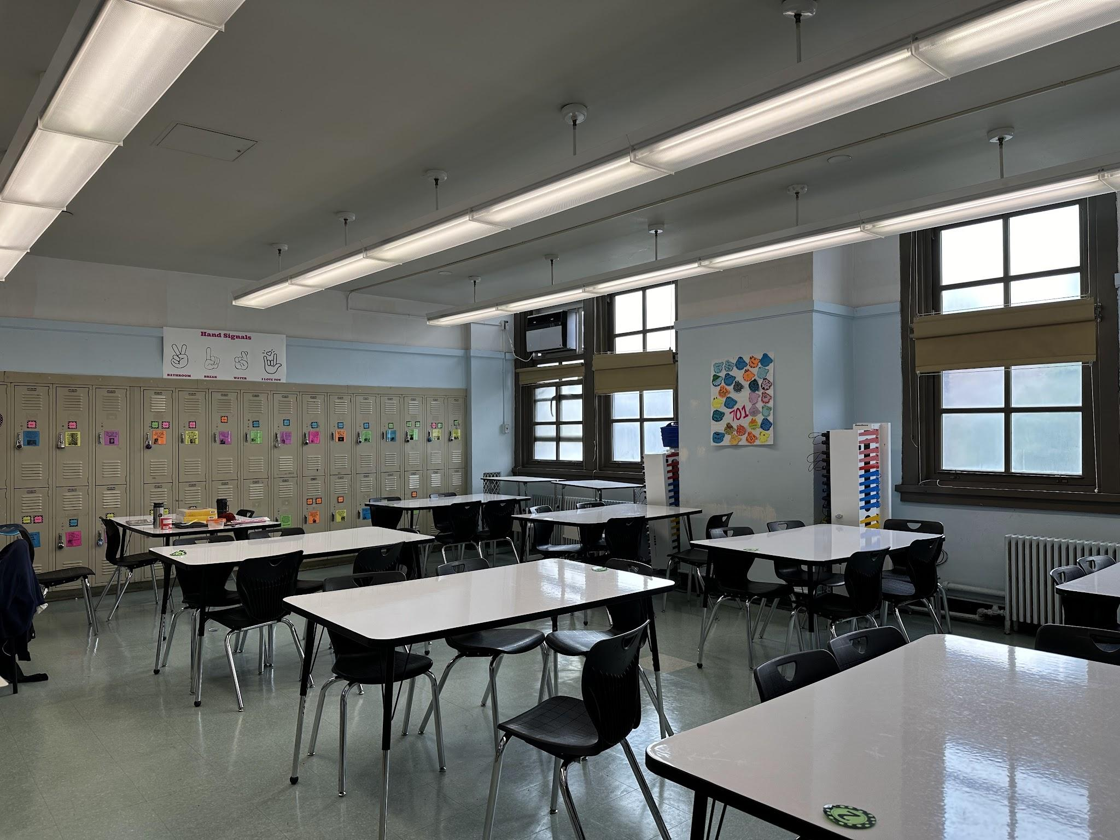
Math Classrooms

Slide 27
Office Hours
Tuesday:
Tony joga
Wednesday:
Liza Zaretsky
Thursday:
Marco Gambino
Kora Wilson
Resources
Illustrative Math: https://ilclassroom.com/resources/24002515
Khan Academy: https://www.khanacademy.org/

Slide 28
EXPlOration
Dave Grosshandler
Joy Canning
Matt McGaley
Teri Yoshiuchi
Theila Smith
William Dych
Next Up:
Science

Slide 29

Expo’s Mission
Exploration inspires students to discover the interconnectedness of the world around them, activating their roles as contributing members to their local and global community.

Slide 30
EXPLORATION CORE LEARNING VALUEs
Expo Is…
Experiential
Project-based
Collaborative & Community-Centered
Interdisciplinary
Socially Conscious
Culturally Sustaining

Slide 31
Units of study
Grade 6 | Grade 7 | Grade 8
Food for Thought | Art for Social Change | Memorializing Movements for Justice
Water Stewardship | Green Infrastructure & Design | My Brooklyn Story
 |  | Passion projects

Slide 32
Teacher contact & Office hours
Tuesday | Wednesday | Thursday
Matthew McGaley (Mr McGaley) mmcgaley@ms447.org | William Dych (Will/Mr Dych) wdych@ms447.org | Theila Smith (Ms Smith) tsmith@ms447.org
Dave Grosshandler (Dave/Mr G) dgrosshandler@ms447.org | Teri Yoshiuchi (Mr Yoshi) tyoshiuchi@ms447.org
 | Joy Canning (Joy/Ms Joy) jcanning@ms447.org

Slide 33
Would you like to chaperone an expo trip?
Sign up on Konstella.
To request an invitation, email TechnologyMS447@gmail.com.

Slide 34
Call for experts!
Are you interested in a particular topic?
Are you an expert or a hobbyist who wants to share your skill and knowledge with middle school students?
Please email us, we are constantly looking for experts to be guest speakers or to workshop a skill.

Slide 35
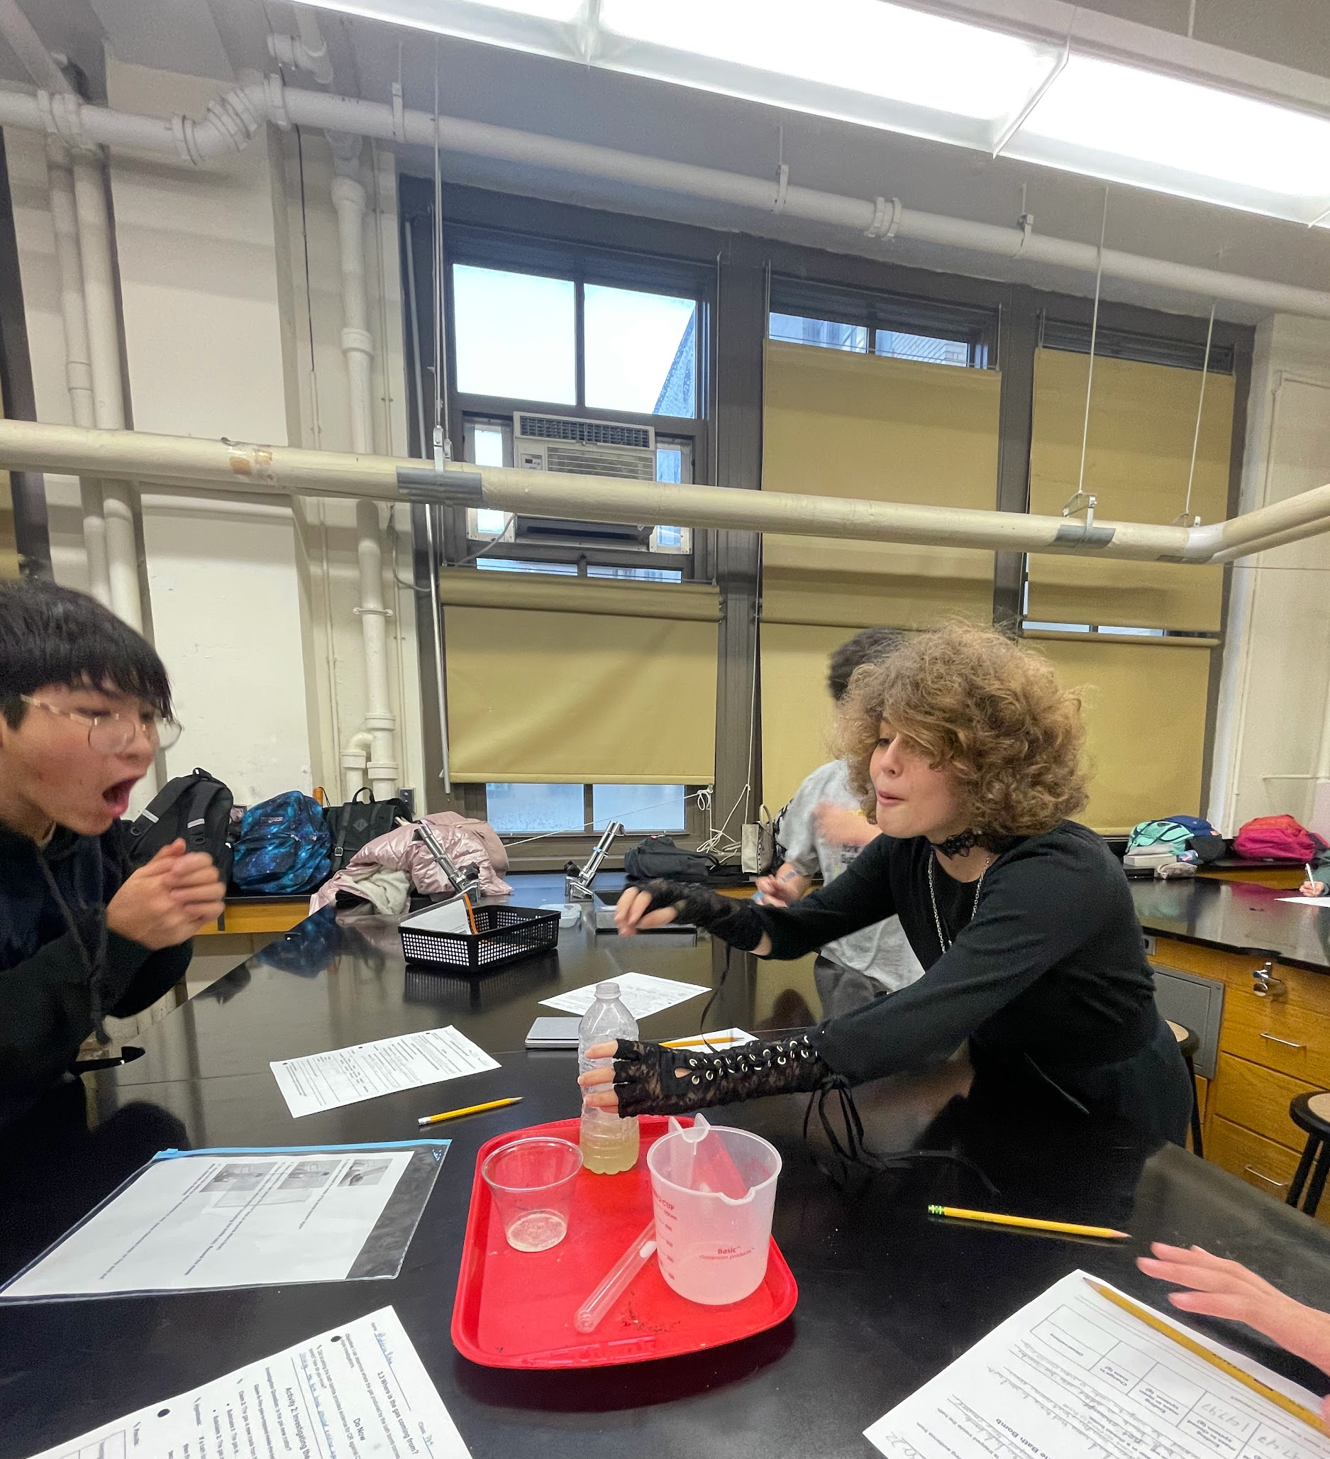
SCIENCE
Andrea Villeda
Quentin Williamston
Next Up:
ELA

Slide 36
Science Units
Unit 1: Nature of Science
Unit 2: Properties of Matter
Unit 3: Atoms & Elements
Unit 4: Chemical Interactions
Unit 5: Energy
Unit 6: Forces and Motion

Slide 37
Skill Development
ask questions and define problems
design and carry out scientific procedures
gather, analyze and interpret data
develop and use models
obtain, evaluate, and communicate information using scientific vocabulary
engage in arguments from evidence
turn research notes into presentations

Slide 38
resources
Contact
Quentin Williamston
Qwilliamston@ms447.org
Office hours: Tuesday
Andrea Villeda
avilLeda@ms447.org
Office hours: Thursday

Slide 39
Resources
Google classroom
701: ulnlrnlt
702: 755qpbvf
703: wwqtk5vc
704: jbqjcae3
705: n7stbtt7
706: aiz4m3dj
Lessons posted daily. Great resource when student is absent.

Slide 40
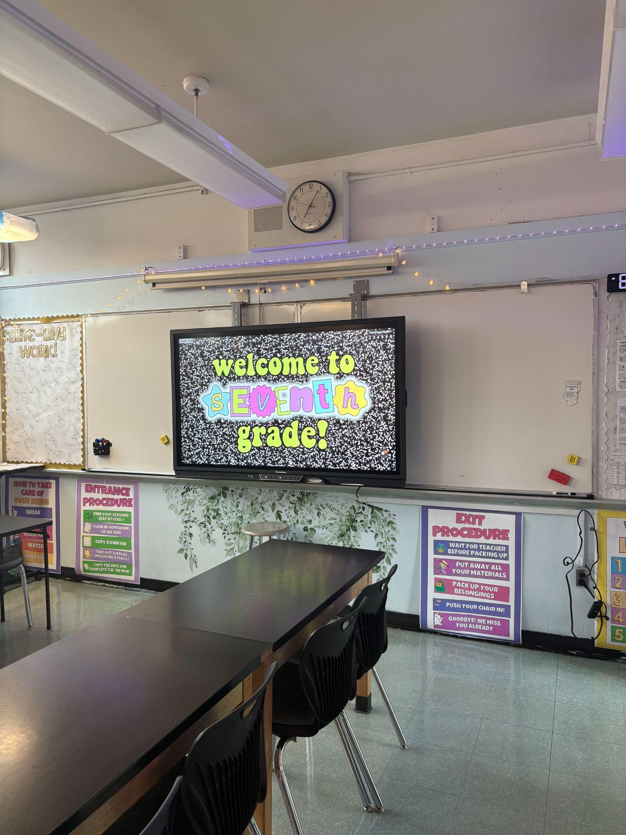
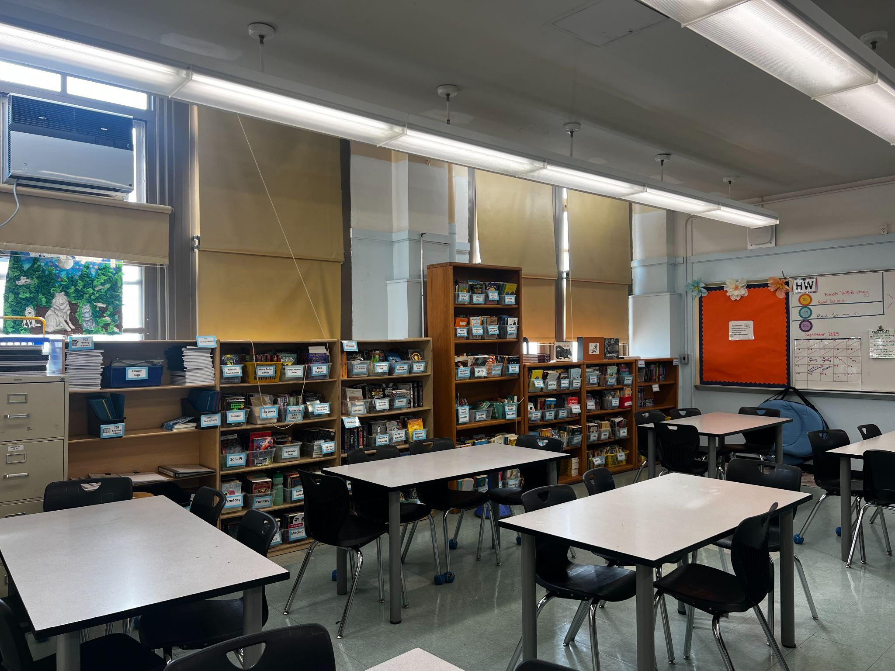
ELA
Cara Haft (702/704); chaft@ms447.org
Aysun O’Keefe (702/704/705); aokeefe@ms447.org
Sarai Hertz-Velazquez (701/703/705); shertzvelazquez@ms447.org
Jules Ross (701/705); jross@ms447.org
Arin Rusch (706); arusch@ms447.org
Jessica Saunders (706); jsaunders@ms447.org
Next Up:
Social Studies

Slide 41



ELA Long Term Learning Goals
Reading: I can read texts in a variety of genres and formats to draw meaning.
Writing: I can write to express my ideas to an audience in a variety of genres and formats.
Speaking & Listening: I can share my ideas effectively and evaluate information presented to me through a variety of media.
Notes:
Jules

Slide 42
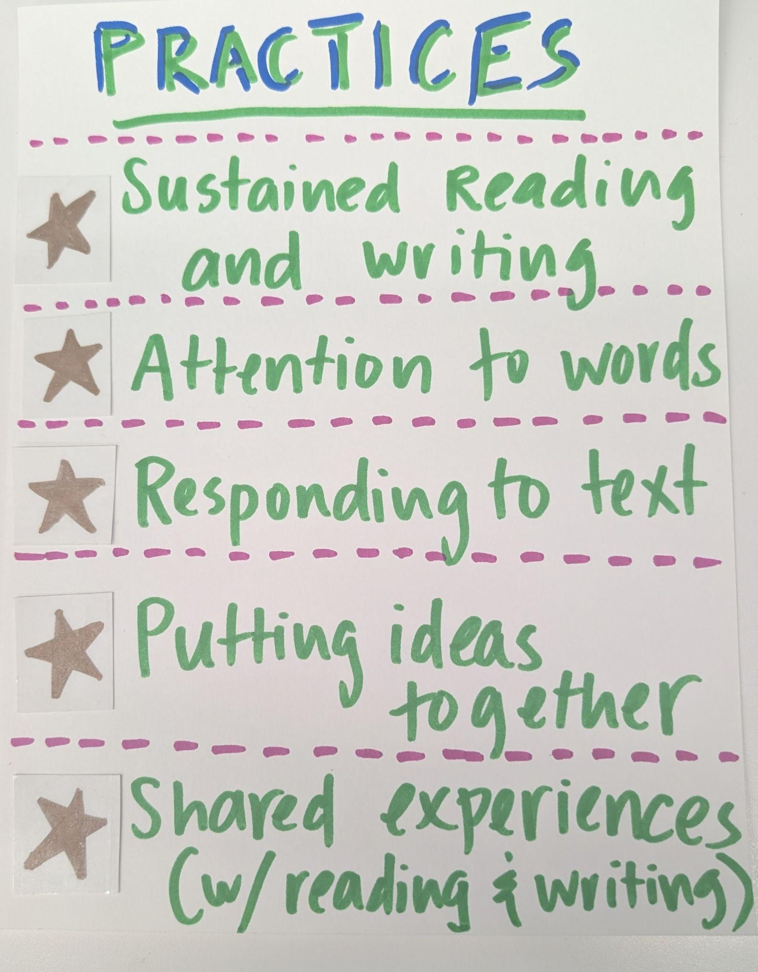

Notes:
Arin

Slide 43
Units final products
U1: Look Both Ways
U2: Podcasting
U3: Literary Analysis
U4: Nonfiction Reading & Persuasion
U5: Poetry Analysis & Comparison
Theme Paragraph
Podcasts
Literary Analysis Essay
Persuasive Presentation
Poetry Analysis Essay
Notes:
Sarai Units, Cara Products
Curricular Units

Slide 44
Reading!
Students should average 30 minutes per night
We set individual reading goals and track progress each trimester
Formal responses to independent reading throughout the year with a creative twist (BECAUSE READING IS FUN!)
Students will occasionally participate in guided reading groups with assigned books, stories or articles
Students will build critical reading skills across many text genres, including fiction, non-fiction, memoir, and poetry
Notes:
Jess

Slide 45
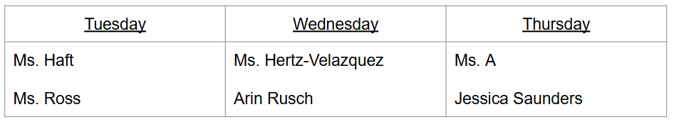
Homework and Assignments
We assign homework from time to time, in reasonable amounts--maybe 20 minutes worth of work or so. BUT, understand that 7th grade requires an increased amount of stamina, independence, and organization! Students are also expected to read for 30 minutes every night.
When they are absent, please remind them to contact the teachers right away to see what they missed!
Office Hours: 3:00-3:40, three days a week!
Notes:
Aysun

Slide 46
SOCIAL STUDIES
Jonathan George
Jack Fairbairn
Next Up: Closing

Slide 47
SS Unit
Historical Units | Academic Calendar
A History Of Us | September-November
From Colonies to Country | November- January
Constitution | January-February
Westward Expansion | March- May
Civil War | May-June

Slide 48
PaRENt anD Student ReSources
Google ClassROOM
Office Hours:
Mr.Fairbairn Tuesday
Mr.George Wednesday
Email:
Mr.Fairbairn jfairbairn@ms447.org
Mr.George Jgeorge@ms447.org
All lessons are posted daily on
Google Classroom.

Slide 49
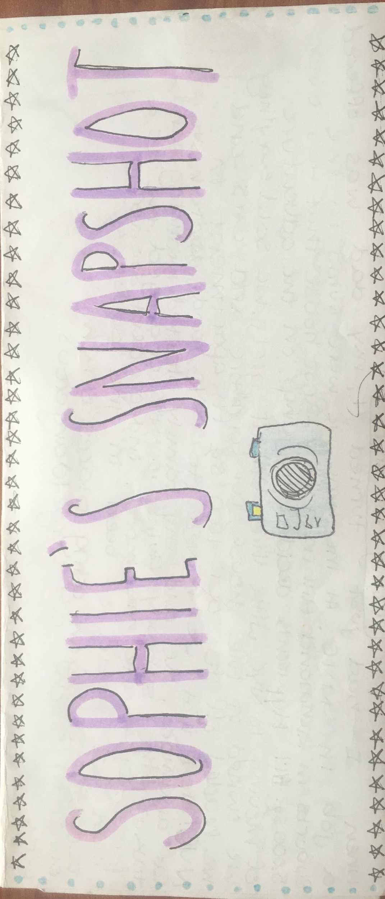
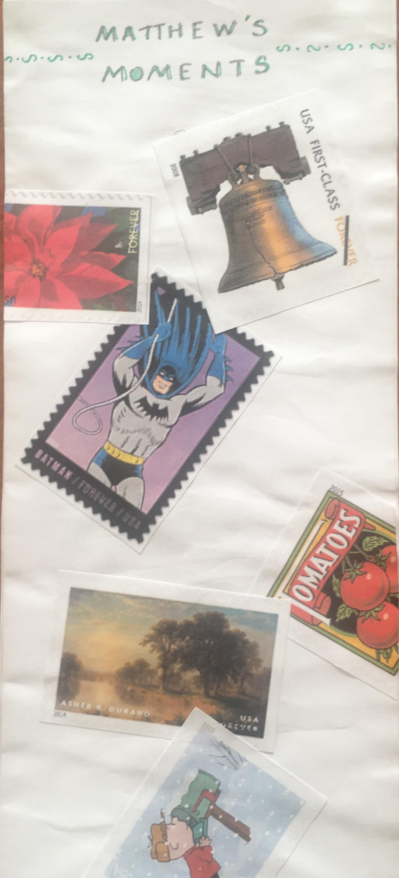
Classroom Expectations
Assessments
SnapShOT Autobiography
Unit Quizzes & Test
Projects
Paragraph writing
Due September 19 for
701/702/703
Due September 22nd for
704/705/706

Slide 50
Thanks!
See you at Student Led Conferences on November 13th.
Visit our website:
www.ms447.org

