Slide 1
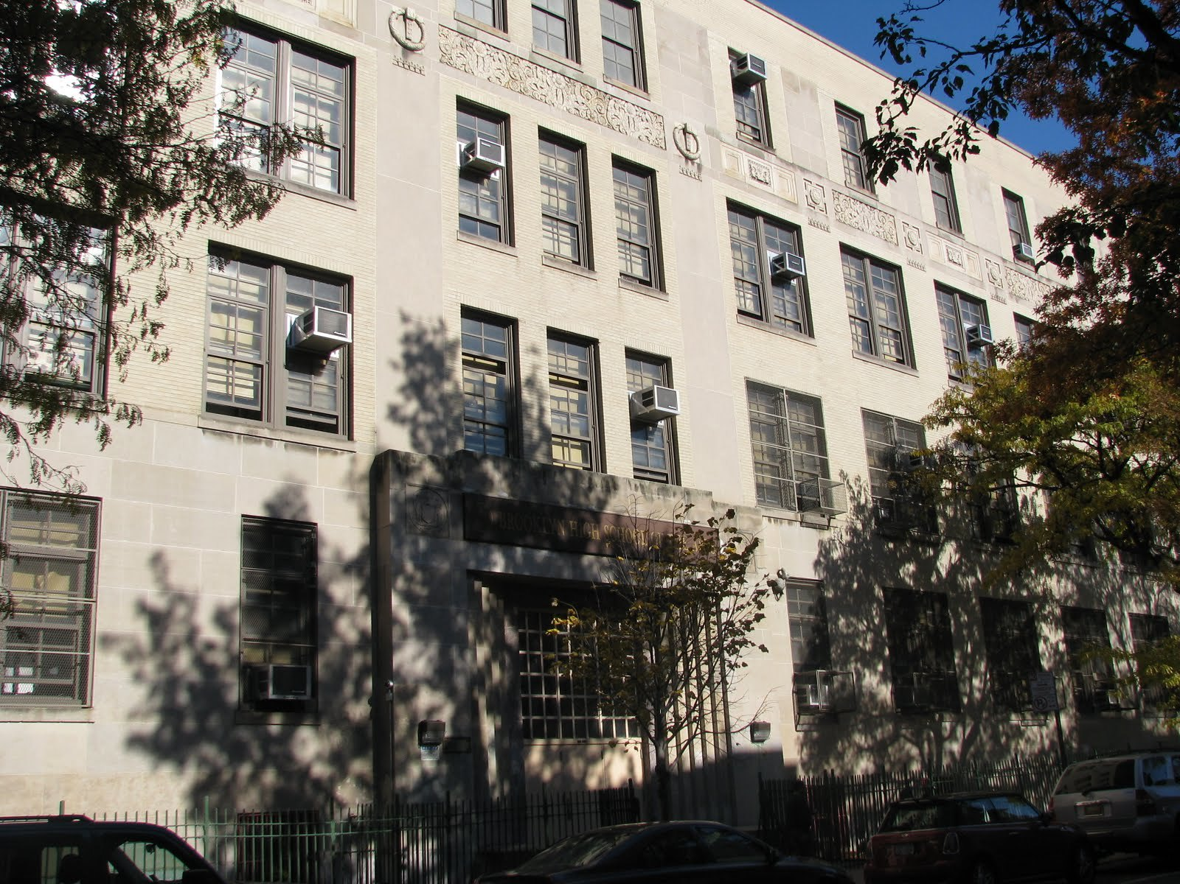
MS447 The Math & Science Exploratory School

Slide 2
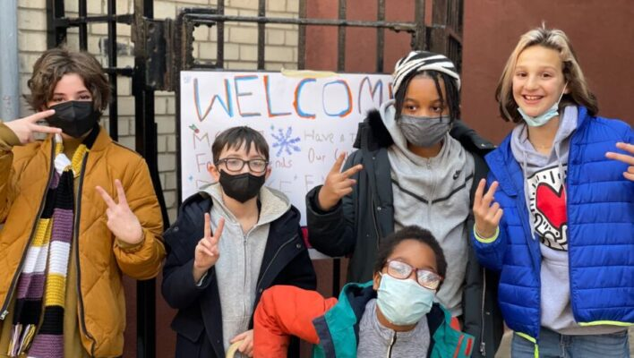
The Basics…
Rigorous and nurturing academic environment
Approximately 550 students
6 classes per grade
Integrated Co-teaching Classes on all grades
3-year advisory program
Busing for 6th Graders
Mastery-based grading

Slide 3
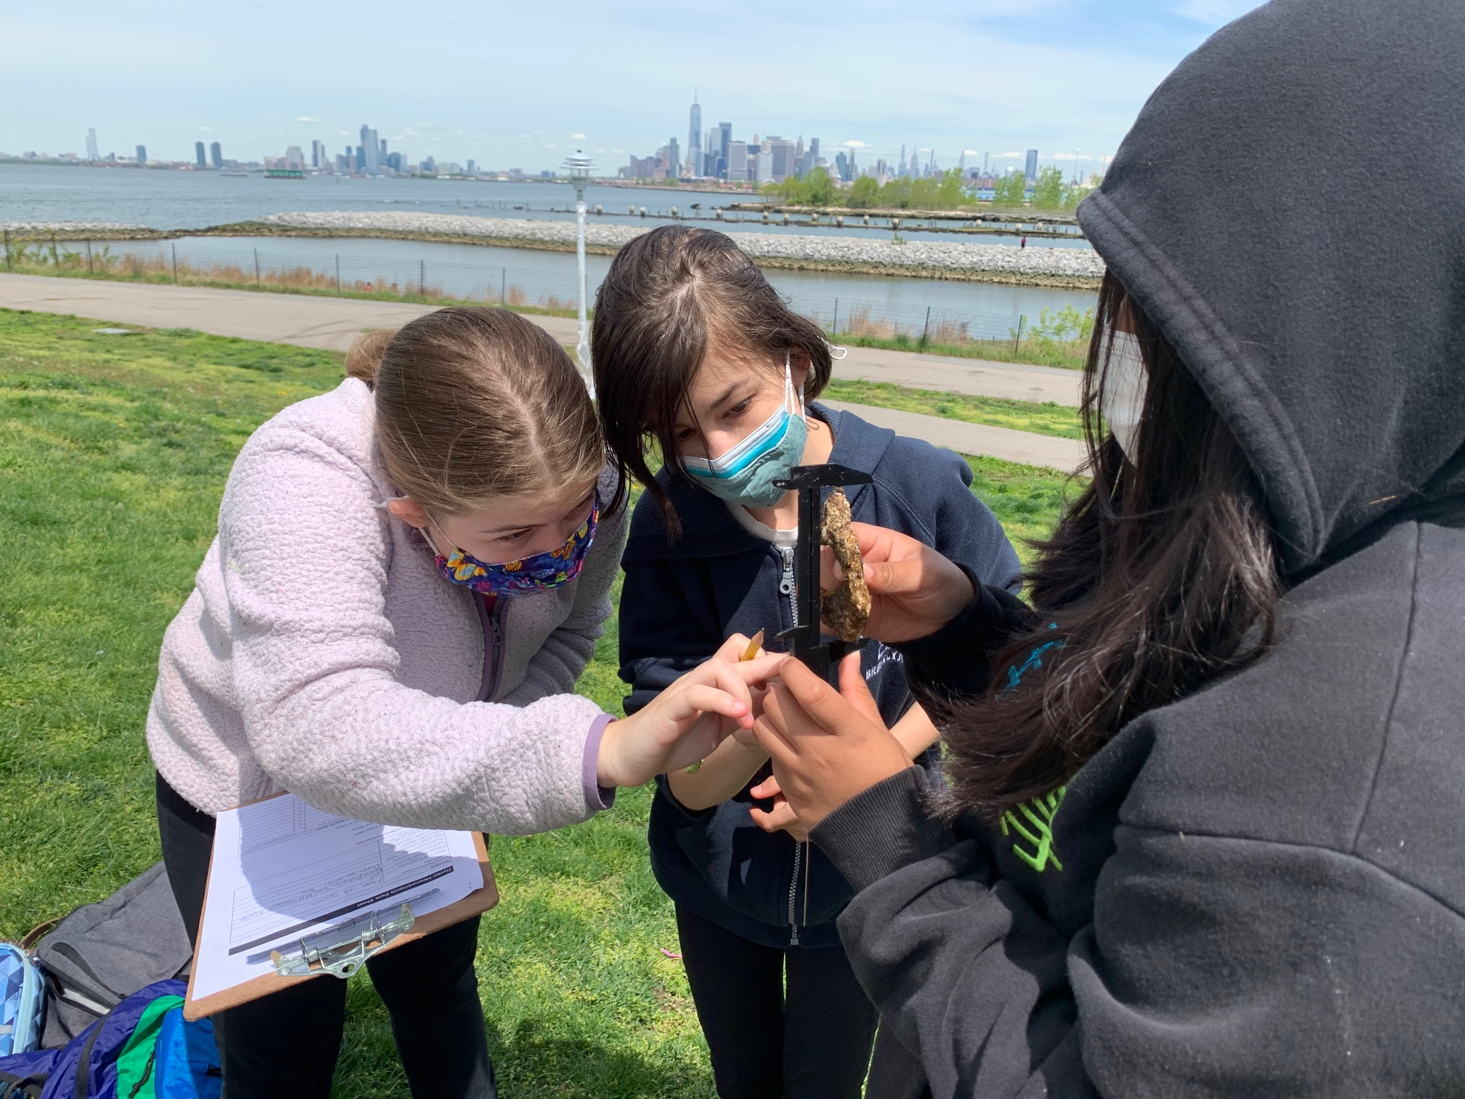
Our Vision…
As inquisitive learners, we grow through perseverance, resilience, and innovation. We believe that, to act with integrity and empathy, we have a responsibility to advocate for ourselves and others, honoring our community and the world.

Slide 4
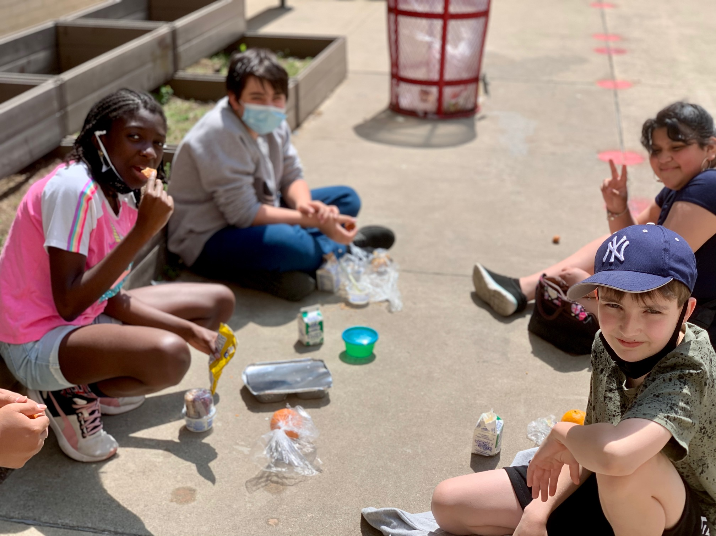
MS 447 CORE VALUES
Learning through Inquiry-Based Experiences: Opportunities that empower students to question, explore and make sense of the world around them.
Collaboration and Partnership: Between students, teachers, families, and our city
Education of the Whole Child: Students as citizens who are self aware, socially aware, and environmentally aware, and act as responsible members of our community.

Slide 5
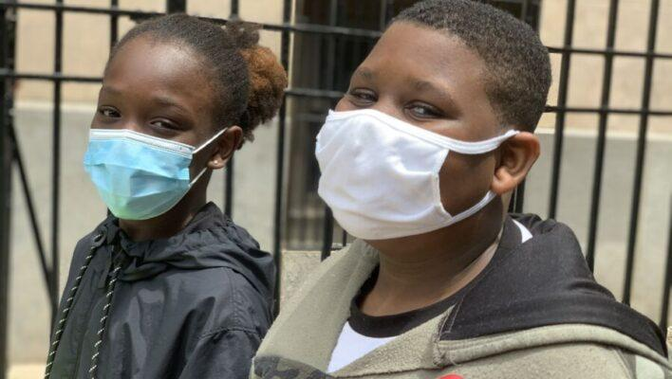
Advisory
Safe, consistent, and nurturing setting
Small Group (8-10 students)
Racial identity and anti-racism
Focus on five competencies:
Self-Awareness
Self-Management
Social Awareness
Relationship Skills
Responsible Decision Making

Slide 6
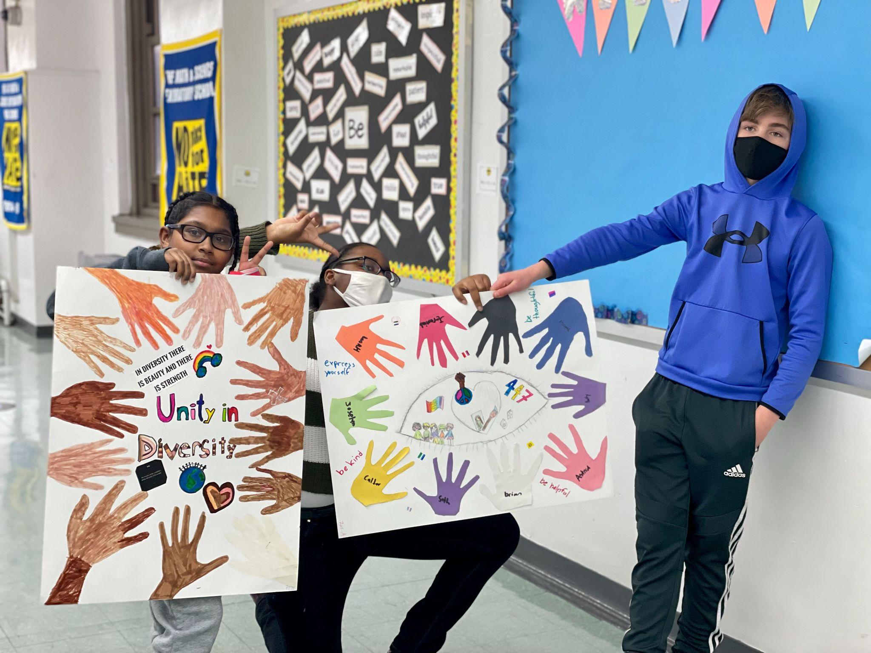
Social Emotional Learning
Conflict resolution
Student Equity Team
Student Council
Peace and Diversity Conference
Restorative approaches to discipline
Lunch Clubs and Recreation
Strong Support Staff

Slide 7
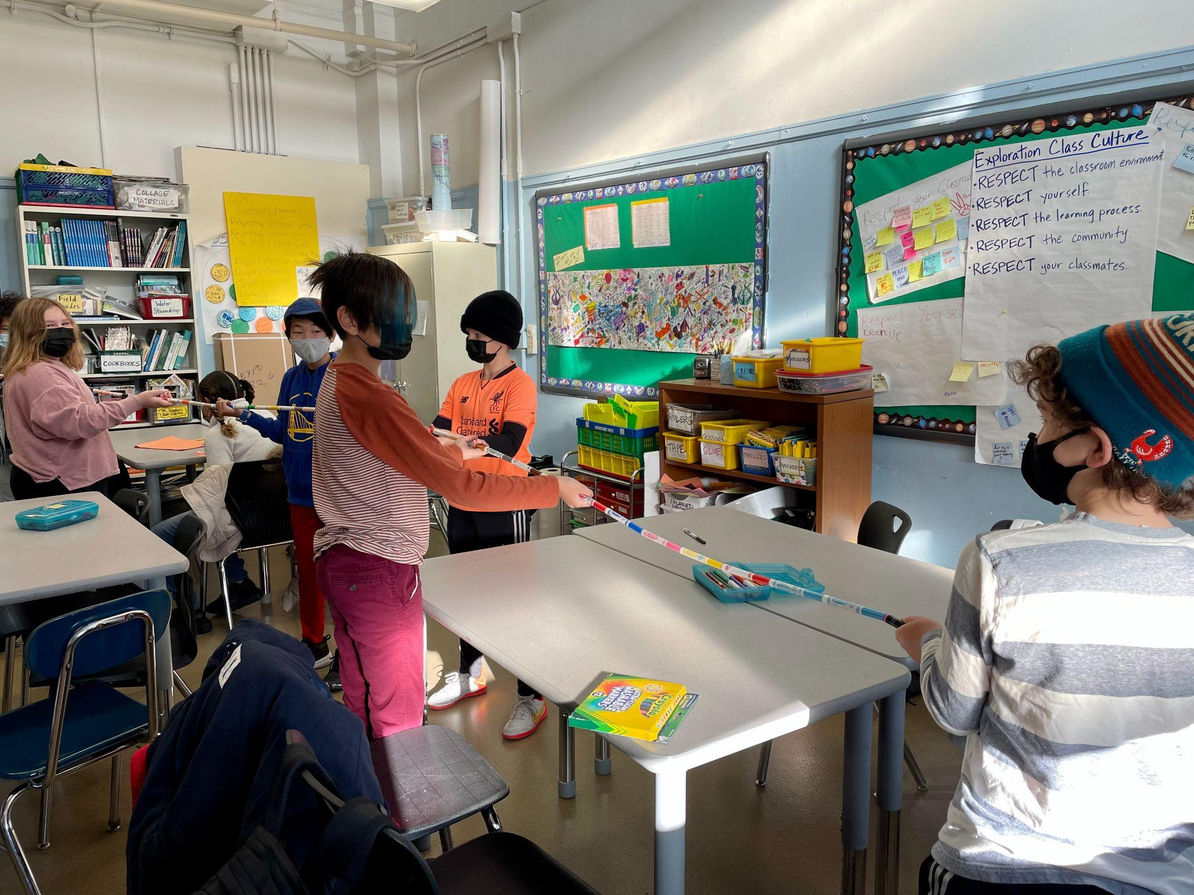
Special Education, ENL, Academic Intervention Services, & Student Support
Integrated Co-Teaching (ICT) inclusion program
ASD Nest Program
SETSS
Speech, OT, and PT
ENL services
Lit Lab and Math Lab for small group targeted instruction and academic intervention
Counselors on all three grades
Office Hours with teachers

Slide 8
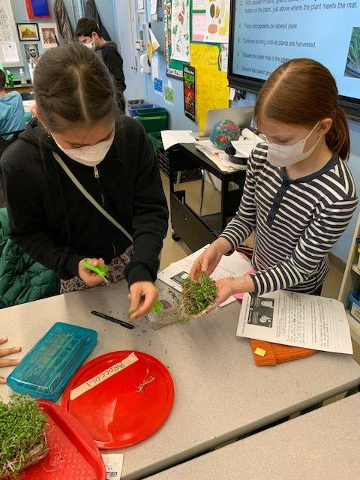
Exploration Program
Interdisciplinary units focused around a central theme
Taught onsite & offsite by a core seven-teacher team
Collaborations with NYC cultural institutions
Each unit ends with an Exposition for friends & family
Exploration Units of Study:
6th Grade: Food for Thought, Water Stewardship
7th Grade: Art for Planet Earth, Gowanus Blue
8th Grade: Mini Passion Project; Inventions and Systems for a Better World, Forensic Science and the Carceral System

Slide 9
Some of Our Destinations and Collaborations…
Brooklyn Botanic Garden
Sloop Clearwater
The Innocence Project
Center for Architecture Foundation
Dolan DNA Learning Center
Gowanus Canal Conservancy
NYC Mayor's Office of Sustainability
Queens Museum of Art
NY Hall of Science
Taste Buds Kitchen

Slide 10
…And Some More
Paley Center for Media
Brooklyn Grange Rooftop Farm
Museum of Natural History – Sackler Lab
Frick Collection
Jamaica Bay Wildlife Refuge
Liberty Science Center
Metropolitan Museum of Art
NYC Greenmarkets
Museum of Tolerance
Oyster Farming in Red Hook
Prospect Park
One World Trade Center

Slide 11
English Language Arts
We follow a comprehensive literacy (reading, writing, word study) curriculum in English Language Arts
Reading and writing across all subjects
Daily instruction reflects a cooperative spirit in which students engage with one another to ask big questions, make meaning, synthesize, apply, and share their learning
Emphasis on student voice

Slide 12
Social Studies
6th Grade: Ancient civilization and non-Western countries
7th & 8th Grades: US History
Collaborations: Facing History and Ourselves, Constitution Works

Slide 13
Mathematics
Development of deep understanding of mathematical processes through problem-solving, conversation, and routine skills practice.
Algebra 1 Regents exam at the end of 8th grade.

Slide 14
Science
Earth Science, Physical Science, Life Science
Inquiry-based lessons and projects
Long-term investigations
Emphasis on four modes of investigation
Controlled experiments
Secondary research
Field study
Exploring working model/systems
Living Environment Regents for all students in 8th grade
Urban Advantage School

Slide 15
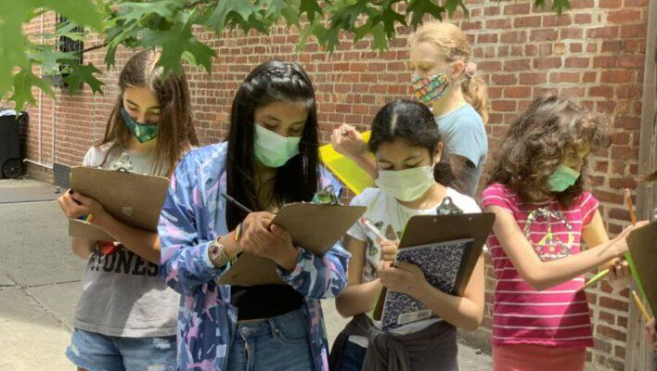
Foreign Language
Spanish, Grade 8
Focus on grammar, reading, writing, and speaking/conversation

Slide 16
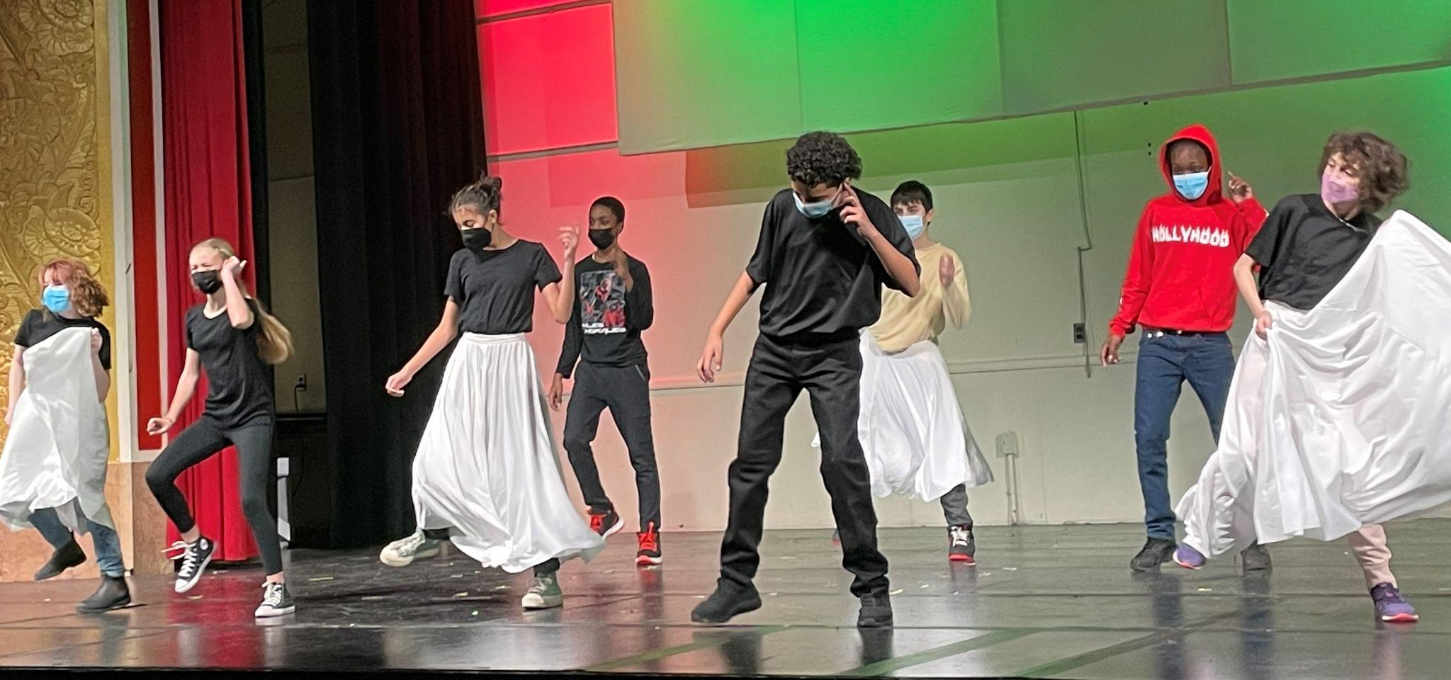
The Arts
All students Grades 6-8 Participate in:
Studio or Performance Art
Technology
Talent choices:
Dance
Instrumental Music
Theater
Studio Art

Slide 17
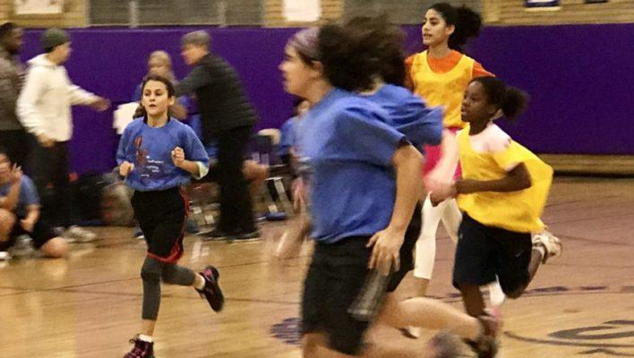
Physical Education & Health
Two P.E. periods per week
Sports and Games/Team building
Fitness/Healthy Living
Additional Health class in 7th Grade
Recess Sports
Morning gym program

Slide 18
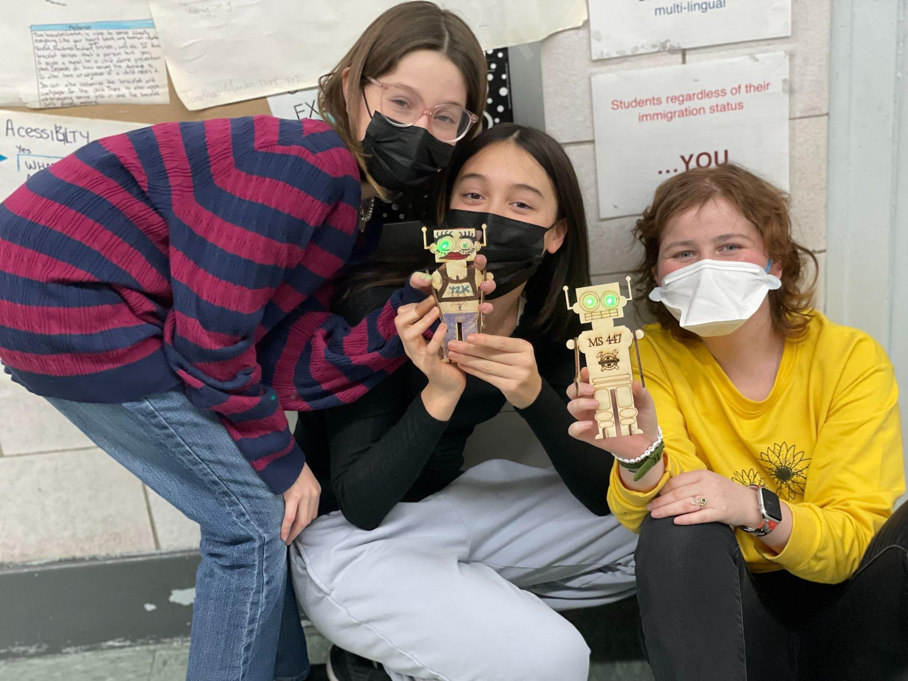
Mastery Based Assessment
Mastery based grading provides built-in, specific, and ongoing feedback to students
Opportunities for revision and goal-setting
Habits of Work
Student-Led Conferences

Slide 19
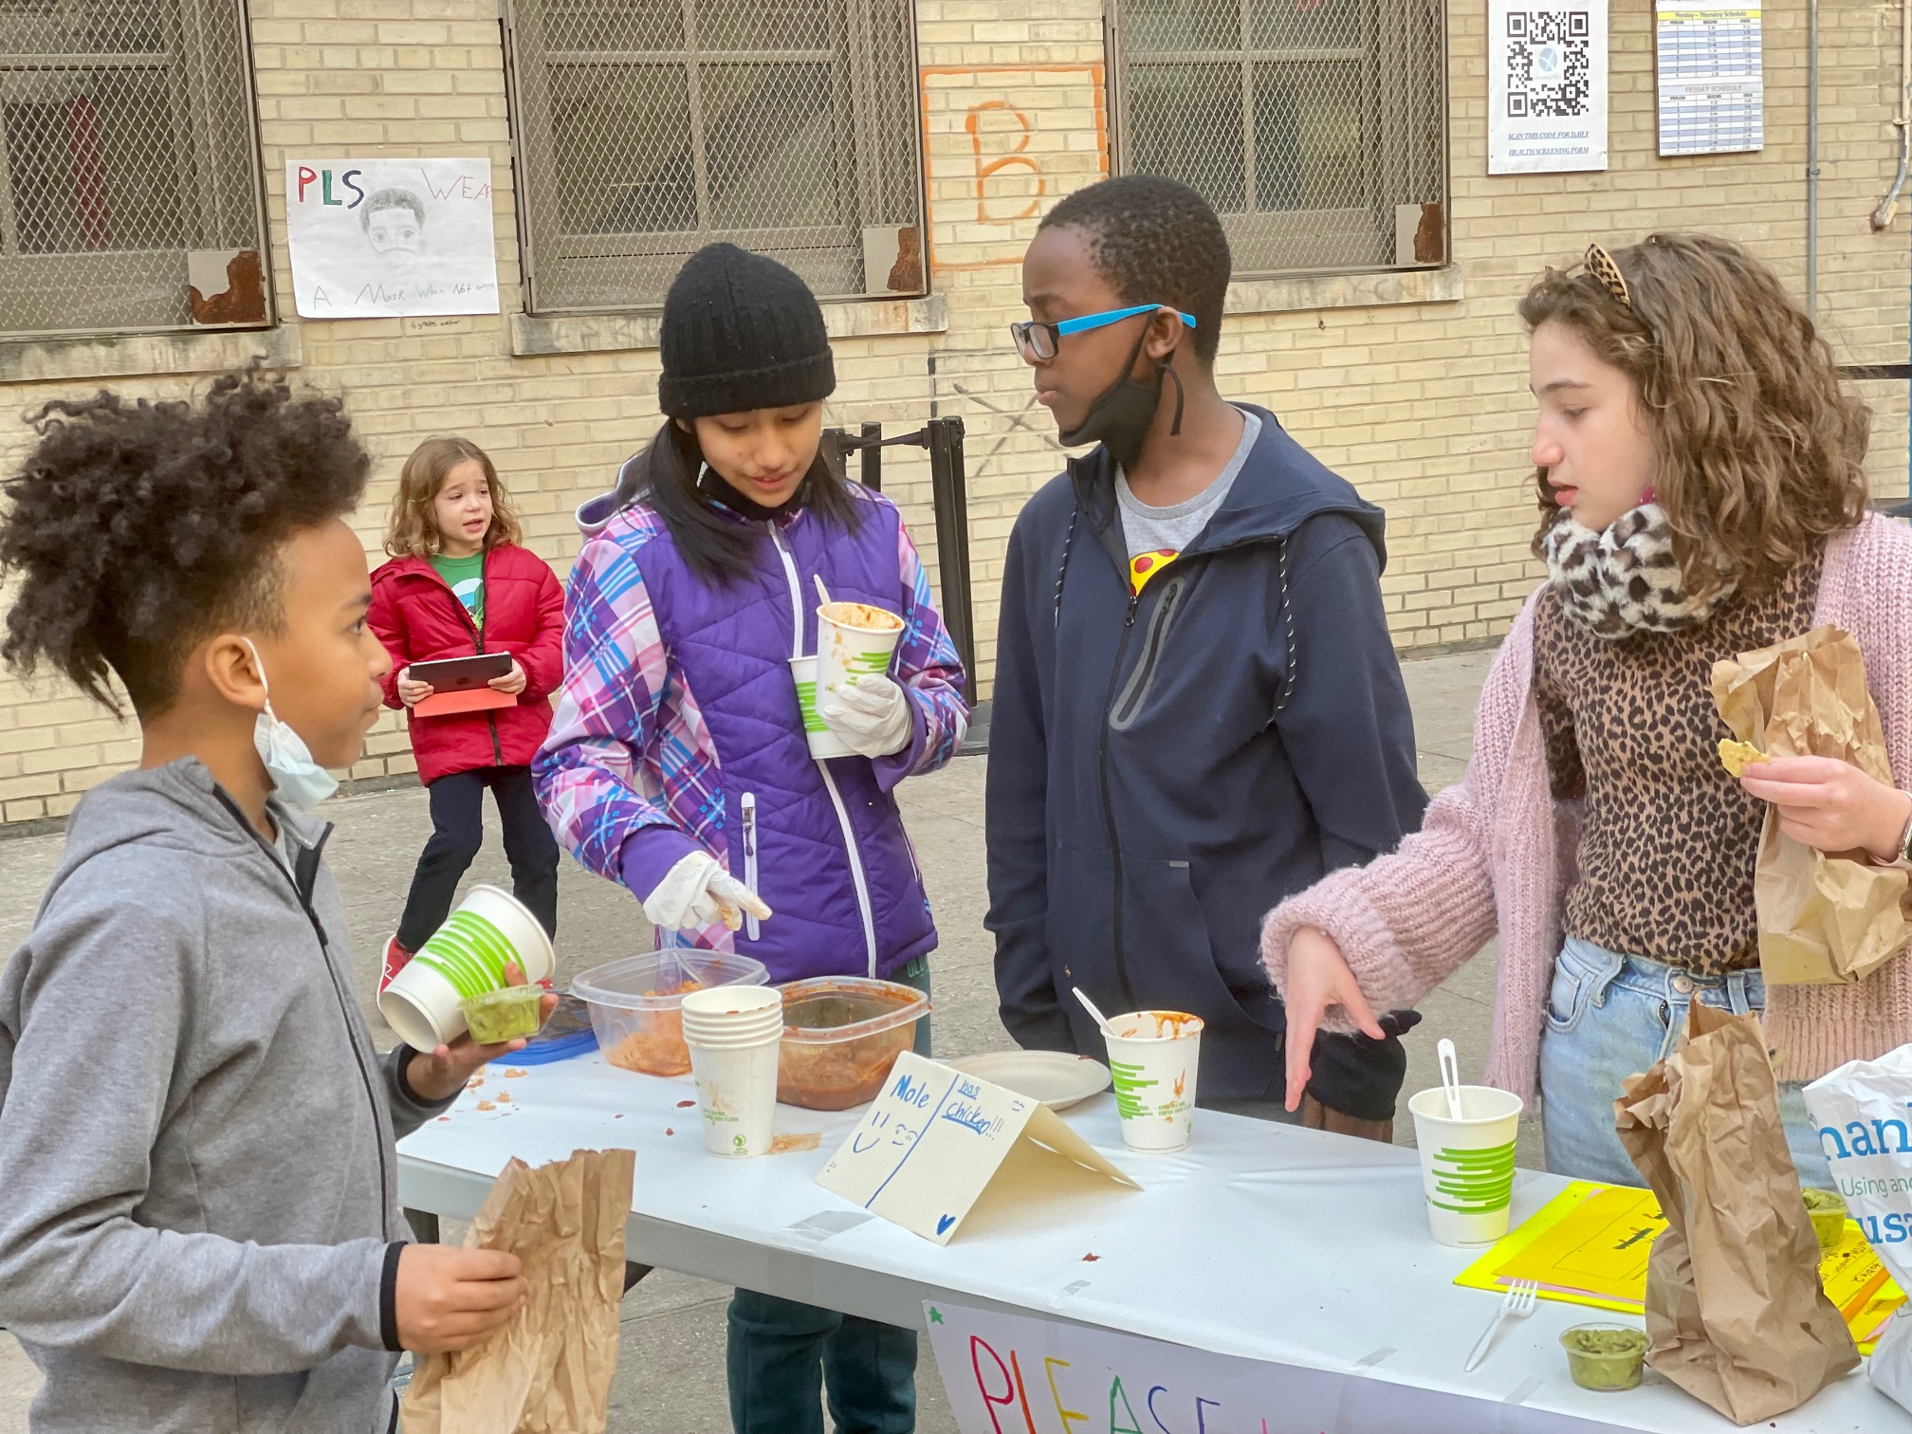
After School Program
Free, full-time after school program (SONYC)
In partnership with LeAP
Robotics, Fine Arts, Dance, Basketball, Flag Football, Soccer, Spoken Word/Creative Writing, Photography, Film Production, Cartooning, Theater, Songwriting, Games Factory, Vocals, Life Skills and Leadership, Homework Help, and more…

Slide 20
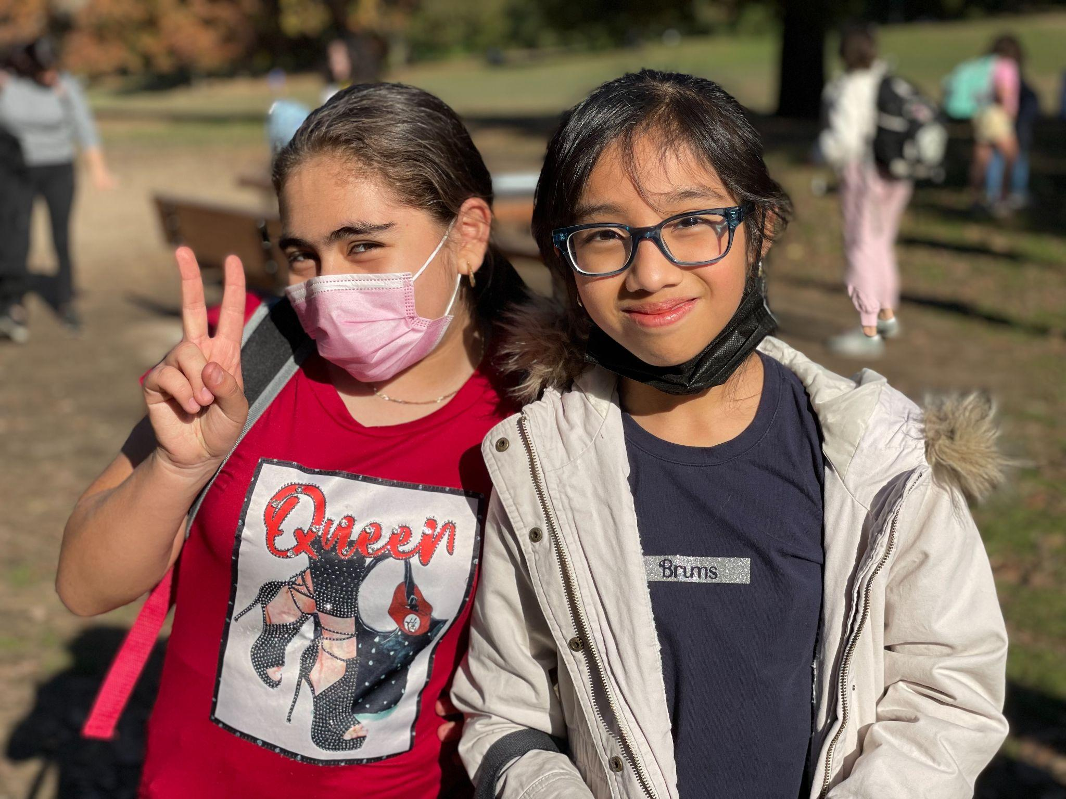
Learn More…
Visit our website: ms447.org
Contact our Parent Coordinator, Amy Sirot asirot@ms447.org

