Slide 1
Registering for PupilPath Mobile!
How to use it

Slide 2
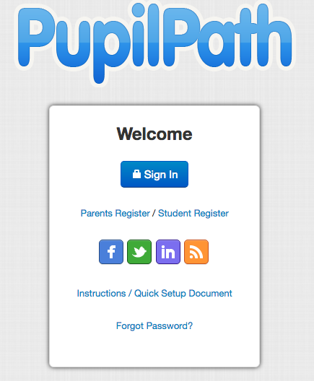
How to register
To register, you need to use an Internet Browser to register. Use either a laptop, desktop, or your smartphone’s browser to register.
You need:
The PupilPath letter given to your student on the 1st Day
Internet access and a connection to an Internet Browser (like Firefox, Chrome, Safari)

Slide 3
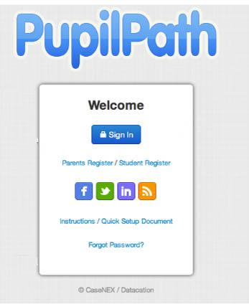
Registering for PupilPath
New MS 447 PupilPath accounts: click the registration link and enter in the required fields.
Parent/Guardian with a current MS 447 student in 7th or 8th grade: Do Not Re-Register. Sign in with your current account. You will be able to add the new student.
If you forget your password:
  Parents/Guardians should click “Forgot Password” to reset password.
  Students should ask the Parent Coordinator for a new registration code.
Parents/ Guardians: Click here if you are registering for the 1st time.
Students: Click here if you are a student that hasn’t registered yet. Most students will register during Tech class.
Click here to reset your password

Slide 4
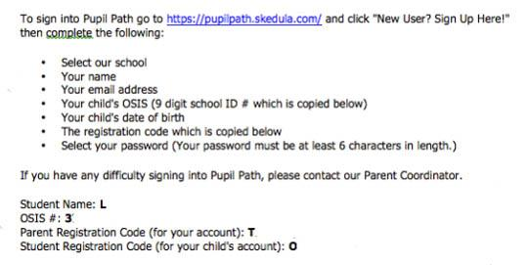
PupilPath Invitation Letter
On one of the first days of school, your student will receive a PupilPath invitation letter. You need this letter to complete the registration process. If you lose yours, please contact the Parent Coordinator.
Important to Note:
The Parent Registration Code can be shared by parents/guardians that are separated or divorced.
Once you are registered, PupilPath will allow each partner or guardian to have their own secure access codes and account that cannot be accessed by the other partner or guardian.
Parents and students should NOT share accounts.
Student ID Number
Notes:
Once your student brings home the PupilPath invitation letter (if you haven't already received it), follow the above instructions for signing up.
Important information to Note:
Parents/Guardians who are divorced/separated can use the same Registration Code and will be able to to secure their own access codes/account once registered.
Parents/Guardians and Students should NOT share accounts.

Slide 5
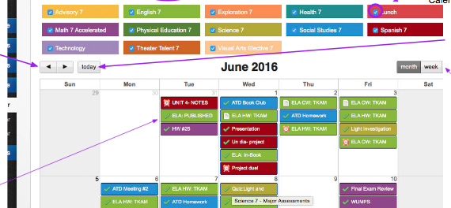
Mobile versus Online PupilPath
Use the one that best fits your life
However, the far superior method is the Online Browser version
The Browser has more options and details that aren’t offered on the Mobile version.
The Online version has the calendar function that is much easier to see and plan out your week
The Online version does not emphasize the grades as much, so students can focus on day-to-day work and obsess less on numeric grades

Slide 6
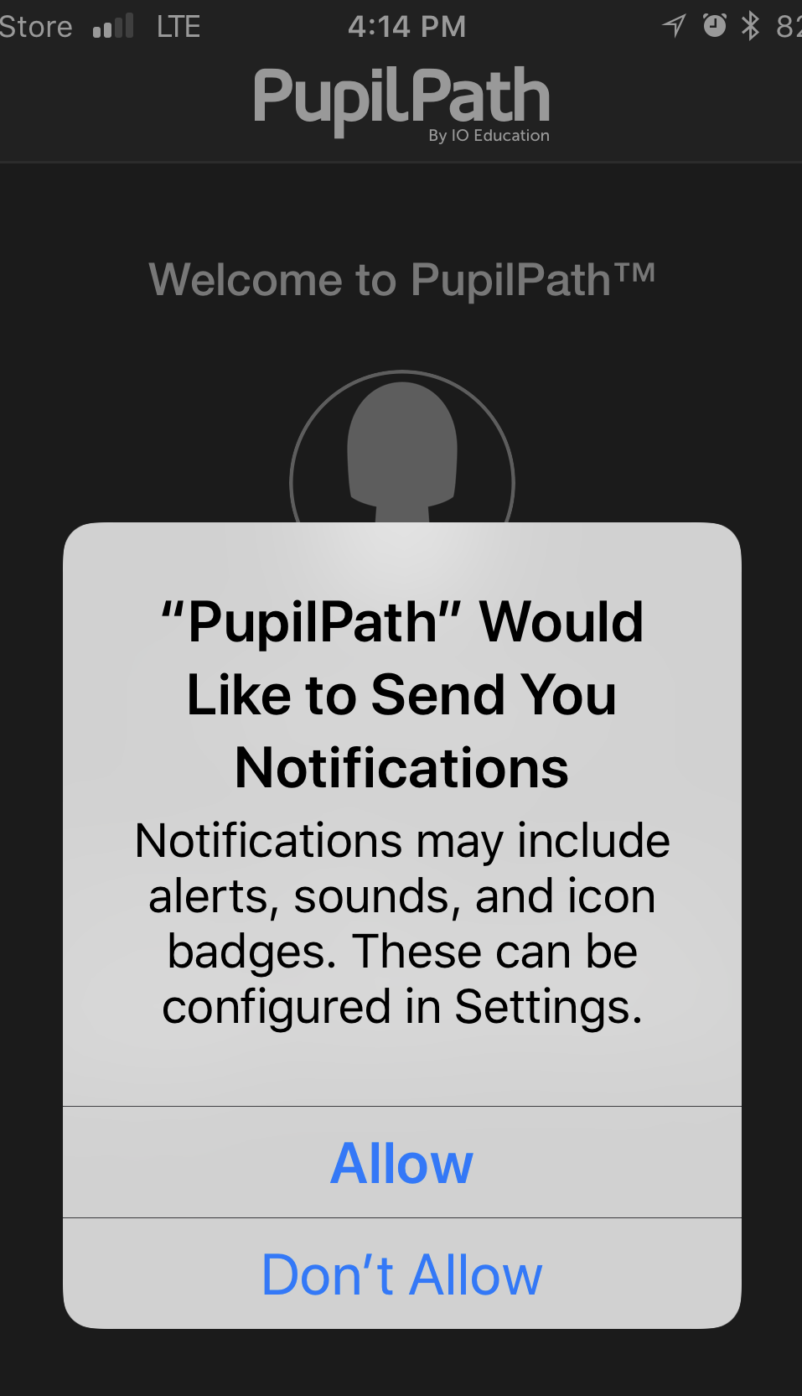
Push Notifications
After you sign into the iO PupilPath App, it will ask you if you want it to send you Push Notifications. You can always change your preferences in ‘Settings’.
Allow - You’ll be alerted that a grade was entered and told the grade
Easier to keep track of your student’s grades
Tells you when your student was given an anecdotal
Don’t Allow - You only see information when you go to the App. Not overwhelming.
If a teacher grades late at night, then you will receive a Push notification very late too!

Slide 7
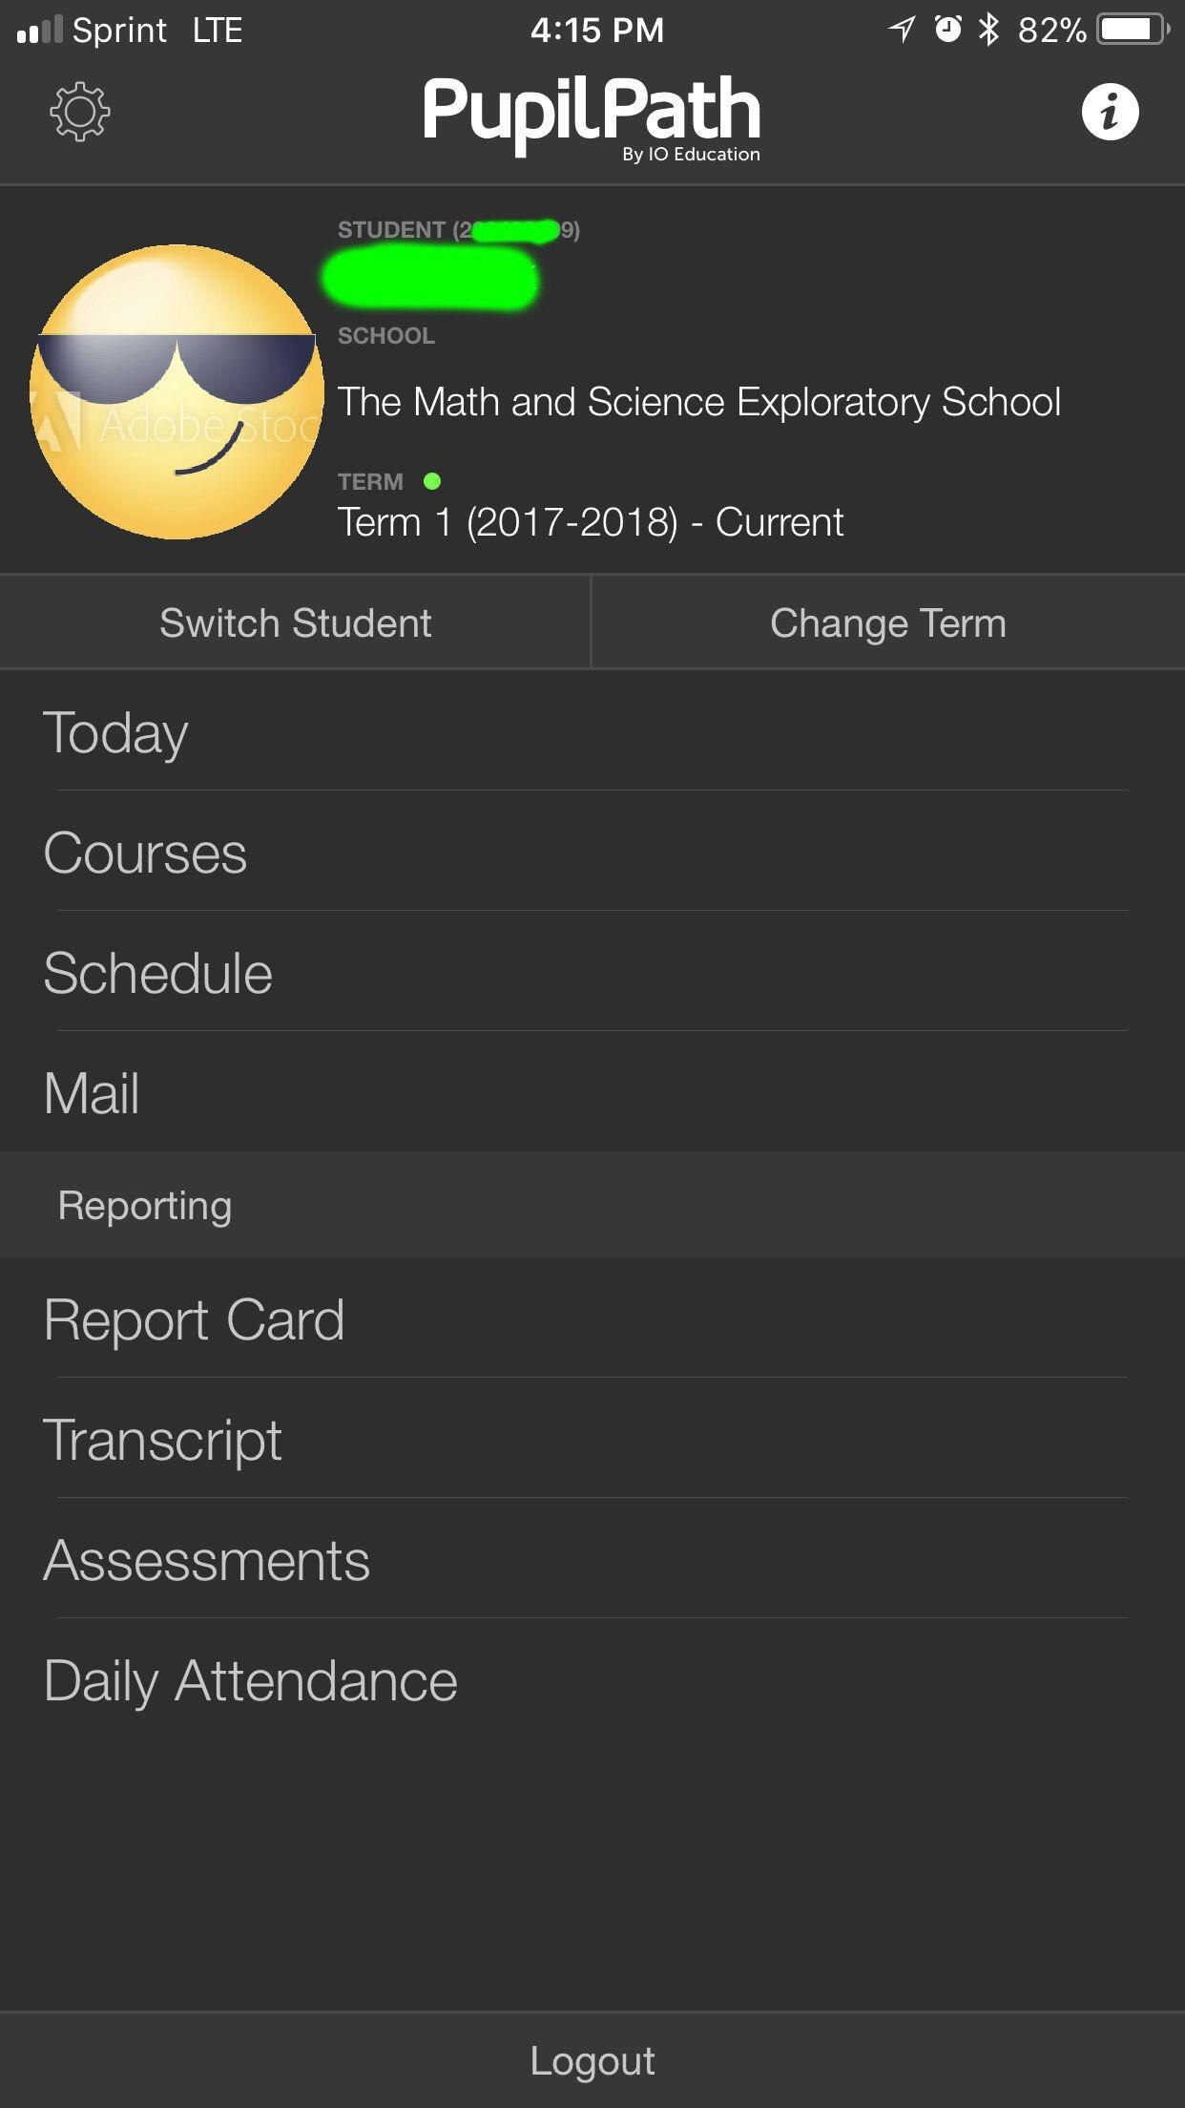
MOBILE LAUNCH SCREEN
The Launch screen is immediately after you log in.
From here:
you can see the work assigned and due Today.
Your student’s courses
Your student’s Report Card
Your student’s Attendance by Course (not the official Attendance).

Slide 8
Reading the Launch Screen
Today - lists all the work that is due today and was assigned today
Courses - lists all your student’s subjects
Schedule - Theoretically a list of each day & period’s classes but doesn’t sync up for our 6 day cycle
Mail - PupilPath mail, but teachers prefer gmail
Report Card - your grades & comments
Transcript and Assessments - State test scores
Daily Attendance - Student attendance for each class

Slide 9
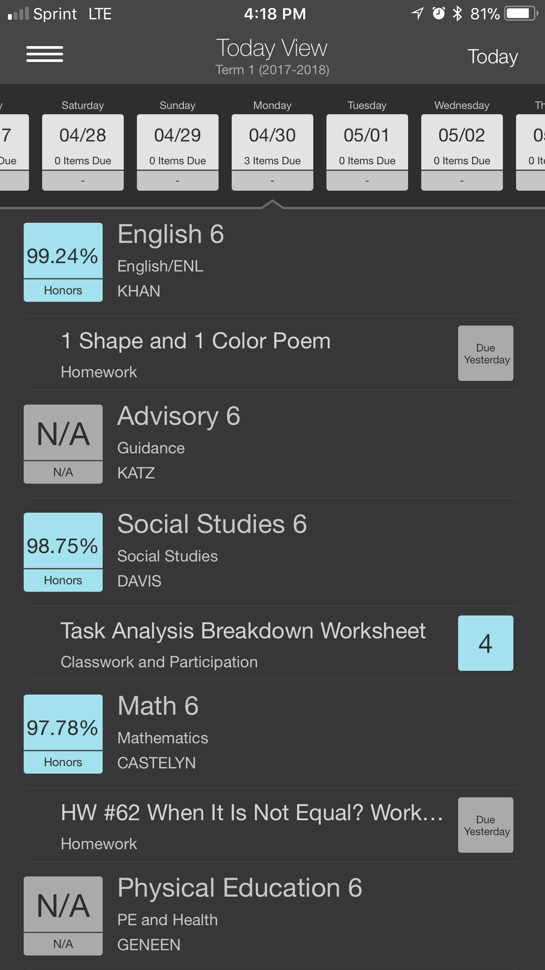
Today Screen
This is probably the most helpful screen!
Each subject (and the current grade) is shown and any assignments are listed below
The due date is listed next to the assignment
When grades are entered, the grade shows up here too
Hint - touch/click on the assignment to see more details

Slide 10
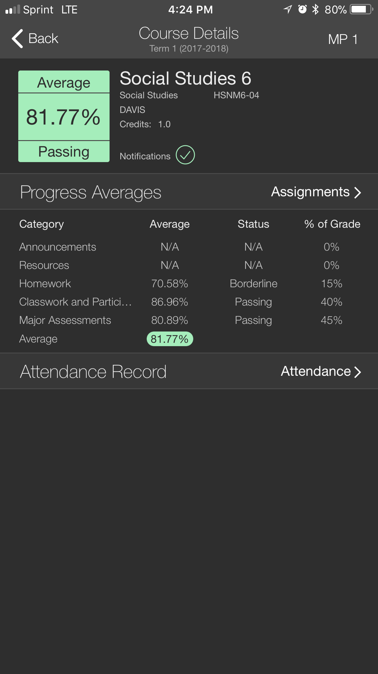
Course Details
Marking Period - Make sure you’re on the right one! Touch and use sliders to move it to correct it
Instantly see how your student is doing in each subject.
Assignments: touch to see all assignments & their grades
Average = the total grade with all the categories averaged together. This is the Report Card grade. Color meaning: blue = honors, green = passing, red = failing
% of Grade: how much weight does this category make up in the final grade.
Progress Averages - Each part (category) of the grade has its own average to see what is being done well or needs improvement

Slide 11
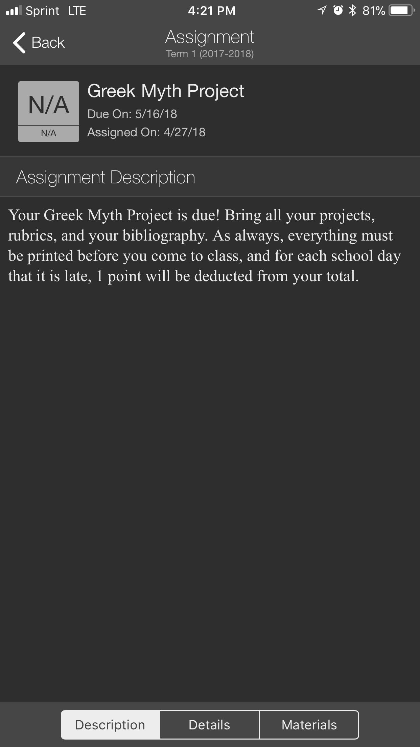
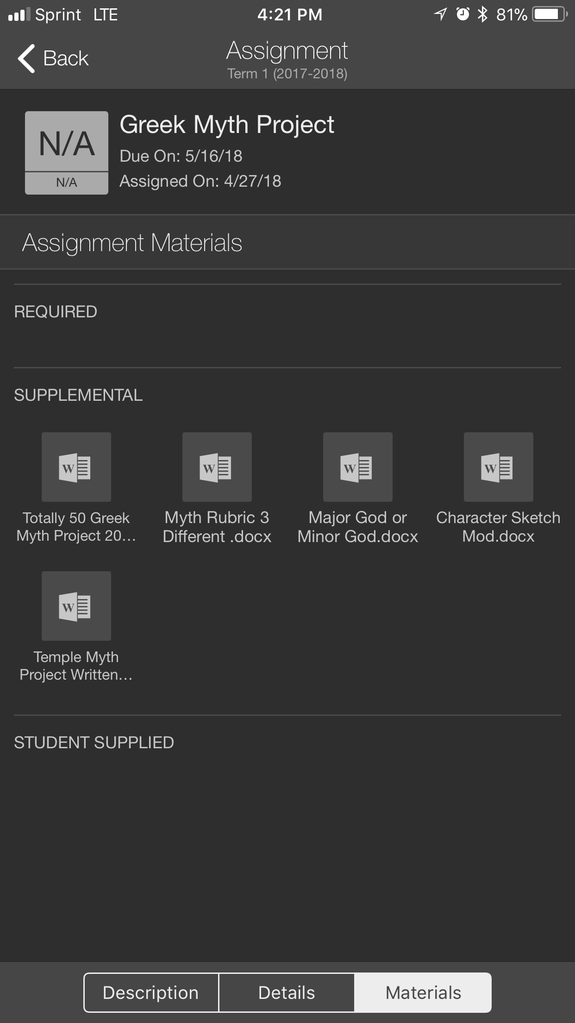
Assignment Screen
Once you touch the assignment you want more information about, you come here.
There might be a description of the assignment to help you
At the bottom of the screen, you can find more details if you touch that box
Or materials attached with this assignment. You can find rubrics, worksheets, and templates here if your teacher uploads them

Slide 12
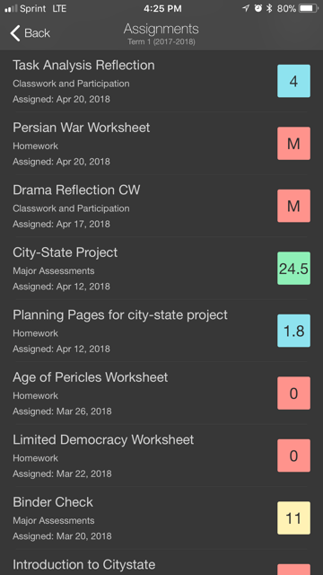
Assignment Codes
When an assignment is graded, the grade shows up next to the assignment in the box.
If you see an ‘M’ in the box, then the assignment has not been turned in. ‘M’s have a value of 0. Students have 1 grading cycle to turn in missing work or the grade is changed into a 0.
  An ‘M’ is not a judgement, it is just stating the fact that the teachers do not have it for a variety of reasons. Think of it as a reminder to students to do the assignment.
A 0 means that the assignment was missing and the student did not make up the assignment. It CANNOT be made up.

Slide 13
More Assignment Codes
An ‘L’ means Late. The assignment was turned in late and points have been deducted from the score.
‘EX’ - excused. The student was excused from the assignment and does not need to make it up.
‘A’ - absent. The student was absent and excused from the assignment
Colors in the mobile app have meanings.
  Blue = honors
  Green = passing
  Yellow = borderline
  Red = failing
Ungraded assignments are gray boxes with the due date in them

Slide 14
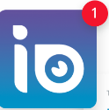
Notifications
When you see the red dot, then the app has new information for you.
It might be:
A new grade update
A new assignment
A message

Slide 15
Contacting Teachers
Encourage your student to contact teachers first
Please use your student’s full name and class. There might be others with your student’s first name in the grade, so this will make it easier for the teacher to give you more specific information
Always use the ms447.org Gmail addresses for teachers so that it reaches them faster
A full list of all the teachers’ emails can be found in the Planner. It will be in the beginning sections
PupilPath mail shouldn’t be used to communicate with teachers

Slide 16
Who to contact
Subject Teachers | Advisor or Social Worker | Parent Coordinator
Grades Homework Concerns Content Questions Extended Absences (you should always tell the Pupil Secretary about absences- send in a note with your student) | Locker Issues Social Issues Illnesses Family Emergencies | Bus Information Lunch Information Lost or forgotten items PupilPath account problems PupilPath password reset for Students Lost Forms
Note: When sending an email, please include your student’s name and class in the subject, and a brief description of the issue, to all teachers of that class!

Slide 17
Forgotten Passwords
If your student forgets or loses their PupilPath password, then email the Parent Coordinator for a new one.
The Parent Coordinator is Amy Sirot (asirot@gmail.com)

Slide 18
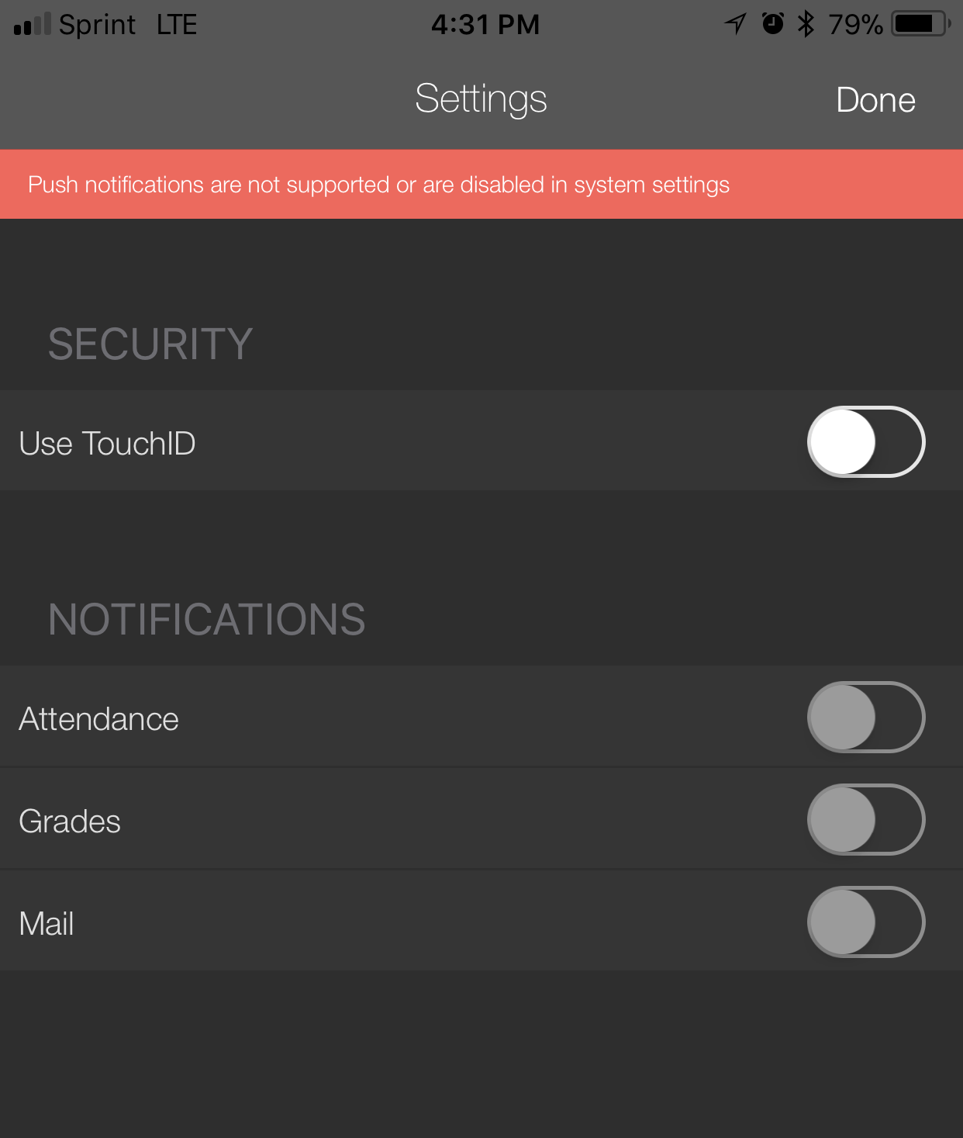
Settings
The Settings page can adjust your preferences.
You can change your Security or Notification selections

