Slide 1
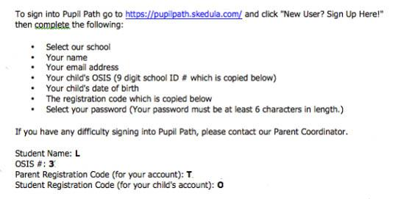
PupilPath Invitation Letter
Your student has already received a PupilPath invitation letter. You need this letter to complete the registration process. If you lose yours, please contact the Parent Coordinator.
Important to Note:
The Parent Registration Code can be shared by guardians that are separated or divorced
.
PupilPath will allow each guardian to have their own secure access codes and account that cannot be accessed by the other partner or guardian.
Parents and students should NOT share accounts.
Student ID Number
Notes:
Once your student brings home the PupilPath invitation letter (if you haven't already received it), follow the above instructions for signing up.
Important information to Note:
Parents/Guardians who are divorced/separated can use the same Registration Code and will be able to to secure their own access codes/account once registered.
Parents/Guardians and Students should NOT share accounts.

Slide 2
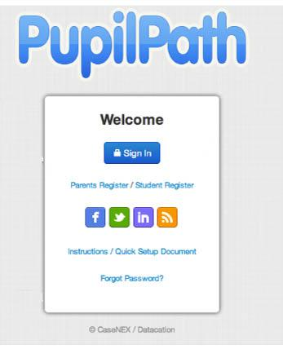
Registering for PupilPath
New MS 447 PupilPath accounts: click the registration link and enter in the required fields.
Parent with a current MS 447 student in 7th or 8th grade: Do Not Re-Register. Sign in with your current account. You will be able to add the new student.
If you forget your password:
Parents should click “Forgot Password” to reset password.
Students should ask the Parent Coordinator for a new registration code.
Parents: Click here if you are registering for the 1st time.
Students: Click here if you are a student that hasn’t registered yet.
Click here to reset your password
Notes:
Be sure to register for PupilPath first. If you have a student who already attends 447, you will not need to re-register. You will simply need to add your new student to your already existing account!
If you forget your password:
Parents- click “Forgot Password” to reset password.
Students- ask the Parent Coordinator for a new registration code.

Slide 3
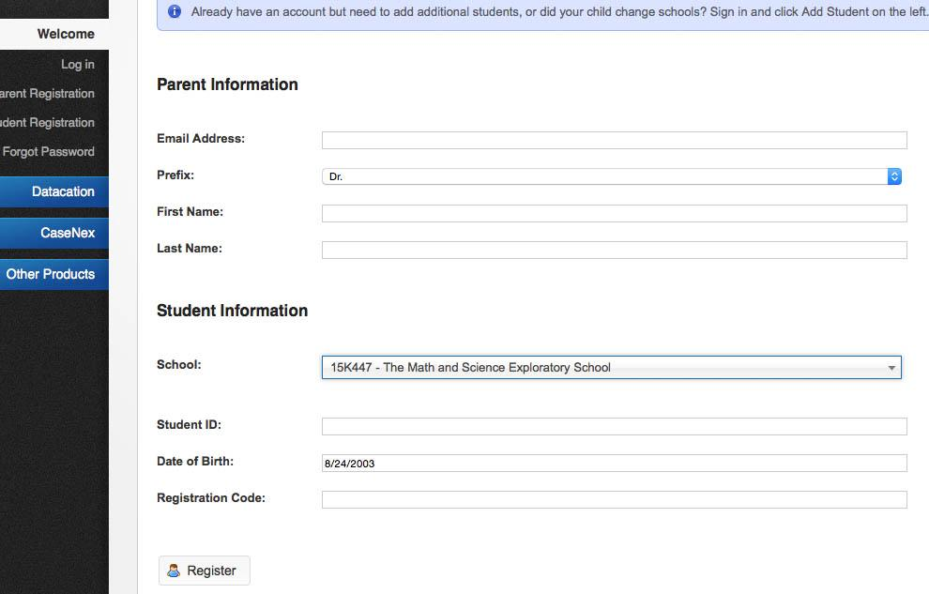
Registration & Password set up
Parents with a current MS 447 student in 7th or 8th grade who already have an account should follow this prompt
The Student ID and Registration Code are both found on the bottom of the PupilPath Registration Letter.
When you successfully complete the registration process, the system will generate a “Thank You for Registering” response and it will prompt you to setup your password.
Notes:
Here is what the Registration screen looks like. Be sure to enter all of the appropriate information found on the Registration Letter.

Slide 4
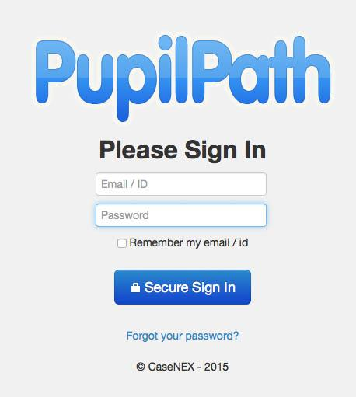
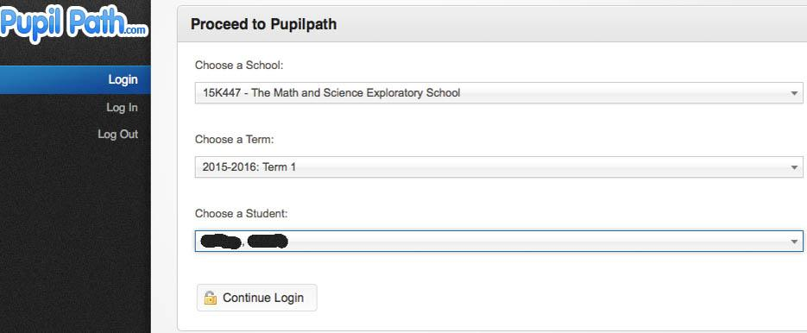
Logging into PupilPath
When you log into the PupilPath sign in screen (www.pupilpath.skedula.com), you need the email address or ID that you used to create your account and your password.
You might be asked to choose the school (15K447), the school Term (2017-2018), and the Student that you wish to view.
Notes:
Log on to PupilPath (https://pupilpath.skedula.com/). Enter your sign in ID and password (must have registered first- if you are unsure of how to register, please see previous screen).
Login drop down menu: Select 15k447, 2016-2017: Term 1, choose your student’s name and continue to login.

