Slide 1
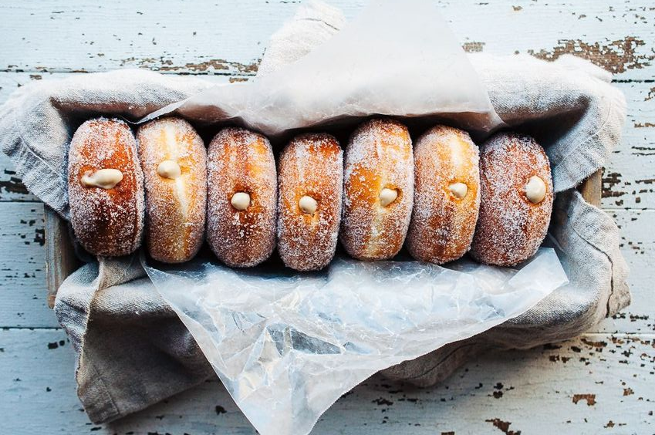
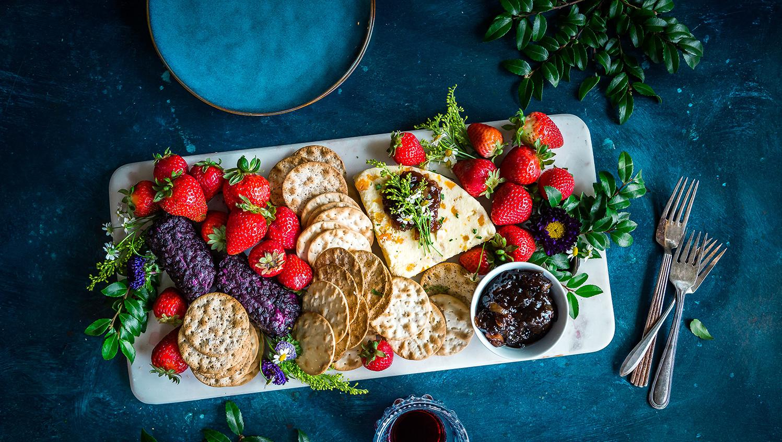
6th GRADE COOKBOOK
Yellow

Slide 2
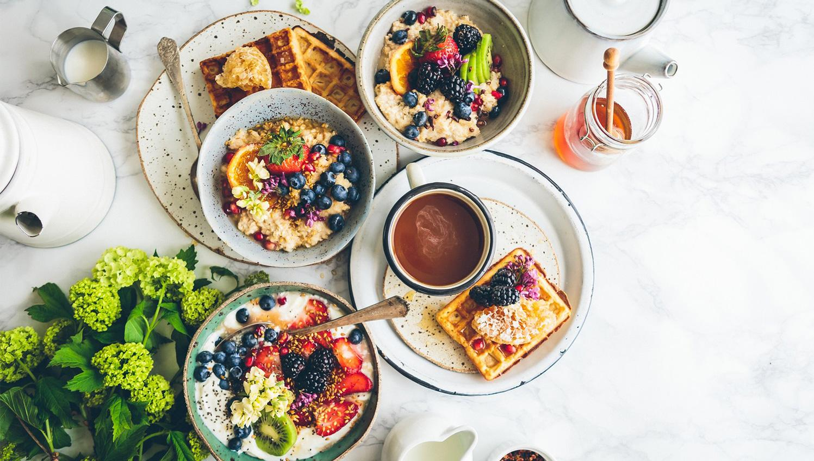
Short description of cookbook project...

Slide 3
TABLE OF CONTENTS
01 BACON SPAGHETTI
02 SALMÓN SUSHI
03 APPLE AND MAPLE SYRUP MUFFINS
04 SALMON RICE AND LENTILS
05 GOYA EGG OMELET
06 TOMATO AND EGG SOUP
07 ISSA’S AWESOME WINGS
08 BANANA MUFFIN
09 GERMAN POTATO SALAD
10 HAMUL PAJEON
11 SPECIAL APPLE TEA
12 LASAGNA THE MONSTER
13 PORKY CHOPS WITH ONION
14 HAMBURGER
18 FAMOUS GUMBO
19 PUMPKIN PIE
20 CRISPY KALE CHIPS
21 TOFU DUMPLINGS
22 PERFECT PESTO
23 MOLE POBLANO
24 EMPANADA
25 BANANA FRITERS
26 CALDO
27 DUMPLINGS
28 EGG CURRY
29 RED VELVET CUPCAKES W/ BLUEBERRIES
30 CEVICHE
31 chocolate cake

Slide 4
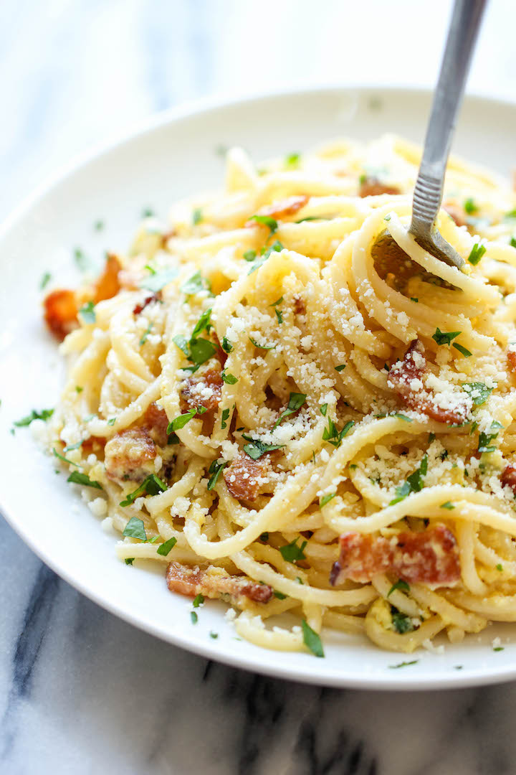
Bacon Spaghetti
Julian Abegg
Entree
4 servings
INGREDIENTS:
1 egg
16 oz box of spaghetti
½ cup of frozen peas
1 lb of bacon
½ cup of parmesan
More parmesan to taste
PROCEDURE:
Boil water in large pot while cooking bacon.
Reserve 2 tablespoons of bacon grease.
Cook spaghetti according to instructions on box.
Cut bacon into quarter inch pieces.
Add frozen peas to pasta during last 3 minutes of cooking.
Drain pasta and peas and return to pot.
Add egg and stir. Heat from cooked spaghetti will cook the egg.
Add parmesan and bacon pieces and stir.
Serve immediately.
INDEX

Slide 5
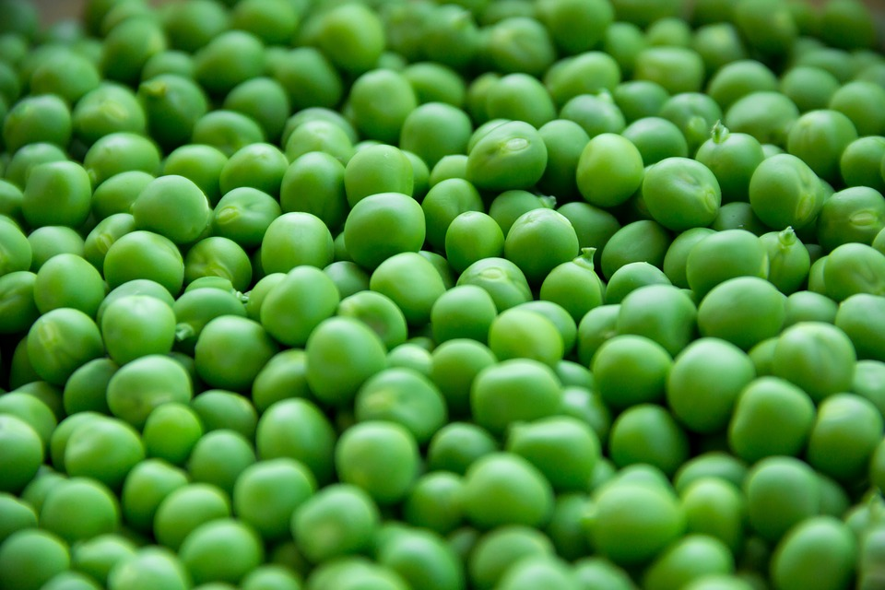
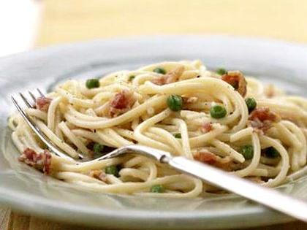
All About My Recipe
My mother learned this recipe in college. One of her housemates made it for the house. She used green beans instead of peas. Everyone loved it- especially when it was cold outside. Also, it was easy to make and the ingredients were easy to find and inexpensive. When she introduced the recipe to my family, we all loved it. We are so happy when she makes it- the whole house smells like bacon.
All About My Spotlight Ingredient
My spotlight ingredient is peas. Peas look like little green balls. Peas taste plain and sweet. Peas are the seed part of the plant. Peas are best when picked in the springtime. Peas are ready to harvest in approximately 60-70 days. When pods of the peas begin to swell and appear to have rounded pea forms visible, they are ready for picking. Peas help protect against heart disease and cancer.

Slide 6
Salmon Sushi
Leo Brese
Appetizer
3-6 servings
INGREDIENTS:
3 cups vinegared rice
3 sheets nori seaweed
Japanese soy sauce
12 oz salmon
10-12 pieces of basil
PROCEDURE:
Make the sushi rice
Make the nori seaweed
Put the salmon in the rice and seaweed
Put the soy sauce and basil on top and eat the sushi
INDEX

Slide 7
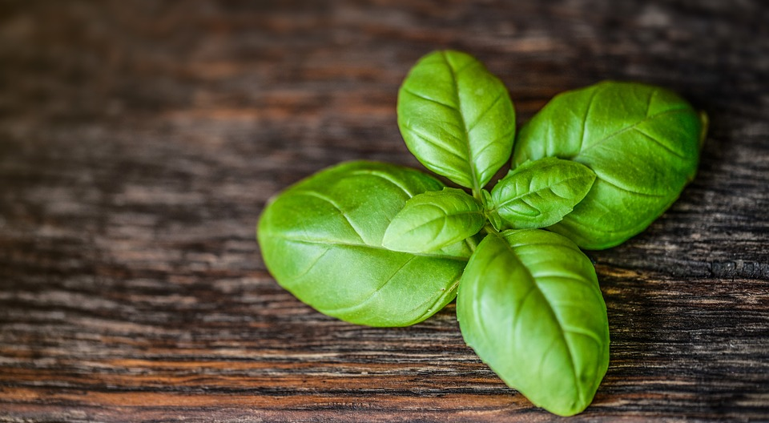
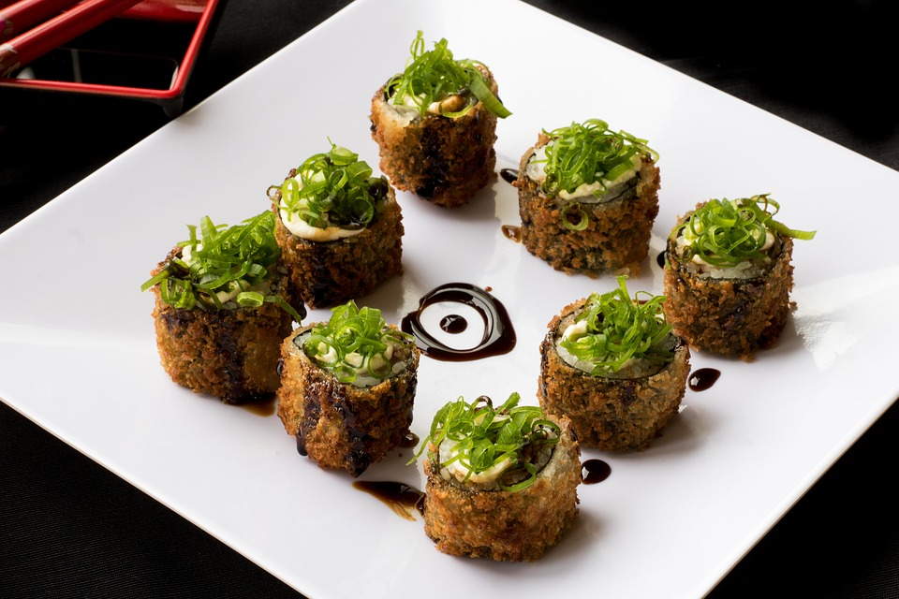
I eat this food when I am happy or when I am celebrating the New Year or a birthday. Maybe celebrating the end of the week. I eat this food when I feel good.
SPOTLIGHT INGREDIENT: Basil
The color of life. It brings the joy to people. It makes people happy and always joyful. It tastes good with a bit of a strong taste to get you to love it on everything.
Basil is the best food that tastes good and is healthy. It helps everything get a better taste and is small enough to put on everything.

Slide 8
APPLE AND MAPLE SYRUP MUFFINS
Penélope Hinchey
Dessert or breakfast
15 muffins per batch
INGREDIENTS:
Ingredients for 15 muffins:
200g all purpose flour
1/2 teaspoon of cinnamon powder
1 tablespoon of baking powder
125 g of melted butter
90 g of brown sugar
60 ml of maple syrup
2 eggs
3 apples
100 g of powdered sugar
PROCEDURE:
Peel the apples.
In a bowl, mix the flour, baking powder, and cinnamon.
In a different bowl, whisk together the melted butter, maple syrup and the brown sugar.
Whisk the eggs and add them to the liquid ingredients. Mix them.
Add the dry ingredients and the previously peeled and grated apples. Mix well.
Preheat oven to 400 ° F
Bake at 400 ° F for 10 minutes, then reduce the heat to 375 ° F for 15 minutes more.
Remove the muffins and sprinkle with the powdered sugar.
Let the muffins cool for 5 minutes, serve warm.
Dig in!!!
INDEX

Slide 9
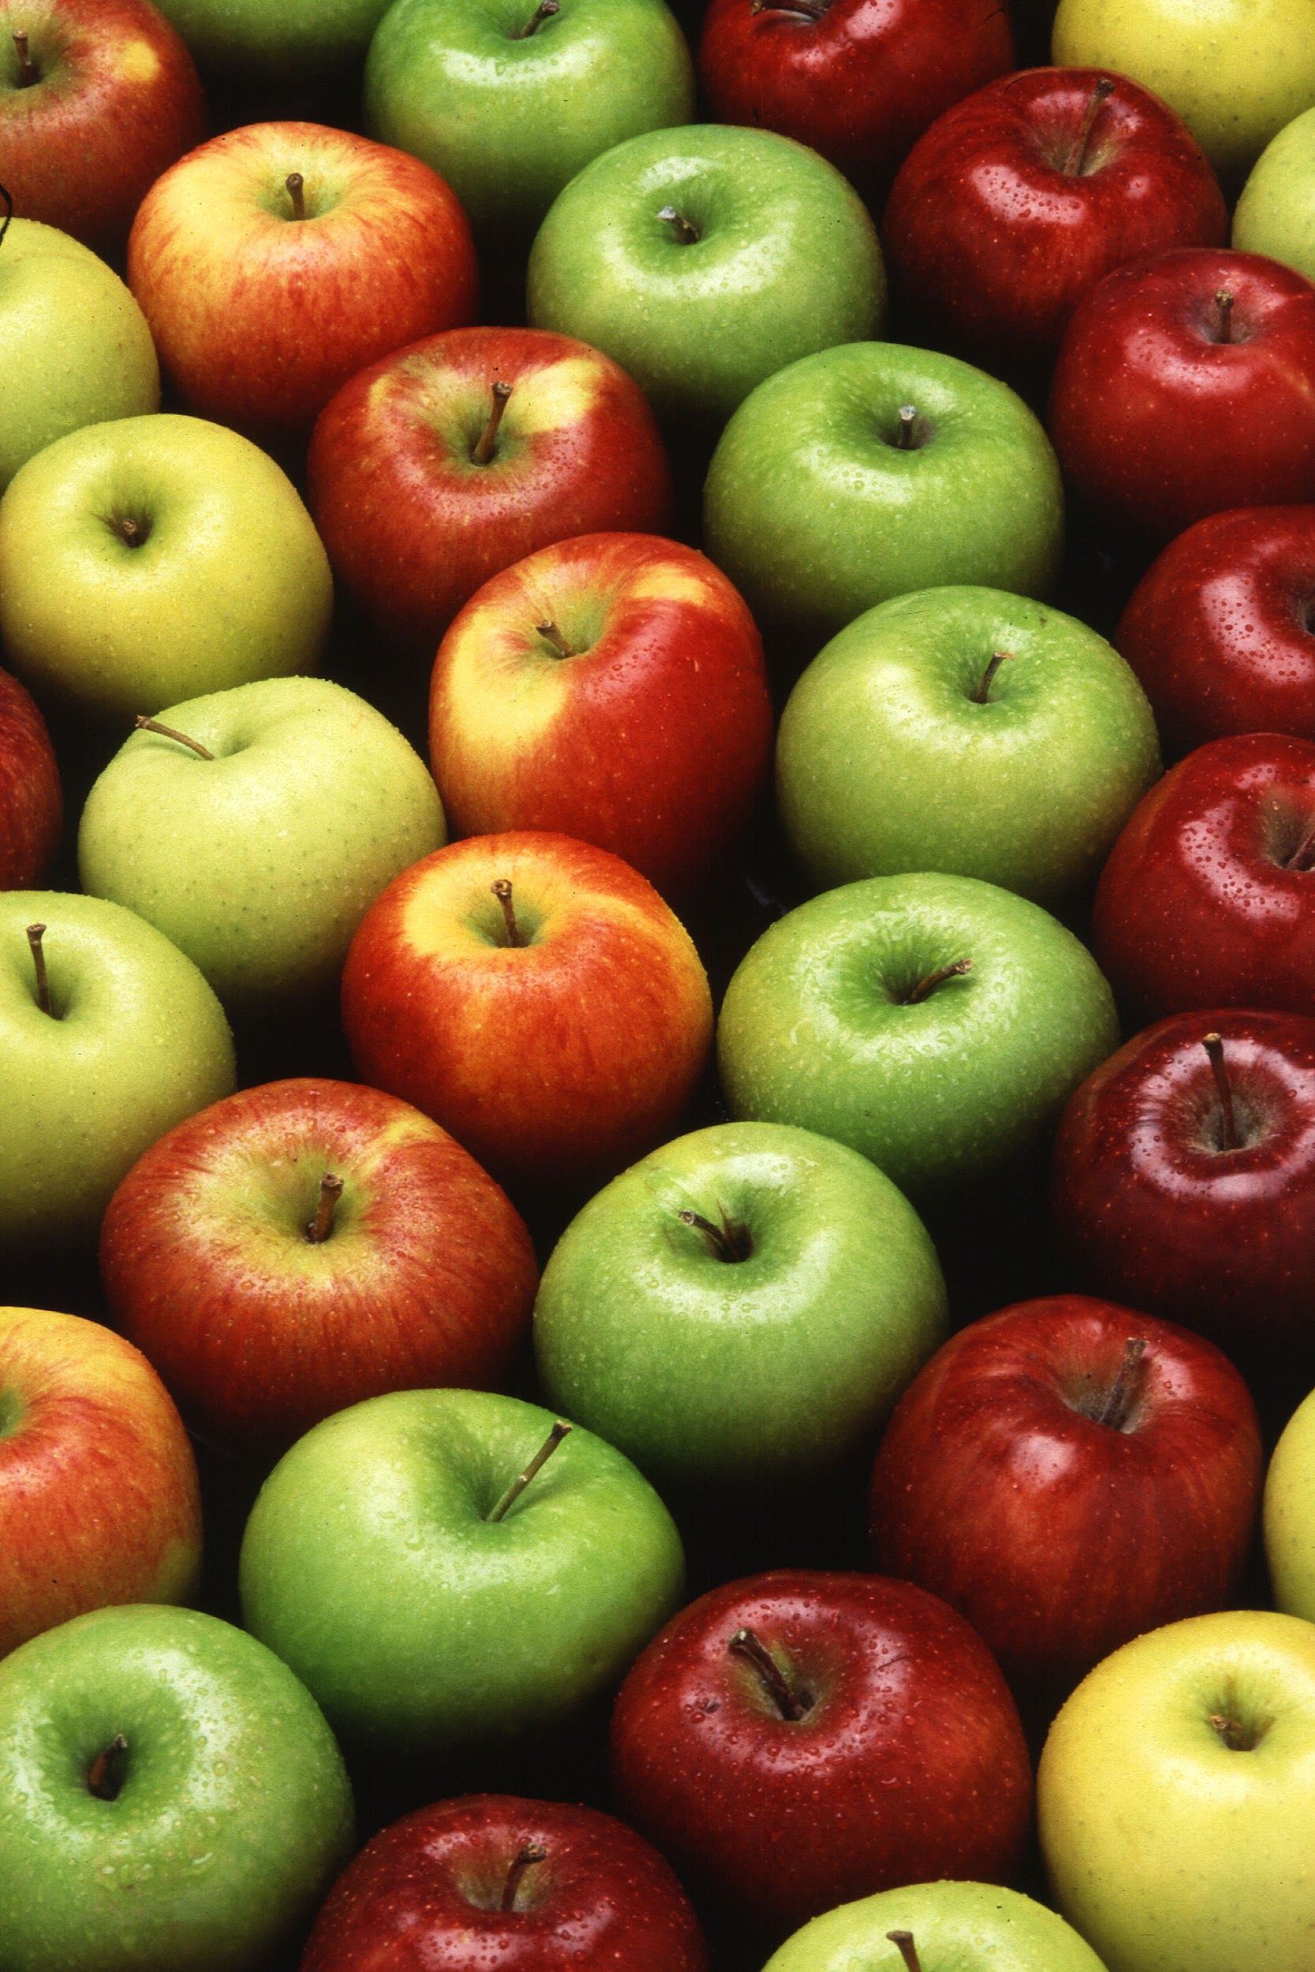
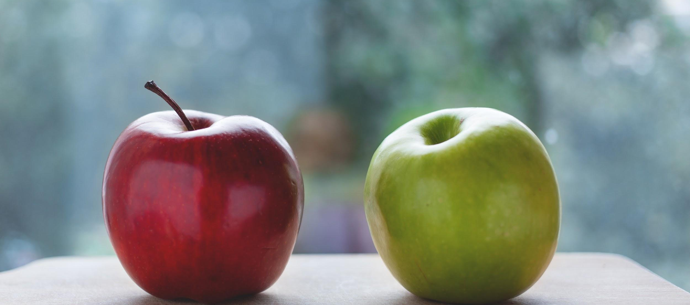
SPOTLIGHT INGREDIENT: APPLE
My spotlight ingredient is apples. They are a crunchy, red or green fruit. Apples can be either sweet or sour. They can always be a tasty, refreshing snack.
Apples are usually harvested from September 1st to October 25th.
They are high in fiber and vitamin C. They are also very low in calories. Apples are local so one of the things I recommend is going apple picking. It is an enjoyable experience no matter what age you are.

Slide 10
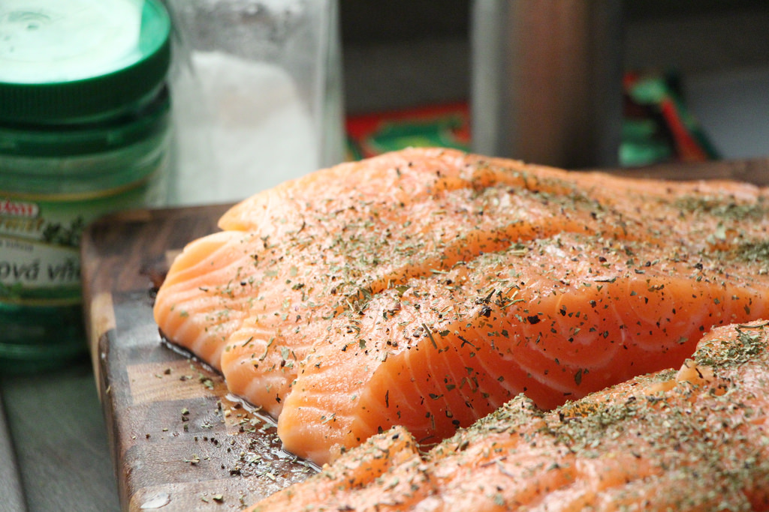
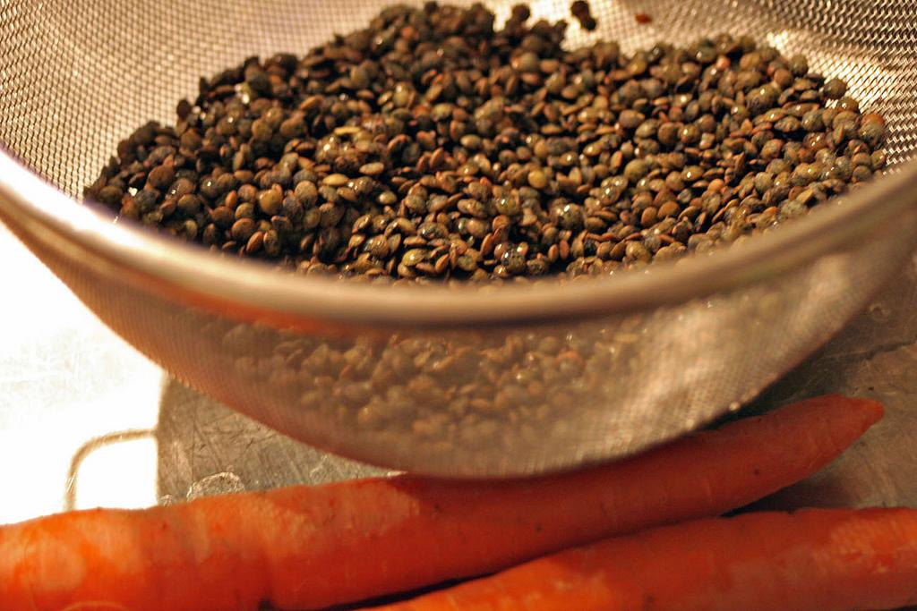
SALMON RICE AND LENTILS
JOAQUIN RODRIGUEZ
Entree
2 servings
INGREDIENTS:
Salmon Fillet
half spoon of salt
Thai Marinade
½ carrot
Can of lentils
¼ onion
¼ piece of pepper
spoon of tomato paste
1 clove of garlic
PROCEDURE:
Make sure lentils are soft 6. Cook for 20 minutes
Sautee all vegetables 7. Put rest of ingredients in
Put in pot 8. Cook Salmon at 350 F
4. Cook until Ready
5. Put in lentils mix all together
INDEX

Slide 11
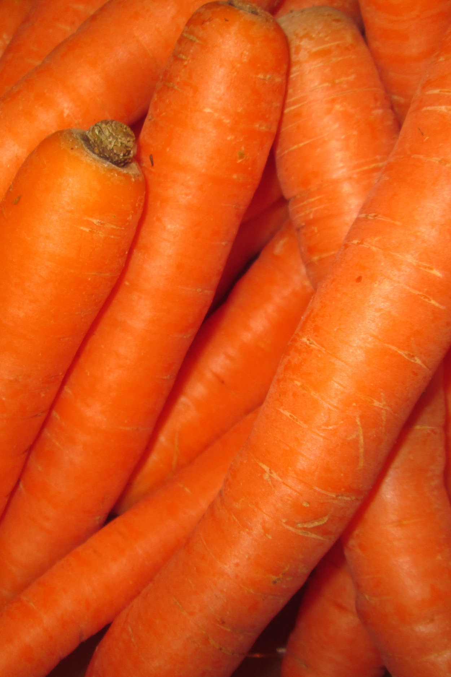
SPOTLIGHT INGREDIENT: CARROT
I would like my spotlight ingredient to be carrots. Carrots and other vegetables are mixed with the lentils. The lentils are big part of my dish, so I want the carrots to be my spotlight ingredient. Rice and lentils are good and complement each other. Carrots are roots. Carrots are crunchy and are highly nutritious. They have vitamin K and many health benefits, they can also help weight loss.

Slide 12
Goya Egg Omelette
Nia Dorestant
breakfast
Number of Servings: 2
INGREDIENTS:
2 Tsp of Goya Seasoning
1 Tsp of Black pepper
3 leaves of chopped Basil
4 Eggs
PROCEDURE:
Crack two eggs and put into bowl
Stir with fork until it bubbles
Add 2 Tsp of goya seasoning
Add 1 Tsp of black pepper
Put a pan on the stove and add ¼ teaspoon of olive oil
Wait for 1 minute until the pan is hot and pour the eggs into the pan
Cook your omelet for 2 minutes
Put on the plate of choice and serve
INDEX

Slide 13
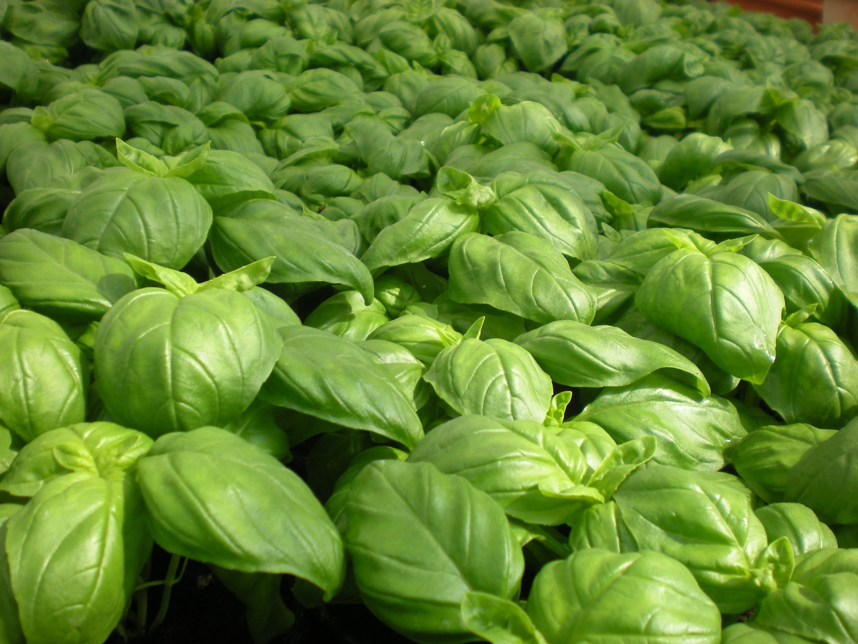
ALL ABOUT MY RECIPE
This recipe is special to me because it is the first thing that my mom taught me how to cook. On most Sundays, I make this recipe at home. My whole family and I get to enjoy it while watching football. This recipe was passed down to my mother by my grandmother. So I want to say that my recipe is american cuisine. What makes my recipe delicious is because the goya seasoning adds tons of flavor to it, and the basil gives it an earthy smell.
SPOTLIGHT INGREDIENT:
Basil is what I chose for my spotlight ingredient. It is a tender plant that is used in a lot of cuisines in the world. Its green leaves usually make food smell fresher. That is why I chose the leaf in particular to be my spotlight ingredient. Basil is also one of the oldest herbs on earth. It smells really strong like green tea. It takes about two to three weeks to grow, and is typically harvested in cooler climates. It is said that basil is good for digestion, and that it has strong anti-inflammatory properties (meaning it helps decrease inflammation). Basil is also used to fight depression, cleanse the skin, and help manage diabetes.

Slide 14
Tomato And Egg Soup
Erica Pan
Soup
Number of Servings: 3
INGREDIENTS:
2 Tomatoes
2 Eggs
2 Sticks of green Onions
PROCEDURE:
Chop 2 tomatoes into 4 pieces
Boil water
When water is boiled, beat up 2 eggs.
Then pour the eggs into the boiled water and leave for 4-5 minutes.
After 4-5 minutes, put the chopped tomatoes into the boiling water and wait for 6-7 minutes.
After 6-7 minutes pour the soup into a bowl and enjoy.
INDEX

Slide 15
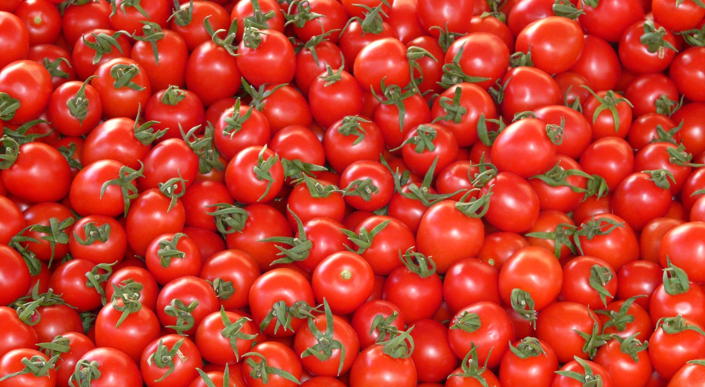
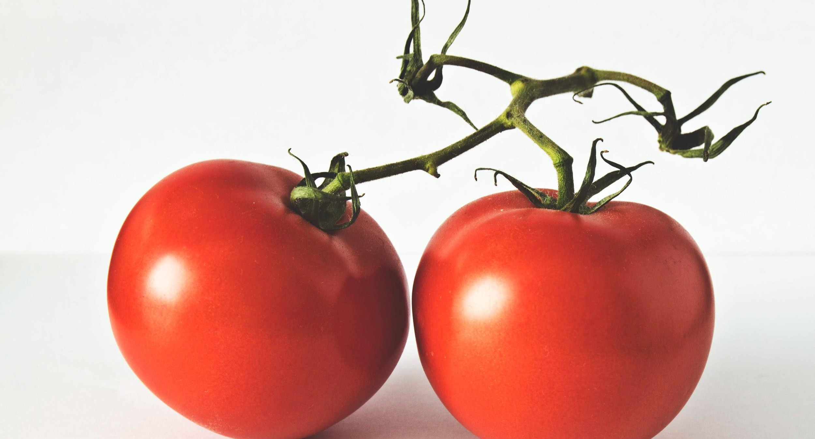
ALL ABOUT MY RECIPE
This recipe is special is, because my dad is only once a week and every time he is home he would cook that. This dish also passed down from generation to generation. My family also loves this dish. My dish is chinese. In my opinion, what I think makes this dish delicious are the eggs.
SPOTLIGHT INGREDIENT: Tomatoes
My spotlight ingredient are the tomatoes. Tomatoes are red and have green stems. My ingredient is the fruit part of the plant. This plant is usually harvested when it is green, because by the time it is transported it would turn red. Some benefits are that it can reduce the chance of a heart attack and cancer. Tomatoes can also be a spotlight for tomato juice.

Slide 16
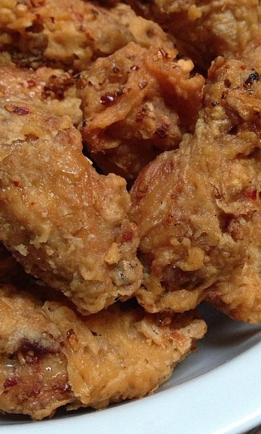
Issa’s Awesome Wings
Issa Caothien
Side
Number of Servings: 4
INGREDIENTS:
2 pounds of party wings.
Corn starch
1 garlic clove
½ stick of butter
Vegetable oil
PROCEDURE:
Wash and dry the party wings.
Cover Cornstarch with all of the party wings.
Pour vegetable oil on a frying pan.
Heat the pan up to 200 degree
Fry all of the wings for ten minutes.
Take wings out of the fryer and let them sit on paper towel for 10.
Raise the temperature on the frying pan on 300 degree F
Deep fry all wings for the second time for 3 minutes this will give the wings a extra crisp.
Heat up the pan.
Put in half a stick of butter on to the pan fryer.
Mince the garlic
Saute the butter with garlic until the garlic is brown.
Add all of the chicken wings onto a paper towel and put them onto a plate
INDEX

Slide 17
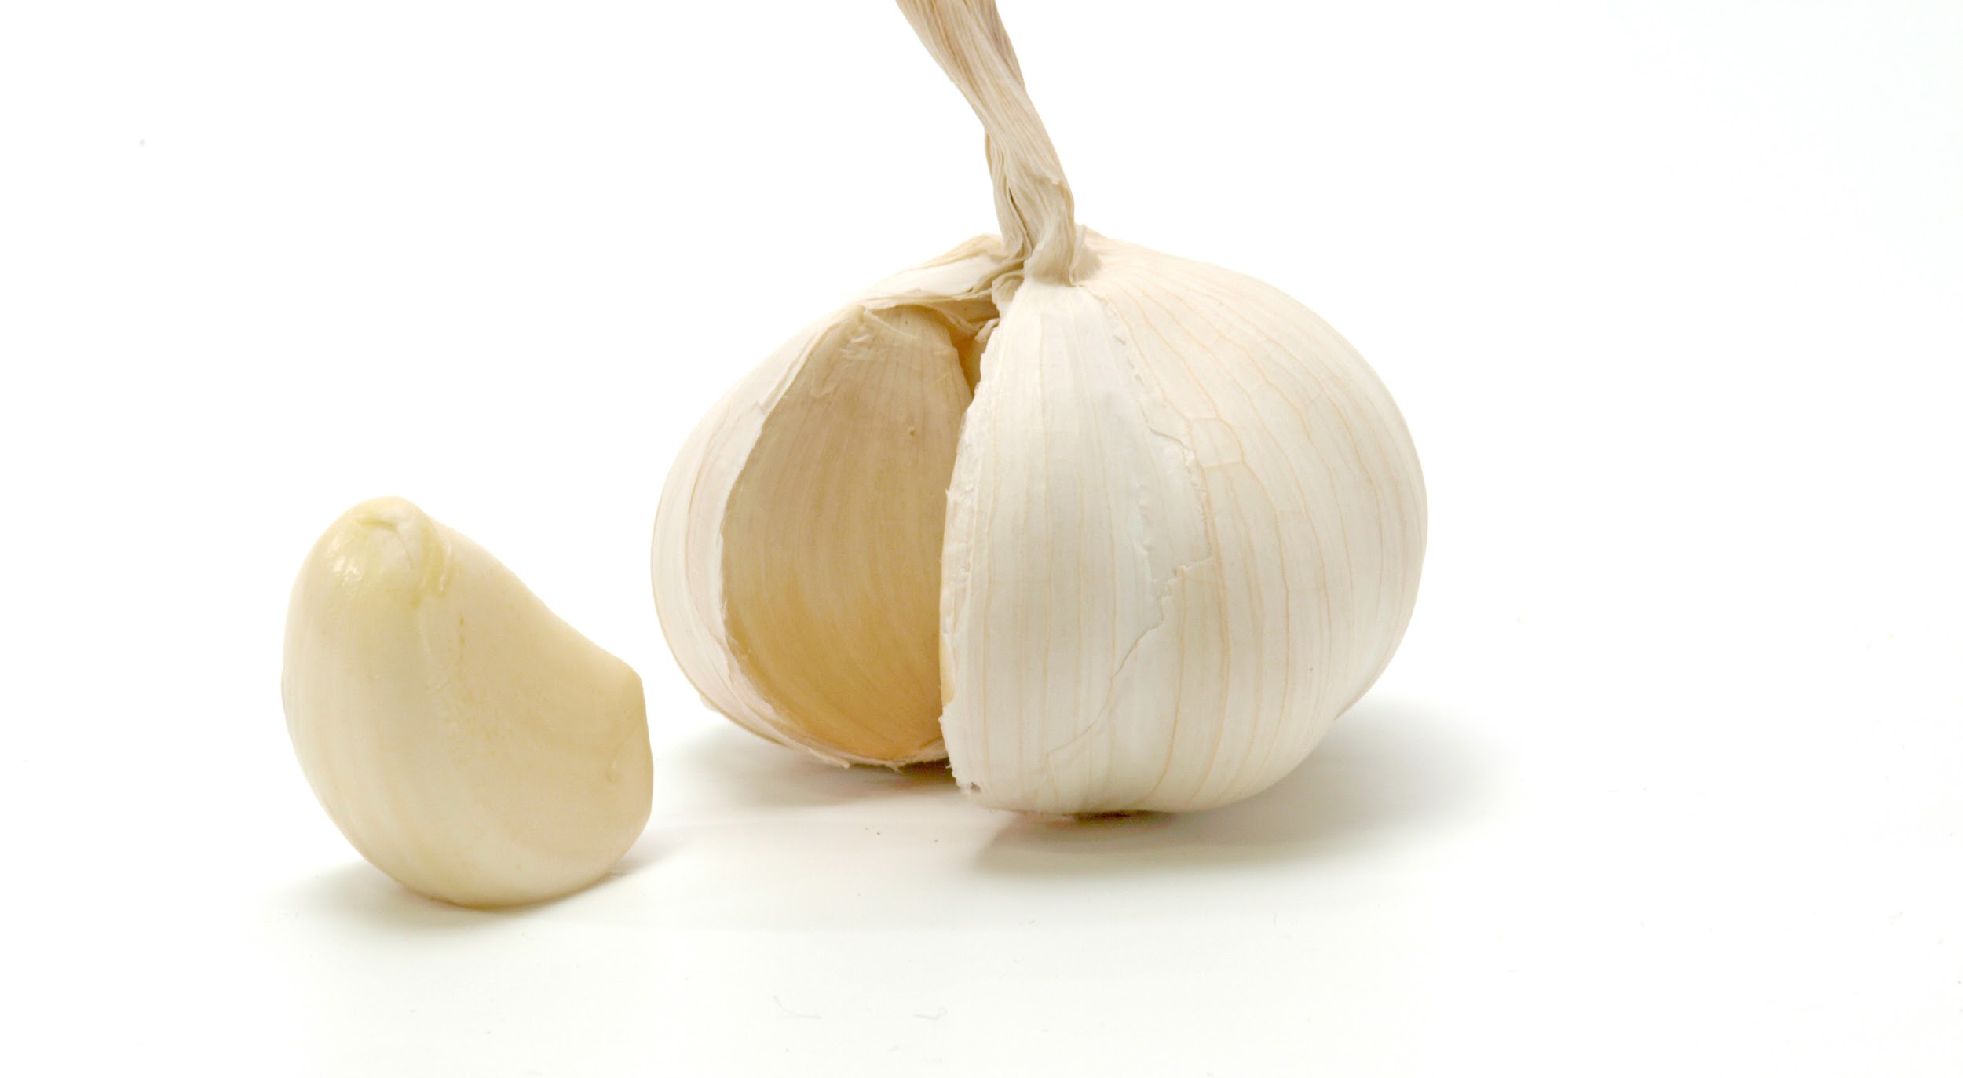
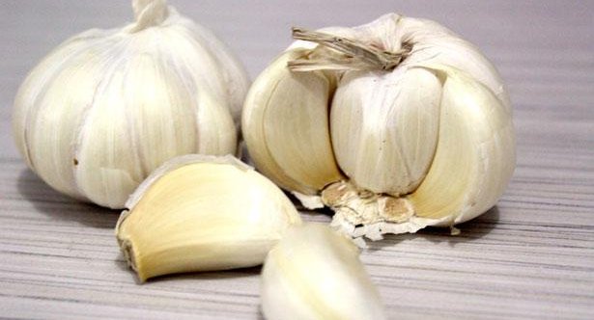
ALL ABOUT MY RECIPE
This recipe is very good and that my family likes to eat it on super bowl day. My recipe is not a food from culture or religion. The chicken wings are very crispy and you can taste the crispy garlic in your mouth. My dad started making this ever since I was 6 years old. My dad is always happy when he makes them to a party.
SPOTLIGHT INGREDIENT: Garlic
My spotlight ingredient is the garlic. It tastes really well with everything you eat. A garlic is a root. It would take 9 months to make the garlic to grow. It looks small but it has a strong taste and it will last very long. The garlic can regulate blood pressure and blood sugar levels.

Slide 18
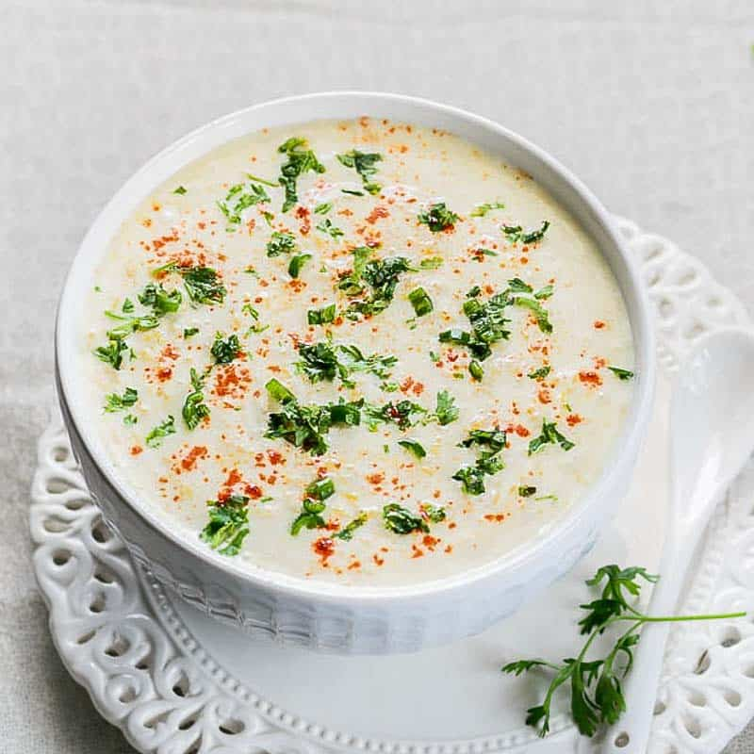
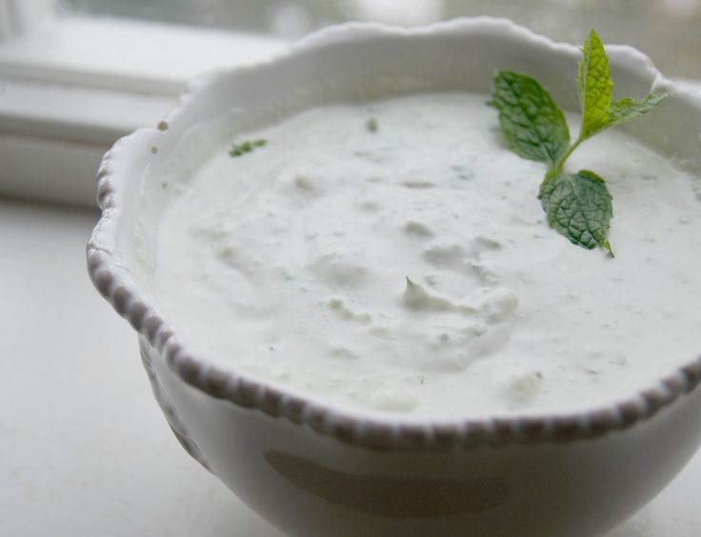
Raita
Amelia Khurana
Sides
8 servings
INGREDIENTS:
1 shredded cucumber (about 2 cups)
1 teaspoon of kosher salt
2 cups of whole milk yogurt
½ cup of chopped red onions
¼ cup coarsely chopped fresh cilantro
2 tablespoons of fresh lime juice
¼ teaspoon ground coriander
¼ teaspoon ground cumin
⅛ teaspoon freshly ground black pepper
Dash of ground nutmeg, cinnamon, and cardamom
PROCEDURE:
Place cucumber in a colander and sprinkle with salt.
Toss well and drain for 30 minutes. Rinse with cold water and drain.
Put cucumber on many layers of paper towels and cover with more paper towels. Let sit for 5 minutes, pressing down occasionally.
Combine the cucumber, yogurt, and the rest of the ingredients.
INDEX

Slide 19
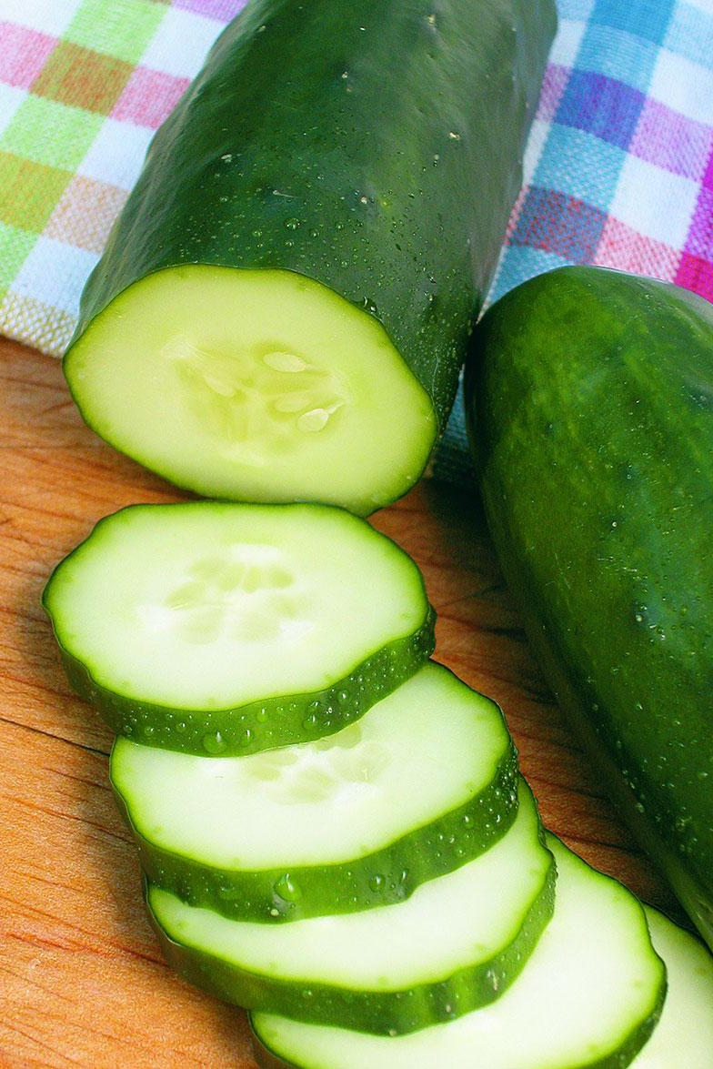
SPOTLIGHT INGREDIENT: Cucumber
My spotlight ingredient is cucumber. They are long, round, green vegetables with the occasional pale green stripe. Cucumbers provide a lot of potassium, which is why cucumbers water is so popular. Cucumber is the main part of this recipe. It gives a soothing flavor to the other spices. Raita is used to calm your mouth when eating spicy foods, specifically Indian dishes. Cucumber is the fruit of the plant. Cucumbers are harvested in periods of time that are warm. It takes 50 to 70 days to grow.Cucumbers are very sensitive to the climate that they are in. They will not thrive in cold or hot temperatures.
Raita is an Indian condiment/dish, so I normally eat it at my grandma’s house when we visit her. We see her mostly on holidays, especially on Diwali. Diwali is an Indian holiday, also known as the Festival of Lights because we light a lot of candles and tell stories about Hindu gods. I celebrated Diwali on 11/9/18 this year and it was especially important because it would be my cousins’ last Diwali, since they were going to college next year. I have only ever had riata at her house and it is always good. The best part is that it can be a dipping sauce or a yogurt to eat with a spoon. The part that makes it so great is the cucumber because it is hidden but still explodes with flavor.

Slide 20
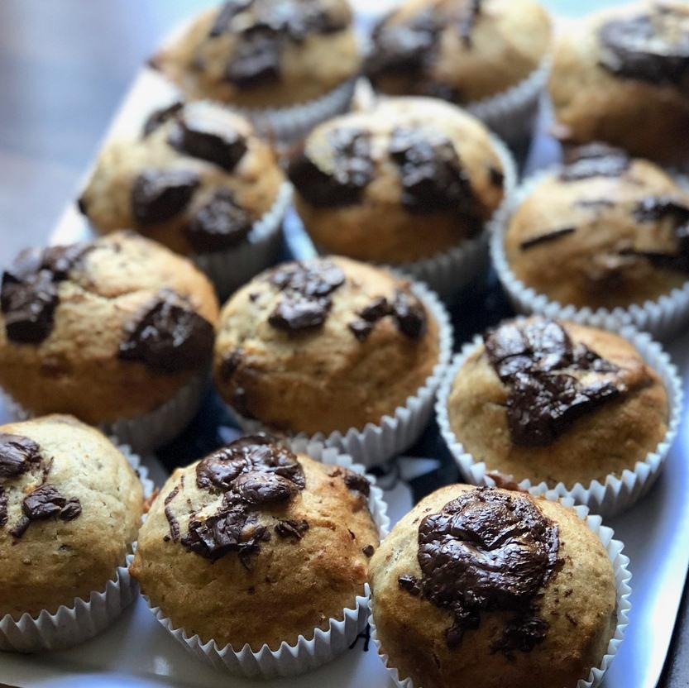
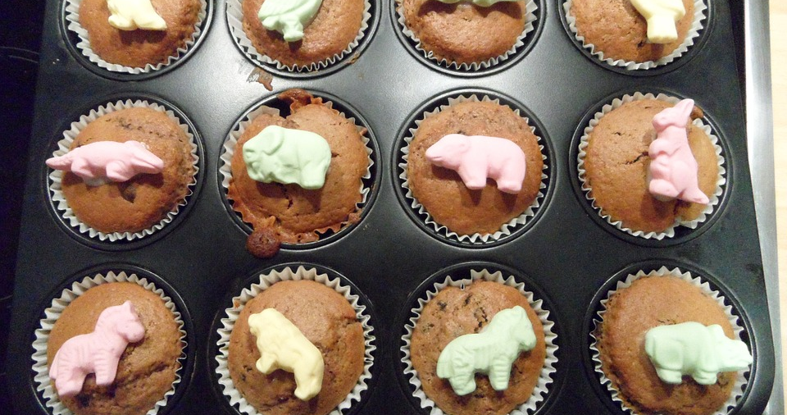
BANANA MUFFIN
Luka Zlatar
Dessert
32 S 15 B
INGREDIENTS:
1 Cup Milk
2 ½ Cup of flour
1 Tp sugar,
1 Tp baking powder
½Tp Salt
2 Banana
½ Tp oil
2 eggs
1 apple on top
PROCEDURE:
In a bowl mix two cups of flour, One cup of sugar, 2 teaspoons of baking powder, ½ teaspoon of salt Mash the bananas mix with the egg and milk and oil Mix the dry ingredients with the banana and egg put it into muffin molds then bake at 375 Fahrenheit for 15 to 20 minutes Additional step sugar on top and apple
Done
INDEX

Slide 21
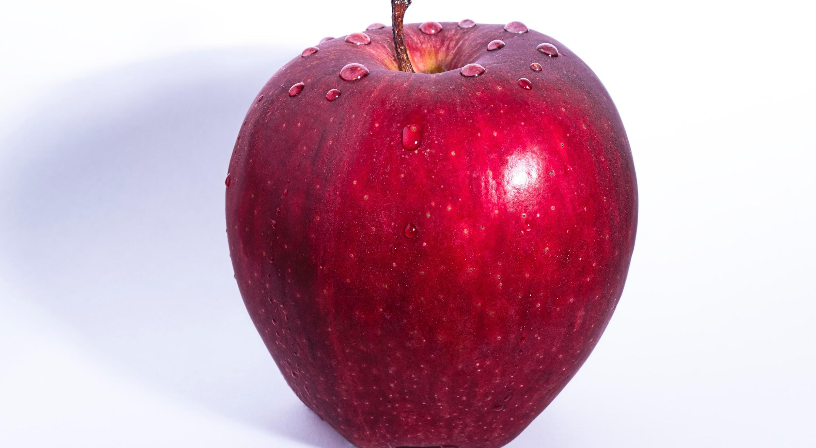
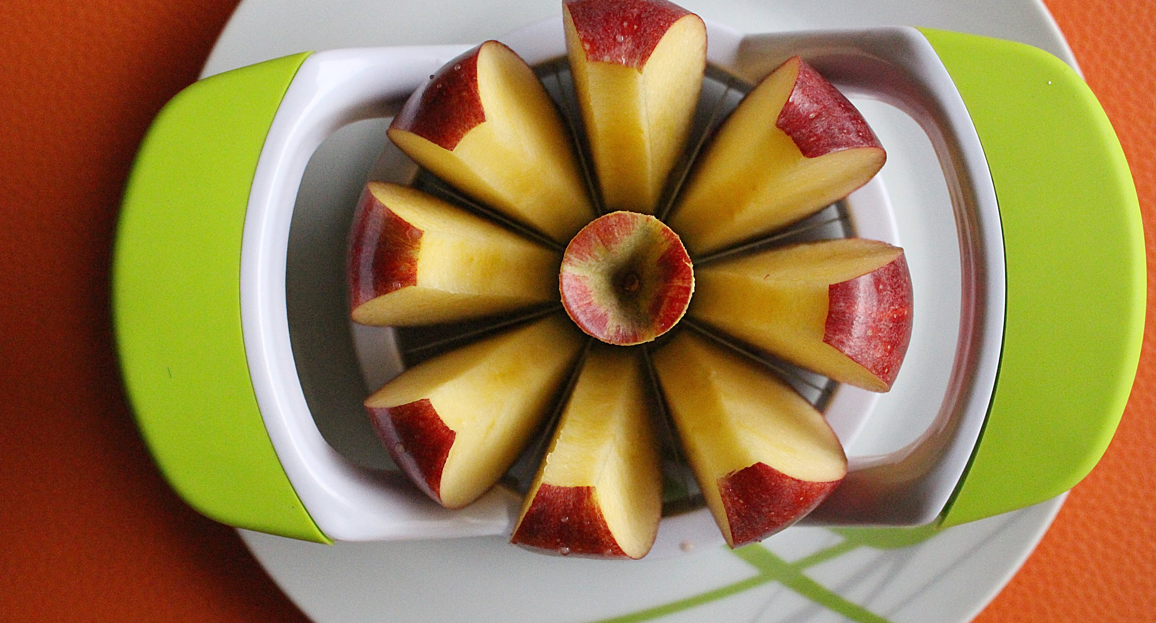
ALL ABOUT MY RECIPE
My recipe is a banana muffin. Banana muffins are like baby food stuffed in a pie crust but with An apple on top and with sugar it like caramel apples to.
SPOTLIGHT INGREDIENT: APPLE
My Spotlight Ingredient is apple it is grown in orchards the transported to the city and then we eat them all up apples are all so homes to worms but they may rot so don't be a bad apple. It pick in the blooming seasons and is a fruit.

Slide 22
GERMAN POTATO SALAD
Beatrix Worthington
Salads & Sides
6 Servings
INGREDIENTS:
6 - 8 medium sized yellow potatoes
1 medium red onion
⅓ cup olive oil
⅓ cup apple cider vinegar
⅓ cup cold water
Salt
Pepper
2 pinches granulated sugar
¼ cup chopped parsley
1 tsp mustard (dijon tastes best)
PROCEDURE:
Put potatoes in a large pot and add cold water until just covering them. (NOT the water in the ingredients) Bring water to a boil over high heat, then turn down to a medium boil. Cook until tender but not so soft they are falling apart. Once at a boil, potatoes should take about 15 - 20 minutes until done. To check boiling potatoes, stick a fork into them to see how soft they are.
When done, pour off hot water and let potatoes cool.
Peel and slice potatoes into a large bowl.
In a separate bowl, mix ⅓ cup oil, ⅓ cup vinegar and ⅓ cup cold water. Season with pepper, 2 pinches of sugar, and salt. (Do a lot of salt, about 1 ½ tablespoons to start)
Add 1 tsp mustard, and mix well until mixture has a thick consistency.
Add liquid mix into potatoes and mix gently, adding more salt if necessary.
Chop the onion, and add to the potatoes. Mix well.
Add chopped parsley and mix very well. Let this sit in room temperature for 1 hour, covered with plastic wrap, then serve. (Keep leftovers refrigerated!)
INDEX

Slide 23
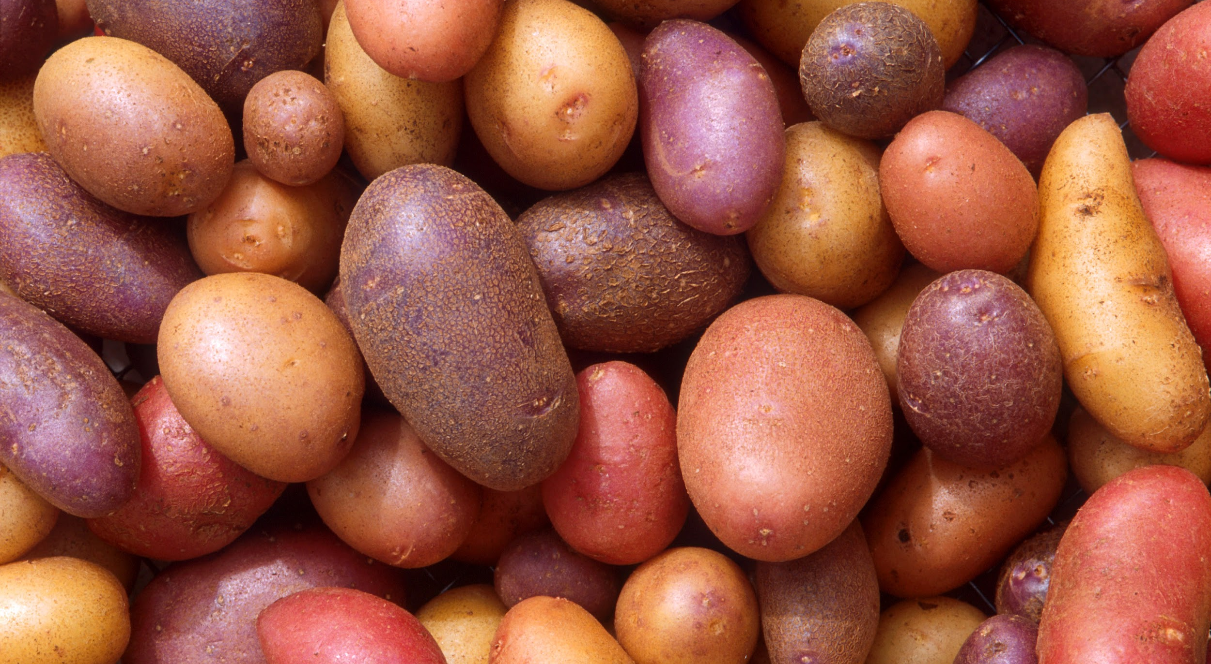
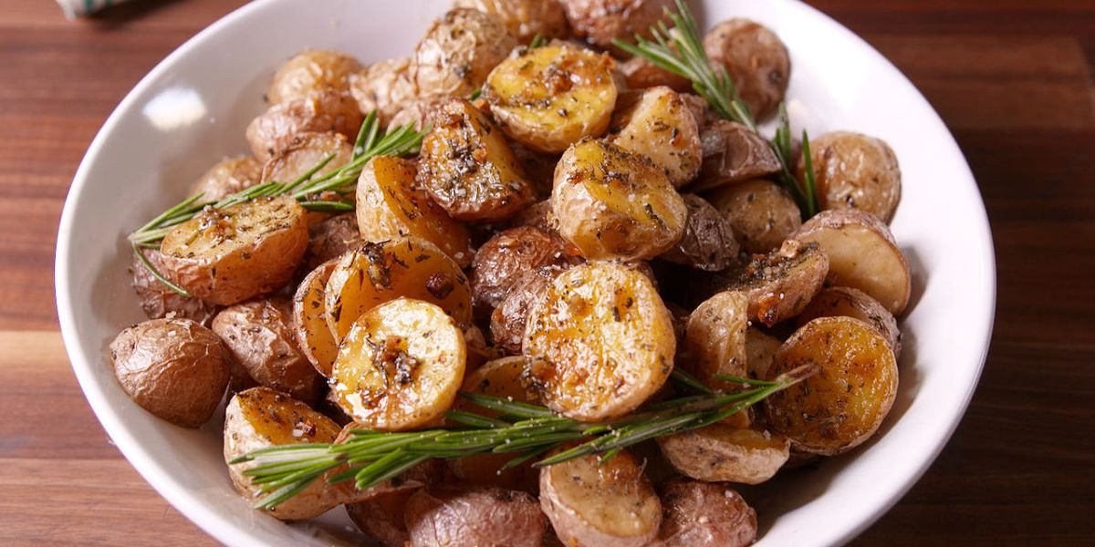
ALL ABOUT MY RECIPE
This recipe is important to my family because it is a German salad, which is where my family is from. My family has made it for a long time, and it’s so delicious! Now I learned to make it, and it’s really fun to make. This recipe is really good in summer, on a picnic. I think this recipe is delicious because, it’s not creamy, like a lot of American potato salads. It more tart, and I think that makes it good.
SPOTLIGHT INGREDIENT: POTATO
My spotlight ingredients are potatoes. Potatoes are small and round, with skin on the outside. Typically, you peel the outside skin, and eat the inside part; but you can eat the skin as well. When cooked, potatoes are soft, and taste good with salt, because they don’t have much flavor on their own. Potatoes are the stem of a plant. Potatoes have no fat, sodium, or cholesterol! They are an excellent source of vitamin C, as well as potassium. Harvest potatoes when all of the foliage has died back.

Slide 24
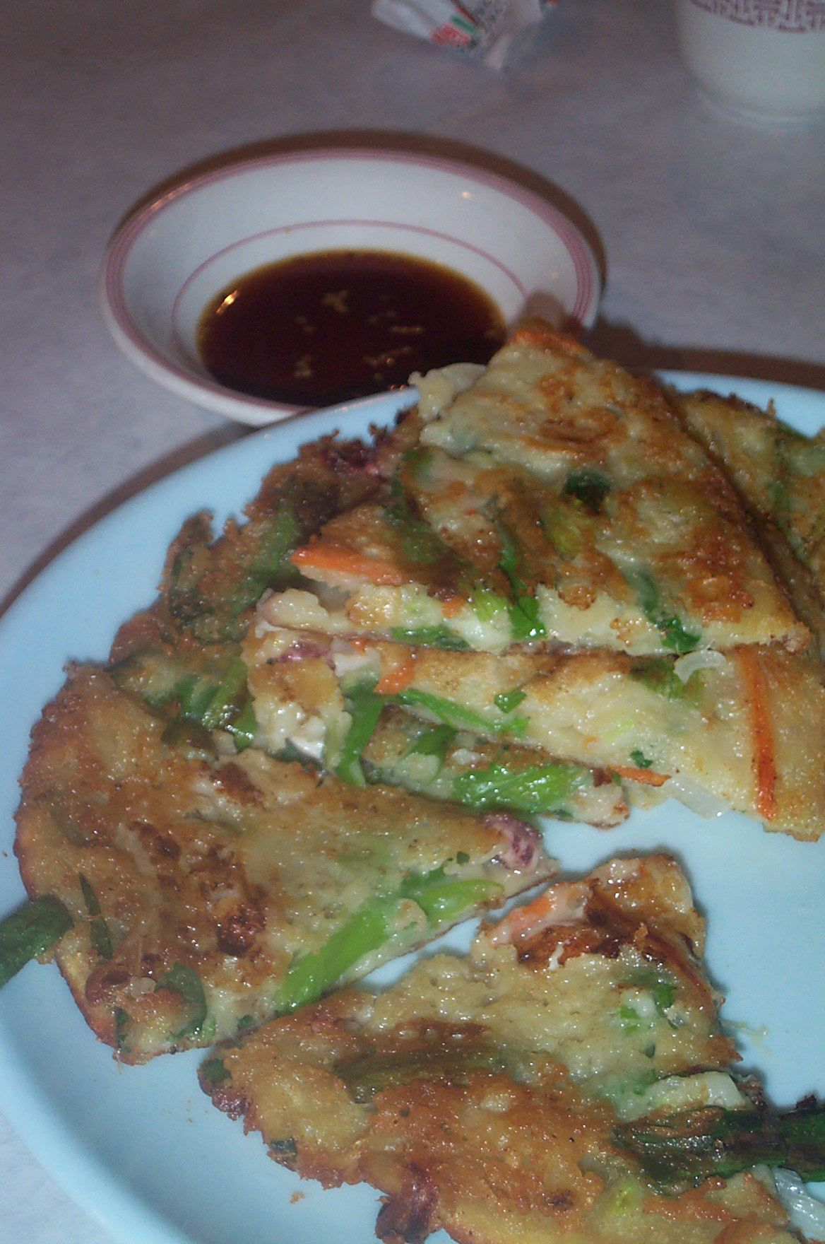
Haemul Pajeon
Deva Herbert-Bai
Appetizer
4 servings
INGREDIENTS:
1-½ cups of assortment seafood squid, shrimp, mussels, oysters, clams, etc.
1 teaspoon of sesame oil
1 bunch (or 2 if small) scallions, cut in half lengthwise
½ red chili pepper thinly sliced - optional
½ green chili pepper thinly sliced - optional
1 egg lightly beaten - optional
Batter
1 cup of korean mix (from a store)
1 teaspoon of garlic minced
½ teaspoon ginger finely minced or juiced
1 egg lightly beaten
Dipping Sauce
1 tablespoon soy sauce
1 tablespoon vinegar
1 tablespoon water
½ tablespoon sugar
Pinch of black pepper
Pinch of gochugaru Korean red chili pepper flakes
PROCEDURE:
Prepare seafood, scallions, and peppers, draining excess water. Then mix seafood with sesame oil.
In a large bowl, mix pancake mix with ¾ cup icy cold water and the egg. Add a little more water until the batter is slightly thick but still runny. Mix in 2/3 of the seafood.
Heat 2 to 3 tablespoons of vegetable oil in a non-stick pan over medium heat, ladle 1/2 of the mixture into the pan and spread it evenly into a thin round shape.
Arrange the scallions in a single layer on top of the batter, and add 1/2 of the remaining seafood and a few slices of the optional peppers.
Spoon one half of the optional lightly beaten egg on top. Cook until the bottom is golden brown (3 – 4 minutes), and turn it over, adding more oil (2 to 3 tablespoons). Turn up the heat briefly to medium high to crisp up the pancakes.
Press it down with a spatula, and cook for another 3 – 4 minutes. Repeat the process with the remaining batter and ingredients. Serve hot off the pan with dipping sauce.
Optional method
You can mix everything with the batter and follow the direction above for pan-frying.
INDEX

Slide 25
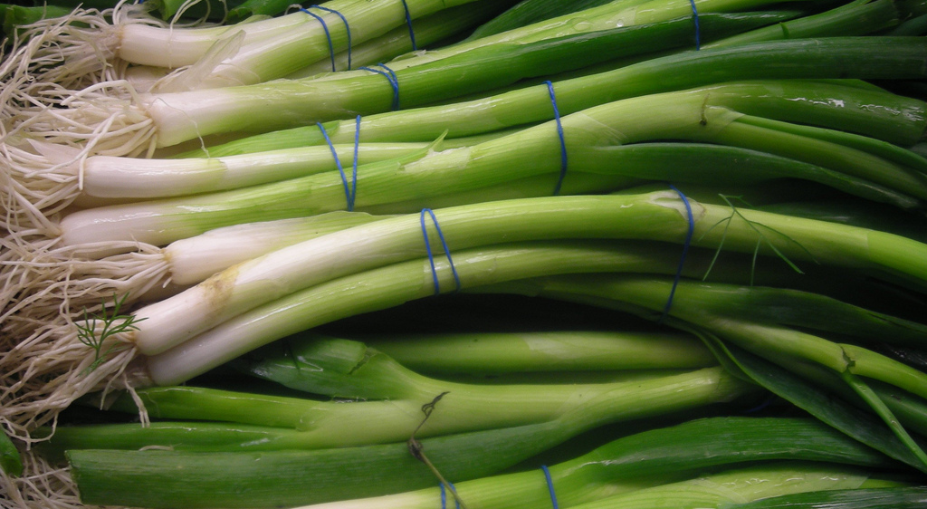
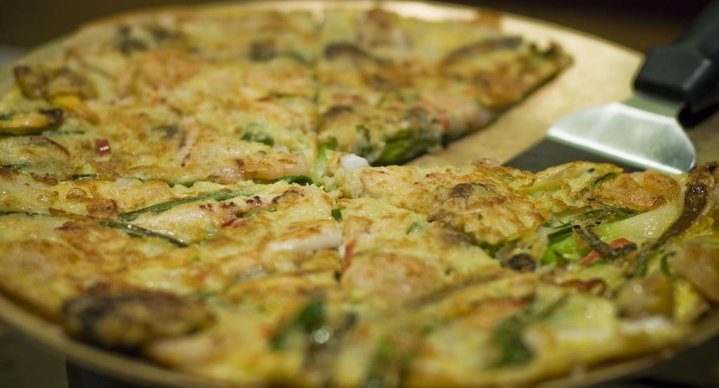
ALL ABOUT MY RECIPE
The seafood scallion pancake (Haemul Pajeon) is one of the few meals I eat with my family. It looks like a vegan pizza. It has a soft, yet crunchy feeling. I feel like the sauce brings out all of the flavor. It is a Korean dish from my mom’s side of the family. It was possibly passed down from generations ago. I am not sure of that much of it.
SPOTLIGHT INGREDIENT: Scallion
My spotlight ingredient is the scallion. Scallion taste like onions, only not as intense. They are like long green stems that have white on the bottom. They are the stem of the plant. Scallions are usually ready to harvest 60 days after planting. They give some fiber, vitamin A, vitamin K, vitamin C, and some iron.

Slide 26
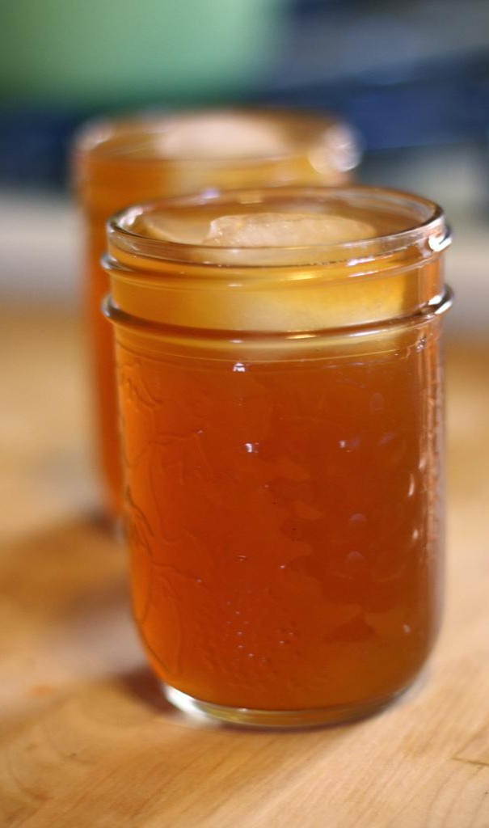
Special Apple Tea
Alice Chen
Beverage
12 servings, 6 servings each cook
INGREDIENTS:
1-2 apples
A few sugar cubes if needed
Hot boil water
PROCEDURE:
Boil some hot water if you didn’t have it prepare.
Take the apples that you choose to put in your apple tea, wash it then you take your knife and start to peel away the outside part and the inside part that has all the seeds, next take a knife and slice the apple into 8-10 slices and put the apple slices into a bowl.
Then, take the bowl full of apple slices in it and pour hot water into the bowl of apple slices, pour about half the amount of apple slices you have.
Now, take a pot and put your bowl of apple slices and hot boiled water in it and put the lid of the pot on the pot, then put it on the stove and turn on the fire and let it cook for at least 15 minutes.
When you see steam coming from the top of the lid you can turn off the fire and wait 1-2 minutes to let the pot cool down a little then you can take the bowl out.
After you take the bowl out, take a sip and see if it is sweet enough for you, if not you can add some sugar cubes in your apple tea. But, don’t add too much because sugar cubes can ruin the natural taste of the apple tea.
7. You can also take the apple crumbs that is left and cook it again with the same steps.
INDEX

Slide 27
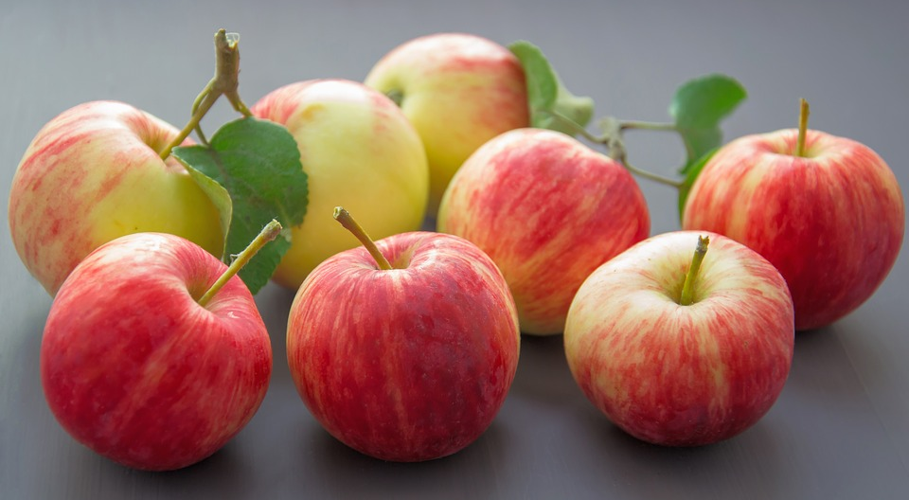
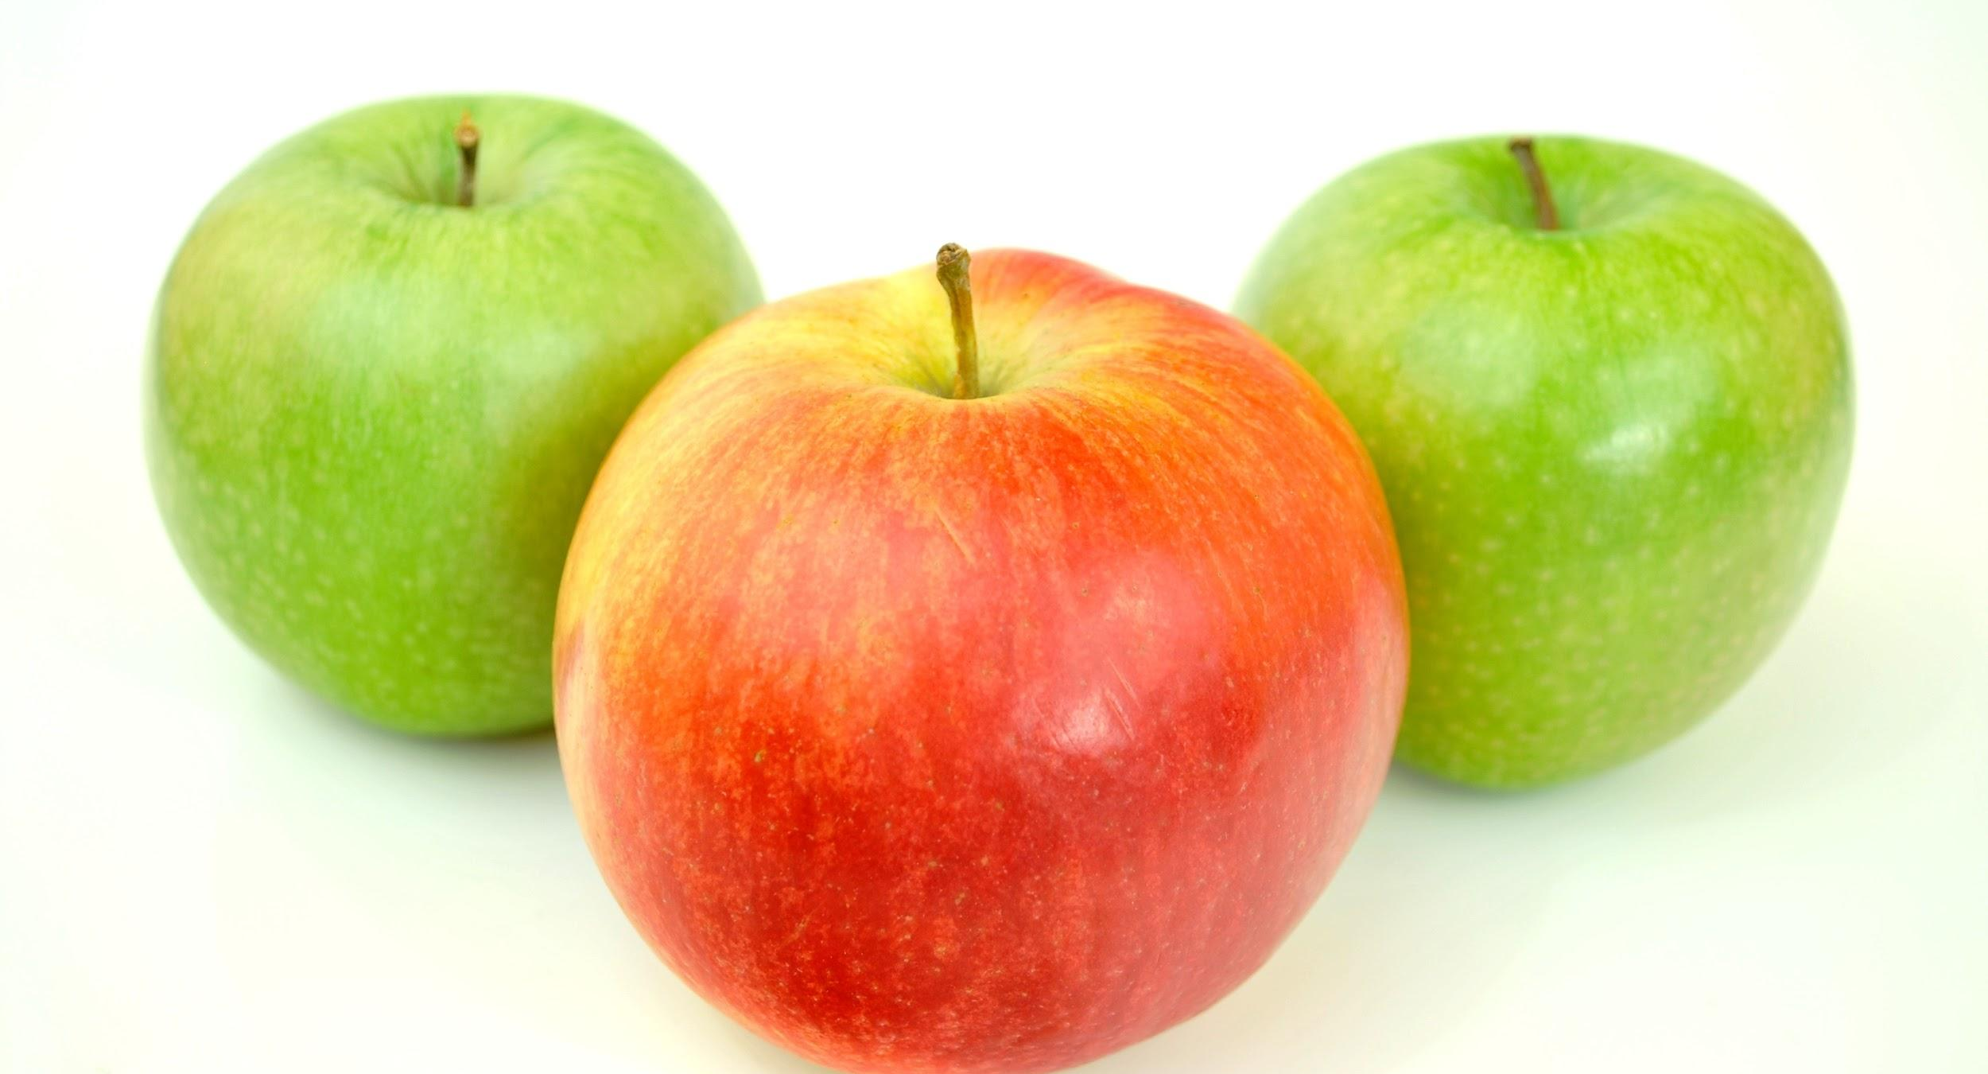
ALL ABOUT MY RECIPE
This recipe is special to me and my family because whenever someone in our family is sick my grandma would always make this special apple tea for us, and for some reason, we always get better when we finish drinking that special apple tea. There is this one day when I was really sick and couldn’t even get up from my bed. So, my grandma went to the kitchen and made this special apple tea for me, and after that first cup I could get up from my bed to use the bathroom, and after drinking this special beverage for the whole day, the next morning I could go to school! My recipe is from my grandma’s culture, her mother use to make this for her, the same as her mother’s mother and this went on. In the old days, people are sick and they don’t have much money they would just use this to cure themselves. In my opinion, what makes this recipe taste so good is that it has my grandma’s kind heart in it and it tastes sweet from the apple.
SPOTLIGHT INGREDIENT: Apples
My spotlight ingredient is apples. It tastes sweet, it looks red on the outside but it looks white in the inside. The part of my spotlight ingredient is the fruit. Apples are harvest in the fall. Not all apples are ripe at the same time. It takes 1-2 weeks to cover a full span. Some health benefits of apples is that they are healthy for your body.

Slide 28
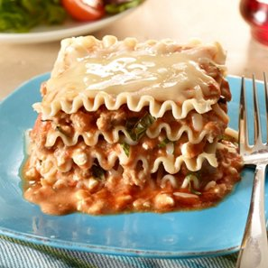
LASAGNA THE MONSTER
ETHAN DAVIDSON
Recipe Type
INGREDIENTS:
4 cups tomato-basil pasta sauce.
6 uncooked lasagna noodles.
1 (15-ounce) container ricotta cheese.
Number of Servings
2 1/2 cups (10 ounces) shredded mozzarella cheese.
1/4 cup hot water
Basil toppings 1-5 pieces of leaf
PROCEDURE:
Cook beef in a large skillet over medium heat, stirring until it crumbles and is no longer pink; drain. Stir in pasta sauce.
Spread one-third of meat sauce in a lightly greased 11- x 7-inch baking dish; layer with 3 noodles and half each of ricotta cheese and mozzarella cheese. Repeat procedure; spread remaining one-third of meat sauce over mozzarella cheese. Slowly pour 1/4 cup hot water around inside edge of dish. Tightly cover baking dish with 2 layers of heavy-duty aluminum foil.
Bake at 375° for 45 minutes; uncover and bake 10 more minutes. Let stand 10 minutes before serving. Add basil to the top of your dish to give it more flavor.
INDEX

Slide 29
SPOTLIGHT INGREDIENT: BASIL
ALL ABOUT MY RECIPE
My spotlight ingredient is basil. Basil looks like a small leaf that adds flavor. I find basil to be extremely aromatic with a scent of mint. The taste is sweet, but savory, and just like the smell it is peppery yet ever so slightly minty. Basil is the leaf of a plant, it usually takes around 75 days to be ready to harvest. Basil is an anti-inflammatory herb. It may help fight cancer. Basil contains natural antibacterial properties.
This recipe is special to me because it takes a long time to make, while I’m waiting I get to bound with my mom or uncles. We usually have lasagna twice a year. I remembered when I first asked for it, I was watching “Garfield” the fat orange cat who eats lasagna everyday. So I asked my mom if I could have some lasagna. Lasagna is good for muscle building because of all the different types of ingredients in it. Lasagna is an Italian dish. In my opinion, what makes lasagna delicious is the combination of meat, cheese, and pasta for 2-3 layers and topping it off with a nice fresh basil.

Slide 30
Porky Chops With Onion
Fionn Taintor
Recipe Type: Entree.
Number of Servings: 1
INGREDIENTS:
Pork chop(s).
Enough onion to cover chop(s).
Enough thinly sliced cheese to cover the chop(s).
2-3 tablespoons of mayonnaise per chop.
PROCEDURE:
1. Preheat oven to 400 degrees fahrenheit. Dry chops with a paper napkin.
2. Place chops inside a plastic bag, and beat with a meat tenderizer.
3. Once chop is soft, place in ceramic tray with high edges.
4. Completely cover meat with a layer of onions.
5.Cover onions with one layer of very thinly sliced cheese.
6. Spread a thin, but firm layer of mayonnaise over the cheese.
7. Place tin foil over the top of the tray and put in oven for 15-20 minutes.
8. take out tray, remove foil, and put back in for another 15-20 minutes
Then take out, salt it, season it (if that's your kind of thing), and serve.
INDEX

Slide 31
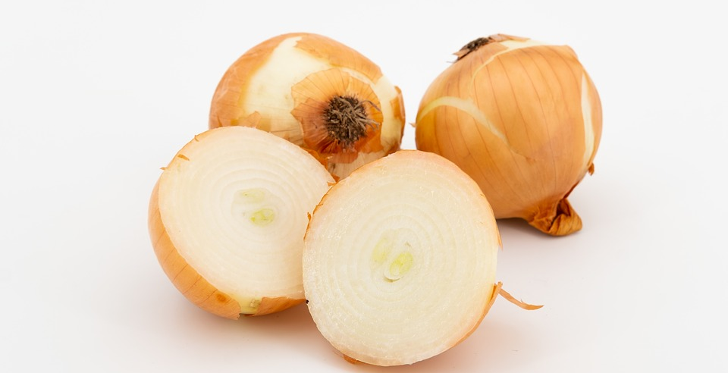
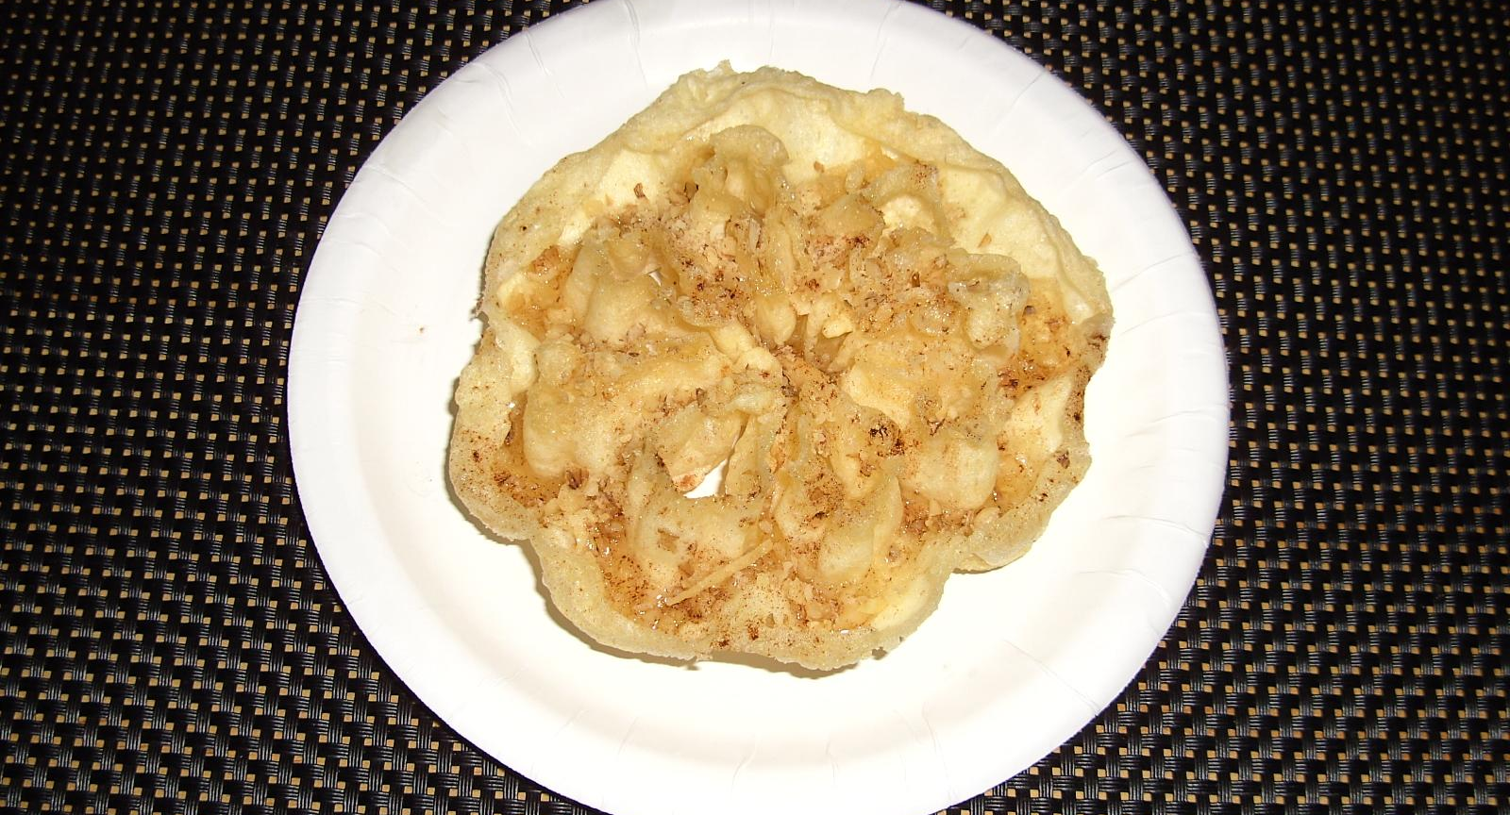
ALL ABOUT MY RECIPE
My grandmother on my mom’s side used to always make this for my mom when she was little, and now she makes it for me. My mom loved it when she was little, and I do too. The first time I had it was when I was 6 years old. I loved it so much that every time I come there for a visit, she makes it for me. Every time, she makes it a little bit differently. Every time, it’s tasty. It’s great during both the warm and cold season.
SPOTLIGHT INGREDIENT: ONION
My spotlight ingredient is onion. Onions are bulb like roots with thick green stems and leaves. Both the root and stem are edible, but the stem has a less strong flavor. They both have a savory meaty flavor with a hint of sweetness and sourness. My spotlight ingredient is the root of the onion which is a big bulb. They are ready to start being harvested around midsummer when the bulbs start to fatten. Bulb onion harvest time can begin with onion tops naturally fall over and brown. This usually happens 100 to 120 days after planting, depending on the cultivar. Eating onions reduces the risk of cancer, diabetes, heart disease, and tooth decay. They have detoxifying properties and healthy digestion. Finally, they increase hair growth and they decrease skin aging. This list could be one hundred times longer, but I’ll leave it at that.

Slide 32
Hamburgers with Lettuce and Onions
Joseph Banks
Entree
10-12 people
INGREDIENTS:
2 strips of lettuce
1 onion
1 Tomato
Chopped turkey meat,
Garlic,
salt,
Organic no-salt seasoning
Worcestershire sauce
PROCEDURE:
In a large bowl put two pounds of turkey meat Add 1 teaspoon of Garlic, salt and Organic no salt seasoning in meat then mix with hands
Add 1 tablespoon of Worcestershire sauce then mix with hands
Use a 3 inch cookie cutter to shape each burger
Preheat a pan for 1 minute
Use 3 teaspoons of olive oil on the pan
Put the burgers on the pan in 2 rows of 4 and 1 row of 2
Then wait 5 minutes until it is ready to flip then flip
Wait 5 more minutes till cooked
Remove from the pan
Then put the burger on a bun
Add lettuce and onions (optional)
INDEX

Slide 33
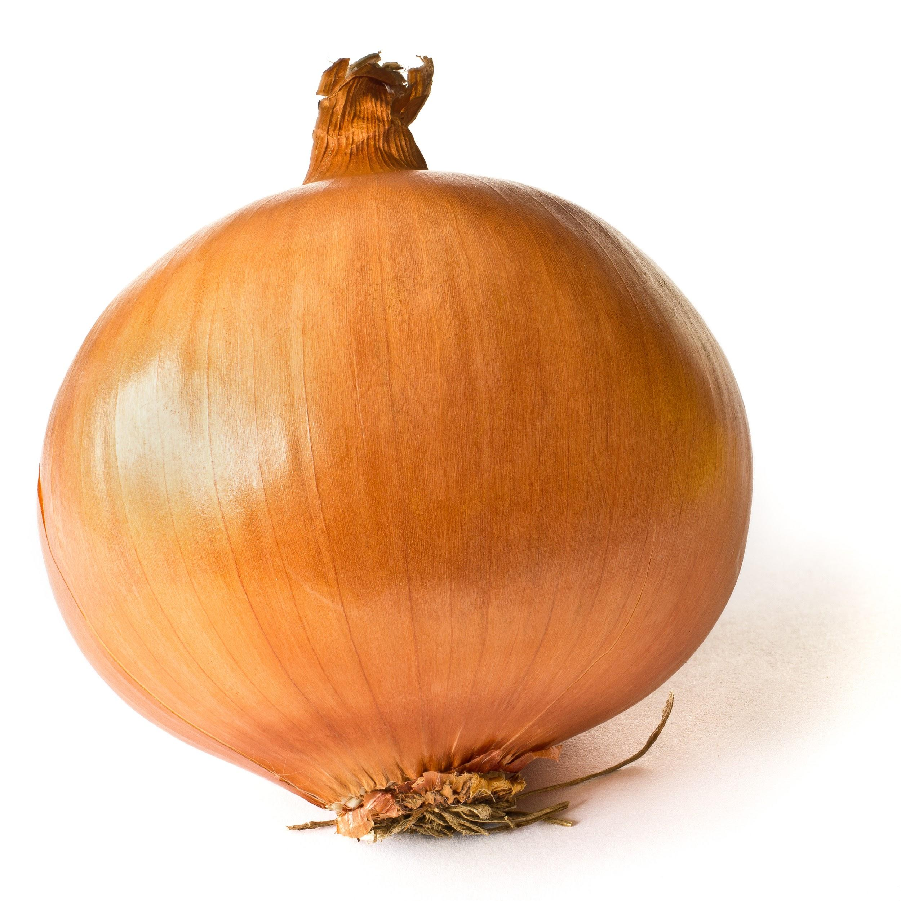
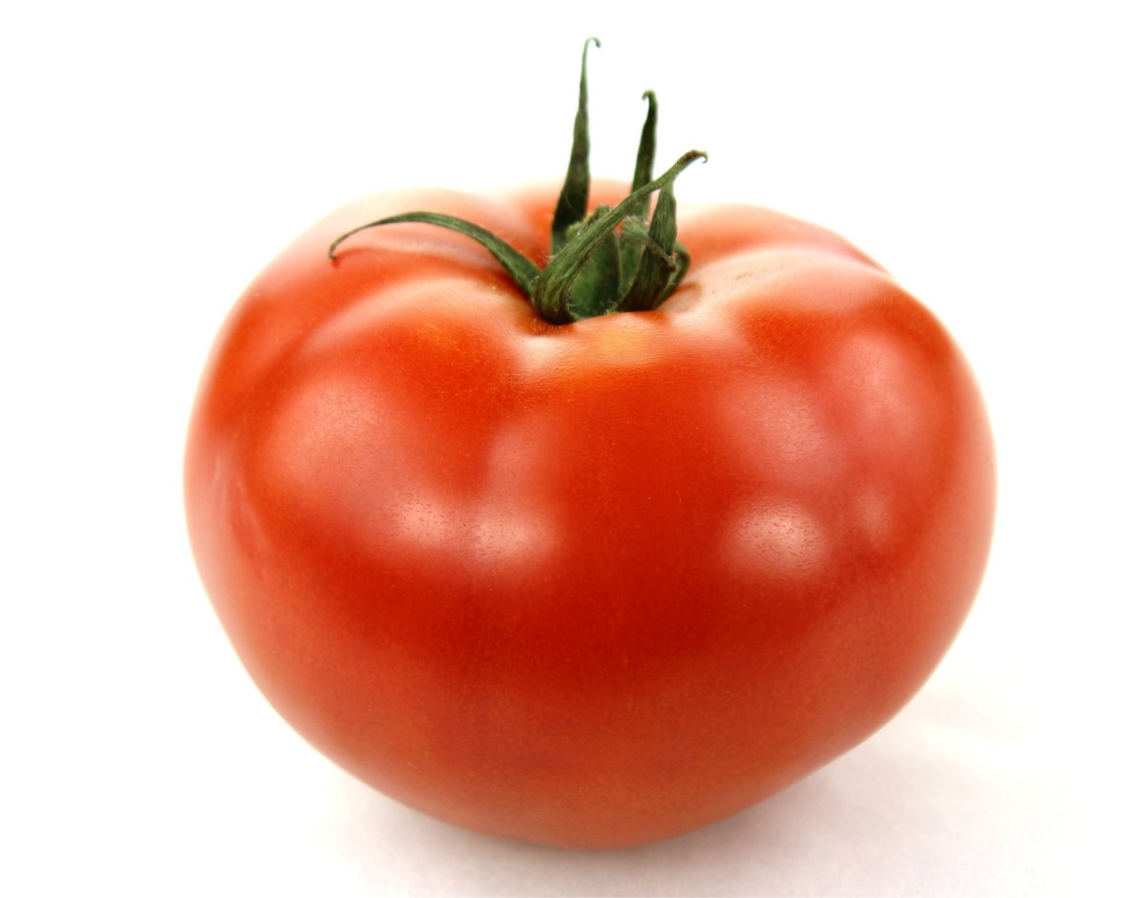
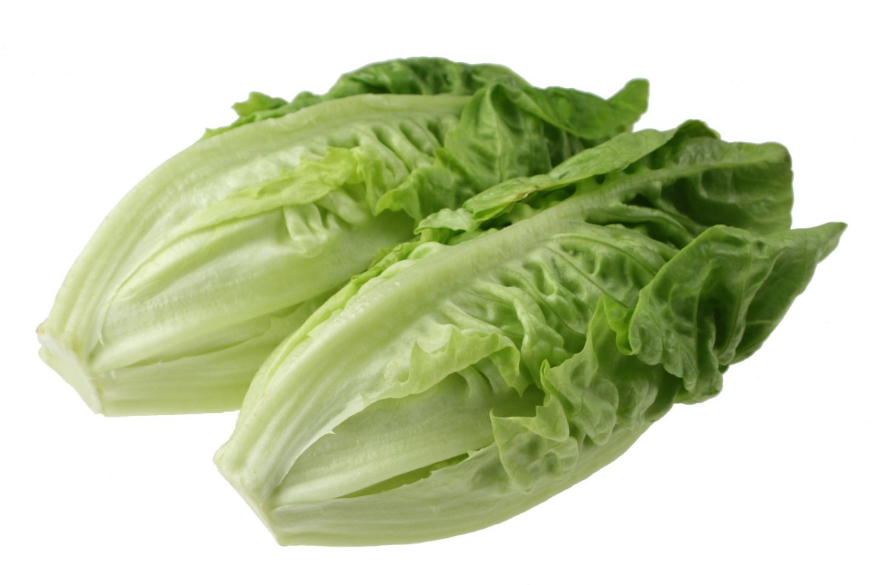
SPOTLIGHT INGREDIENT
My spotlight ingredients are lettuce, onion, and tomatoes because a lot of people like toppings on their burgers so instead of one spotlight ingredient I have three.

Slide 34
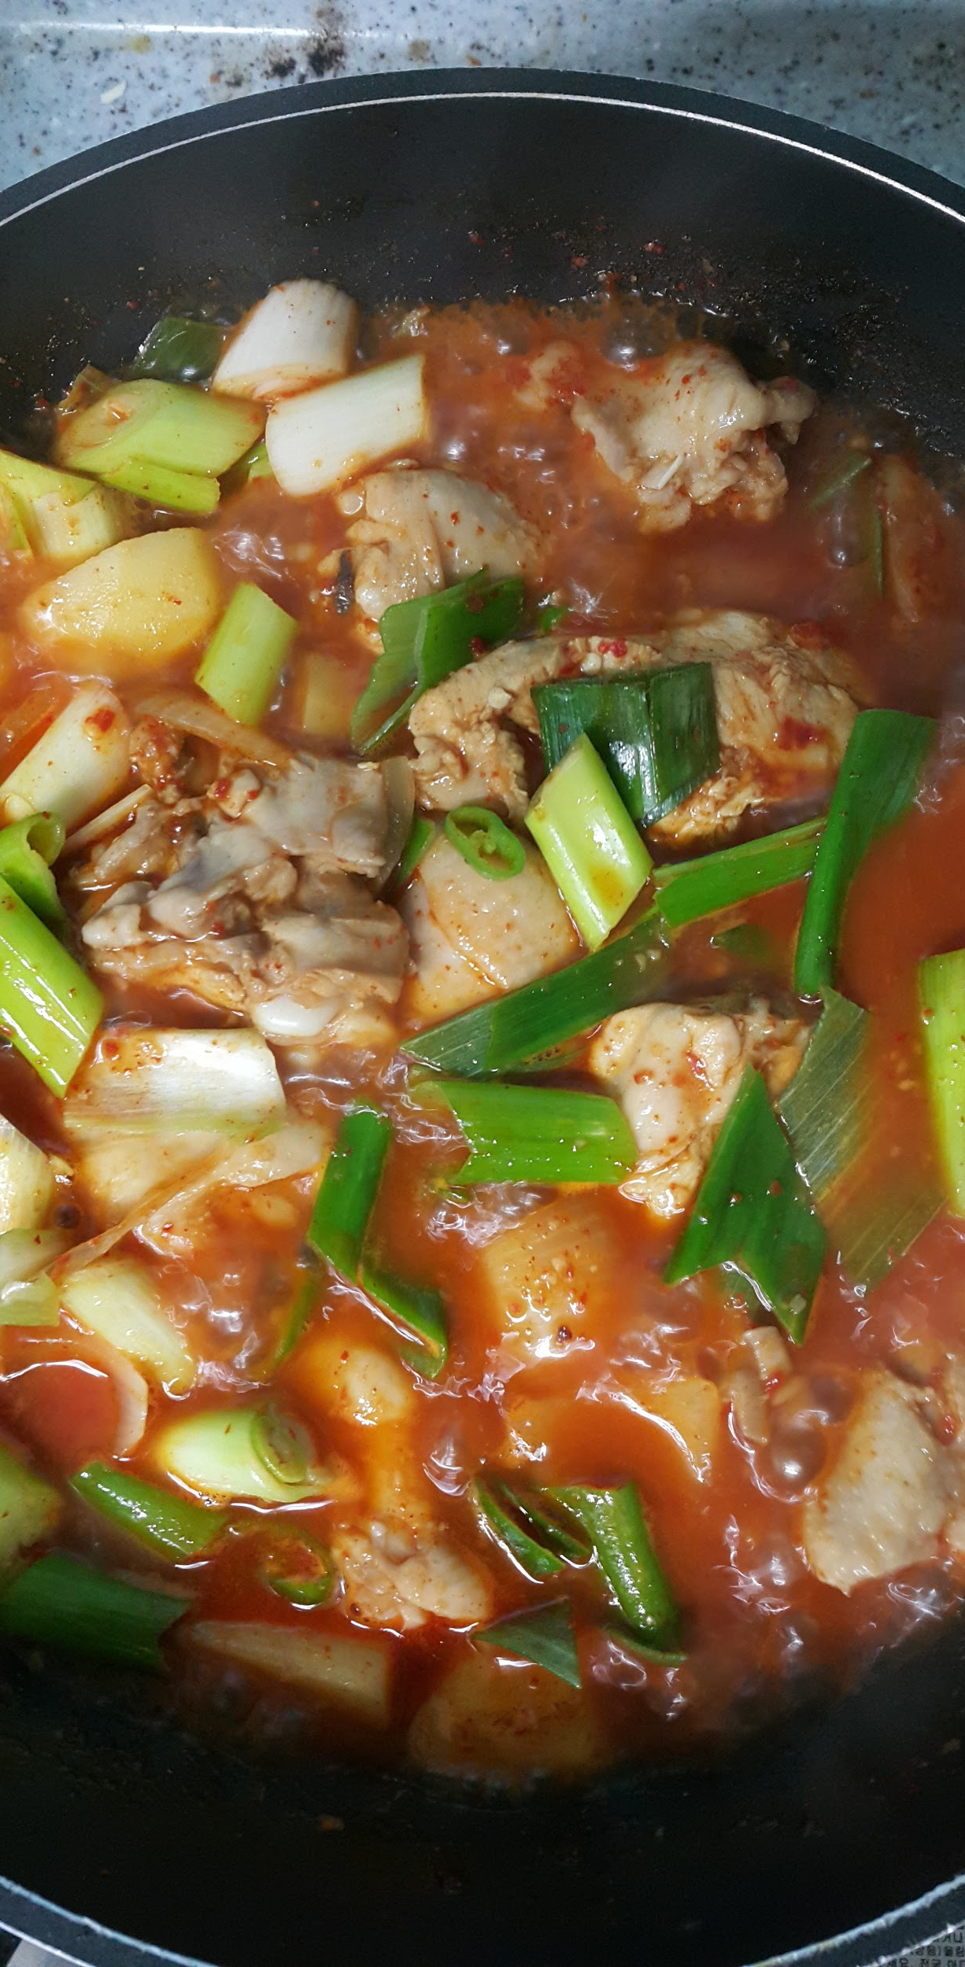
Famous Gumbo
Monty Shikler
Entree
20 people
INGREDIENTS:
1 cup all-purpose flour
3/4 cup bacon drippings
1 cup coarsely chopped celery
1 large onion, coarsely chopped
1 large green bell pepper, coarsely chopped
2 cloves garlic, minced
1 pound andouille sausage, sliced
4 bay leaves
1/2 teaspoon dried thyme leaves
1 (14.5 ounce) can stewed tomatoes batter:
2 lbs carrots
12 button mushrooms
3 quarts water
6 cubes beef bouillon
1 tablespoon white sugar
salt to taste
2 tablespoons hot pepper sauce (such as Tabasco®), or to taste
1/2 teaspoon Cajun seasoning blend (such as Tony Chachere's®), or to taste
PROCEDURE:
Make a roux by whisking the flour and 3/4 cup bacon drippings together in a large, heavy saucepan over medium-low heat to form a smooth mixture. Cook the roux, whisking constantly, until it turns a rich mahogany brown color. This can take 20 to 30 minutes; watch heat carefully and whisk constantly or roux will burn. Remove from heat; continue whisking until mixture stops cooking.
Place the celery, onion, green bell pepper, and garlic into the work bowl of a food processor, and pulse until the vegetables are very finely chopped. Stir the vegetables into the roux, and mix in the sausage. Bring the mixture to a simmer over medium-low heat, and cook until vegetables are tender, 10 to 15 minutes. Remove from heat, and set aside.
Bring the water and beef bouillon cubes to a boil in a large Dutch oven or soup pot. Stir until the bouillon cubes dissolve, and whisk the roux mixture into the boiling water. Reduce heat to a simmer, and mix in the sugar, salt, hot pepper sauce, Cajun seasoning, bay leaves, thyme, stewed tomatoes, and tomato sauce. Simmer the soup over low heat for 1 hour; mix in 2 teaspoons of file gumbo powder at the 45-minute mark.
Meanwhile, melt 2 tablespoons of bacon drippings in a skillet, and cook the okra with vinegar over medium heat for 15 minutes; remove okra with slotted spoon, and stir into the simmering gumbo. Mix in crabmeat, shrimp, and Worcestershire sauce, and simmer until flavors have blended, 45 more minutes. Just before serving, stir in
2 more teaspoons of file gumbo powder.
INDEX

Slide 35
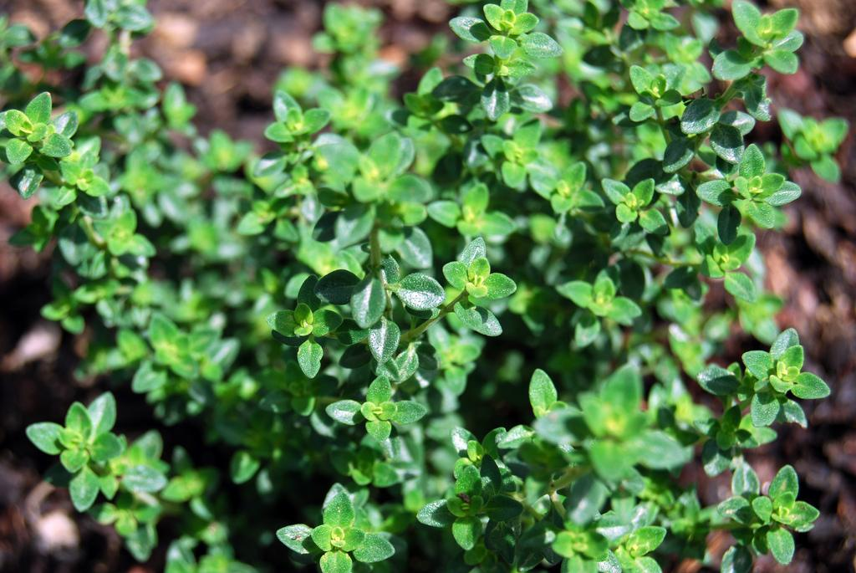
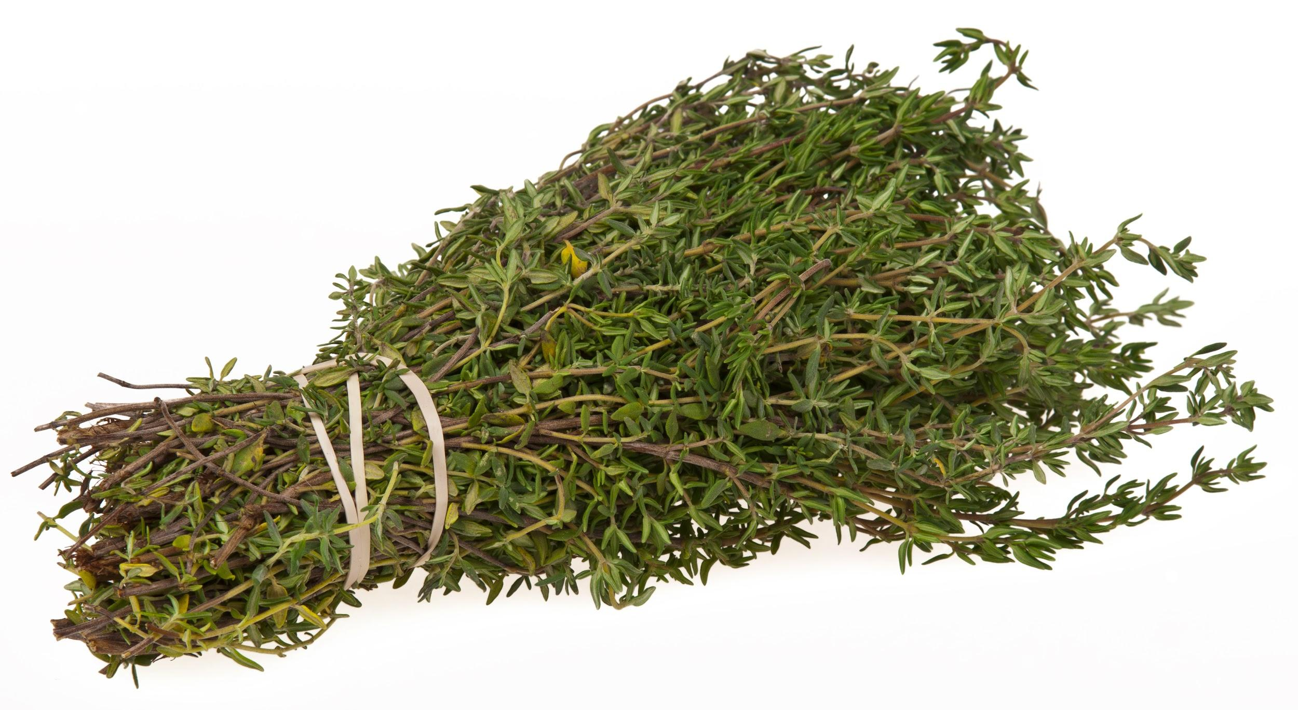
Spotlight Ingredient: Thyme
My spotlight ingredient is the herb Thyme. Thyme looks like a mini bundle of logs with tiny leaves, like a mini bundle of forest. It smells of a sour minty flavor. Thyme is part of the leaf and can be harvested at any time in the spring or summer. Thyme has dietary, medicinal and ornamental uses. Thyme has cures for diarrhea, stomach ache, arthritis and sore throat.

Slide 36
Pumpkin Pie
Ella Wassell
Dessert
Serves 8 people
INGREDIENTS:
¾ cup white sugar
1 tsp cinnamon
½ tsp salt
½ tsp ground ginger
¼ tsp ground cloves
2 large eggs
1 can (15 oz) pumkin
1 can (12 oz) evaporated milk
1 unbaked pie shell
PROCEDURE:
Mix sugar, cinnamon, salt, ginger, and cloves in a small bowl.
Beat eggs in a large bowl. Add pumpkin and sugar/spice mixture. Gradually stir in the evaporated milk.
Pour into the pie shell. Bake at 425 degrees and bake for 15 min. Reduce heat to 350 degrees. Bake another 40-50 min. Knife should come out clean in center of pie.
INDEX

Slide 37
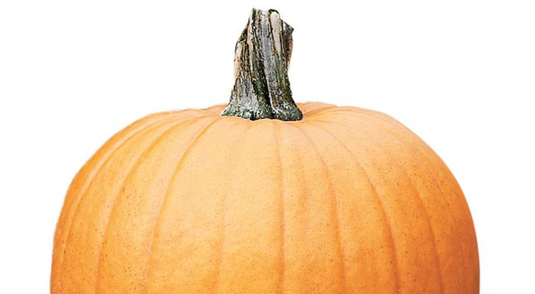
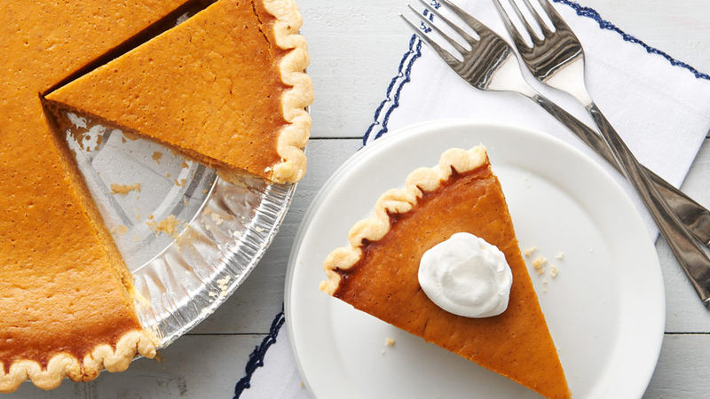
ALL ABOUT MY RECIPE
My family makes this pie about 2 times a year. It is a family recipe and everyone loves it. My family makes this pie for Thanksgiving and Christmas. I love making this with my Mom and Grandma. This pie is not from a specific culture, but, we always make this for Thanksgiving and Christmas. In my opinion this recipe is delicious because it has a lot of spices, but not so much sugar that it overpowers the pumpkin flavor.
SPOTLIGHT INGREDIENT: Pumpkin
My spotlight ingredient is pumpkin. Pumpkins are round orange fruits, and, they taste sweet and a little bit tart. They have a lot of oval shaped seeds on the inside and have a green and brown stem on the outside, it is also orange on the inside. Pumpkins are fruits and they grow on long vines. Pumpkins are harvested September through October. Sometimes harvesting may start in mid August to early September. Pumpkins need between 90 and 120 days after planting the seeds before harvest time. Highly Nutritious and Particularly Rich in Vitamin A. Packs Vitamins That May Boost Immunity. Vitamin A, Lutein and Zeaxanthin May Protect Your Eyesight. Nutrient Density and Low Calorie Count May Promote Weight Loss.

Slide 38
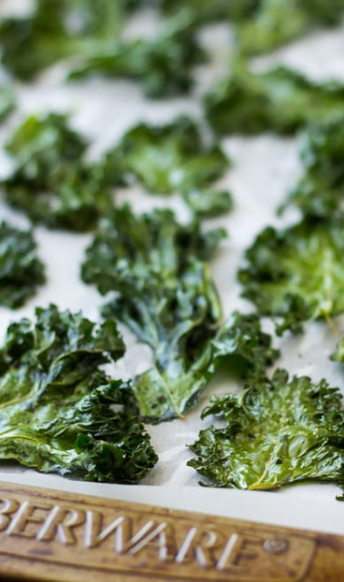
Crispy Kale Chips
Danielle Zinman
Side
As many as you want!
INGREDIENTS:
Cooking spray
Salt (to your liking)
Kale (as much as you want)
Olive oil (basically bathe the kale in oil)
PROCEDURE:
Preheat the oven to 350º Fahrenheit. Grease the pan with canola oil spray or vegetable oil.
Wash your kale in a colander until all the kale is wet and washed.
Take your kale, and take off most of the stem. There should only be the leaf left. Put the leaves in a separate bowl from the stems.
Get a small bowl and fill it up a quarter of the way with olive oil. Take a leaf of kale, and put your fingers in the olive oil and massage the oil into the kale thoroughly. Repeat until all the leaves are on the trays.
Sprinkle salt to your liking, then put the kale in the oven. Set a timer for 20 min. And check to see if the kale is crispy enough to your liking.
Put in a bowl, and enjoy!
INDEX

Slide 39
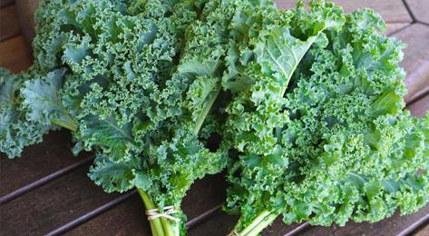
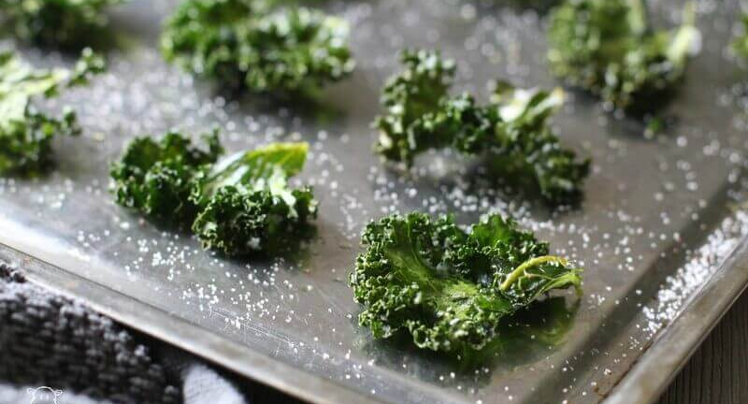
ALL ABOUT MY RECIPE
This recipe is special to my family because we get a farm share every other week and sometimes we would get kale. We would make kale chips because we have the kale and I get to spend some quality time with my mom since I usually have a lot of homework. Whenever we get kale in the house, we make these delicious chips. What makes this recipe delicious is the crunchiness and if you like salt, saltiness, but also the amazing health benefits.
SPOTLIGHT INGREDIENT: KALE
My spotlight ingredient is kale. Kale, Brassica oleracea variant acephala, is a leafy green vegetable. The kale plant is a cabbage-like plant with curly or straight, green or purple leaves. Kale is usually grown as an annual plant, harvested after one growing season. It grows native in regions of the eastern Mediterranean and Asia. Kale is pretty bitter. The part of the plant that is my spotlight ingredient is mainly the leaf, but if someone likes the stem they can add more. After about 1 year is how long it takes to be ready to be harvested. Some health benefits are powerful antioxidants and lots of vitamin C. It can be grown at any season.

Slide 40
Tofu Dumplings
Ruby Keh
10-15
INGREDIENTS:
1 package of firm tofu
1 shallot, chopped
1 clove, garlic, minced
3 tsp olive oil
2 tsp cornstarch
2 tsp of salt
mix 2 tsp water
PROCEDURE:
For the skin: 2 cups of all purpose flour, 3\4 cup of water
Methods: 1- sautee the shallot, 2- add the filling + cookwell, add the starch mixture and cook for another min, 4- let it cool down
Next Method: make a dough with the flour and water , divide the dough into 20 little balls , roll out about 3 and 1/2 in the diameter for each ball
Final Steps: After the tofu mixture and the skin prepared put one tsp filling in the middle of the skin. Close it up like a half moon. Then cook it in boiling water for 3 mins. Take it out let in cool down then eat!
INDEX

Slide 41
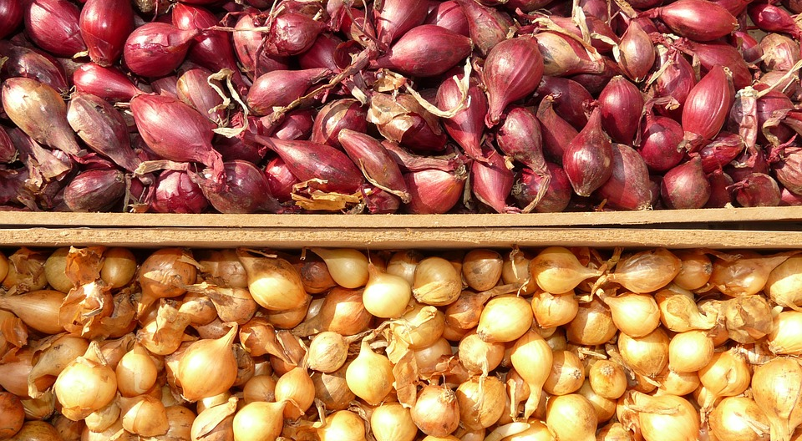
ALL ABOUT MY RECIPE
This recipe is special to my family because we make it whenever we go to my grandmas house, my grandma made dumplings when she was a lot younger and she wanted to show me and my brother how to make them also. This is a popular tradition that me and my family always do.
SPOTLIGHT INGREDIENT: SHALLOT
My spotlight ingredient is shallot. This is my spotlight ingredient because this gives my dumpling recipe a lot of flavor. It is a purple root plant, that has a very good flavor. It makes my dumplings 10 times better. If i didn't have shallot in my dumpling it would taste pretty bland. Shallots probably originated in Asia, traveling from there to India and the eastern Mediterranean. All though this may cause some pollution in the air it doesn't cause as much as some others things would. This is an amazing ingredient that you should always cook with.

Slide 42
Perfect Pesto
Sofia Mcnally
Entree
Six to seven servings
INGREDIENTS:
Basil (one plant)
Garlic (2-5 cloves)
Parmesan cheese ( one and a half cups)
Olive oil (2 tablespoons)
Pasta (one 1 pound package)
PROCEDURE:
Blend the olive oil and garlic together
Blend basil into garlic and olive oil mixture
Mix parmesan cheese into mixture
Boil water for pasta
Cook pasta in the boiling water until al dente (about 10 minutes)
Strain pasta and mix in pesto
INDEX

Slide 43
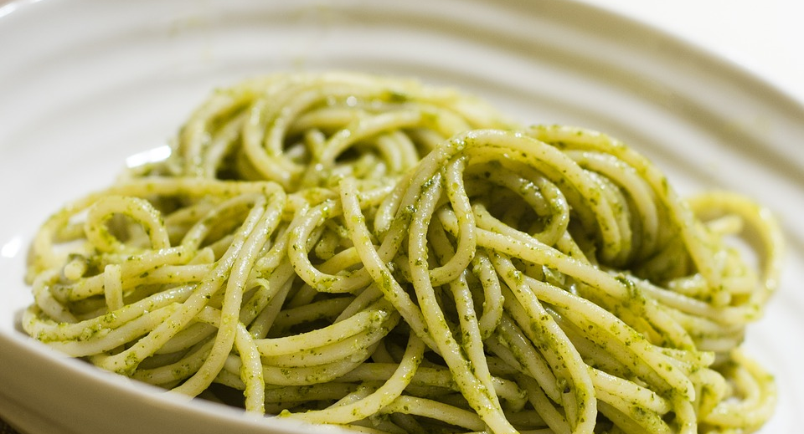
ALL ABOUT MY RECIPE
This recipe is special to my family because we use fresh basil and garlic from my grandpa’s garden in vermont. We usually make our pesto in the summer because the garden is at the peak of its freshness. This recipe tastes so good on a hot day in mid summer because everything is and tastes so fresh and delicious.I remember helping my grandpa make pesto when I was three or four . In my opinion the best part of the pesto is the basil because it’s so flavorful and really stands out in your mouth.
SPOTLIGHT INGREDIENT: Garlic
I My spotlight ingredient is going to be garlic. I chose garlic because basil would typically be the spotlight ingredient but garlic is seasonal and more local than basil is. Garlic is also high in the vitamin Manganese, vitamin B6, vitamin C and has very little calories. Garlic has a sort of spicy taste and is the stem of the plant. Cloves of garlic have an ivory tint to them and are about half an inch wide and one inch tall. Garlic is usually harvested in late June or early July.

Slide 44
MOLE
Amaris Garcia
Entrées
INGREDIENTS:
3 medium tomatoes, coarsely chopped
6 each dried ancho, mulato and pasilla chilies, stems and seeds removed
10 tablespoons shortening, divided
1/4 cup sesame seeds, toasted
1/4 teaspoon each coriander seeds and aniseed, toasted
10 whole peppercorns
4 whole cloves
1 cinnamon stick (1/2 inch)
1/4 cup chopped almonds
1/4 cup salted pumpkin seeds or pepitas
3 garlic cloves, peeled
1/4 cup raisins
2 slices French bread (1 inch thick), cubed
8 cups chicken broth, divided
2 ounces Mexican chocolate, chopped
1/4 teaspoon salt
PROCEDURE:
In an ungreased skillet, cook tomatoes over medium heat for 10 minutes or until browned; set aside. In the same skillet, cook peppers, a few at a time, over medium heat in 4 tablespoons shortening for 20-30 seconds, turning often; drain. Place peppers in a large bowl of hot water; cover and soak for 1 hour.
In a spice grinder, combine sesame seeds, coriander seeds, aniseed, peppercorns, cloves and cinnamon; process until finely ground. Set aside.
In a skillet, cook the almonds, pumpkin seeds and garlic in 4 tablespoons shortening until lightly browned, stirring often. Add raisins; cook and stir for 1-2 minutes or until raisins are plump. Add bread cubes; cook and stir for 2-3 minutes or until crisp. Drain well.
In a blender, combine 1 cup broth and reserved tomatoes; cover and puree. Add seasoning mixture, raisin mixture and 1 cup broth; blend until very thick. Pour into a bowl; set aside.
Place 1-1/2 cups broth in blender. Add peppers, one at a time; process to a thick consistency. In a Dutch oven, melt remaining shortening over medium heat. Add pepper mixture; cook and stir for 10 minutes. Add tomato mixture; cook and stir for 6-8 minutes or until thickened. Add the chocolate, salt and remaining broth. Simmer, uncovered, for 45 minutes or until mixture reaches desired consistency. Serve with poultry.
INDEX

Slide 45
ALL ABOUT MY RECIPE
My recipe is mole poblano. Mole poblano is a mexican spicy food. In my family mole is normally only eaten during party’s
SPOTLIGHT INGREDIENT: CILANTRO
Cilantro adds flavor to a dish. It can be eaten alone or with other foods

Slide 46
Banana Fritters
Anthonise Collingwood
Dessert
4-6
INGREDIENTS:
½ cups of flour
¼ cup of milk
3 tablespoons of sugar
¼ teaspoons of vanilla extract
3 bananas
2 apples
PROCEDURE:
Gather all the ingredients and blend them except for the apples
Then boil it with oil
Consequently cut up the apples into slices on the side
INDEX

Slide 47
ALL ABOUT MY RECIPE
My recipe is very special to me and my family because we only do it once in a while and it is sort of a tradition to us. However I don’t really have a special memory connected to it. This recipe also connected to the rest of my groups recipes. A group member of mine has a banana muffin as there recipe. Hence it was perfect for both of to keep the recipe and have kind of like a fruit and dessert section in our menu
SPOTLIGHT INGREDIENT: Apples
My spotlight ingredient is apples. It is either red or green, round and big enough to fit in your palm even though in my recipe we will be slicing it into pieces and usually the red one is sweeter than the green. This apple is considered a fruit. Apples are typically harvested in late September and early October. It can take up to 100 to 200 days before it can be harvested or fully grown. Apples are very healthy and tastes really delicious.

Slide 48
Empanadas
Angelo Negrette Lopez
Appetizer/breakfast
10 servings
INGREDIENTS:
3 cups all purpose flour,
¼ cup to ½ cup of teaspoons,
6 oz unsalted butter {1 ½ sticks}
1 egg, ¼ cup to ½ cup of water or milk,
adjust as needed to obtain a soft and smooth dough.
PROCEDURE:
Add the butter and pulse
To make the empanada dough by hand, follow the same instruction but use your hands to mix the ingredients together.
Split the dough into 2 large ball, flatten slightly into the shape of disks. The dough can be used immediately or refrigerated until ready to use (1-2 days max).
Roll out the dough into a thin sheet and cut out round disc shapes for empanadas (use round molds or a small plate). You can also make small individual balls with the dough and roll out each individual ball to a round shape (doesn't need to be perfectly round) - if you have a tortilla press you can use it to flatten the dough balls.
Use immediately, or store in the refrigerator/freezer to use later.
INDEX

Slide 49
SPOTLIGHT INGREDIENT: Empanadas
My spotlight ingredient is lettuce and a little bit of chicken. This ingredient will give a nice spice especially with the chicken, like without this ingredient it will just taste like a breed, because without something inside it wouldn't have any taste. The chicken is basically chopped up in little slices and the chicken is like the spice that makes you want more and the lettuce is like the thing that makes it healthy and makes it yummy.
It can also be put meat or chicken which makes it very yummy.

Slide 50
Caldo
Eric Sosa
Soup
12
INGREDIENTS:
Water (1 liter)
carrots 1/4
green beans
Corn (Cut in thirds)
1 Chicken piece
PROCEDURE:
Get a pot, fill 1 liter of water or more
Put in the vegetables, if you want you can put in chicken
Put in the corn
Let it boil
INDEX

Slide 51
ALL ABOUT MY RECIPE
This is special because we can make this so if we want something healthy and we want soup this is a good option. We eat this recipe 2 times a week and we eat this on the fall and winter. We make this in every holiday. This recipe is delicious for me because when you put in all of the vegetables he caldo taste like regular soup but 5 times better.
SPOTLIGHT INGREDIENT: Green beans
The spotlight ingredient is the green beans. The green beans are peas but the peas are inside the green beans and they taste sweet. Green beans have stems. You can plant green beans in the spring or on fall. It is a good source of fiber and vitamin C.

Slide 52
DUMPLINGS
Yu Yang
Appetizers
4, 3 or 2 people
INGREDIENTS:
500 grams (4 cups/180 ounces) all purpose flour
265 milliliter (1 cup plus two tablespoons/9 ounces) water (room temperature)
About 4 cups preferable dumpling filling (refer to lamb with vegetables, kimchi pork or pork, shrimp and mushroom.)
PROCEDURE:
Add flour into a large bowl. Slowly pour water into the bowl while mixing it with a mixer.
When the water is mixed with the flour, dust both hands with flour and start kneading to form dough. The dough with be quite tough and should easily be able to lifted from the bowl without sticking to the bottom.
When dough has formed, dust the working space with flour and dust your hand again with flour. Transfer the dough to working surface and continue to knead it until its surface become smooth.
First dust the bottom of a cleaned large bowl with flour and then put the dough in it. Cover with damp dish towel and a lid (plastic wrap). Let the dough rest for 2 hours or longer like 4 to 5 hours.
After resting, the dough will be softened and have a smooth texture. Dust the working surface, knead the dough repeatedly for another 3-5 minutes, until the dough hardens again. Let the dough rest about 30 minutes or longer.
During this time, you can prepare the dumpling fillings.
Dust the working surface again and put the dough onto it. Slice ⅙ of the dough off and place the rest into a big bowl. Cover it with damp dish towel.
Roll the dough into a long stick, about 1 inch. Use a knife to cut the dough stick into about 12 small doughs.
Slightly dust both sides of each small dough with flour. Work on them one at a time.
Dust the working surface, take on dough and press it to a round disc. Roll it with a rolling pin into a round sheet. Try to roll it so that the edge is thinner than the center.
Starting here work quickly, brush a bit of water over the edge so you can still seal the dough.
Scoop about 1 tablespoon of dumpling filling and place it in the center of the wrapper (the dough) and starting to seal the edges, do not let the filling touch the sealing area. Our goal is to make the dumpling hold their shape.
Place the dumplings on the working surface and work on the rest of the doughs in the same manner.
Try to warp and cook dumplings in small batches(20 -25 dumplings at a time)
Bring a large pot of water to a boil.
Carefully add dumplings one at a time into the water. Use a big ladle to stir the water gently.
When the dumplings float to the surface, continue boiling until the dumplings until the dumplings doughs start becoming transparent.
INDEX

Slide 53
SPOTLIGHT INGREDIENT: MUSHROOMS
My spotlight ingredient is MUSHROOMS. My spotlight ingredient is brown and white and some are all white. Mushrooms are very juicely, it mostly don’t have a taste if you boil it so you have to season it.
Mushrooms are the fruit if the plant. Mushrooms are typically harvested on week 3 after it is planted. The plant need to grow about 3 weeks. The fiber, potassium and vitamin C content in mushrooms all contribute to cardiovascular health. Potassium and sodium work together in the body to help regulate blood pressure.

Slide 54
Egg Curry
Abtahi Hasan
Recipe Type Entree
Number of Servings 4
INGREDIENTS:
4 eggs
4 cups of chopped onions
½ cup of chopped tomatoes
2 teaspoons of chopped chilli pepper
2 teaspoons of chopped cilantro
1 teaspoon of turmeric powder
1 teaspoon of coriander powder
1 teaspoon of cumin powder
1 teaspoon of salt
½ teaspoon of red chilli pepper
PROCEDURE:
Have a medium sized pot.
Put it on the stove and wait until it is warm.
Put any type of cooking oil in the pot and wait until it is warm.
Now, put 4 cups of chopped onions, ½ cup of chopped tomatoes, 2 teaspoons of chopped chilli pepper, then wait till it is looking brown, then put 2 glasses of water, and now add 1 teaspoon of turmeric powder, 1 teaspoon coriander powder, 1 teaspoon of cumin powder, ½ teaspoon of red chilli pepper, wait 5 minutes, now put 4 eggs without the shells, wait another 5 minutes, then put 2 teaspoons of chopped cilantro, turn off the stove, and now ready to serve.
INDEX

Slide 55
ALL ABOUT MY RECIPE
The reason this recipe is special and significant to me and my family because since my Dad goes to work, my Mom is the one who really cooks more. Sometimes, my father cooks, and this is one of the recipes that he cooks while he spends time with us. A special memory that I have that is connected to this recipe is that maybe a couple of weeks ago, since my mother was not able to cook, my father decided to cook, and this is one of the recipes that he cooked. I think that this a recipe from the tradition of Southern Asia. In my opinion, the thing that makes this recipe delicious is that with the eggs and onions, the peppers also add flavor.
SPOTLIGHT INGREDIENT: ONIONS
This is the spotlight ingredient of my recipe, onions. You could easily see the onions with the eggs. The onions also add flavor to the eggs.

Slide 56
Red Velvet cupcakes w/blueberries
Zeke Johnson
Recipe Type
1-24 cupcakes
INGREDIENTS:
2 and a half cups of all purpose flour
1 and a half cups sugar
-1 teaspoon baking soda
-1 teaspoon fine salt
-1 tablespoon cocoa powder
-1 and a half cups vegetable oil
1 cup buttermilk[room temp]
1-2 oz red food coloring
-1 teaspoon white distilled vinegar
1 teaspoon vanilla extract
Frosting:
8 oz cream cream cheese
1 pound confectioners sugar
1 stick unsalted butter
1 teaspoon vanilla extract
Add 4 blueberries when done
PROCEDURE:
sift together the dry ingredients, whisk and sift a second time
In large bowl whisk together the oil, buttermilk, food coloring vinegar and vanilla.
Using a standing mixer, mix the dry ingredients into the wet ingredients until just combined and a smooth batter is formed
INDEX

Slide 57
ALL ABOUT MY RECIPE
Red velvet cupcakes are special to my family because my dad is really good at making them. For the superbowl, we would go to our friends apartment with the cupcakes. Me and my dad would decorate the cakes the colors of the teams that made it to the superbowl. Everyone at the party loved them. They are so delicious because of their soft and sweet taste.
SPOTLIGHT INGREDIENT: BLUEBERRIES
Blueberries are one of my favorite fruits. They are small blue fruits that taste sweet, and the bigger ones are the juiciest. The first time i used blueberries for the cupcakes was one super bowl and we were making Giants-themed cupcakes, for the blue on their uniforms we used blueberries. Blueberries can be used to help prevent cancer. You can pick blueberries all year round.

Slide 58
CEVICHE
Meylyn Martinez
Appetizer
20 servings
INGREDIENTS:
6 Tomatoes
20 Limes
½ of Coriander
5 pinches of salt
1 Box of Shrimp
1 ½ of fillet
5 pinches of pepper
½ of onion (optional)
PROCEDURE:
Buy ingredients and wash shrimp with cold water ,take out shell & make small cut on shrimp to take out crap & cut shrimp into little pieces and put in bowl.
Cut Fillet in half with thin slices, then on small pieces in shape of square & grab a seperate bowl to put the fillet.
Cut the limes in half and grab a seperate bowl and squeeze the lime juice either with your hand or a lime squeezer tool.
Cut tomatoes,coriander & onions into little pieces and put everything together (shrimp,fillet,tomatoes,onions,coriander,lime juice) in one bowl and mix while mixing add pepper & salt.
Grab bowl, put in fridge for 30 mins and enjoy

Slide 59
SPOTLIGHT INGREDIENT:CILANTRO
My spotlight ingredient is Coriander, It’s main color is green has little tiny leaves and taste almost like spinach., Coriander leaves begin to be harvested in about 3 to 4 weeks.Coriander has Vitamin C, Vitamin K and protein. They also contain small amounts of calcium, phosphorous, potassium, thiamin.
In my spotlight ingredient

Slide 60
Chocolate Fruit Cake
Yamilet Ruiz
dessert
4 servings
INGREDIENTS:
1 cup of water
⅓ cup of vegetable oil
3 large eggs
A blender or a spoon
Dark coated pan or glass pan
Cake mix
PROCEDURE:
Preheat oven to 350 degrees for metal or glass pan,
325 degrees dark pan,grease sides & bottom of pan. add flour lightly,
Pour in the cake mix then the 1 cup of water in bowl
then the ⅓ cup of vegetable oil
And last the 3 large eggs.you will know when it's done when its moistened
Pour in the batter in pan and bake immediately, BAKE in center of the oven at 350 degrees fahrenheit, add 3-5 minutes for dark pan,Cake is done when toothpick come out clean

Slide 61
SPOTLIGHT INGREDIENT:Strawberries
My spotlight ingredient is strawberries. It is a fruit and is red with seeds all over it. The strawberry has Vitamin A, C, and D. These fruits are very sweet and have a good flavor. The spotlight ingredient is a fruit which is a strawberry and it has little seeds on the outside of the strawberry. The green leaves on top of the strawberry are a plant. A strawberry has 45 calories and you shouldn’t eat more than 8 strawberries.

