Slide 1
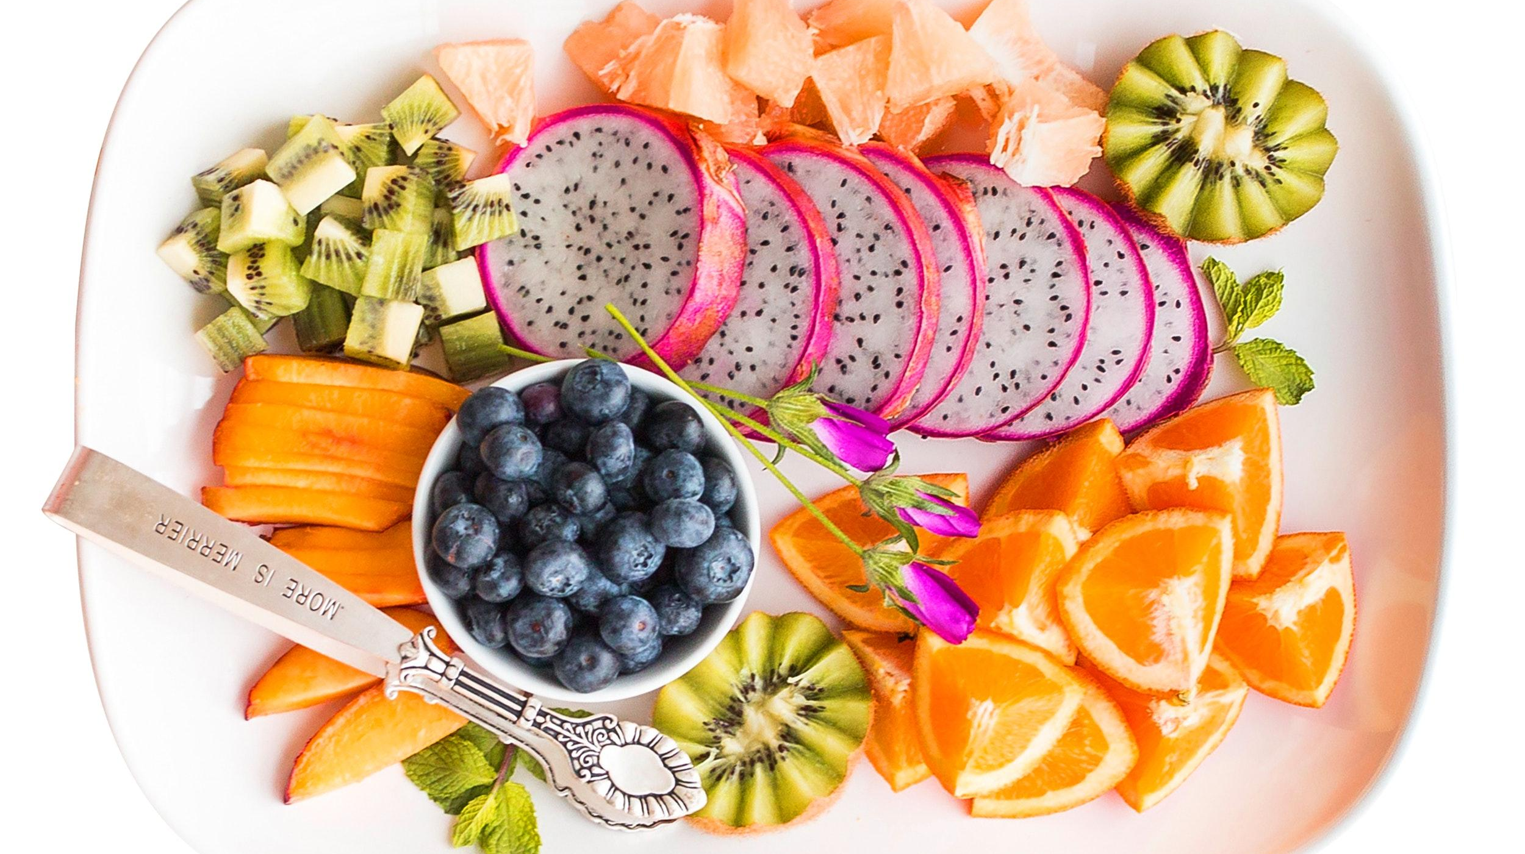
6th GRADE COOKBOOK
RED

Slide 2
In this unit “Food For a Thought” we look at towns with food swamps. Food swamps are places where there aren’t many healthy food sources. While learning about that we also went on trip to places like the Green market, M.O.F.A.D., and the botanical gardens. Those trips were very fun. Soon our teachers decided that we should make our own restaurants. That is what this slide is about. It is our recipe book. Our whole
Expo group made food important to our families and cultures. We all have different restaurants but made this cookbook to show how diverse they all are.

Slide 3
TABLE OF CONTENTS
01 PUMPKIN PIE DELIGHT
02 MAPLE BACON CUPCAKES
03 SEASONAL SALAD
04 TABBOULEH SALAD
05 ROYAL ICE CREAM TORTE
06 CREPES
07 TOMATOES AND SCRAMBLED EGGS
08 STRAWBERRY BANANA SMOOTHIE
09 VIETNAMESE SALMON BOWLS
10 PAKORA
12 GUACAMOLE
11 TOMATO FRIED RICE
13 PEPPER AND SAUSAGE FRITTATA
14 APPLE CRUMBLE
15 CHEERY CHICKEN FAJITA TACOS
16 SHRIMP SCAMPI
17 STIR FRY BROCCOLI
18 BRUSCHETTA
19 BUTTERMILK FRIED CHICKEN
20 ALOO GAJAR
21 PENNE ALLA VODKA
22 GRILLED JERK CHICKEN
23 SPAGHETTI AND MEATBALLS
24 DUMPLINGS
25 PASTA WITH CHEEZEY CHEEZ
26 RASTA PASTA
27 STUFFED BELL PEPPERS
28 LASAGNA
29 EMANADAS
30

Slide 4
Pumpkin Pie Delight
Jack Wassell
Dessert
Nine Servings
INGREDIENTS:
(15 oz)Pumpkin
(½ tsp)Salt
(¾ cups)White sugar
(1 tsp)Cinnamon
(¼ tsp)Ground cloves
(½ tsp)Ground ginger
2 eggs
(12 oz)Evaporated milk
Unbaked pie shell
PROCEDURE:
Mix sugar, cinnamon, salt and ginger in small bowl.
Mix eggs in large bowl. Add pumpkin and sugar/ spice mixture. Gradually stir in evaporated milk.
Pour into pie shell. Bake at 425 degrees for 15 min, reduce heat to 350, bake for another 40-50 min, knife should come out clean in center of pie.
INDEX

Slide 5
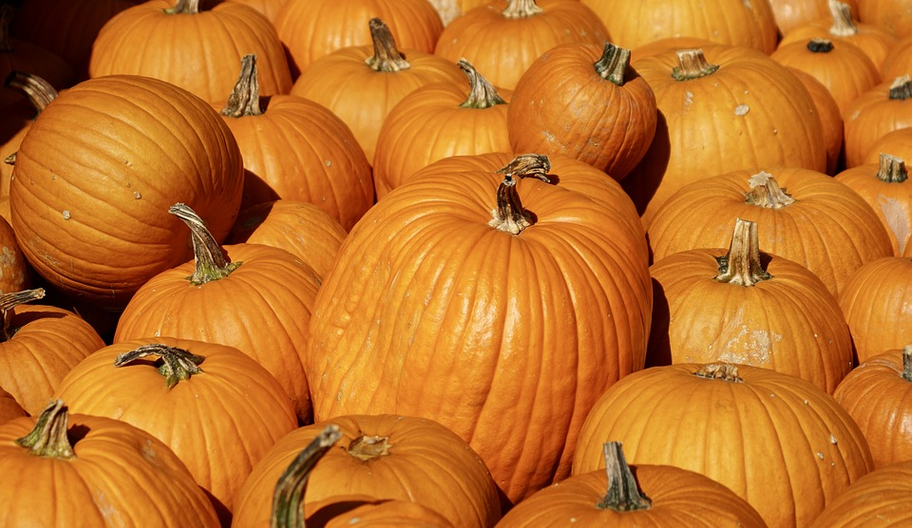
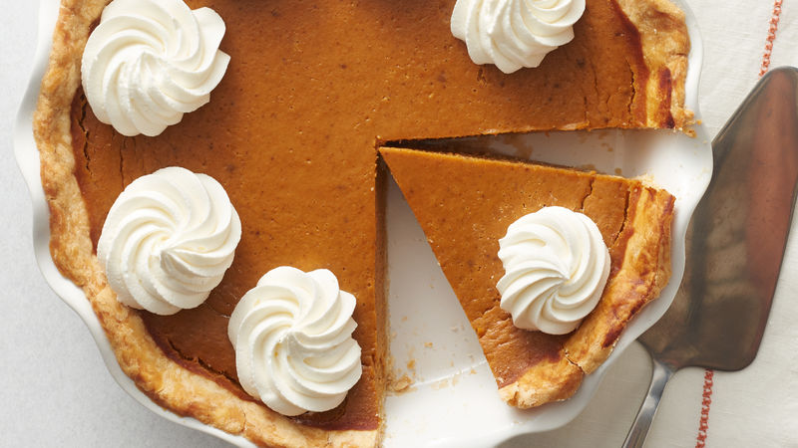
ALL ABOUT MY RECIPE
Pumpkin pie delight originates from my great grandma. She made the recipe when my grandma was little. My great grandma’s pumpkin pie is my favorite dessert ever. Enjoy the pumpkin pie everyone.
SPOTLIGHT INGREDIENT: PUMPKIN
Pumpkin is the spotlight ingredient in my recipe. Pumpkin is a fruit with a stem and a gooey inside. Pumpkin has a sour taste, it’s the seeds that you roste to a crisp, and save the pumpkin for the pie. And if you want to, you could put the roasted seeds on the pie. After flowering, a pumpkin is ready to be picked at around 40-55 days.

Slide 6
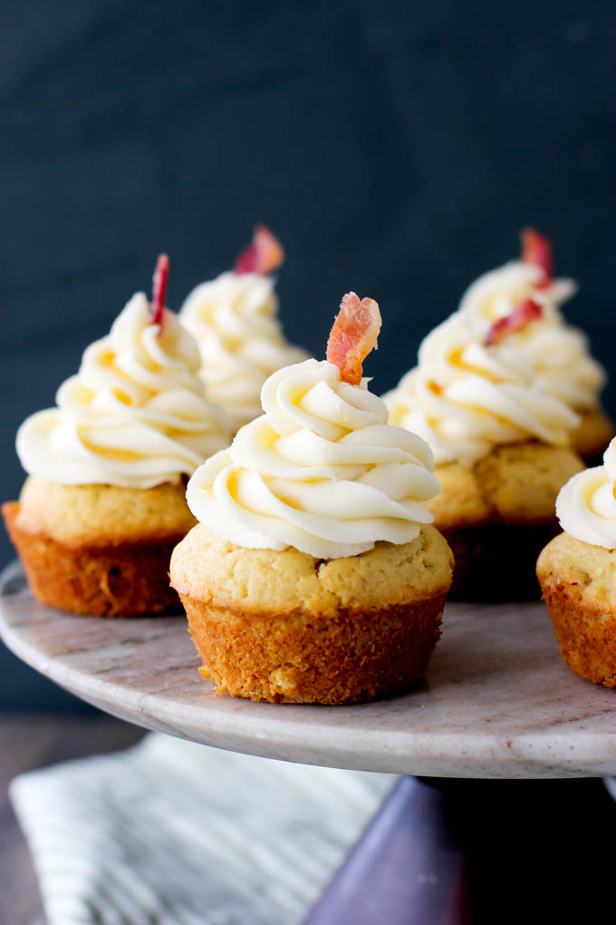
Maple Bacon Cupcakes
Blaze M
Dessert
⅓ cup (80ml) vegetable or canola oil (or melted coconut oil)
2 teaspoons pure vanilla extract
1/2 cup (42g) unsweetened natural cocoa powder3/4 teaspoon baking powder
Serves 6 people
INGREDIENTS:
1 pack Bacon
3 tbsp maple syrup
¼ Brown sugar
3/4 cup (95g) all-purpose flour
1/2 cup (100g) granulated sugar
1/2 cup (100g) packed light brown sugar
1/2 teaspoon baking soda
1/4 teaspoon salt
2 large eggs
1/2 cup (120ml) buttermilk, at room temperature*
Any vanilla frosting recipe
Maple syrup
PROCEDURE:
CUPCAKES:
Preheat the oven to 350°F (177°C). Line a muffin pan with cupcake liners. Line a second pan with 2 liners - this recipe makes about 14 cupcakes. Set aside.
Whisk the flour, cocoa powder, baking powder, baking soda, and salt together in a large bowl until thoroughly combined. In a medium bowl, whisk the eggs, granulated sugar, brown sugar, oil, and vanilla together until smooth. Pour half of the wet ingredients into the dry ingredients. Then half of the buttermilk. Gently whisk for a few seconds. Repeat with the remaining wet ingredients and buttermilk. Stir until *just* combined; do not overmix. The batter will be thin.
Pour or spoon the batter into the liners. Fill only halfway (this is imperative! only halfway!) to avoid spilling over the sides or sinking. Bake for 18-21 minutes, or until a toothpick inserted in the center comes out clean. Allow to cool completely before frosting.
MAPLE BACON:
Preheat oven to 350 degrees
Lay bacon on a sheet pan
Coat bacon in a thin layer of brown sugar
Cook bacon for 15 mins or until crispy
MAPLE FROSTING:
For the frosting combine maple syrup with your vanilla frosting
Lastly decorate however you want. Be creative!
INDEX

Slide 7
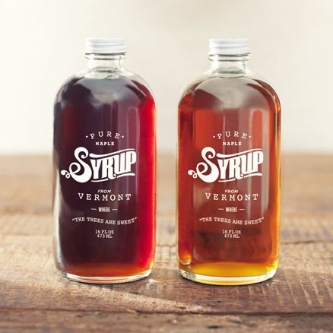
ALL ABOUT MY RECIPE
This recipe is special to me and my family because not only do we have a sweet tooth, but boy do we all love bacon! Me and my family like to make this recipe towards the holiday season when we throw a holiday party. In my opinion this recipe is delicious because the savory aspects of the bacon balance out the sweetness of the cupcake.
SPOTLIGHT INGREDIENT: MAPLE SYRUP
My spotlight ingredient is maple syrup. Maple syrup is a delicious amber colored treat that can make a good old fashioned stack of pancakes complete. My spotlight ingredient, maple syrup comes from the trunk of a tree. Trunks are like stems, but the word stem usually refers to a plant, while a trunk refers to a tree. Maple syrup comes out of a tree usually towards the end of its life cycle or when full grown. Maple syrup provides zinc, witch helps your immune system. Maple syrup also contains Potassium, this helps maintain a healthy blood pressure.

Slide 8
Seasonal Salad
Shiyanne Katz
Sides
It serves 4 or more the exact max is 10
cherry tomatoes,
cranberries
sliced carrots
shredded beets
INGREDIENTS:
Spring mix lettuce
bell peppers
a dressing on the citrus basil olive oil
PROCEDURE:
Get a bowl
Rinse the ingredients (except dressings
Then add lettuce, then carrots and then put in the rest except for beets.
Toss them (not to high up)
Miix them up( leave dressing)
Make a cool design for your beets on the top
Eat up and enjoy
INDEX

Slide 9
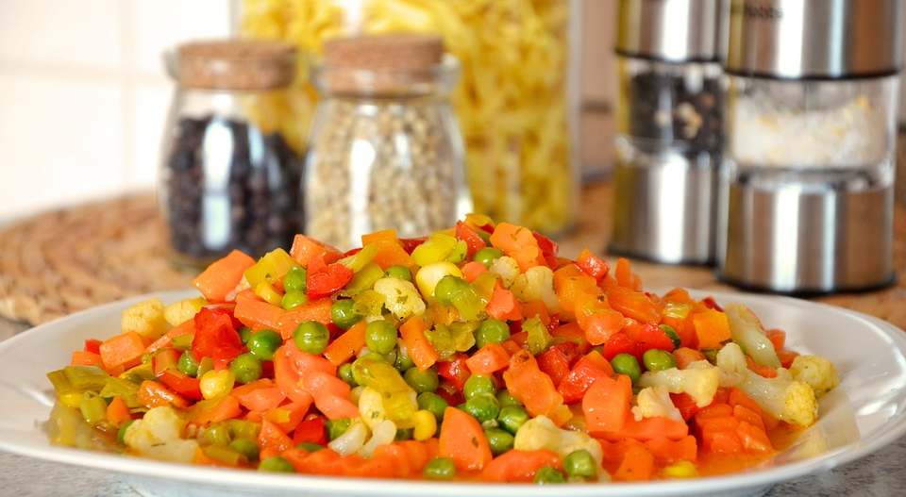
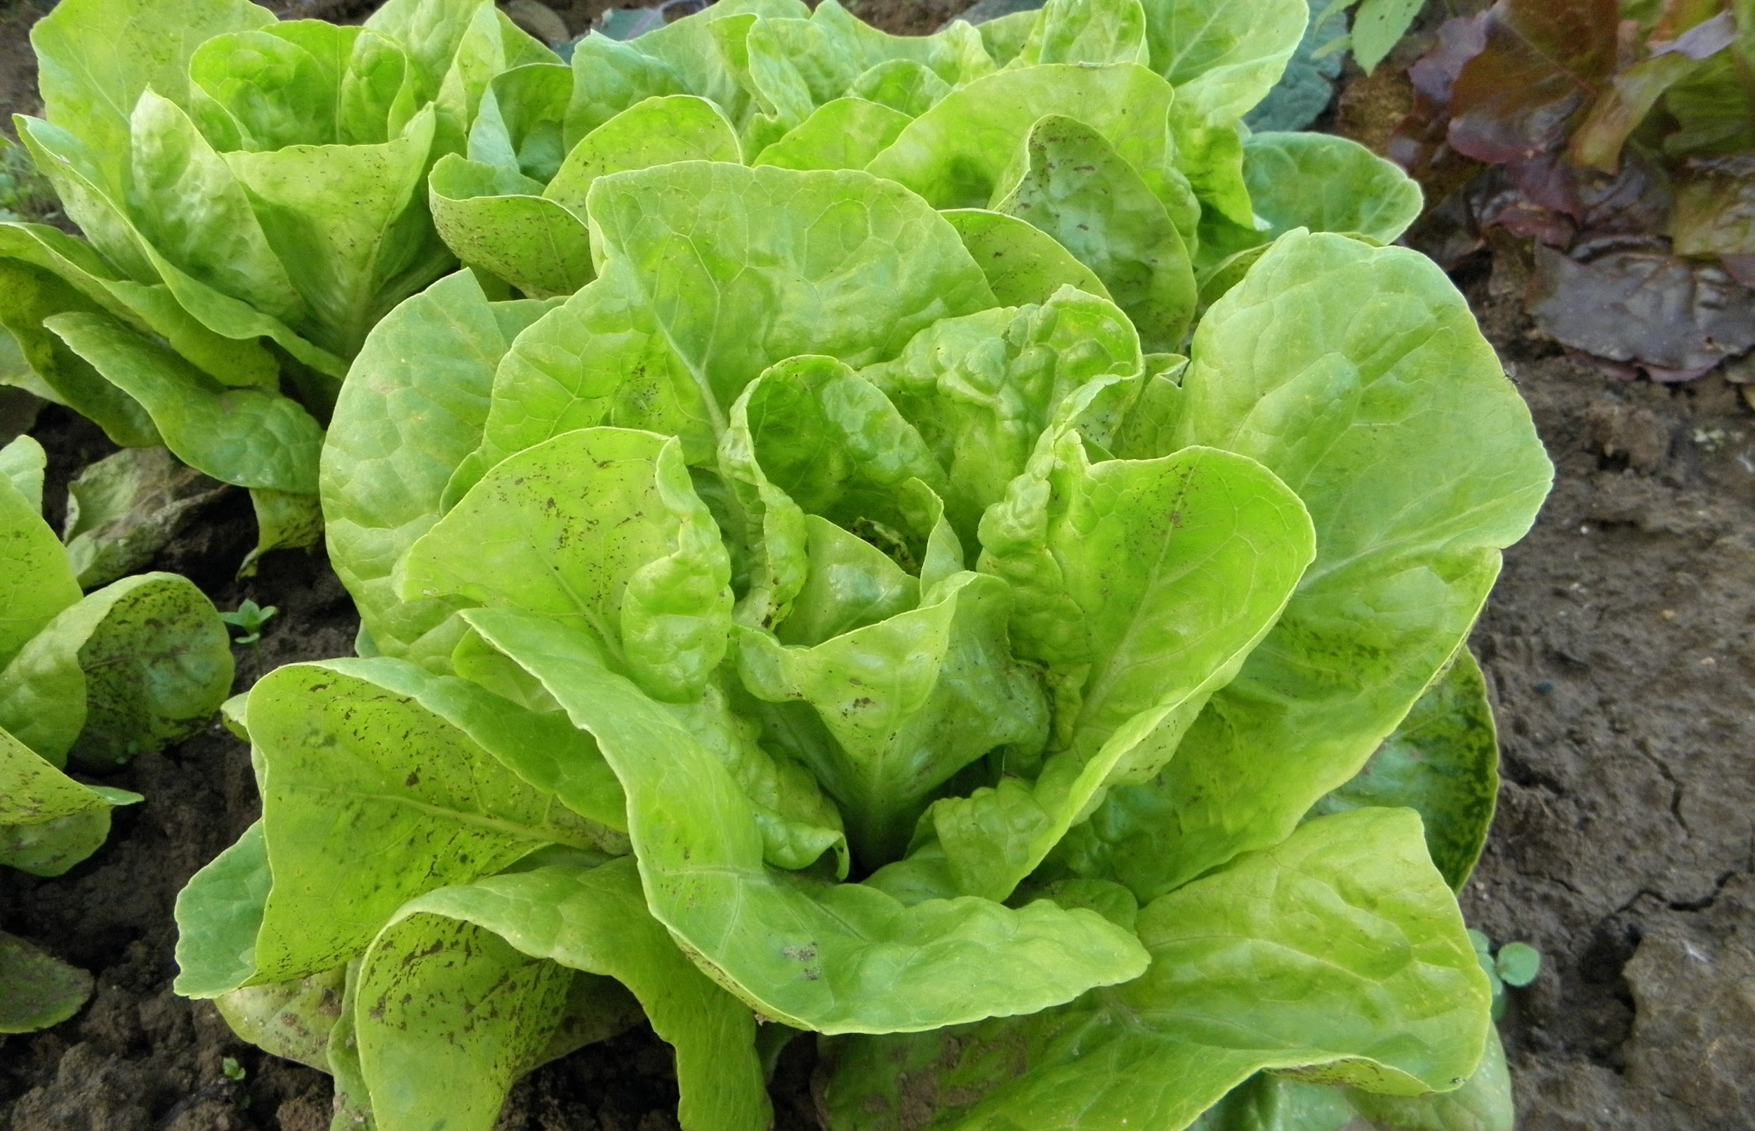
ALL ABOUT MY RECIPE
The recipe is important to my family because, we love salad. We like the nutrition, and the flavor it gives. No we don’t have any special time to eat our salad.. We don't really have special occasion food. It could be from any part of the world but we don't know. We think this salad goes for any religion. I think that all of the food combined and the sauces make it delicious.
SPOTLIGHT INGREDIENT: LETTUCE
My spotlight ingredient is lettuce. I chose it because i love the crunchy parts of it and it is a nutritious, healthy, and delicious.Lettuce is a green, leafy, flower like vegetable. I say it's like a flower because, the layers of the leafy green deliciousness are surrounding the middle like petals on the seeds.My spotlight ingredient is a leaf because the lettuce parts are like going around things. Like the leafs surround stems. The time when lettuce is harvest is about 75 days from the first day it was planted to 75 or 76 days after.Some types of lettuce grows flowers that are able to perform self pollination. Lettuce provides vitamin A, B9, And C.

Slide 10
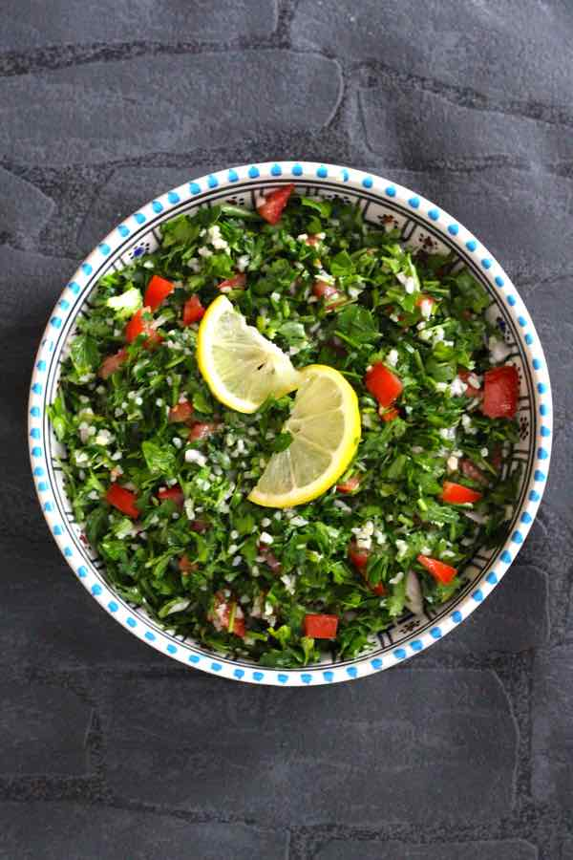
TABBOULEH
Stanislav Daaboul
Salad
2 people
INGREDIENTS:
3 bunches finely chopped flat leaf parsley
1 cup chopped fresh mint
2-3 tablespoons fine bulgur
1 chopped firm tomato
2 scallions chopped
1/2 cup extra Virgin olive oil
1/4 cup fresh lemon juice
salt and pepper to taste
1/2 teaspoon cayenne pepper (optional)
1 bunch romaine lettuce
PROCEDURE:
Prepare the chopped parsley, mint, tomatoes, scallions and set them aside.
In a large bowl, mix Bulgur, chopped tomatoes, chopped scallions with lemon juice, salt and pepper.
Add to them the parsley and mint and olive oil and mix, adjusting seasoning by adding more oil and lemon if desired.
Serve cold garnished with romaine lettuce
INDEX

Slide 11
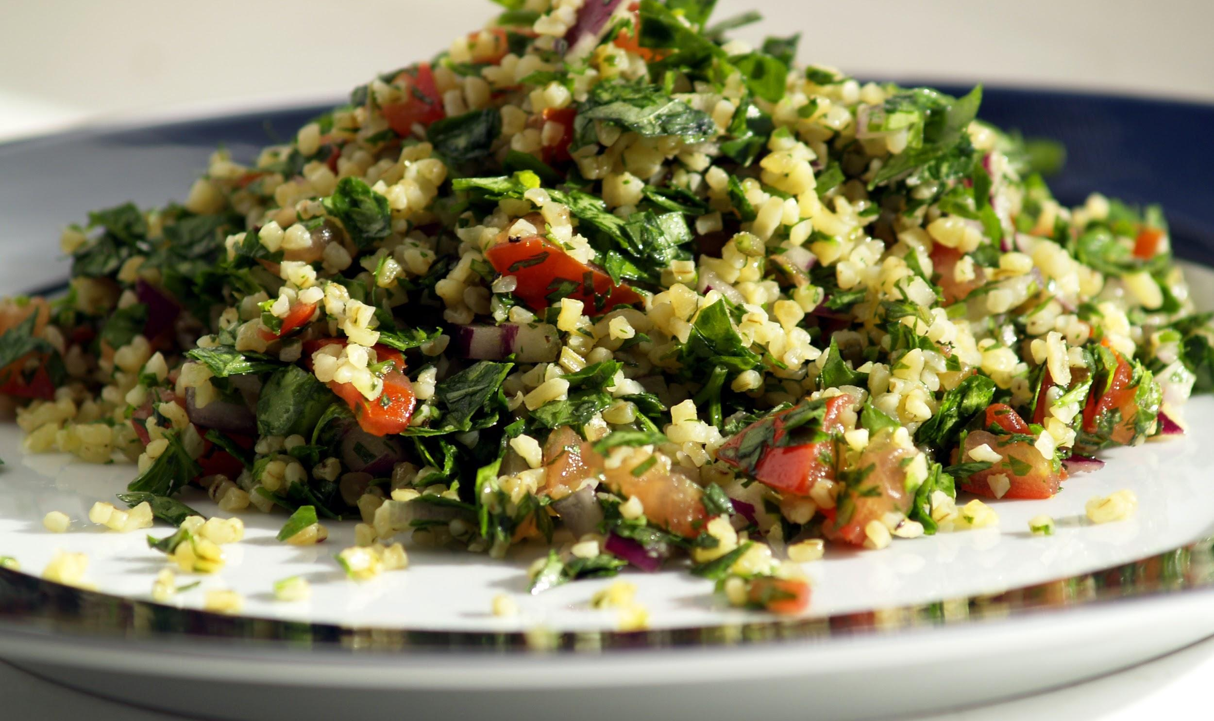
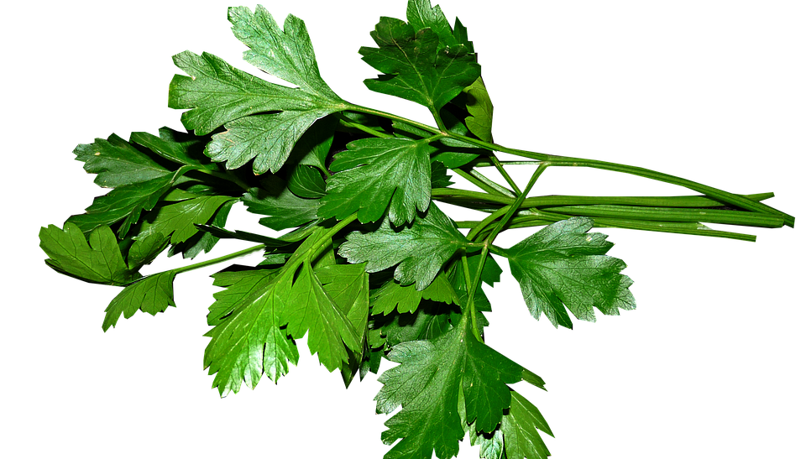
ALL ABOUT MY RECIPE
Tabbouleh originates from the middle east, specifically Lebanon, which is where my dad is from. It takes a while to make it, but it is worth the chopping and the mixing being one of the most refreshing salads ever. This recipe was one of my dad’s childhood foods and it is now mine and my sister’s! It is special to me because I love salad and it is something my family enjoys eating together. I love every single vegetable inside of tabbouleh, especially scallions. This recipe is delicious because of how refreshing it is, which is partially on account of the lemon juice and the scallions.
SPOTLIGHT INGREDIENT: PARSLEY
Parsley is the spotlight ingredient in my recipe. Parsleys are edible leaves. Parsley usually has a mildly bitter taste, and is usually used as a garnish to balance out recipes. It makes them more bitter if needed, and looks like pointy and small. We commonly eat the leaves of the parsley. It typically 70 to 90 days until it is ready to be harvested. It is a cool weather plant. It can help prevent cancer, diabetes, asthma and even bone weakness.

Slide 12
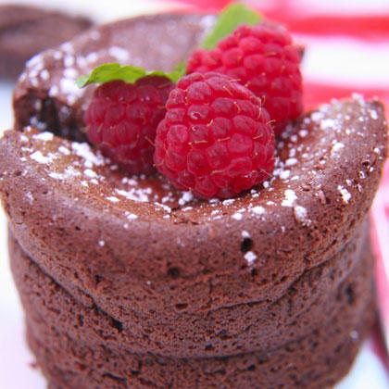
Royal Ice Cream Torte
Leo Duhl
Desert
20 Servings
PROCEDURES:
Oil the springform pan.
Crush oreo cookies and spread half of the crumbs over the bottom of the pan and press down.
Let the chocolate ice cream soften slightly.
Spread the chocolate ice cream over the crushed oreos.
Drizzle 2 tablespoons of the fudge sauce over the ice cream. Spread the remaining crushed oreo cookies over the sauce.
Top with raspberry sorbet and 2 tablespoons of fudge sauce.
Sprinkle the crushed heath bar over the entire torte.
Freeze for 4 to 5 hours.
Serve with fresh raspberries.
INGREDIENTS:
1 ½ cups of crushed oreo cookies.
2 pints of chocolate chocolate chip ice cream.
8 oz bottle of fudge sauce.
2 pints of raspberry sorbet.
¼ to ½ pounds of crushed heath bar.
10 raspberries.
Oil to grease the pan.
1 springform pan.
INDEX

Slide 13
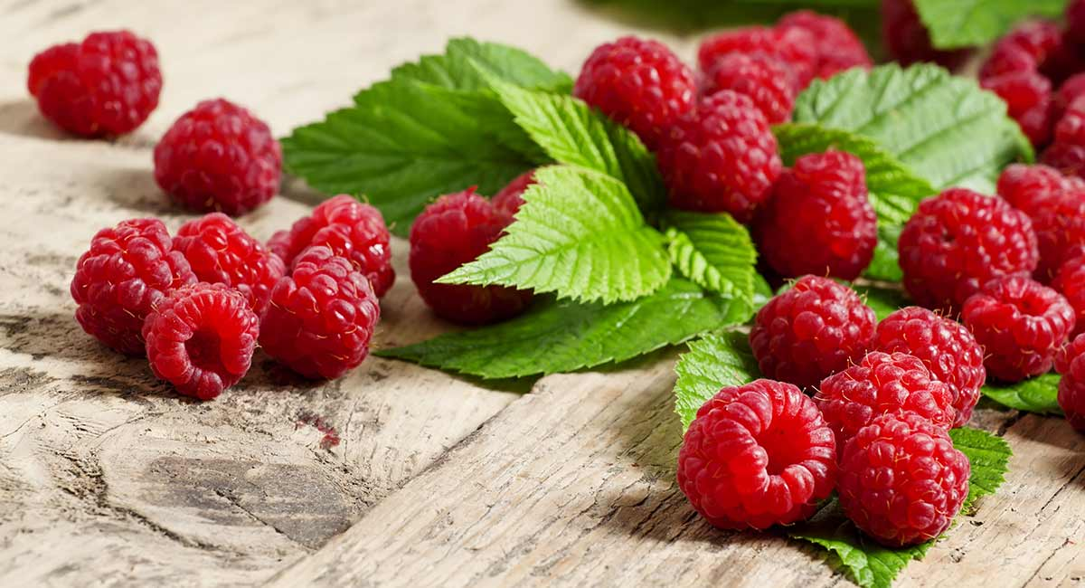
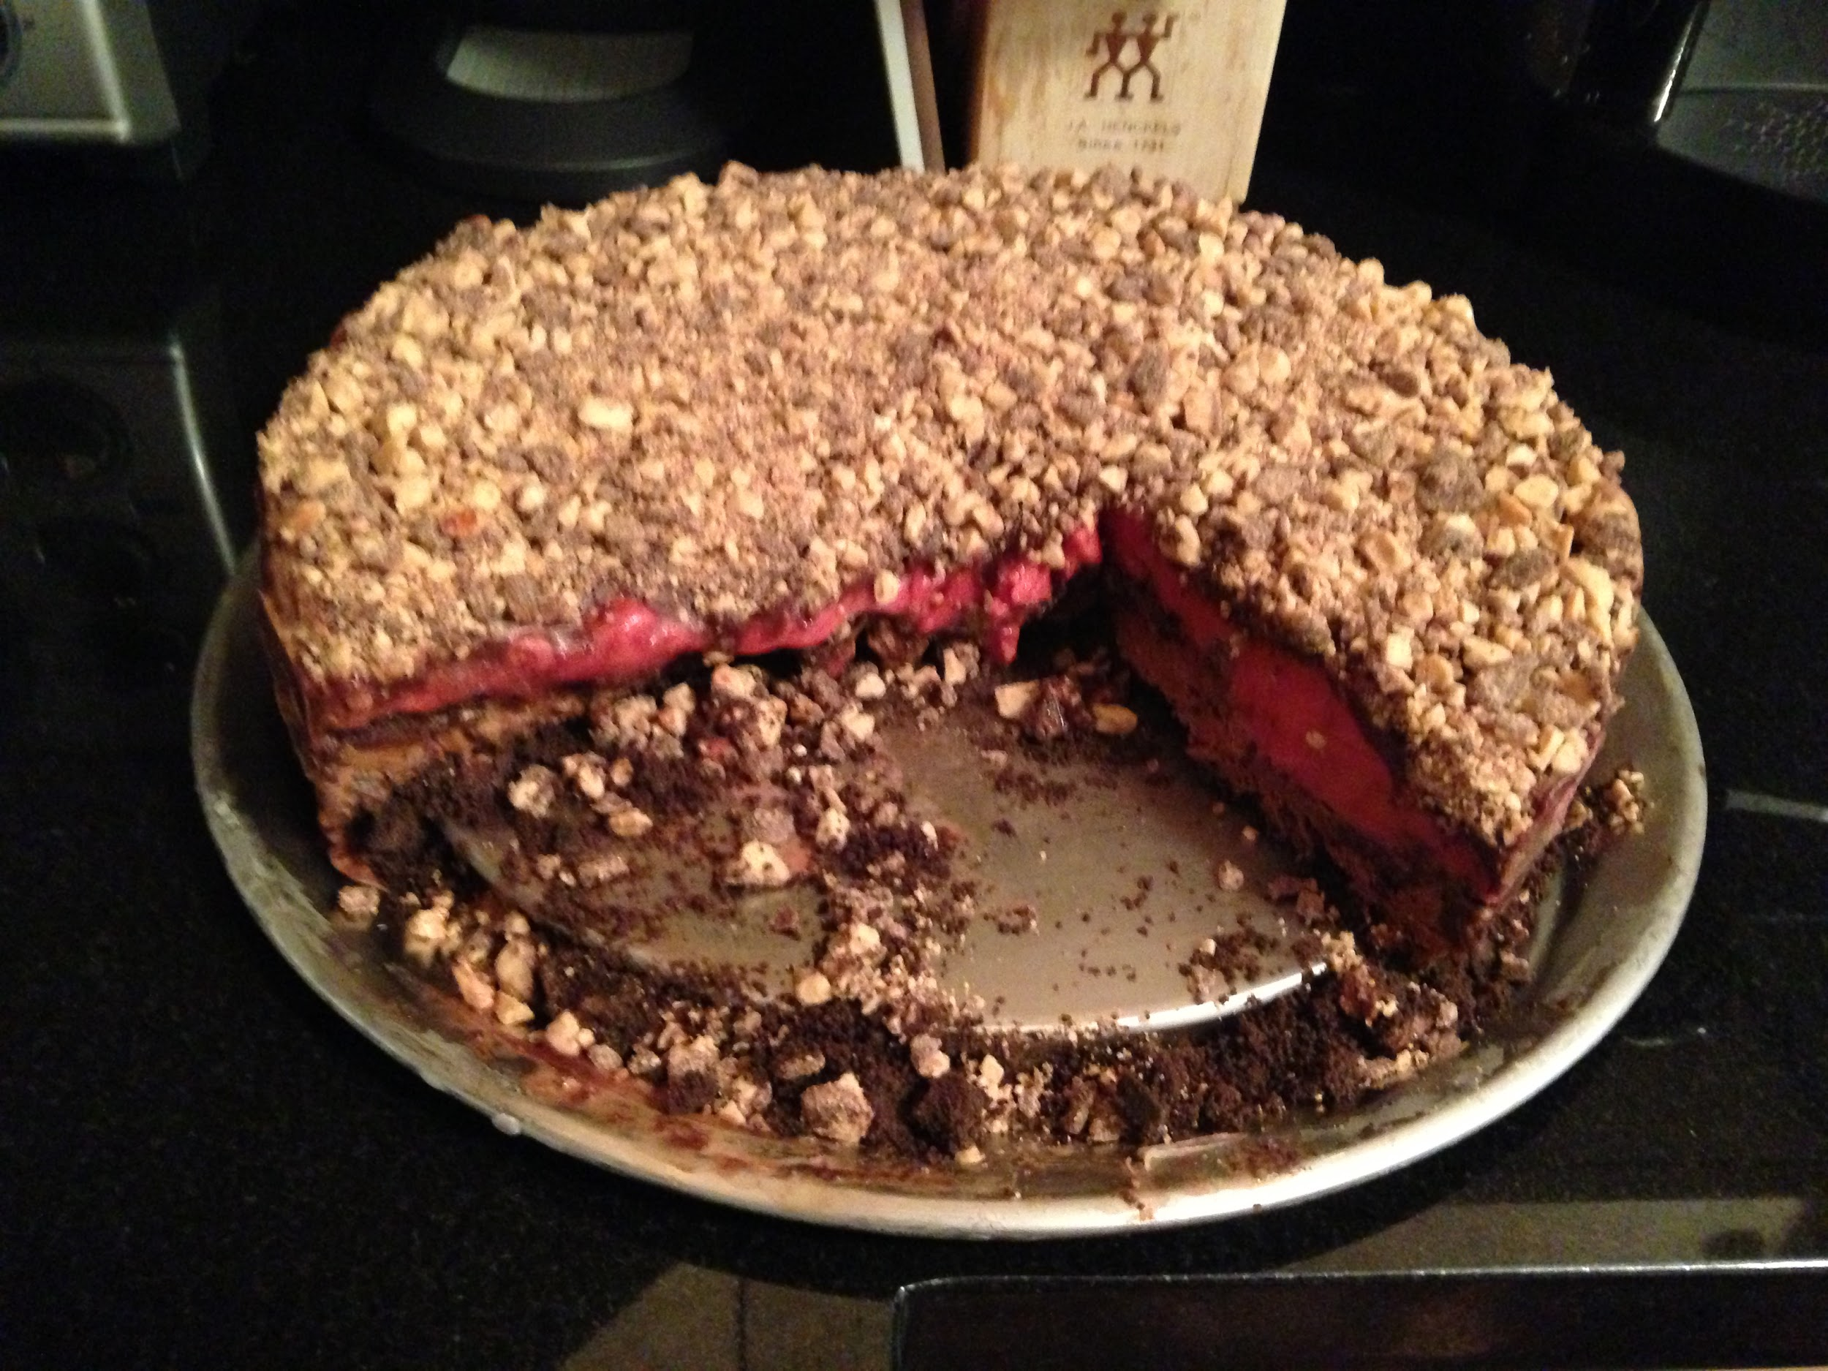
ALL ABOUT MY RECIPE
This recipe is special to me because we always have it when we go to my grandparent’s home for Thanksgiving. Every year we go to my grandma’s house in Evanston, Illinois for Thanksgiving and the torte is always there. One time I really enjoyed this recipe was when my dad and I made it by ourselves for my mom’s birthday. The torte is delicious and it reminds me of all the fun I have with my grandma and my family. I really enjoy it because along with having lots of chocolate ingredients it has raspberries on top which gives it a delicious and flavorful taste. This recipe is an American Thanksgiving tradition for my family.
SPOTLIGHT INGREDIENT: RASPBERRIES
My spotlight ingredient is raspberries. Raspberries are the fruit part of the bush. They are red and have a bit of a bumpy texture. Raspberries have a sweet but sour taste. They are mainly harvested in June and July. Some are also harvested in the fall. It takes them approximately 6 weeks to grow. Raspberries have lots of health benefits. They are loaded with potassium which helps decrease risks of diabetes, obesity, and heart disease.

Slide 14
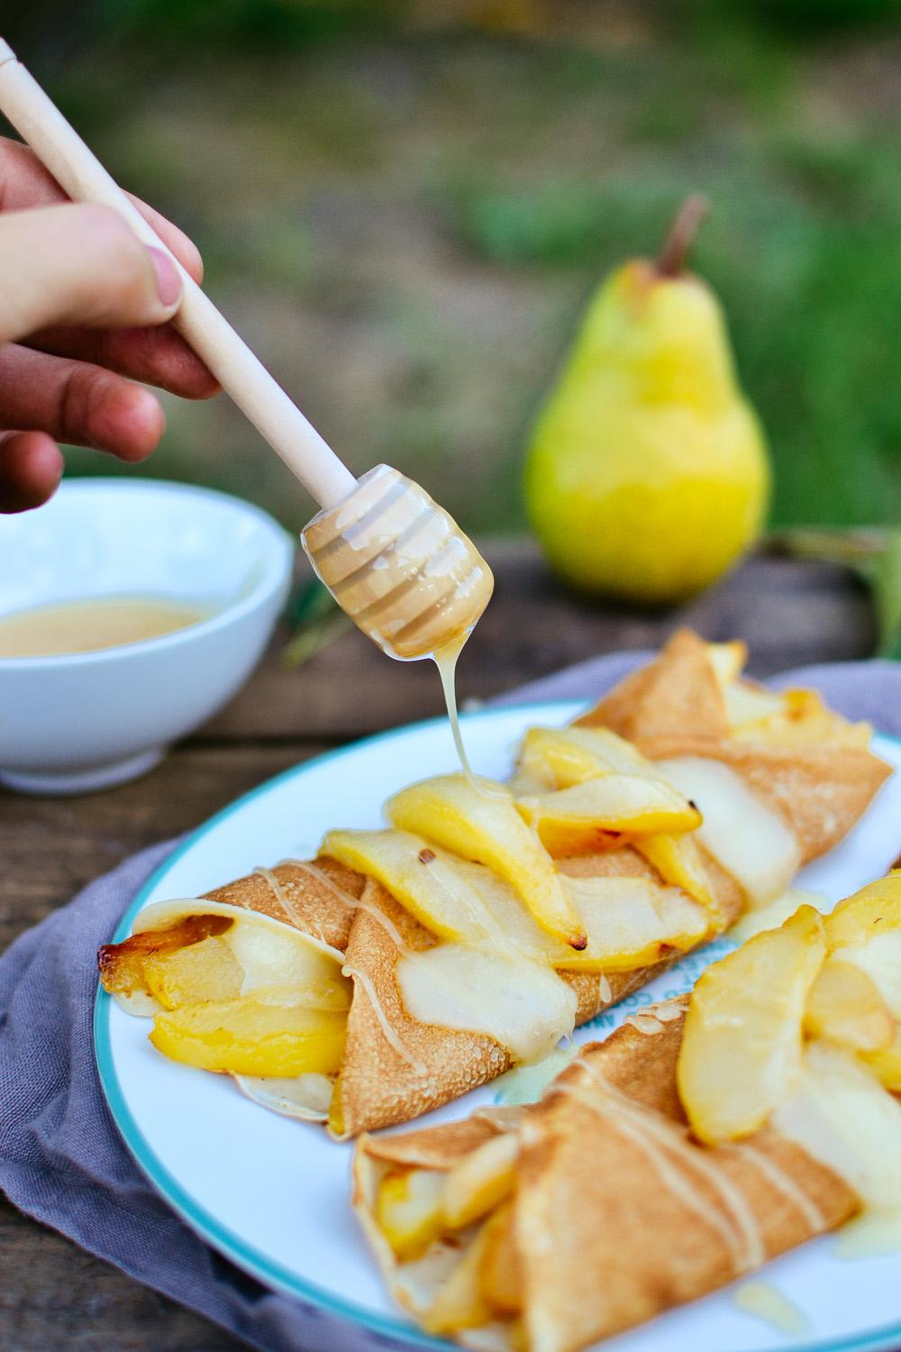
CREPES
Anae Dorais
Recipe Type: Dessert
Number of Servings: About 6 people
INGREDIENTS:
⅔ of a cup of whole milk
½ a cup of all purpose flour
Two fresh eggs
2 tablespoons of whole yogurt
1 tablespoon of butter (room temperature)
Pears (cut the pear into tiny pieces, 1 cup)
PROCEDURE:
Mix the milk, the flour, the eggs and the batter by hand, until the batter is smooth
Add the yogurt (if you want to have yogurt) add the pears
Preheat a flat pan on medium fire
Pour ⅓ of a cup of batter and make a flat circle of it on the pan. Once many bubbles appear, (about 1 minute) flip the crepe for another minute
Then voila! You made your crepe!
INDEX

Slide 15
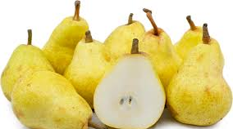
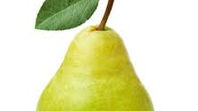
ALL ABOUT MY RECIPE
This recipe is special to my family because my mom makes it and sometimes I help her and we do it together. We also eat them together for breakfast. My family enjoys this recipe because it’s a family recipe which sometimes can have an extra ingredient on it like yogurt or many fruits. I don’t think this recipe is from a particular food culture. In my opinion, the way my mom puts yogurt or fruits inside the crepe is delicious.
SPOTLIGHT INGREDIENT: PEAR
My spotlight ingredient is a pear Its color is a greenish yellowish color and sometimes it can be hard when you bite into it or smooth. The taste can be sweet and it can be juicy. It is a fresh fruit. The part of the plant is a fruit. The pears life cycle typically harvested is from late August to early October. You have to wait about three to five months before it could get harvested, (115 to 165 days). Eating a medium pear makes 12 percent of vitamin C.

Slide 16
Tomatoes and Scrambled Egg
Jolin Zheng
1 tablespoon water
1 pinch sugar
chopped spring onion (for garnishing, optional)
Entrée
For 2 people
INGREDIENTS:
3 ripe tomatoes
3 eggs
3 cloves garlic, sliced
2 tablespoons + 1 teaspoon vegetable oil
PROCEDURE:
Peel off the skin of the tomatoes (see note). Then cut them into small chunks.
Beat the eggs with 1 tablespoon of water.
Heat 2 tablespoons of oil in a wok (or a frying pan) on high heat. Pour in eggs when oil smokes. When the edge is cooked, push to one side to let uncooked part touch the bottom of the wok. Take the egg out as soon as there is no more liquid (do not overcook).
Put 1 teaspoon of oil to the same wok, cook tomato and garlic on medium heat until tomato is a little mushy.
Add cooked egg. Roughly break up the egg with the end of a spatula. Sprinkle salt and sugar, then give everything a quick stir.
Garnish with spring onion before serving if you wish.
Notes:Cut a small cross on each tomato. Place them in very hot water. Take them out when you see the cut split. Pull the skin off when cool enough to touch.
INDEX

Slide 17
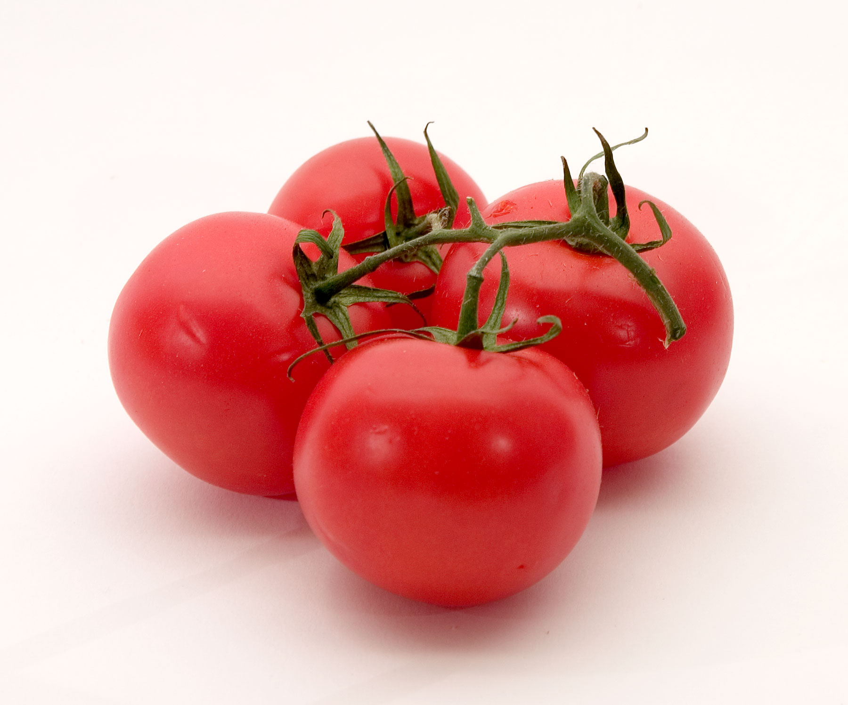
SPOTLIGHT INGREDIENT: TOMATOES
My spotlight ingredient is tomatoes. Tomatoes is red fruit that is oval shaped. Tomatoes needs 6 hours of sunlight each day to grow. The benefits of eating tomatoes is that it reduces risk of heart disease and cancer, tomatoes are also a great source of vitamin C, potassium, folate, and vitamin K.Tomatoes take 6 to 8 week to grow from seed to tomatoes. Germination in warm temperatures 68 to 75 Fahrenheit for 5 to 12 days 6 hour of sunlight. Day of harvest 65 to 85 days after planting.

Slide 18
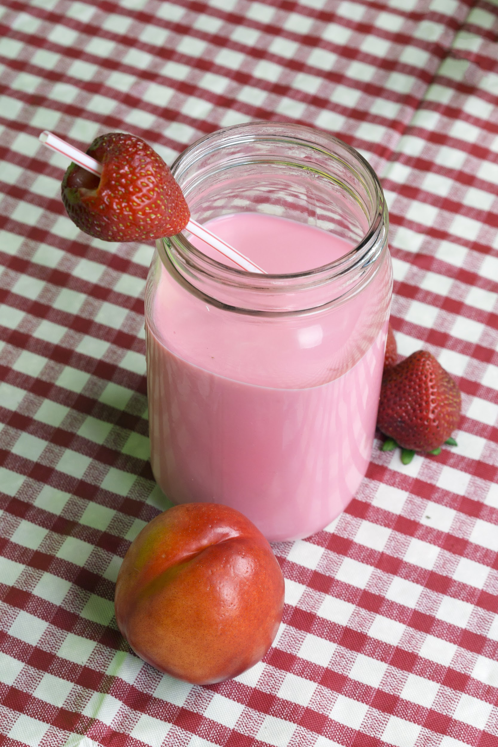
STRAWBERRY BANANA SMOOTHIE
Asher Cohen
Beverage
Number of Servings: 1
INGREDIENTS:
1 fresh banana peeled
1 cup milk
2 cup frozen strawberries
1 cup ice
1 tablespoon chocolate sauce
1 single ladies playing
PROCEDURE:
Dip fruit in chocolate sauce
Blend
Done
INDEX

Slide 19
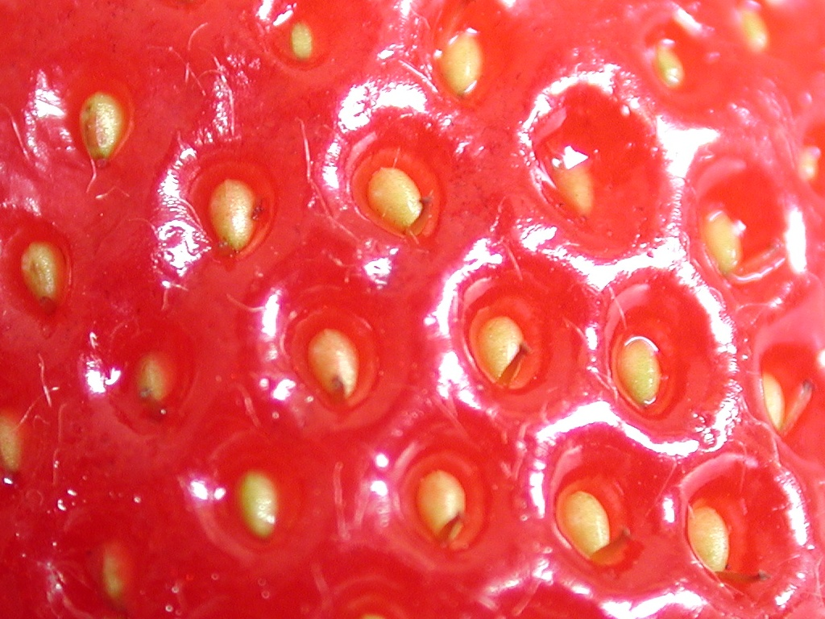
SPOTLIGHT INGREDIENT: Strawberries
Strawberries are amazing when they are fresh. They act like arrows of sweetness that seep into your heart. Strawberries need a couple months after they are planted to be picked but once they are delicious.

Slide 20
VIETNAMESE SALMON BOWLS
Zoey Berlín
Entree
6-8 servings
INGREDIENTS:
Low sodium miso (2 Tbsp)
Salmón (2 pounds)
Olive oil (¼ cup)
Mirin (⅓ cup)
Salt and pepper (a couple pinches)
Lettuce greens (2 cups) ( not romaine! That's bad for you!!!)
Rice (2 cups)
Hot chili peppers (¼ pe
Carrots shredded (1 cup)
Persian cucumbers (5 small)
Mint (½ cup)
Chopped basil (1 cup)
Scallions (1 bunch)
Furikake (as much as you want)
Vietnamese nouacman fish sauce (⅓ cup)
Limes (½ cup)
Rice wine vinegar (¼ cup)
Sugar (⅛ cup)
Hot water (1 cup)
Garlic cloves (2 minced)
PROCEDURE:
Prepare rice as directed on the package.
Salt and pepper both sides of the salmon. Place salmon in a pyrex baking dish covered in tin foil.
Mix miso, mirin, and olive oil in a bowl until it forms into a paste.
Brush the paste onto the salmon (top and sides)
Put the salmon in a cold oven. Then, set temperature to 400 degrees for fifteen minutes on the middle rack of the oven.
Chop all the vegetables/herbs in separate bowls.
For the fish sauce dressing:
Add the water, vietnamese noucmam, limes, rice wine vinegar, garlic cloves, and sugar in a bowl, and mix.
Cooking the salmon:
After the salmon has cooked for 15 minutes at 400 degrees, move the salmon up to the to rack and broil for 5 minutes.
Take the salmon out and and assemble the salmon bowls in the following way:
Line the bottom of the bowl with lettuce.
Put rice over the lettuce and top with the vegetables/herbs.
Pour sauce over rice and put the salmon on top.
Eat and enjoy!
INDEX

Slide 21
SPOTLIGHT INGREDIENT: HOT CHILI PEPPERS
My spotlight ingredient is red hot chili peppers. Hot chili peppers are red with a short green tip. In the middle there are seeds on each side where the stem is. They taste really spicy and fresh. The part of the plant that the chili peppers are, is fruit. Surprisingly, red hot chili peppers can be harvested at any moment at any time, however they do take 2 to 4 months to become ripe. Red chili peppers have a lot of vitamin C as well as potassium and vitamin K1, which can help your kidneys and prevent blood clots.
red hot chili peppers can be harvested at any moment at any time, however they do take 2 to 4 months to become ripe. Red chili peppers have a lot of vitamin C as well as potassium and vitamin K1, which can help your kidneys and prevent blood clots.

Slide 22
Pakora
Rafay Waraich
Recipe Type: Appetizer
Number of Servings: 4
INGREDIENTS:
Salt
Red pepper
Coriander
Chickpea flour
Onions
Sliced potatoes
PROCEDURE:
Gather all materials listed above
Mix all ingredients with water in a bowl
Fry both sides in oil until both sides are brown
Let sit
Serve
INDEX

Slide 23
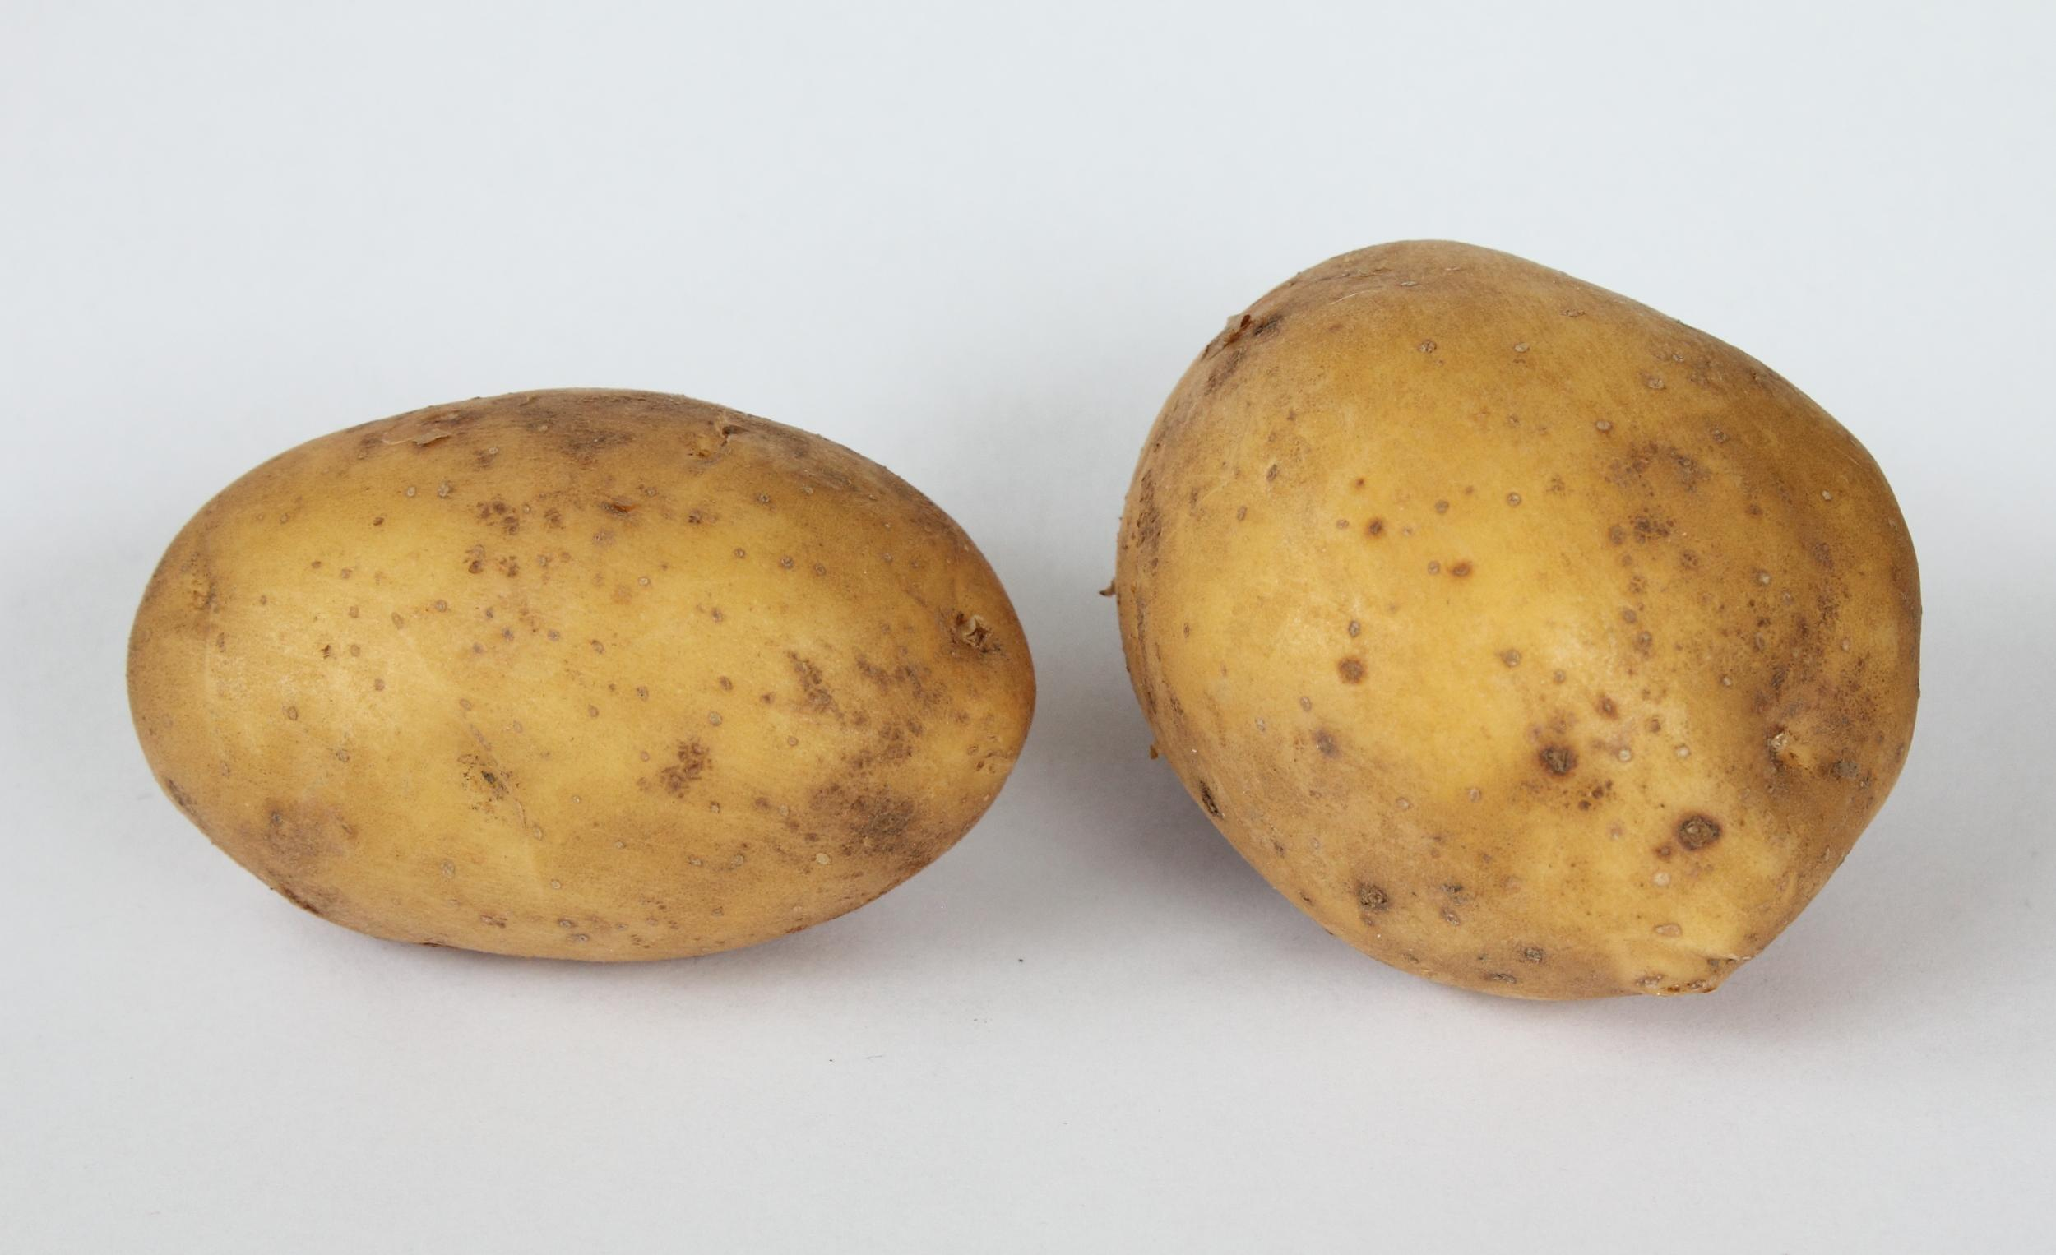
ALL ABOUT MY RECIPE
This recipe is special to my family because it is a passed down recipe and reminds my family of Pakistan. This is where my family is from. We cook it when we want, but on Eid we also usually make it for lunch. Also we make it for for everyone in our family. I have a lot of memories of this recipe.
SPOTLIGHT INGREDIENT: Potato
My spotlight ingredient is potatoes. The shape it takes is like an oval and is most of the time brown,and has a smooth texture. The part of the plant I use is the flesh. It takes 70-120 days to grow. A potato is a good source of vitamin C, and B

Slide 24
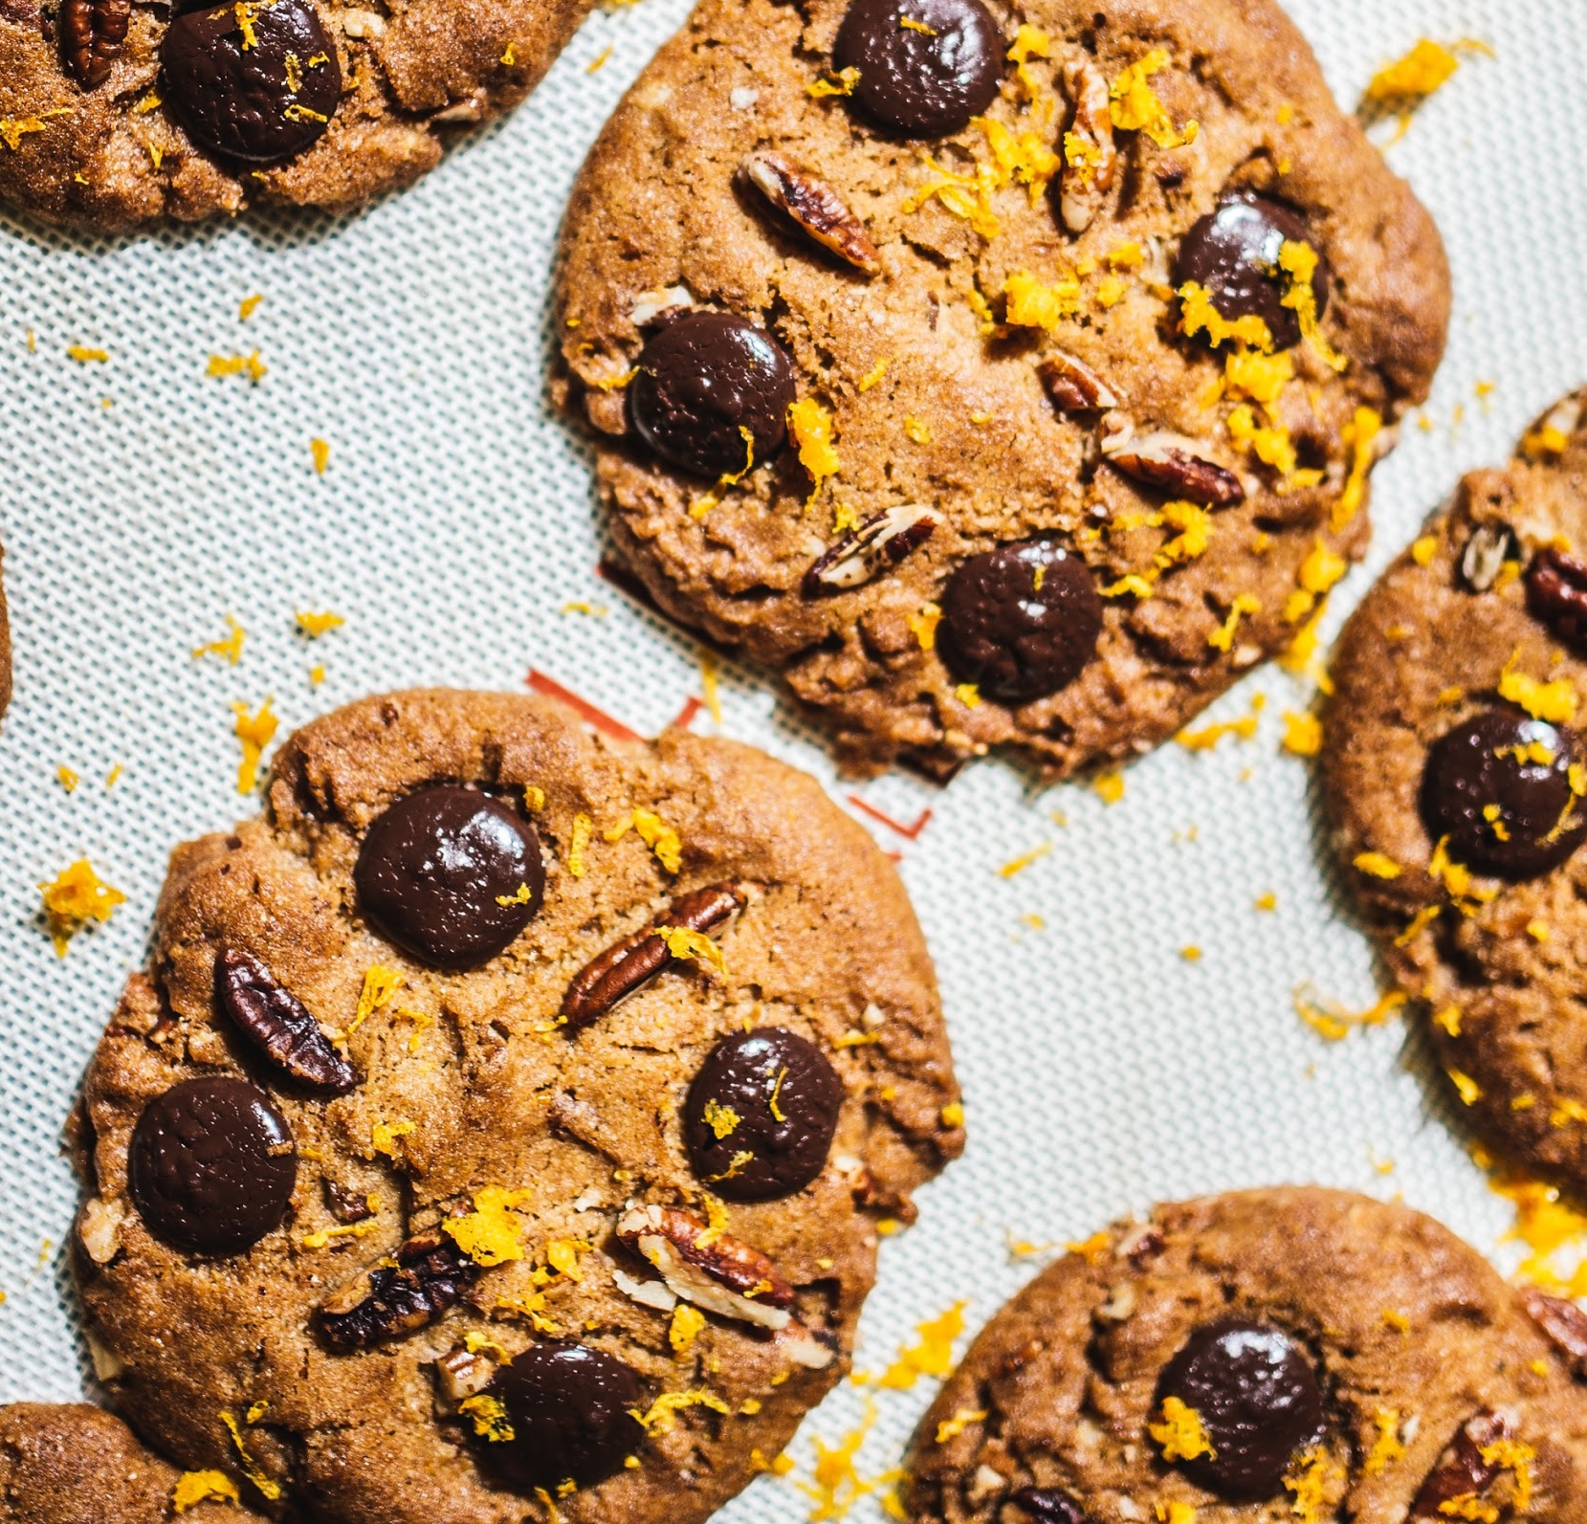
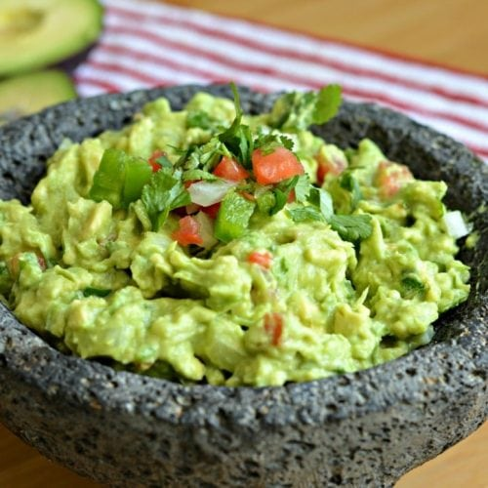
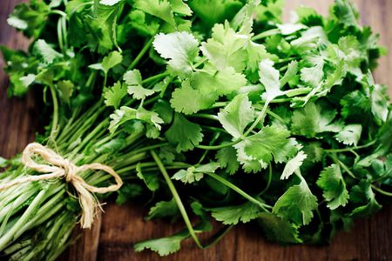
Guacamole
Annette Palacios
side
1-7 people
INGREDIENTS:
2 avocados
½ cup of onion small diced
Tablespoon of cilantro, chopped
salt to taste
PROCEDURE:
My first step is get two avocados cut in halves, scrape it off into a bowl. Second step mash avocados and add ½ cup of small diced onion.
Then add three tablespoons of cilantro, chopped.
Lastly, add salt to taste and mix well.
INDEX

Slide 25
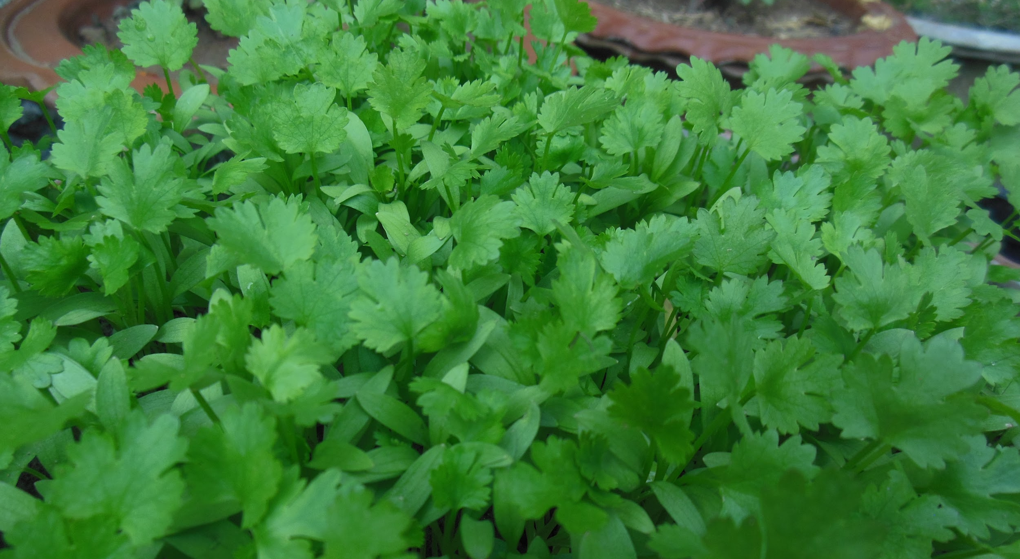
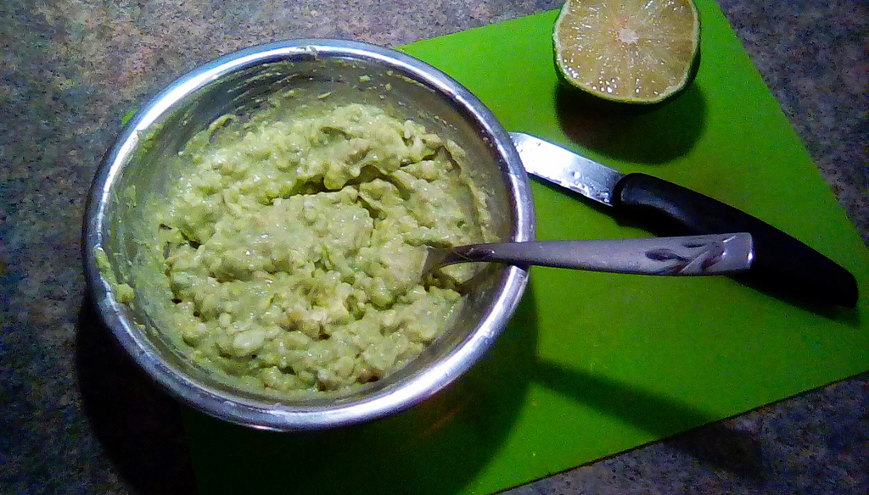
ALL ABOUT MY RECIPE
Guacamole is an typical food in Mexico. They eat it as an side so, you can eat it with tortilla chips or something else. It is really easy to make and fast. It is kinda also traditional in my family. Something that makes my recipe delicious is the nice picked avocados. It from Mexico but eaten in many different places.
SPOTLIGHT INGREDIENT: Cilantro
My spotlight ingredient is cilantro, is spanish for coriander. Cilantro is an plant it’s green and you sometimes see it on tacos tastes kinda weird. Cilantro is an leaf. Cilantro plants should be spaced about 6 to 8 inches apart. To harvest fresh cilantro all season, make successive sowings every 2 to 3 weeks starting in late spring. From the time of sowing seed, cilantro leaves can begin to be harvested in about 3 to 4 weeks. Cilantro seeds can be harvested in about 45 days. The health benefits of cilantro come from beneficial phytonutrients and antioxidants, especially the flavonoid quercetin. Cilantro is also good sources of dietary fiber and iron.

Slide 26
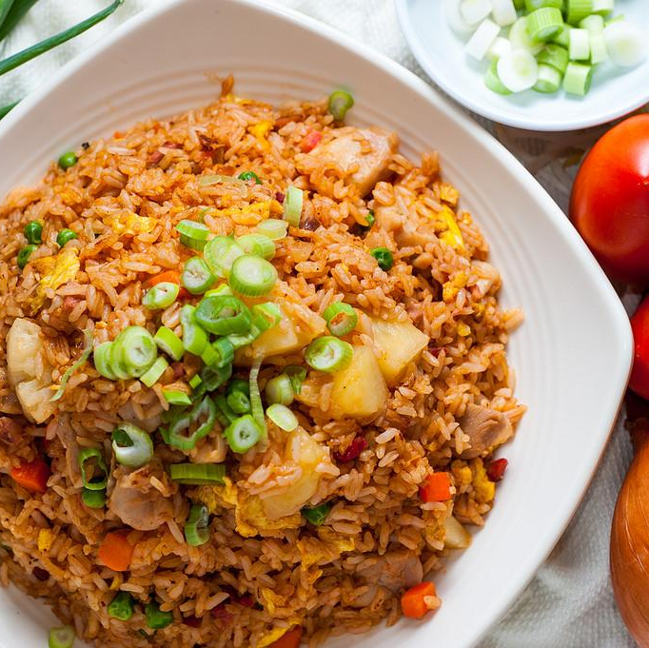
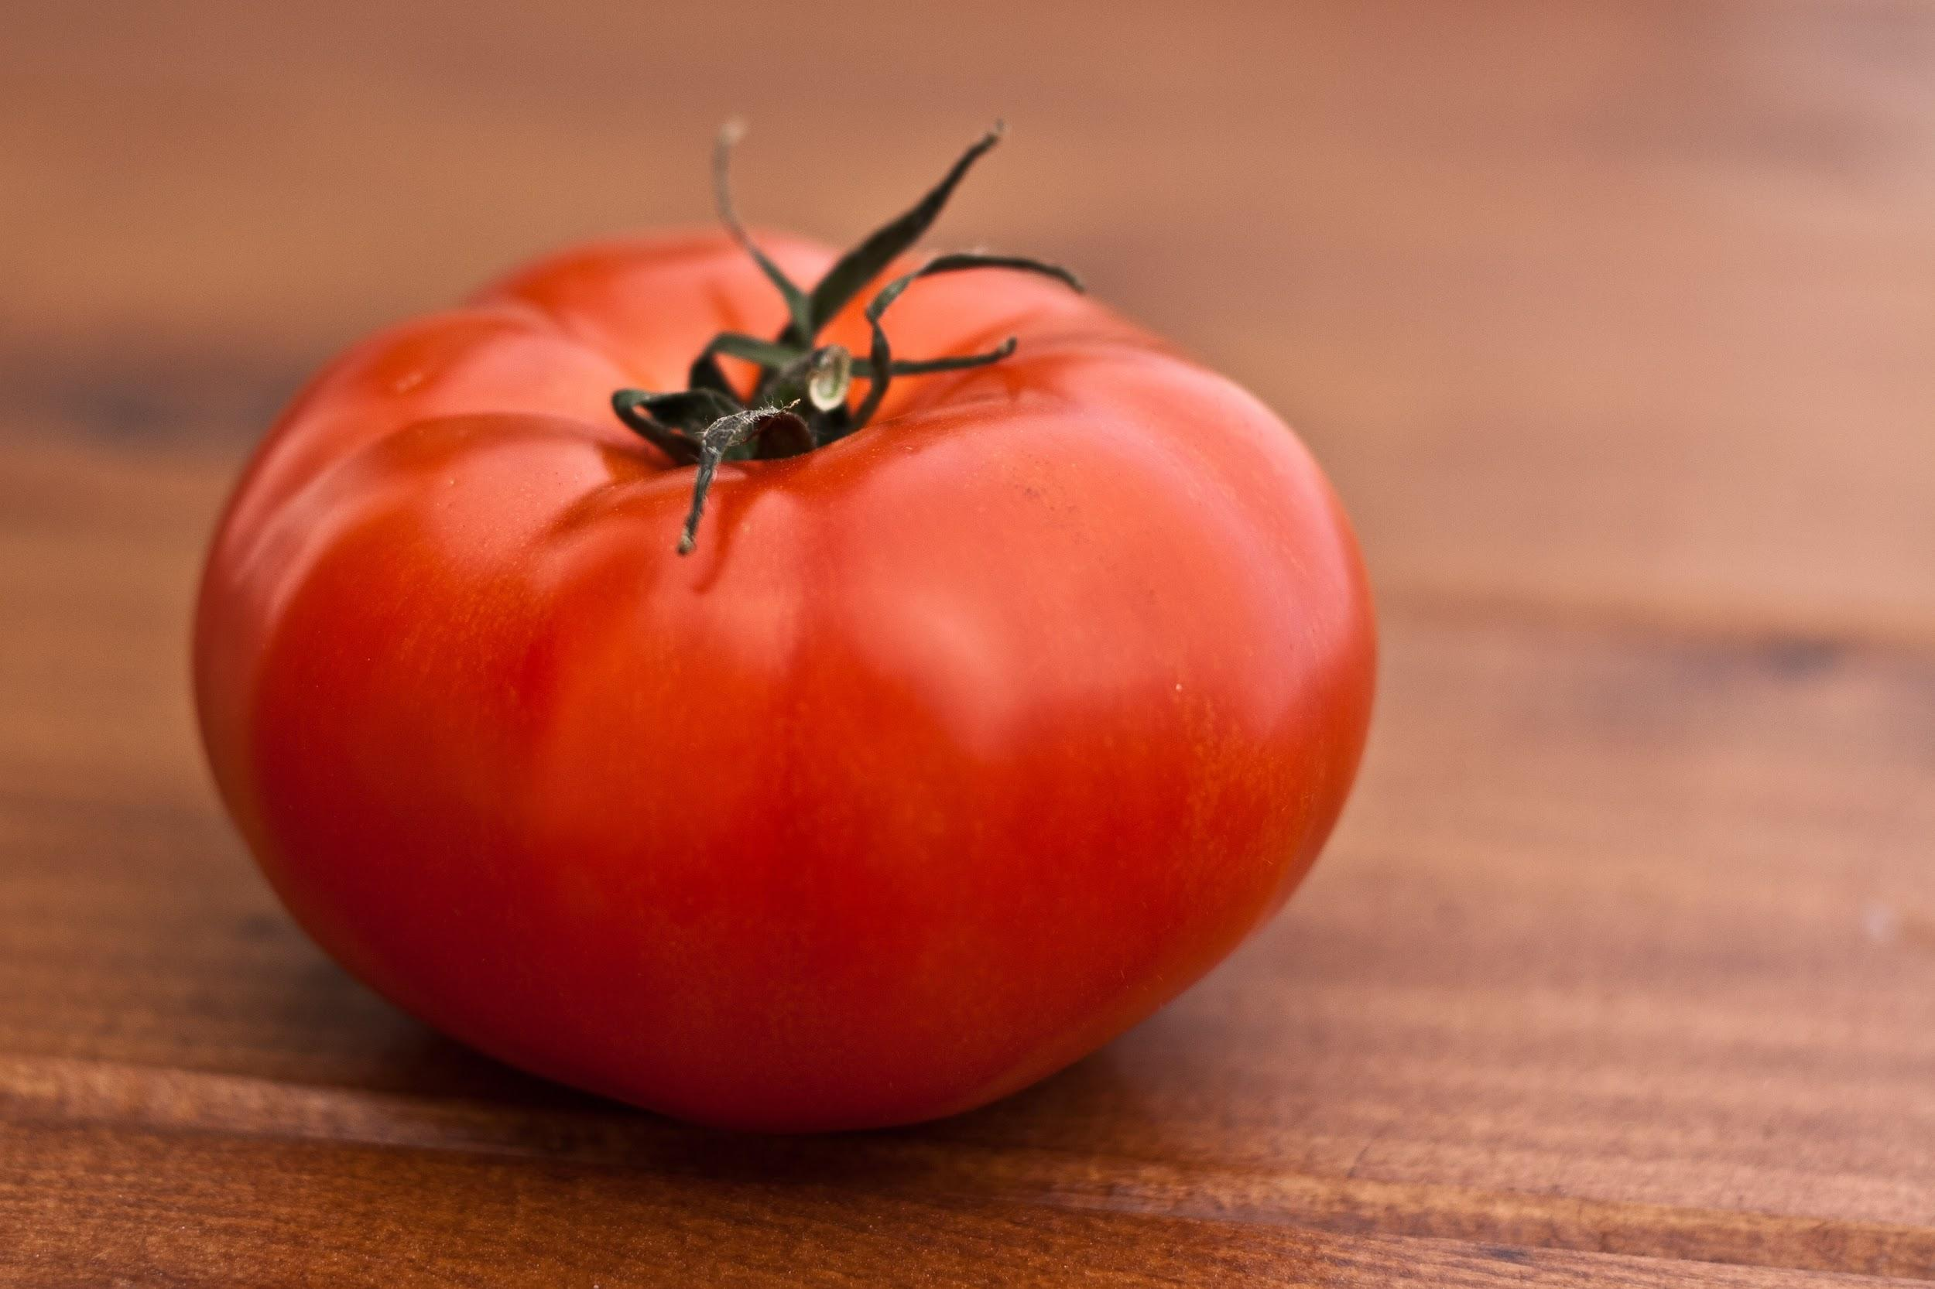
Tomato Fried Rice
Nissa Morrow
Entree
4 Bowls
INGREDIENTS:
1: 2 Tomatoes
2: 3 Eggs
3: 4-5 Cups of pre cooked rice
4: 3 handfuls of frozen peas
5: 3 handfuls of frozen corn
PROCEDURE:
1: Scramble the 3 eggs in a bowl
2:Take a pan, and pour a little bit of olive oil in.
3:When the olive oil starts to boil, go to the next step
4:Toss the handfuls of frozen veggies in.
5:Then put the scrambled eggs in.
6:Then, mix all of the ingredients together.
7:When all of the rice and the other ingredients are mixed together, take it out and equally serve everything into 4 bowls.
INDEX

Slide 27
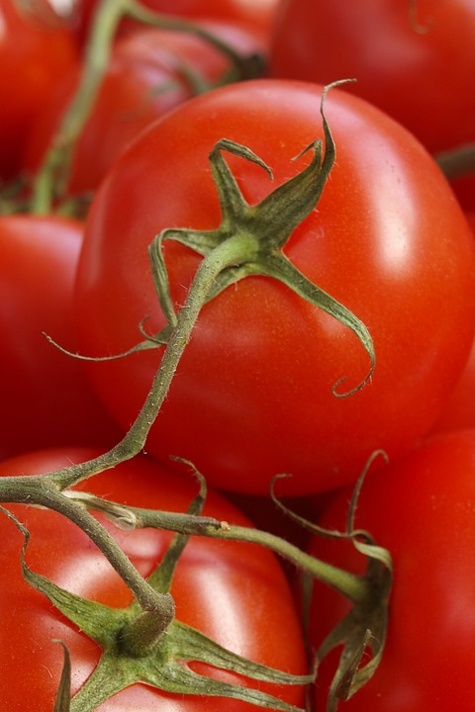
SPOTLIGHT INGREDIENT: TOMATOES
My spotlight ingredient is tomatoes. Tomatoes are red and they taste sweet. For my fried rice, I’m using the fruit of the tomato, the red part. A tomato is usually harvested when it’s ripe. The plant needs about 80 days to grow before it can be harvested, and be ripe.
Tomatoes can help cool your sunburn down.

Slide 28
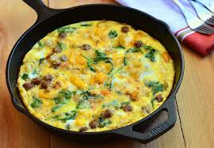
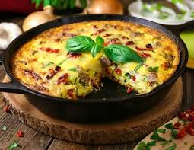
Pepper and Sausage Frittata
Jonny Schlossberg
Number of servings
8 people
INGREDIENTS:
3 links hot Italian sausage, removed from the casing an
Extra-virgin olive oil crumbled
1 red bell pepper, 1/4-inch dice
1 yellow bell pepper, 1/4-inch dice
1 cup grated Parmigiano-Reggiano
12 eggs, beaten with 1/4 cup water
PROCEDURE:
Preheat the oven to 350 degrees F.
Coat a nonstick 10-inch saute pan with olive oil. Add the sausage and brown. Add the peppers and saute until they are soft.
In a bowl, add the Parmigiano to the beaten eggs and season lightly with salt. Using a heatproof rubber spatula, stir the eggs into the pan with the sausage and peppers. Stir the eggs to evenly distribute the sausage and peppers throughout the eggs. Once the eggs set on the bottom and around the sides of the pan, place the pan in the preheated oven for 7 to 8 minutes or until the eggs are cooked through. Remove from the pan. Cut into wedges and serve hot or a room temperature.
INDEX

Slide 29
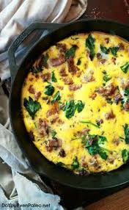
SPOTLIGHT INGREDIENT: Green Peppers
My spotlight ingredient is red peppers. This is a red tasty crunchy yummy vegetable. When it is cooked it tastes even better. The fruit is the spotlight ingredient. It is a fruit because it is filled with seeds. It is harvested the harvest takes about 75 days. green peppers have tons of vitamins in them.
This is a very important recipe to my family because it is a fun little thing that is simple to make that will last about a day. There is no particular memories that i have from this recipe. It also has no religious backstory. It is just a awesome recipe that is a ton of fun. To me The mixture of texture is what makes this recipe delicious.

Slide 30
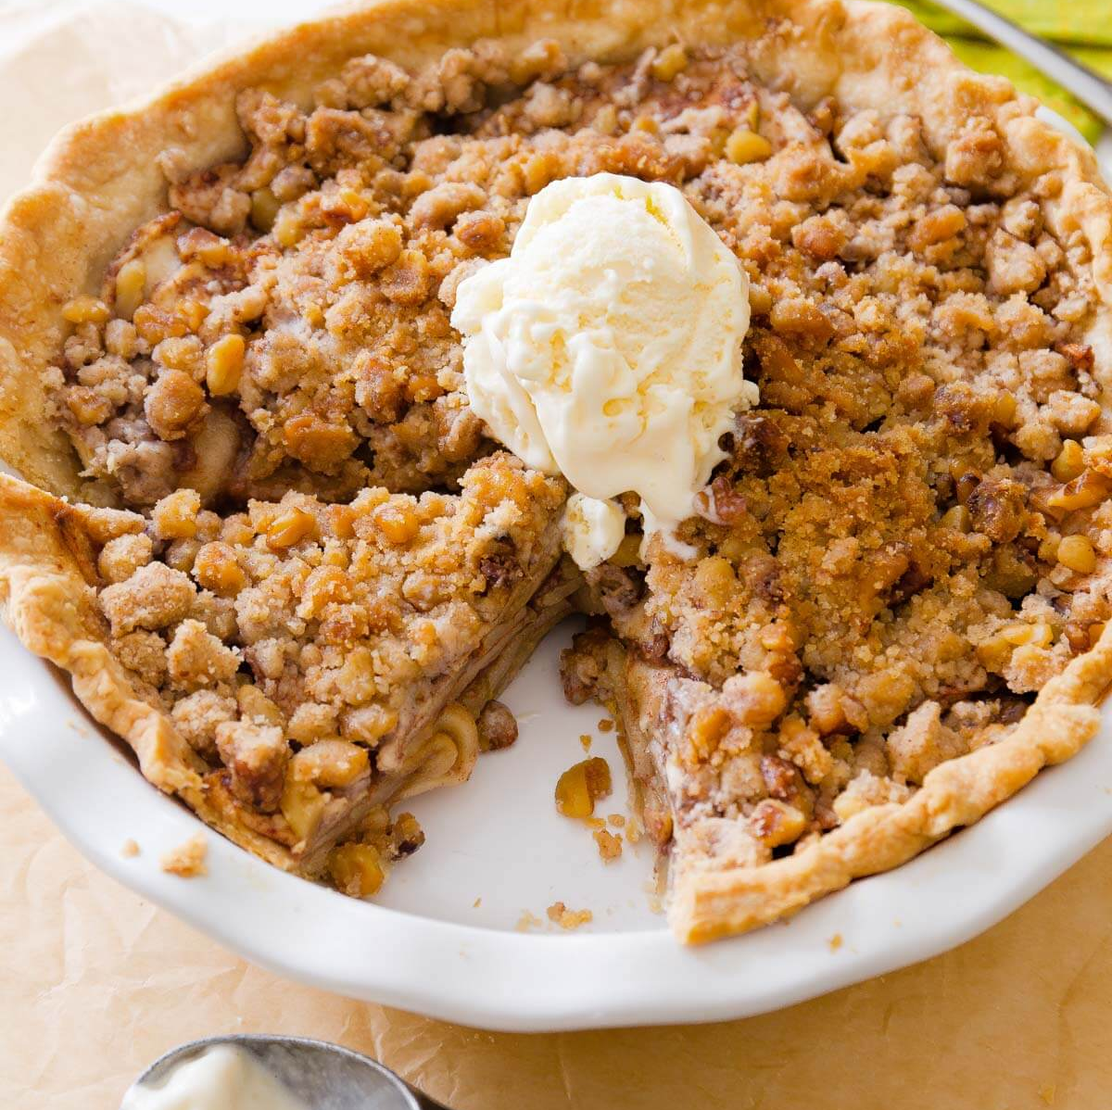
Apple Crumble
Nia
Dessert
Number of servings: 8
INGREDIENTS:
6 Granny Smith apples
½ cup of white sugar and 1 ½ teaspoon cinnamon
7 tablespoons of cold butter cubes
½ cup of white sugar
¾ cup flour
A pinch of Kosher salt
A tub of vanilla ice cream
PROCEDURE:
Preheat the oven to 350 degrees
In a pie dish butter the bottom and sides
Peel, core, thinly slice 6 Granny Smith apples
Mix the sliced apples with ½ cup of white sugar and 1 ½ teaspoon cinnamon
Pour the apple mixture into the buttered pie dish juices and all (there is going to be a lot of excess juice but still pour it in) Then put cubes of cold butter on top of the apple mixture.
To make the Crumble
½ cup of white sugar
¾ cup flour
6 tablespoons of cold butter in chunks
Mix all together until crumb like. Then sprinkle on top of the apple mixture.
Next sprinkle granola on top of the crumble.
Last add a dash of cinnamon and Kosher salt (don’t skip this part, it is very important!!!)
Bake for 40-45 minutes until the apples are soft.
Serve with vanilla ice cream, Enjoy!! 😃
INDEX

Slide 31
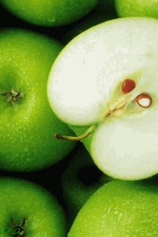
SPOTLIGHT INGREDIENT: Green Apples
My spotlight ingredient are apples I know apples are in season because I saw apple pie, apple cider, apples, apple donuts, caramel apples. Apples can be many colors and they taste sweet and sometime sour. The apple is the fruit. Usually the apple needs 100 days to 200 days to harvest. It is a fruit when harvested. apples may help reduce the risk of developing cancer, hypertension, diabetes, and heart disease.

Slide 32
Cheery Chicken Fajita Tacos
Tilly Fein
Entrée
6 servings
INGREDIENTS:
1 tablespoon vegetable oil
1½ pounds boneless skinless chicken breast, thinly sliced
1½ cups sliced red and/or green bell peppers
1 cup sliced onions
1 cup broccoli
1 cup water
12 6-inch flour or corn tortillas, warmed
Taco toppings such as shredded lettuce, guacamole, and shredded cheese
3¾ tablespoons of olive oil
PROCEDURE:
In a skillet, heat oil over medium-high heat. Add chicken, peppers, broccoli, and onions. Fry until chicken is cooked through, about 5-6 minutes; drain off liquid.
Stir in water. Continue cooking for 4-5 minutes.
3. Serve in warmed tortillas with cheese, shredded lettuce, and/or salsa
INDEX

Slide 33
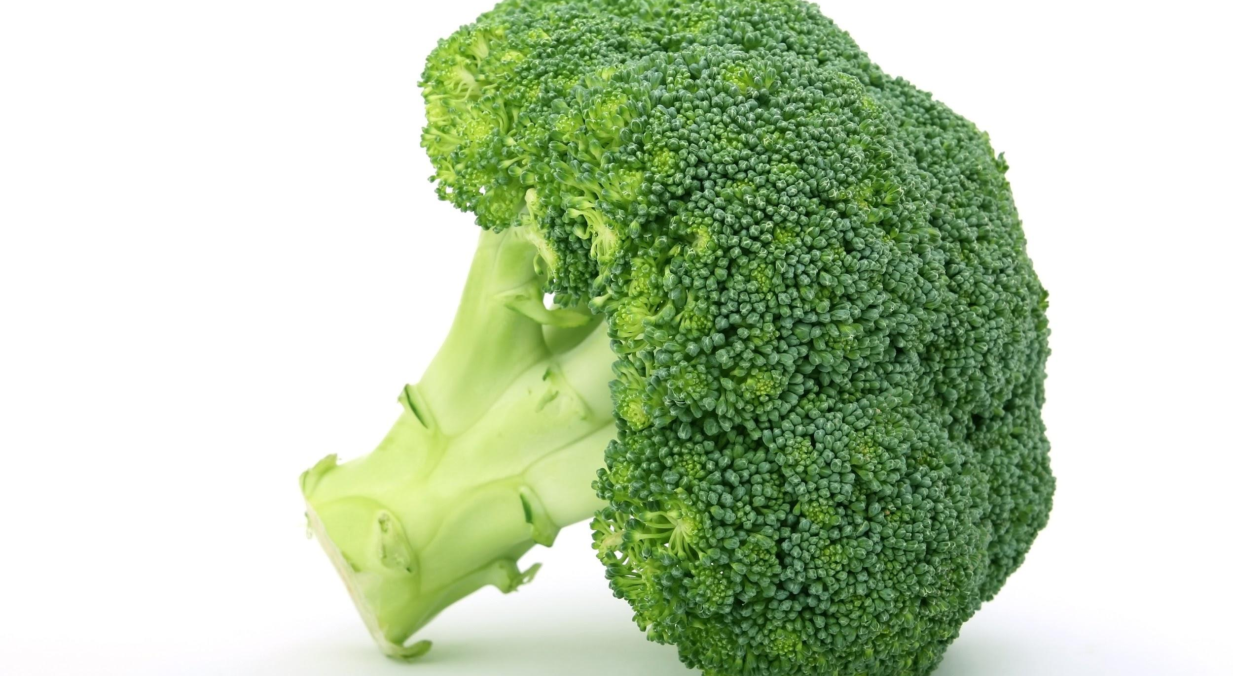
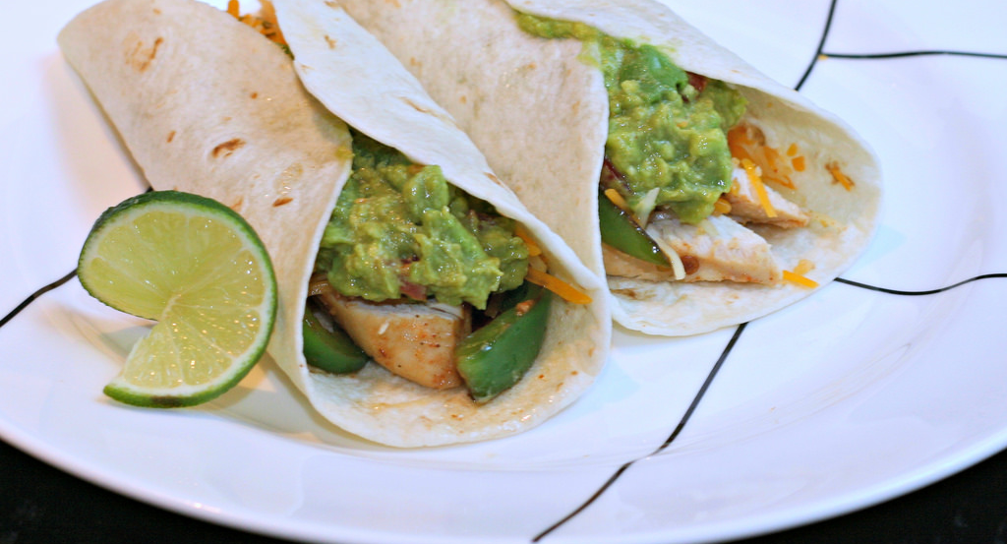
ALL ABOUT MY RECIPE
My family all loves taco night; that is, eating it and mostly the fact that we make it ourselves (although to me, chipotle might have a better experience ;)). Join my family tradition: It’s free! My family especially likes to eat tacos on Fridays, because they have so many things in common! (If you don’t believe me, just think, who doesn’t like tacos? Now think, who doesn’t like Fridays? See? That’s something they have in common!) but we also like to eat on Tuesday, because of taco Tuesday! I remember the first time I made homemade tacos is when me and my brothers first ate at Chipotle. (If you can’t already tell, I love Chipotle!) We were going through that I-just-tried-the-best-food-I’ve-had-in-years phase so one day, my little brother strangely wanted tacos for dinner, and chicken being our meat go to, mom made chicken fajita tacos, and we all loved them! And of course, tacos come from Mexico, which has the perfect food if you need some more spice in your life. Or, if you prefer savory things, just remove the peppers from your recipe, and you can make sure the chicken is not spicy. Or you can use sweeter peppers to make this recipe a little bit more on the sweet side. The best thing about this recipe is that people with all different taste buds can have it just the way they like it.
SPOTLIGHT INGREDIENT: BROCCOLI
My spotlight ingredient for this recipe is broccoli. Most tacos aren’t served with broccoli, but broccoli is a common vegetable in my family. My family likes to eat them in different ways, too. My brother likes to eat it raw, while I like to eat it steamed. I don’t like it raw, or roasted. If you don't like broccoli, you most likely didn't cook it the right way! When it is raw, it tastes very plain, almost like tofu. This is because broccoli is an edible flower, and most raw (or cooked) flowers don't taste like anything; neither do the stems. The best way to cook broccoli in this recipe is by Sautéing it. sautéing broccoli means you fry it in a small amount of fat, which gives it a more Mexican-like feel. You can also sauté the chicken, peppers, and onions. Broccoli is harvested before its flowers begin to bud, so super early in its life cycle. Broccoli grown from seeds will come to harvest in 100 to 150 days; however, when grown from transplants broccoli will come to harvest in only 55 to 80 days. Broccoli has a great source of vitamins K and C, a good source of folic acid and also has a lot of potassium and fiber.

Slide 34
Shrimp Scampi
Altaseb Huhn-Rich
Entree
4
INGREDIENTS:
5 tbsp. Unsalted butter.
2 tbsp. Olive oil.
1 lb. medium shrimp, peeled, deveined, tails attached.
Kosher salt and freshly ground black pepper, to taste.
¼ tsp. Crushed red chile flakes.
4 cloves of garlic, finely chopped.
2 shallots, finely chopped.
½ cup white wine.
¼ cup fresh lemon juice.
1 tsp. Lemon zest.
1 lb. thin spaghetti, cooked.
¼ cup roughly chopped parsley.
PROCEDURE:
Heat 3 tbsp. Butter and oil in a 12” skillet over medium-high heat;
season shrimp with salt and pepper, and add skillet.
Cook, turning once, until beginning to turn pink, for about 3 minutes.
Transfer to a plate.
Add chile flakes, garlic, and shallots to skillet; cook until soft, about 3 minutes.
Add wine, lemon juice, and zest; cook until reduced by half, about 5 minutes.
Add pasta, shrimp and remaining butter; mix until evenly combined.
Bring to a serving platter; sprinkle it with parsley.
INDEX

Slide 35
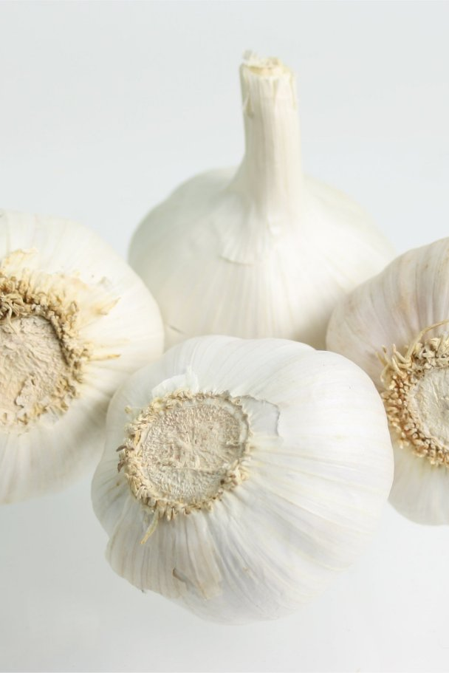
SPOTLIGHT INGREDIENT: Garlic
The spotlight ingredient in shrimp scampi is probably the garlic.
Garlic brings a strong burst of a sweet and spicy and very strong (might sound weird, but true). It is used best when finely chopped and used as a before taste and/or after taste. The texture might be smooth and/or crunchy ( it depends).
Garlic is very nutritious, but has a very small amount of calories.
Garlic gives you vitamin c, which is 15 percent of your RDA in a day ( recommended daily allowance ). Garlic contains 0.6 grams of fiber, Manganese: 23% of the RDA,Vitamin B6: 17% of the RDA,Selenium: 6% of the RDA. For instance: “People with heart disease who took garlic oil for 6 weeks had a 12% reduction in peak heart rate and better exercise capacity.”I’m guessing one reason some of the facts above have happened is because garlic is a root. Roots are vegetables that grow underground and naturally absorb nutrition.
This recipe is important because we usually have it as a celebration of something that happened. Sometimes when special guests come over for a hangout we have shrimp scampi. These are the occasions when we have shrimp scampi: After... report cards, birthday, I do something that I don’t really want to do, when particular guests come.

Slide 36
STIR FRY BROCCOLI
Micah Finkelstein
Appetizer
Serving: 2 people
INGREDIENTS:
Broccoli
Onion
Peppers
Soy sauce
(Optional): Rice
PROCEDURE:
Cut up broccoli and cut up a small onion (broccoli: 3 pieces,Onion: 5 pieces.)
Put oil in a wok. Add broccoli and onion and and stir for 5 minutes.
Add broccoli and onion and and stir for 5 minutes.
Add pepper and soy sauce and stir again but this time for 2 minutes.
(Optional): Serve with rice
INDEX

Slide 37
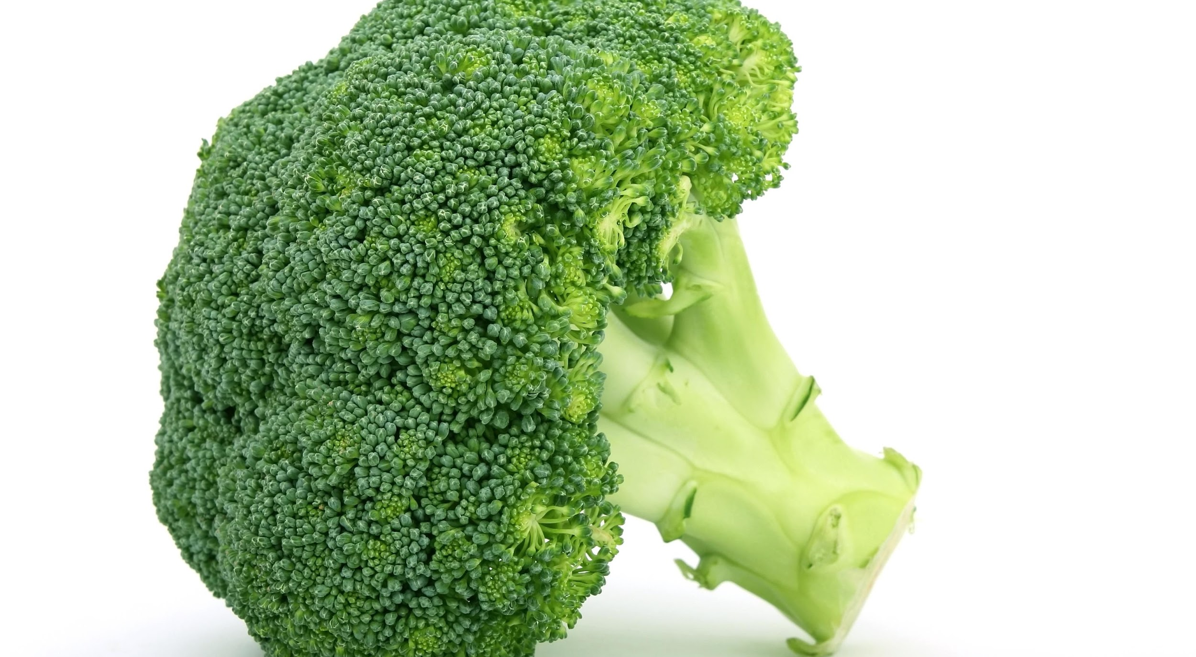
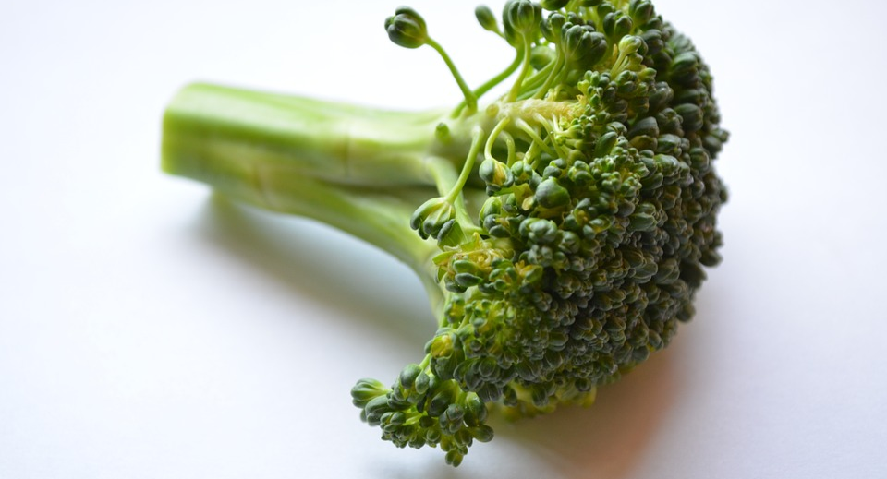
SPOTLIGHT INGREDIENT: BROCCOLI
My spotlight ingredient is broccoli. This ingredient was convenient since i'm doing stir fry broccoli. So thats why its my spotlight is broccoli. Broccoli has nothing special do it so that's why I like it. Broccoli has also always been a part of all my family special recipes. And it's been passed down every generation. Plus everyone in the family likes broccoli so that's another reason it's kind of special. And one health benefit from eating broccoli is the fiber in the broccoli can help with preventing constipation. Also broccoli can lower the risk of colon cancer. I'm not sure what that is but it sounds bad.
ABOUT MY RECIPE:
It is a common recipe and very simple but its a recipe my family likes a lot. my grandmothers mom was the one who started it and she made it for my grandmother and she liked it and then he served it to my mom and then so on.

Slide 38
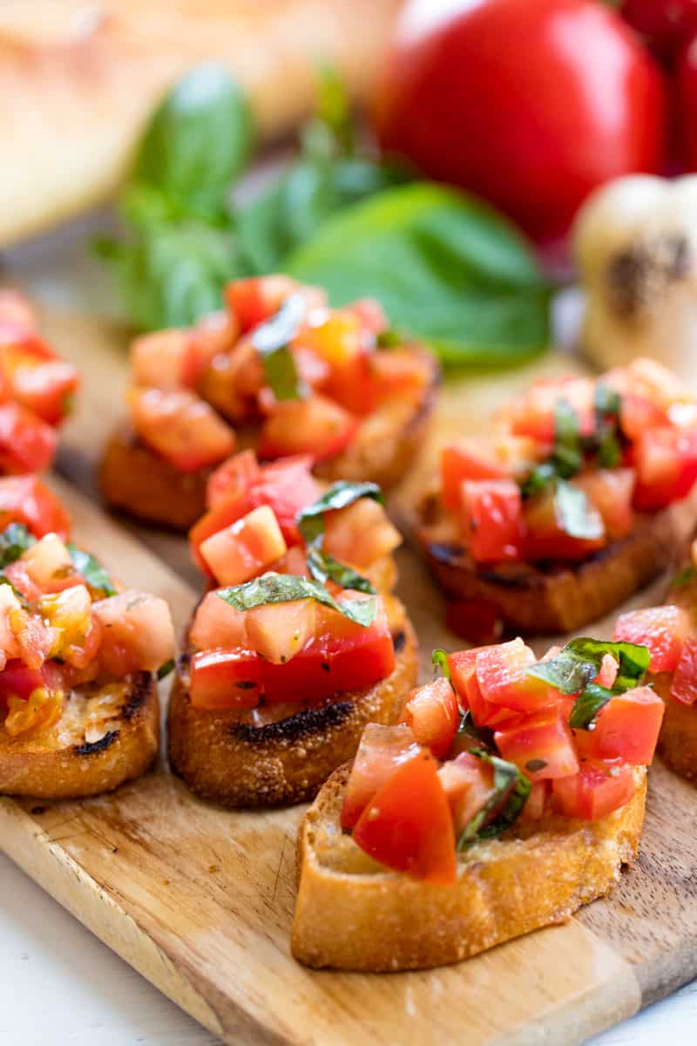
BRUSCHETTA
Xanny Suarez
Appetizer
Number of Servings 5 people
INGREDIENTS:
1 Baguette
6 Tomato
10 leaves of Basil
¼ of an onion
A pinch of Oregano
2 tbsp olive oil
Salt and fresh cracked pepper
PROCEDURE:
First you cut a baguette and toast it.
Next u cut 6 medium tomatoes into tiny pieces.
Then you add these ingredients in a bowl.
¼ of onion, pinch of Oregano, 2 tbsp of olive oil, 10 leaves of basil.
Now you mix them all together
When your done you take a spoon and put on bread.
Now you add salt and fresh cracked pepper and your done.
INDEX

Slide 39
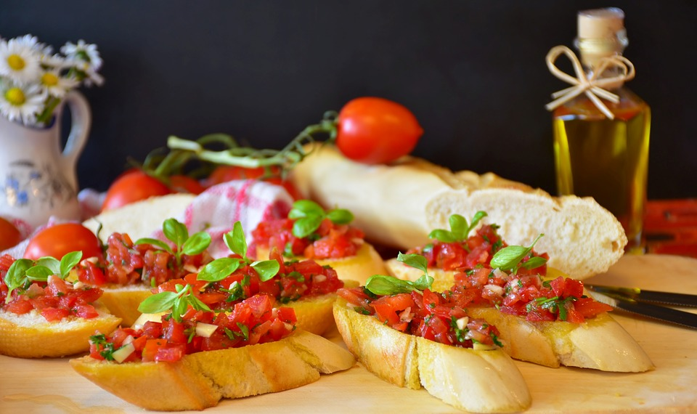
SPOTLIGHT INGREDIENT: TOMATO
My spotlight ingredient is a tomato. I chose this because its the main thing in my recipe. It looks red it tastes like sweet and a little bit sour. It has seeds so its a fruit. “A tomato will be late in a life cycle. They are also a great source of vitamin C, potassium, folate and vitamin K.They are also a great source of vitamin C, potassium, folate and vitamin K.”

Slide 40
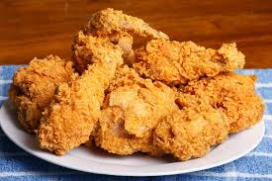
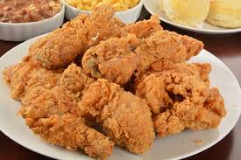
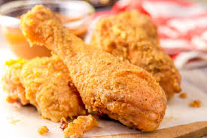
Buttermilk Fried Chicken
Avery Green
Entree
4 servings
INGREDIENTS:
3-4 pounds whole chicken or chicken pieces
2 cups buttermilk
1 cup water
3 tablespoons kosher salt
1 tablespoon granulated sugar
2 teaspoons garlic powder
6 whole black peppercorns
2 large sprigs fresh rosemary
8 small sprigs fresh thyme
2 more cups of buttermilk
3 cups all-purpose flour
1 ½ teaspoons kosher salt
1 teaspoon white pepper
¼ teaspoon ground cayenne
1 ½ teaspoons garlic powder
1 ½ teaspoons onion powder
1 teaspoon paprika
3 or more cups lard
2 lbs carrots
12 button mushrooms
Cut chicken into 10 pieces (2 wings, 2 thighs, 2 legs and two breast halves cut in half again) and place in a gallon zip lock bag.
In a bowl mix two cups of buttermilk with water, salt, sugar, 2 teaspoons garlic powder, peppercorns, rosemary and thyme.
Pour marinade over chicken. Press out air and refrigerate overnight for at least 12 hours and as long as 24 hours.
The next day discard marinade and rinse chicken pieces under cold water.
Place chicken pieces on a rack that sits over a sheet pan and let sit at room temperature for one hour.
Place two cups of buttermilk in a medium bowl.
In a separate medium bowl, place flour, salt, pepper, cayenne, garlic powder, onion powder and paprika. Whisk to combine.
Place a cast iron skillet on your burner and add enough lard to come halfway up the side of the pan. Heat to 340 degrees F. Use a candy thermometer or other means to maintain that temperature and never go any higher.
Turn oven on to warm and place a rack over a sheet tray and set aside.
Cook four breast pieces first by placing in buttermilk, then flour, then back in buttermilk then back into flour mixture. On this second pass, really push the flour into the chicken so it has clumps of flour. This will provide a nice crispy crust.
Use tongs and place the chicken breasts skin side down one at a time into the hot fat. Each piece will froth up the fat, so be careful that it doesn’t froth over. Adding one piece at a time and waiting a few seconds for the froth to die down before adding the next one will avoid any issues.
Cook the breasts for about four minutes then check color of bottom using tongs. If nice and golden, flip with tongs and continue cooking for about 12-16 minutes total. I turned mine a few additional times to get an even brownness. They are done when the internal temperature is 165 degrees F. Use a probe thermometer.
Remove these to the pan with the rack and place in the oven to keep warm while you cook the remaining chicken.
Once the fat is back up to 340 degrees F, double bread the remaining pieces as before and start by placing the thighs in, skin side down. Then add legs skin side down, then finally the wings.
As before, wait about 4-5 minutes, check color and flip to cook both sides.
The wings will be done first, then the legs and thighs. Use tongs to move each to the rack in the oven. The same internal temperature rule of 165 degrees applies, however the cooking time will be less by 2-4 minutes overall.
I don’t salt after they come out of the fat because I think they are seasoned correctly and do not need more salt.
INDEX

Slide 41
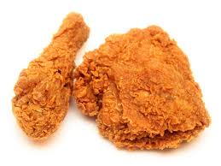
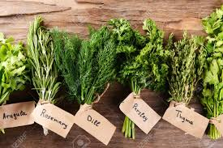
ALL ABOUT MY RECIPE
My recipe is buttermilk fried chicken. I love fried chicken because it is fried and most things that taste good are fried. I love the recipe because it is something that I usually have at my house on special occasions. This is kind of a tradition in my family tradition.
SPOTLIGHT INGREDIENT: FRESH HERBS
My spotlight ingredient is fresh herbs, I chose this ingredient because I think that it would add a lot of flavor to my fried chicken. The fresh herbs would be rosemary and thyme. The ingredient would be used to marinate the chicken and give it a fresher more natural taste.

Slide 42
Aloo Gajar Sabzi
Mohan Saluja
Recipe Type: Entrees
Number of Servings: 1-2
INGREDIENTS:
1 table of oil
Optional 1 pinch slightly bitter agent (Hing)
1 teaspoon of cumin seeds
¼ teaspoon of Corian Powder
1 inch ginger peeled and chopped
¼ teaspoon Turmeric Powder
1 teaspoon Coriander Powder
¼ teaspoon Red Chili Powder
½ pound potatoes peeled and diced into ½ inch pieces
½ pound carrots peeled and diced
½ teaspoon salt (and more to taste)
¼ teaspoon Garam masala
PROCEDURE:
Put oil in a pan and heat over medium flame
Add cumin seeds to the pan and brown
Add Hing if using and heat for 30 seconds
Add the ginger and cook until fragrant smell.
Add powders and keep stirring.
Now add carrots, potatoes and red chilli and salt; stir and cook for 2 minutes.
add ¼ cup of water to the pan cover it and cook it for 7 to 8 minutes low flame.
If potato and carrots are soft to piers with a fork move to number ten.
If not then add ¼ cup water to pan, cook covered for additional 4 or 5 minutes.
If done then add garam masala and mix well. Serve hot.
INDEX

Slide 43
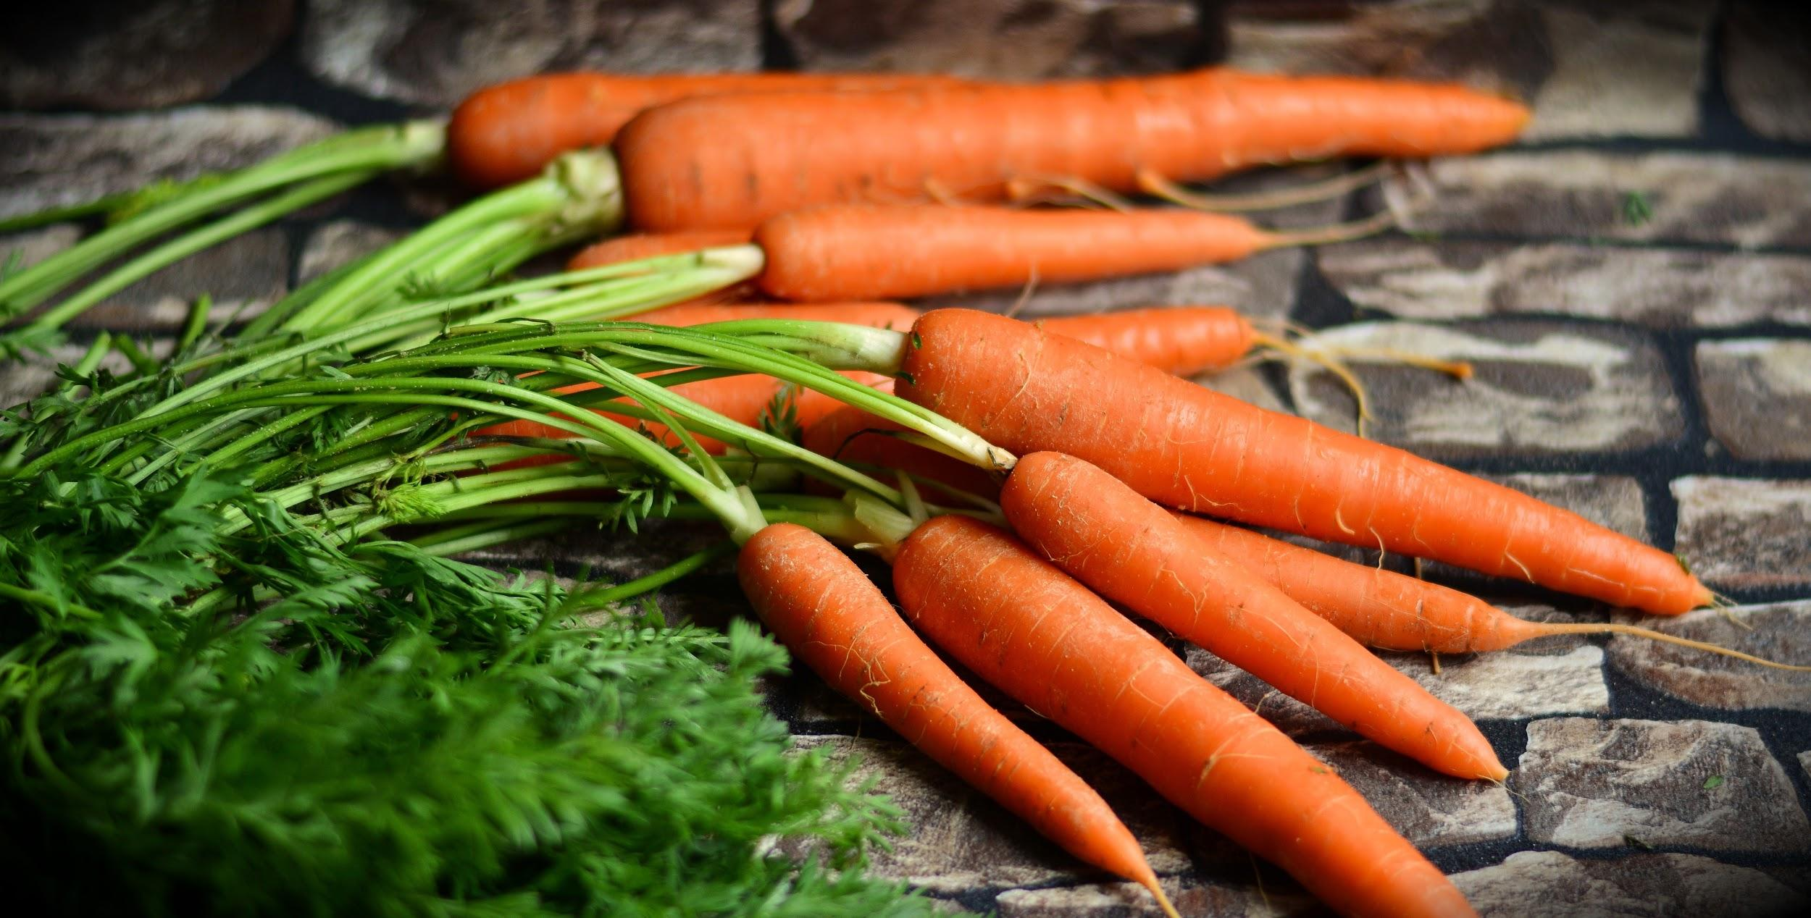
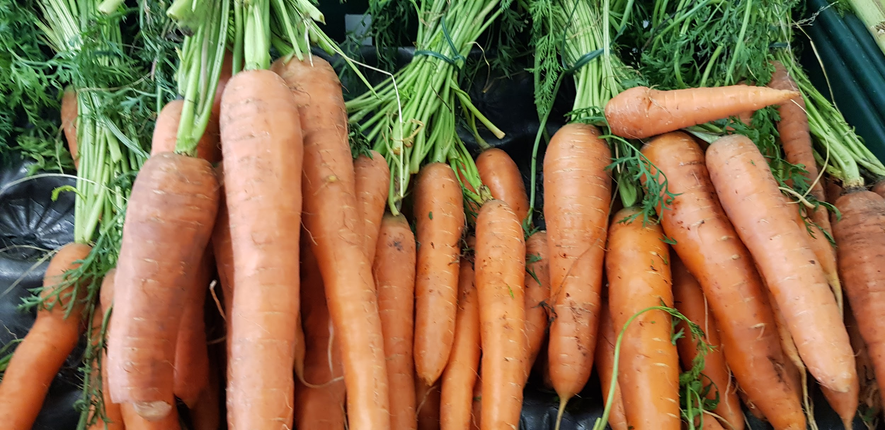
ALL ABOUT MY RECIPE
This recipe is vegetarian. My religion does not eat a lot of meat... but I do.
SPOTLIGHT INGREDIENT: CARROTS
My spotlight ingredient is carrots. This is a hard root but when in this dish it becomes soft and smooth. It feels rough. It needs at least 2-4 months to harvest. There is a myth that it helps eyesight. It contains vitamin A and can reduce the chance of cancer for the consumer. This is a really good root of a plant.

Slide 44
PENNE ALLA VODKA
DALIA MULLENS
Entree
Serves 4-6 people
INGREDIENTS:
¼ cup olive oil
2 ½ cups chopped Spanish onion (1 large)
1 tablespoon minced garlic (3 cloves)
½ teaspoon crushed red pepper flakes
1 ½ teaspoons dried oregano
1 cup vodka
2 28-ounce cans peeled plum tomatoes
A pinch of kosher salt and freshly ground black pepper
1 box of penne rigate or other short pasta shape
2 tablespoons chopped fresh oregano, plus extra for serving
1 cup heavy cream
½ cup freshly grated Parmesan cheese
PROCEDURE:
Heat oven to 375° F.
Heat the olive oil in a large (12-inch) ovenproof sauté pan (the pan should have a tight-fitting lid) over medium heat and leave it uncovered.
Add the onions and garlic and cook for about 5 minutes until the onions semi-transparent.
Add the red pepper flakes and dried oregano and cook for 1 more minute.
Add the vodka and simmer for 5 to 7 minutes, until the mixture is reduced by half.
Meanwhile, drain the tomatoes through a strainer and crush them into the pan with your hands. Add 2 teaspoons salt and 1/2 teaspoon of black pepper.
Cover the pan with a tight fitting lid and place it in the oven for 1 1/2 hours. Remove the pan from the oven and let cool for 15 minutes.
Bring a large pot of salted water to a boil and cook the pasta. Then drain and return to the pot.
Place the tomato mixture in a blender and puree in batches until the sauce is a smooth consistency.
Return to the pan. Reheat the sauce, add 1 tablespoon fresh oregano and enough heavy cream to make the sauce a creamy consistency. Add salt and pepper, to taste, and simmer for 10 minutes.
Add the sauce to the pasta, reserving any excess, and cook for 2 minutes more. Stir in 1/2 cup parmesan.
Finally, serve with fresh basil to sprinkle on top.
INDEX

Slide 45
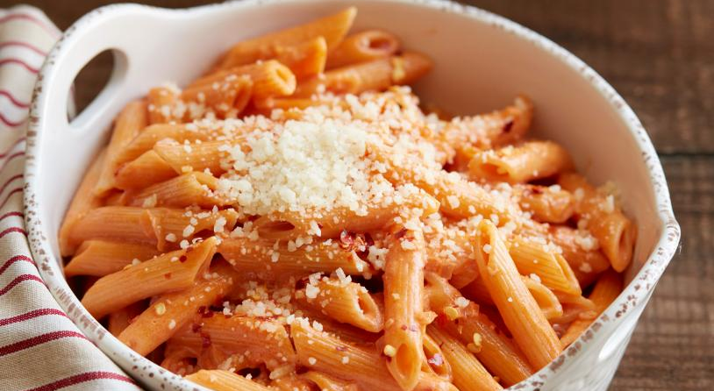
ALL ABOUT MY RECIPE
This recipe is significant to my family because we eat it for dinner very often, and we can all help make it. We can all eat it, and we all enjoy it. We eat it at home and at restaurants. Every year when I come back from sleepaway camp, we go to our favorite restaurant, and me and my brother share a dish. This recipe is an Italian recipe, and my spotlight ingredient basil, though it is originated in India, is most commonly eaten in Italy. This recipe is delicious because it is a simple meal (pasta) with a very creamy and flavorful sauce.
SPOTLIGHT INGREDIENT: BASIL
My spotlight ingredient is basil. Basil is a green leaf herb, about 2 inches long. It has a fresh taste, and adds flavor to many dishes. It has an earthy taste, and tastes both sweet and savory. It’s flavor is like a bell pepper, but less sweet. Basil is a leaf vegetable. Basil is normally harvested from 8 days to 2 weeks after it has been planted. It is typically harvested in its juvenile stage. Basil has a substantial supply of antioxidants, and helps prevent inflammations. It is helpful for digestion and is believed to be able to fight depression. It is supposed to be able to stimulate chemical messages sent to the brain that make people happy and energized. Another surprising health benefit of basil is that it has the ability to help the body fight cancer!

Slide 46
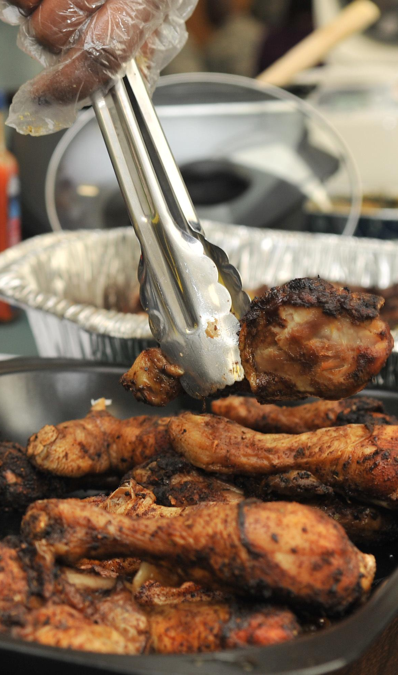
Grilled Jerk Chicken
Ayodele Joa-Griffith
Main course
15 wings
INGREDIENTS
enough Orégano
enough Soy sauce
enough black pepper
enough Lemon
enough Chicken
PROCEDURE:
Put chicken parts in a large bowl.
Scoop out enough jerk seasoning with a tablespoon such that you can cover all the chicken with a thin layer.
Sprinkle black pepper and oregano over chicken.
Turn the pieces over and repeat.
Use the soy sauce for salt taste and to thin out the seasoning
Mix the ingredients with the chicken so that you can easily spread the mixed sauce over all of the sides of the chicken before and during cooking.
Set grill or oven to about 400 degrees F
Cook on grill for about 90 minutes, or if you use a oven it is only 75 minutes.
Turn the chicken so that both sides are brown or blackened, not charred or burnt.
INDEX

Slide 47
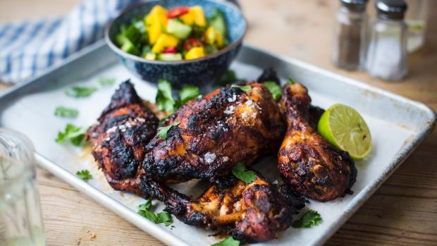
ALL ABOUT MY RECIPE
Grilled jerk chicken originates from my family’s jamaican heritage. And with the many different variations of the recipe it could also be used in my dominican part of heritage. It is often used in family gatherings or, just in a simple dinner. It is one of my favorite foods!
SPOTLIGHT INGREDIENT: CAULIFLOWER
My spotlight ingredients are fresh spices (oregano and black pepper) I chose these because they are very important to the recipe and the chicken would not be the same without it. The black pepper adds a spicy taste to the chicken along with the jerk if you decide to pick spicy. The Oregano adds a salty and savory taste along with the soy sauce. All together they blend into a delicious blend of herbs and spices and with the chicken, it’s the best thing ever!

Slide 48
SPAGHETTI AND MEATBALLS
Ryan Burgos
Entree
6 people
INGREDIENTS:
box of spaghetti
tomato sauce;
chopped onions;
basil
italian seasoning
chopped meat
chopped green peppers
one egg
bread crumbs,oil
PROCEDURE:
Put oil, green peppers, and onions all into a saute pan until brown.
Add tomato sauce into the pan.
Bring to a simmer for 1 hour
Bring a pot of water to a boil and add spaghetti. Cook for 15-17 minutes and drain.
Add all seasonings, egg, and breadcrumbs to the chopped meat and form meatballs.
Brown the meatballs in pan with oil.
INDEX

Slide 49
ALL ABOUT MY RECIPE
Spaghetti and Meatballs is special to me and my family because that is my favorite meal that my dad makes. This recipe is important to me because when I lost a championship game in basketball I was so upset. So then my dad made spaghetti and meatballs then was happy again. Also when I won MVP ( Most Valuable Player) in a basketball camp and league he made me it and I felt proud.
SPOTLIGHT INGREDIENT: Basil
The spotlight ingredient in spaghetti and meatballs is Basil. The leaf in Basil adds sweet flavor in the spaghetti to make you have a great taste in your mouth. It Basil takes 14 days for it to be harvest. It is healthy because it provides you with vitamin k.

Slide 50
Dumplings
Fiona Xu
About 50 dumplings // 6-10 people
Entree
INGREDIENTS:
½ cup of soy sauce
1 tablespoon season rice vinegar
1 tablespoon finely chopped chinese chives
1 teaspoon sesame seeds
1 teaspoon chile garlic sauce
1 pound ground pork
3 cloves garlic, minced
1 egg, beated
PROCEDURE:
Combine ½ soy sauce, rice vinegar, 1 tablespoon of chives, sesame seeds, and chile sauce in a small bowl.
Mix pork, garlic, egg, 2 tablespoons of chives, soy sauce, sesame oil, and ginger in a large bowl until thoroughly combined.
Heat 1-2 tablespoons vegetable oil in a large skillet over medium high heat.
INDEX

Slide 51
ALL ABOUT MY RECIPE
According to Chinese tradition, we eat dumplings during Chinese New Year. Dumplings symbolizes family reunion, family harmony, and good luck. Dumplings are from China. In my opinion, the pork part makes it taste delicious. Also in my opinion, the skin part also makes it taste delicious.
SPOTLIGHT INGREDIENT: CAULIFLOWER
Chinese chives is my spotlight ingredient. The parts of the chinese chives that are edible to eat are the long stalks which are great in salads or other dishes and the part of the plant it is the stem part. Chives tastes like garlic flavored. It takes 75 to 90 days to harvest. It helps us by boosting our eyesight or vision.

Slide 52
Caprese Pasta Salad
Solomon Sherman-Drury
ENTREE
3-6 people
INGREDIENTS:
bag (16 oz) penne pasta, 2 beefsteak tomatoes
parmesan cheese, (not for cooking) ⅓ cup extra virgin olive oil
1 ovoline fresh mozzarella. (ALSO FRESH BASIL)
PROCEDURE:
Boil penne for 15 minutes in a medium pot or until soft.
Chop 2 large tomatoes into a large bowl. Sprinkle 1 teaspoon of salt over tomatoes and mix. Place a plate over a bowl and let salted tomatoes stand for 5 minutes.
Take 12 large basil leaves and rip each in half. After 5 minutes add basil leaves, one-third cup of olive oil and mozzarella (cut like this) to the tomatoes.
Drain pasta and put back in the pot, mixed with 1 tablespoon of oil to keep pasta from sticking together. Serve pasta onto individual plates and spoon tomato mixture over it. Sprinkle parmesan CHEEZY CHEEZ as garnish.
INDEX

Slide 53
SPOTLIGHT INGREDIENT: TOMATOES
The fruit is the spotlight ingredient and is read, green or orange. It has a thin skin and tastes sweet or salty and even sour depending on the season. It is harvested when it is in fruition.Tomatoes are a source of the antioxidant lycopene. This is the cause of many health benefits, including less risk of heart disease and cancer. They are also a good source of vitamin C, potassium, folate and vitamin K.
It tastes really good and we all love it. The recipe celebrates the summer. AND, we get ingredients from my godparent's garden up in willow. The recipe has 2 different CHEEZY CHEESES. It is not from any cookbook or religion, so it’s OG BOIIIIIIII!!!!!!!!!!!

Slide 54
RASTA PASTA
Toshian Bonamy
Entree
9 Servings
INGREDIENTS:
2 cups penne pasta
1 stalk green onion
1 pack knorr parma rosa sauce mix(a creamy sauce)
1 large garlic clove
2 cups grated cheese(mozzarella or sharp cheddar)
2 bell peppers(red and green)
1 ½-2 cups milk
1 teaspoon jerk seasoning
PROCEDURE:
Boil pasta and strain
In a pot heat oil on medium heat
Add green onions and garlic and stir
Add jerk seasoning and stir making sure onions are coated
Add milk and mix
Add bell peppers to oven coated in olive oil,salt,and black pepper
Add half pack of parma rosa to pasta
Add half of cheese and stir well
Add rest of parma rosa and cheese and mix well
Add half of pasta and stir
Add bell peppers,and remaining pasta and a little more
Take off heat and serve.
INDEX

Slide 55
ALL ABOUT MY RECIPE
It is special because my family likes it a lot and we mostly eat it on sunday. My family doesn’t eat this on specific occasions but my sister loves it a lot and eats it the most so it is funny how she enjoys it so much.My family is jamaican so it is basically a jamaican version of pasta. To me what makes this recipe good is the sauce because it gives the pasta flavor and taste good.
SPOTLIGHT INGREDIENT: BELL PEPPERS
My spotlight ingredient is bell peppers. Bell peppers are crunchy,bumpy,a little spicy and I think it looks like a pumpkin. Bell peppers are the fruit part of the plant.The life cycle of a bell pepper is germination,growth,pollination,fruiting, and ripening.You can harvest bell peppers when the are a full fruit (when they are green), you can leave them on the stem to turn from green to red to orange to yellow. Sweet peppers take 60-90 days before being harvested and hot peppers take up to 150 days before being harvested. Benefits of bell peppers is that they have many vitamins,antioxidants, and eye health, and reduced risk of several chronic diseases.

Slide 56
Stuffed Bell Peppers
Zuriel Fernandez
Recipe Type
1-2 servings
INGREDIENTS:
Combine ground beef, cooked rice,
Parmigiano-Reggiano cheese, put a tint of salt 1/4 cup parsley, 2 tablespoons tomato sauce,
garlic, salt, and black pepper in a large mixing bowl.
Lightly stuff peppers with meat mixture.
Spread 1 tablespoon remaining tomato sauce on top of particular portion of stuffing;
PROCEDURE:
Heat oven to 350°F.
Cut thin slice from stem end of each bell pepper to remove top of pepper. Remove seeds and membranes; rinse peppers. If necessary, cut thin slice from bottom of each pepper so they stand up straight. In 4-quart Dutch oven, add enough water to cover peppers. Heat to boiling; add peppers. Cook about 2 minutes; drain.
In 10-inch skillet, cook beef and onion over medium heat 8 to 10 minutes, stirring occasionally, until beef is brown; drain. Stir in rice, salt, garlic and 1 cup of the tomato sauce; cook until hot.
Stuff peppers with beef mixture. Stand peppers upright in ungreased 8-inch square glass baking dish. Pour remaining tomato sauce over peppers.
Cover tightly with foil. Bake 10 minutes. Uncover and bake about 15

Slide 57
SPOTLIGHT INGREDIENT: Stuffed Bell Pepper
My spotlight ingredient is pepper because it can be used on anything and using it on this type of Entrees is taking advantages of the spice and that's good for the taste the pace that give the most taste is the seeds because it gave all of the taste that it need normily if you burn the seeds to much you taste a little burned but the seeds and the meat it doesn't burn the seeds. It takes 3 to 4 weeks tell the bell pepper turns to green to chocolate color to red the bell pepper red bell peppers are none for vitamin A, C and B6 but yellow bell peppers has 3 times extra vitamin C then reds.
This food from my culture because Peru is known for its spice and the most common colors of bell peppers are green, yellow, orange and red. More rarely, brown, white, lavender, and dark purple peppers can be seen, depending on the variety. Most typically, unripe fruits are green or, less commonly, pale yellow or purple. Red bell peppers are simply ripened green peppers,

Slide 58
Lasagna
Justin Torres
Entree
12 people
INGREDIENTS:
9 lasagna noodles
1 ¼ pounds of ground mild Italian Sausage
¾ pound of ground beef
1 medium onion, diced
3 garlic cloves, minced
2 cans of crushed tomatoes (1 28 ounces, 1 15 ounces)
2 cans of tomato pasta (6 ounces each)
⅔ cups of water
2 to 3 teaspoons of sugar
3 teaspoons plus ¼ cup minced fresh parsley, divided
2 teaspoons of dried basil
¾ teaspoons of salt
¼ teaspoons coarsely ground pepper
1 large egg, lightly beaten
21 carton of ricotta cheese (15 ounces)
4 cups of shredded part-skim mozzarella cheese
¾ cups of grated Parmesan cheese
PROCEDURE:
Cook noodles according to package directions. Meanwhile, in a Dutch oven, cook sausage, beef and onion over medium, heat for 8 to 10 minutes or until meat is no longer pink, breaking up meat into crumbles. Add garlic, cook for 1 minute. Drain.
Stir in tomatoes, tomato paste water, sugar, 3 tablespoons parsley, basil, fennel, ½ teaspoons salt and pepper; bring to a boil. Reduce heat; simmer, uncover, 30 minutes, stirring occasionally.
In a small bowl, mix egg, ricotta cheese, and remaining parsley and salt.
Preheat oven to 375 degrees. Spread 2 cups of meat sauce into an ungreased 13x9 in, baking dish. Layer with 3 noodles and ⅓ of the ricotta mixture. Sprinkle with 1 cup of mozzarella cheese and 2 tablespoons of Parmesan cheese. Repeat layers twice. Top with remaining meat sauce and cheese. (Dish will be full)
Bake, covered, 25 minutes. Bake, uncovered, 25 minutes longer or until bubbly. Let stand 15 minutes before serving.

Slide 59
ALL ABOUT MY RECIPE
I chose lasagna because every holiday my grandma makes it. It taste so good every time we are about to eat it, I am the first 1 at the table ready to eat.
My recipe came from Italy. My family is 5.7% french.
The things that makes lasagna delicious is the tomatoes in it. My recipe has a lot of tomatoes in it. I love tomatoes a lot, I eat it every day for dinner.
SPOTLIGHT INGREDIENT: Tomato
My spotlight ingredient taste juicy and delicious like a peach. It looks like a mango, but is more red than a mango.
My spotlight ingredient is the fruit of a plant.
My spotlight ingredient will take about 80 days (2 months and 20 days) to grow and be harvested.
My spotlight ingredient is a tomato. It is a edible fruit which is a round circle and juicy. It is light red and has many good reasons to eat it. Like a tomato can reduce the risk of getting heart disease and cancer. Tomatoes are good sources of vitamin C, potassium, folate, and vitamin K.

Slide 60
EMPANADAS
DERIK CHARLES
Dinner And Lunch
Depends
INGREDIENTS:
½ lbs of ground beef
1 tbsp olive oil
2 tbsp sofrito
1 packet sazon with coriander and annatto
¼ cup goya tomato sauce
1 tsp minced garlic
½ diced onion
6 stuffed pimento olives diced
⅛ tsp black pepper
½ tsp dried oregano
½ cup mexican blend cheese
1 package goya discos frozen turnover dough
1 cup corn oil
PROCEDURE:
1.brown ground beef in skillet
2.stir all ingredients ( Except cheese,discos,and oil).
3. Simmer for 10 to 15 minutes .
4.then goya discos.
5.spoon about one tbsp of the meat mixture into the middle and sprinkle with cheese.
6. Fold over dough and use a fork to close the dough edges
7. Fri in oil on medium heat on both sides until the color has gotten tannish brown.
8.remove from oil,drain on paper towels and eat!!!

Slide 61
SPOTLIGHT INGREDIENT: ONION
This is my spotlight ingredient because i saw it at the green market and it is so delicious!!!!!! This recipe is important to my family because we only make it on special holidays. My family enjoys this recipe because it is just the best taste in the world. This is delicious because it is every taste you would need in one food.
This is my spotlight ingredient because i saw it at the green market and it is so delicious!!!!!! This recipe is important to my family because we only make it on special holidays. My family enjoys this recipe because it is just the best taste in the world. This is delicious because it is every taste you would need in one food.

