Slide 1
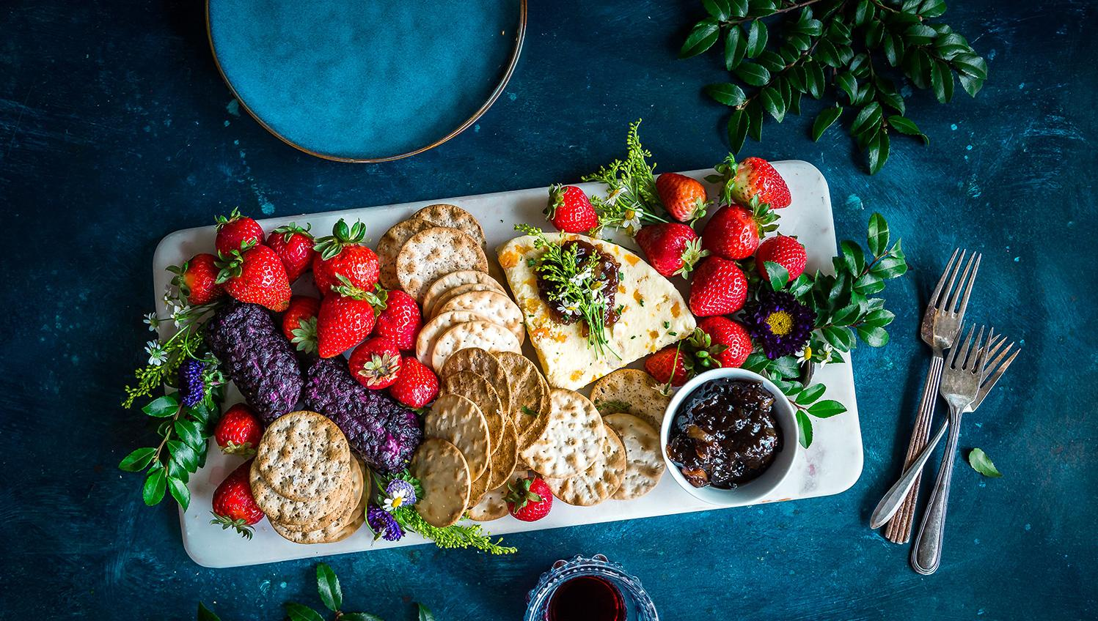
6th GRADE COOKBOOK
Orange

Slide 2
Short description of cookbook project...

Slide 3
TABLE OF CONTENTS
16 RAITA
17 PUMPKIN BREAD
18 APPLE PIE
19 APPLE AND FENNEL SALAD
20 CHICKEN BROCCOLI
21 2 BEAN CHILI
22 MATZO BALL SOUP
23 RASPBERRY BUCKLE
24 APPLE PIE
25 PUMPKIN PIE
26 CHICKEN CURRY
27 QUINOA AND KALE SALAD
28 HONEY GINGERBREAD
29 APPLE PIE
30 RED LENTIL DAHL
31
01 CHOCOLATE CHIP PANCAKES
02 LASAGNA
03 BLINTZES
04 RHUBARB SQUARES
05 ZUCCHINI PASTA
06 MOUNT RASPBERRY BISCUITS
07 PETER LUGER STYLE STEAK
08 YELLOW LENTIL SOUP
09 KOREAN STYLE BEEF
10 COLLARD GREENS
11 PASTA MARINARA
12 LASAGNA
13 STRAWBERRY SMOOTHIE
14 RICE AND BEANS
15 RICE KRISPIE CAKE + BLUEBERRIES

Slide 4
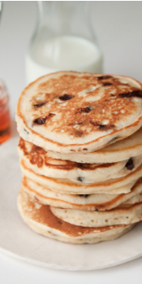
Chocolate Chip Pancakes
Theo Fein
Entrée
12 Servings
INGREDIENTS:
1 ¼ cups flour
1 tablespoon sugar
¼ teaspoon cinnamon
1 tablespoon baking powder
¼ tablespoon salt
2 eggs
1 cup milk
4 tablespoons melted butter
¾ teaspoon vanilla
⅓ cup chocolate chips
PROCEDURE:
Preheat fry pan
Combine flour, sugar, cinnamon, baking powder and salt in a large bowl
Mix together wet ingredients and beat into dry mixture until smooth
Fold in chocolate chips
Pour or spoon batter into fry pan in desired quantity

Slide 5
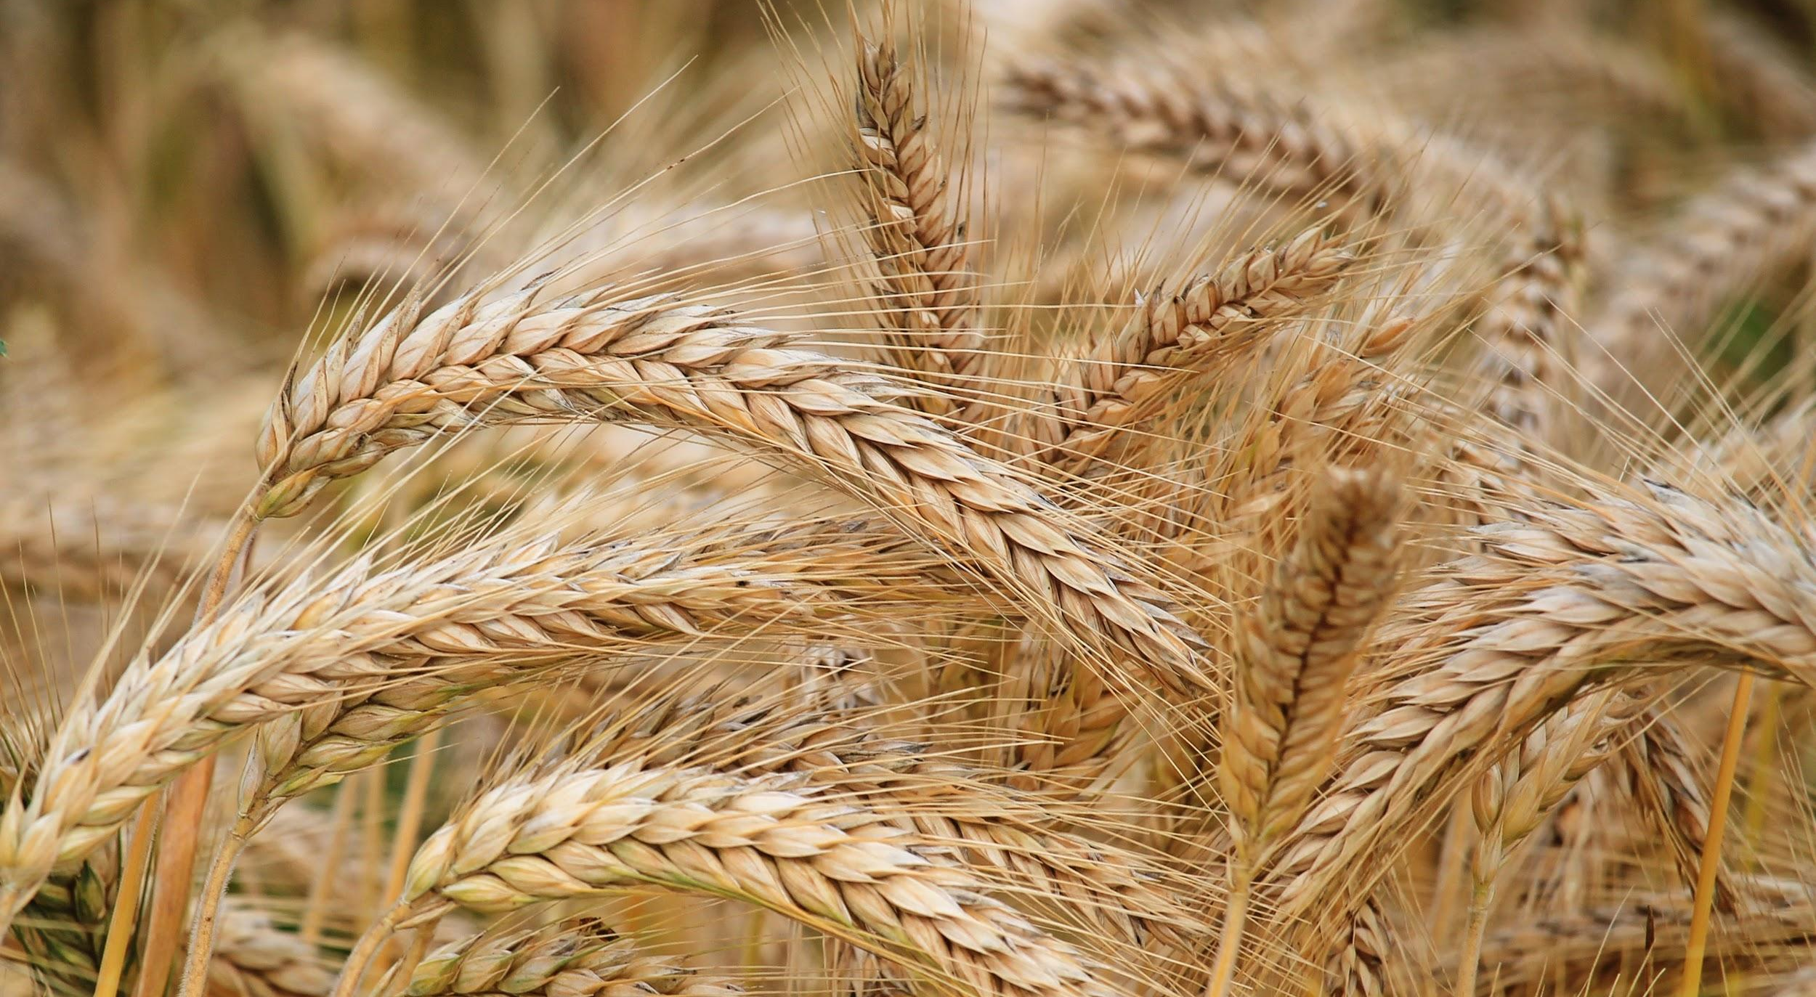
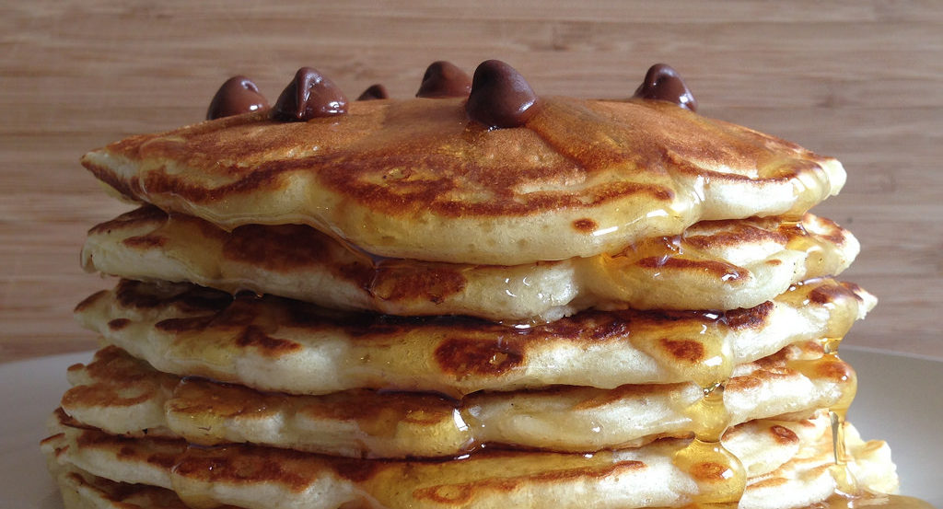
ALL ABOUT MY RECIPE
This recipe is very important to our family because we always have it on the weekends. Sometimes, if i’m lucky, I get it on the school days! There is many different cultures that make different kinds of pancakes. To me, the reason why they are so delicious is because they’re super fluffy!
SPOTLIGHT INGREDIENT: WHEAT
My spotlight ingredient is wheat. My spotlight ingredient looks like a weed and it tastes not so good on its own. You need cook or bake it first. The seed of the wheat plant is what we use to make flour. It is planted from September to November and harvested in the summer. It can also inhibit type 2 diabetes!

Slide 6
LASAGNA
Aidan Messina
Recipe Type
4-6 Servings
INGREDIENTS:
1 pound lean ground beef
9 pieces of lasagna noodles
1 [15 ounce] container ricotta cheese
2 ½ cups [10 ounces] shredded mozzarella cheese
¼ cup of grated parmesan cheese
4 cups tomato basil sauce
PROCEDURE:
Season and brown the ground beef in a frying pan
Boil water and add lasagna noodles, cook until al dente
In a large and deep pan begin assembling the ingredients using the following steps:
Lightly cover the bottom of the pan with tomato sauce
Carefully place 3 cooked noodles side by side on top of the tomato sauce
cover the noodles with a light layer of tomato basil sauce
Cover the tomato sauce with a light layer of cooked chopped meat
Cover the meat with shredded mozzarella cheese
Add 3 dollops of ricotta cheese and spread out over the layer
Sprinkle parmesan cheese over the entire area
Repeat 2 times
Cover the pan with tin foil
Put in a 350 degree preheated oven for 45 minutes

Slide 7
SPOTLIGHT INGREDIENT: BASIL
My spotlight ingredient is basil. Basil is a culinary herb from the mint family which makes sense because it has a strong taste and is fragrant.
There are many different types of basil but for this recipe, we are using Genovese basil aka sweet basil. The leaves of the basil plant are most commonly used in cooking, they are large, flat and green. However, the seeds of some types of basil are soaked and used in drinks and desserts in parts of Asia.
The parts of the basil plants include roots, stem, leaves, flowers, seeds.
Basil is sensitive to the cold, it grows best outdoors in hot and dry environments.
Basil can be harvested as soon as the plant is 6 to 8 inches tall and is done by picking leaves off the stem. Harvesting actually encourages the plant to continue growing and should be done regularly throughout the season.
My lasagna recipe is special to me and my entire family because it's been passed down through my family for generations. My Grandfather taught my Mother this recipe and she has been making it for Christmas for as long as I can remember.
Lasagna is typically associated with the Italian culture which is my families ethnicity but I think lasagna is so popular that now everyone makes and enjoys it.
I love pasta and cheese but knowing that my family has made this recipe from scratch for generations makes it delicious to me.

Slide 8
Blintzes
Recipe Type: Dessert
Number of Servings: 3
INGREDIENTS:
1 cup all purpose flour
3 Tbsp sugar
eggs
1 cup water
2 Tbsp of unsalted butter, melted
2 Tbsps unsalted butter
for baking crepes and filled blintzes, 1 Tbsp vegetable oil
1 lb cream cheese
1 cup large curd cottage cheese
⅔ cup sugar
1 tsp vanilla extract.
PROCEDURE:
Mix the flour, sugar, and cornstarch together in a small bowl and set aside
Using an electric mixer set on high, beat the eggs, water, butter, and oil together until light yellow. Reduce the speed to low and blend in the flour mixture all at once, just until the white disappears. Do not overbeat as this can make the crepes tough.
Pre-heat a crepe pan over medium-high until a drop of water sprinkled on the pan sizzles. Brush the hot pan with butter, coating it well.
For each crepe, pour about ¼ cup of batter into the pan and immediately tilt the pan so the batter, completely but lightly, coats the bottom (some batter may move up the pan sides a little). Cook about 30 seconds until the bottom of the crepe id golden brown (lift an edge to check). Shake pan to loosen crepe, then gently turn it over with a spatula, being careful not to tear it. Cook crepe on the underside, about 15 seconds, just until it’s set. Turn the crepes, light underside-up onto a cooling rack.
Refrigerate crepes for up to 2 days or freeze up to a month.
Make the filling: stir filling ingredients in a bowl spoon until blended. To fill each crepe, spoon 3 tablespoons of filling in the center on the underside of the crepe, then fold the edges over like an envelope: first the top edge, then the left side, the right side and finally the bottom edge. Be sure the filling is tightly enclosed.
To fry the blintzes, melt butter in a large skillet over medium heat. Place the filled blintzes in the skillet folded ends down. Fry blintzes until golden on both sides,turning once, about 5 minutes total.

Slide 9
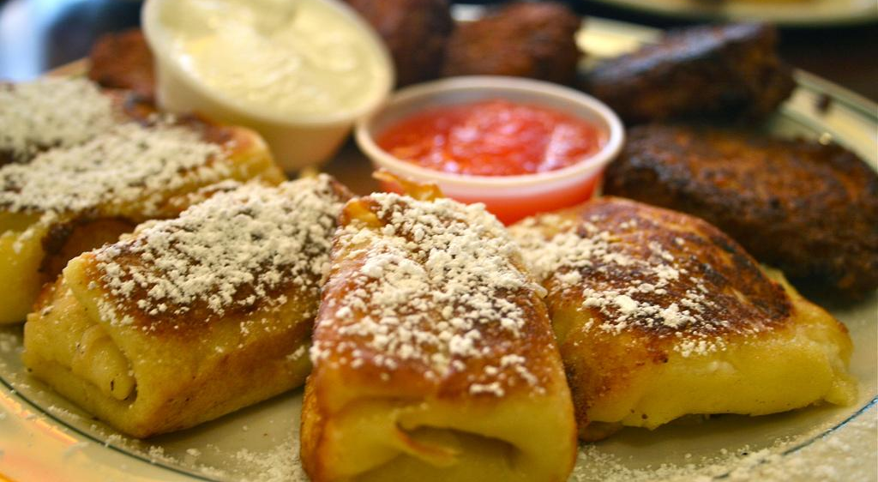
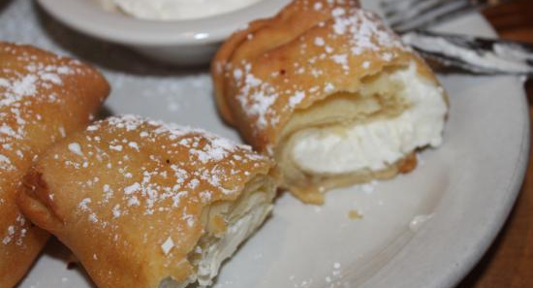
ALL ABOUT MY RECIPE
The recipe I chose was blintzes. Ever since I was in diapers, my family and I have gone to a very well-known Brooklyn diner called Juniors. I have celebrated almost all of my birthdays there as well as my sister’s birthday, my aunt’s birthday and any other family event. Every time I go to Juniors, I order blintzes with strawberry jam. I feel as if every time I go there the blintzes get better. Blintzes are a traditional Jewish food. I think they are so delicious because of their soft and sweet cheese filling. The crepes are fried to crispy perfection, and their crunchy outside tones down the sweet flavor and I love the crunch followed by the smooth cream texture.
SPOTLIGHT INGREDIENT: Strawberries
Strawberries are the spotlight ingredient in my recipe. Strawberries are fruits which are red ovals with green seeds all over. Depending on which season you eat them in, strawberries can be sweet or sour. Strawberries are the fruit part of the plant. They are harvested in the young plant phase and only need 4-6 weeks before harvesting. You can use strawberries in many other recipes including pies, cakes, and other pastries.

Slide 10
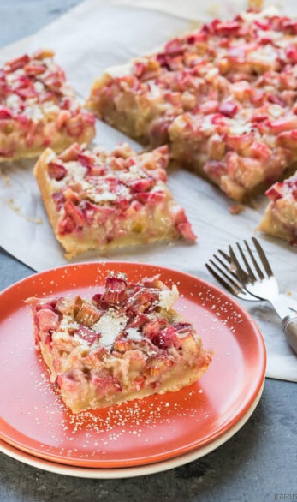
Rhubarb Squares
Maggie Handelman
Dessert
Serves 8-12 people
INGREDIENTS:
½ cup Butter or Oil
1 cup Flour
¼ cup powdered sugar
2 eggs, slightly beaten
1 ½ cups sugar
¼ cup flour
¾ teaspoon baking powder
2 cups Rhubarb
PROCEDURE:
Mix butter, flour and powdered sugar like pie crust, (cut the butter into chunks and mix in.
Pat into a 9 by 12 pan.
Bake 15 min at 350.
Mix the eggs, sugar, flour, baking powder, and rhubarb together
Pour the Rhubarb mixture into the crust.
Bake 35 min.
Break crust with a fork 10 minutes before done.
Enjoy!

Slide 11
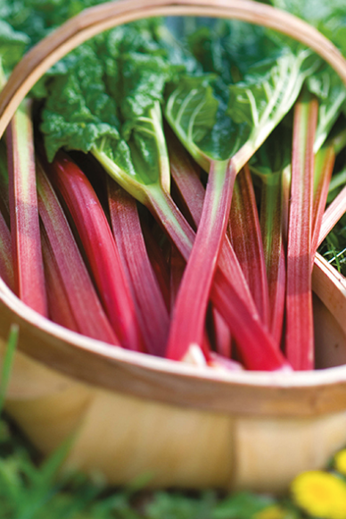
SPOTLIGHT INGREDIENT: RHUBARB
My spotlight ingredient is Rhubarb. It tastes super tart, until you add sugar and cook it. It’s colors vary from green to red, sometimes a mix of both! It is the stalk of the plant--long and stiff but when it’s cooked it becomes soft and falls apart easily. It can be used to make compote which is great to eat on yogurt or ice cream. Rhubarb is typically harvested in May to August. It’s sweetest when it is pink or red but still safe to eat when it is green. You can usually harvest it from 8-10 weeks long. Rhubarb is an excellent source of fiber.
My dad used to have these rhubarb squares when he was a kid and now my family makes them. We also make rhubarb compote and freeze it for the winter. I think this recipe is delicious because I love rhubarb. Although some people dislike the texture of Rhubarb I think that the texture doesn’t stand out that much once it is mixed with sugar, eggs, and cooked so it appeals to more people who dislike rhubarb. It is both sweet and tart making it delicious!

Slide 12
Zucchini Pasta
Sasha Chajet Wides
Pasta
Four-Eight Servings
INGREDIENTS:
1 large red onion (or 2 medium onions) chopped into small pieces
12 cloves garlic, minced
bunch fresh basil, finely chopped
2 cups grated parmesan cheese
6-8 fresh zucchinis, peeled and cut into thin slices
1 egg
1 box penne or bowtie pasta
Salt
Nutmeg
Olive oil
PROCEDURE:
In large skillet, caramelize chopped onions on low heat in 3 tablespoons of olive oil; when onions almost done, add minced garlic and saute until golden. Remove caramelized onions and garlic mixture from the skillet and put in a large serving bowl.
After removing onions, heat 1 tablespoon of olive oil in skillet; add one third of the sliced zucchini and cook on high heat until soft (but not soggy). As zucchini cooks, stir in a pinch of salt and a dash of nutmeg (2 shakes). Set aside cooked zucchini in the same serving bowl with the onions and garlic mixture. Repeat two more times until all of the zucchini is cooked.
Cook pasta in boiling water (follow cooking directions on box).
When pasta is ready, quickly drain the water and return pasta to the hot pot. Crack the egg in the hot pasta and mix swiftly until the egg is is cooked and the pasta is well coated. Add 2 tablespoons of olive oil, several pinches of salt and a dash of black pepper and stir into the pasta. Add the pasta to the serving bowl, and toss the pasta with the zucchini and onion mixture.
Add parmesan cheese and chopped basil and mix thoroughly into the pasta and zucchini.
ENJOY!!! 😁🍝

Slide 13
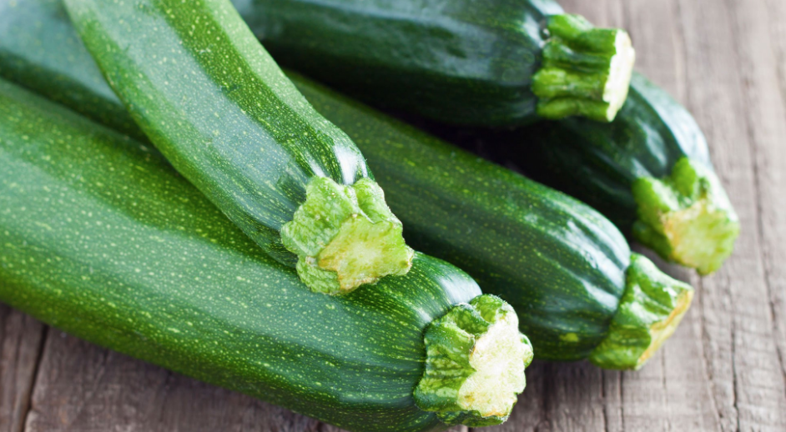
ALL ABOUT MY RECIPE
This is important to me because my family has been cooking this recipe for forever. My dad learned how to cook it in college however he has made his own adjustments to the recipe to make it his own. The earliest memory I have of making it is from when I was four and my family took a vacation to California. We got really good zucchini while we were there. I remember begging my dad to let me help him cook. It was the first real meal I ever made. This recipe is delicious because it has really yummy veggies in it. Also, the secret trick to making it is right after you drain the pasta and put it into a bowl while it’s still hot, you crack a raw egg into it and stir it in.
SPOTLIGHT INGREDIENT: Zucchini
My spotlight ingredient is zucchini. Zucchini is a green summer squash that can be cooked in many forms. Its skin is dark green and the inside is light green. Both the skin and the flesh are edible but most people peel the skin off. Zucchini is typically sweet but mostly used in savory dishes with salt added to it. When cooked, it can be soft or crispy. Zucchini is a fruit but often is put into the category of vegetable. They are harvested 45-55 days after you plant it. When you pick them they generally are 6 inches long. You pick them in the summer. Zucchini contains zero fat, and is high in water and fiber. It also contains significant amounts of vitamins B6, C, and K, and minerals, like potassium.

Slide 14
Mount Raspberry Biscuits
Stella Yampolsky
Dessert
INGREDIENTS:
Biscuits:
2 cups of flour (all purpose)
1 Tablespoon of baking powder
1/4 teaspoon baking soda
2 teaspoons of sugar
3-6 servings
1 teaspoon of salt
6 tablespoons (85 grams) of cold unsalted butter, cubed
3/4 cup (180 ml) of cold buttermilk, plus more for the tops of the biscuits
“Mountain”
Whipped cream (store bought or homemade)
Raspberries
PROCEDURE:
Preheat the oven to 450°F.
Line a large baking sheet with parchment paper or a silicone baking mat and set it aside.
In a large mixing bowl, whisk together the flour, baking powder, baking soda, sugar, and salt until they are well mixed.
Add the in the cubed cold butter and cut into the dry ingredients using a pastry cutter (you can also use a food processor for this step) until you have small pea sized pieces of butter.
Pour the cold buttermilk into the mixture and gently knead it until the dough starts to form.
Scoop the dough onto a lightly floured surface and gently work it together with your hands.
Pat the dough into a rectangle and fold it in thirds. Turn the dough, gather any crumbs, and flatten back into a rectangle.
Repeat steps 6 and 7 two more times.
Place the dough onto a lightly floured surface and pat it down into a 1/2-inch thick rectangle (make sure to measure!).
Using a floured 2.5-inch biscuit cutter, cut out the biscuits. Continue to gather any scrap pieces of dough, patting it back down to 1/2-inch thickness, and cutting it until you have 12 biscuits. The biscuits quality will decline the more you work the dough so try to get as many as you can the first try!
Arrange the biscuits on the baking sheet touching each other. Brush the top of each biscuit with a little bit of buttermilk.
Bake at 450°F for about 15-17 minutes or until lightly golden brown.
Remove from the oven and brush with melted butter if desired. Allow it to cool for a few minutes.
Add the whipped cream on top and place the raspberries in it.

Slide 15
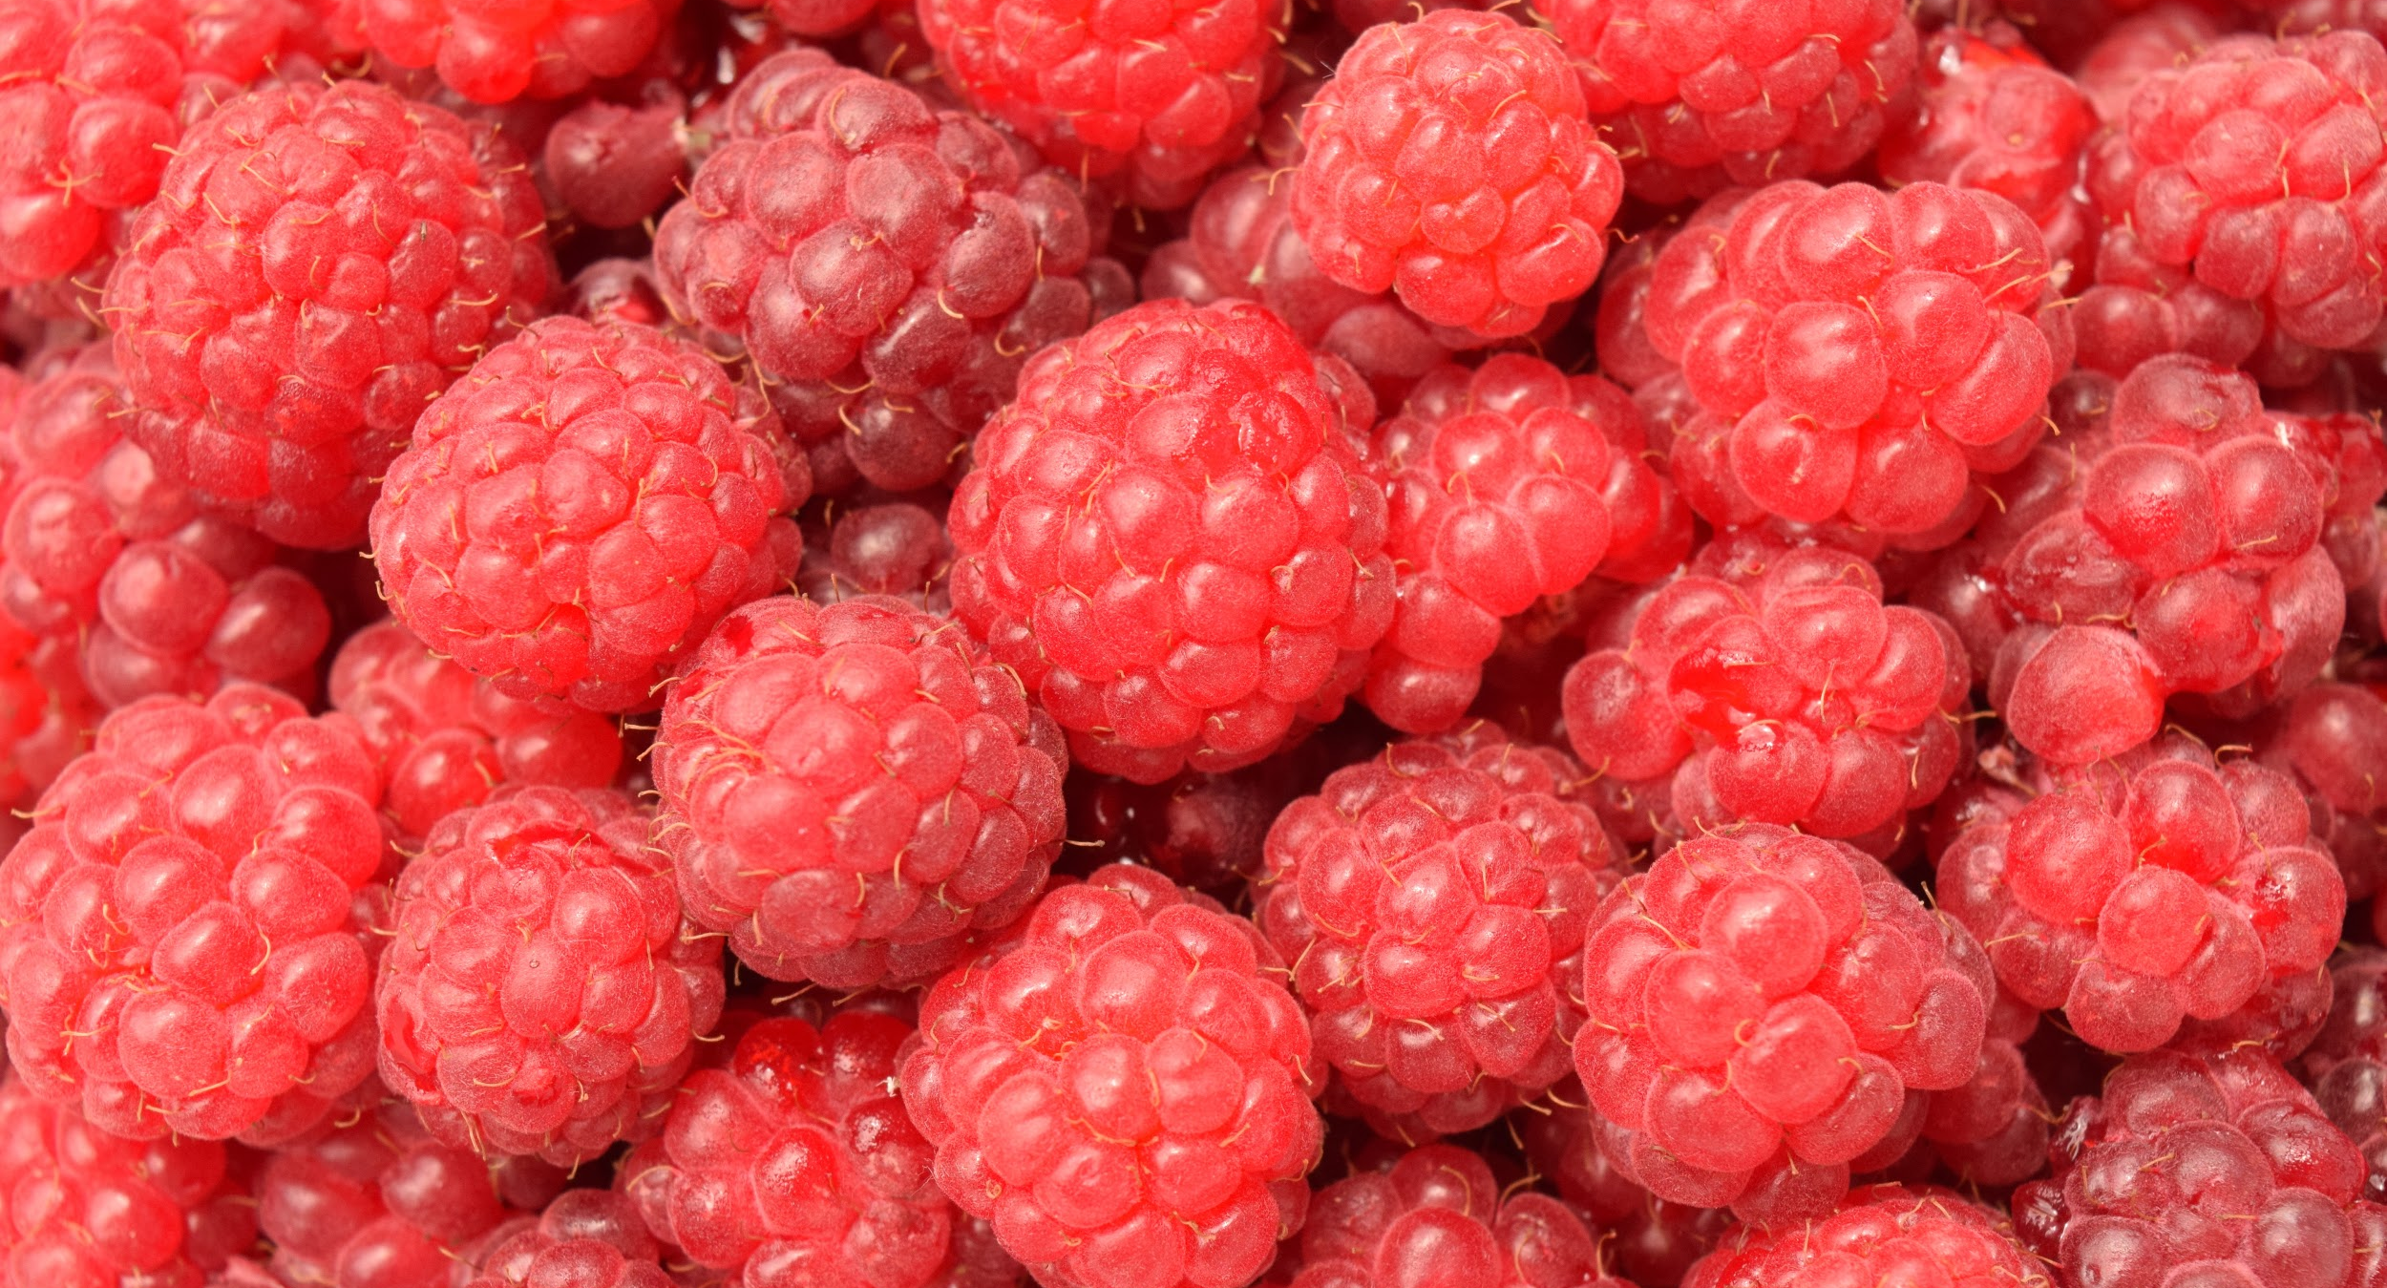
ALL ABOUT MY RECIPE
My dad makes biscuits a lot and we have a lot of happy memories eating them together. Biscuits are light and soft. I decided to add the raspberries and whipped cream because it would give it a sweet and sour flavor burst. Whipped cream goes well with sour berries. Biscuits go well with whipped cream. Everything works out well.
SPOTLIGHT INGREDIENT: Raspberries
My spotlight ingredient is raspberries.They look like clumps of tiny red berries. They are sour and sweet. Raspberries are the fruit of the plant. It is harvested after the berries have turned red. It takes about 16-18 months after planting to be ready to harvest. Raspberries contain vitamin C and gallic acid which fight cancer and heart disease.

Slide 16
Peter Luger Style Steak
Harrison Makai Holden
Entrée
4 people
INGREDIENTS:
Porterhouse steak
Salt
Butter (lots o butter)
Potatoes
PROCEDURE:
With oven temp at 500 degrees place steak in preheated cast iron pan and put it oven-flip steak once during cooking to create a quick char on the outside.
Remove and slice steak. Put it back in pan with butter and back into the oven for a quick minute or two.
Remove from heat and serve at once.

Slide 17
SPOTLIGHT INGREDIENT: Potatoes
Potato is my spotlight ingredient in my recipe. potatoes are edible roots that come out of the ground. Potatoes have a slightly bitter and pulpy texture taste.
It looks like a soft brown rock. It grows in early spring. It has an excellent source of vitamin C.

Slide 18
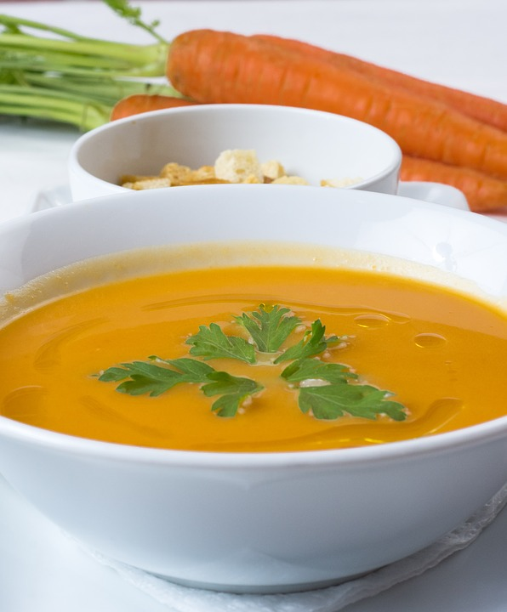
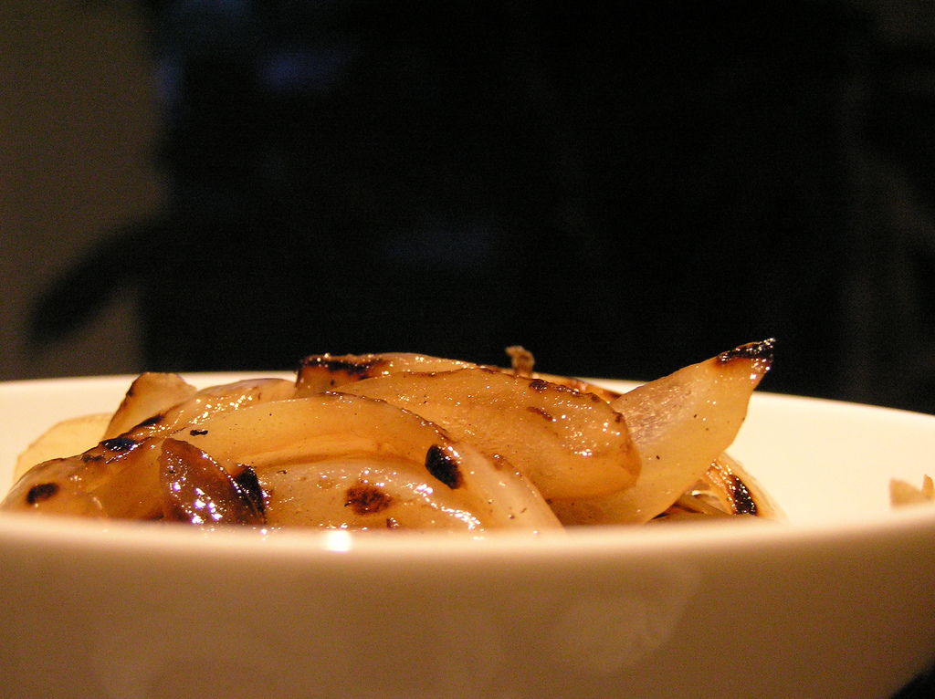
Yellow Lentil Soup with Caramelized Onions
Eve Penner
Recipe Type: Soup
Number of Servings: 5-6
INGREDIENTS:
1 ½ cups yellow-orange lentils, dried
1 1/2 - 2 small cloves of garlic, minced
2 small carrots peeled and diced
¼ cup of celery (NOT celery! Celery root looks like rutabaga.)
2 bay leaves
Excellent quality olive oil and 3 tablespoons
Excellent quality sea salt (Maldon brand is my preference!)
3-4 tablespoons excellent quality Italian olive oil
1 ½ large sweet onion, peeled, sliced, diced very small,
Fax oil to top it all off
1 ½ large sweet onion, peeled, sliced, diced very small,
Fax oil to top it all off
PROCEDURE:
Directions for Soup: Put olive oil in a medium-size soup pot and gently heat under a low flame. After about 30 seconds, put the carrots and celery root in the olive oil and saute for 4 minutes, stirring often so the vegetables do not become brown. Add the garlic and watch carefully that it doesn’t burn, stirring every 20 seconds or so for another minute. Add lentils measure out them add 4 cups of water. Raise the flame to medium-high and cook the ingredients until the soup starts to simmer. Once simmering, lower the heat to low, add the 2 bay leaves and cook for another 20-25 minutes or so, stirring often. Add water to desired consistency, (more water if you want watery soup). Take bay leaf out and compost it once the soup is done. Serve with a drizzle of olive oil or flaxseed oil, generous amounts of sea salt and top with caramelized onions.
Directions for Caramelized Onions: Once lentils and water are added, start your onions in a separate frying pan. Heat the pan with 3-4 tablespoons of olive oil over medium heat for a minute. Add the very tiny diced onions. Stir often and cook until the onions are golden brown and crisp. Take the onions out of the pan with a slotted spoon and put on a plate. Use as a generous garnish for the soup.

Slide 19
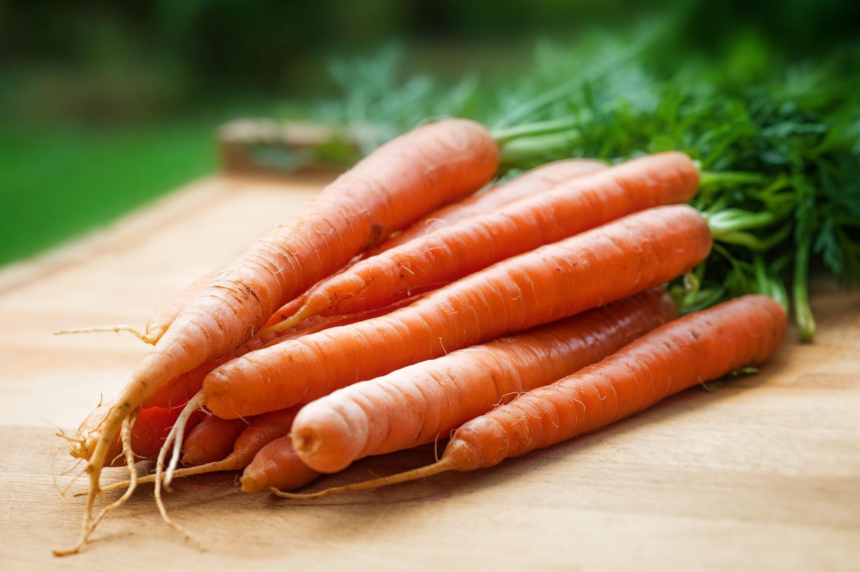
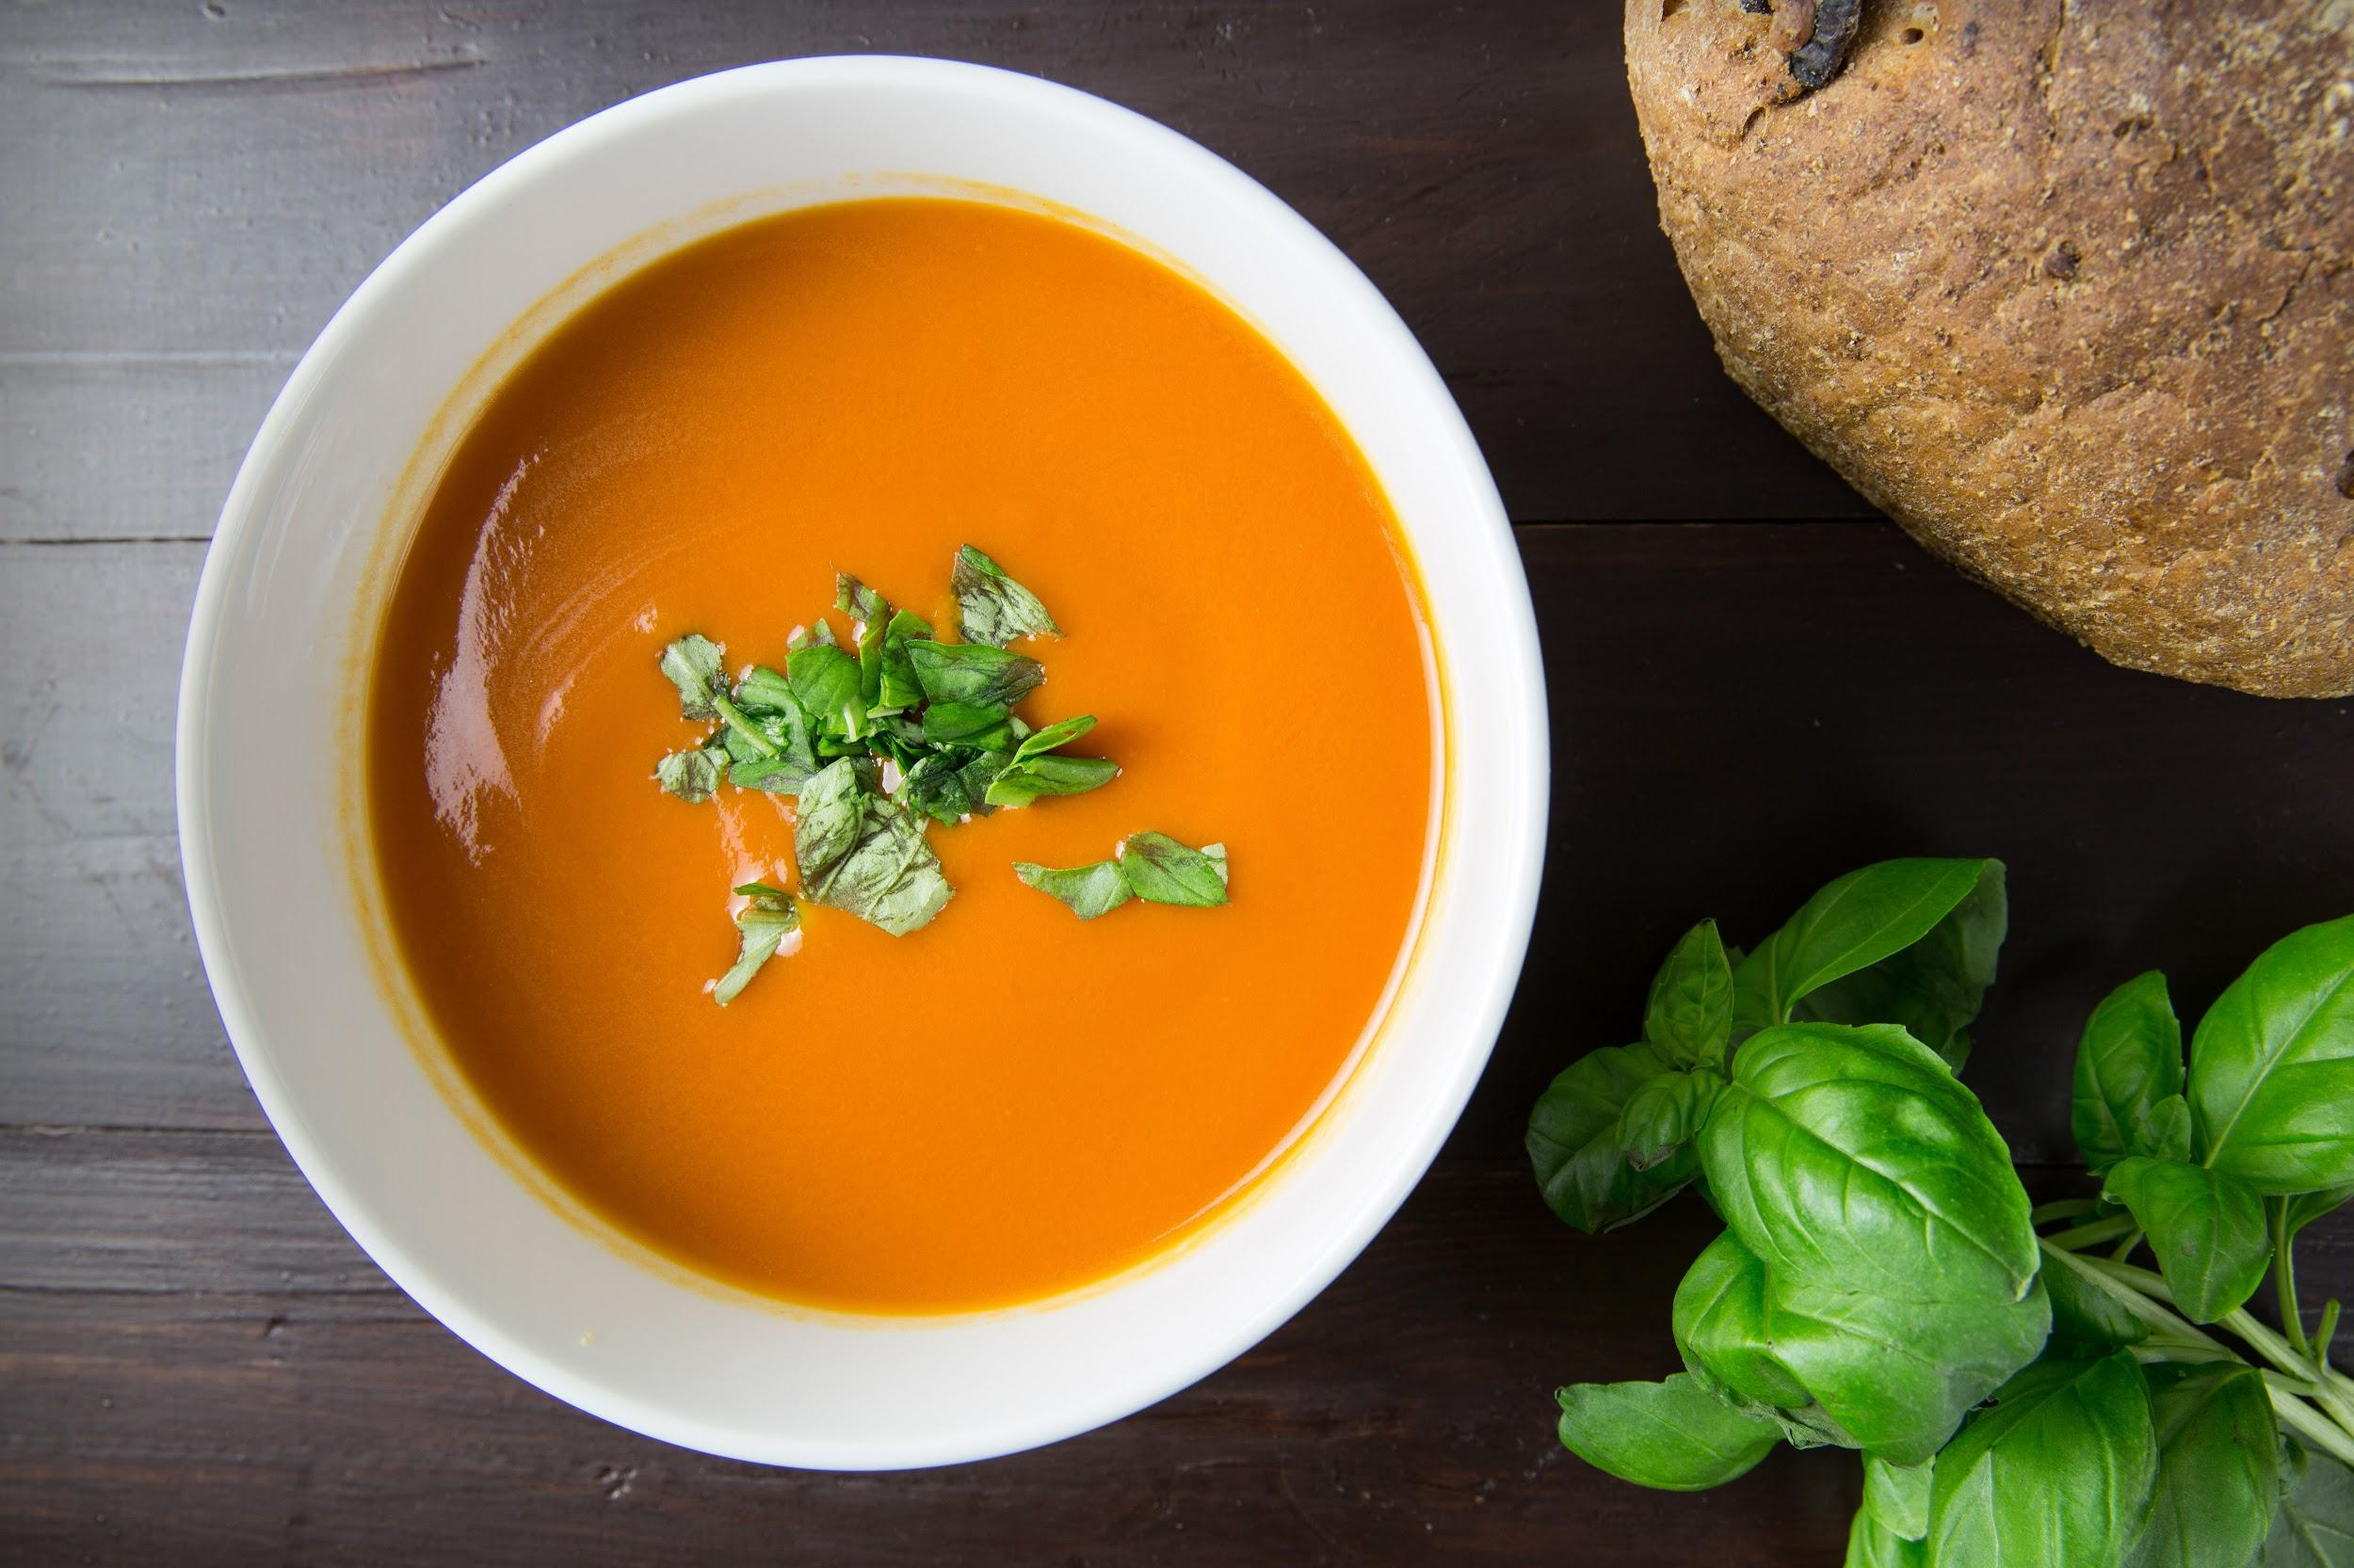
All About My Recipe:
This is a recipe my parents invented. My mom was always making a complicated lentil soup that took almost 2 hours to prepare and cook. My dad told her about orange/yellow lentils which cook a lot quicker and he showed her the basis of this soup (which he made up.) My mom changed a few things--- adding the minced garlic, a drizzle of flax oil, and her special caramelized onions on top…..this is the recipe I love!
My Spotlight Ingredient:
My spotlight ingredient is organic carrots. Carrots contain vitamin A which is turned into purple pigment which improves your night vision! It also prevents lung, breast, colon cancer along with stroke and heart disease. Not to mention it helps with the skin and the teeth and gums. In this recipe, the carrot contains a lot of power. The part of the carrot that is used in this recipe is the root. The carrot is harvested in the in between summer and fall.

Slide 20
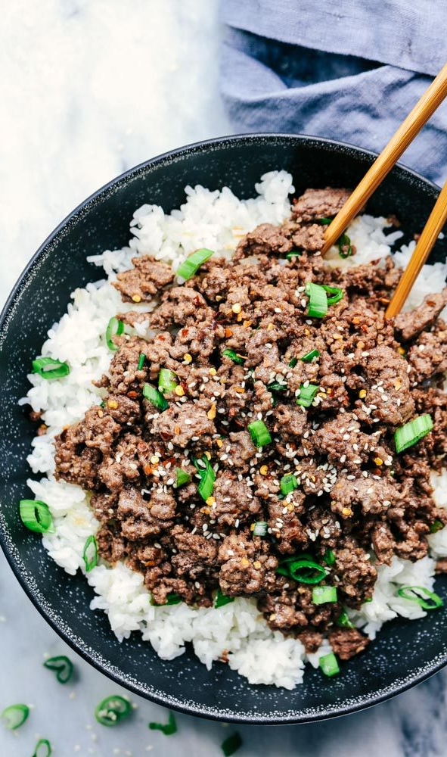
KOREAN STYLE BEEF
Sonia Dragusin
Entree
4 Servings
INGREDIENTS:
3 cloves of garlic, minced
1 pound of ground beef
3 green onions, chopped
2 tsp of sesame seeds
3 cups of white rice, cooked
Sriracha Sauce, optional
½ tsp of red pepper flakes, crushed
¼ of a cup of brown sugar
2 tbsp of ginger, grated
¼ of a cup of sesame oil
¼ of a cup of reduced sodium soy sauce
PROCEDURE:
In a large skillet, cook the ground beef and garlic, breaking it into crumbles over medium heat until it is no longer pink.
In a small bowl, whisk brown sugar, soy sauce, sesame oil, and red pepper flakes.
Serve over hot white rice and garnish with green onions and sesame seeds and drizzle as much sriracha sauce as you like.

Slide 21
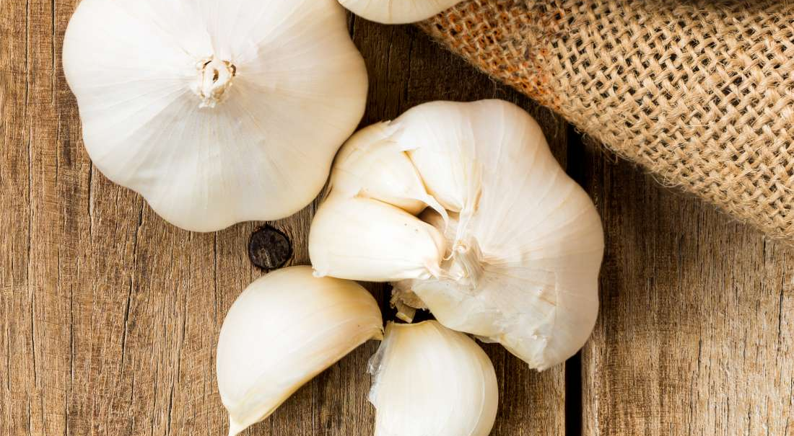
ALL ABOUT MY RECIPE
My recipe, ground korean style beef, is a great comfort food and nice on cold days. It’s warm and spicy which is why it’s one of my family’s favorite winter dish. My recipe is korea, which is not where I’m from but I still enjoy it a lot! One of my favorite memories with this is when my entire family put a lot of sriracha sauce on each of our dishes and we had a competition to see who had the most spicy tolerance! This recipe is special because I like to make it with my sister a lot and I like to cook in general.
SPOTLIGHT INGREDIENT: GARLIC
My spotlight ingredient is garlic, it’s usually white and can be a reddish purple too. A garlic bulb is split into sections called cloves which are the parts that can be ripped off, and has a spicy and a little sweet taste that is very pungent. Garlic is an underground stem and is planted in the fall and harvested usually in late July. It also was believed to have healing powers by ancients about 5,000 years ago, and it actually does. Garlic helps lower your cholesterol and blood pressure because of the antioxidants in it and regulates your blood sugar too!

Slide 22
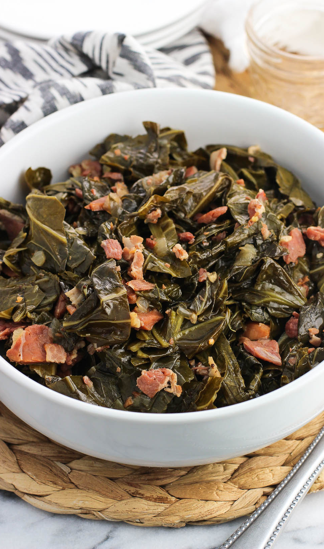
Collard Greens
Hayden Hall
Side
4-8
INGREDIENTS:
Pre washed Collard Greens {1 bag}
Chicken Stock or Water {2 cups}
Onion powder to taste
Seasoned salt {½ tablespoon}
Vinegar {1 drop}
Sugar {1 tablespoon}
PROCEDURE:
Rinse off Collard Greens
Strain Collard Greens
Put Collard Greens in pot
Sprinkle ALL seasoning
Pour on Chicken Stock
Put stove on LOW heat, let simmer
Check persistently

Slide 23
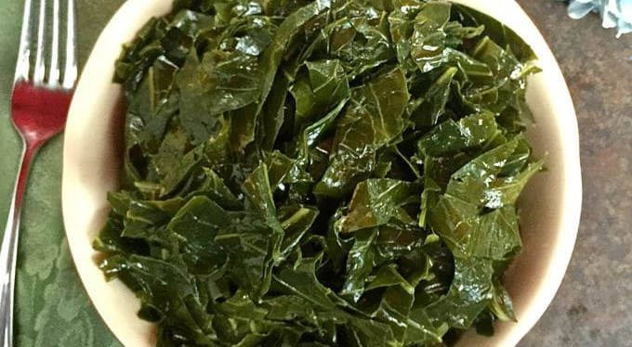
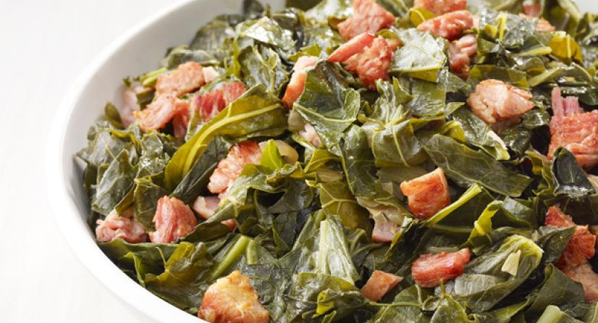
ALL ABOUT MY RECIPE
This recipe is important to myself and family because of our Southern roots. My grandmother is from the North Carolina, and it is an item that is particularly celebrated in the state. My family usually consumes this dish after church on Sunday or on major holidays. I remember when I was little we were at our church, and the service was over. After service we commonly go upstairs to eat. I loved to see the foil pans with the lighters under them. I was especially excited to see my favorite vegetable, collard greens. My recipe is from my culture’s food, soul food;soul food is southern. It generally uses pork. In my recipe, you can also at pork to it. What I think makes the recipe delicious is where it comes from. Soul food means, food from the soul and for the soul. I feel like since the soul includes love and care, that makes it good; knowing that people really used effort to make this dish for me.
SPOTLIGHT INGREDIENT: Collard Greens
My spotlight ingredient is, Collard Greens! Collard Greens taste like leafy,salty,bitter lettuce. It is a dark green and looks like a fan made out of leaves. They are the leaf part of the plant. Collard Greens are typically harvested during the spring season in its 2 year life cycle. Some health benefits include, vitamin a and c.

Slide 24
PASTA MARINARA
Will Maggio
Entree
4-6 People
INGREDIENTS:
1 cup of chopped carrots
1 cup of chopped celery
1 cup of diced yellow onion
1 cup of chicken stock
3 boxes of Pomi plum tomato puree
1 cup of white wine
1 tsp. of salt
1 tsp. of dried oregano
1 tsp. of black pepper
¼ of a cup of extra virgin olive oil
1 pound of spaghetti
PROCEDURE:
In a pot add olive oil, onions, carrots and celery. Cook until soft (about 10 mins). Add chicken stock and let reduce by half. Add tomatoes and white wine and let that reduce. Add salt, pepper and oregano and stir. Let sit on low heat for two hours. In a separate pot bring water to a boil. Add spaghetti and cook until al dente (about 10 mins). Drain that spaghetti and put back into the pot. Add sauce to the cooked spaghetti - mix and serve.

Slide 25
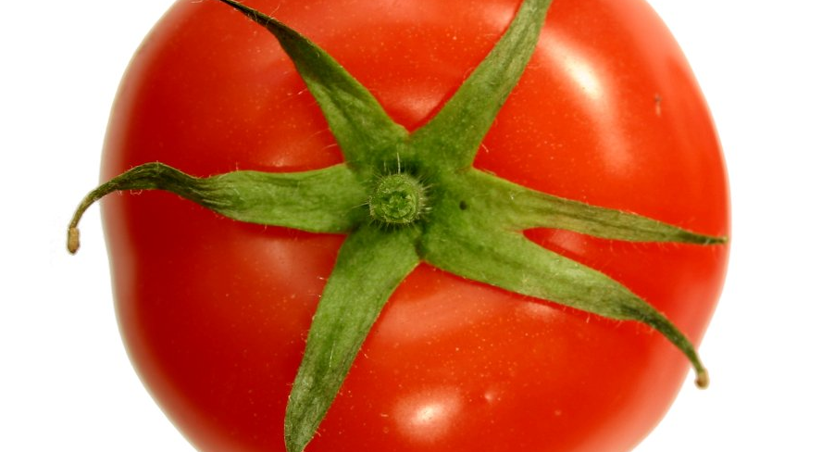
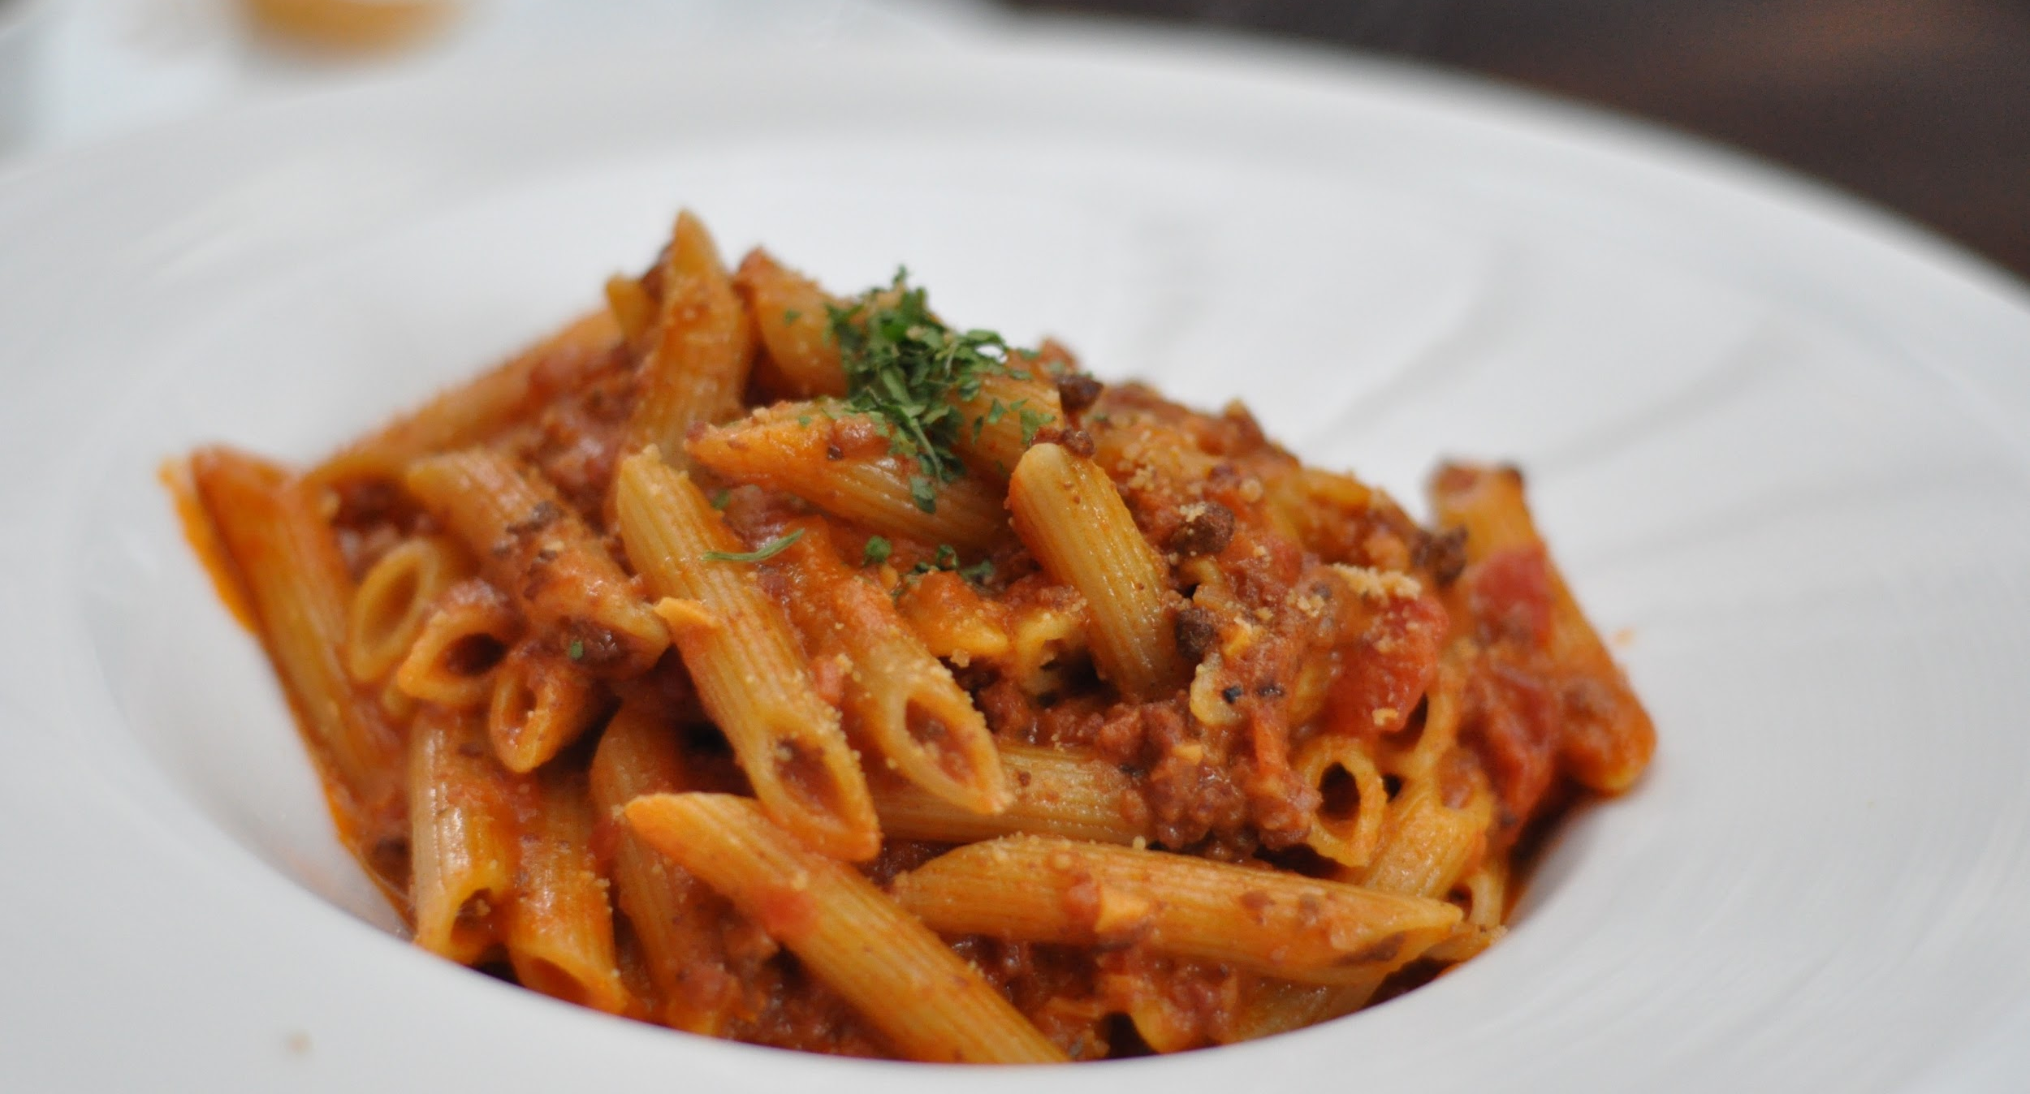
ALL ABOUT MY RECIPE
This recipe is important because it has been a tradition within my family for generations. Me and my family have that meal every single sunday. It is a way for us to stay connected to our family, even through just one meal. This recipe originated from the southern part of Italy. I find this recipe delicious because of the perfect blend of tastes that it creates.
SPOTLIGHT INGREDIENT: TOMATO
My spotlight ingredient are tomatoes. The tomatoes used in this recipe are bright red with a short green stem. It typically has a relatively sour and sweet taste. The tomato is the fruit of the plant. Tomatoes are harvested around May and early June, it generally takes about 100 days for it be to be ready for harvest. The tomato has lots of fiber, potassium, and vitamin C, all of which benefit your health strongly.

Slide 26
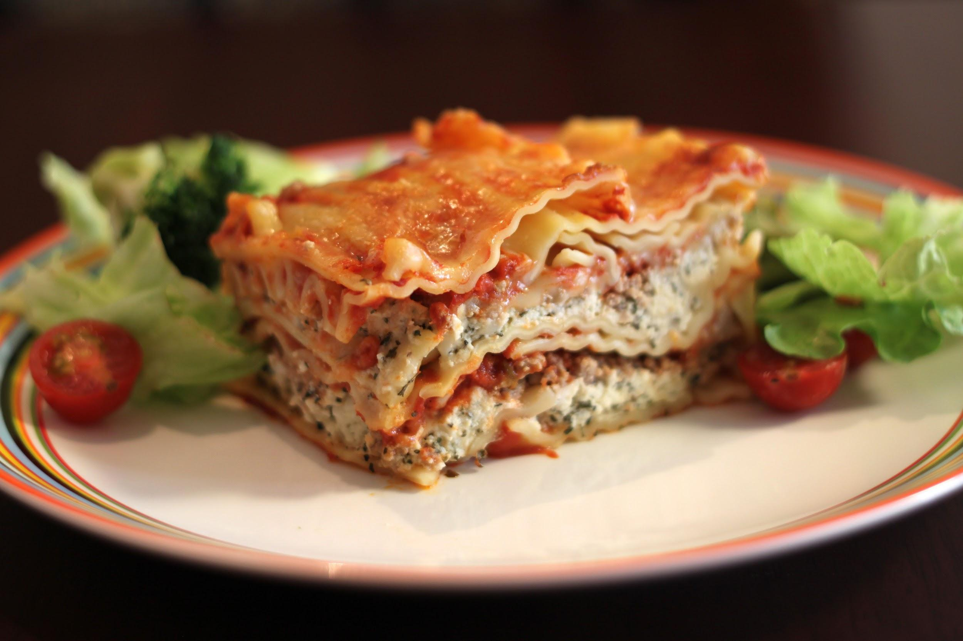
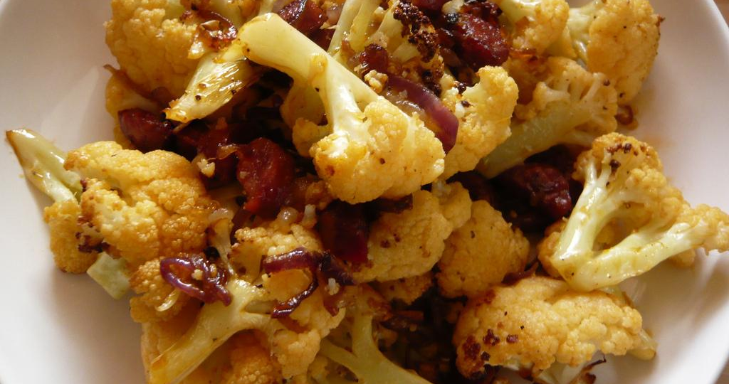
LASAGNA WITH A SIDE OF CAULIFLOWER
Seamus McGovern
ENTREE
Number of Servings: 8+
INGREDIENTS:
1 (9 ounce) box of no-boil lasagna noodles
2 eggs
1 (15 ounce) container of ricotta cheese
4 cups of shredded mozzarella cheese
1/2 cup parmesan cheese
1 pound of sausage
2 (24 ounce) jars marinara tomato sauce
Parsley (to garnish)
1 bunch of cauliflower
Olive oil and salt
PROCEDURE:
Preheat oven to 375.
In bowl, combine beaten eggs, ricotta cheese and TWO cups of the mozzarella cheese and parmesan.
If you choose not to use the parmesan, just add more mozzarella.
Set aside.
In a 13X9X3 pan, spread 1 cup of sauce on bottom of pan.
Layer in the order, 4 uncooked lasagna noodles (they will overlap), then 1/3 part of the ricotta cheese mixture, half the browned meat, 1 cup mozzarella cheese, and 1 cup of spaghetti sauce.
Next layer, 4 uncooked lasagna noodles, 1/3 part of the ricotta cheese mixture, and 1 1/2 Cups sauce.
Next layer, 4 uncooked lasagna noodles, remaining ricotta mixture and remained meat, 1 cup of sauce.
For top layer, 4 uncooked lasagna noodles, remaining sauce, and remaining 1 cup mozzarella.
Bake covered with foil for 50-60 minutes.
Uncover and continue cooking until all the cheese is melted on the top (about 5 minutes).
Let stand 15 minutes before serving.
If you are using a 13X9X2 pan---just make 3 layers to avoid boiling over.
In the meantime, wash and cut cauliflower.
Place pieces of cauliflower on a 13by9by2 pan.
Then coat with olive oil and salt to taste.
Roast at 425 degrees for 30 minutes, stirring occasionally.

Slide 27
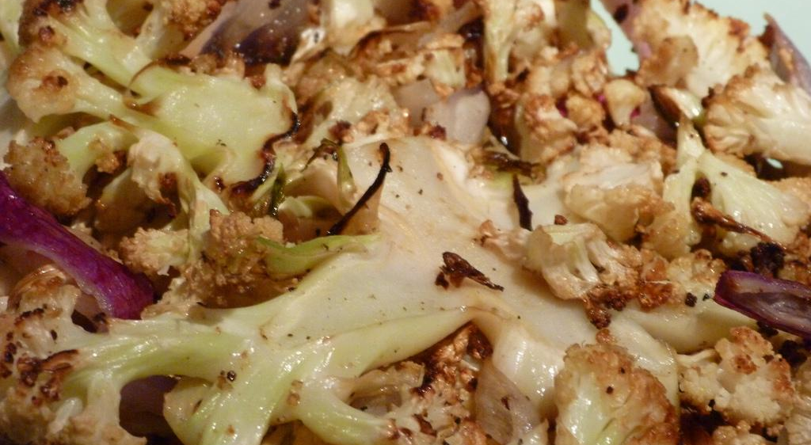
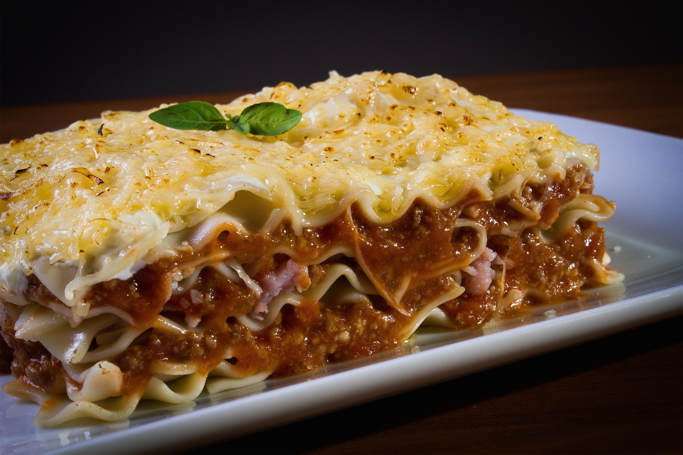
ALL ABOUT MY RECIPE
Lasagna is special for me because I really enjoy it and gives me something to look forward to for dinner. A memory of lasagna was that someone gave us lasagna for my family when I was born, now we have lasagna when other people come over. My family doesn’t really have lasagna for tradition, but we mainly have it during the winter. I like lasagna and cauliflower because lasagna is really cheesy and tastes like pasta. I like cauliflower because I like the tastes, and it isn’t to sweet or to hot.
SPOTLIGHT INGREDIENT: CAULIFLOWER
My spotlight ingredient that I saw at the green market was cauliflower. Cauliflower looks like a tree and it tastes a little bit like rice and has a mild taste. Cauliflower is from the flower or stem of a plant. Cauliflower is harvested when the head of the cauliflower opens up. It usually takes around 6 to 8 months to harvest. Some benefits of a cauliflower is it keeps your bones healthy because it has vitamin C and vitamin K.

Slide 28
Strawberry Smoothie
Hakkai Compere
breakfast
1-2 servings
INGREDIENTS:
3 strawberries
1 banana
10 blueberries
1 cup of protein powder
some milk
as many cocoa nibs as you want.
PROCEDURE:
Put 3 strawberries in blender.
Put 1 banana in blender.
But 10 blueberries in blender.
Put 1 cup of protein powder in blender.
Put milk past fruit and protein powder.
Add as much cocoa nibs as you want.
BLEND!

Slide 29
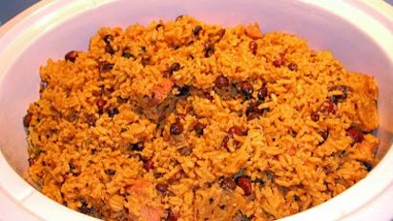
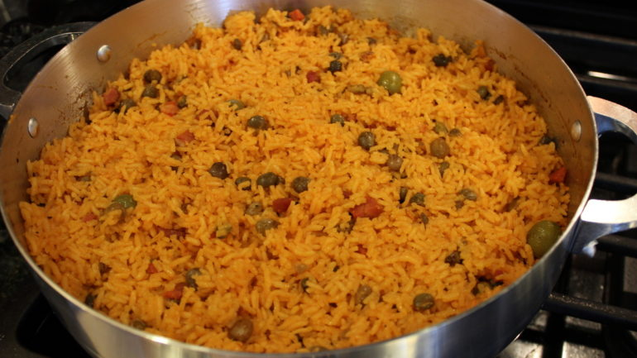
RICE AND BEANS
Steven Gomez JR
Recipe Type
Number of Servings
INGREDIENTS:
white rice beans
water
salt
oil
rice 3-4 cups salt to your liking oil 2 tbsp,water 3-4 cups,beans,1 can of goya bean,2-3 tbsp of sofrito 1 pack of saz`on,a sprinkle of abobo,about one can and ½ of water (so after you put the beans in the pot, fill the empty can of beans
PROCEDURE:
: white rice, rice 3-4 cups salt to your liking oil 2 tbsp,water 3-4 cups,beans,1 can of goya bean,2-3 tbsp of sofrito (green peppers,garlic,onions,cilantro,and recao),1 pack of saz`on,a sprinkle of abobo,about one can and ½ of water (so after you put the beans in the pot, fill the empty can of beans with water and pour in pot and then ½ of the can with water).

Slide 30
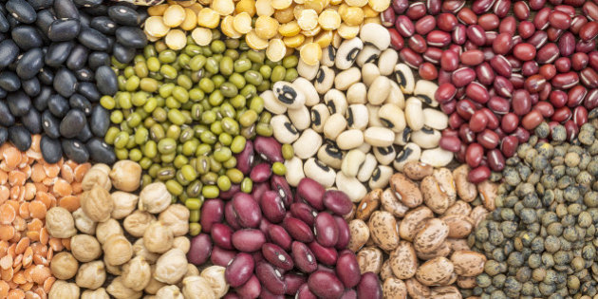
SPOTLIGHT INGREDIENT: Beans
My spotlight is Beans, my spotlight ingredient is really good in my opinion, it is many different colors of the beans. The part of beans is the seed. The plant should be pick after, two or four weeks, and the bean must firm and crisp, and pliable tips. Some of the healthy parts of my spotlight ingredient is that it gives protein, it gives fiber, iron, folate, calcium, potassium, phosphorus, and zinc, and it can lower a lot of heart stof.

Slide 31
RICE KRISPIE CAKE (with blueberries)
Cooper Richmond
Dessert
Serves 4-8 People
INGREDIENTS:
4 cups marshmallows (the smaller ones)
10 cups Rice Krispies (homemade or store-bought)
Any amount of blueberries
PROCEDURE:
In a large saucepan melt over low heat. Add 4 cups of marshmallows & stir until completely melted. Remove from heat.
Add the Krispies & stir until well coated.
Using buttered spatula or wax paper evenly press mixture into spring-form pan coated with cooking spray. Cool & cut into 2-inch squares.
Decorate with blueberries.
NOTE: for 2-tiered cake, make 3 batches.

Slide 32
SPOTLIGHT INGREDIENT: BLUEBERRIES
My spotlight ingredient is blueberries. They look like small blue orbs with little openings at the top. They taste like a cross between an apple and a citrus fruit. The berry, if you didn’t guess is the berry on the blueberry plant. They should be harvested about five years after planting. They are low in calories but high in nutrients.

Slide 33
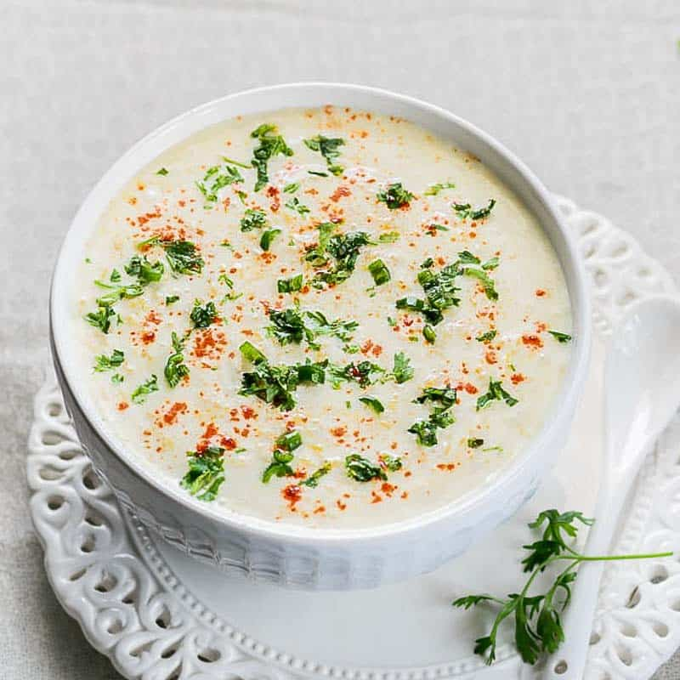
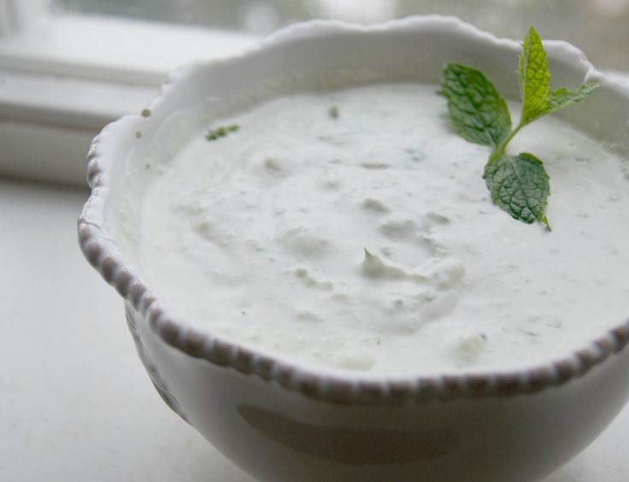
Raita
Amelia Khurana
Sides
8 servings: size serving is ⅓ cup
INGREDIENTS:
1 shredded cucumber (about 2 cups)
1 teaspoon of kosher salt
2 cups of whole milk yogurt
½ cup of chopped red onions
¼ cup coarsely chopped fresh cilantro
2 tablespoons of fresh lime juice
¼ teaspoon ground coriander
¼ teaspoon ground cumin
⅛ teaspoon freshly ground black pepper
Dash of ground nutmeg, cinnamon, and cardamom
PROCEDURE:
Place cucumber in a colander and sprinkle with salt.
Toss well and drain for 30 minutes. Rinse with cold water and drain.
Put cucumber on many layers of paper towels and cover with more paper towels. Let sit for 5 minutes, pressing down occasionally.
Combine the cucumber, yogurt, and the rest of the ingredients.

Slide 34
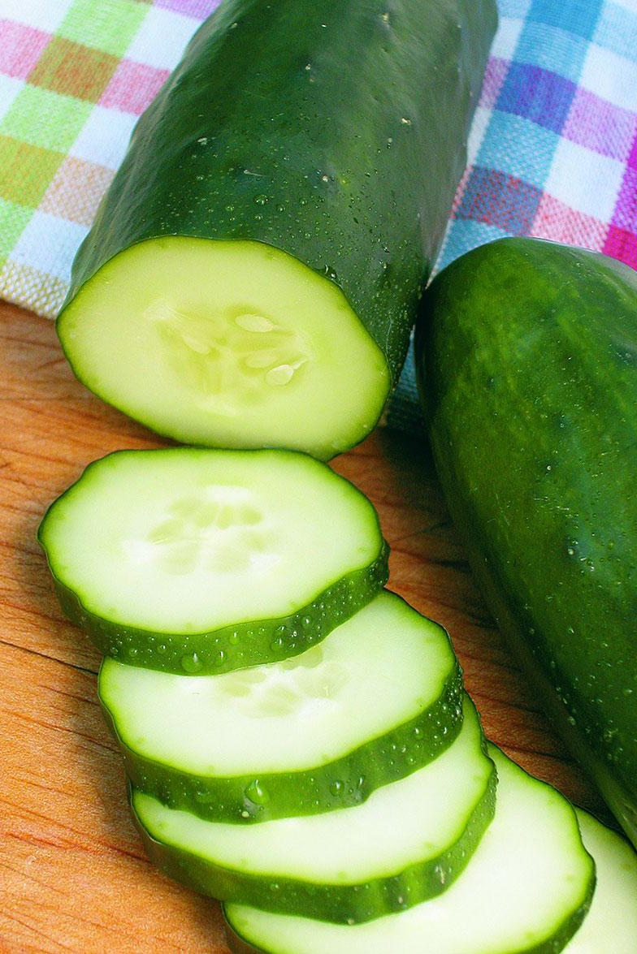
SPOTLIGHT INGREDIENT: Cucumber
My spotlight ingredient is cucumber. They are long, round, green vegetables with the occasional pale green stripe. Cucumbers provide a lot of potassium, which is why cucumbers water is so popular. Cucumber is the main part of this recipe. It gives a soothing flavor to the other spices. Raita is used to calm your mouth when eating spicy foods, specifically Indian dishes. Cucumber is the fruit of the plant. Cucumbers are harvested in periods of time that are warm. It takes 50 to 70 days to grow.Cucumbers are very sensitive to the climate that they are in. They will not thrive in cold or hot temperatures.
Raita is an Indian condiment/dish, so I normally eat it at my grandma’s house when we visit her. We see her mostly on holidays, especially on Diwali. Diwali is an Indian holiday, also known as the Festival of Lights because we light a lot of candles and tell stories about Hindu gods. I celebrated Diwali on 11/9/18 this year and it was especially important because it would be my cousins’ last Diwali, since they were going to college next year. I have only ever had riata at her house and it is always good. The best part is that it can be a dipping sauce or a yogurt to eat with a spoon. The part that makes it so great is the cucumber because it is hidden but still explodes with flavor.

Slide 35
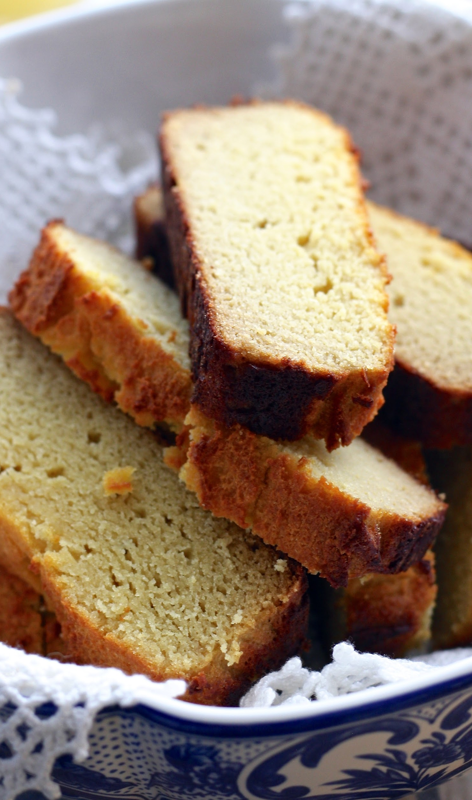
Pumpkin Bread
Thomas Dono
Desert
5-6 servings
INGREDIENTS:
1 Pumpkin (canned)
1c sugar
1 egg
1 ½c flour
¼c (½ stick) butter
1tsp baking soda,
1tsp salt.
PROCEDURE:
Preheat oven to 350 degrees F (175 degrees C). Grease and flour 7x3 inch loaf pans. (use how many you want)
In a large bowl, mix together pumpkin, eggs, oil, water and sugar until well blended.
Bake for about 50 minutes in the preheated oven.

Slide 36
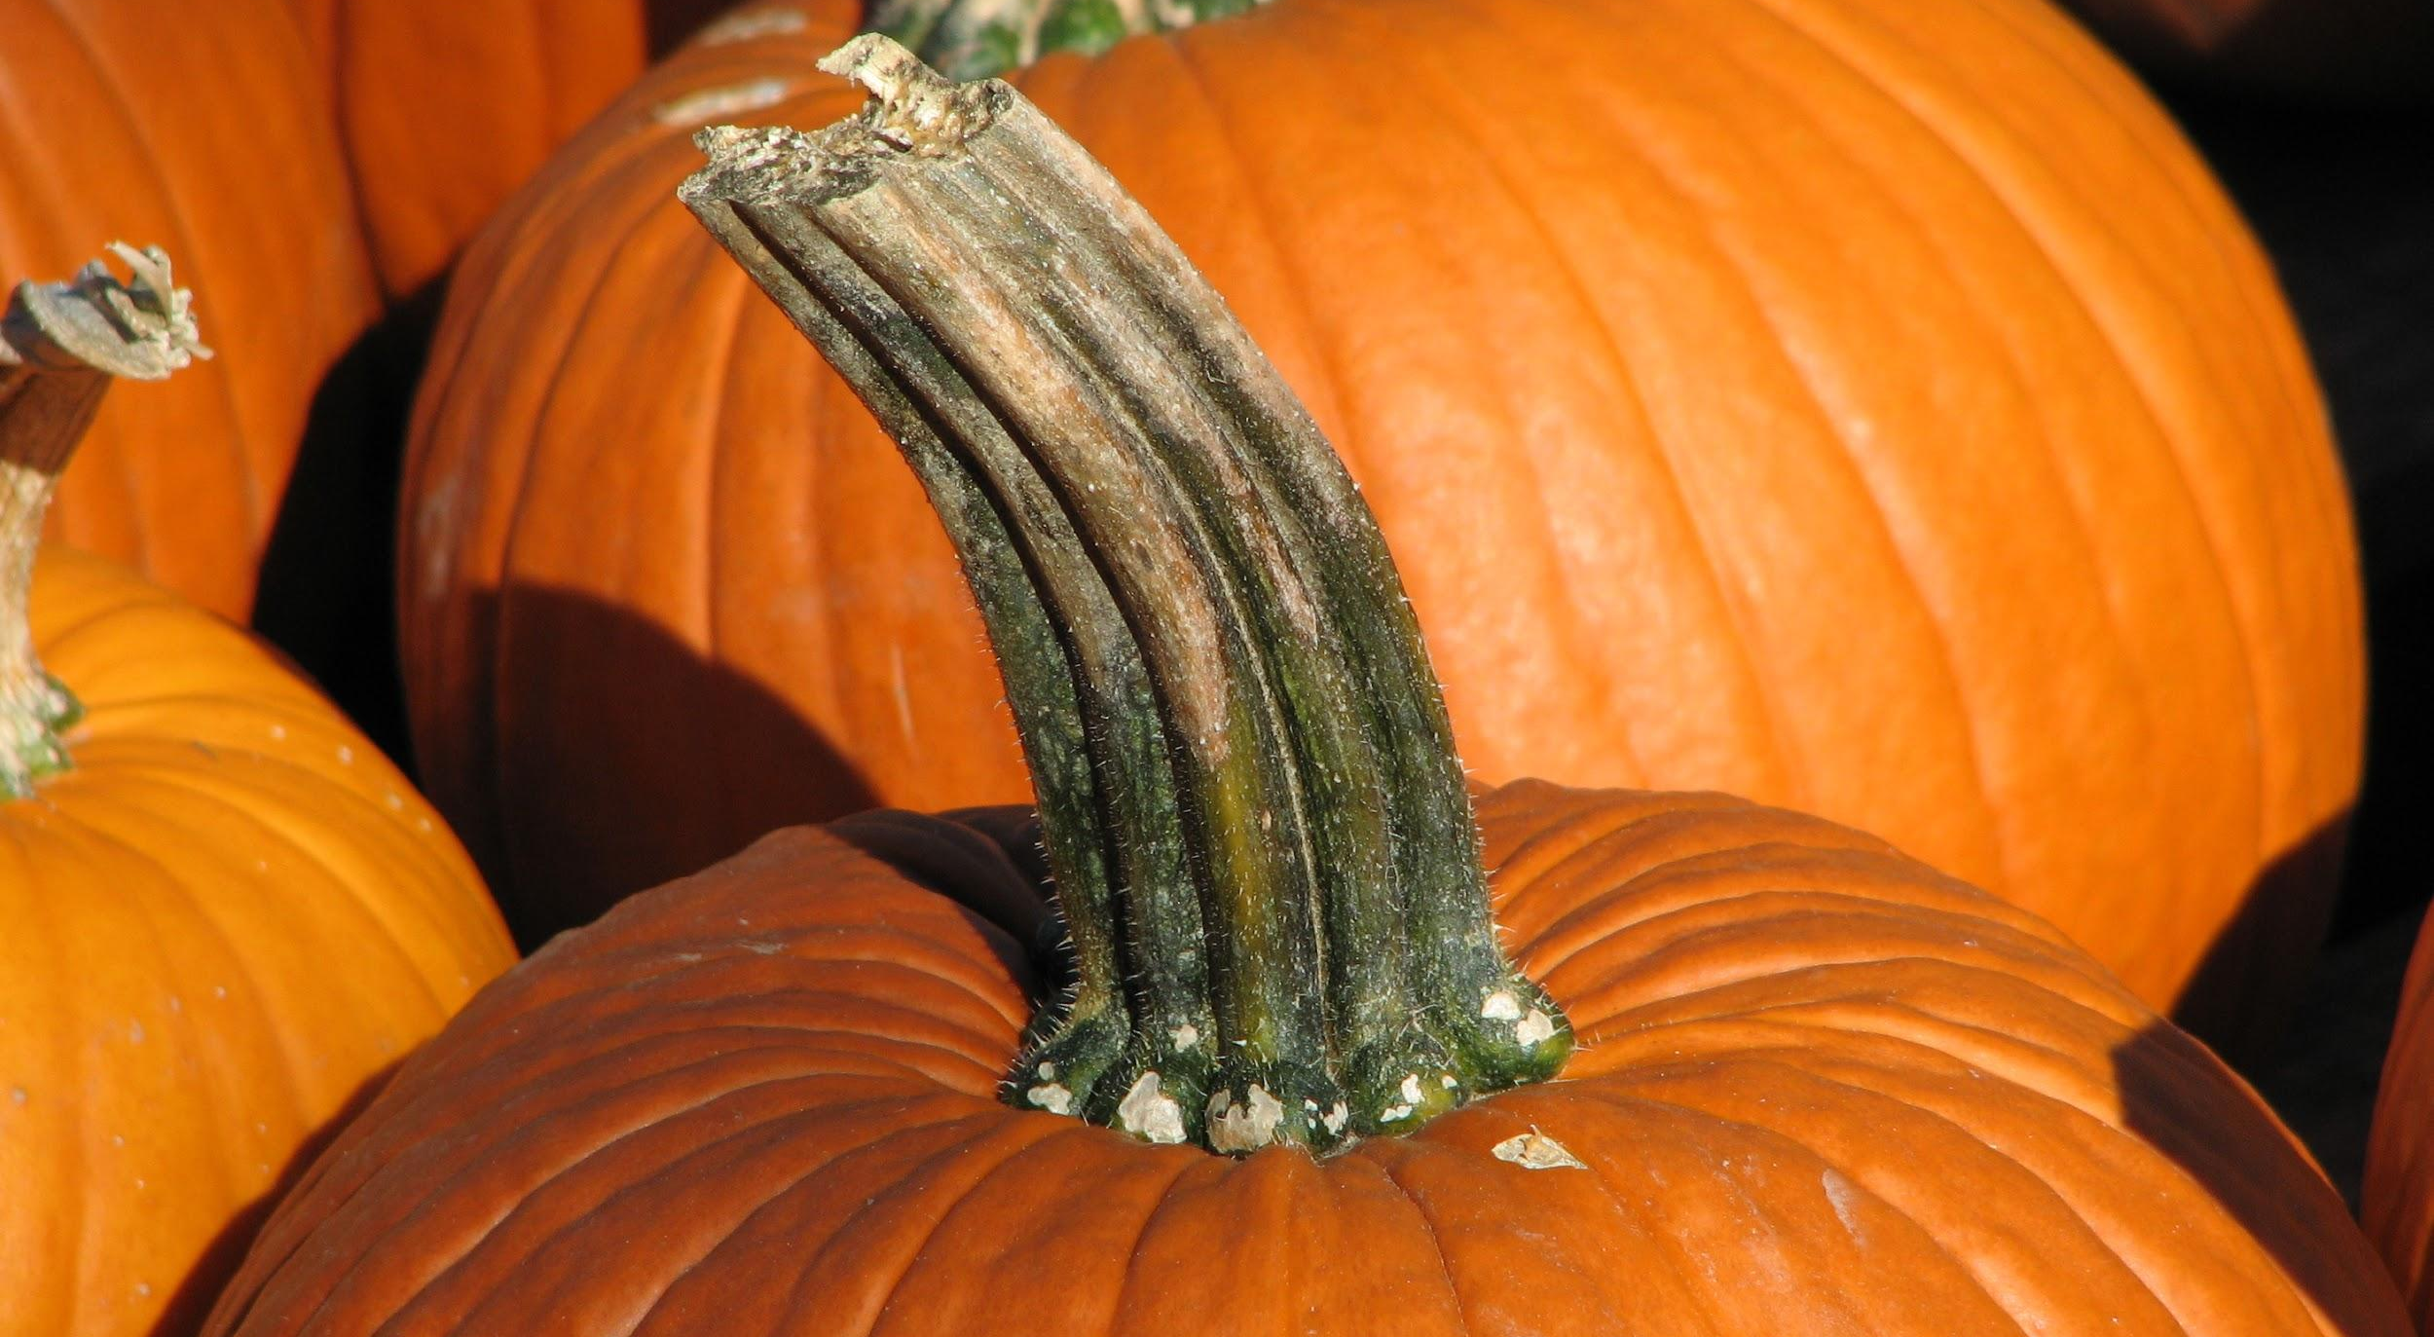
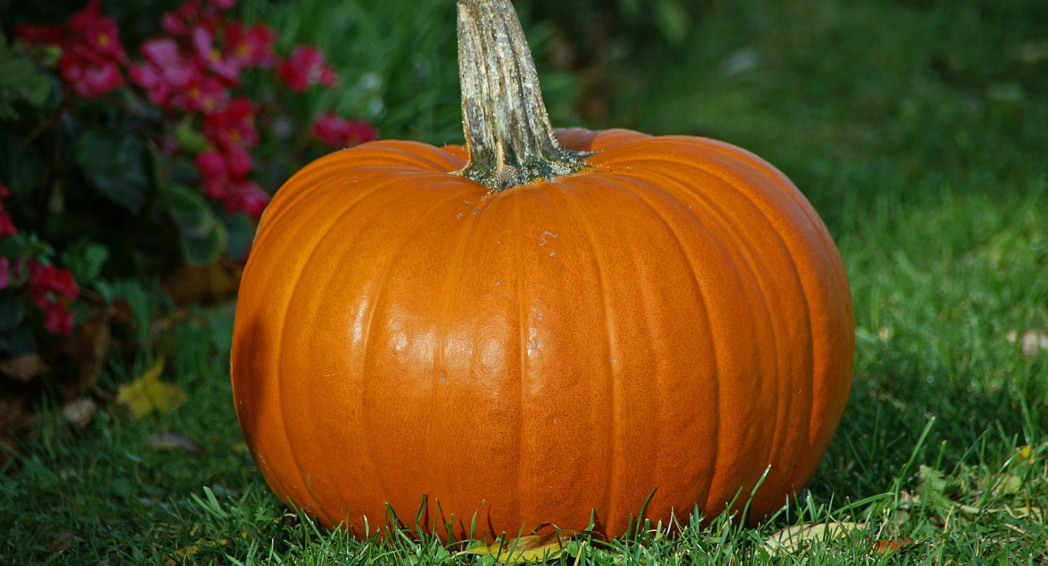
ALL ABOUT MY RECIPE
This recipe is special to my family because it’s my mom’s
Recipe. This is not something we have on a special Occasion it just something we love to eat and it tastes really good. This Is not a recipe that is from a culture.
SPOTLIGHT INGREDIENT: Pumpkin
Pumpkin. A pumpkin is a large rounded orange-yellow fruit with a thick skin, edible flesh, and lots of seeds. A pumpkin is a fruit. Pumpkins need between 90 and 120 days before harvest time. Harvest after flower blooming. Pumpkins are good sources of iron, vitamin C, potassium, magnesium, and the dark orange carotenoid called lutein, which is important for prostate and heart health..

Slide 37
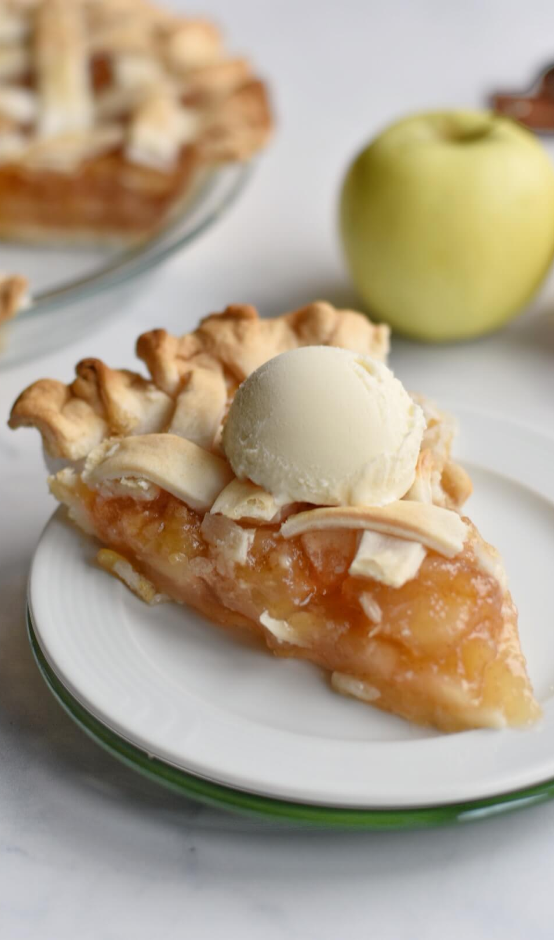
Apple Pie
Anasofia Rice
Dessert
Serves 8 people
INGREDIENTS:
6 cups of sliced Red Delicious apples
¾ cups of brown sugar
¼ teaspoon salt
⅛ teaspoon ground nutmeg
premade pie crusts
egg wash (whisked egg whites)
PROCEDURE:
Preheat oven to 425 degrees Fahrenheit
Line a 9-inch pie pan with a disc of pie crust
In a large bowl, gently mix all of the filling ingredients
Spoon the filling evenly into the pie pan
Top the pie with another disc of pie crust
Trim any excess dough from the edges
Pinch the edges of the dough until it is completely sealed
Brush a thin layer of egg wash over the top layer of dough
Make a few slits in the dough
Put in the oven to bake for 40-45 minutes (after the first 15-20 minutes, cover the edge of the crust with strips of foil to prevent excess browning)
You are done!

Slide 38
SPOTLIGHT INGREDIENT: Red Delicious Apples
My spotlight ingredient is Red Delicious apples. Red Delicious apples are deep red in color, with a sweet but slightly bitter taste.This is the fruit of the plant. It takes 2-10 years for an apple tree to start producing fruit, and 100-200 days for the apples to be ready for harvesting. They are usually harvested in early fall. Apples are full of antioxidants, and dietary fiber. They help reduce the risk for diabetes, heart disease, and cancer. They are often sprayed with pesticides, so they should always be washed before eating.
This recipe is special to me because in the fall, my dad and I are like to eat apple pie for dessert. This is also very important to me because my grandmother was a big cook, and she was well known for her apple pies. Apple pies are usually made with Granny Smith apples, but in her recipe she used Red Delicious apples. This makes the recipe very unique to my family and I.

Slide 39
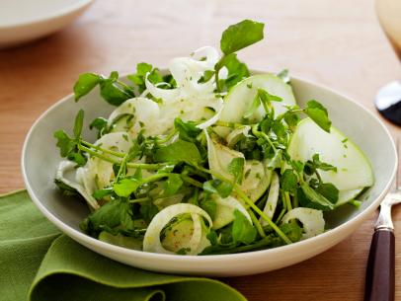
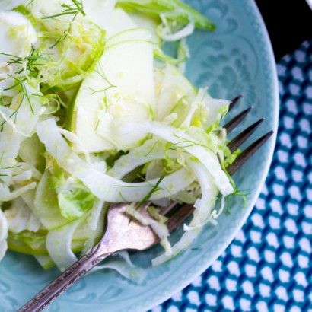
Apple and Fennel Salad
(Ag
Darby Lind
Salad
6-7 servings
INGREDIENTS:
3 green apples
3-4 pieces of fennel
apple cider vinegar
salt
mint (optional)
PROCEDURE:
Take Fennel, cut it into julienne (matchstick shape) and do the same to green apples
Use a green (either the top of fennel, arugula, etc.)
One splash of apple cider vinegar
Add a small amount of olive oil
Add mint (optional) and 2 pinches of sea salt
mix together

Slide 40
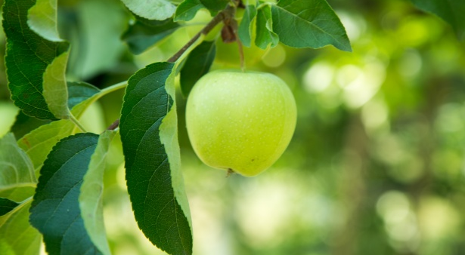
ALL ABOUT MY RECIPE
This recipe is important to my family because this is the most common salad we make, and it is something that we like to eat together. No it is not from any culture or religion, but my dad usually makes it. The thing that makes it delicious is probably when you eat the apples and fennel in one bite, because they go well together. We don’t eat it on any special occasion but we eat it every week or so.
SPOTLIGHT INGREDIENT: GREEN APPLE
My spotlight ingredient is green apples. My family usually eats this salad on sundays when everyone is home, and this is important to me because it is probably my favorite salad to eat, and it is something that almost everyone can like . The best time of the year to get green apples is during the fall, most of the time the apples are light green, but they can have blotches of red, and yellow. The ideal texture of the apple should not be mealy, instead it should be crunchy. The part of the plant the green apple is, is the fruit. The tree usually starts producing good apples, at 4-6 years old. And specifically the granny smith is a late harvest tree, usually harvested oct-jan. And granny smith apples are usually harvested 200 days after blooming in the spring. A common saying is “apple a day keeps the doctor away”, this can be true because it has a lot of benefits to the human body including: High vitamin C rates, anti-antioxidants, and lots of fiber. Apples have a lot of other uses, especially in food: Apple pie, apple tart, fruit salad, etc.

Slide 41
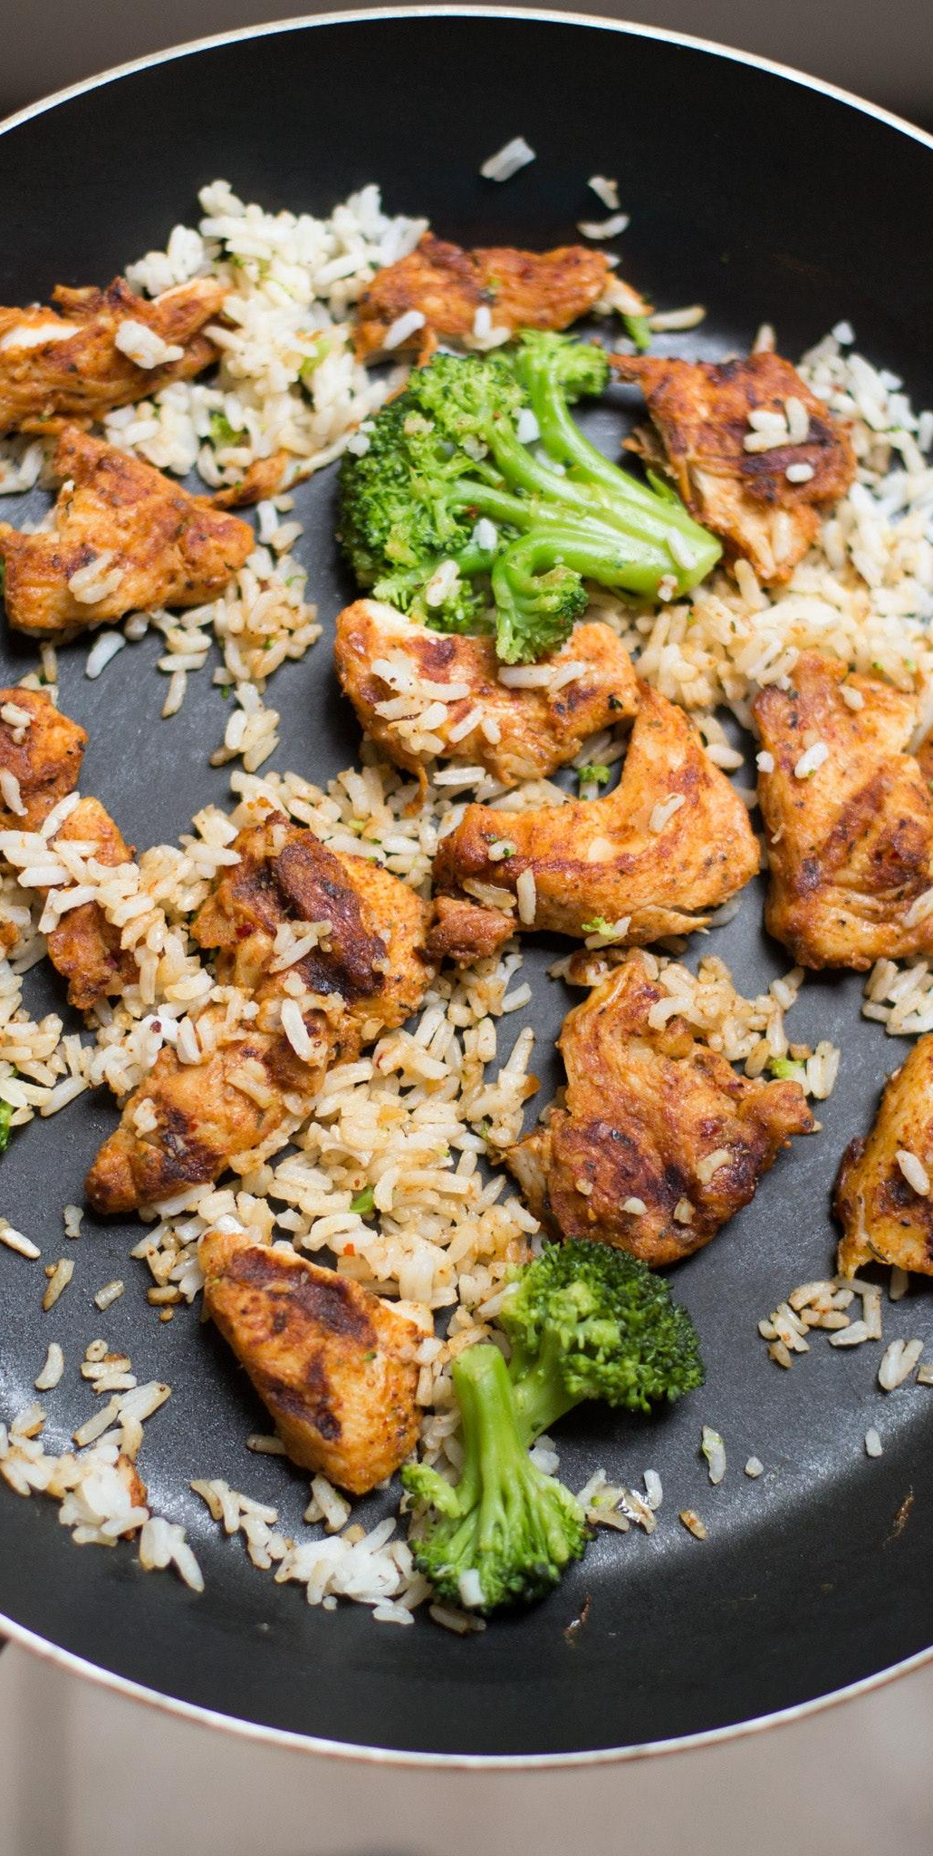
Chicken Broccoli
Willow Roundy
Recipe Type: Entree
Number of Servings: 3-4 people
⅔ cup soy sauce
¼ cup brown sugar
1 pinch pepper flakes
2 tablespoons water
2 tablespoons cornstarch
2 tablespoons vegetable oil
3 skinless boneless chicken breast halves cut in chunks
one onion sliced
3 cups broccoli florets
PROCEDURE:
Stir soy sauce,brown sugar,ginger and pepper flakes in a bowl to dissolve sugar into liquid. Mix water and cornstarch together in small bowl mix until cornstarch dissolves.
Heat oil in large skillet over high heat. Fry chicken and onion in hot oil until chicken is not pink in center and onion is tender, 5-7 minutes. Stir broccoli with onion and chicken; saute until broccoli is hot, about 5 minutes. Push chicken vegetable mixture to the side of the skillet.
Pour soy sauce mixture in vacant part of skillet. Stir cornstarch slurry into soy sauce mixture until the color is consistent. Move chicken and vegetables back to the center of the pan; saute until sauce thickens and coats the chicken and vegetables, about 5 minutes more.

Slide 42
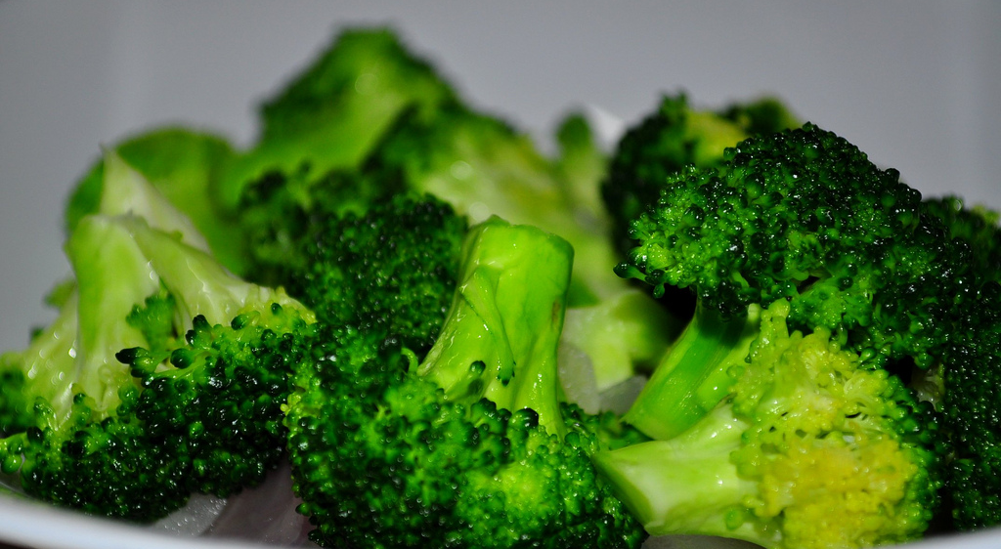
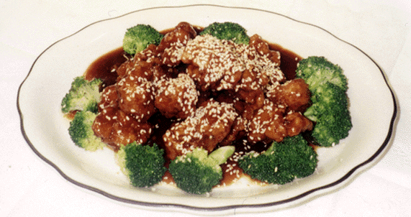
ALL ABOUT MY RECIPE
I always order Chicken and Broccoli when I have Chinese food. I share a container with my dad because the servings are so humongous. Even though I am just sharing food, it is a fun time with my dad because we always watch a show together when we order in. Chicken Broccoli is usually a Chinese- American dish.What I love about it is how it tastes sweet and salty and has a combination of kinds of food in it.
SPOTLIGHT INGREDIENT: CAULIFLOWER
My spotlight ingredient is broccoli. Broccoli is a plant that varies from a dark green color to a green with a purplish tint. The stem and bud are the most commonly eaten. Broccoli is bumpy in some places and smooth in others. It tastes bitter but other than that not very flavorful. Broccoli is a flower. Broccoli is usually picked in the spring or fall it grows for about 8 weeks before being picked. Broccoli has vitamin k and calcium in it. It also contains things that fight cancer and provides a lot of vitamin C.

Slide 43
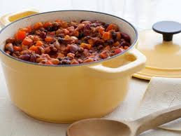
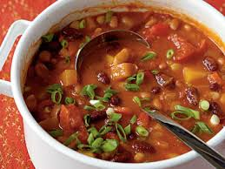
Number of Servings: One big pot for 12
3 Bean Chili
INGREDIENTS:
2 tablespoons olive oil
2 onions
Salt and Pepper
Two thinly sliced Carrots
2 cloves of garlic
2 tablespoons tomato paste
Jenna Medina
1 can tomatoes
1 teaspoon cinnamon
1 can tomatoes
1 can black peas
1 can pinto beans
1 can garbanzo beans
¼ cup apple cider vinegar
2 tablespoons cumin
2 tablespoons chili powder
2 tablespoons smoked paprika
1 teaspoon cinnamon
1 can tomatoes
PROCEDURE:
1. In a big deep pot heat oil on low heat add all of the onions and a pinch of salt and stir them until they are lightly brown for about 15-20 minutes.
2. Add your carrots and onions to the same pot and stir in tomato paste. Cook for about 5 minutes until the carrots are softened.
3. Add all of your spices in the pot, add the canned tomatoes and the beans. Then cook over low heat, and you can stir occasionally until the flavors mix and the chili thickens, for about 45 minutes.
4.Add a splash of Apple Cider Vinegar and some more salt and pepper then taste and Enjoy!

Slide 44
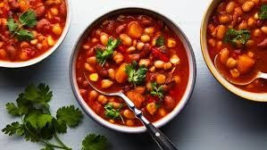
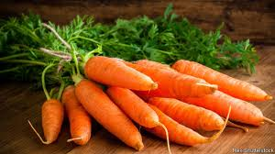
I learned how to make this recipe in a cooking class that I go to on Thursday where we bring home dinner. When I brought my Chili home that night my family loved it we even had left overs that we all took for lunch the next day. It was a perfect meal for my family since my sister is a vegetarian and it was vegetarian Chili, we all thought it was delicious! We don’t particularly cook this Chili on holidays, but we usually cook it for dinner. This recipe does not come from a particular culture but my family and I love to eat it. I think for me all the beans and sour cream just make it so yummy it's just so creamy and my taste buds ask for more.
My spotlight ingredient is carrots, I choose carrots because without them the Chili is not the same. Carrots are very soft when you cook them they are filled with juicy flavor and taste amazing! They look soft and orange on the outside and is very smooth. I know carrots are a root because they grow under the ground. Carrots are vegetables and are very healthy and delicious, they also could help you see. It takes 3 weeks in order to harvest carrots.

Slide 45
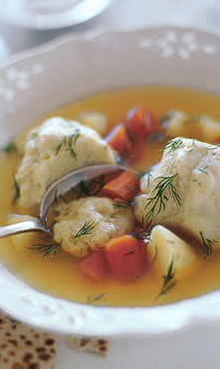
Matzo Ball Soup
Benjamin Israel
Soup
Servings: 6-8
INGREDIENTS:
2 5-pound chickens
3 large yellow onions, peeled and quartered
6 carrots, peeled and chopped into chunks
4 stalks celery with leaves, cut into thirds
4 parsnips, unpeeled and cut in half
1 purple turnip cut into small pieces
1 bunch fresh parsley
1 bunch fresh dill
5 large cloves of garlic
2 large leeks cut up
3 tablespoons kosher salt
2 teaspoons ground black pepper
Matzo Balls (recipe follows)
PROCEDURE:
MATZO BALLS
Use a box of manischewitz matzo ball mix.
Put up a pot of water to boil.
For each packet of matzo ball mix add two eggs, and a quarter cup of canola oil.
Mix well and place in the refrigerator for 15 minutes.
Then take the mixture out of the refrigerator and with wet hands form balls the size of a walnut and place them in the boiling water.
Cover the pot and cook for 30 minutes at a lower temperature.
When they are done, remove from the pot with a slotted spoon into a bowl. Then put them in the soup.
SOUP
Place the chicken and salt in to a large pot of boiling water. As it cooks skim off the fat that floats to the top.
After 45 min throw in onions, carrots, celery, parsnips, parsley, dill and garlic in the soup pot with the chicken and cook for an hour and a half.

Slide 46
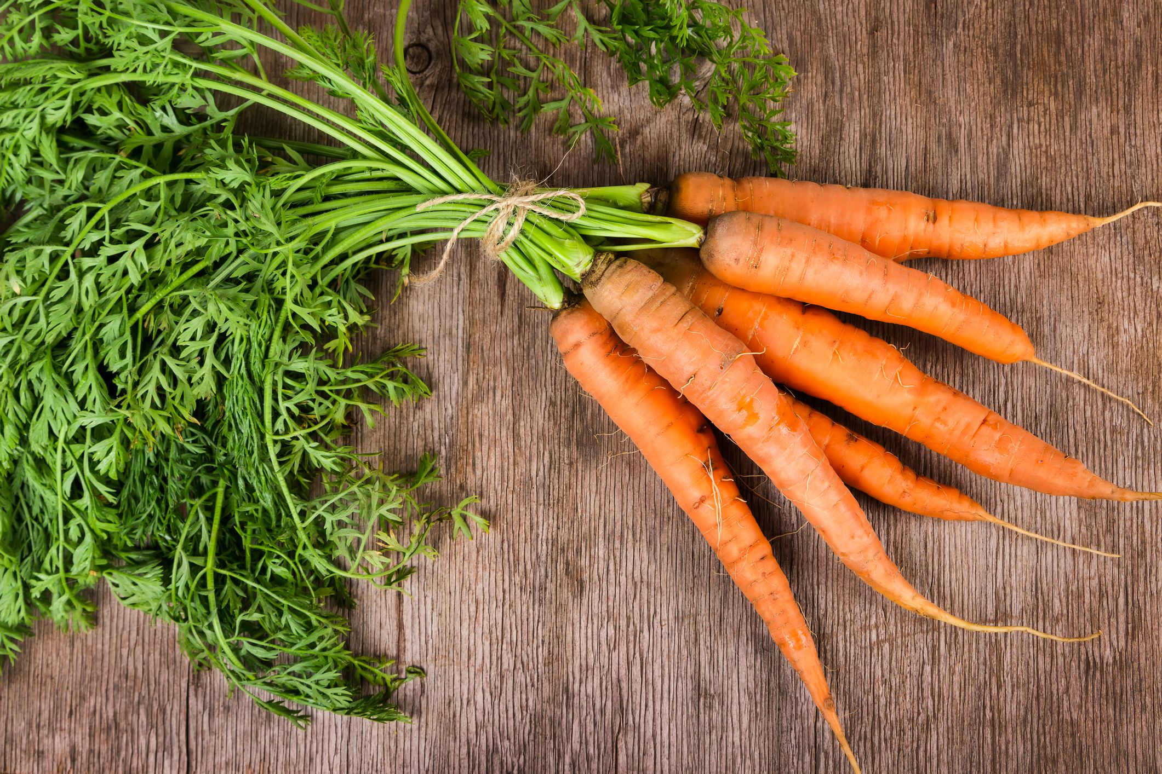
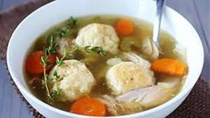
ALL ABOUT MY RECIPE
The significant thing about this Matzo Ball Soup recipe is that my grandmother, Priscilla makes it every Passover and Rosh Hashanah. It is one of my favorite foods because I love the flavor of the broth and the texture of the matzo balls. One of my memories is that it was one of the only foods I ate at Passover when I was little and one time I ate thirteen matzo balls. Matzo balls are eaten at Passover in the Jewish tradition because we are not allowed to eat anything that rises made of grain so we eat matzah and matzo ball soup. This matzo ball soup is filled with proteins, vitamins and will make you feel better if you have a cold.
SPOTLIGHT INGREDIENT: CARROTS
My spotlight ingredient is a carrot.
Carrots are long, orange and have green leaves.
They taste very good in soups because they become very soft and sweet. Raw carrots are also good and taste sweet
and are very crunchy.
Carrots are the roots of the plant that they grow on.
Carrots take 2-4 months to grow from their seed.
They should be planted outdoors 3-5 weeks before the last spring frost date.
Carrots are rich in sugar, vitamins and carotene.
Carrots are harvested when the root is ready.
Some health benefit of eating carrots are lower risk of heart attacks, improved vision and a stronger immune system.

Slide 47
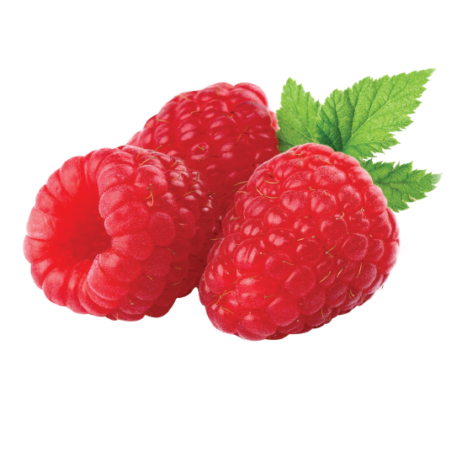
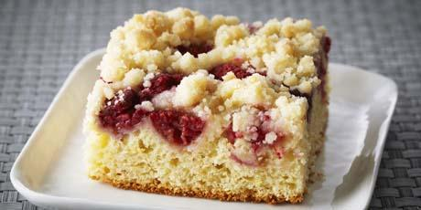
Raspberry Buckle
Sierra Weissman
Dessert
8-16 servings
INGREDIENTS:
1 egg
½ cup of milk
2 cups of flour
¼ cup of salt
1 ¼ cup of well drained razzberries
1t cinnamon.
¾ cup of sugar ×2
¼ cup of melted butter
⅔ cup melted butter
2t baking flour;
PROCEDURE:
Mix sugar, ¼ cup butter and egg.
Then, stir in milk and add flour, baking powder and salt
After that add the razzberries into the mixture.
Put batter into a well buttered pan.
Then sprinkle with sugar, flour, ⅔ cup butter and sugar (mixed)
Bake at 375 fahrenheit for about 35-40 minutes.

Slide 48
ALL ABOUT MY RECIPE
The blueberry buckle recipe has been in my family for years. When I was younger, my dad and I would make it during the summer and eat it all the time. Then a few months ago, our buckle-making tradition didn’t just happen in the summer, but year round. My family had great experiences with the buckle and it brought us together.
SPOTLIGHT INGREDIENT: Raspberries
My spotlight ingredient is the razzberry. Is is a fruit that is that is best harvested in the summer months. It takes about 13-15 months for a razzberry to fully ripen. A razzberry is a red, cup shaped fruit made of droplets that has a sweet, tangy flavor. Raspberries have vitamin C and acids that fight cancer.

Slide 49
Apple Pie
Dessert
Jonas Cruz
Serves 4 to 8 people
INGREDIENTS:1 basic pie dough; 2 tablespoons unbleached all purpose flour; 3 large Granny Smith apples (about 1½ pounds);
4 large Golden del apples (about 2 pounds); 1 tablespoon juice and 1 teaspoon grated zest from one lemon; ¾ cup plus 1 tablespoon sugar;
¼ teaspoon freshly grated nutmeg; ¼ teaspoon ground cinnamon; ⅛ teaspoon ground allspice; ¼ teaspoon salt; 1 egg white, beaten lightly.
PROCEDURE:
Adjust an oven rack to the lowest position, place a rimmed baking sheet on it, and heat the oven to 500 degrees. Remove one piece of dough from the refrigerator (if refrigerated longer than an hour, let stand at room temperature until malleable).
Roll the dough on a lightly floured work surface or between 2 large sheets of parchment paper or plastic wrap to a 12-inch circle. Transfer the dough to a 9-inch pie plate by rolling the dough around the rolling pin and unrolling over the pan. Working around the circumference of the pan, ease the dough into the corners by gently lifting the edge of the dough with one hand while pressing into the pan bottom with the other hand. Leave any dough that overhangs the pie plate in place; refrigerate the dough lined pie plate.
Peel, core, and quarter the apples; cut the quarters into ¼- inch slices and toss with the lemon juice and zest. In a medium bowl, mix ¾ cup of the sugar, the flour, spices, and salt. Toss the dry ingredients with the apples. Turn the fruit mixture, including juices, into the chilled pie shell and mound it slightly in the center.
Roll out the second piece of dough to a 12-inch circle; place it over the filling. Trim the edges of the top and bottom dough layers to ½ inch beyond the pan lip. Tuck this rim of dough underneath itself so that the folded edge is flush with the pan lip. Flute the edge or press with fork tines to seal. Cut four slits in the dough top. If the pie dough is very soft, place the pie in the freezer for 10 minutes. Brush the egg white on the top crust sprinkle evenly with the remaining 1 tablespoon sugar.
Place the pie pie on the baking sheet and lower the oven temperature to 445 degrees. Bake the pie until the top crust is golden, about 25 minutes. Rotate the pie from front to back and reduce the oven temperature to 375 degrees; continue baking until the juice bubbles and the crust is deep golden brown, 30 to 35 minutes longer.
Transfer the pie to a wire rack; cool to room temperature, at least 4 hours

Slide 50
My Spotlight Ingredient: Golden Delicious Apples.
Golden Delicious apples are good for a healthy and fresh eating diet. They are a good source of fiber and vitamins A and C. It is also low in calories. Grown in fall and summer, golden del apples have the right amount of acid content and stability for baking. The flavor has been described as honeyed, meaning a mix of sweet and tart. They are small and medium in size, making them easy to cary.

Slide 51
Pumpkin Pie
Zoe Schotland
Desert
6-8 people
INGREDIENTS:
1 disk of pie dough
flour for dusting
1 15-ounce can pure pumpkin; 1 ¼ cups heavy cream
⅔ cup granulated sugar
3 large eggs
1 teaspoon ground cinnamon
½ teaspoon freshly grated nutmeg
½ teaspoon vanilla extract
¼ teaspoon of salt
coarse sugar for sprinkling.
PROCEDURE:
Place dough gently on 9-inch pie plate.
Chill for at least 1 hour or overnight.
Preheat oven to 350 degrees F.
Wrap foil over chilled pie and weigh it down.
Bake it in the oven until edges are golden (20-25 min.)
Remove foil and bake for 10-15 more minutes, until golden all over.
Let it cool completely.
FILLING: Gently stir pumpkin, cream, granulated sugar, 2 eggs, cinnamon, nutmeg, vanilla and salt.
Beat 3rd egg and brush along pie crust edge.
Sprinkle with coarse sugar, and pour in filling.
Bake for 50 minutes to 1 hour.

Slide 52
ALL ABOUT MY RECIPE
My recipe is pumpkin pie. My family has it every Thanksgiving. We usually have it with vanilla ice cream. I look forward to it every year.
SPOTLIGHT INGREDIENT: PUMPKIN
My spotlight ingredient is pumpkin. Pumpkin is a fruit because it has seeds. A lot of people carve and decorate pumpkins on Halloween. They should be planted in May or June, and should be harvested in mid-fall. Pumpkins need about 90-120 days to grow.

Slide 53
Chicken Curry
Dylan Paul
Entree
Serves 4
INGREDIENTS:
3 tbsp olive oil
1 small onion chopped
2 cloves garlic, minced
2 skinless, boneless chicken breast halves - cut into bite size pieces
3 tbsp curry powder
1 tsp ground cinnamon
1 tsp paprika
1 tbsp tomato paste
1 cup plain yogurt
½ a lemon, juiced
1 bay leaf
½ tsp grated fresh ginger
½ tsp sugar
salt, to taste
¾ cup coconut milk
½ tsp cayenne pepper
PROCEDURE:
Heat olive oil in a skillet over medium heat. Saute onion until lightly browned. Stir in garlic, curry powder, cinnamon, paprika, bay leaf, ginger, sugar and salt. Continue stirring for 2 minutes. Add chicken pieces, tomato paste, yogurt, and coconut milk. Bring to a boil, reduce heat, and simmer for 20 to 25 minutes.
Remove bay leaf, and stir in lemon juice and cayenne pepper. Simmer 5 more minutes.

Slide 54
Spotlight ingredient
My recipe is called chicken curry. It’s really good we eat it about 3 times a month. It’s a good recipe that doesn’t take too long to make.
My spotlight ingredient is Onion. Onion is a really good plant for taste you can add it in a lot of stuff. My plant is a root.Green onions can be ready in 20 to 30 days after planting. Dry bulb onions can take 100 to 175 days. Onions can help you when you have Cancer, Diabetes, Heart Disease and Tooth Decay.

Slide 55
Quinoa and Kale Salad
Jasper Yu-Dawidowicz
Salad
Serves 6
INGREDIENTS:
1 cup of Quinoa rinsed using a fine mesh strainer
¾ tsp salt
3 cups loosely packed, finely chopped kale, stems removed
1 red bell pepper, seeded and chopped
1 jalapeno, finely chopped
½ small red onion, chopped
½ cup chopped cilantro leaves
1 oz (15 oz) black beans drained and rinsed
⅓ cup lime juice (3 limes)
⅓ cup olive oil
1 avocado sliced (optional)
½ cup grated Cotija, crumbled feta cheese, or chopped olives (optional)
PROCEDURE:
In a medium saucepan over high heat, bring to boil the quinoa, 1 ½ cup water, and ½ teaspoon salt (or cook in a rice cooker for about ½ a hour). Reduce heat to low simmer, covered until quinoa is tender and all water has been absorbed, 15 - 20 minutes. Transfer to large salad bowl and fluff with fork, let cool 3 minutes.
Add kale, red bell pepper, jalapeno, onion, cilantro, black beans, lime juice, oil, and remaining ¼ teaspoon of salt to quinoa and toss to combine. Taste and add additional salt if needed. Chill in fridge until ready to serve.
Just before serving, top with avocado slices and/or the cheese/olives (combine olives/cheese before adding avocado).
TIPS
If you don’t like the aftertaste of raw onion, soak in a bowl of water for 10 minutes before adding.

Slide 56
ALL ABOUT MY RECIPIE
Quinoa and kale salad is special to my family because my mom wanted me to eat more vegetables and to eat more healthier. I think that this recipe is delicious because there are so many different flavors to taste at once. We usually try to make this salad every other week, although a lot of times we don’t get a chance to make it. The first time my mom and I made this salad, I didn’t really think that I was going to like it. It turns out that it’s one of my favorite dishes to make.
SPOTLIGHT INGREDIENT
My “spotlight ingredient¨ is kale. Kale is a bunchy leaf and has an earthy and slightly bitter taste. Kale is in the Brassica (cabbage) family which includes broccoli, cauliflower, cabbage, and brussel sprouts. Kale is a cool season vegetable meaning that you can plant it in the spring of fall and is ready to harvest when a leaf is about the size of your hand. Kale is one of the most healthiest foods for you. Kale contains lots of vitamin A, K, and C. One cup of kale contains 206% DV of vitamin A, 684% DV of vitamin K, and 134% DV of vitamin C. Kale helps your vision, immune system, your organs, helps your body heal, and helps keep you healthy and not sick.

Slide 57
Honey Gingerbread
Ivy Bloomfield
Dessert
Serving size: about 36 cookies
INGREDIENTS:
1 cup - Honey
½ cup - Shortening
½ tsp - Salt
2 tsp - Ground Cinnamon
2 tsp - Baking Soda
3 cups - Flour
2 tsp - Ground Ginger (You need ¼ tsp ground ginger for every tbsp of fresh ginger.)
PROCEDURE:
Heat the honey to 110 degrees fahrenheit.
Melt the Shortening into hot honey.
Stir in ground ginger, cinnamon, baking soda, and salt.
Stir thoroughly.
Mix in flour.
Roll out onto floured board and cut the dough with cookie cutters.
Bake on an ungreased cookie sheet at 350 degrees fahrenheit for 10 minutes.

Slide 58
ALL ABOUT MY RECIPE
My grandma came up with the recipe when she was younger as a way to be healthier (by using honey instead of using artificial sugar) but as it turns out, it also tastes a lot better! Me and my family often have it around winter times, because it gets us in a festive spirit, and there is almost nothing better than fresh, hot, Gingerbread on a cold day. My family celebrates Christmas and so for us this represents a part of Christmas. I think the main thing that I love about this recipe is the honey, because it adds a whole new perspective on desserts being healthy and still tasting great!
SPOTLIGHT INGREDIENT: CAULIFLOWER
My spotlight ingredient is ground ginger. It is a pale yellow color and it has a dusty texture. It has an incredibly strong smell of spice to show how fresh it is. It tastes zesty, kind of woody, a little bit sweet, and bitter. While most people think it is a root, it is actually an underground stem. If you live in a place that gives a full 10 months of growing / harvesting season, you have to harvest ginger when the leaves turn a yellow color and leaves start falling off. Otherwise, you harvest it little by little, on around the fourth month of growth. It has been used to help fighting the flu/cold, reduce nausea, and help digestion. It can also lower blood sugar, relieve muscle pain, and can even help prevent cancer!

Slide 59
Apple Pie
Titan Vision
Dessert
8 servings
INGREDIENTS:
6 tablespoons of unsalted butter
¼ cup of white sugar
½ cup of brown sugar
1 pinch of salt
¼ teaspoon of ground cinnamon
¼ cup of water
1 package double crust ready-to-use pie crust can work
4 large fuji apples, cored and thinly sliced
PROCEDURE:
Preheat the oven to 425 degrees F (220 degrees C).
Melt butter in a saucepan over medium heat Stir in white sugar, brown sugar, salt, cinnamon, and water. Bring the syrup to a boil, stirring constantly to dissolve sugar, then remove from heat.
Unroll pie crusts, press one into a 9-inch pie dish, and place the apples into the crust. Unroll the second crust on a work surface, and cut into about 8 1-inch wide strips. Criss-cross the strips over the apples, or weave into a lattice crust. Crimp the bottom crust over the lattice strips with your fingers. Spoon caramel sauce over pie, covering lattice portion of top crust; let remaining sauce drizzle through the crust.
Bake in preheated oven for 15 minutes. Reduce heat to 350 degrees F (175 degrees C), and bake until the crust is golden brown, the caramel on the top crust is set, and the apple filling is bubbling, 35 to 40 more minutes. Allow cooling completely before slicing.

Slide 60
ALL ABOUT MY RECIPE
My mom would sometimes make Apple pie after we went apple picking.
It was kind of a tradition for my family to go apple picking every year.
Other times, my dad would go to the store getting ingredient for the apple pie and my sister would make it. I think the flavor of the sweet apples makes it taste delicious. (my opinion)
SPOTLIGHT INGREDIENT: Apples
Fuji apples are medium to large. The thick skin of the Fuji apple is light red with a yellow blush, and is oftentimes lined with red vertical stripes. (You can see that on step 10 when I show a picture of it.) The Fuji’s inside creamy white flesh is dense, juicy, and crisp. Low in acid, the flavor is mild yet very sweet with hints of both honey and citrus.
It is the fruit
Its harvest season extends from the middle of August to mid-September.
It's filled with potassium, vitamin C, carbohydrates, and fiber.
(A lot of the vitamins come from the peel so try not to peel a fuji apple when you eat one

Slide 61
Red Lentil Dahl
Jeremiah Zion Smith
entree
4-6 people
INGREDIENTS:
2 tablespoons vegetables oil
1 cup finely chopped onion
2 ½ cups finely diced sweet potato
1 tablespoon minced ginger
2 garlic cloves, minced
1 thai or birds-eyes red chili
1 cup red lentils
2 teaspoons ground coriander
2 teaspoons ground cumin
2 teaspoons turmeric
1 teaspoon ground ginger
1 cup canned chopped tomatoes salt
3 tablespoons chopped cilantro
Pieces of coconut flesh from fresh coconut( optional)
PROCEDURE:
In large saucepan over medium-low heat, heat oil, and saute onion until softened. Add sweet potato, and saute for about 5 minutes. Add minced ginger and garlic;stir, and reduce heat to low.
2. Finely dice chili, keeping seeds if you wish to add more heat. Add chili, lentils, coriander, cumin, turmeric and ground ginger to pan. Stir until lentils are well coated with oil. Add tomatoes and 4 cups water. Raise the heat to bring to a boil, then reduce heat until mixture is at a fast simmer. Cook uncovered until lentils and potatoes are soft, stirring occasionally, about 25 minutes
3. Season to taste with salt, and continue to simmer until mixture has thickened, about 10 minutes. Whisk dal on to amalgamate lentils and sweet oats toes. If Dahl is too soupy, increase heat and cook a little longer.
4. To serve, place Dahl in a serving bowl and sprinkle with chopped cilantro. If desired, shave thin strips of fresh coconut on top. Serve hot.

Slide 62
ALL ABOUT MY RECIPE
Sometimes I celebrate the Sabbath so after Sabbath and that’s usually my meal.I always love the taste of sweet potatoes and lentils so this meal was really good meal for me to eat. since I was about five years old I always loved it.
SPOTLIGHT INGREDIENT: Tomatoes
My spotlight ingredient is tomato. I like how tomatoes are really juicy and how its fruit. This meal is the one meal I like tomatoes with.

