Slide 1
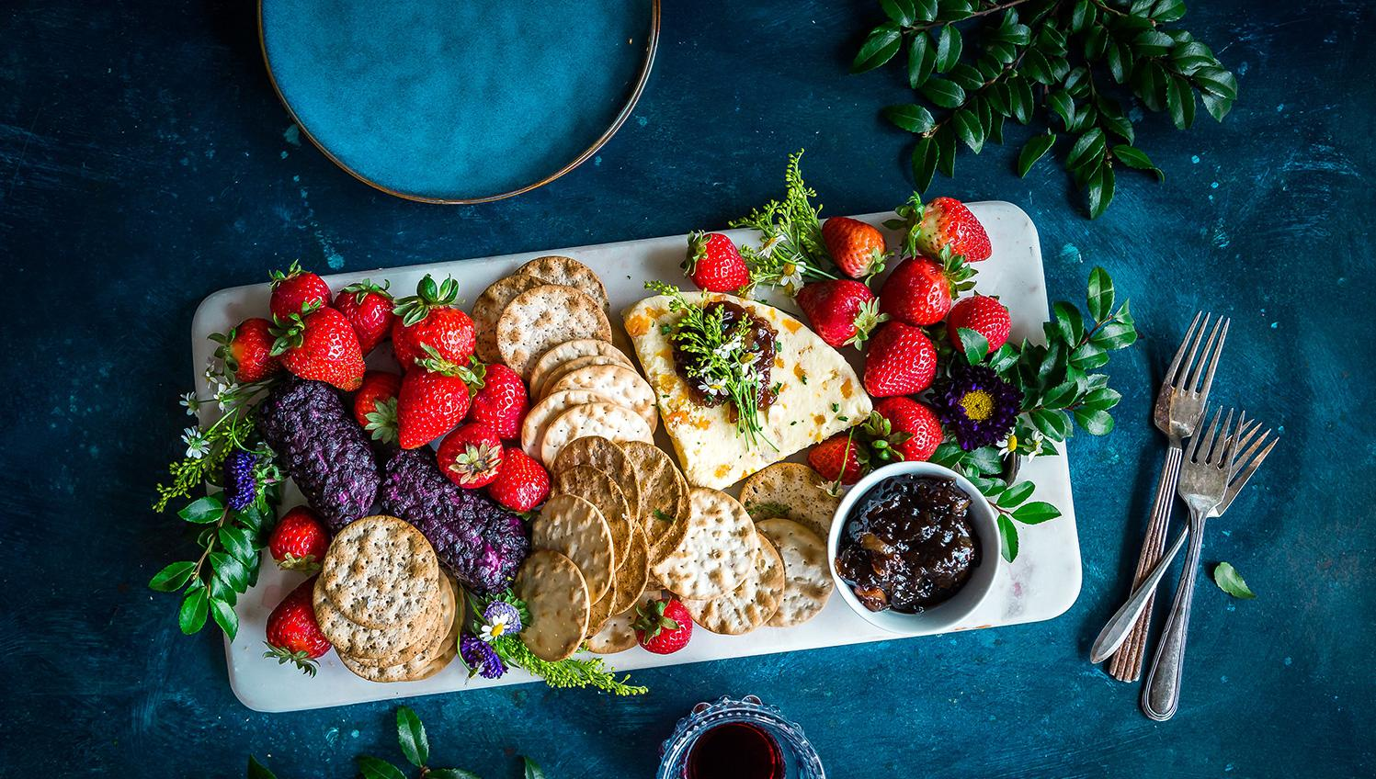
6th GRADE COOKBOOK
Green

Slide 2
TABLE OF CONTENTS
01 HONEYCRISP TOP CHEESECAKE
02 DAD’S FAMOUS STEAK
03 PICKLED BEETS
04 APPLE PIE
05 BASIC BURRITOS
06 GARLIC BREAD
07 COD ON POTATO RAFTERS
08 FRENCH EGGS WITH MUSHROOMS
09 CAPRESE
10 PUMPKIN SEEDS
11 HOMEMADE PIZZA
12 PERFECT PUMPKIN PIE
13 APPLE CINNAMON PANCAKES
14 BAKED ZITI
15 PUMPKIN SPICE PANCAKES
16 FRENCH TOAST
17 PUMPKIN PIE
18 APPLE CRISP WITH OAT TOPPING
19 PESTO PASTA
20 EMPANADA DE VERDE
21 PIZZA
22 PUMPKIN PIE W/ APPLE ICE CREAM
23 SALMON AND BROCCOLI
24 BASIC EGG PASTA DOUGH WITH SAUCE
25 SHEPHERD’S PIE
26 CHOCOLATE LAVA CAKE W/ STRAWBERRY SAUCE
27 RICE AND BEANS WITH CARROTS
28 CHAULAFAN
30 CREPES WITH STRAWBERRIES
31

Slide 3
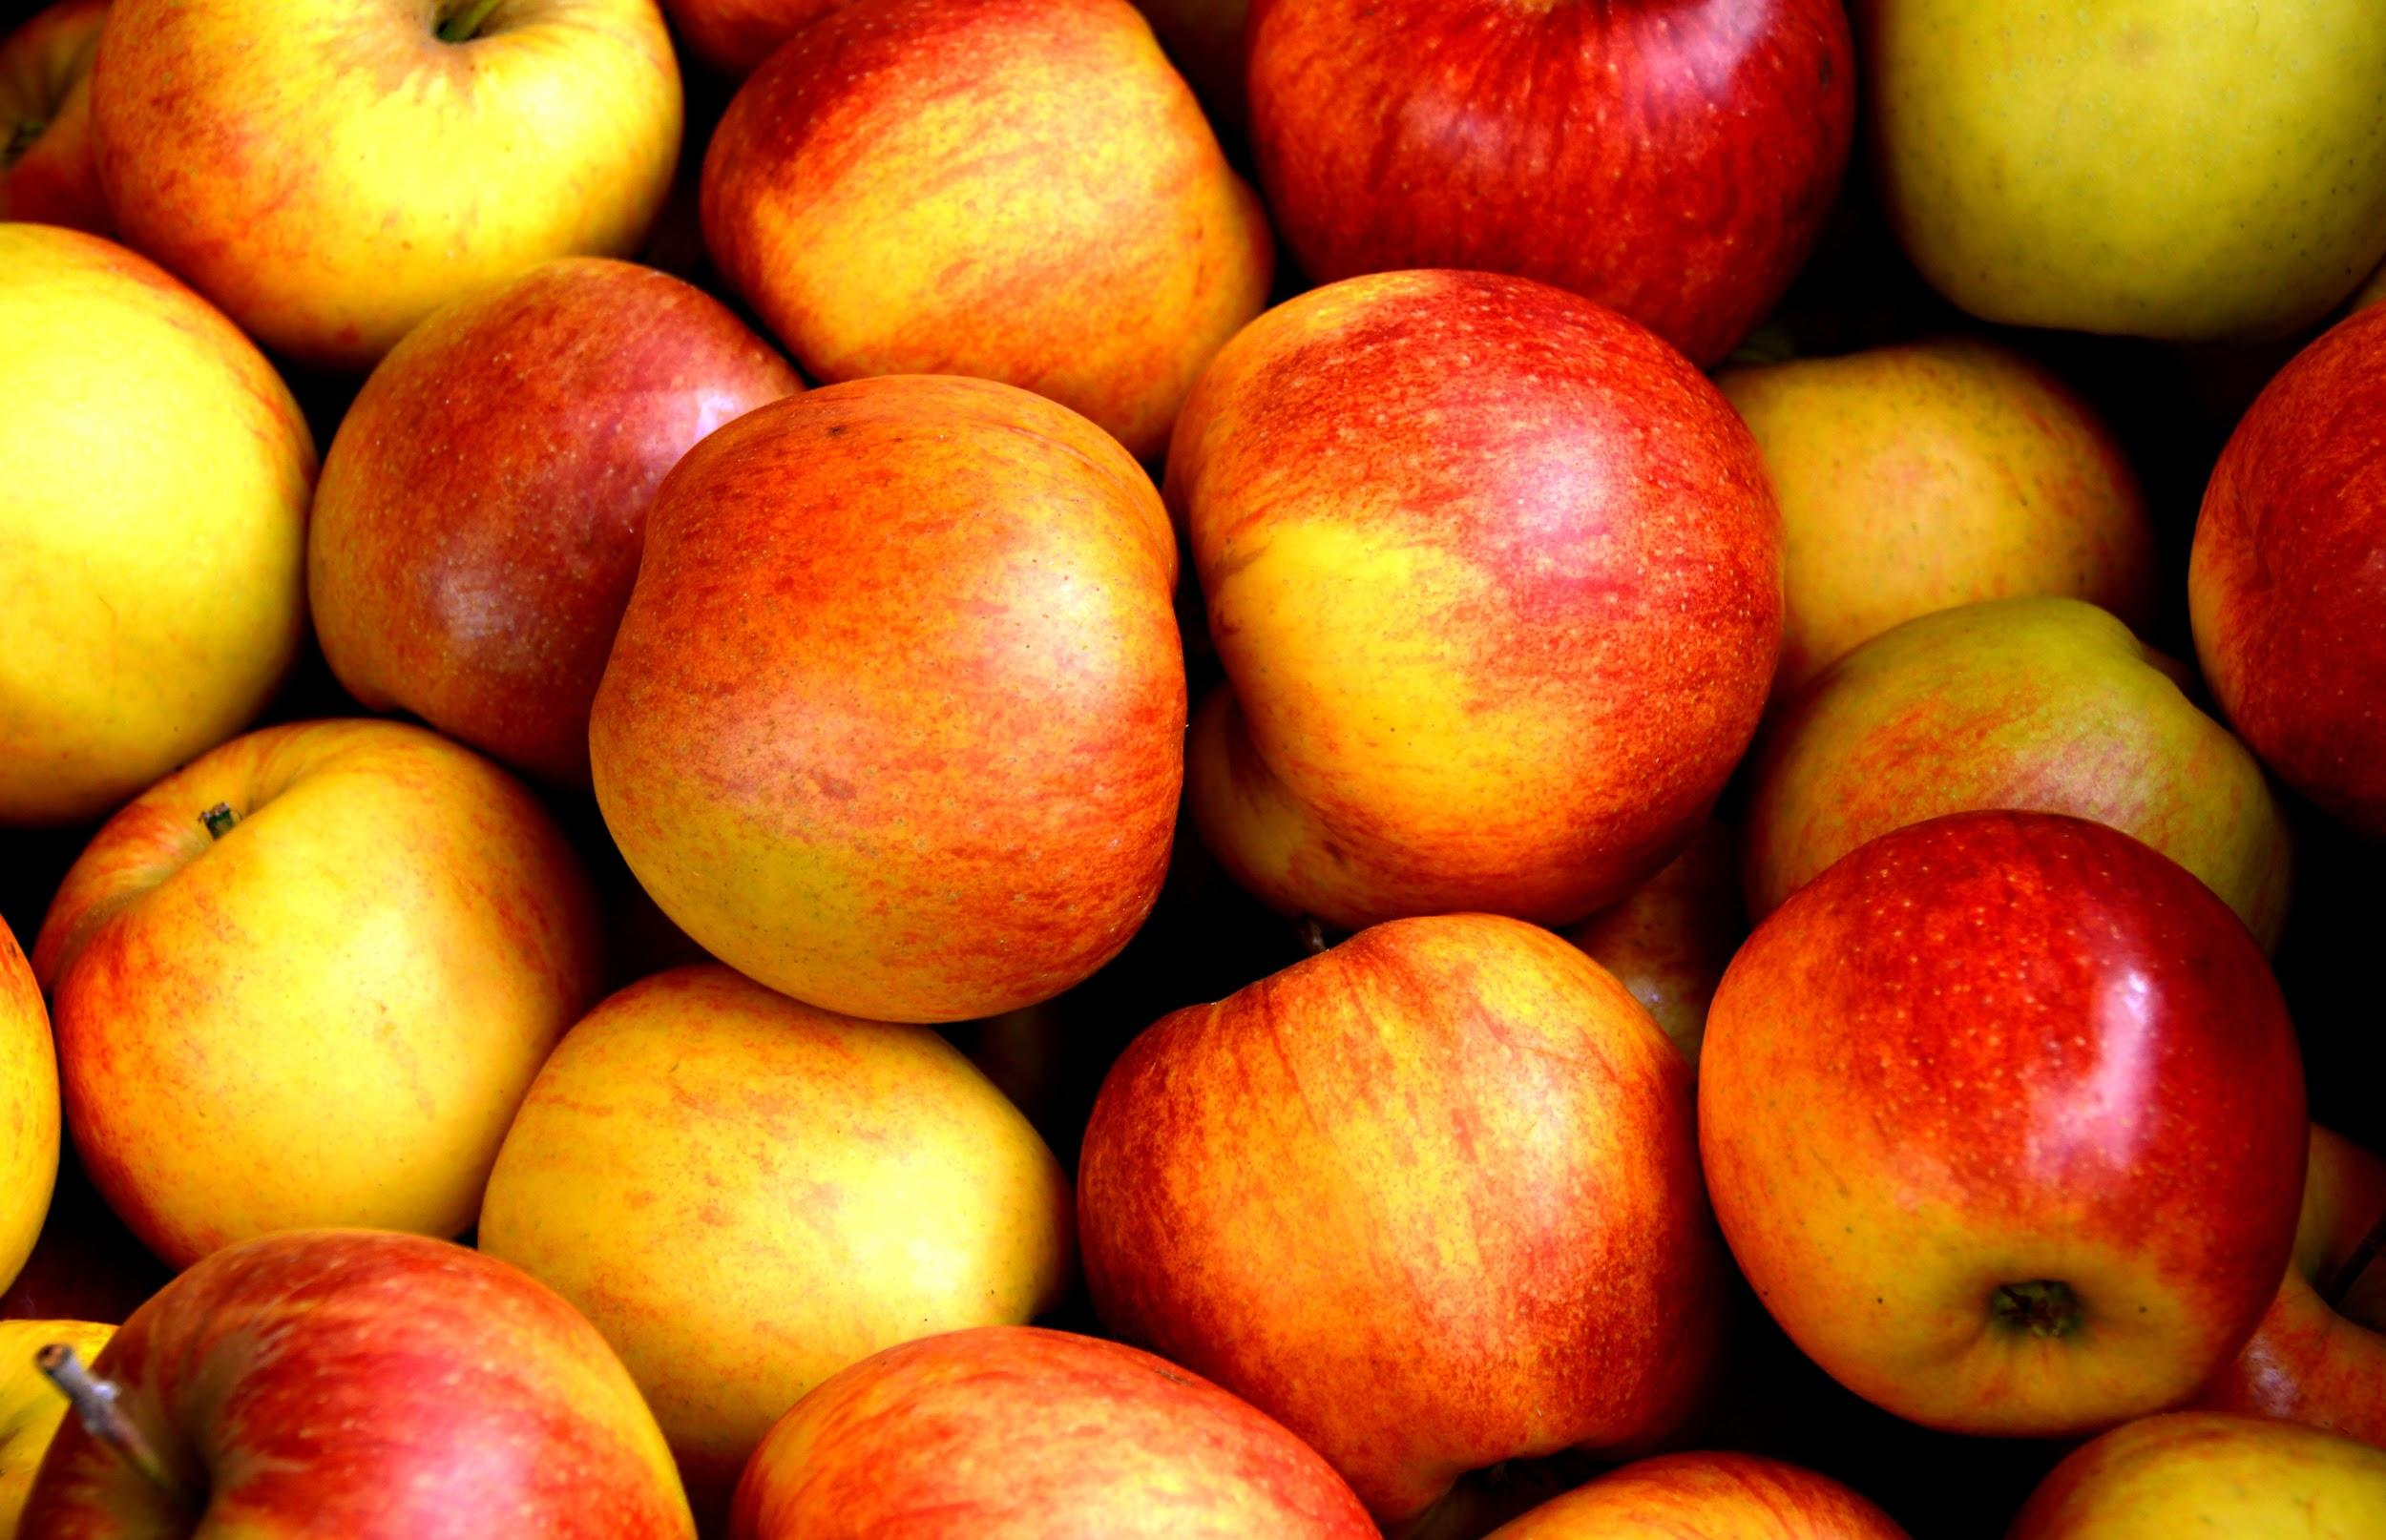
Honeycrisp Top Cheesecake
Veronika Zioueche
dessert
Crust:
1 and a half cups of graham cracker crumbs;
1 fourth cup sugar;
a half a cup of unsalted butter melted
Cheese Topping:
16 ounces of sour cream;
1 fourth cup of sugar;
1 teaspoon of vanilla (note you will need a 9 inch springform pan)
6-8 servings
INGREDIENTS:
Apple topping:
4 whole honeycrisp apples (sliced)
3 tablespoons of ground cinnamon;
4 tablespoons of lemon juice
Cheesecake: 3 8 ounce Packages of cream cheese, at room temperature
1 and a fourth cups of sugar;
4 eggs
2 teaspoons of vanilla
2 teaspoons of fresh lemon juice
PROCEDURE:
Preheat oven to 350 degrees and prepare ingredients (measure out amounts).
Combine graham cracker crumbs, sugar and butter in bowl.
Press evenly into 9 inch spring pan press evenly over bottom and 1 inch up sides.
Beat cream cheese and sugar at medium speed in large bowl until blended
Beat in eggs,vanilla and lemon juice until blended
Pour into prepared pan
Bank in preheated 350 degree oven for 50 minutes or until puffed and golden
While cheesecake is baking take your apples (sliced) and put them in a bowl pour in lemon juice and cinnamon stir together
puree until slightly chunky
Transfer onto wire rack or if you don’t have a wire rack put on a plate and let stand for 15 minutes increase oven temperature to 450 degrees
Stir together sour cream sugar vanilla in a small bowl until blended
Spoon other top of cheesecake spread evenly
Bake 10 minutes just until the topping is set transfer cheesecake to surface to completely cool
Pour apple mixture spread evenly
Refrigerate overnight before serving

Slide 4
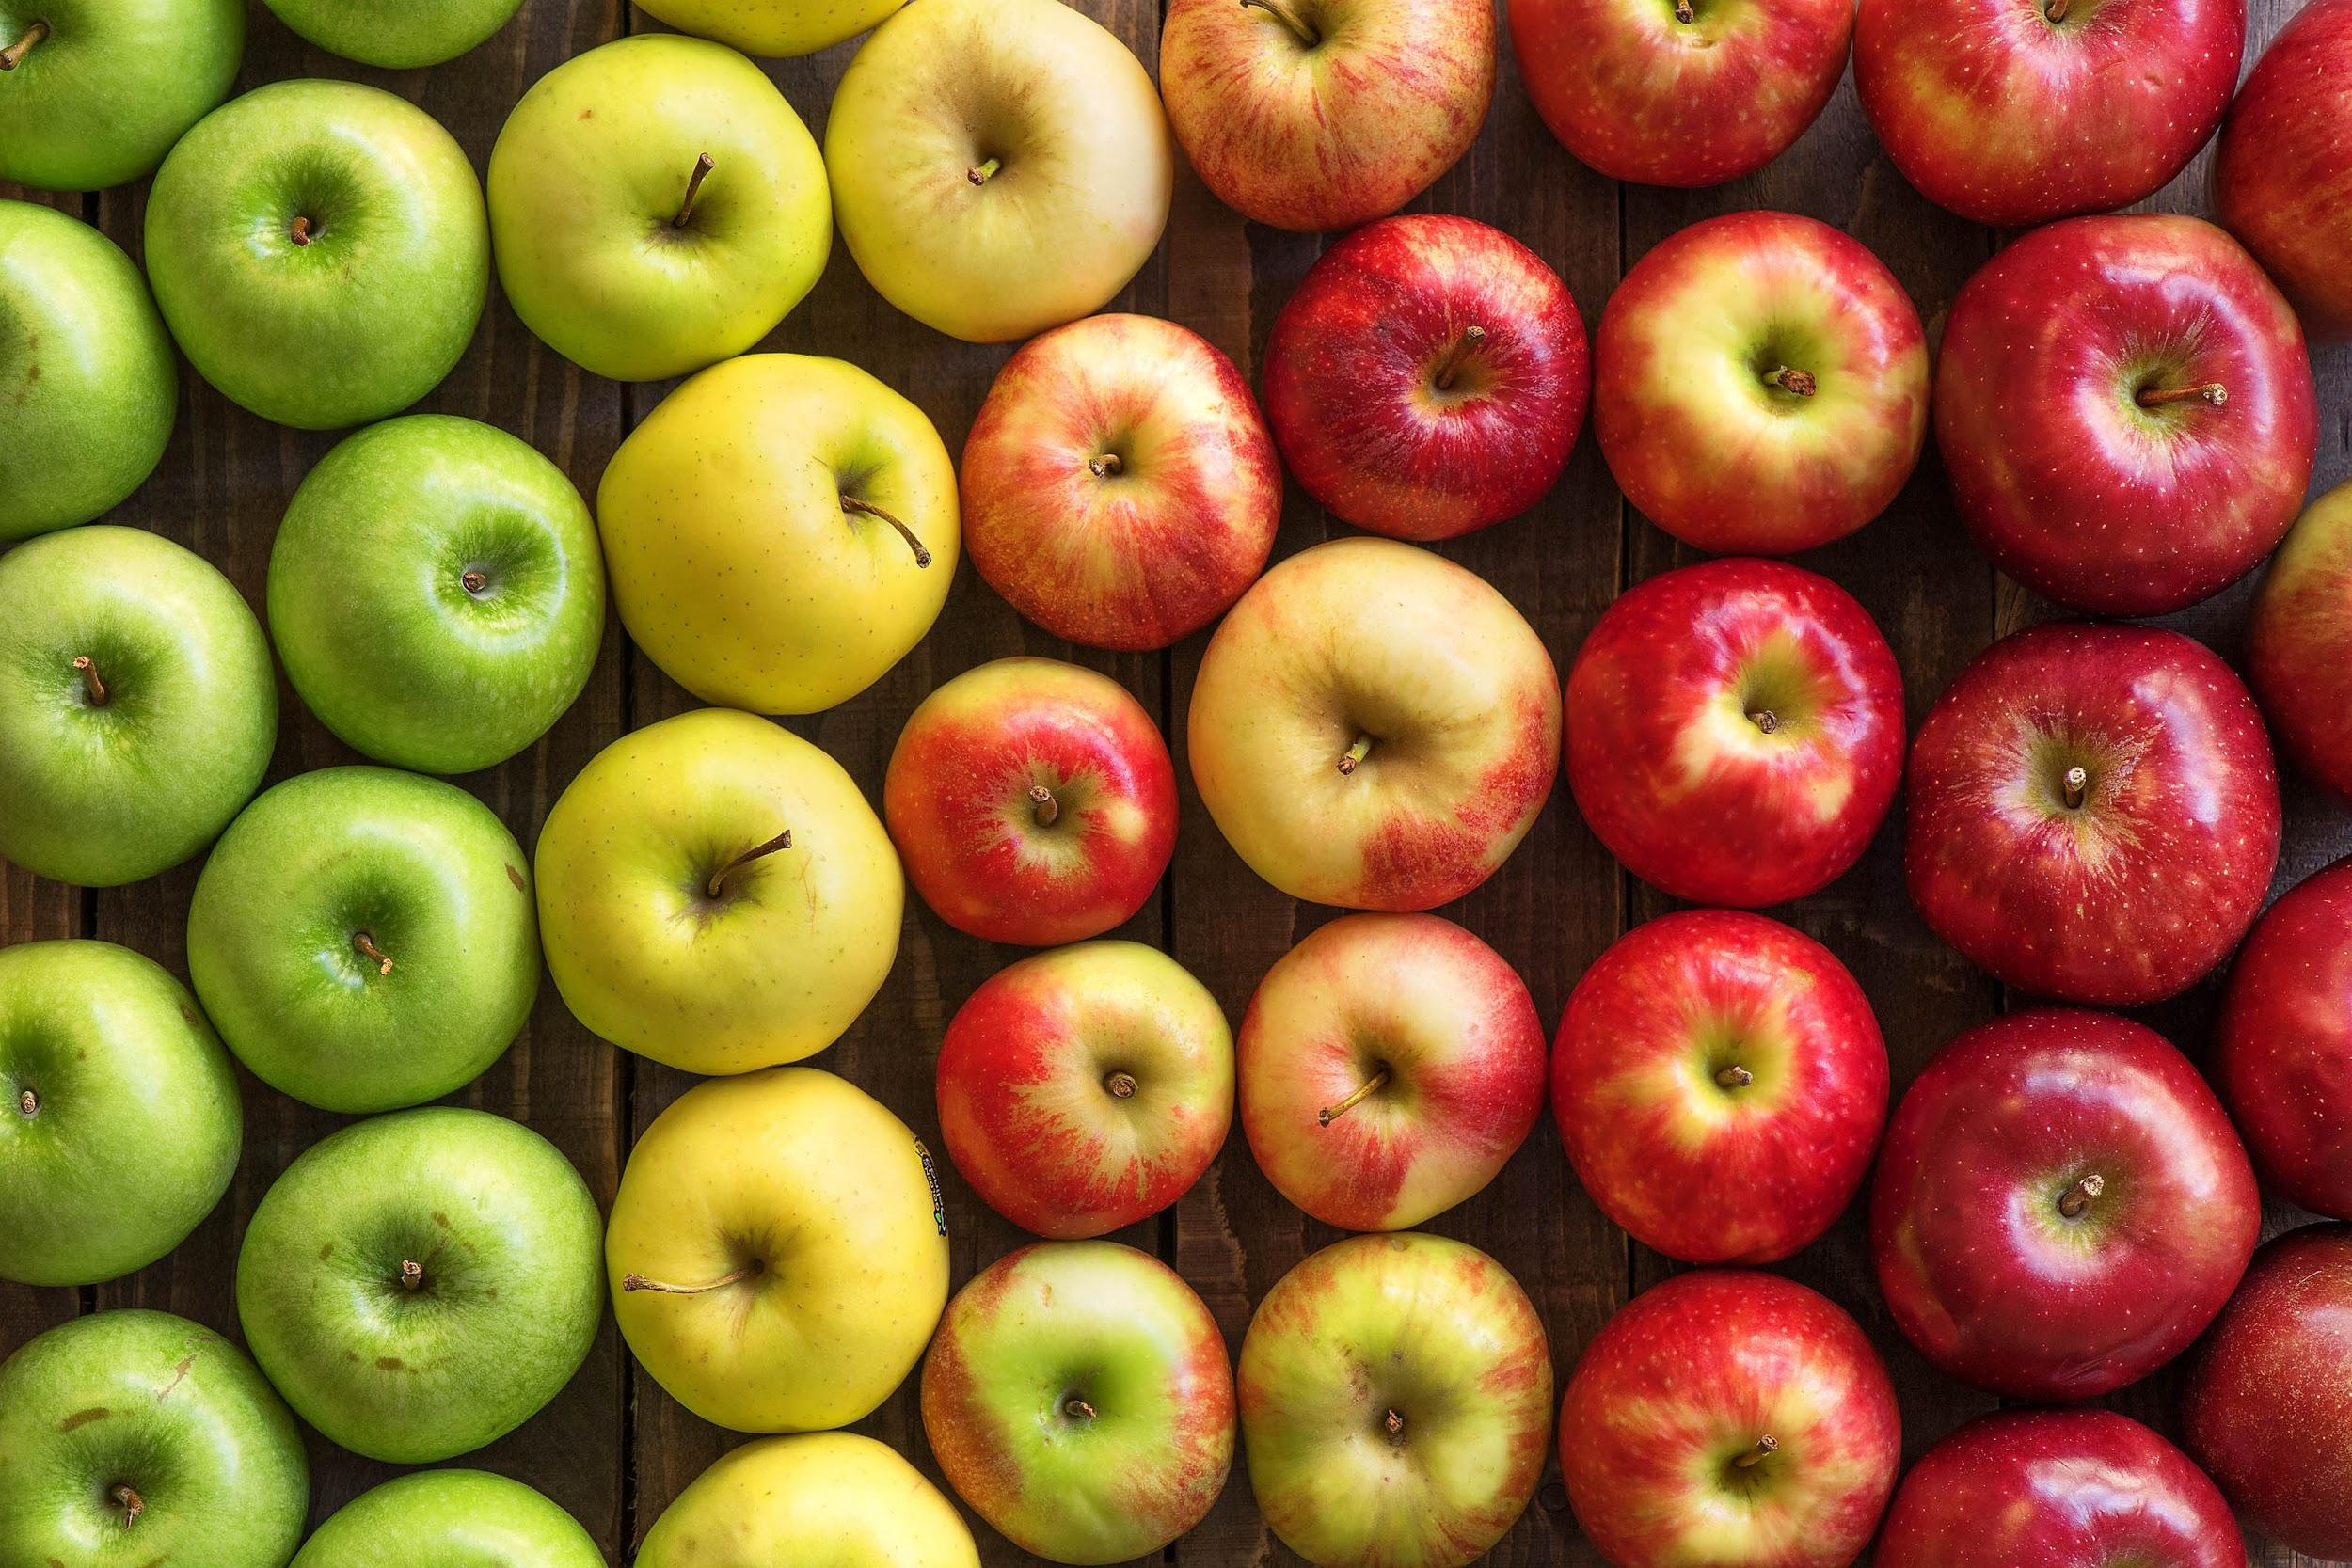
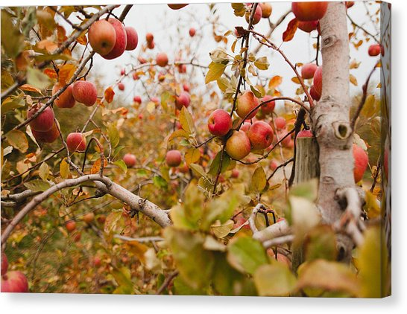
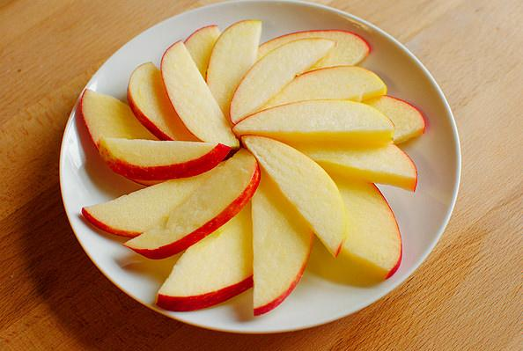
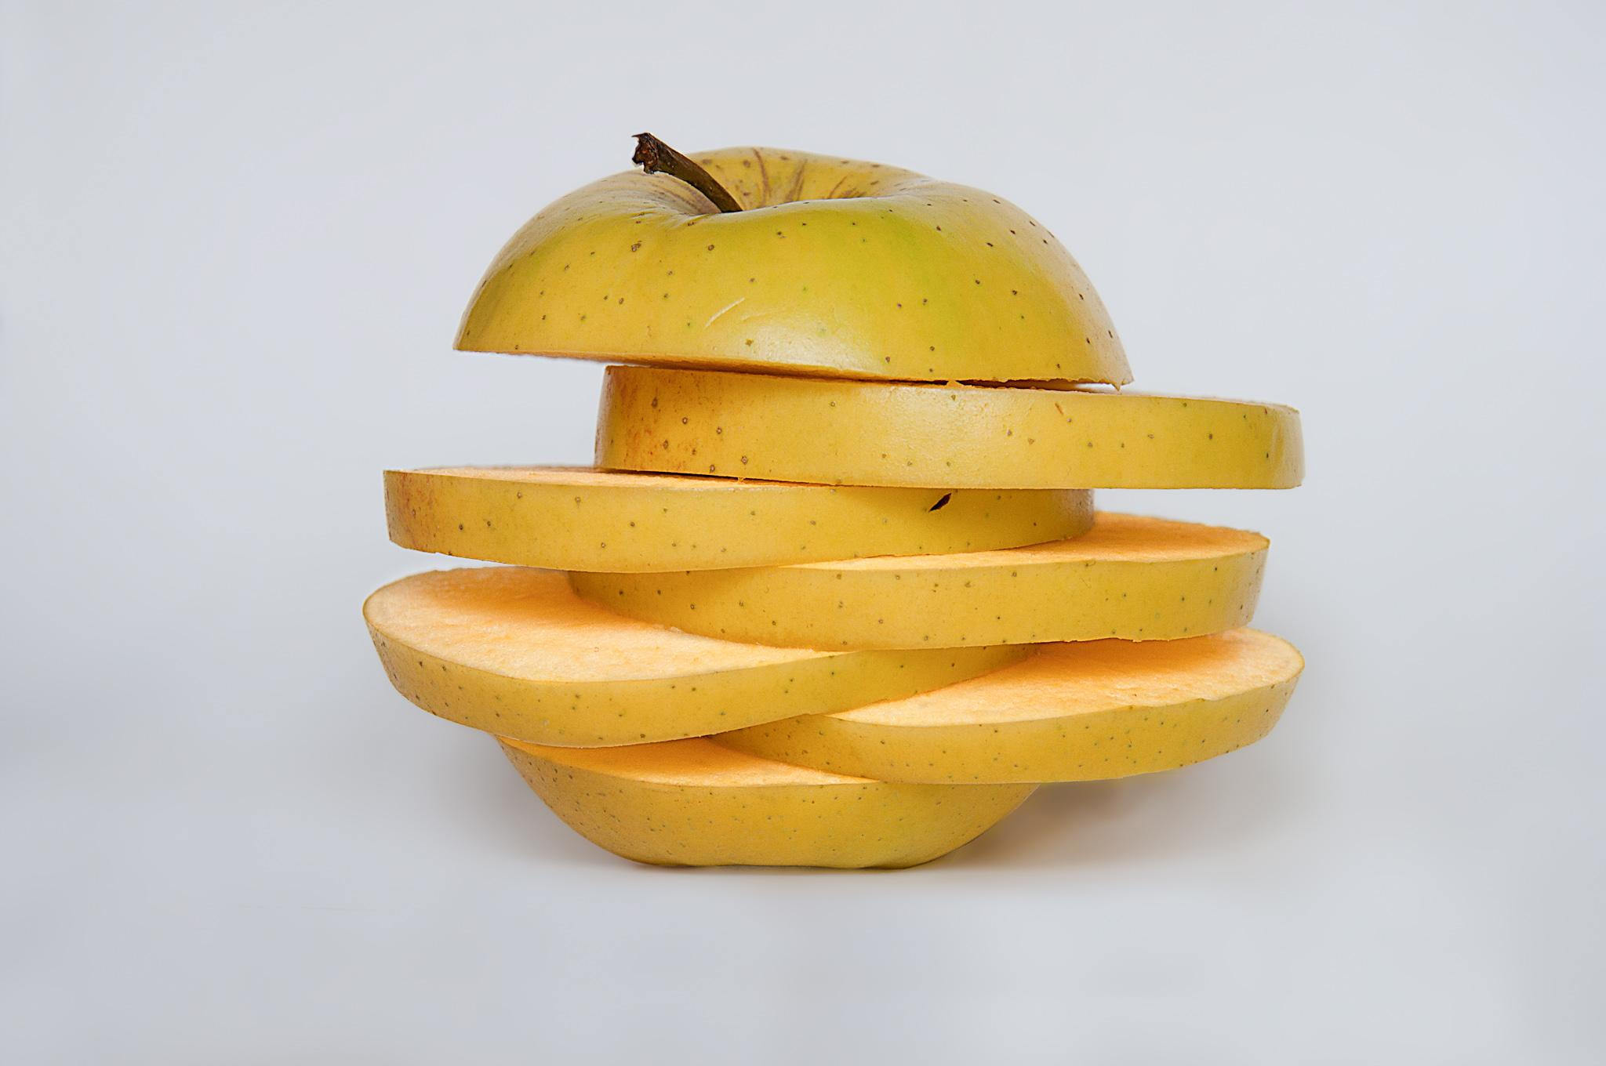
Honeycrisp apples
For this project my spotlight ingredient is Honeycrisp Apples. Honey crisp apples are a fruit. They are a yellowish green and red in color. They are crispy and sweet yet tangy and their juice explodes in your mouth. Their white flesh is crisp and refreshing. A full grown apple tree needs a few months for the apples to mature. They are really healthy and their nutrients can help prevent various diseases such as alzheimer's disease. They contain vitamin c which helps common illnesses such as colds.

Slide 5
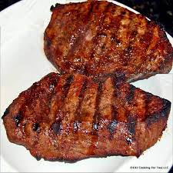
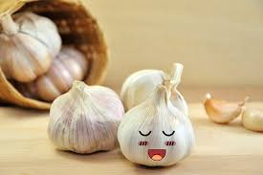
My Dads Famous Steak
Jude Van Ooyen
4 people
INGREDIENTS:
1 cup olive oil
2 tablespoon honey
salt and freshly ground black pepper
half cup balsamic vinegar
2 tablespoons chopped garlic
1 tablespoon dijon mustard
3 pounds skirt steak
PROCEDURE:
Which together the oil, vinegar, garlic, mustard, honey, and pepper.
Pour over steak marinade wait for at least 3 hours.
Grill the steak medium rare
Let steak rest for ten minutes and add salt to taste and serve.

Slide 6
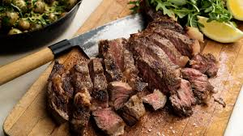
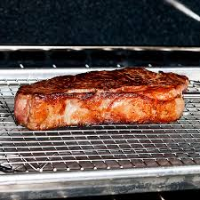
ALL ABOUT MY RECIPE
This recipe was first used in my family by my dad. He always makes this when were having a party or if were having just a family dinner. Lastly this is are best dish so if we're having special people coming over he will make this so the guest will all eat a good dinner.
SPOTLIGHT INGREDIENT: Garlic
The garlic is a big part of the marinade of the steak. If you don't have the garlic then you won't be able to get a good taste. I also saw this garlic in the green market when we went there. So, if i had all the ingredients besides garlic we could count on the green market to have garlic. Lastly I think garlic would be the last part of the marinade from the steak. Garlic is a root. Garlic lowers your cholesterol and blood pressure. You harvest garlic plants during springs when the plant is about 1 foot tall.

Slide 7
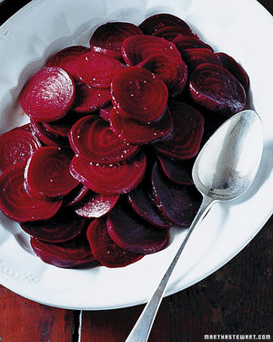
PICKLED BEETS
Mercer Mauldin Young
Side
Serves 5
INGREDIENTS:
½ cup red wine vinegar
2 tablespoons sugar
1 stick cinnamon
4 whole peppercorns
2 whole cloves
3 cups sliced beets, steamed, ½ - 1 inch thick
PROCEDURE:
Cook beets in water until tender. Set aside.
In small saucepan, combine all other remaining ingredients. Bring to boil over medium heat. Simmer for 2 minutes, and remove from heat.
Drain beets and add to sauce. Marinate 30 minutes before serving.

Slide 8
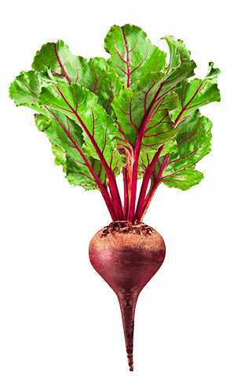
SPOTLIGHT INGREDIENT: BEETS
My spotlight ingredient is the beet. The beet is usually reddish purple with rings on the inside. It is also a sweet vegetable, and a root. Beets need 60-85 days before they can be harvested, and beets are harvested in the mid to late part of the plant life cycle. Beets lower blood pressure significantly, which also take down the risk of heart attacks. They have also been shown to increase stamina and athletic performance.
ALL ABOUT MY RECIPE
This recipe is special to my family because it was passed down from my great-great-grandma, and the beets are delicious. I love the sweet and bitter combination in this recipe. My great-grandmother owned a farm, and she probably grew beets, among other things. My grandmother also made these when she visited last year. All of the beets that my great-grandmother would have eaten were all home-grown.

Slide 9
Apple Pie
Julia Lovell
Dessert
8 Servings
INGREDIENTS:
1 box uncooked pie crust
6 cups thinly sliced, peeled apples
¾ cup sugar
2 tablespoons all-purpose flour
¾ teaspoon ground cinnamon
¼ teaspoon salt
⅛ teaspoon ground nutmeg
1 tablespoon lemon juice
PROCEDURE:
Heat oven to 425°F. Place 1 pie crust in ungreased 9-inch glass pie plate. Press firmly against side and bottom.
In large bowl, gently mix filling ingredients; spoon into crust-lined pie plate. Top with second crust. Wrap excess top crust under bottom crust edge, pressing edges together to seal. Cut slits or shapes in several places in top crust.
Bake 40 to 45 minutes or until apples are tender and crust is golden brown. Cover edge of crust with 2- to 3-inch wide strips of foil after first 15 to 20 minutes of baking to prevent excessive browning. Cool on cooling rack at least 2 hours before serving.
Enjoy!

Slide 10
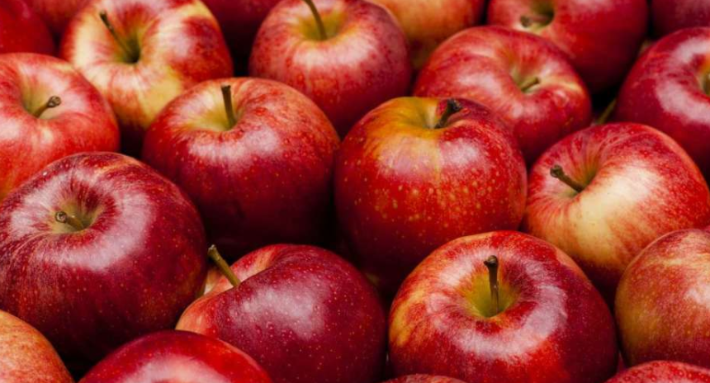
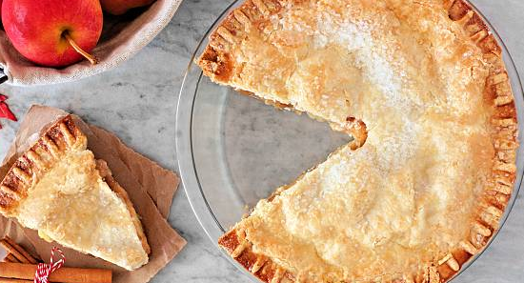
ALL ABOUT MY RECIPE
My family and I always make a delicious apple pie for every Thanksgiving. We often in the winter just make it for fun. I learned how to make it when I was really young and I’ve always loved it. This recipe is so delicious because we get really good apples and then we put a really good homemade whipped cream with it. My whole family always eats it up so fast.
SPOTLIGHT INGREDIENT: Apples
My spotlight ingredient is apples. Apples are red or green and they are sweet and a little sour. They are crispy and very delicious. An apple is a fruit. Apples are primarily harvested in September and October. On average apples need to grow 100-200 days before they can be harvested. Apples are very good for you, they are nutritious, they’re good for weight loss, they’re good for your heart, you have lower risk of diabetes from them, they promote good gut bacteria, and they prevent cancer. Did you know that Pilgrims planted the first U.S apple trees in the Massachusetts Bay Colony?

Slide 11
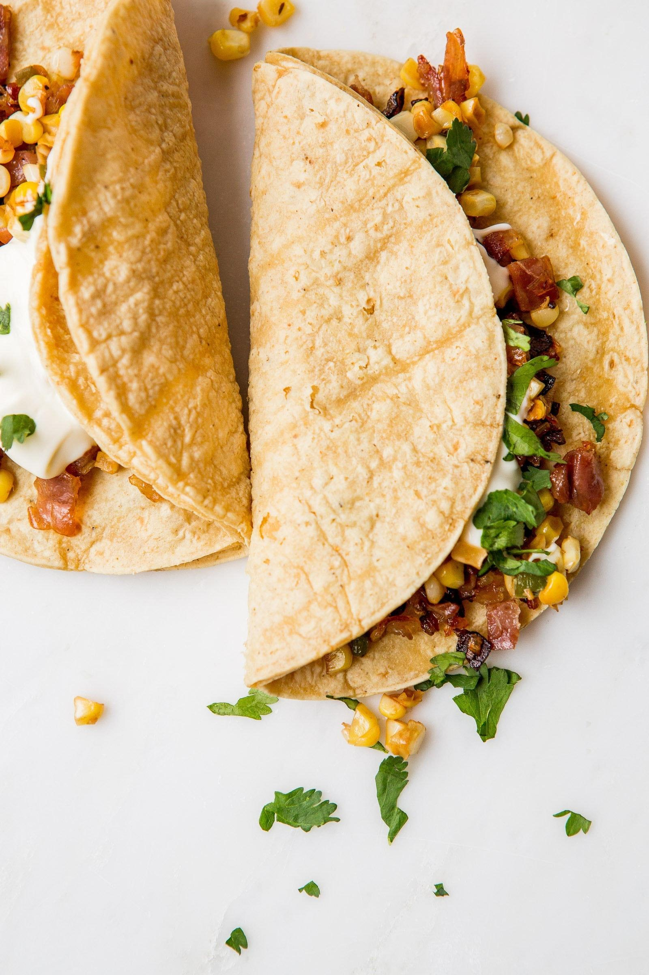
Basic Burritos
Entree
Vera Lapidus
6 servings
INGREDIENTS:
Refried Beans
1 large clove of garlic
½ a white onion
Salt and pepper to your taste
½ teaspoon of cumin
1 tablespoon of white vinegar
½ a tomato, diced
1 tablespoon of cilantro
Rice
1 cup of white rice
½ cup of water
1 tablespoon unsalted butter
½ teaspoon of salt
Guacamole
2 ripe avocados
Juice of 1 lime
3 tablespoons of cilantro
1 large garlic clove
½ cup red onion
salt and pepper to your taste
Meat
1 pound of ground turkey (turkey is better for you, and therefore being used in this recipe)
1 package of taco seasoning
½ cup of water
PROCEDURE:
To make the beans: Chop your garlic and onion finely. Move to a sauce pan to saute on medium heat with a little bit of olive oil. Add salt and pepper. Once onion is soft, add one can of beans and pour in most of the liquid. In our case we’re using black goya beans but you can use whatever you want. Stir in the white vinegar, cumin, chopped tomato, and cilantro and leave to simmer. Take off heat once beans are mushy and soft. Take out a masher or fork and mash the beans.
To make the rice: Put rice, water, butter, and salt in a small saucepan over high heat. Once water starts to boil, lower heat. Cover for 15 minutes. After, take the saucepan off the heat. Fluff with a fork and put cover back on until serving.
To make the guacamole: Cut avocados in half. Scoop the insides into a small bowl and mash with a fork. Add all remaining ingredients, and mix together. Garlic should be diced, and red onion chopped into small pieces, almost diced. Cover with saran wrap and chill in fridge.
To make the meat: Brown meat in large saucepan over high heat until you can’t see anymore pink. Add seasoning and water. I know that using a package seasoning is kind of lame, but it adds really nice flavor. Stir until the meat is a nice brown color and the water has evaporated.
To make the guacamole: Cut avocados in half. Scoop the insides into a small bowl and mash with a fork. Add all remaining ingredients, and mix together. Garlic should be diced, and red onion chopped into small pieces, almost diced. Cover with saran wrap and chill in fridge.
For the tortillas: Wrap tortillas in aluminum foil and toast at 350 degrees until warm, about 5 minutes.
To Eat: Put all dishes on the table, and build your delicious burrito! Enjoy!

Slide 12
SPOTLIGHT INGREDIENT: GARLIC
All About My Spotlight Ingredient
My spotlight ingredient is garlic. It is essential to harnessing and adding to the amazing flavor of this dish. Garlic has a white flaky skin surrounding the cloves inside. The cloves have a yellow tint to them, and have a brown edge. If you cut a clove open, it has small green rings inside. Depending on how you cook your garlic, it has different flavors. Raw garlic has a very tangy, strong, and earthy flavor. However, when you roast garlic, it is very soft, oily (in a good way), and lessened in flavor. Roasting garlic is best for coating meats, and adding flavor to dishes. And when you saute garlic, it absorbs all the flavor making it delicious!!! Garlic is surprisingly not a root. Like potatoes, it is an underground stem. It is best to plant garlic in the fall. So, assuming you planted your garlic in fall, you should harvest them in July/ August. Make sure to harvest your plant before it becomes a flower, or it will result in low flavor and smaller cloves. Garlic is great for your immune system. If you can handle the flavor, garlic is great to take when your sick! Garlic also lowers cholesterol levels, making you less vulnerable to heart problems/ diseases.
All About My Recipe
This dish is very important to my family. With a sister of 14 years, there are very few times when we cook together. This dish gives us the opportunity to spend time together. There are many separate parts to this dish, and each one of us can make one, and then come together to make something delicious and special, that we can all share and enjoy together. I’m not sure if this is a specific occasion, but almost every week, we have this meal. It is so good, and easy that it makes all happy to eat it. It is also an opportunity for my mom to cook instead of my dad. My dad is the chef in the house, so it always nice for my mom to get to cook. Burritos are culturally from Mexico. Burritos are made up of some combination of cheese, meat, beans, rice, guacamole, onion, cilantro, let me ask you, how could that not be delicious???

Slide 13
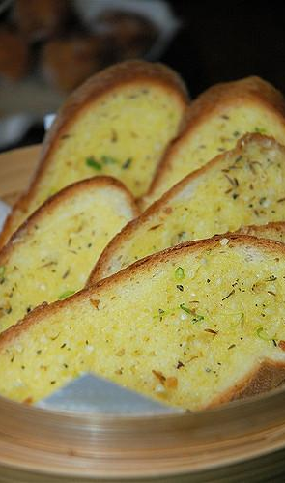
GARLIC BREAD
ANTONIO VILLANUEVA
Appetizer
4 Servings
INGREDIENTS:
½ cup of melted butter
3 to 4 garlic cloves; minced
Teaspoon of olive oil
1 loaf/ 1 pound of french bread halved lengthwise
PROCEDURE:
In a small bowl combine butter, garlic and olive oil.
Brush over cut sides of bread.
Place, cut side up, on a baking sheet.
Bake at 350 degrees for 5 minutes.
Broil 4-6 inches from the heat for 2 minutes or until it’s golden brown.
Cut into 2 inch slices.

Slide 14
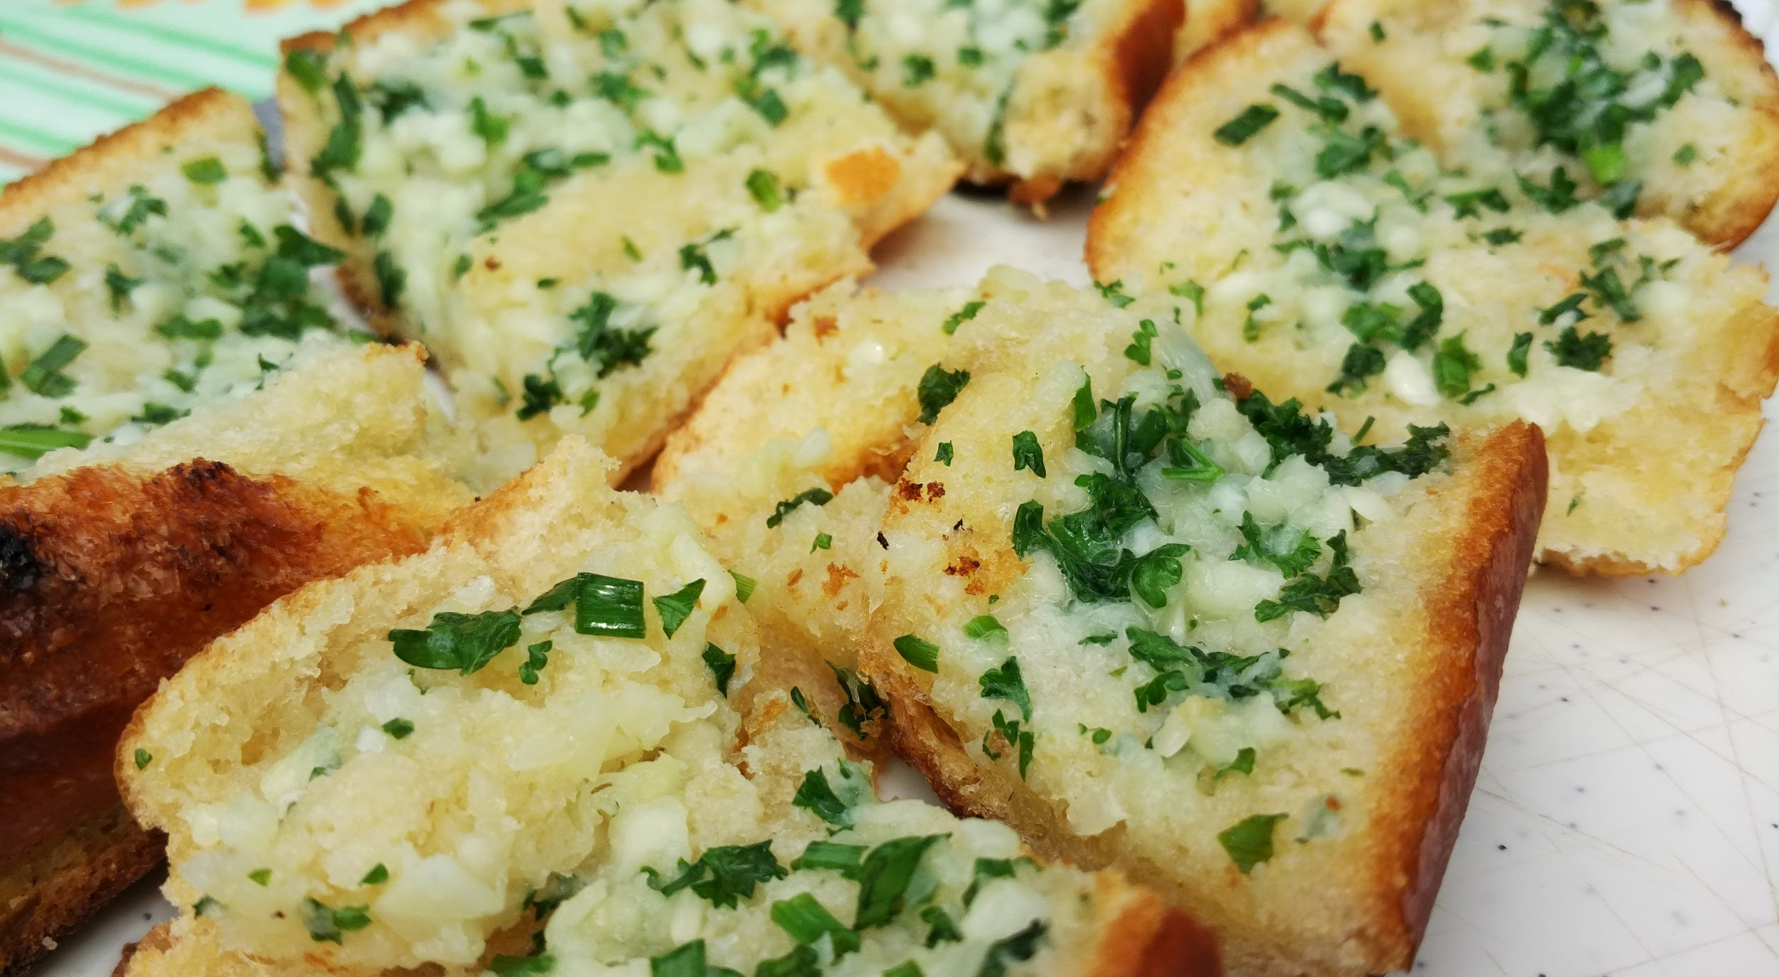
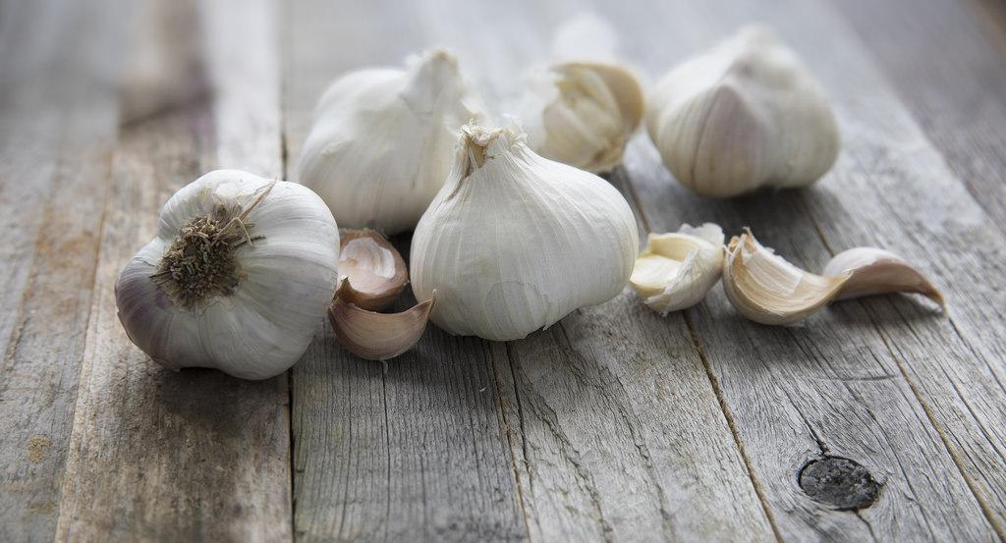
ALL ABOUT GARLIC BREAD
Garlic bread is special to my family because whenever we eat dinner together we’d always have Garlic Bread as a appetizer. While many people think that Garlic bread is from Italy it was actually made in America. I think Garlic bread is delicious because I really enjoy French bread on its own, but adding garlic to the mix makes it a treat. Also I rarely eat it so it makes it the more delicious to eat. Finally I really like garlic bread just because it has lots of flavor that makes it strong and delicious.
SPOTLIGHT INGREDIENT: GARLIC
My spotlight ingredient is Garlic. When Garlic is minced it looks like white popcorn kernels. The taste can be pretty strong but it’s still delicious with French bread. Garlic is the Bulb or the underground stem. Garlic is usually harvested in July about 9 months after being planted. There are some health benefits to Garlic. One of them is that it’s very nutritious but has little calories. Also Garlic can be used to cure many illnesses, including, the flu and the common cold.

Slide 15
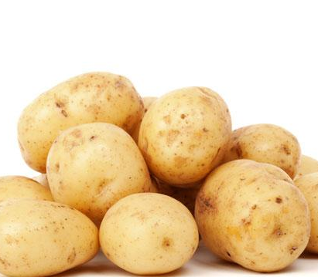
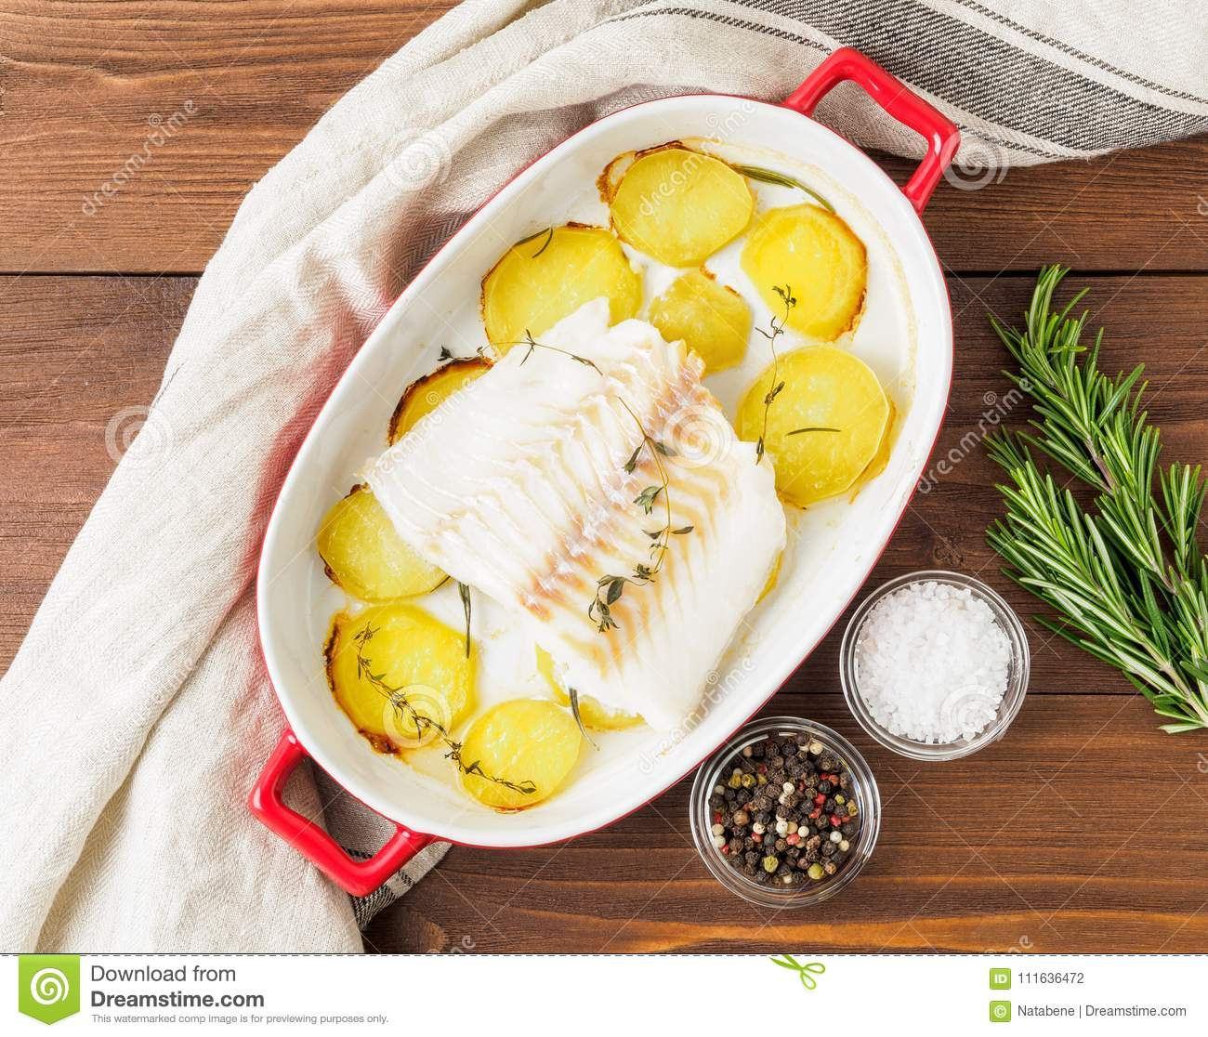
COD ON POTATO RAFTERS
NORA SPINGARN
ENTREE
5 SERVINGS
INGREDIENTS:
1 ½ pounds yukon gold potatoes, unpeeled and scrubbed, sliced into ¼-inch-thick rounds
2 tablespoons olive oil
4 cloves garlic, minced
½ teaspoon kosher salt
½ teaspoon freshly ground pepper
½ teaspoon freshly ground pepper
4 skinless cod fillets about 5 oz each
4 tablespoons butter
Fresh thyme sprigs if you have them, otherwise a bit of dried thyme
Slices of lemon to garnish (optional)
PROCEDURE:
Preheat oven to 425 with rack in the center position. Line a sheet pan with parchment paper
In a large bowl, toss the potatoes with the olive oil, garlic, salt, and pepper until thoroughly coated
Assemble four potato rafts by overlapping potato slices on the prepared pan in rectangular mounds. Each raft should consist of 3 or 4 shingled rows and be roughly 4 by 6 inches; use 3 or 4 slices of potato per row.
Roast the potatoes, rotating the pan halfway through, until golden brown and beginning to crisp, about 30 minutes. Remove pan from oven.
Blot the fish fillets dry with a paper towel. Place one, skinned side down, centered on top of each potato raft. Tope each piece of fish with 1 tablespoon butter and 2 sprigs thyme (or dust with dried thyme).
Return the pan to the oven and roast until the fish is flaky and opaque, about 15 minutes.
Transfer the potato rafts and accompanying fillets to individual pates, ideally with a big spatula. Serve hot.
Enjoy!

Slide 16
Spotlight Ingredient: POTATOES
This recipe is special to my family because I don’t eat that much meat, but I love fish. Also, we go to Cape Cod, Massachusetts every year and cod on potato rafters is a traditional dish when we go there. The potatoes and the cod clashes wonderfully, with a mix of perfect and interesting textures. The seasoning makes everything better, too. It is delicious because the cod is perfectly seasoned and goes really well with the potatoes. When I put it in my mouth, I am met with a crazy but perfect combination of textures and flavors
The spotlight ingredient of this dish is potatoes. Potatoes taste starchy, earthy and rich, thick with soft and pasty insides. The skin is light brown or tan, with little indents and dots all over. The insides are a lighter tan. The potato might seem like a root because it grows underground, but, like garlic, onions and radish, it is actually an underground stem. The actual roots sprout out of the bottom of the vegetable. The harvest of potatoes should lie in September or `October, as potatoes have a ripening time of 140 – 160 days. Potatoes are a good source of antioxidants, which may reduce the risk of chronic diseases like heart disease, diabetes and certain cancers. However, more human-based research is required before making any recommendations. The potato, in combination with the zinc and copper strips acts as a battery. The potato is about 80% water and 20% solids.

Slide 17
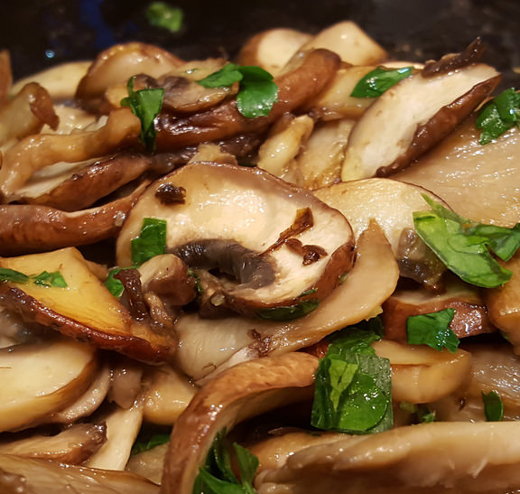
French Eggs With Mushrooms
Abel W. Bellows
Entree
Serves 4
INGREDIENTS:
6 eggs
4 chives chopped
8 portobello mushrooms sliced
3 Tablespoons butter
Dash of olive oil
4 slices of bread
PROCEDURE:
Saute mushrooms until browned, set aside.
Melt ⅔ of butter in a pan over low heat until completely melted
Beat eggs and add to pan with mushrooms.
Stir constantly in 1 direction until it forms into curds continue stirring for 1- 2 min and add remaining butter and stir for 2 min more.
Toast bread for 5 min under broiler.
Put eggs on bread and sprinkle chives on top.
Serve hot.

Slide 18
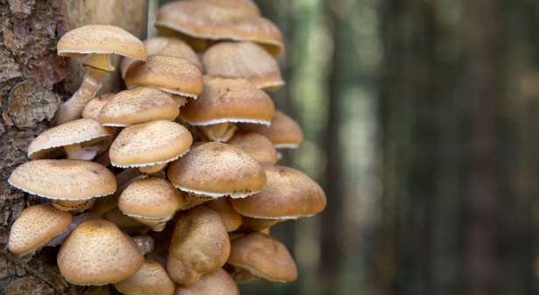
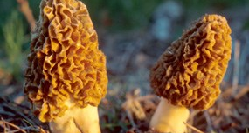
My Recipe
This recipe is the first recipe I ever made by myself. My family loves to eat this recipe with toast in the morning for breakfast, lunch or dinner. We first made this recipe in California on a vacation. We fell in love with french eggs at first taste. This recipe is delicious because of the sauteed mushrooms. They add a meaty flavor that makes this dish as good as it is.
SPOTLIGHT INGREDIENT: MUSHROOMS
My spotlight ingredient is mushrooms. Most Mushrooms are brown, white or yellow. The body of the mushroom, the mycelium, can stretch for miles. Mushrooms are a anti-inflammatory. This means that mushrooms reduce swelling and pain. Mushrooms are technically not plants they are fungi. The mushroom we eat is the cap and stem of this fungus. Mushrooms need to grow for 60 days from planting. Mushrooms taste good in many things such as pasta, omelettes, pies, soups, and salad.

Slide 19
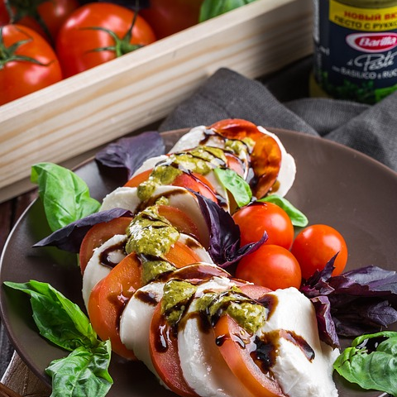
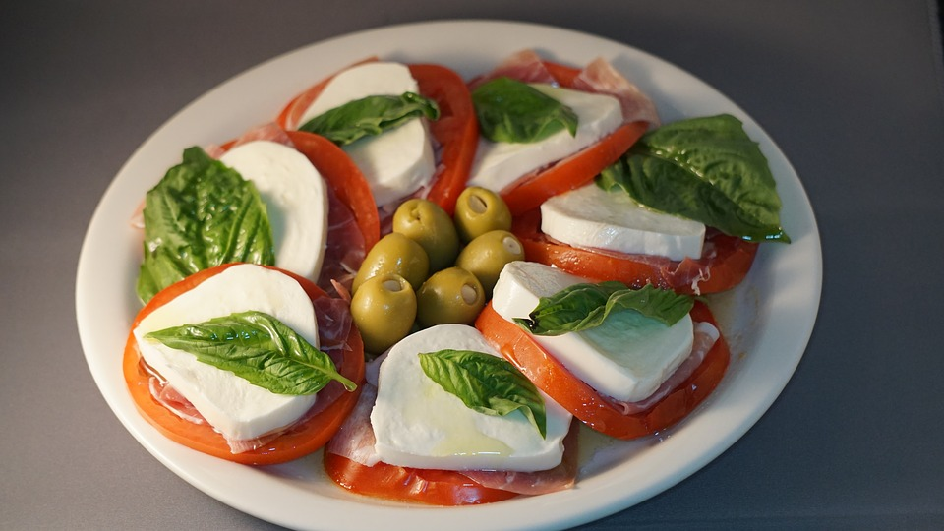
CAPRESE
Mateo Noto
Appetizer
3 people
INGREDIENTS:
1 medium to large tomato
¼ cup fresh basil leaves
4 ounces of fresh mozzarella cheese
4 teaspoons of balsamic vinegar
Caprese is a great tasty appetizer with tomatoes, mozzarella, and basil.
PROCEDURE:
Step #1: Slice the tomato in approximately ¼ inch thick slices. Do the same for the mozzarella.
Step#2: Alternate layers between the tomatoes, mozzarella, and basil. First, a tomato slice, then mozzarella slice, then a couple leaves of basil; beginning and end of the tomato.
Step#3: Drizzle balsamic vinegar on top.

Slide 20
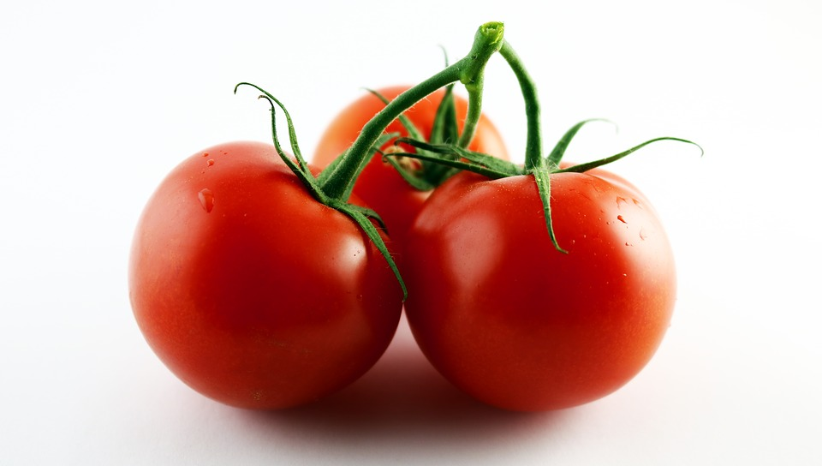
Tomatoes are fruits that are used in lots of dishes, especially Italian foods. They are red on the outside and very juicy on the inside. It is probably one of my favorite fruits. They are also part of the nightshade family. Tomatoes didn't arrive in Europe until the 16th Century, although it is not exactly known how they got there.
Tomatoes are red juicy fruits that everybody loves. They are best when ripe and freshly picked off the vine.
Short description of cookbook project...
They grow best in warm weather and are harvested in the summer. Tomatoes can reduce the risk of heart disease and cancer while giving you a lot of vitamins.
Q: Why is a tomato round and red?
A: Because if it was long, skinny, and green, it would be a bean.
Mateo Noto

Slide 21
Pumpkin Seeds
Holden Miller
Snack/Treat
Number of Servings:
About 3-4 people
INGREDIENTS:
All seeds from 1 pumpkin
A pinch of salt
¼ of a stick of butter (melted)
PROCEDURE:
Cut open pumpkin, find/pull out seeds.
Put seeds on baking tray (spread evenly).
Bake until seeds are golden-brown.
Add butter and salt.
Let them cool off.

Slide 22
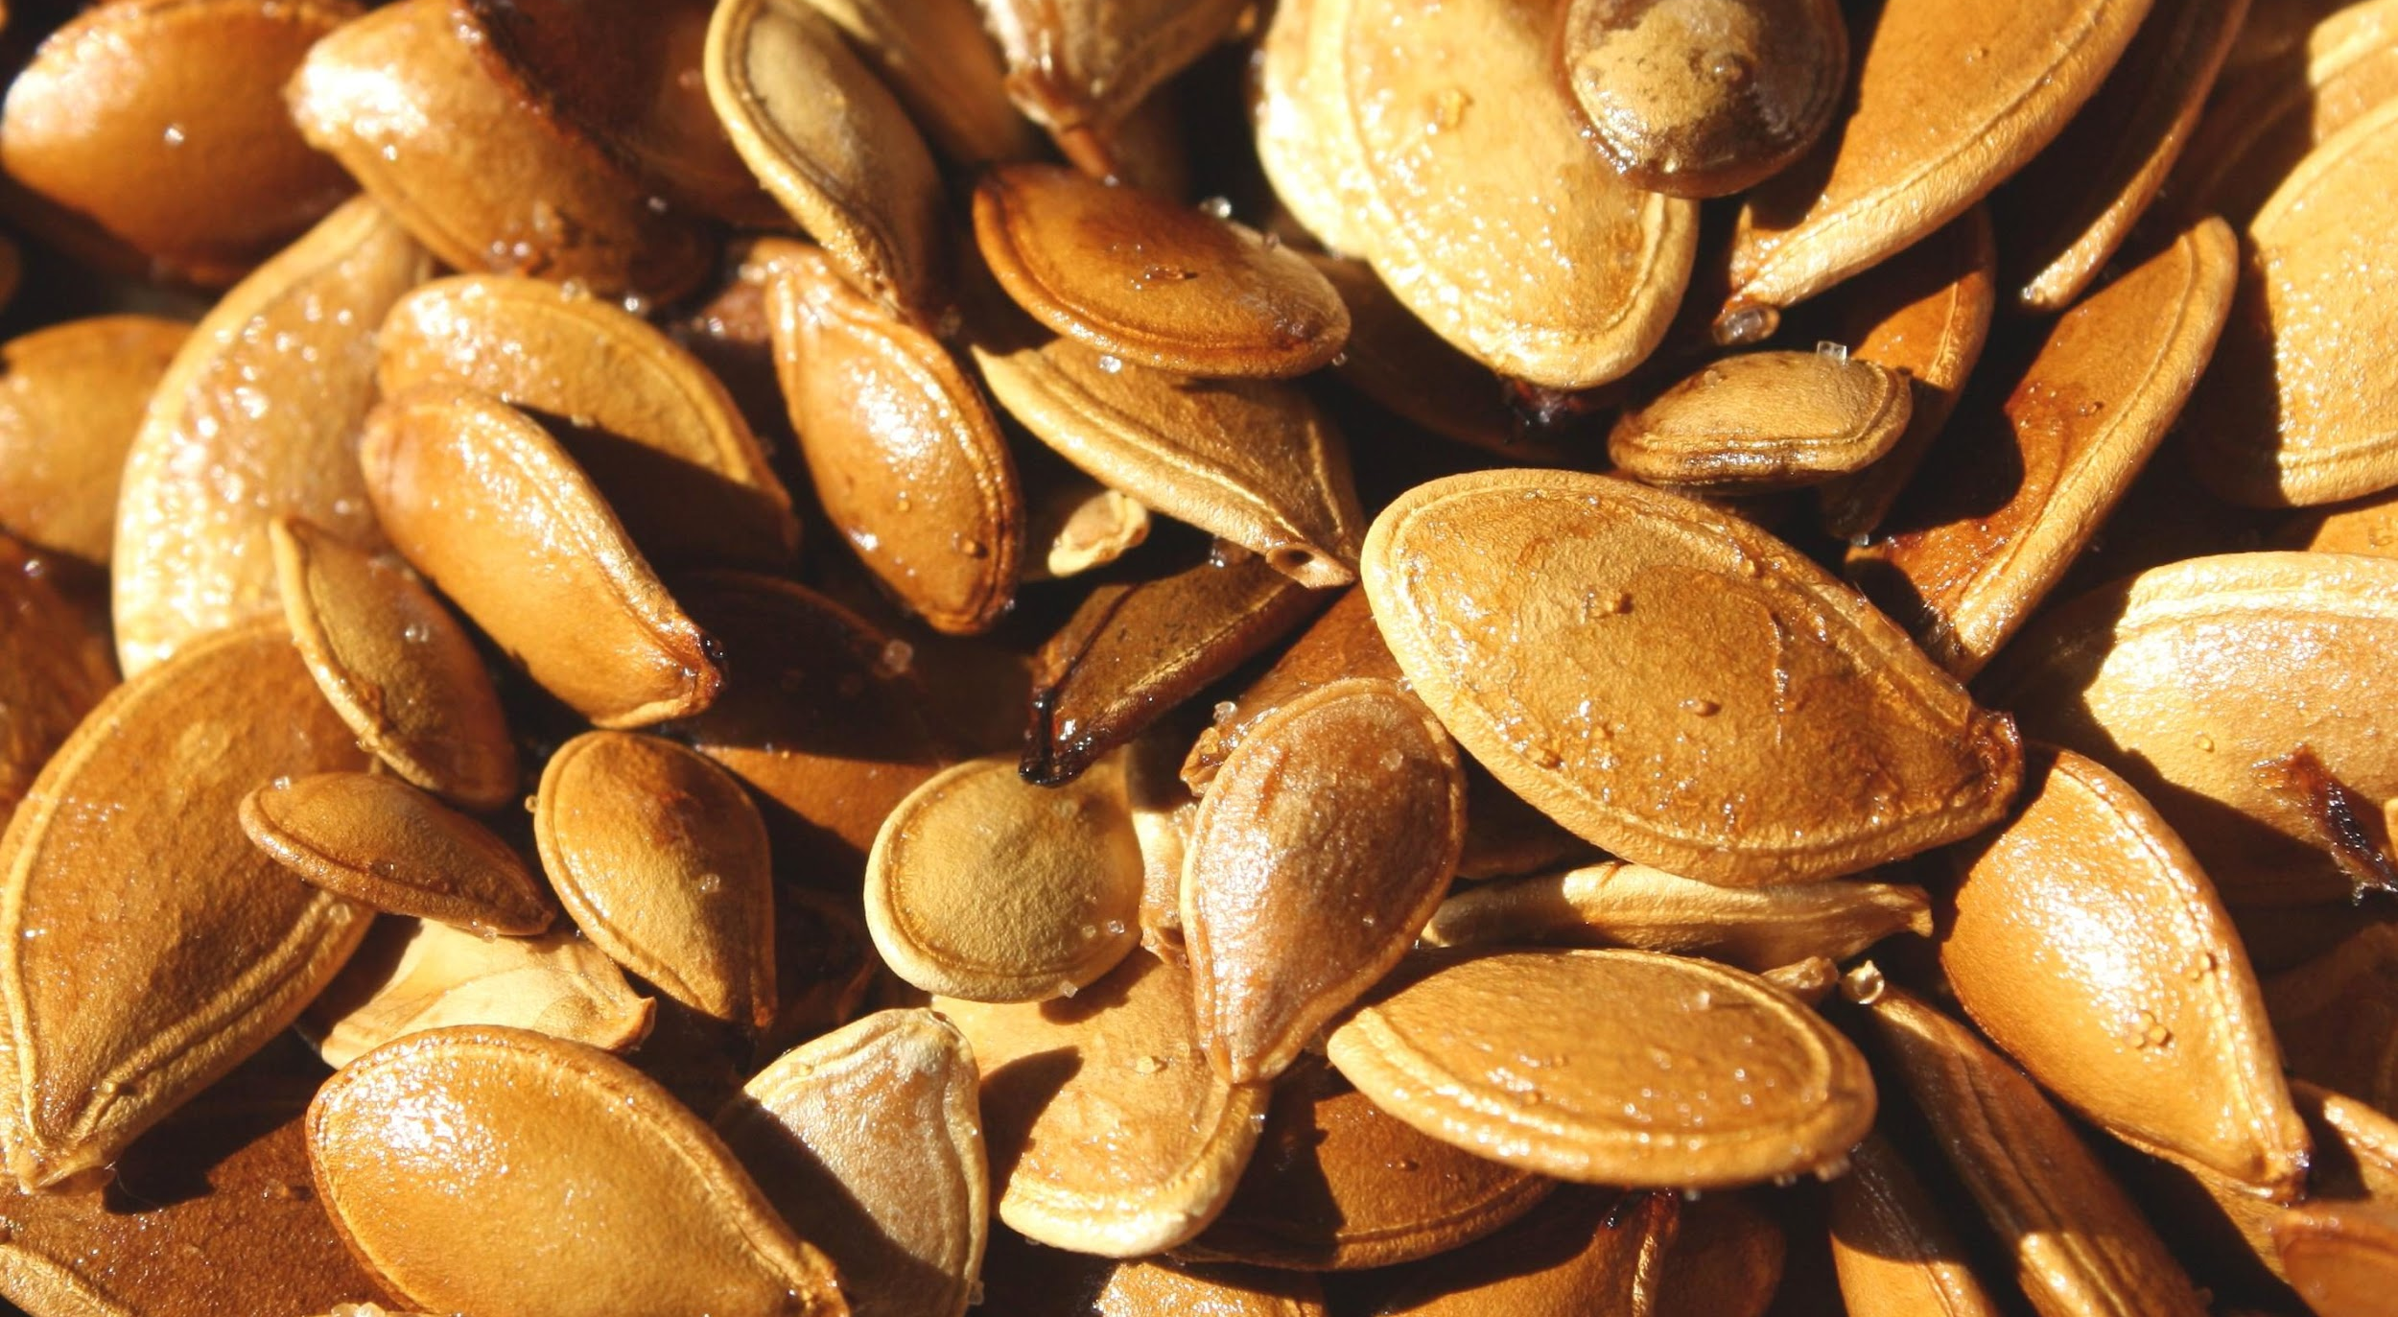
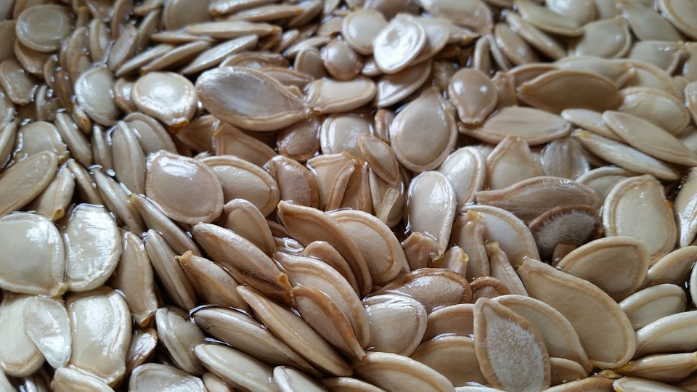
ALL ABOUT MY RECIPE
Pumpkin seeds are an excellent snack for a football game and gripping TV shows alike. Great for any occasion! They are extremely healthy, but watch out, They make you really thirsty!
SPOTLIGHT INGREDIENT: Pumpkin Seeds
Pumpkin seeds obviously come from pumpkins. While a lot of people think “Gross! Those seeds come from pumpkins that are filled with pumpkin guts! The seeds are contaminated!” The truth is, as long as you wash them. They go well with salt. Plus, they are good roasted.

Slide 23
Homemade Pizza
Olivia Kern
Entreè
2 Servings
INGREDIENTS:
1 baguette
2 cups fresh mozzarella cheese, sliced
Sauce:
1 teaspoon sugar
¼ cup olive oil
1 teaspoon salt
1 small onion, chopped
1 clove fresh garlic, peeled
1 large can san marzano tomatoes
3 teaspoons fresh basil
1 teaspoon red pepper flakes
PROCEDURE:
1. Preheat the oven to 400°.
2. First make the sauce. Saute the onion and garlic until the onion is translucent. Add the rest of the sauce ingredients and simmer for 20 minutes.
3. Next cut the baguette in half long ways. Toast the baguette in the oven for 5 minutes on a sheet pan. Take the baguette out and spoon some sauce on it. Top with mozzarella cheese and drizzle with olive oil.
4. Bake at 400° for 10 minutes or until top is lightly browned.

Slide 24
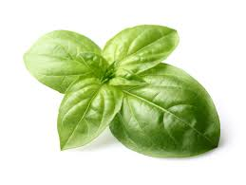
ALL ABOUT MY RECIPE
This recipe is special to me and my mom because she has been making it for me ever since I was really little. I was a picky eater, but I loved pizza so that’s why she started making it for me. Now, we make it together, because it’s very simple, fast, and easy to cook. I have many happy memories of me and my mom making it together, and eating this pizza together. Pizza originally comes from Italy, but this recipe is from Brooklyn. One difference is that we put the ingredients on freshly baked baguette bread instead of using dough. I think what most makes this recipe delicious is the fresh mozzarella cheese. When it is all melted on top of everything, it tastes really amazing, and I usually don’t even like cheese. The other ingredient that makes it taste so good is my mom’s homemade tomato sauce, made from san marzano tomatoes.
ALL ABOUT MY SPOTLIGHT INGREDIENT
My spotlight ingredient is fresh basil leaves. Basil is a plant with small, green leaves that smell fresh, minty, green, and taste a bit peppery. We grow it in pots on our porch, so we can get it anytime. You can pick basil leaves as needed. We usually pick a few leaves off each plant, instead of cutting off the whole stem. The basil is harvested while it is still in it’s “transition” stage, after the plant is old enough to be cut without dying, but before it flowers and the leaves turn bitter. The life cycle of basil grown in a pot is about 4 months. It takes about 75 days until you can harvest it. Basil contains antioxidants, vitamin K, vitamin A, and magnesium.

Slide 25
Perfect Pumpkin Pie
Ronen Battis
Dessert
4-6 Servings
INGREDIENTS:
1 medium pumpkin (baked and pureed)
14 ounce sweetened condensed milk
2 large eggs
1 teaspoon ground cinnamon
½ teaspoon ground ginger
½ teaspoon salt
1 (9 inch) unbaked pie crust
PROCEDURE:
Preheat oven to 425 degrees F. Whisk pureed pumpkin, sweetened condensed milk, eggs, spices and salt in medium bowl until smooth. Pour into crust and bake 15 mins.
Reduce oven temp to 350 degrees and continue baking 35 to 40 mins or until knife inserted 1 inch into crust comes out clean. Cool. Garnished as required. Store leftovers covered in refrigerator

Slide 26
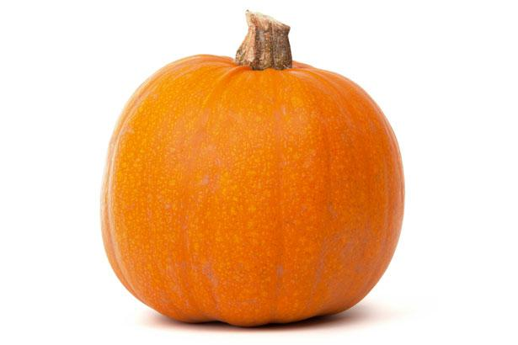
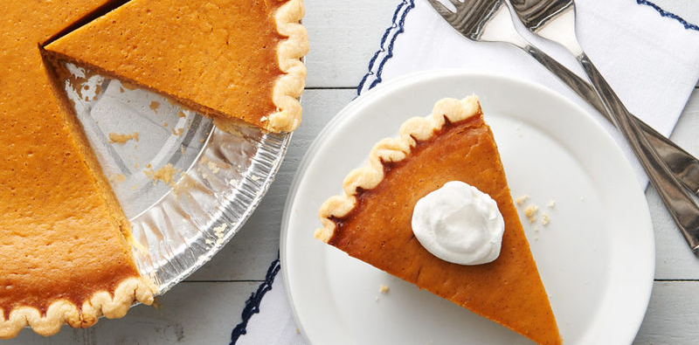
My Spotlight Ingredient
My spotlight ingredient is a pumpkin. A pumpkin is round shaped and orange with a filling of seeds surrounded by the sweetest part of the fruit. A pumpkin is the fruit of the plant and grows on a vine. According to pumpkinnook.com there is no limit to how big a pumpkin can grow. But it can also be as small to fit in your hand. Pumpkins are harvested between August and October. Usually it takes 90 to 100 days from planting seeds until the pumpkins are ripe. A pumpkin is harvested late in the plant life cycle. The pumpkin is the fruit of the plant and it needs time to turn orange and become ready to harvest.
About My Recipe
This recipe is perfect to have with the whole family. During the fall, around thanksgiving, my family always either makes or buys pumpkin pie. Every Thanksgiving this recipe is always eaten for dessert and we all enjoy it. Now I am excited to make this recipe. Something that makes this recipe so delicious is its flavorful sweet filling. Pumpkin pie also has a flaky, crumbly crust.

Slide 27
Apple Cinnamon Pancakes
Frank Leimsider
Entreé
4 - 6
INGREDIENTS:
1 fresh eggs
1 cup milk
1 cup shredded tart apple
¼ cup melted butter
¼ teaspoon ground cinnamon
1 tablespoon white sugar
1 ¼ cups all purpose flour
1 ¼ teaspoons baking powder
PROCEDURE:
In a large bowl, combine butter, egg, milk and apple. In a separate bowl, sift together flour, baking powder, cinnamon and sugar. Stir flour mixture into apple mixture, just until combined.
Heat a lightly oiled griddle or frying pan, over medium high heat. Pour or scoop the batter onto the cooking surface, using ¼ of a cup for each pancake. Brown on both sides and serve warm.

Slide 28
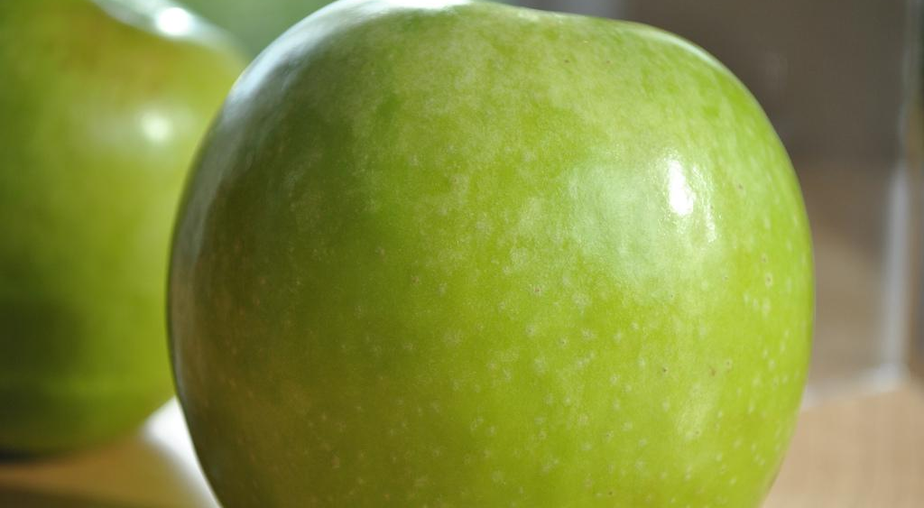
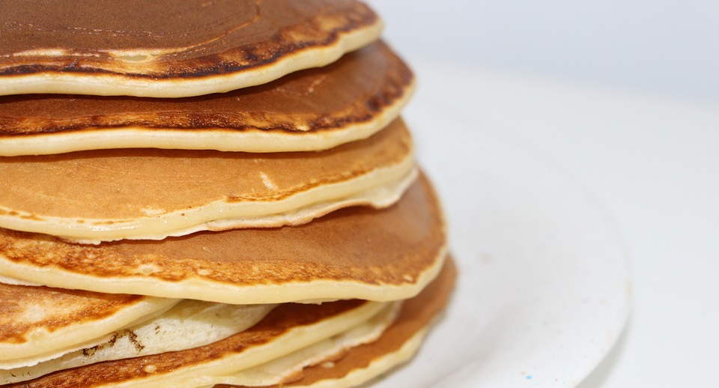
ALL ABOUT MY RECIPE
This recipe is a warm, friendly breakfast, perfect for cold, chilly mornings. It spreads joy in its delicious welcoming taste. A mouth watering smell, mixed with a comfy coziness, is what this is all about.
It is the perfect meal to celebrate with the whole family, and is special to me because it brings the family together, and we have shared happy memories eating this delight.
SPOTLIGHT INGREDIENT: APPLE
My spotlight ingredient is a Granny Smith apple. This apple is round and green with a brown stem. It is tart and juicy. An apple is the fruit of a plant. Apples are most commonly harvested in the fall when they are most ripe and sweet. It takes about 100 - 200 days for an apple to grow, and be picked. Apples may be good for weight loss, beneficial for your heart, good for bone health and they may protect your brain during old age.

Slide 29
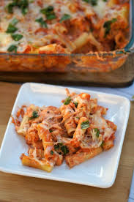
Baked Ziti With Basil
Sage Hueston
Entree
Serves 8-12 people
INGREDIENTS:
One package of ziti
One jar of tomato sauce
3 tablespoons of ricotta
Shredded cheese (as much as you want)
Fresh basil (as much as you want)
PROCEDURE:
Bring a pot of water to a boil
Add ziti into pot
Cook ziti until it is almost fully cooked and take out
Drain the water out of the pot, keep the ziti inside
Add about ¾ of the jar of tomato sauce into the pot and mix
Add about 3 tablespoons of ricotta into the pot and mix
Pour your ziti mixture into an oven pan and spread it out evenly
Pour your remainings of the tomato sauce on top of the ziti
Sprinkle your shredded cheese over the ziti (Use as much as you like)
Chop up the fresh basil
Sprinkle the basil over the ziti (Use as much as you like)
Preheat oven to 350 degrees
Once the oven is 350 degrees place the oven pan in the oven for 30 minutes
Take out and let cool
Enjoy!

Slide 30
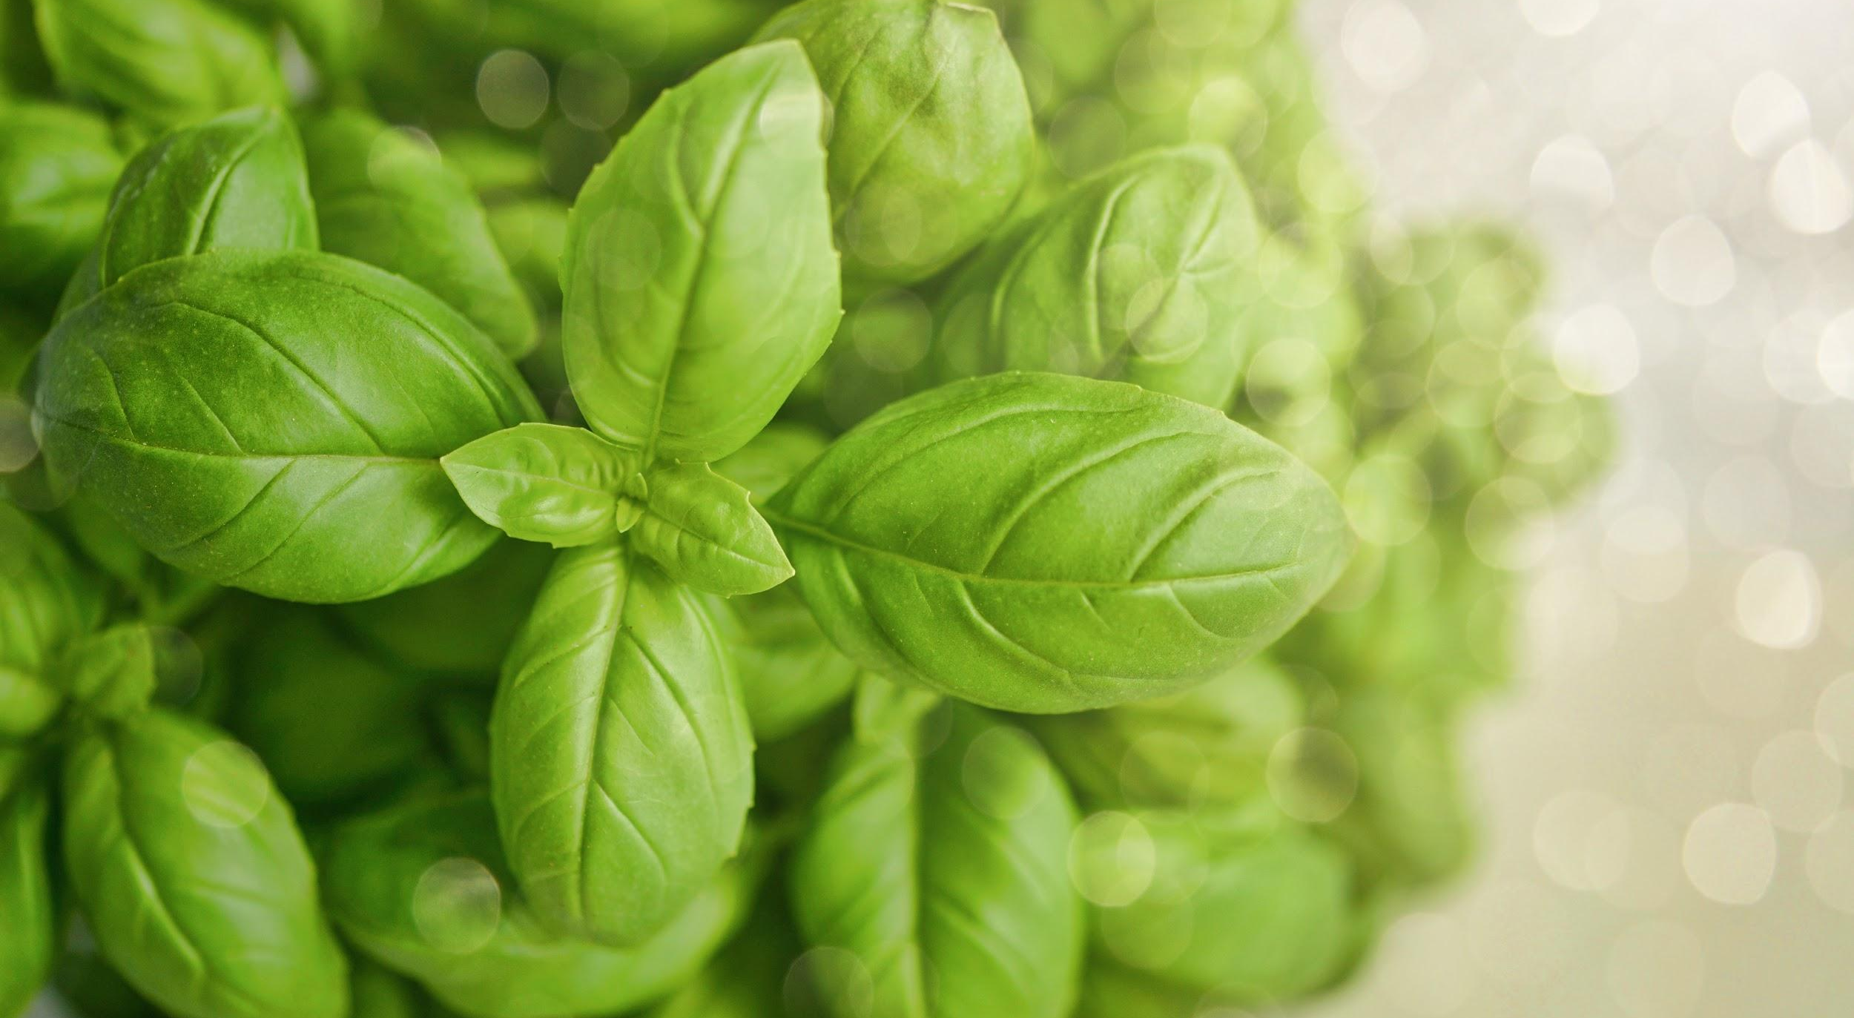
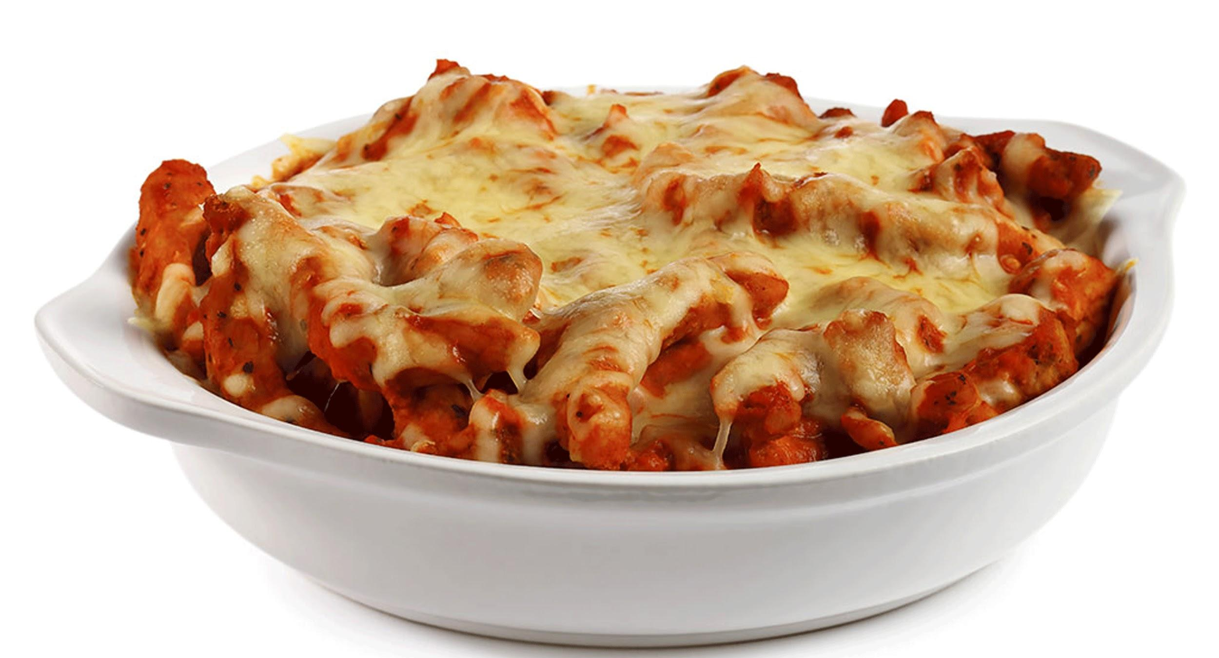
ALL ABOUT MY RECIPE
This recipe is important to me because it is one of my favorite meals to cook with my family and one of my favorite meals to eat. This is a recipe from Italy. In my opinion what makes this meal soooo good is if you mix of a lot of cheese and a lot of sauce together.
SPOTLIGHT INGREDIENT: BASIL
My spotlight ingredient is basil. Basil is an herb. It is green and oval shaped and on its own it tastes slightly peppery. Basil is a leaf and it takes about 4-5 weeks to grow it. When you harvest the basil it should be in about the middle You can pick basil mostly any time of the year. But the best time of day to harvest basil the morning. Basil has powerful antioxidants and it may help fight cancer.

Slide 31
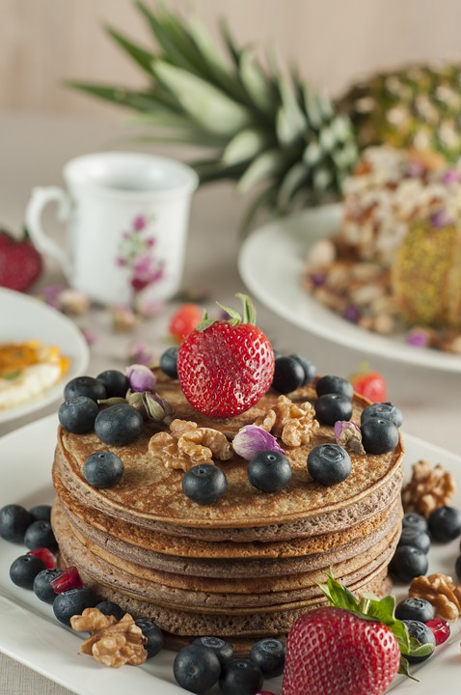
Pumpkin Spice Pancakes
Abena Swanzy
Dessert
5 people
INGREDIENTS:
½ cup pumpkin puree
1½ Aunt Jemima pancake mix
½ cup water. Add more water for thinner pancake.
PROCEDURE:
Mix all ingredients in a bowl.
Pour ¼ cup batter onto non-stick pan.
Cook for 2-3 minutes on each side.
4. Remove from pan when done and repeat. Enjoy!

Slide 32
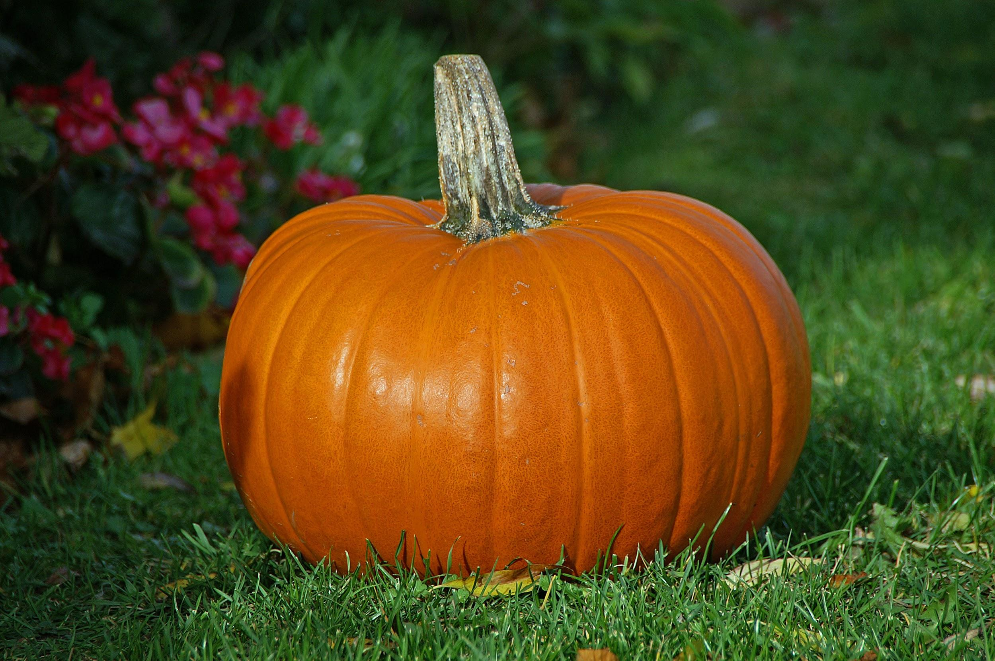
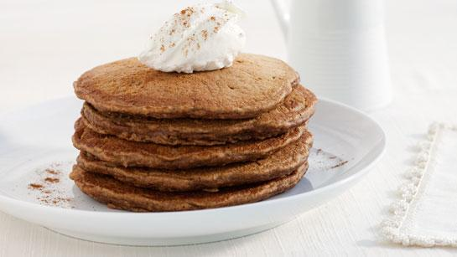
All about my spotlight Ingrediant
My spotlight ingredient is a pumpkin. Pumpkins are bright orange fruits that have hard and bumpy skin. A fresh pumpkin smells like a squash. Cooked pumpkin has a sweet-savory taste. The parts of the pumpkin plant we eat are the flesh and seeds. Pumpkins are planted in June. These plants take at least 2 months to grow from a flower before being harvested as fruits. Pumpkins have nutrients that boost immunity and are rich in vitamin A. They are mostly water, so you stay hydrated and improve your vision.
All About my Recipe
This recipe is important to my family because we love pancakes. My mom customizes the pancakes so that we don’t get bored. We try out many pancakes and this recipe is one of our favorites. We enjoy these pancakes in the fall so that the pumpkin spice mix doesn’t run out. What makes the pancakes taste great is the pumpkin spice mix.

Slide 33
French toast
Eric Edwards
Breakfast
Number of Servings
INGREDIENTS:
Two eggs
milk
Vanilla extract
Cinnamon
French toast bread
Butter
2 strawberries
syrup
6-8 people
PROCEDURE:
Crack two eggs into a bowl ( make sure bread can fit into the bowl)
Pour milk into the bowl until you can’t see the eggs
Beat the eggs until you can’t see yolk
Put in vanilla extract but don’t change the color of the batter
Put cinnamon in the batter
Beat the batter
Put pan on the stove between 4-5
Put butter on the pan spread it out
Keep brea on the pan for 3-5 minutes
Flip it over
Repeat step 9
Put strawberries on

Slide 34
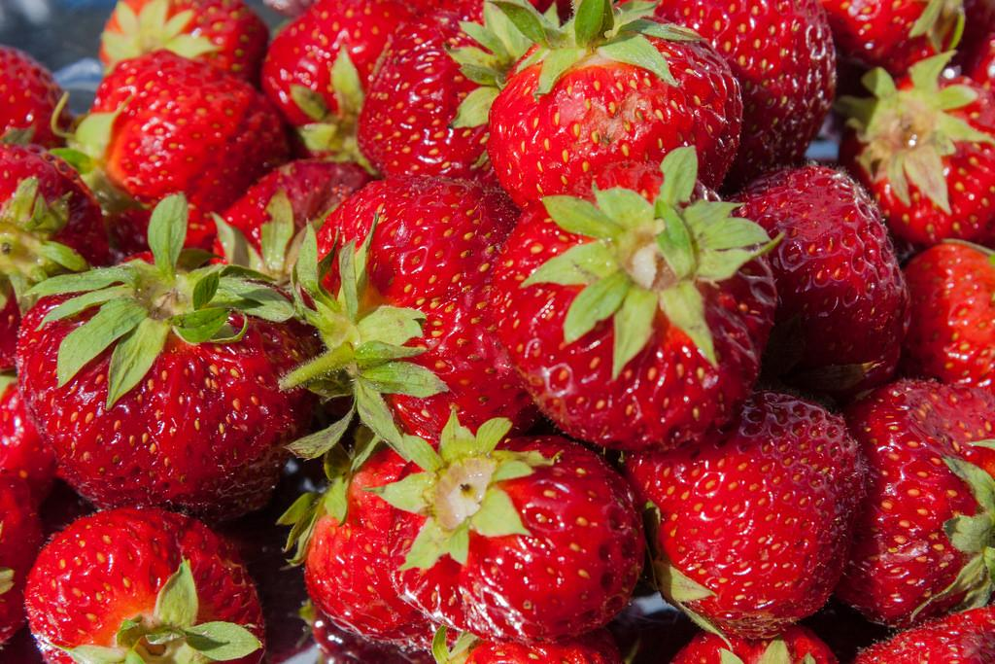
All About my recipe
French toast is basically cooked bread with ingredients on the outside. My family really likes to eat french toast and like using syrup. French toast was made by the roman empire, the roman empire took over France. The syrup make french toast delicious. Also the egg part tastes good.
All About my spotlight ingredient
My spot light ingredient is strawberries. Strawberries are red and have seeds on the outside of them, they are really sour. They have a leaf on top of them. Everything on the strawberry is edible even the leaf. Strawberries are fruit part of the plant. The strawberry is the last part of the plant life cycle. It takes a strawberry two months to be fully harvest. Strawberries lower blood pressure, they offer protection against cancer, and it lowers the risk of a stroke.

Slide 35
Pumpkin Pie
Taylor Dorta
Dessert
8-9
INGREDIENTS:
¾ cup granulated sugar
1 tsp ground cinnamon
½ tsp of salt
½ tsp of ground ginger
¼ ground cloves
2 large eggs
1 can (15oz) LIBBY'S 100% pure pumpkin
1 can (12 fl.oz) NESTLE CARNATION evaporated milk
1 unbaked 9-inch deep dish pie shell
Whipped cream (optional)
PROCEDURE:
Mix: sugar, cinnamon, salt, ginger and cloves in a small bowl
Beat eggs in large bowl
Stir in pumpkin and sugar spice mixture
Gradually stir in evaporated milk
Pour in pie shell
Bake in preheated 425 degrees F oven for 15 minutes
Reduce temperature to 350 degrees F
Bake to 40 to 50 minutes until knife inserted near center comes out clean
Cool on wire rack for 2 hours
Serve immediately or refrigerate
Top with whipped cream before serving

Slide 36
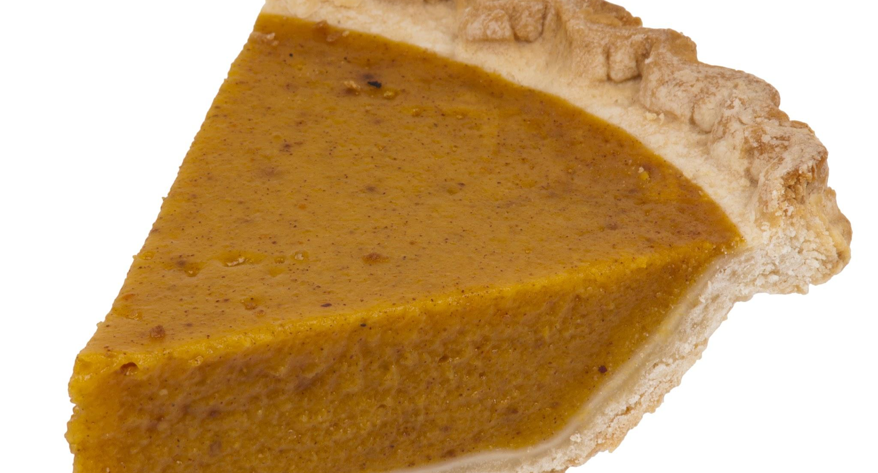
ALL ABOUT MY RECIPE
This recipe is important to my family because we make it for the holidays. In my opinion there is no one part from this pie that makes it good, I think the whole thing is what makes it delicious. We also just use this recipe for desserts even when it's not a holiday. Pumpkin pie isn’t as sweet but it has a little sweetness in it. Pumpkins are a bright orange with bumpy skin.
SPOTLIGHT INGREDIENT: PUMPKIN
My spotlight ingredient is pumpkin. The pumpkin comes from the fruit part of the plant because it has seeds. A pumpkin tastes like not sweet but has a little sweetness to it but not much. Pumpkins are usually harvested between September through October. Pumpkins have vitamin A, C, E and B2. Pumpkins need 90-120 days to grow fully so it can be harvest. The pumpkin would probably be in the middle of the pumpkin life cycle because it's when the pumpkin if fully grown but after that it can rot and it wouldn’t be good anymore to eat. So the pumpkin life cycle will be the seed, the full pumpkin and lastly the pumpkin rotting.

Slide 37
Apple Crisp with Oat Topping
MIles Meade
Desserts
Servings: 9 people
INGREDIENTS:
2 tablespoons of white sugar
½ teaspoon of ground cinnamon
1 cup of brown sugar
¾ cup of old-fashioned oats
¾ cup of all-purpose flour
1 teaspoon of ground cinnamon
PROCEDURE:
Preheat oven 350 degrees F (175 degrees C)
Toss apples with white sugar and 1/2 teaspoon cinnamon in a medium bowl to coat; pour into a 9-inch square baking dish.
Mix brown sugar, oats, flour, and 1 teaspoon cinnamon in a separate bowl. Use a pastry cutter or 2 forks to mash cold butter into the oats mixture until the mixture resembles coarse crumbs; spread over the apples to the edges of the baking dish. Pat the topping gently until even.
Bake in preheated oven until golden brown and sides are bubbling, about 40 minutes

Slide 38
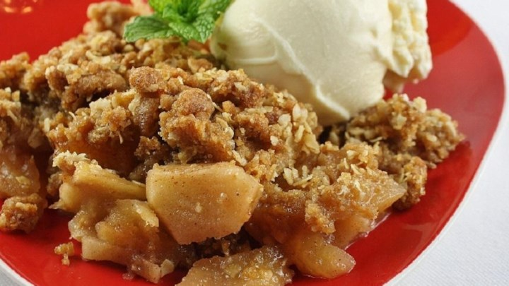
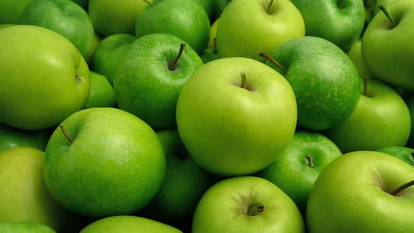
ALL ABOUT MY RECIPE
Apple Crisp with Oat Topping was first made in my family at thanksgiving and everyone loved it so we kept on making it. It does not take that long to make and it is so good every time we make it. I like how sweet the apples are. Hot sweet apples with oats are life changing. Having them with cold ice cream is even better.
SPOTLIGHT INGREDIENT: CAULIFLOWER
Apple Crisp with Oat Topping was first made in my family at thanksgiving and everyone loved it so we kept on making it. It does not take that long to make and it is so good every time we make it. I like how sweet the apples are. Hot sweet apples with oats are life changing. Having them with cold ice cream is even better.

Slide 39
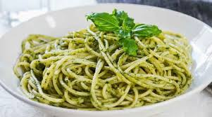
Pesto Pasta
Axel Foley
Entree
serves 6
INGREDIENTS:
½ cups of almonds
1 teaspoon coarse salt
1 small clove garlic
1 cup packed fresh basil leaves, soaked in water and dried
¼ cup or more light Ligurian olive oil
¼ cup grated fresh Parmigiano Reggiano cheese
1 cup all purpose flour (or Italian 00 flour)
2 eggs
2 tablespoons white wine
PROCEDURE:
For the pesto:In a bowl of a mortar, place the almonds and coarse salt and start grinding. Add the garlic and grind until a fine paste forms. Scrape down the pesto with a spoon periodically. Slowly add the basil leaves and grind until completely smooth. Add the olive oil slowly and grind and then add the cheese last.
For the pasta: Place flour on workspace and make a well in the center. Crack the eggs in the well and beat lightly with a fork. Add white wine to beaten eggs and mix with the fork. Slowly incorporate the flour with the fork until the dough forms. Knead and add flour so the dough is not sticky anymore. This may take a little more flour - you need to go just by the feel of the dough. Wrap in floured plastic and let rest in room temperature for 15 minutes. Cut it into thirds and take each piece and run it through pasta rollers on the widest setting. Fold in third and run through several more times. Adjust rollers to next thinnest setting and pass pasta through. Pass through until you get to the thickness you like - #5 or #6. Lay pasta sheets on floured counter and cut into squares.
If you do not want to make homemade pasta, you can buy lasagna noodles, boil them and cut them into squares.
Assemble: Bring large pot of salted water to boil. Add pasta sheets and boil for just a couple of minutes. In a cold skillet (not over any heat) add the pesto and just a little of the hot pasta water and stir. Add the boiled pasta squares and toss gently. Transfer to a serving platter and drizzle a little more olive oil and garnish with fresh basil.

Slide 40
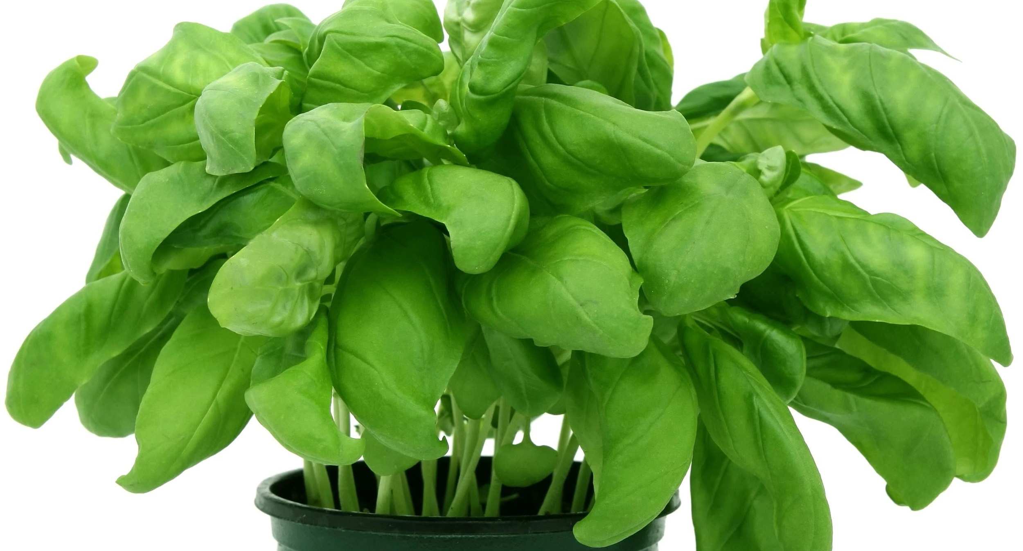
ALL ABOUT MY RECIPE:
This recipe is special to me because it was the first dish I ever made by myself from scratch. It doesn't have pine nuts in it, instead it has almonds which are healthier. We have this whenever we want it is not just on special occasions like birthdays. This recipe just makes your mouth water when you smell it’s sweet pesto.
SPOTLIGHT INGREDIENT: BASIL
My spotlight ingredient is basil. It looks like a smooth green leaf and tastes a little rich and like mint, you can also find it on pizza. My spotlight ingredient is the leaf part of a plant. You can harvest basil whenever you want. Morning is the best time to harvest basil. Usually harvested in the third cycle.

Slide 41
Empanada de Verde
Christopher Calle
Recipe Type: Entree
Number of Servings: 4
INGREDIENTS:
1 pound of meat
1 pinch Pepper
5 green silvers/bananas
1 Onion
1 Tomato
1 pinch of Comino [A spice for flavor]
PROCEDURE:
Cook the green silvers/bananas by frying them
Cook the meat on medium heat on a stove
Heat the green bananas until it’s thick enough to use
Mix all the ingredients together (The green bananas are the outside and the meat goes inside and the rest of the ingredients give it flavor)
Cut the tomato and onions, mix them together and it makes a juice for the food (You can add the juice on the food if you would like to, optional)
Finally you have your very own Empanada de verde

Slide 42
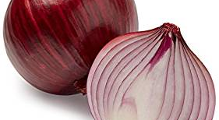
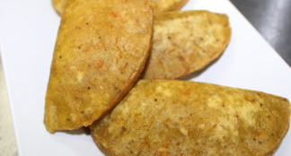
ALL ABOUT MY RECIPE
This recipe is significant to my family because it is delicious, we all enjoy it, and finally it’s a way to get the family together, the food is delicious because it has a juicy flavor. This recipe is also special to my family because it is one of our cultural foods (Ecuador). Another reason my family enjoys this recipe is because it makes us relax from any stress. One reason I enjoy it is because of all the mixed flavors. This is why me and my family like this recipe.
SPOTLIGHT INGREDIENT: ONIONS
My spotlight ingredient is Onions. The spotlight ingredient is juicy, it’s purple, and it adds a lot of flavor to the food. An onion is a stem in a plant so I will be using the stem for my food. The onion takes 20-30 days until it’s ready to be harvested. In an onions life cycle the onion should be harvested in the fall. Other uses of my spotlight ingredient is that they make the food more delicious for the eater because of it’s juicy flavor. Some health benefits are that it can eliminate Cancer, heart disease, etc.

Slide 43
Pizza
Dyami
8
INGREDIENTS:
1/2 recipe homemade pizza crust.
2 - 3/4 cup (127-190g) pizza sauce, depending how much you like here is the sauce recipe:
1. Place tomatoes, water, and olive oil in a blender or food processor; blend until smooth.
2. Transfer tomato mixture to a large pot.
8 ounces sliced mozzarella cheese.
1 and 1/2 cups (6 oz or 168g) shredded mozzarella cheese.
2-3 Tablespoons (10-15g) grated Parmesan cheese.
ground basil, to taste.
Number of Servings
PROCEDURE:
heat oven to 425 fahrenheit spread pizza sauce over dough to within ½inch of edge.
bake classic crust 10 to 15 minutes, thin crust 8 to 13 minutes, or until crust is golden brown.
Cut into 8 slices

Slide 44
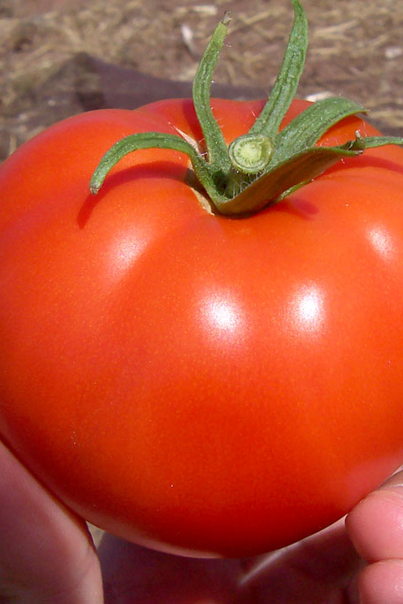
SPOTLIGHT INGREDIENT: Tomato
All About My Spotlight Ingredient: tomato
My spotlight ingredient is tomato. Tomatoes look like small red pumpkins they can be changed to taste much sweeter than they really are. The part of tomato plant that I use in my dish is the fruit. Tomatoes can even help your heart. They are harvested when they are firm and very red
Pizza is special to our family Because we really like it and it's fun to make.
Pizza is from Italy. I think if the pizza has really good crust than it can be the best part of the pizza.

Slide 45
Pumpkin pie w/ an Apple Cinnamon Ice cream
Tyler Cunningham
Dessert
6-8 servings
INGREDIENTS:
2 eggs, beaten
3 green apples, grated
1 teaspoon cinnamon
1 tablespoon lemon juice
1 teaspoon grated lemon zest
3 eggs
2 egg yolks
1 teaspoon vanilla essence
1 cup sugar
2 cups cream
1/2 teaspoon salt
1/2 cup shortening
3 1/2 tablespoons cold water
1 1/3 cups all-purpose flour
2 cups mashed, cooked pumpkin
1 (12 fluid ounce) can evaporate milk
2 eggs, beaten
3/4 cup packed brown sugar
1/2 teaspoon ground cinnamon
1/2 teaspoon ground ginger
1/2 teaspoon ground nutmeg
1/2 teaspoon salt
PROCEDURE:
Preheat oven to 400 degrees F (200 degrees C).
Prepare pie crust by mixing together the flour and salt. Cut shortening into flour; add cold water 1 tablespoon at a time (you may need only 3 tablespoons or up to 4 tablespoons). Mix dough and repeat until dough is moist enough to hold together.
With lightly floured, hands shape dough into a ball. On a lightly floured board roll dough out to about 1/8 inch thickness. With a sharp knife, cut dough 1 1/2 inch larger than the upside-down 8- to the 9-inch pie pan. Gently roll the dough around the rolling pin and transfer it right-side up onto the pie pan. Unroll, easing dough into the bottom of the pie pan.
In a large bowl, beat pumpkin with evaporated milk, eggs, brown sugar, cinnamon, ginger, nutmeg and salt with an electric mixer or immersion blender. Mix well. Pour into a prepared crust. Bake 40 minutes or until when a knife is inserted 1 inch from the edge comes out clean.
Apple Cinnamon Ice Cream
Place apples, cinnamon, lemon juice and lemon zest in a bowl.
Mix well.
Place eggs, egg yolks, vanilla and sugar in a bowl of an electric mixer and mix until light and creamy.
Reduce speed and pour in cream and apple mixture.
Pour the mixture in a bowl and place in the freezer for about 6 hours.

Slide 46
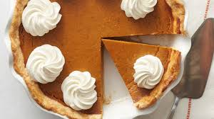
All about my recipe
All about my spotlight ingredient
My recipe is a pumpkin pie w/ an apple cinnamon ice cream. I chose this recipe because pumpkin pie and ice cream are very delicious. I and my family love eating it on Thanksgiving. And it gives me good memories. I added apples and cinnamon because I would have my favorite fruit, my favorite type of pie, and my favorite dessert.
My recipe is a pumpkin pie w/ an apple cinnamon ice cream. I chose this recipe because pumpkin pie and ice cream are very delicious. I and my family love eating it on Thanksgiving. And it gives me good memories. I added apples and cinnamon because I would have my favorite fruit, my favorite type of pie, and my favorite dessert.

Slide 47
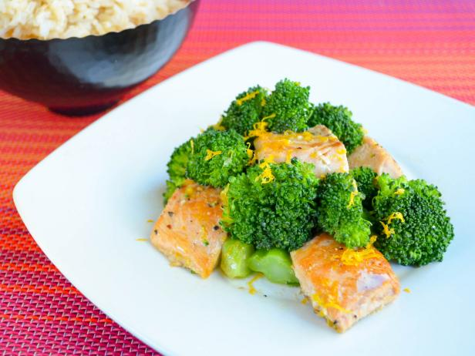
Salmon & Broccoli
Katia Hudock
Recipe Type
Servings: 3
INGREDIENTS:
Fine sea salt
¼ cup roughly chopped flat-leaf parsley
1 tablespoon pine nuts (optional)
1 small garlic clove, roughly chopped
1 whole dried chile pepper, crumbled, or ¼ to ½ teaspoon red pepper flakes
1 ¼ pounds broccoli
5 tablespoons extra-virgin olive oil plus more for drizzling
1 ½ pounds skinless salmon fillet, cut into ¾-inch cubes
freshly ground black pepper
PROCEDURE: 1. Bring a large saucepan of salted water to a boil.
2. Meanwhile, on a cutting board, mound parsley, pine nuts (if using), garlic and crumbled dry chile or red pepper flakes. Finely chop together; set aside. 3. Cut broccoli stems from crowns. Trim and peel stems, then cut into ½-inch pieces. Separate crowns into florets. 4. Cook broccoli in the boiling water until tender. About 5 minutes, then, using a slotted spoon, transfer to a colander to drain; reserve ½ cup of the broccoli cooking liquid. 5. In a large nonstick skillet, heat 1 tablespoon oil over over medium-high heat until hot but not smoking. 6. In a single layer, add salmon pieces; cook, turning once halfway through and removing thinner pieces as they are done, until pieces are cooked through but slightly pink in the center , 3 to 5 minutes, depending on thickness. 7. Remove pan from heat, transfer fish to a plate and season with salt and pepper. 8.Return skillet to medium-high heat. 9. Add remaining 4 tablespoons oil and heat until hot but not smoking. 10. Add broccoli, parsley mixture and ¼ teaspoon salt; cook, stirring occasionally, 2 minutes. 11. Add reserved cooking liquid, increase heat to high, and cook until broccoli is very tender and water has mostly evaporated, about 2 minutes more. 12. Adjust seasoning to taste. Serve salmon and broccoli together in shallow bowls, drizzled with oil.

Slide 48
ALL ABOUT MY RECIPE
My family likes salmon and broccoli because it tastes good. I actually don’t know where it comes from.
SPOTLIGHT INGREDIENT: BROCCOLI
My spotlight vegetable is broccoli. It is green and tastes bitter. It is the flower part of a plant. Broccoli is harvested when the buds first appear. It takes 100-150 days for it to grow from a seed. Broccoli is a good source of vitamins K and C. Vitamin C is necessary for healthy bones.

Slide 49
Basic Egg Pasta Dough with Sauce
Lola Gonzalez
Recipe Type: Entrée
Number of Servings: Six servings of pasta
INGREDIENTS:
Dough:
4 cups of unbleached all-purpose flour
6 large eggs
½ teaspoons of salt
½ teaspoons of extra virgin olive oil
Tomato Sauce:
4 tablespoons extra virgin olive oil, plus more for finishing
2 garlic cloves
1 pinch peperoncino
1 (16-ounce) can whole, peeled Mutti Italian tomatoes, crushed by hand
3-4 sprigs basil
PROCEDURE: Pasta:
Form a ball. On a marble or wooden work surface, pile the flour into a mound. Make a well in the center of the mound. In a small bowl, beat the eggs, salt, and olive oil together with a fork until blended, and then pour them in the well. Continue beating the egg mixture with the fork, gradually drawing in flour from the sides of the well until the egg has been absorbed by the flour. If needed, drizzle a small amount of warm water, and continue mixing. Once the dough has formed, clean your hands and the work surface.
Knead and knead (and knead). Flour the work surface again. Knead the dough: press the heel of one hand deep into the ball, keeping your fingers high, then press down on the dough while pushing it firmly away from you. The dough will stretch and roll under your hand like a large shell. Turn the dough over, then press into the dough, first the knuckles of one hand, then with the other; do this about ten times with the knuckles of each hand. Then repeat the stretching and knuckling process, using more flour if needed to prevent sticking, until the dough is smooth and silky, for about 10 to 20 minutes. Roll the dough into a smooth ball.
Rest. Place the dough in a small bowl and cover with plastic wrap. Let the dough rest for at least 1 hour at room temperature or up to 1 day in the refrigerator, before rolling and shaping the pasta. If the dough has been refrigerated, let it stand at room temperature for at least 1 hour before rolling and shaping.
Roll. Shape the dough into a rough circle. Lightly flour the clean work surface. With a rolling pin, begin rolling the dough as you would a pastry crust, starting in the center and rolling away from you to the outer edge. Turn the dough a quarter-turn, and repeat, working your way around, until the sheet of dough is 1/8 inch thin or less. Scatter a small amount of flour on the dough whenever it starts to stick to the surface or the rolling pin. Italian tradition dictates that the sheet of dough be transparent enough to read the text beneath.
Shape. From orecchiette to lumache, there are hundreds of shapes of fresh pasta. For a simple hand-cut tagliatelle, gently roll the sheet of dough around the rolling pin, and slip it off onto a clean, lightly floured work surface. Cut the roll of dough into strips the desired width, then gently lift them in the air and drop on a dishtowel, separated. Repeat with the remaining sheets of dough.
Cook. Fresh egg pasta cooks in a flash (think: 10 to 15 seconds). As soon as it rises to the surface of the heavily-salted cooking water, it is likely ready. A taste test will show if it is al dente enough.
Serve. Every pasta variety and shape pairs uniquely with various sauces. Tagliatelle ribbons are delicious with a heavier sauce featuring meat or seasonal vegetables.
Tomato Sauce:
Place a saucepan on the stove, and heat the extra virgin olive oil over medium heat. Using the heel of your hand, crush 2 of the garlic cloves, and add them to the olive oil, cooking them until they are golden brown.
Once the garlic is brown, add the peperoncino, and then immediately add the crushed tomatoes to the saucepan. Mix the tomatoes, and season them with salt, to taste. Simmer the sauce over low heat for approximately 20 minutes so that it begins to thicken.
Turn off the heat, and add the basil sprigs while the sauce is cooling, remembering to remove them once the sauce has cooled completely. The tomato sauce should be a rich red color. If it is brick red, it is too thick and needs to be thinned with water. Incorporate the sauce into your favorite dish, and enjoy!

Slide 50
ALL ABOUT MY RECIPE
This recipe is significant to my family because we all make it together and we have lots of fun doing it. The recipe also is originated in Italy although the pasta was made in China. In my opinion, I think this recipe is delicious because when I make it I use fresh ingredients so that it is healthy and so it has more flavor. This pasta dough recipe can also have additional ingredients like basil to give it a stronger flavor. My family likes to eat this dish when we have guests over because it is a delicious and fun food to eat.
SPOTLIGHT INGREDIENT: TOMATO
My spotlight ingredient is a tomato because tomatoes can be used to make tomato sauce which you can put in your pasta. Tomatoes are actually a fruit and not a vegetable because the tomato has seeds and only fruits have seeds. Another fact on tomatoes is that China is the country that produces the most tomatoes in the world. Tomatoes come in many different colors like green, yellow, purple, white, brown, black, orange, white, and the most common color red. The life cycle of a tomato starts with a seed, then a young plant, a mature plant, a flower, and then finally a fruit. In my opinion, I like to cut my tomato and then sprinkle salt and pepper on it.

Slide 51
Shepherd’s Pie
Simone Mena
Entree
8 servings
INGREDIENTS:
For the potatoes
1 ½ pounds russet potatoes
¼ cup half-and-half
2 ounces unsalted butter
¾ tsp kosher salt
¼ tsp ground pepper
1 egg yolk
1 cup chicken broth
1 tsp Worcestershire sauce (optional)
2 tsp freshly chopped rosemary leaves
2 tsp freshly chopped thyme leaves
½ cup fresh/ frozen corn kernels
½ cup fresh/ frozen peas
FOR THE MEAT
1 pound of ground turkey
1 package of mushrooms (optional)
2 carrots peeled and sliced thin
2 cloves of garlic minced
1 tsp kosher salt
½ tsp of ground black pepper
2 tbsp all- purpose flour
2 tsp tomato paste
PROCEDURE:
Peel the potatoes and cut into ½ - inch dice. Place in a medium saucepan and cover with cold water. Set over high heat, cover and bring to a boil. Once boiling, uncover, decrease the heat to a simmer and cook until tender and easily crushed with tongs, approx 10-15 min. Place half- and - half and butter in a microwave -safe container and heat in the microwave until warmed through, about 35 seconds. Drain the potatoes in a colander and then return to the saucepan. Mash the potatoes and add half- and- half, butter, salt, and pepper until smooth. Stir in the egg yolk until fully combined.
Preheat oven to 400 degrees F.
While the potatoes are cooking, Prepare the meat filling. Place canola oil into a 12 inch saute pan and set over medium high heat. Once the oil shimmers, add the carrots and onions and saute until they take on colo(u)r, about 3-4 minutes. Add garlic and stir to combine. Add the turkey, salt and pepper and cook until browned and cooked through, about 3 minutes. Sprinkle the meat with flour to coat, continuing to cook for another minute. Add tomato paste and chicken broth worchestire sauce rosemary and thyme and stir to combine. Bring to a boil then reduce the heat to low, cover and simmer slowly about 10-12 minutes or until the sauce thickens slightly.
Add the corn and peas to the turkey mixture and spread evenly into an 11 by 7-inch glass baking dish. Top with the mashed potatoes, starting around the edges to create a seal to prevent the mixture from bubbling up and smooth with a rubber spatula. Place on a parchment lined half sheet pan on the middle rack of the oven and bake for 25 minutes or just until the potatoes begin to brown. Remove to a cooling rack for at least 15 minutes before serving.

Slide 52
ALL ABOUT MY RECIPE
This recipe is very special to me because I always have it and make it with my Mama and it’s comes out so yummy! It’s a year round recipe so I don’t have to wait for a specific holiday for my mom to make it. Since the recipe is 8 servings and it’s usually just my mom, my step-dad and I, we normally freeze a portion for easy meals for days. It’s also one of my favorite lunches ever! It’s the best!
MY SPOTLIGHT INGREDIENT: POTATOES
My spotlight is potatoes because it’s one of the key ingredients and who doesn’t like potatoes! It’s smooth and in an array of shades of browns.
Potatoes are underground stems. They are typically picked in colder seasons of the year.Like fall or winter.
Some of the health benefits of potatoes is that they are high in potassium and vitamin C and extremely versatile. You usually pick it around the middle of its life.

Slide 53
Chocolate Lava Cake With Strawberry Sauce
Dessert
Charlotte Baier
INGREDIENTS:
1/2 cup butter
1 cup powdered sugar,
2 eggs
2 egg yolks
6 tablespoons flour
1 pint fresh strawberries
4 chocolate lava cakes
⅓ cup of white sugar, preferably Domino sugar
1 teaspoon vanilla
PROCEDURE:
Preheat oven to 425 degrees. Spray 4 custard cups with non-stick cooking spray and place on baking sheet.
In microwave-safe bowl, melt butter and chocolate until butter is melted. Stir until chocolate is melted. Stir in sugar until well blended. Whisk in eggs and egg yolks. Stir in flour. Divide evenly between baking dishes.
Bake 13-15 minutes until sides are firm and center is soft. Let stand 1 minute before removing. Serve warm with ice cream.
STRAWBERRY SAUCE:
Wash strawberries and remove stems; cut large berries in half or roughly chop them.
Combine strawberries, sugar, and vanilla in a saucepan. Cook over medium-high heat, stirring occasionally. The mixture will sizzle for a while, but then juice will begin to form. Continue stirring; mash a few strawberries with a wooden spoon or heat-proof spatula to help produce the syrup. Cook until sauce thickens, about 15 minutes.
Remove from heat. In a blender, puree about 1/3 of the sauce, then mix back into remaining topping. Store in refrigerator.

Slide 54
ALL ABOUT MY RECIPE
I love chocolate lava cakes, they are one of my favorite desserts! Also, strawberries are one of my favorite fruits. When my family and I go apple picking we like to pick some strawberries too. I wanted to find a way to combine two of my favorite foods. My dad was the producer of Unstuck: an OCD kids movie, my sister and I are in it since my sister has OCD. We spoke and presented at an event, it was my favorite event besides London and San Francisco, it was so fancy! They served chocolate lava cake after my sister and I spoke. I don’t have a particular culture or tradition for chocolate lava cake, but I like to eat them at special events. For instance, the week before school started I stayed with really close family friends and their four daughters, we went to see a show, at it they served chocolate lava cake., it was amazing!
SPOTLIGHT INGREDIENT: STRAWBERRIES
Did you know the average strawberry has about 200 seeds. Some benefits of having strawberries are they have a rich source of antioxidants. They help support your immune system. Sometimes they can help with blood sugar regulation, as well as weight management. Also, they can improve heart health. In the USA most strawberries harvest in April, May, and June. The average strawberry takes 4 to 6 weeks to grow. The part of the plant strawberries are is a fruits. Strawberries are red with seeds covering them, they have green stems and leaves.

Slide 55
Rice and Beans with Carrots
Paco Cubria
Entree
6-8
INGREDIENTS:
rice
beans
carrots
oil
garlic
salt
onion
water
PROCEDURE:
1: Put 1 oz of olive oil in a pot; brown the garlic in oil.
2: Add rice to the oil and garlic; add a bit of salt and stir till rice is well mixed with the oil.
3: Add cups of water.
4: Boil for about 20m.
Beans:
1: Place the black beans in water the night before cooking them.
2:Add olive oil to a pan, heat it up and add garlic, carrots, onions and brown for 5 minutes.

Slide 56
ALL ABOUT MY RECIPE
his recipe is significant to my family because we eat it a lot and my grandma also makes it and my dad had it a lot in spain when he was a kid.
We have it a lot but not in any specific occasion. This recipe is from a lot of places but I usually I have the spanish or dominican recipe. I think the mix of rice and beans and an egg and carrots and garlic and a lot of things tastes really good.
SPOTLIGHT INGREDIENT: CARROTS
My spotlight ingredient is carrots. My spotlight ingredient is carrots, carrots are orange and they are long and they are crunchy and juicy.Carrots are the roots of a plant.We usually eat it in about 70 to 80 days after planting it. Carrots are usually prime to harvest within 3 months.Carrots can actually help prevent cancer and other diseases.

Slide 57
Chaulafan
Kayla Ortiz
Recipe Type:Entree
Number of Servings:12-15 people
INGREDIENTS:
Chicken Broth:
5 lbs of Chicken (whole chicken or assorted pieces)
10 cups of water
1 white onion , diced
2 carrots
2 celery stalks , finely chopped
5 cilantro springs
Salt to taste
Rice :
1tbs oil
2 tbsp white onion diced
3 ¼ cups of chicken broth
3 cups uncooked rice
Salt to taste
2-3 tbsp oil or butter +3 tbsp of butter
1 cup of diced white onions
6 garlic curves, crushed
4 oz pancetta or diced bacon
3 tbsp finely chopped cilantro
2 tbsp ground cumin
½ tbs ground cumin
½ tbs achiote powder
1 cup of cooked peas
½ cups of raisins
6 eggs worcester sauce
Avocado slides
Side : avocado
Procedure:
Bring the water , carrots ,onions , celery and herbs to boil in large pot , add the chicken and cook over medium heat for about an hour until chicken is very tender and fully cooked
Remove the chicken from broth and save the broth
To cook the rice, heat the butter , add the onions and the rice , stir well. Then add the broth , bring to boil, then reduce the heat to low , cover and simmer for about 20 minutes
Meanwhile debone the chicken and reserve the chicken meat for later
Heat the first 2-3 tbsp butter or oil over medium heat in a large pan to prepare a refrito or base for the chaulafan
Add the chopped onions,diced pancetta , crushed garlic ,1 tbsp worcester sauce ,cumin ,cilantro, and achiote powder, cook for about 5-8 minutes, stirring occasionally
Add the cooked rice , chicken meat , and diced bell peppers . Stir well and cook over medium high heat for about 5 minutes , stirring occasionally .
Stir in the remaining worcester sauce , scrambled eggs , peas, carrots , raisins, mix well
Add the chopped herbs and green onions
Serve on plate with avocado on the side and ENJOY !!!!!!!!

Slide 58
ALL ABOUT MY RECIPE
This recipe is special to me and my family it's like saying welcome to your guests also because it is really delicious . People usually cook this when someone they are meeting for the first time is coming to their house . Also when somebody you haven't seen in a long time is coming to your house.This recipe is a traditional Ecuadorian recipe . In my opinion the ingredient that makes this dish so good is the chicken . The chicken is my favorite ingredient because first of all i really like chicken also because the way it's cooked just gives it this whole new good flavor .
SPOTLIGHT INGREDIENT:ONIONS
My spotlight ingredient is an onion . An onion is white , round , smooth , has multiple layers when you cut it . An onion also makes your eyes cry . It tastes kind of spicy but still is very good in foods including this dish. An onion is the stem part of a plant .Before a onion is harvested it is grown for 100 to 175 days .Families believe that onions are good for cleaning the inside of your stomach and is also good to keep the doctor away by cleansing and detoxifying the body to prevent and treat ailments — from diabetes to heart disease.

Slide 59
Crepes with Strawberries
William Plache
desert
4 servings
INGREDIENTS:
1 cup of flour
1 cup of whole wheat flour
1 cup of water
1 ½ cups of milk
6 tablespoons of butter
4 eggs
strawberries
PROCEDURE:
beat the eggs
mix all ingredients in a big bowl
heat an 8-inch pan to medium
add a slice of butter to a heated pan to prevent sticking
pour one small ladle of mixed ingredients into pan
move mixture in pan to spread around
cook for 30 seconds
flip crepe over and cook for 15-20 seconds
remove crepe from pan and add strawberries on crepe

Slide 60
ALL ABOUT MY RECIPE
My dad’s grandma made crepes for him. My whole family likes and eats crepes. Me and my dad make crepes every weekend morning.
Crepes were originated in france. I don’t like crepes by themselves that much. I like them filled with something in them, like fruit.
SPOTLIGHT INGREDIENT: strawberries
My spotlight ingredient is strawberries. Strawberries are bright red with very small seeds all around it. They taste sweet as you take your first bite on the bright red juicy outside. You taste more sour and bitter as you eat into the white core of the strawberry. My spotlight ingredient is a fruit. Strawberries get picked
four to six weeks after they blossom. Strawberries are a good source of manganese and potassium.

