Slide 1
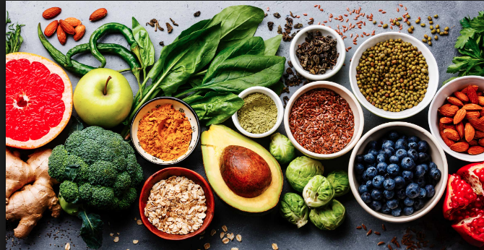
6th GRADE COOKBOOK
BLUE

Slide 3
TABLE OF CONTENTS
01 PARFAIT TARTE AUX POMMES
02 FRIED RICE WITH CHICKEN AND BROCCOLI
03 CUCUMBER SUSHI
04 MARVELOUS MARGHERITA PIZZA
05 TURKEY BURGER
06 BLUEBERRY PANCAKES
07 TUNA SEARED STEAK WITH SALAD
08 CREAMY BROCCOLI AND CHICKEN PASTA
09 SCRAMBLED EGG WITH TOMATOES
10 SWEET POTATOES WITH MARSHMALLOWS
11 FANTASTIC FRIED RICE
12 SPICY ROASTED RED PORK BELLY
13 TURKEY CHILI
14 SNAPDRAGON APPLE PIE
15 TOMATO MOZZARELLA
16 APPLE CRUMB CAKE
17 SPAGHETTI MONSTER
18 SPAGHETTI CARBONARA
19 PORK DUMPLINGS
20 FARRO SALAD
21 TACOS DORADOS
22 RICE & BEANS
23 PUMPKIN PIE
24 pumpkin breAD
25 THE SWEET BALL OF DOUGH
26 TOSTADAS
27 GREEN PASTA
28 PESTO AND TORTOLINI

Slide 4
Pumpkin Bread
Xavier O’neill
Breakfast or dessert
8 people
5 ounces of pumpkin puree
4 eggs
½ cup of vegetable oil
½ cup applesauce
⅔ cup water
2 cups of sugar
3 ½ cups of all-purpose flour
2 teaspoons of baking soda
1 ½ teaspoons of salt
1 teaspoon of cinnamon
1 teaspoon of ground nutmeg
½ teaspoon of ground cloves
½ teaspoon of ground ginger
PROCEDURE:
Preheat oven to 350 degrees. Grease and flour three 7x3 inch loaf pans.
In a large bowl, mix together the pumpkin puree, eggs, oil, applesauce, water and sugar until well blended.
In a separate bowl, whisk together the flour, baking soda, salt, cinnamon, nutmeg, cloves and ginger.
Stir the dry ingredients into the pumpkin mixture until just blended. Don’t over mix.
Optional - add in 2 cups of chocolate chip.
Pour into the prepared pans.
Bake for about 50 minutes or until a toothpick comes out clean.
INDEX

Slide 5
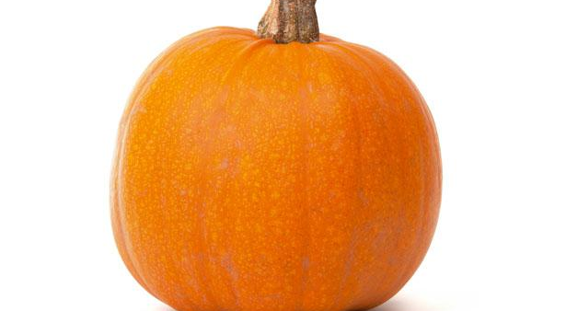
Paragraph: All About Your Spotlight Ingredient
My spotlight ingredient is a big huge awesome orange PUMPKIN!
1 Pumpkins are round with a brown stem and they taste like sweet stuff but they don’t taste good alone
2 Pumpkins are the fruit of the plant
3 it takes a pumpkin 90 to 120 days to grow from being planted as a seed
4 pumpkins contain potassium, fiber and vitamin C it also supports the heart
ALL ABOUT MY RECIPE
Whenever me and my family goes to couchouge we go pumpkin picking and when we come back, we make pumpkin bread with my cousins so we always have it in the fall when pumpkins are in season
Pumpkin bread originated in Mexico and central America
What makes this recipe delicious is the top of the bread because it gets rubbery and it tastes beautiful

Slide 6
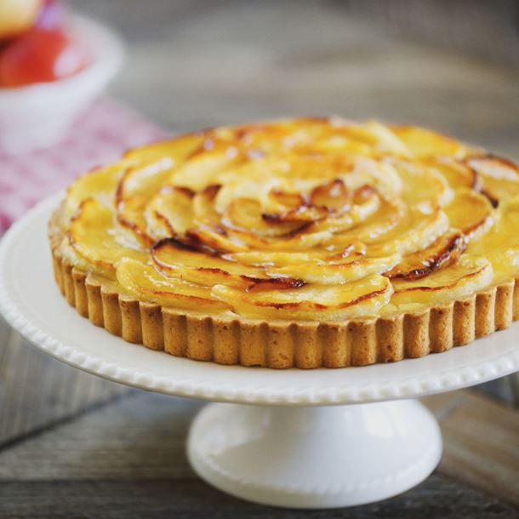
Parfait Tarte aux Pommes
Oskana Moullé-Berteaux
INGREDIENTS:
4 apples
100g flour
50g butter
30g sugar
1 large egg
1-2 soup spoons water
Recipe Type: Dessert
Number of Servings: 6
PROCEDURE:
preheat oven to 425 f for 30 minutes
make a flat sablée pastry:
add butter,
mix in sugar,
add yolk,
add flour little by little
fill in mold 26cm with the following mix of ingredients:
Put pastry in mold, down the bottom and up the side,
peel four apples.
cut them into thin slices.
lay into spiral at bottom of mold, on pastry
INDEX

Slide 7
FRIED RICE WITH CHICKEN AND BROCCOLI
Emile Shishonok
Main Meal
Number of Servings : 4
INGREDIENTS:
4 cups of Basmati Rice with ¼ cups of soy sauce
2 Chicken Breasts
1 tsp of Salt/Pepper
½ cups of Broccoli, cut up in bite size
1 cup of Sweet Peas
1 cup of cut up Carrots
2-3 tbsp of Olive Oil
1 cup of cut up Yellow Corn
PROCEDURE:
Bring a large pot of water to boil, make water salted, add rice. Cook until rice almost ready. Then, pass it through the strainer and leave it to cool.
Prepare chicken. Wash and dry chicken breast, cut it into cubes.
Heat up a frying pan with olive oil and add chicken. Cook until it is nice and brown. Add a pinch of salt and pepper.
Add on all vegetables and continue frying for another 5-7 min. Add soy sauce for flavor and put vegetables aside. Use the same frying pan, add more olive oil, and heat it really, really hot, which is 210 degrees fahrenheit.
Add cooked rice and small cup of soy sauce.
Stir often while it’s frying for 3 min.
Add cooked vegetables and put it together.
Turn off the heat, cover mixture with a top and let it stay for 30 min, so all ingredients can absorb each other’s flavors.
Serve fried rice in bowls and enjoy your meal.
INDEX

Slide 8
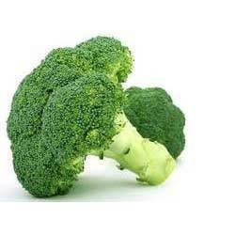
ALL ABOUT MY RECIPE
The recipe is special to my family because everyone in my family loves it and likes to eat it for lunch. We want it every day pretty much. The first time I experienced was a few years ago when it was my birthday and my parents decided to take me to a hibachi restaurant, where the cook put on a show to cook the fried rice right in front of us, I loved it. There was one part where the cook threw broccoli in my mouth to see if I could catch it. It was a good time. It is an Indonesian meal that is cultivated in many different countries as well. I think what makes this recipe delicious is the chicken, the peas, and the soy sauce because they water my mouth the most.
SPOTLIGHT INGREDIENT: BROCCOLI
Broccoli is my spotlight ingredient. Broccoli is light green on the bottom and dark green on the top with a hint of purple. Some people says it tastes like bitterness, while others say it has a taste of pepper. It is one of the flowers in a plant. When you see yellow pedals, harvest these broccoli ASAP. You need to grow this plant 55-80 days until harvest. Broccoli is anti-inflammatory which means it decreases swelling and inflammation. Broccoli has vitamins K and C, builds collagen which forms body tissue and bone, and heals all wounds and cuts.

Slide 9
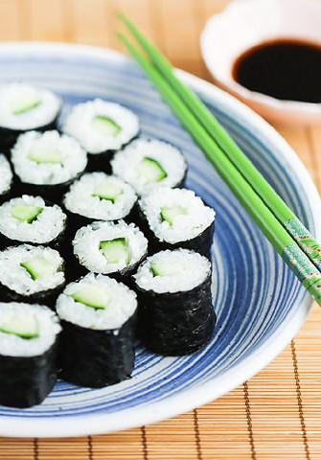
Cucumber Sushi
By Andrew Denaro
Recipe Type
Number of Servings
INGREDIENTS:
Cucumber
Rice
Seaweed
Appetizer (20)
For one (10)
PROCEDURE:
Cut cucumber
Flaten seaweed
Put rice all over the seaweed
Put a pieces of cucumber on the rice
Roll the seaweed
Cut into small portions
INDEX

Slide 10
SPOTLIGHT INGREDIENT: Cucumber
I love this a lot. My mom makes this and I love it. Other cooks in my family make cucumber sushi too. I love cucumber sushi. It’s refreshing due to the cucumber.
My spotlight is cut cucumber. It’s a cucumber that was cut into 20 or more pieces. It’s very watery and has green skin with a very light green interior. It’s a fruit. Usually harvested while fruiting. It has lots of water.
Q: What is your spotlight ingredient? It must be a plant you saw at the Greenmarket. A: My spotlight is a cucumber.
Q: Give a description of your spotlight ingredient, including how it looks and how it tastes. A: It’s a cucumber that was cut into 20 or more pieces. It’s very watery and has green skin with a very light green interior.
Q: What part of the plant is your spotlight ingredient? Parts of a plant include: roots, stem, leaf, flower, fruit, seed. A: Fruit
Q: When in this plant’s life cycle is it typically harvested? About how much time does the plant need to grow before it can be harvested?
A: Usually harvested while it has fruit
Q What are some health benefits or other uses of your spotlight ingredient? A: It has lots of water.

Slide 11
MARVELOUS MARGARITA PIZZA
Julia Nathan-Campbell
Entree
Number of Servings: 6
INGREDIENTS:
(.25 ounce) package active dry yeast
1 teaspoon white sugar
1 cup warm water (110 degrees F/45 degrees C)
2 1/2 cups bread flour
2 tablespoons olive oil
1 teaspoon salt
1 cup marinara sauce
1 log fresh mozzarella cheese thinly sliced
1 bunch of fresh basil leaves
PROCEDURE:
Preheat oven to 450 degrees F (230 degrees C). In a medium bowl, dissolve yeast and sugar in warm water. Let stand until creamy, about 10 minutes.
Stir in flour, salt and oil. Beat until smooth. Let rest for 5 minutes.
Turn dough out onto a lightly floured surface and pat or roll into 2 round balls.
Using hands and a rolling pin, form thin round pizza crusts.
Transfer each crust to a lightly greased pizza pan or baker's peel dusted with cornmeal.
Bake each crust for 5 minutes
Spread on marinara sauce and place mozzarella cheeses on top of each crust. Bake in preheated oven for 8-12 minutes, or until golden brown.
Top pizza with basil leaves. Let baked pizza cool for 5 minutes before serving.
INDEX

Slide 12
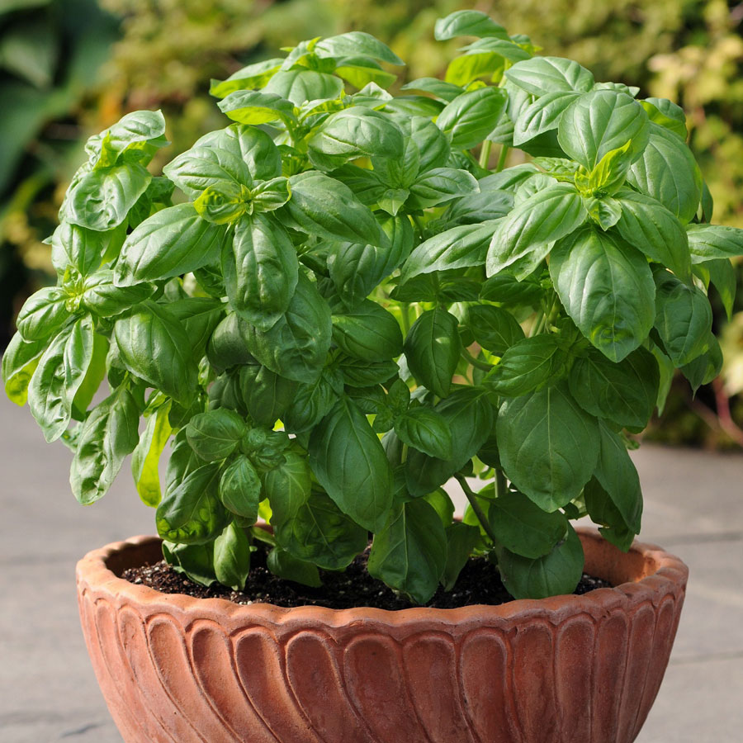
ALL ABOUT MY RECIPE
This recipe is special to my family because my mom makes it often, and me and my brother go down to my building’s garden to pick basil for the pizza. We also go to a place called LePaddok, Which uses the same recipe for their pizza, and we go there on weekends. This recipe is Italian. I really like this recipe because I love pizza, and basil gives it more flavor.
SPOTLIGHT INGREDIENT: BASIL
My spotlight ingredient is basil. Basil is peppery, aromatic, minty, and slightly sweet, and it is a green, leafy plant. The part of Basil my spotlight ingredient is are the leaves. Basil can be harvested at any time, and it takes two to three weeks to grow. Basil has vitamin K, vitamin A, and may help fight and prevent cancer.

Slide 13
TURKEY BURGER
Kei Banks
Recipe Type: Entrée
INGREDIENTS:
1 lb. ground turkey
1 large egg,beaten
1 clove garlic
1 tbsp. Worcestershire sauce
2 tbsp. freshly chopped parsley
Kosher salt
Freshly ground black pepper
1 tbsp. extra-virgin olive oil
Hamburger buns
Lettuce
Tomatoes
Mayonnaise
PROCEDURE:
In a large bowl, mix together turkey,egg,garlic,Worcestershire sauce, and parsley, then season with salt and pepper.
Form mixture into four patties.
In a medium skillet, over medium heat, heat olive oil.
Add patties and cook until golden and cooked through, 5 minutes per side.
Serve on a bun with desired toppings
INDEX

Slide 14
SPOTLIGHT INGREDIENT: TOMATOES
My spotlight ingredient is tomatoes. It’s important to me because I used to dislike tomatoes. But once I had forgot to take out the tomatoes; and I regretted ever disliking tomatoes. And when I disliked tomatoes, my family was trying to convince me to eat tomatoes. Where tomatoes are on the plant is they’re the fruit. This is usually harvested in late May or early June. It takes 20 to 30 days for the tomato to be mature.
This is recipe is mostly significant to my dad and I because time to time I like to have a turkey burger. And I probably was interested in turkey burgers when my dad was having one. Since he can't have beef I decided to try something new. The recipe isn't really a cultural thing but It's still important to my dad and I (mostly my dad). What makes the Turkey burger good is that it's almost as good as a cow beef burger but this is way more healthy. And sometimes when I want a junk food ex: burger I could get a healthier option that's still a burger.

Slide 15
Blueberry Pancakes
Adam Brukman
Breakfast
For 4 people
Dry ingredients
1.5 cups of flour.
0.5 cups of buckwheat flour.
3 tablespoons of sugar.
0.5 teaspoons of baking powder.
1.5 teaspoons of baking soda.
0.5 teaspoons of salt.
Wet ingredients.
1 cup of blueberries.
3 tablespoons of melted butter.
2 large eggs.
Stick of butter for greasing the griddle.
Procedures
Combine all dry ingredients in a bowl and mix.
Combine all wet ingredients in a separate bowl (except blueberries) and mix.
Pour the mixture of wet ingredients over the dry ingredients and gently mixing just until combined.
Fold in the blueberries into the mix.
Preheat a griddle to medium temperature.
Rub butter on the griddle.
Spoon one third of a cup of the pancake batter onto the griddle for each pancake, nudging the batter into rounds.
Cook until top of each pancake is speckled with bubbles and some bubbles have popped open, then flip and cook the underside until is slightly brown.
Serve immediately (syrup is an option).
Enjoy!
INDEX

Slide 16
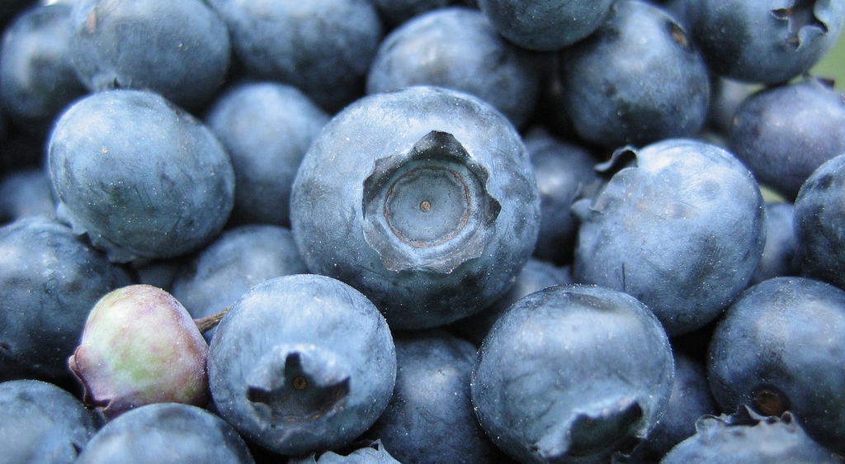
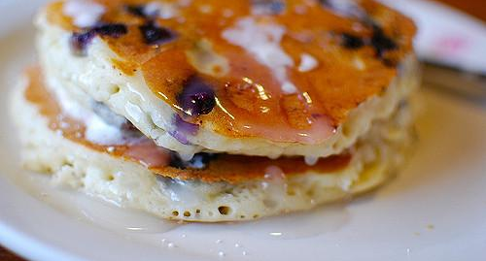
ALL ABOUT MY RECIPE
My dad makes these amazing pancakes in which my family eats. Pancakes originated from China. It is delicious because it has no buckwheat, which ruins pancakes and also my life.
SPOTLIGHT INGREDIENT: BLUEBERRIES
Blueberries are blue. That’s why they are called blueberries. They are delicious, and addicting. It tastes tart, but also sweet. It’s a fruit. Harvested in late July to mid August.

Slide 17
Tuna Seared Steak With Salad
Nina Vaz
Entree
About 4 people
INGREDIENTS:
2 pieces of tuna steaks
apple vinegar
olive oil
-salt
-pepper (black)
PROCEDURE:
1. Season the tuna with 2 tablespoons of teriyaki sauce per stake; and half of a lemon (squeeze the lemon on the tuna) for both stakes.
2. leave the tuna marinating for about 15 minutes
3. take a frying pan and add 2 tablespoons of olive and let it sit at a high heat till the pans warm
4. in the meantime spread a ½ a cup of sesame seeds on a plate. Then press the steaks on the sesame in all sides
sesame seeds
-1 lemon
-teriyaki sauce
-1 Japanese cucumber
-2 heirloom tomatoes
5.one side at the time hold the stake in place with a tong for 30 seconds (make sure you do this with all sides)
6.now cut them into 1 centimeter wide slabs, the serve
Salad time:
1. cut up 2 large heirloom tomatoes is to tiny cubes
2. cut up 1 Japanese cucumber into the same sized cubes
3. combine then season with olive oil, salt, pepper, and apple vinegar
INDEX

Slide 18
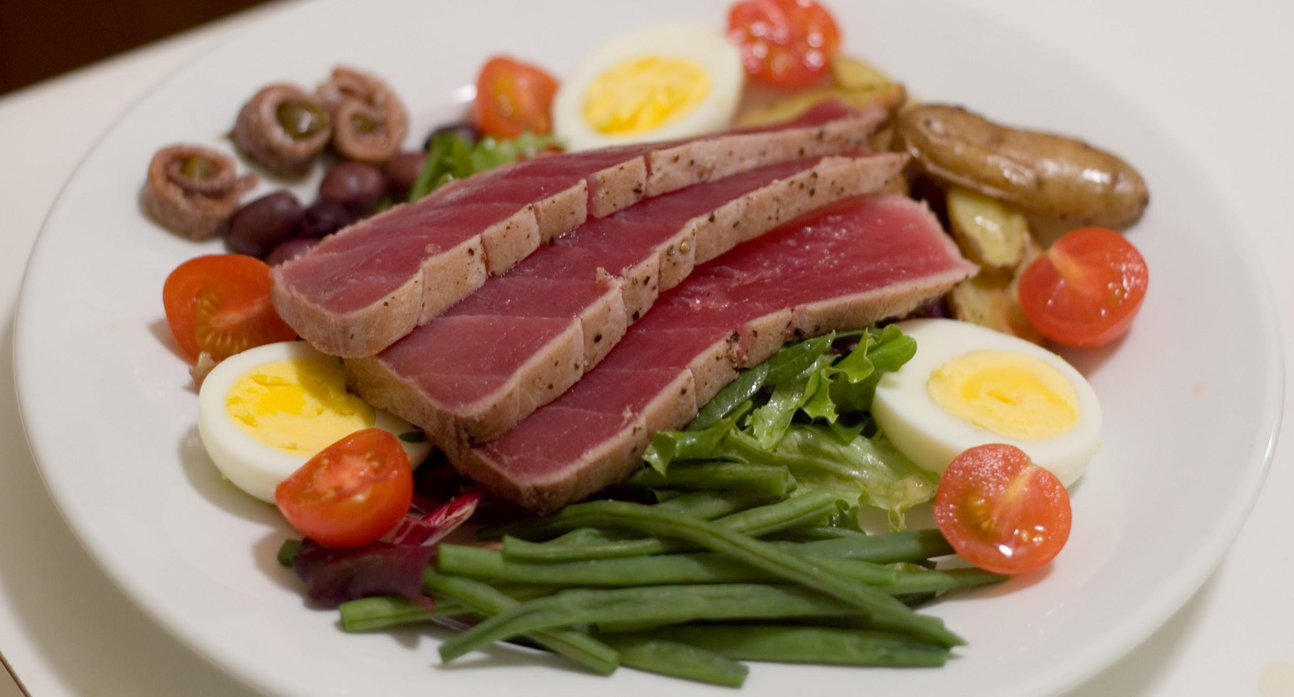
ALL ABOUT MY RECIPE
This recipe is important to me because I have always made this with my family. It’s usually me and my mom making this recipe together and we usually don’t cook together a whole lot. I don’t believe theres a specific cuisine/culture that this dish originates. I really like this recipe because I personally love fish and cucumber, add a little seasoning and voila; it’s now delicious.
SPOTLIGHT INGREDIENT: Tomatoes
In this dish my spotlight ingredients is tomatoes or more specifically heirloom tomatoes. Tomatoes are quite a common fruit, it a has round like shape and it taste a bit sweet. Tomatoes are both red on the outside and inside, they have tiny yellow seeds inside them too. As I have stated before in the a plants life cycle a tomato makes up the fruit or the fruiting plant. Typically tomatoes grow from 70 to 80 days before they are harvested. Some benefits to eating tomatoes is that they have been linked to reduced risk of heart disease, the number one leading cause of death in the US.

Slide 19
Creamy Broccoli And Chicken Pasta
Dylan Hollingworth
Entree
4 people
INGREDIENTS:
1 lb of chicken breast
1 pint of heavy cream
1 lb of broccoli
2 Tbsp of olive oil
A third of a cup of white wine
¾ pound Racchette De Cecco noodles
1 cup of grated parmesan
PROCEDURE:
Warm up olive oil in pan
Once pan is hot, add and saute chicken
After sauteing chicken for three minutes, add white wine and continuing sauteing chicken
Put cream in a different pan until it reaches a low simmer, and bring a half gallon of water to a boil in a different pan than the cream.
. After chicken is cooked for 5 more minutes, add broccoli, and cover and bring heat to a low simmer.
When water hits boil, put pasta in water and cook for 11 min.
Drain pasta
Place pasta back in the bowl.
Add the grated parmesan to the cream, and increase heat.
Keep whisking cream until it thickens.
Add chicken and broccoli to pasta
Add cream to pasta, let it cool for 5 min, then serve!
ENJOY!!!
INDEX

Slide 20
SPOTLIGHT INGREDIENT: Broccoli
My spotlight ingredient is Brocoli, and it is the flower part of the plant. It tastes a bit earthy, a bit like a olive; but better. It would be harvested when it is a flower. I think that the brocoli mashes up well with the sweetness of the cream. I think broccoli is one of the best vegetables. 1 health benefit is that is helps form body tissue.

Slide 21
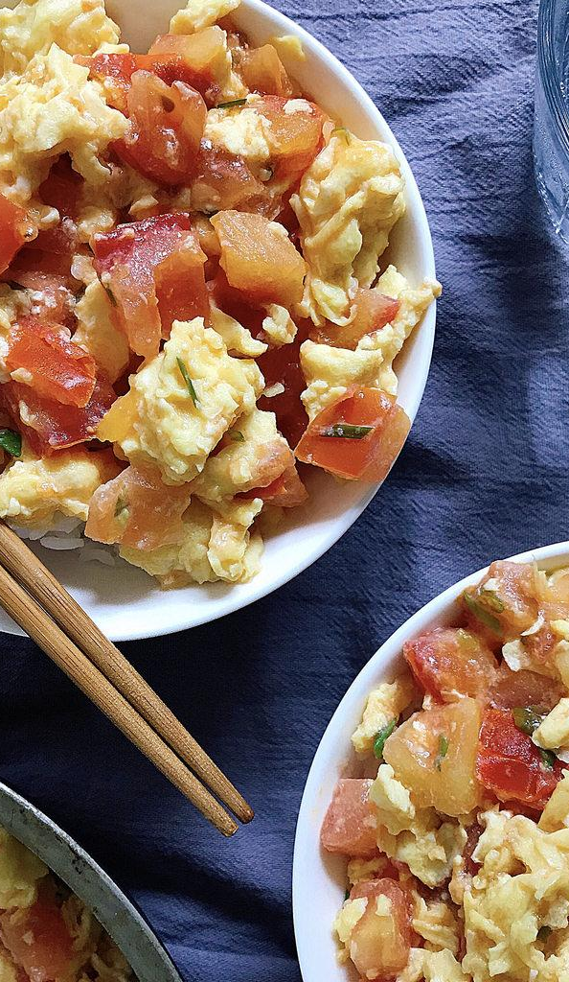
SCRAMBLED EGG with TOMATOES
Eric Jiang
Entrées
2-3 serving
INGREDIENTS:
6 teaspoon of oil (any oil)
¼ teaspoon of salt
½ teaspoon of sugar
1 shallot
½ teaspoon of cooking wine
1 squirt of ketchup
2 tomatoes
2 eggs
Cut the tomatoes into small pieces
Get the shallot. Wash it and cut into pieces smaller than the tomatoes
Take the egg and crack it in a bowl. Stir it
Pour 3 teaspoons oil into the pan
Get the bowl fill with stirred egg and fired until it’s ready
Take the finish scrambled eggs and clean the pan that you just cook on
Pour the rest of the oil into the pan
Remember the cutted tomatoes. Get them and dump the tomatoes into the pan
Cook until the juice come out
Take the scrambled eggs and dump it into the pan
Pour ¼ teaspoon of salt into the pan
Pour the ½ teaspoon of sugar into the pan
Pour the one squirt of ketchup into the pan
Pour ½ cooking wine into the pan
Stir the pan well
Pull the cut up shallot into pan
Wait for 5 minutes
INDEX

Slide 22
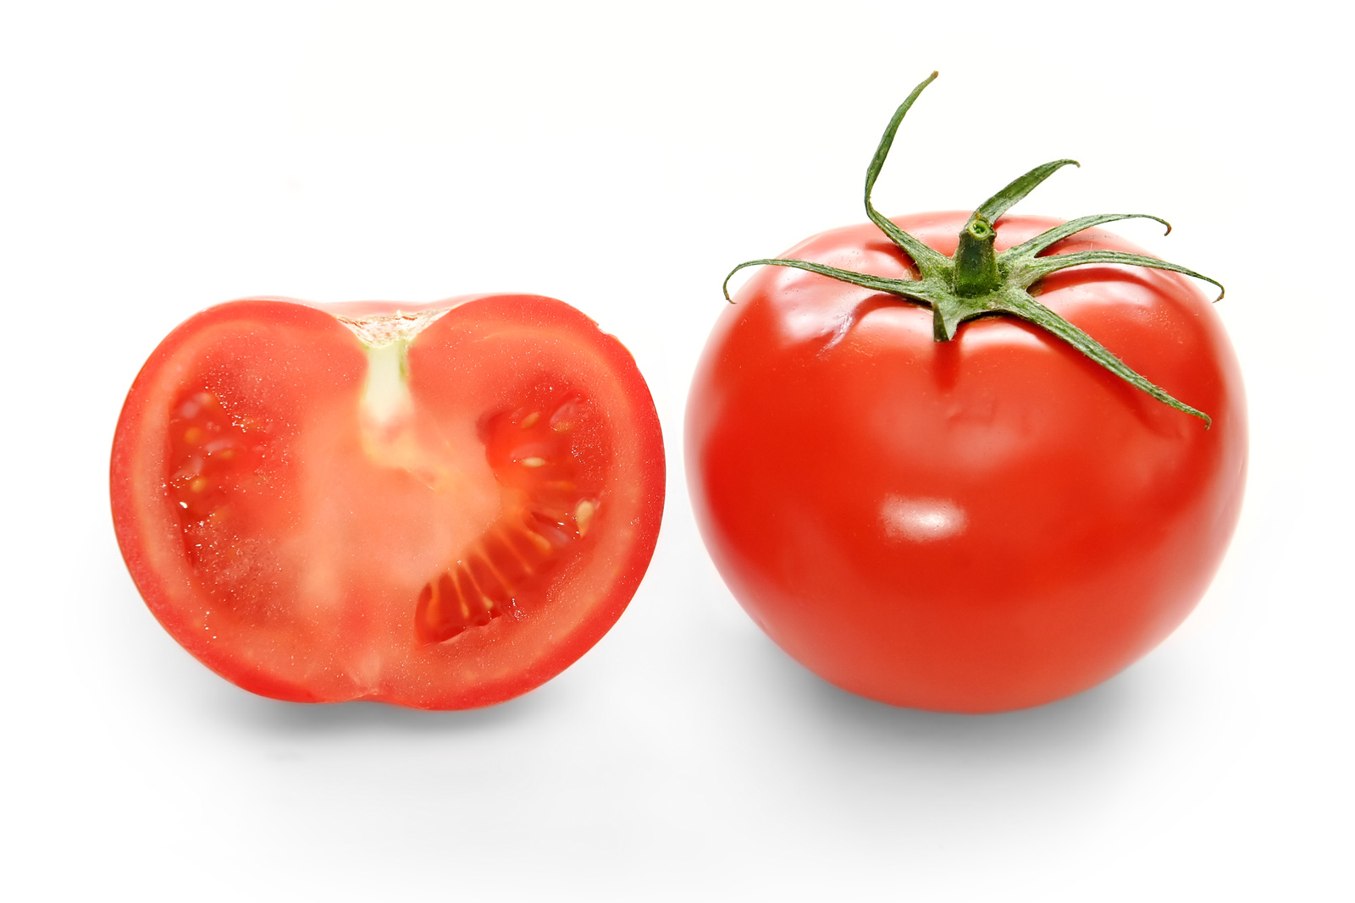
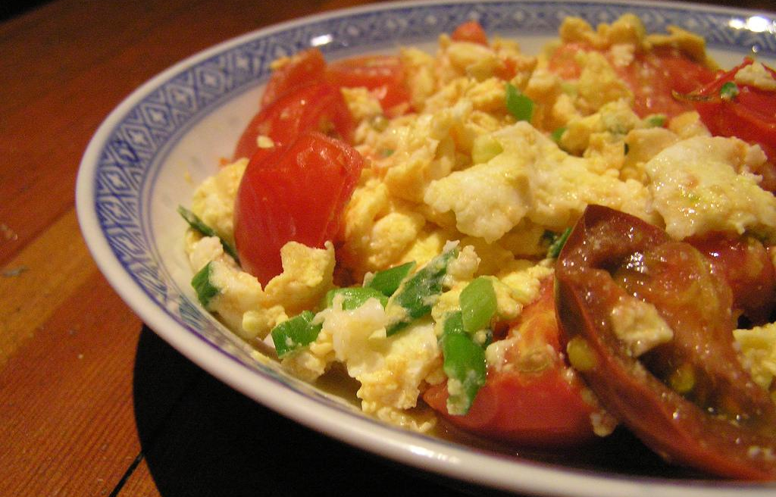
ALL ABOUT MY RECIPE
The recipe is important to my family because when my family isn’t in the mood of cooking. It is quick to make.The tomatoes make the recipe delicious. The recipe is Asian and American.
SPOTLIGHT INGREDIENT: Tomatoes
Tomatoes is my spotlight ingredient and in the Philipp Farm. It is sweet and tart and are usually red when is mature but can come in variety of colors like yellow, orange, green, and purple. It is the fruit part of the plant. It is harvest in the fruiting plant. It takes six to eight weeks for the tomatoes to grow from seeds to tomatoes. Tomatoes are the major dietary source of antioxidant lycopene, which has bee link to many health benefit. Like reduced risk of heart disease and cancer. They are also a great a source of vitamin

Slide 23
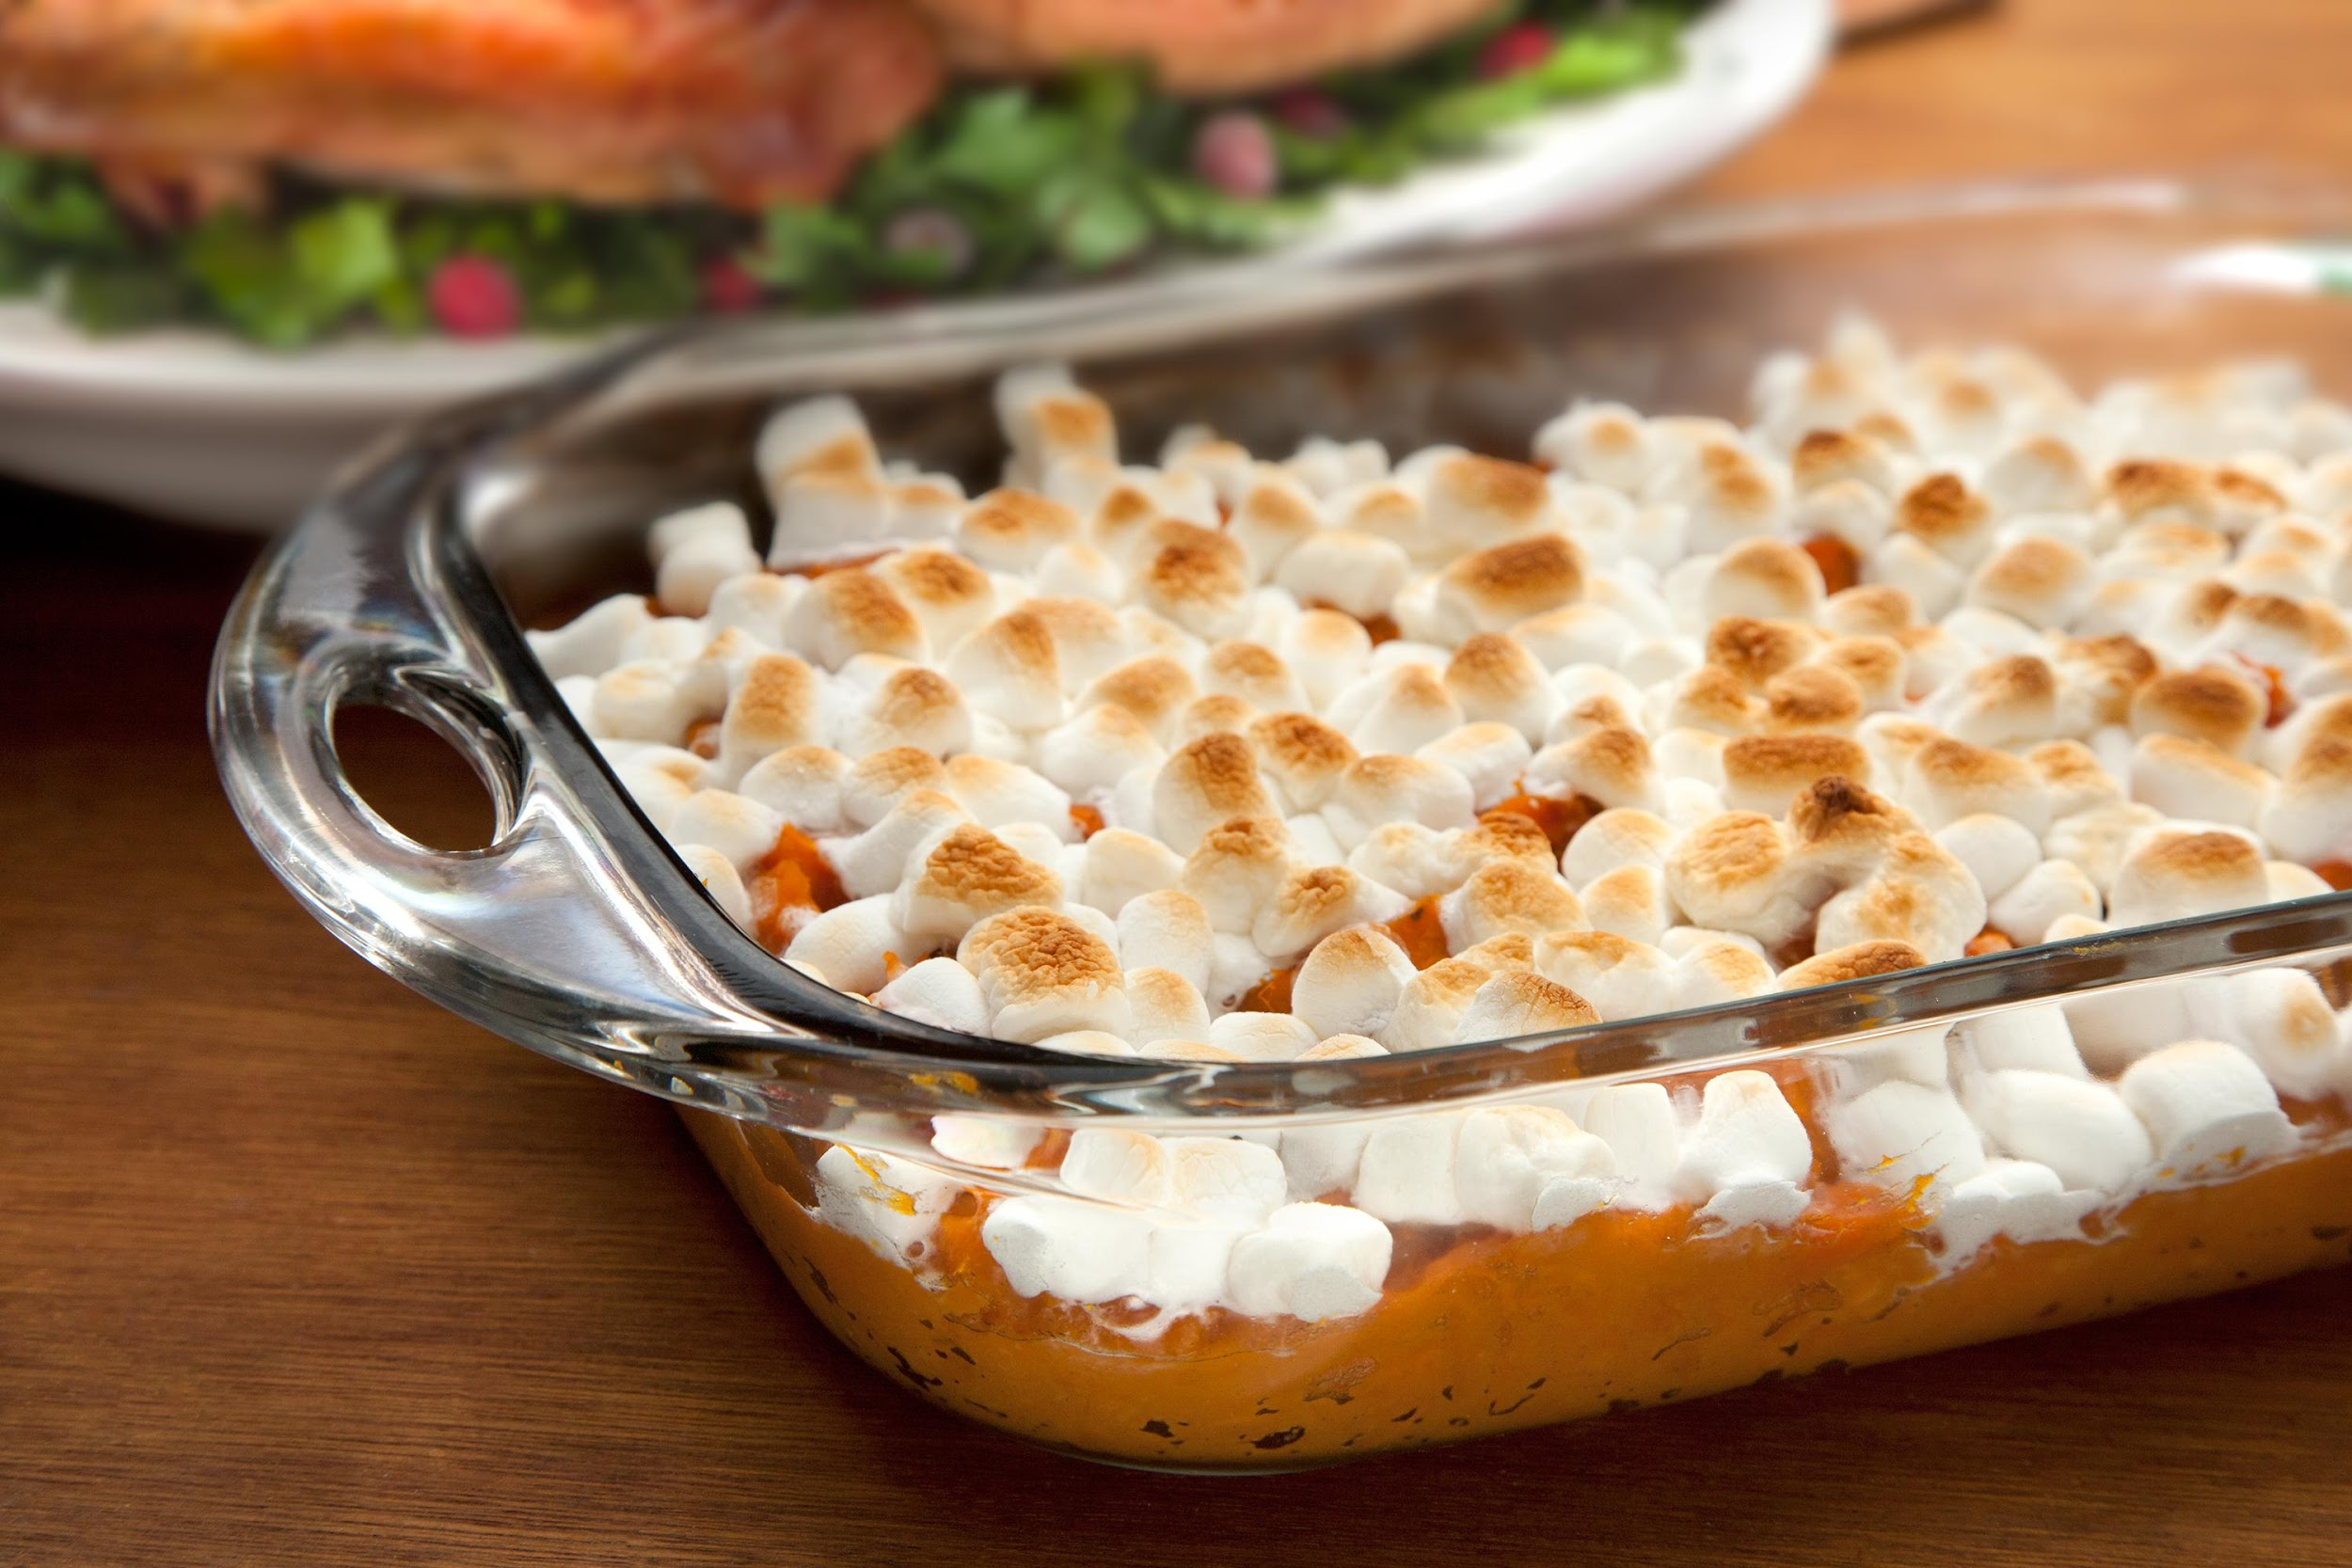
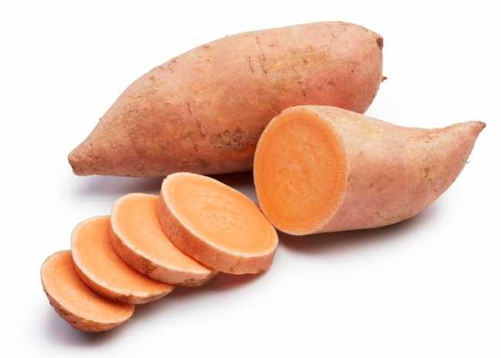
Sweet Potatoes with Marshmallows
Mikaela Hendrickson
Side Dish
6-8 people
INGREDIENTS:
1 cup brown sugar
¼ cup margarine
¼ cup water
A pinch of salt
2 yams
A pinch of pepper
A bag of marshmallows
PROCEDURE:
Preheat oven to 400 degrees
Wash and scrub yams
Peel the yams
Slice the yams into thin slices
Place your yams on a well greased baking sheet
Sprinkle the yams with salt and pepper
Bake for 45 mins
While the yams are cooking boil all other ingredients except for the marshmallows for 5 minutes
When the yams are done cooking arrange them in a casserole dish
Then pour the mixture you just mixed over yams
Then bake at 375 degrees for 45 minutes
Cover the yams with marshmallows
Broil that for 5 minutes
Eat
INDEX

Slide 24
ALL ABOUT MY RECIPE
This recipe is special because we have eaten it at thanksgiving for years upon years. I remember one year when I was little me and my cousin were protesting against all of the other thanksgiving foods ( no idea why), and we only ate sweet potatoes with marshmallows. This recipe is southern. It is mainly made on thanksgiving. In my opinion what makes this recipe delicious is because if the mix of the potato texture and the marshmallow taste.
SPOTLIGHT INGREDIENT: Yams(sweet potatoes)
My spotlight ingredient is yams (sweet potatoes). Yams are orange on the inside and outside, they taste sweet with a texture of a potato. Yams are roots. Yams are typically harvested 3-4 months after they are planted, when they are mature.
Some health benefits of yams are a good source of vitamin c and b, they have a good amount of fiber, manganese and potassium. Yams can be used to make sweet potato fries.

Slide 25
Fantastic Fried Rice
Willa Romer-Mack
Entrēe
Serves 6
INGREDIENTS:
10 oz of frozen green peas
1 medium-sized yellow onion
1 ½ cups of rice (can be any kind of rice except sushi rice.)
⅝ cup soy sauce
2 T oil
9 oz spinach
3 cups of water
4 ½ oz Jerusalem artichokes
2 eggs
2 oz ham (optional)
PROCEDURE:
Put rice and water into a pot at a high temperature until boiling.
In the meantime, cut your onions, and then sautee your yellow onions at medium, with 1 T of oil, and ⅛ c soy sauce.
Once your onions are brown, put your bag of frozen peas on top of your onions. Let defrost.
Once rice is boiling, turn down to low and wait until all water evaporates.
Peel and dice your Jerusalem artichoke.
Slowly tear or chop (Depending on what type of ham you have.) your ham.
Add your spinach in handful intervals, only add more once the spinach has shrunken.
Add your rice once all of the water has disappeared.
Slowly add the rest of your soy sauce in ⅛ intervals.
Add your Jerusalem artichoke and ham.
Crack your two eggs into the pan and incorporate them in with a spatula.
Once the egg is cooked, serve in bowls.
INDEX

Slide 26
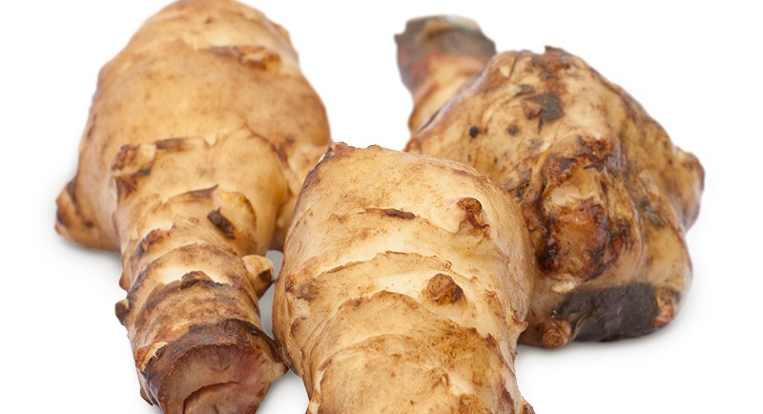
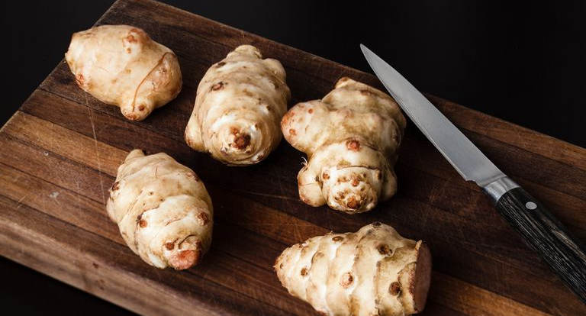
ALL ABOUT MY RECIPE
This recipe is really important to me because my best friend gave me this recipe. She had to move back to the Netherlands because her parents work had brought them here but then it was taking them back. When they first gave it to me it didn't have amounts, they had just used leftovers, but it was one of the best things I had ever tasted. So in homage to them, I created amounts for each ingredient. This recipe does not have a food culture. I think that this recipe is delicious because it is homey, cozy dish that has a whole range of natural ingredients.
SPOTLIGHT INGREDIENT: Jerusalem Artichoke
My spotlight ingredient is the Jerusalem artichoke. It has a pleasant, earthy, and somewhat sweet flavor. It can be eaten raw, and when cooked adds nice flavor to the main ingredient. It looks a lot like ginger in shape and color. Probably the coolest thing about it is that it is the root of the sunflower!!!!!! The roots should be harvested in November when the sunflower is dying. The Jerusalem artichoke needs at least 8 months to grow.

Slide 27
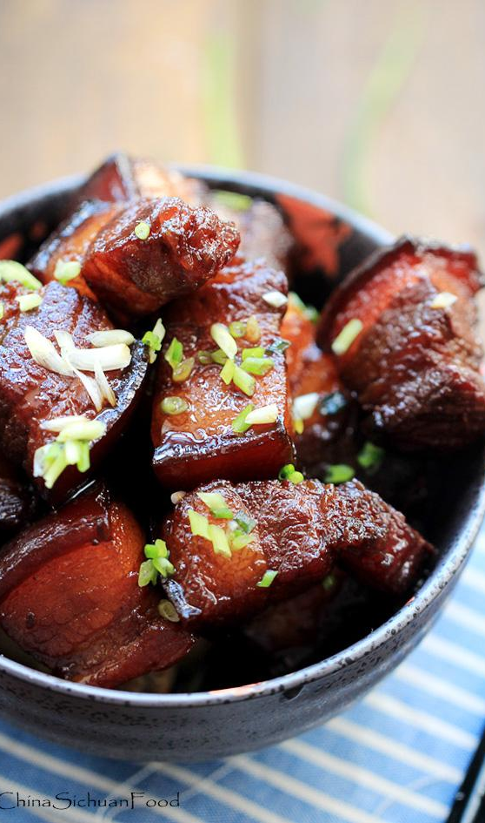
Spicy Roasted Red Pork belly
Daniel Chi
Side
4 to 8
INGREDIENTS:
1 lb of Pork
2 Red Pepper
4 Garlic
8 Shallot
2 tablespoons of oyster sauce
1 tablespoon of oil
2 Crystal Sugar
4 star anise
little oil
1 cup of cooking wine
small amount of ginger
2 tablespoons soy sauce
PROCEDURE:
1:Put the Pork in cold water and then cook for 45 minutes
2:Cut the Pork in to pieces
3:Put 1 tablespoon of oil in a pan and heat it for 2 minutes
4:Put the Pork inside and cook for 15 minutes
5:Cut the garlic in to pieces and put it in
6:Cook for 5 to 6 minutes and put red pepper,star anise, and ginger inside
7:Cook until it smells good
8:Add 1 cup of cooking wine
9:Cook for 5 minutes and then put oyster sauce inside
10:Add the crystal sugar and soy sauce inside
11:Put the cover on add cook with a small fire for 45 minutes
12:Cook it with big fire to cook away any liquids
INDEX

Slide 28
SPOTLIGHT INGREDIENT: Red Chili Pepper
My Spotlight Ingredient is the red chili pepper. It looks like a bent knife. It taste spicy. It is the seed of a plant. It ripen in 2 to 4 months but it can be harvested almost anytime. It can also help you burn calories and it can also shocking relieve pain if consumed regularly. It also have low calories and a good source of fiber, vitamin C and vitamin B6.

Slide 29
Turkey Chili
Leah Josephson
Entree
6 people
INGREDIENTS:
Group 1-
1 tablespoon of olive oil
1 cup of onions
one tablespoon of garlic
1\4 cup of red bell pepper
Group 2-
1 lb of ground turkey
Group 3-
1 small can of tomato paste
1 lb of beans
1 large tomato
1 tablespoon of chilli powder
1 tablespoon of sugar
2 cups of water; 1\2 teaspoon of garlic
1 teaspoon hot sauce
1 ½ teaspoon of salt
1 teaspoon of basil
½ teaspoon of oregano.
PROCEDURE:
saute group one
add group two and cook until browned
add group three and cook in low flame for an hour or pressure cook all ingredients in a pressure cooker for fifteen minutes.
INDEX

Slide 30
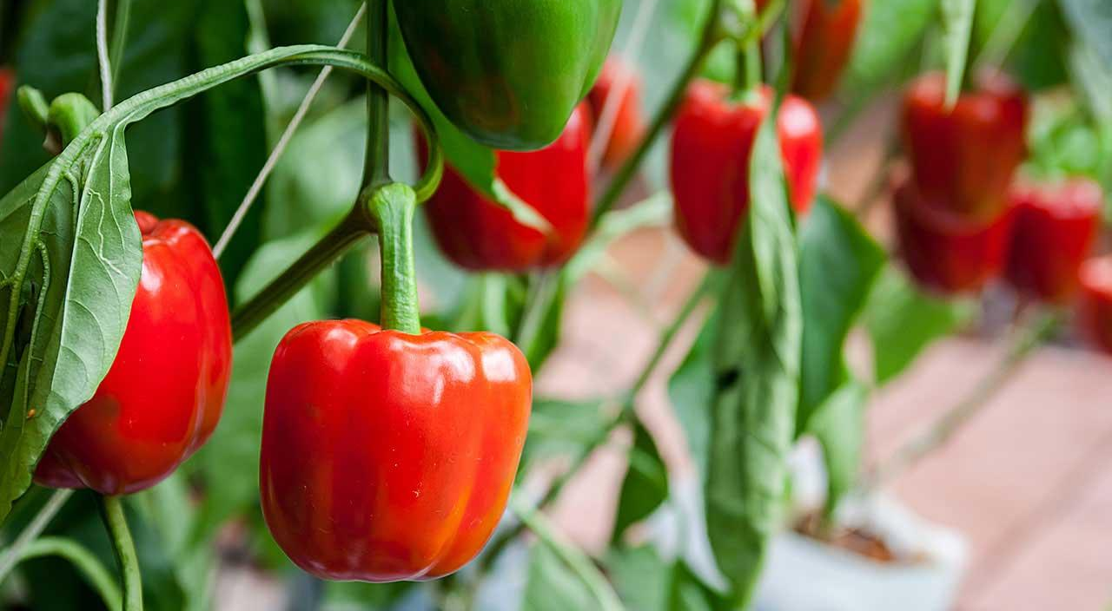
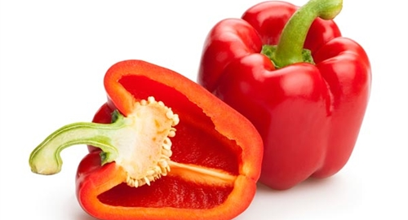
ALL ABOUT MY RECIPE
This recipe is a meal that my whole family can eat. Since I am allergic to gluten and my dad also has foods that he cannot eat this is like a comfort food to the family. It has something for everyone. Beans for me, healthy bell peppers for my mom, not to spicy for my brother, and turkey for my dad. It is a meal with a little bit of everything.
SPOTLIGHT INGREDIENT: Bell Pepper
My spotlight ingredient is red bell pepper. A sweet crunchy fruit that comes in all different colors. For the recipe I am doing the color red goes nicely with it. This fruit can be grown indoors until it turns into a more sturdy plant. Then you can put it out in the warmer months. There is no specific time to harvest. Just pick when the fruit is a suitable size for you. Red and green bell peppers contain high amounts of vitamin c and vitamin a. Red peppers also contain appropriate amounts of iron and potassium.

Slide 31
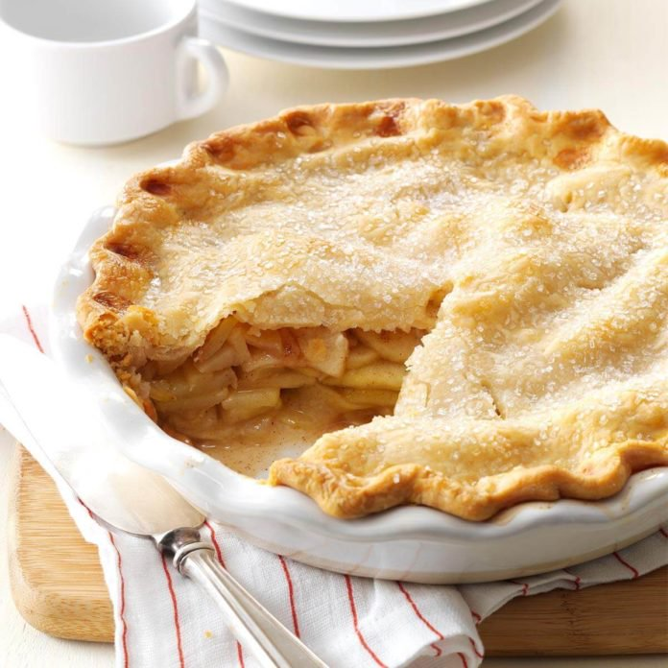
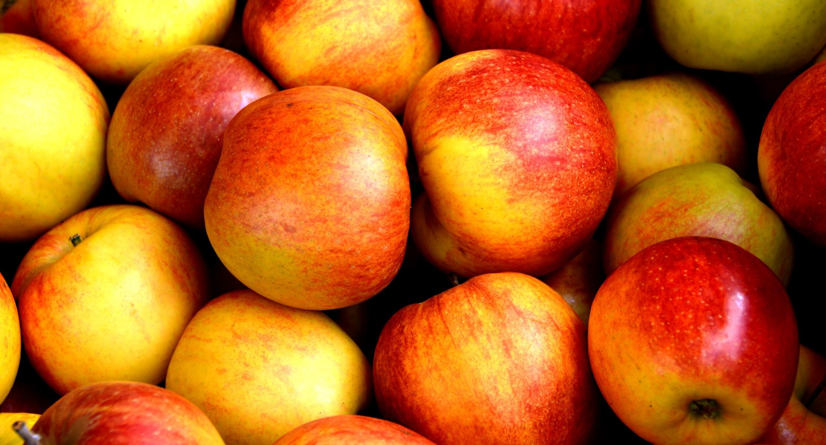
SnapDragon Apple Pie
Stella Dichiaro
Dessert
6 to 8 people
INGREDIENTS:
Four to Five snapdragon apples
1 tablespoon of ground cinnamon
½ tablespoon of ground nutmeg
Lemon juice
½ cup of sugar
2 1/2 cups all-purpose flour plus more to dust, *measured correctly
2 1/2 cups all-purpose flour plus more to dust, *measured correctly
1/2 Tbsp granulated sugar
1/2 tsp sea salt
1/2 lb COLD unsalted butter (2 sticks) diced into 1/4" pieces
6 Tbsp ice water (6 to 7 Tbsp)
PROCEDURE:
Place flour, sugar and salt into the bowl of a food processor and pulse a few times to combine.
Add cold diced butter and pulse the mixture until coarse crumbs form with some pea-sized pieces then stop mixing. Mixture should remain dry and powdery.
Add 6 Tbsp ice water and pulse just until moist clumps or small balls form. Press a piece of dough between your fingertips and if the dough sticks together, you have added enough water. If not, add more water a teaspoon full at a time. (Be careful not to add too much water or the dough will be sticky and difficult to roll out.)
Transfer dough to a clean work surface, and gather dough together into a ball (it should not be smooth and DO NOT knead the dough). Divide dough in half and flatten to form 2 disks. Cover with plastic wrap and refrigerate 1 hour
Peel, core and slice your apples *make sure to slice the apples thin.
Put the apples into a big bowl and add the cinnamon, sugar, and nutmeg.
7. Add squirts of lemon juice frequently, so apples don’t brown.
8. Divide the dough into two separate even, pieces. 9. Roll out both of the doughs until about ¼ and inch thick
10. Then lay one on the bottom of the pie tin. Use the rolling pin to help with laying it on.
11. Add all the apples.
12. Lay the second pie crust on the top of the apples
13. Use a fork to make indents all along the sides of the pie tin.
14. Take a knife and make four slits about and inch long, on top of the the pie.
15. Stick in oven at 420 degrees fahrenheit wait till crust is golden brown so about fifteen to twenty minutes
16. Then turn the oven down to 350 degrees fahrenheit and bake till apples are soft (Another forty to forty five minutes)
INDEX

Slide 32
SPOTLIGHT INGREDIENT: Dragon Snap Apples
All about my spotlight ingredient:
My spotlight ingredient is dragon snap apples! Dragon snap apples are a golden red. They are sweet and tangy, and just perfect for apple pie. The part of the plant that dragon snap apples are the fruit. Apples take about 10 years until they can be harvested. In the fruits life cycle it is usually harvested when it is at the stage fruiting plant.
Health benefits:
Dragon snap apples are really healthy and are really good just by them self. They don't need to be in a fancy dish to be good. Dragon snap apples can help with lower risk of cancer, and diabetes. They are a really good source of energy too. They are a really healthy fruit and delicious. They are perfect for an afternoon snack. As they say “an apple a day keeps the doctor away.”

Slide 33
Tomato Mozzarella
Bradley Lyon
appetizers
servings 1-5 people
INGREDIENTS:
baby tomatoes
balsamic vinegar
Mozzarella cheese
basil
PROCEDURE:
Wash the tomatoes and basil leaves.
Place whole basil leaves evenly around the plate.
Cut the tomatoes in half and place them evenly across the plate on top of the basil.
Place the slices of mozzarella underneath the basil leaves
Cut all the artichokes in half and place them evenly around the plate filling in any open space.
Squirt the balsamic vinegar evenly over the plate of food.
Enjoy!
INDEX

Slide 34
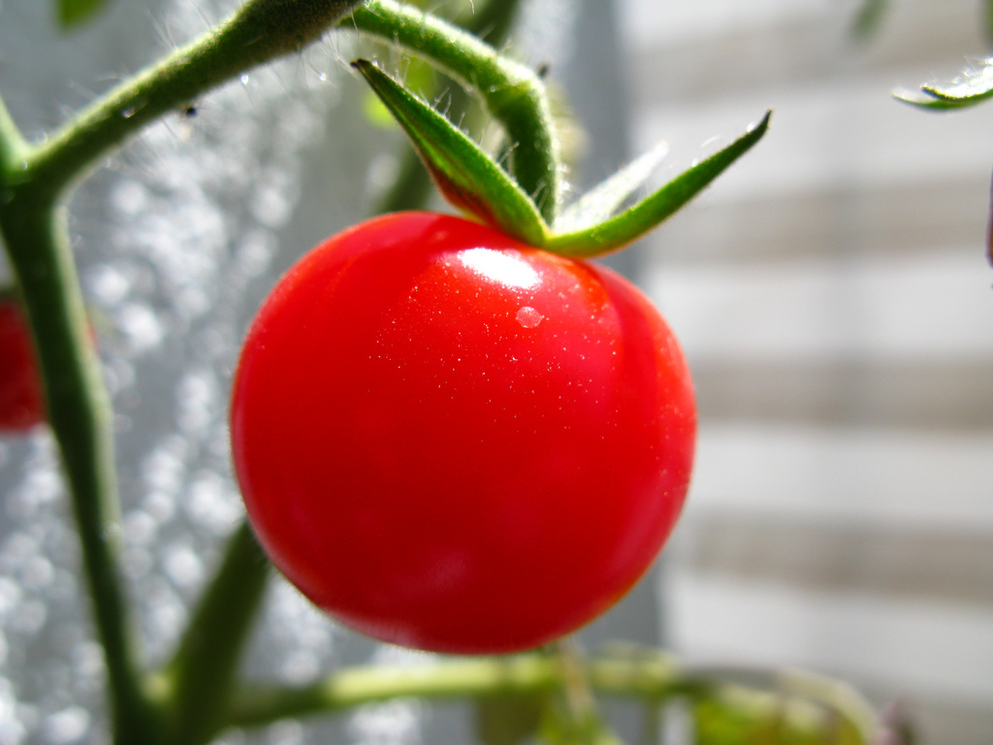
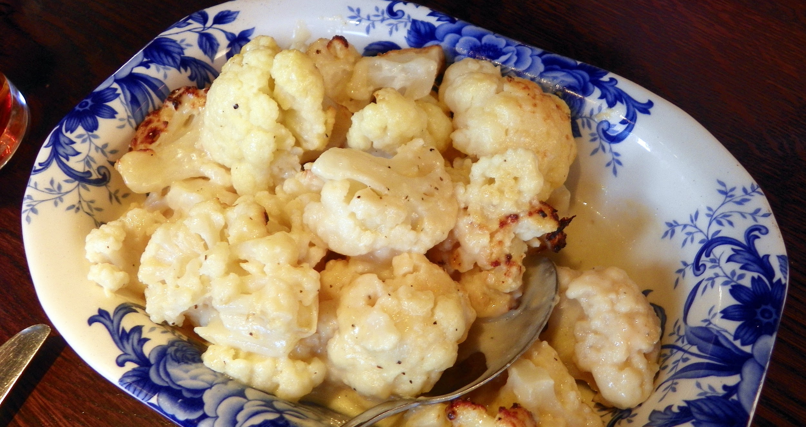
ALL ABOUT MY RECIPE
This recipe is important to my family because we make it in the summer with are harvest of tomatoes and basil. It represents a final pay off of all are hard work. It also shows how much effort we put in and that strongly impacts how well the tomatoes are.
SPOTLIGHT INGREDIENT: tomatoes
My spotlite ingredient is tomatoes. My spotlight ingredient is important to me because my family usually grows tomatoes in the summer, and making dishes like tomato mozzarella represents the end of the season and that all the hard work paid off. tomatoes are the fruit of plans, they are very healthy and delicious. This plant usually takes about 1-2 months to harvest, oily throughout the entire time still making tomatoes.

Slide 35
APPLE CRUMB CAKE
Dessert
By: Scarlett Staiano
About 12 Servings
CRUMBS/TOPPING
1 stick butter
½ cup brown sugar
1 ¼ cup flour
1 tsp cinnamon
1 tsp nutmeg
APPLES
2-3 granny smith apples (depending on how much apple you want)
2 Tbsp butter
1 Tbsp sugar
½ tsp cinnamon
INGREDIENTS:
CRUMB CAKE
1 stick butter
1 cup sugar
2 eggs
1 cup milk
2 cups flour
1 pinch salt
2 heaping tsp baking powder
1 tsp vanilla
PROCEDURE: (Reminder Tbsp=Tablespoon tsp=teaspoon C=cup) Take out your materials. THE APPLE PART!: Peel your apples- then dice them up into really small pieces.Put a frying pan on the stove and then put in 2 Tbsp of butter and put the heat up to medium. Mix 1 Tbsp sugar and ½ tsp cinnamon into the apples. Put the apples into the pan with the melted butter when the butter is melted. Cook until the apples are soft.
THE CAKE PART!: Put 1 stick butter and 1 C sugar in the mixer and then wait until it is fully incorporated. When it is you can put in 2 eggs 1 at a time until again they are fully incorporated. Next put in 1 C of milk. Also put in 1 tsp vanilla. (wet mixture) Take another bowl and put in 2 C flour, 1 pinch salt, and 2 heaping t baking powder. Mix this all together. (dry mixture) Take your dry mixture and slowly pour it into the wet mixture until it is fully mixed together. Take your apples that have hopefully cooled a little and with a spatula gently fold in your diced apples.(not to hard so your apples do not all go to the bottom of the pan) Take out your 13x9 pan and pour in your apple crumb cake mixture. Put in the oven at 350 degrees. Bake for about 35 minutes.
THE CRUMB PART!: Take 1 stick of butter and put it in the mixer. Add in ½ C of brown sugar, 1&¼ C flour, 1 tsp cinnamon, and 1 tsp nutmeg. Put the mixer on slow and stir until it all mixes together and is crumbly. Leave it to sit. After the 35 minutes are up check on your cake to see if it is ready to be brought out.If the cake is ready you can take out the cake and carefully pour all of your crumbs onto the cake so that all corners of the cake get to have some crumbs on them.
INDEX

Slide 36
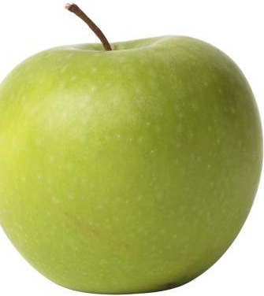
SPOTLIGHT INGREDIENT: Granny Smith Apple
My spotlight ingredient is a granny smith apple. Granny smith apples are green apples that have faint white spots called lenticels. Granny smith apples medium to large in size and are round. Granny smith apples are firm and juicy. They have a tart taste but a sweet flavor. Granny smith apples are the fruit part of the plant (tree). A apple tree will take 4 to 6 years to grow. It usually takes about 100 to 200 days for apples to grow. Granny smith apples are usually harvested in november when they are ripe. Granny smith apples originated from Australia. Granny smith apples usually will be good in the fridge for 1 to 2 months but can last 6 or more months if they are kept in a place that is between 30 to 40 degrees fahrenheit. Some health benefits are that apples are nutritious and may be good for weight loss, apples are good for your heart, and that they may prevent cancer and help asthma. They have lots of fiber and vitamin C. Granny smith apples are often used for pies, cakes, muffins, cobblers, and tarts. They are mostly used for baking because they hold their shape and their tart flavor mixes with the sweet flavor of most deserts.
Apple crumb cake:This recipe is important to my family because in my grandmothers house she has a box full of recipes. One of them is crumb cake. Since we saw apples at the farmers market I decided that it would be good to add apples to the recipe because I had heard that it was good that way. Some time that we eat this crumb cake are at Easter, Christmas, or Thanksgiving. What makes this recipe delicious is that you eat the nice soft part of the cake and then on top of the cake you have these delicious “crumbs” that are crumbly and soft and almost melt in your mouth. What makes the apple crumb cake delicious is everything I just said but also you now have these juicy apple pieces (when me and my mom made it we diced the apples into really small pieces like smaller than my fingernail) that just add texture and more flavor.
An APPLE a day keeps the doctor away!!!
Apples have many health benefits such as preventing cancer or helping asthma.
Apple Crumb Cake!-The delicious dessert that is basically a cake with a delicious crumb topping that you can add many different types of fruits to such as apple, raspberries, blueberries, peach, lemon, and strawberry.

Slide 37
Spaghetti Monster
Emily Zarate
Recipe Type- Main meal
Number of Servings 7-10
INGREDIENTS:
spaghetti
tomato sauce
salt
water
utensils
pot/noodle drainer
Full box of spaghetti
As much sauce you want
1 tbsp of salt
4 quarts of water
PROCEDURE:
Before you start, fill up a large pot with water and add in some add in salt and put it in the stove boiling .
Once the water is boiled, you can add in your spaghetti in.Typically it should cook in 7-11 minutes just follow the time on the box.
Mix /stir well every minute with a utensil
Drain your noodles once it is cooked and add it in pot with noodles on the tomato sauce in and mix well until everything is good mixed.
put your pot with noodles once it is cooked and add it another pot
serve and enjoy.
INDEX

Slide 38
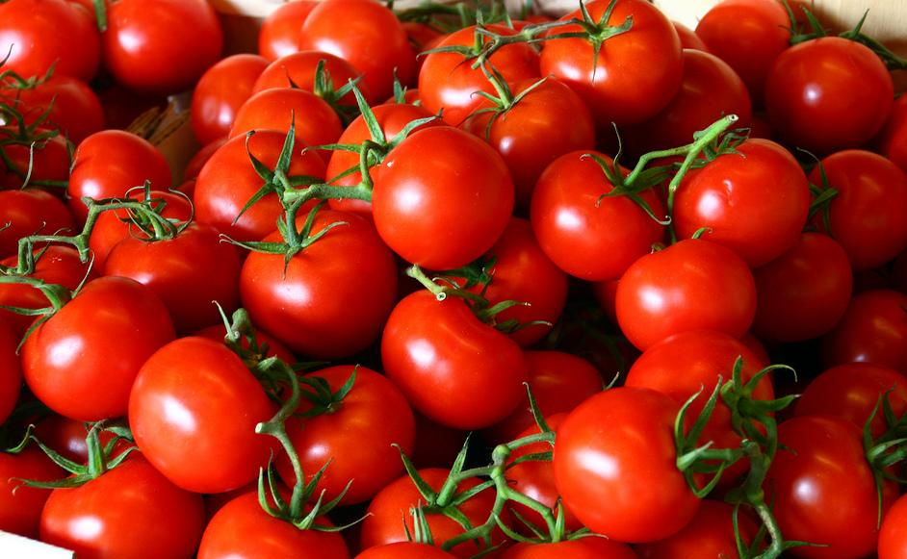
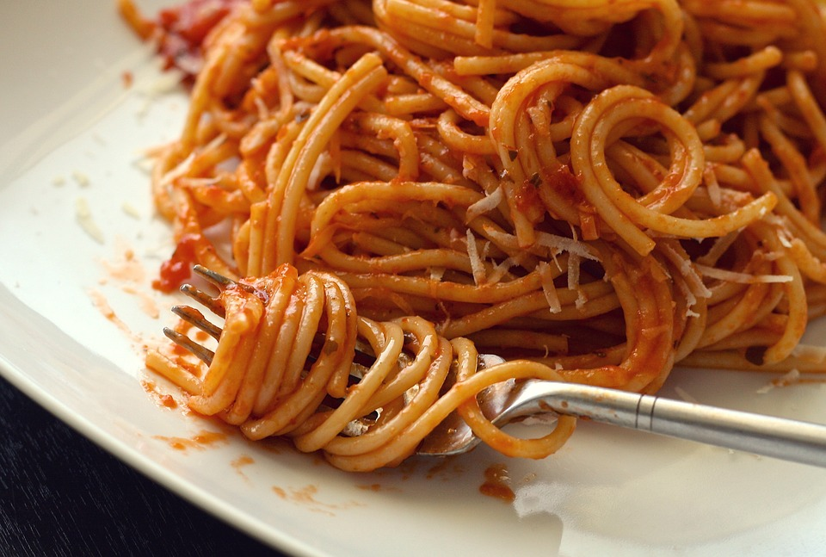
All About My Spotlight Ingredient
My spotlight ingredient is tomato.
Tomato is a red fruit it tastes fine but even better in spaghetti.
Tomato is the fruit part of the plant.
A tomato is harvested when it is ripped.
A health benefit of tomato is that it is good to eat.
All about my recipe
I chose to do this recipe because I really enjoy when I eat it. A special connection I have with spaghetti is that when i did my communion i had a party and one of the dishes was spaghetti that my god father made it was so good. This dish is a italian recipe. In my opinion what makes this a good dish is the flavorness that it has.

Slide 39
Spaghetti Carbonara
Morten Heim Klepaker
Entree
4 Servings
INGREDIENTS:
400 grams spaghetti,
A little oil,
8 slices of bacon,
2 cloves of garlic,
3 eggs,
4 tablespoons cream
50 g parmesan,
½ dl olive oil,
Salt and pepper,
Basil and other herbs
PROCEDURE
1. Cook pasta
2. Cook bacon, at the end of fry time put the garlic in the pan
3. Put eggs in a bowl and mix with cream and parmesan then mix with pepper, salt, oil and herbs
4. When pasta is done put in a colander and wait a bit, then put in a big cold bowl and mix with bacon and egg mix.
INDEX

Slide 40
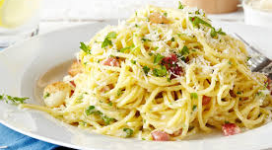
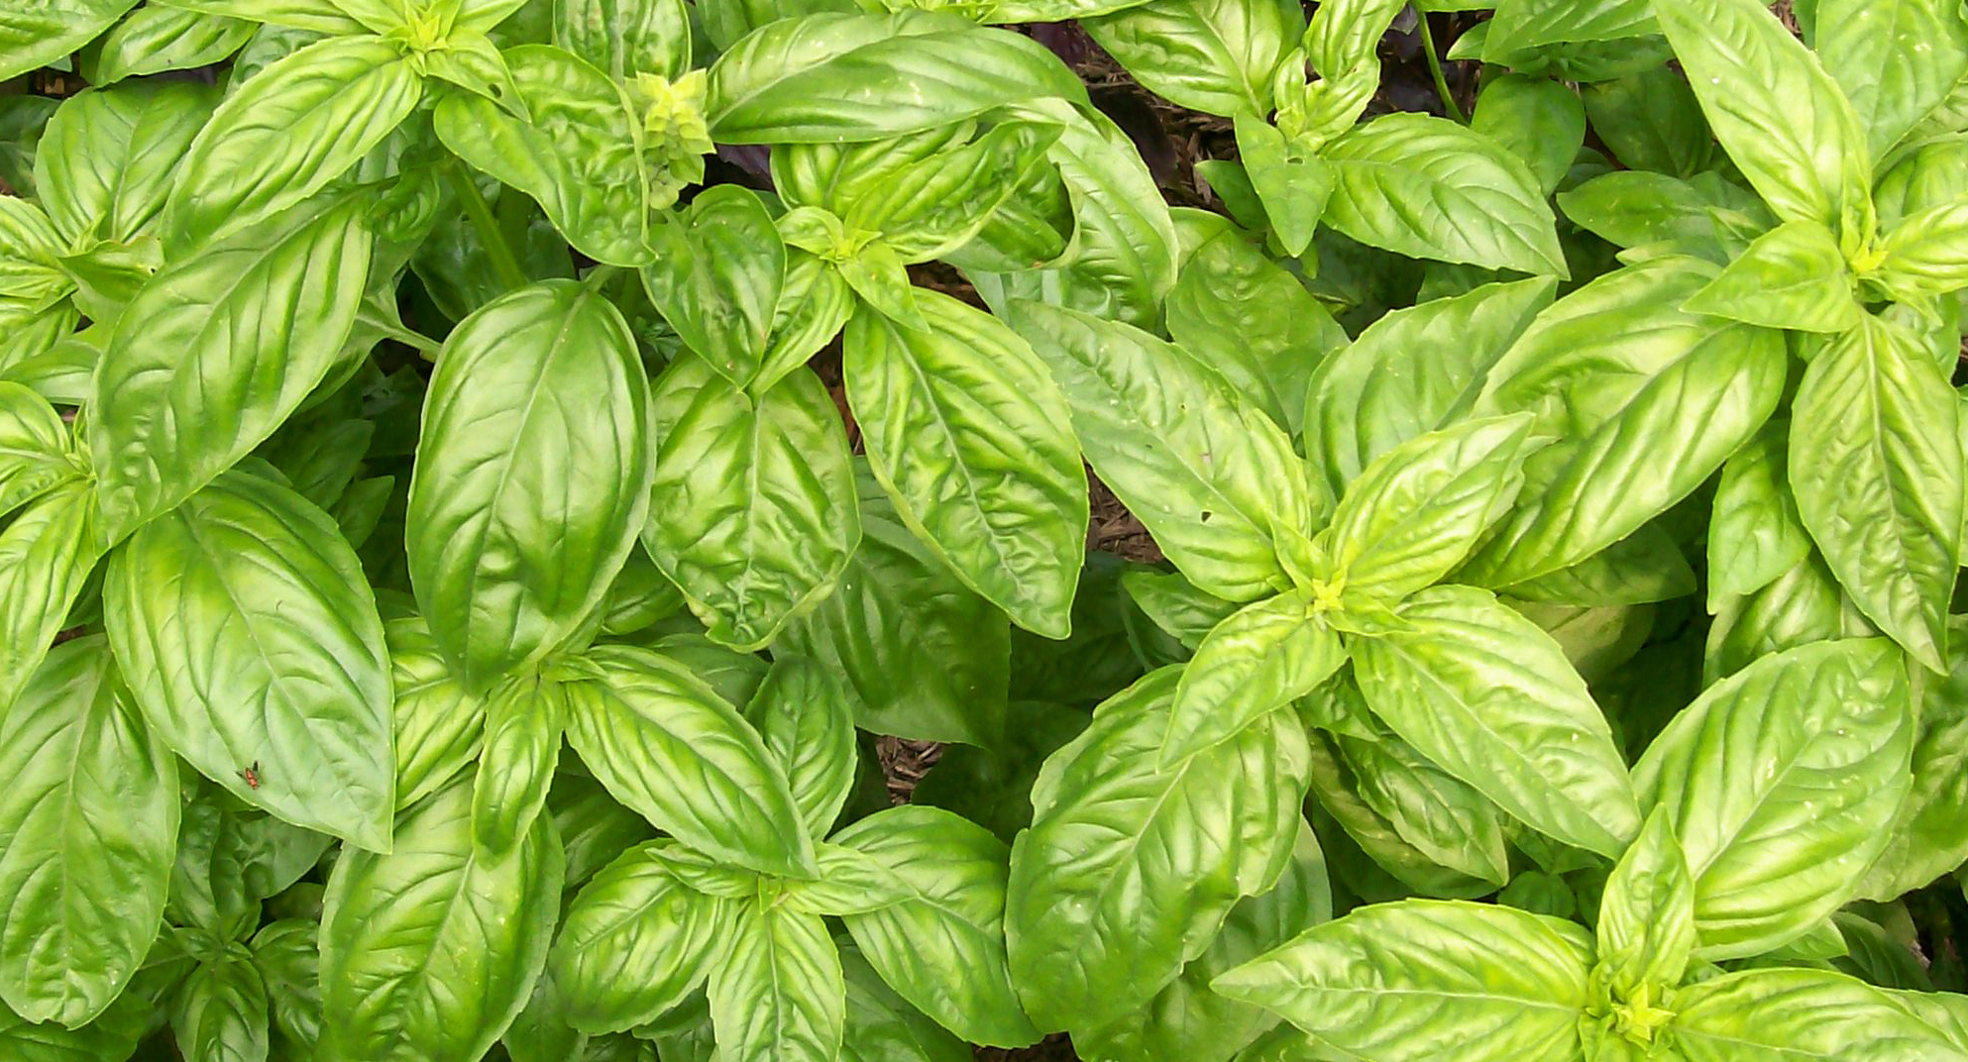
ALL ABOUT MY RECIPE
The reason I chose this recipe is because my sister and I sometimes make it and it brings the family together. I think the recipe is italian but I don’t have any connection to Italy. What makes this dish delicious is that it has a lot of tastes and it brings back memories.
SPOTLIGHT INGREDIENT: CAULIFLOWER
My spotlight ingredient is Basil, I saw this many times at the greenmarket. My spotlight ingredient tastes a little sweet and savory with a hint of mint, it looks like a leaf(because it is) and it is all green. My spotlight ingredient is the leaf of the plant.
I think the plant is harvested in the middle of its lifecycle.
I think basil helps you stay healthy longer.
Basil helps bring more taste to the dish and makes it taste fresher

Slide 41
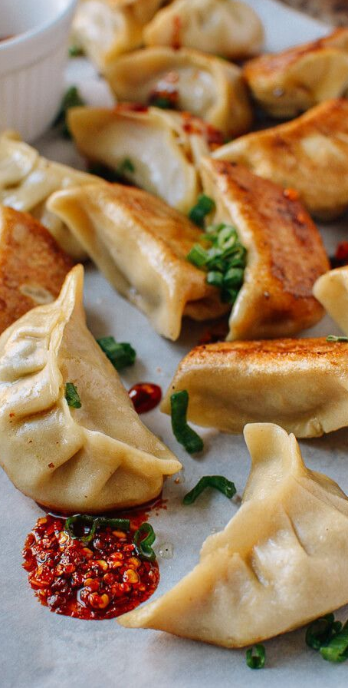
Pork Dumplings
Shelby Huang
Recipe Type: side dish
Number of Servings: 2-4
INGREDIENTS:
Package of Dumpling skin
Ground meat ½ pound Pork
Finely chopped cabbage ½ pound
1 tablespoon Sugar
1 teaspoon Rice wine
2 tablespoons Soy sauce
2 tablespoons flavorless oil; Vegetable oil
1 Teaspoon to a tablespoon salt
PROCEDURE:
Put ground meat into a bowl with the chopped cabbage & mix by squishing them together
Add the sugar, rice wine, soy sauce, vegetable oil, and the amount of salt you prefer to mix it all together
Put a ½ tablespoon of the mixture into the dumpling skin put water on the rim of the skin and fold across the rim.
Repeat step 4 until all meat mixture is gone. Then boil the dumplings or fry until the skin slightly more translucent and some may be floating if boiled.
INDEX

Slide 42
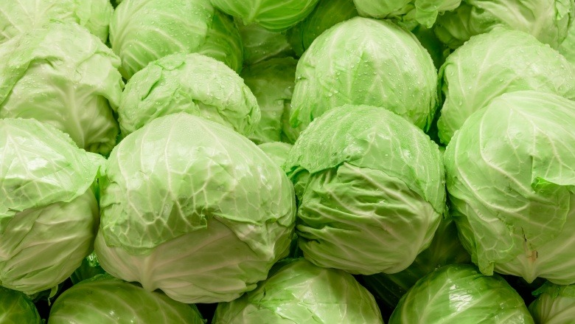
ALL ABOUT MY RECIPE
This recipe we eat during family gatherings and on Chinese new year. But we mainly eat it during a normal day or at a restaurant. It is also great on a winter day and summer days so it is a versatile dish. On most family gatherings where someone cooks we normally always have dumplings. You can enjoy this recipe any day you want to. When we visit China we always get dumplings from stores or someone in our family makes the dumplings. This food is from China invented in the Han dynasty but, many cultures and different countries enjoy different forms of dumplings. The filling makes it delicious if the filling is bad the dumpling is not a good dumpling. However, the skin should still be good the skin matters too. My favorite part of a dumpling is the filling it gives all the flavor and it tastes very good.
SPOTLIGHT INGREDIENT: Cabbage
My spotlight ingredient is cabbage I saw cabbages at the green market. Cabbage is usually a light vibrant green that is round like a ball sometimes more flat. It has a very fresh taste and is mostly crunchy. It has lots of water and moisture. The cabbage is the leaf of the plant. But this is for head cabbage different types of cabbage is different parts of the plant. When ready to harvest it should be firm all the through doesn’t matter what size it will vary. This will be roughly the leaves and flowering stage of the plant. You can harvest from 80 to 100 days of planting harvest before too warm. Cabbage can provide hydration lots of nutrient and is packed with vitamin c.

Slide 43
Farro Salad
Pazia Goldstein
Salad
Serves 5-6
INGREDIENTS:
1 cup farro
1 cup apple cider
2 teaspoons salt
2 bay leaves
8 tablespoons extra-virgin olive oil
2 tablespoons fresh lemon juice
½ cup parmesan cheese, shaved with vegetable peeler
½ cup chopped pistachio nuts
2 cups arugula leaves
1 cup basil leaves, torn
1 cup mint leaves, torn
¾ cup halved cherry tomatoes
Flaky sea salt for finishing
PROCEDURE:
In a medium saucepan, bring farro, apple cider, salt, bay leaves and 2 cups of water to a simmer. Simmer until farro is tender and liquid evaporates, about 30 minutes. If all the liquid evaporates before the farro is done, add a little more water. Let farro cool, then take out bay leaves.
In a salad bowl, whisk together olive oil, lemon juice and a pinch of salt. Add farro, cheese and pistachios and mix well. Just before serving, fold in arugula, herbs, tomatoes and flaky salt to taste.
INDEX

Slide 44
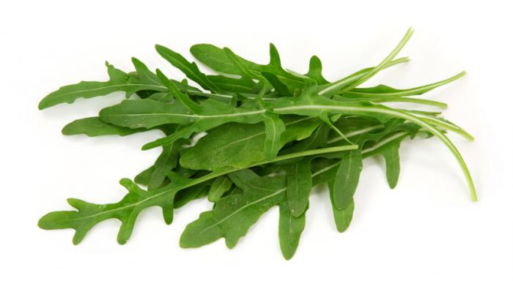
ALL ABOUT MY RECIPE
This recipe is important to me and my family because during the summer, my mom makes it and puts it in the refrigerator and we eat cold to refresh us. We usually eat it in the summer or spring. I grow most of the herbs in our garden on the balcony. To me, this recipe is so amazing because it feels very refreshing when I eat it and tastes like it has a lot of herbs and plants (because it does).
SPOTLIGHT INGREDIENT: ARUGULA
My spotlight ingredient is arugula. Arugula is a green leaf that tastes like it is a little bitter but not too bitter. The leaf looks like an oak tree leaf but it is not. Arugula needs about as little as 30 days before it can be harvested. The flavor grows stronger after it blooms. Arugula has calcium, vitamin C, and vitamin K. Vitamin C makes your blood more healthy.

Slide 45
TACOS DORADOS
By Angel Torralba
Entree
INGREDIENTS:
1 Tortilla
½ liter of oil
1 toothpick
¼ a teaspoon of pepper
PROCEDURE:
Take a tortilla and warm it up for approximately 2 minutes on medium heat
Slice up your cheese
Take your slice of cheese and put it in the middle of the tortilla then sprinkle the ¼ of pepper and then grab one end and roll it up and grab a toothpick and put it in the middle to hold the taco while it’s cooking in the oil.
Warm up the oil on your pan for approximately 3 minutes
Once your oil is ready place the taco on the pan for approximately 5-8 minutes and take it out once it has a yellowish color
INDEX

Slide 46
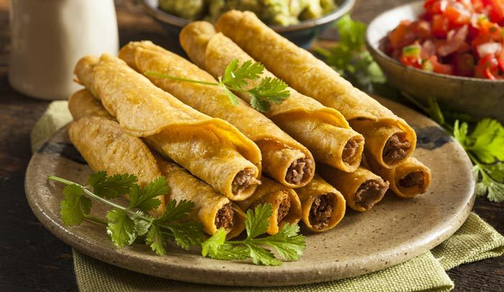
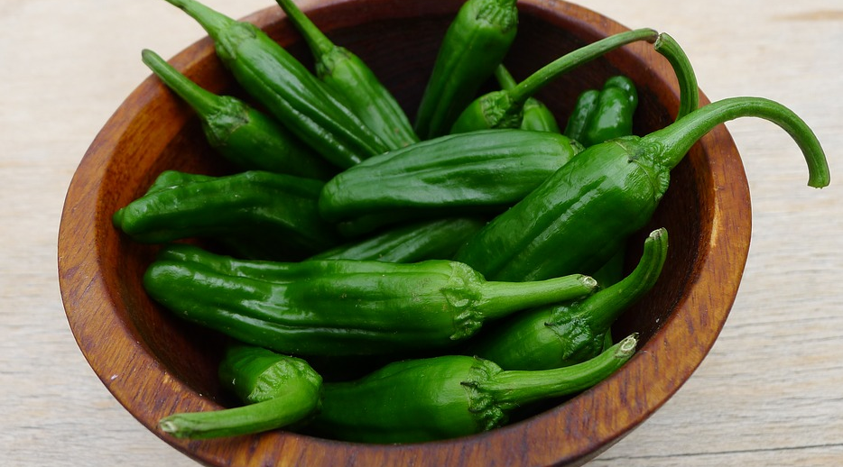
ALL ABOUT MY RECIPE
This recipe is important because it comes from my culture which is Mexico and me and my family always eat this recipe for holidays like Thanksgiving, Christmas etc. Well, my family love every type of food but especially Taco Dorados a special memory to my family is when everyone from my family came to visit and all we ate were Taco Dorados. This recipe is a Mexican food it first came from Mexico and then expanded into more Latin countries. In my opinion, it would have to be the fried tortilla it is delicious.
SPOTLIGHT INGREDIENT: SHISHITO PEPPERS
My spotlight ingredient is the Shishito Pepper I saw it at the Green Market. The Shishito Peppers can sometimes be Red or sometimes be Green. It is actually the fruit part of the plant. It will take within 60-90 days till it can be harvested. Shishito Peppers have a lot of Vitamin C which helps reduce heart diseases and provides antioxidants.

Slide 47
RICE & BEANS
Diego Quiroz
Entrée
2-3 servings
INGREDIENTS:
1 tbsp olive oil
2 large cloves of garlic (lightly crushed and minced
1 large red onion (diced)
1 stalk of celery (diced)
1 green bell pepper (stem and seeds removed)
2 (1-lb) cans of beans (any)
1 tsp onion powder
1 tsp salt
¼ tsp ground black pepper
2 ½ cups chicken stock
1 cup uncooked white rice
1 tbsp butter
1 tbsp minced fresh cilantro leaves (optional)
PROCEDURE:
Heat olive oil over medium-high heat in a large saucepan.
Sauté garlic, onion, celery, and bell pepper until tender.
Stir in kidney beans, onion powder, salt, and pepper.
Reduce heat to low and let mixture simmer slowly while you cook the rice.
Bring the chicken stock to a boil and stir in rice and butter.
Heat olive oil over medium-high heat in a large saucepan.
Sauté garlic, onion, celery, and bell pepper until tender.
Stir in kidney beans, onion powder, salt, and pepper.
Reduce heat to low and let mixture simmer slowly while you cook the rice.
Bring the chicken stock to a boil and stir in rice and butter.
Return to a boil, reduce heat to low, cover and cook for 20 minutes without removing the lid.
Remove from heat and let stand for 5 minutes to cool down.
Fold rice and beans gently together and transfer to a serving dish. Serve garnished with cilantro (optional).
INDEX

Slide 48
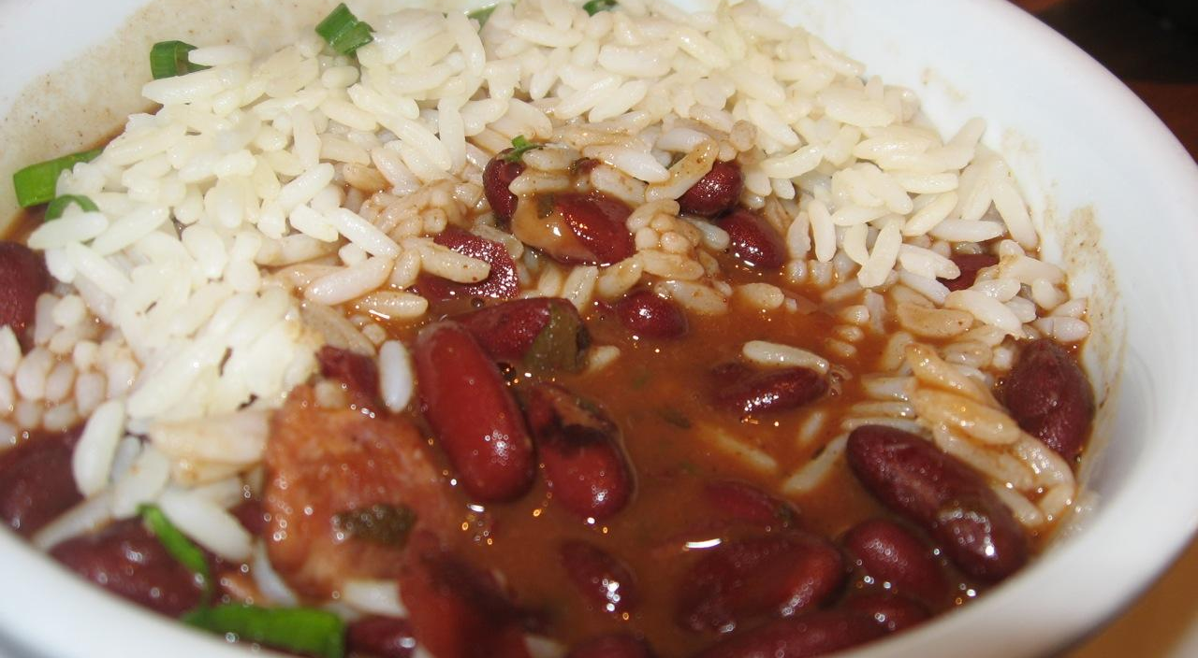
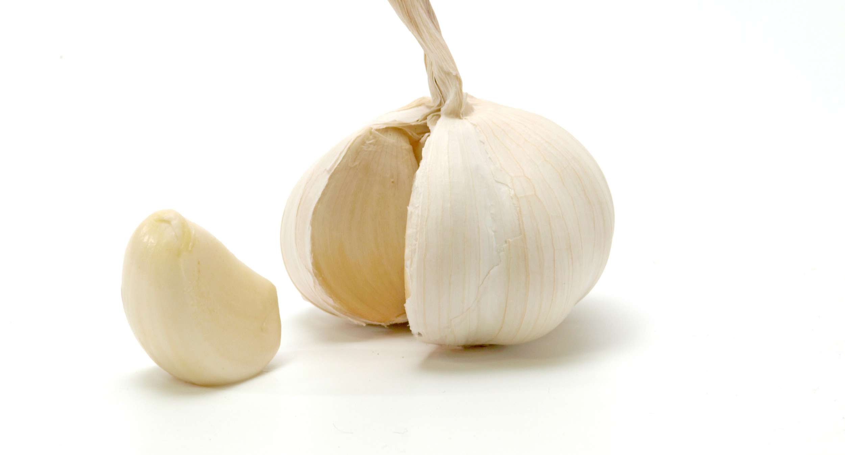
ALL ABOUT MY RECIPE
Rice & beans is special to my family because it’s a tradition. We eat the dish nearly every day, and we usually add meat as well. Any meat can go along with rice and beans - whether it be chicken, pork, or beef. Rice & beans is a Spanish dish, and considering I come from a Spanish family, it’s perfect! There’s a lot of variety with rice & beans. You can use any type of rice and any type of beans, and it’s still delicious every time. Plus, meat isn’t the only thing you can add to the recipe. Experiment!
SPOTLIGHT INGREDIENT: GARLIC
My spotlight ingredient is garlic, which is flavorful bulbs that are white, and have a strong taste. Garlic is a popular food ingredient around the world, whether it be minced or in cloves, many people eat the ingredient. Garlic is actually a bulb. Onions are bulbs too. Garlic plants are harvested when the leaves are one-third brown. There are many health benefits that come from garlic. It’s very nutritious, yet has few calories. Garlic supplements can actually help boost your immune system, and there’s tons more benefits as well.

Slide 49
Pumpkin Pie
Sebastian Wells
Dessert
8 Servings
INGREDIENTS:
1 ⅓ cups all purpose flour
½ teaspoon salt
½ cup shortening
½ teaspoon ground ginger
3 ½ tablespoons cold water
2 cups mashed cooked pumpkin
12 fluid ounce evaporated milk
2 eggs beaten
¾ cup packed brown sugar
½ teaspoon ground cinnamon
½ teaspoon ground nutmeg
PROCEDURE: 20 minutes prep, 40 minutes cook, ready in 1 hour.
Preheat oven to 400 degrees F (200 degrees C).
Prepare pie crust by mixing together the flour and salt. Cut shortening into flour; add cold water 1 tablespoon at a time (you may need only 3 tablespoons, or up to 4 tablespoons). Mix dough and repeat until dough is moist enough to hold together.
With lightly floured, hands shape dough into a ball. On a lightly floured board roll dough out to about 1/8 inch thickness. With a sharp knife, cut dough 1 1/2 inch larger than the upside-down 8- to 9-inch pie pan. Gently roll the dough around the rolling pin and transfer it right-side up onto the pie pan. Unroll, easing dough into the bottom of the pie pan.
In a large bowl, beat pumpkin with evaporated milk, eggs, brown sugar, cinnamon, ginger, nutmeg and salt with an electric mixer or immersion blender. Mix well. Pour into a prepared crust. Bake 40 minutes or until when a knife is inserted 1 inch from the edge comes out clean.
INDEX

Slide 50
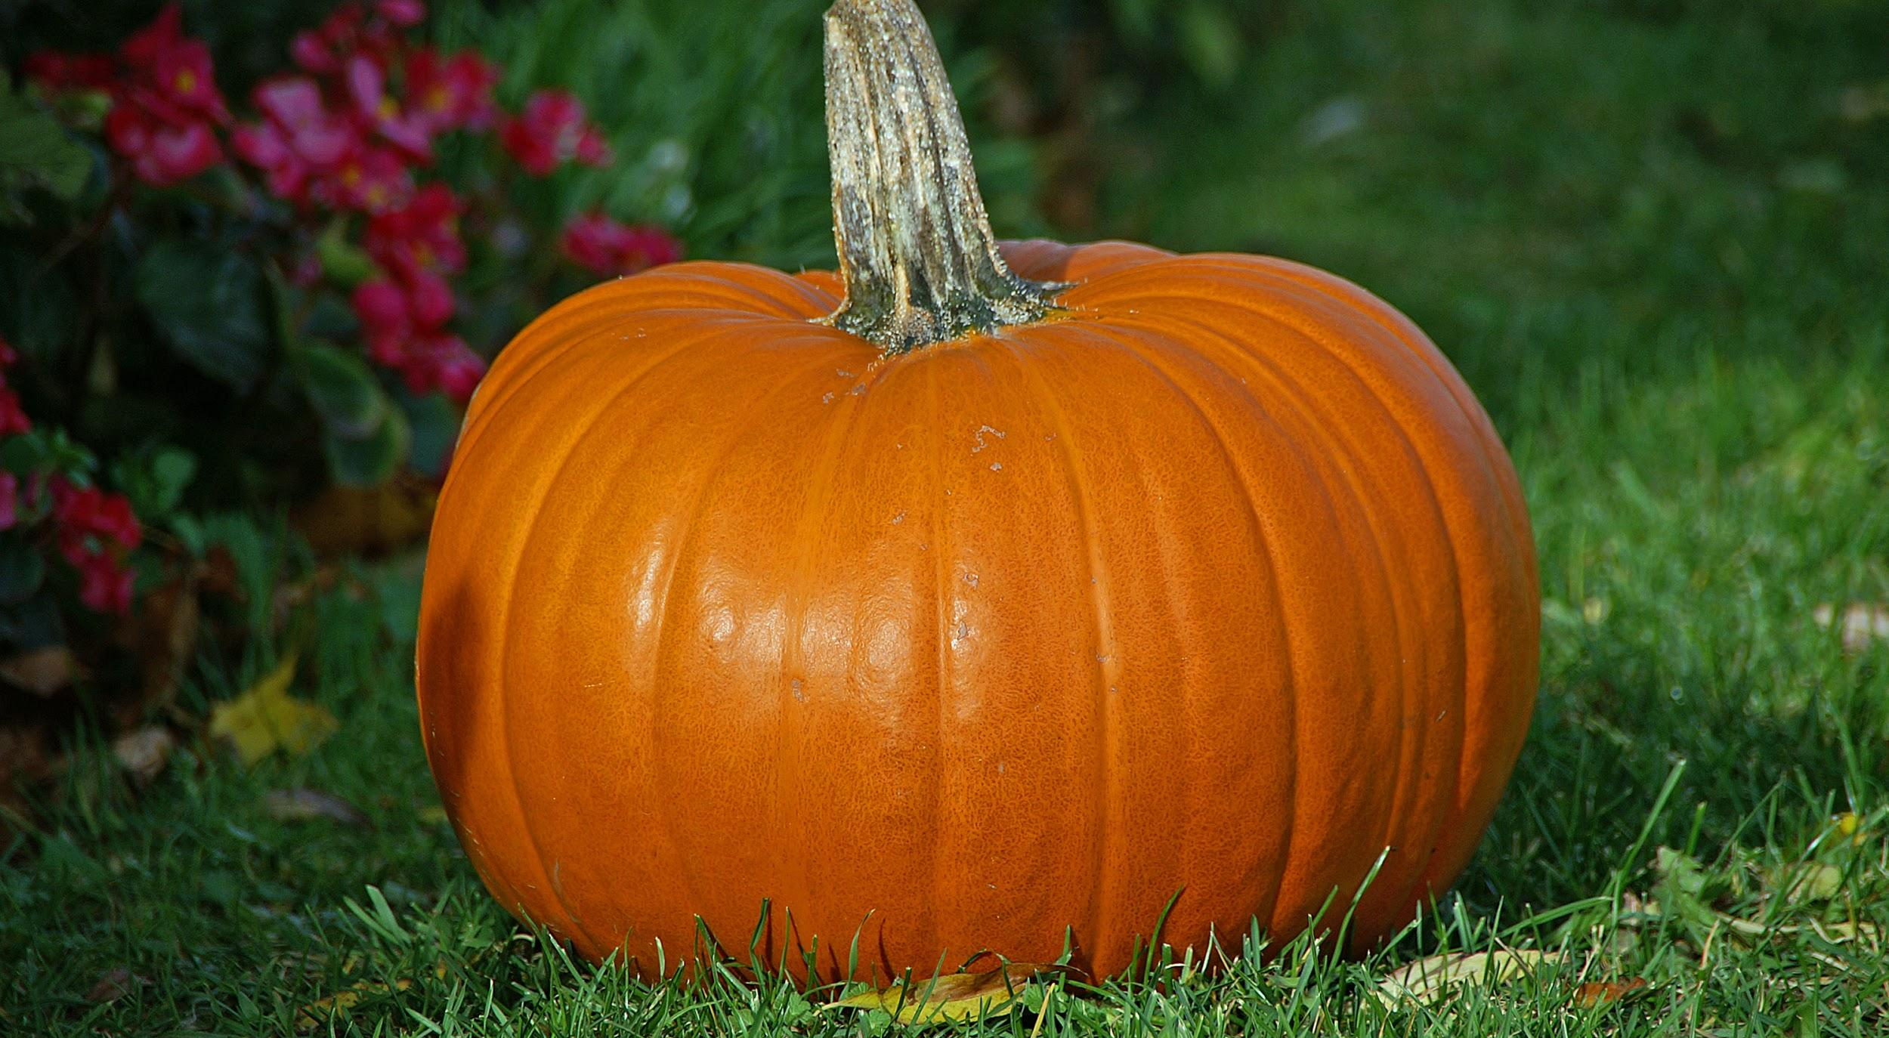
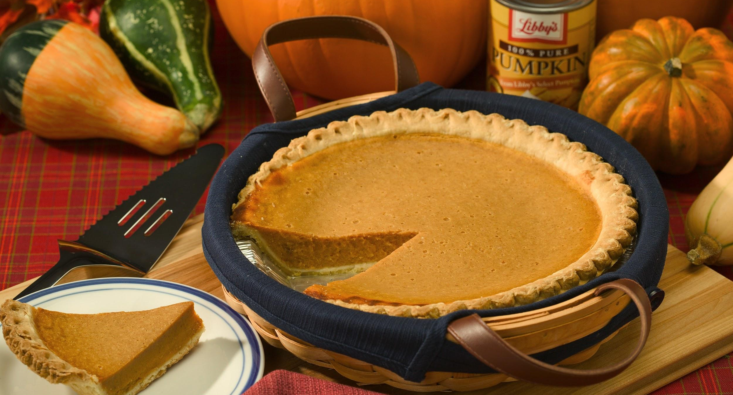
ALL ABOUT MY RECIPE: PUMPKIN PIE
This recipe is special to me because my dad makes it sometimes. We usually eat pumpkin pie around October and November. This recipe comes from no culture at all. This recipe is good because it has lots of sugar in it. I like to eat pumpkin pie.
SPOTLIGHT INGREDIENT: PUMPKIN
My spotlight ingredient is pumpkin. I saw this at the green market. “A large rounded orange-yellow fruit with a thick rind, edible flesh, and many seeds.” From the dictionary. The pumpkin is a fruit. The pumpkin takes about 5 months to grow and then you eat the pumpkin. Other uses are: Jack-O-Lantern, pumpkin pie, and people use the seeds for roasting, because they are claimed to be good roasted. This tastes like bitter sugar. This way, sweet and savory makes up this pumpkin pie.

Slide 51
Sweet Ball Of Dough
JiaYuan Lin
Dessert
4-8
INGREDIENTS:
Dough
types of any kind of sugar that can be used in food
flour
sesame[mostly black]
2 to 3 cm[If you want bigger you can do 5 cm].
PROCEDURE:
you need dough 6.put it into a bowl and put some water into it
you need sesame and black sugar 7.cook it
separate the dough into 5 or 6 cm 8.it’s ready to be eaten
put a amount of sugar into the dough
roll the dough into a ball
INDEX
Notes:
INDEX

Slide 52
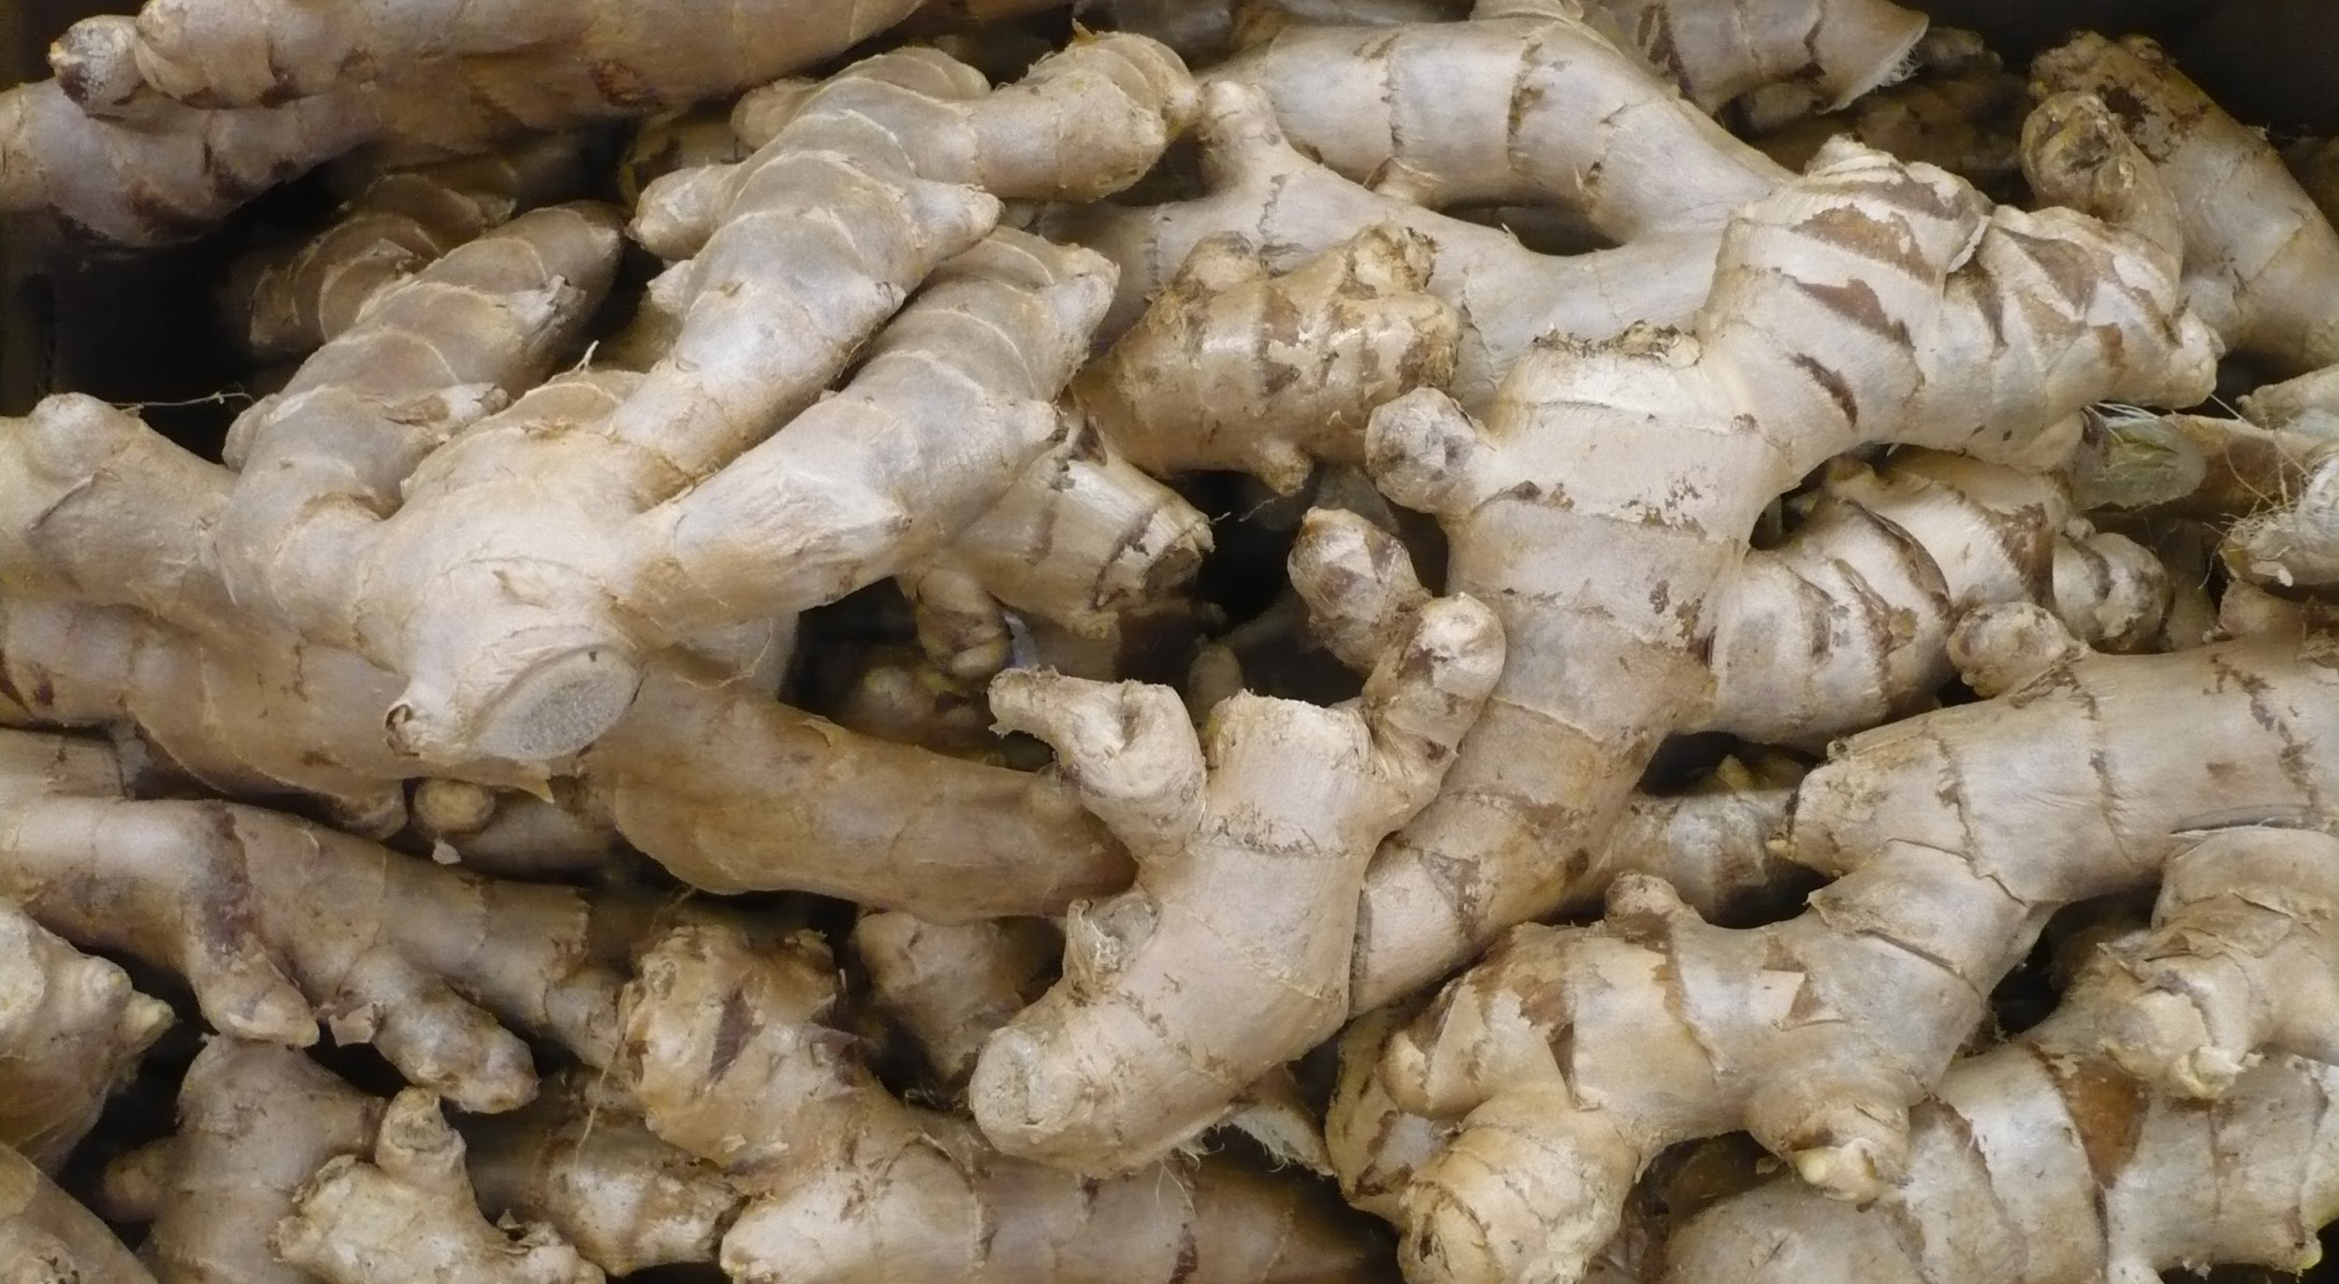
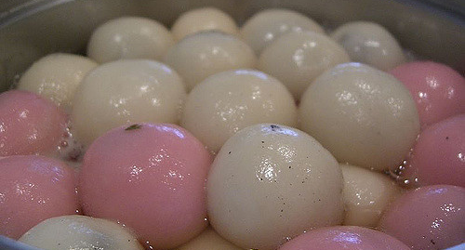
ALL ABOUT MY RECIPE
This is special to my family because it’s a food where we eat when it is a holiday called Lantern Festival. We enjoyed eat it because it is very sweet and if you bite inside of it you can taste the good sweet black sugar in there. And we had a good time celebrating the holiday. The food culture is in China. In my opinion I think the sugar and things inside of it makes it very delicious.
SPOTLIGHT INGREDIENT: GINGER
My spotlight ingredient is Ginger syrup.It tastes kind of spicy in a way.And many people used it in their meals. Also it looked like a twig in a way just thicker and more yellow.It’s a root so it would be harvested around the middle of the plant life cycle.
And it would take it eight-ten months to be full grown.It could be used to relieve nausea, loss of appetite, motion sickness, and pain.So ginger is a very good food for you when your sick or when you are having a stomach problem.

Slide 53
TOSTADAS
VALERIA PAVON
Entree
Around 10 people
INGREDIENTS:
Shredded chicken
Beans
Vegetable oil
Fried Tortilla
Lettuce
Shredded Cheese
Cloves Garlic Minced
Salt
Spanish onion
Pepper
Ground cumin
Ground coriander
Lime Juice
PROCEDURE:
Use vegetable oil to fry the a tortilla or you can just buy one at the store
Cook 3 cups of shredded chicken until nice and warm
Add chicken in a bowl with oil, lime juice and most importantly salt and pepper
Then put in container and close
Heat 2 tablespoons of oil in a large skillet
Add ¼ of medium spanish onion, finely chopped, add ¼ of medium spanish onion, finely chopped, 1 teaspoon ground coriander, 1 teaspoon ground cumin
Add beans and wait for 2 min for them to get lightly brown and then add 4 cloves garlic that are minced
Then in 5 min add salt and wait for beans to finish
It’s time to ensemble the tostadas, first add the beans on the fried tortilla
Add the cooked shredded chicken
Add shredded cheese
Then cut up some fresh lettuce
Then add it on top of the cheese
Time to eat
INDEX

Slide 54
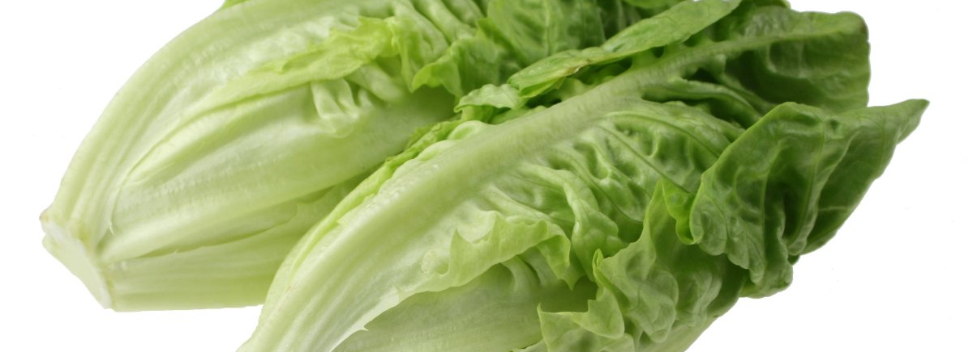
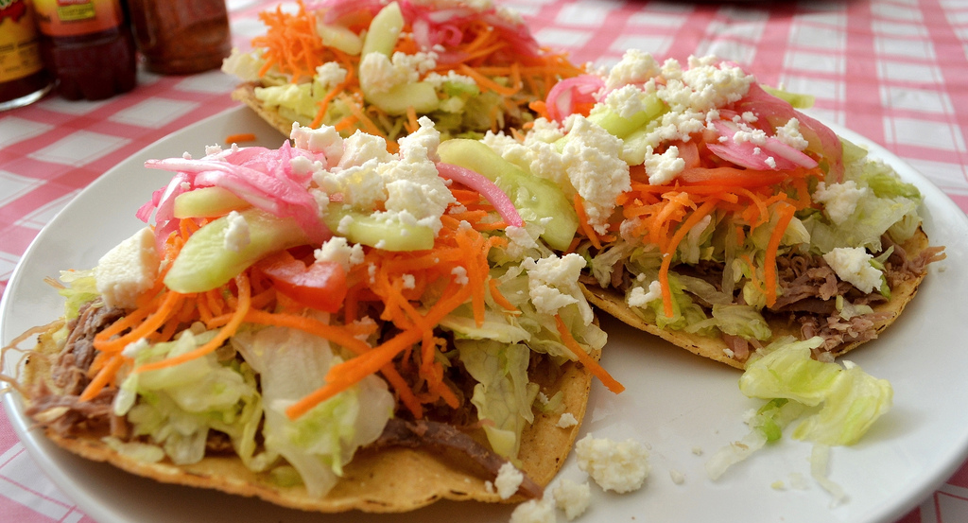
ALL ABOUT MY RECIPE
My recipe is tostadas, it has over 10 steps to make this dish. This dish is very complicated because the chicken has to be just right which makes the dish amazing. This dish is very special to my family because it has been a tradition to my family since I was born. My mom made this dish in Mexico and she makes here in New York. My grandmother showed my mother and my mom still is trying to teach me. In Mexico they didn't have much things to cook with so they had to be creative. I hope I can pass down this dish like mother did. She makes a bunch of dishes but this is my favorite dish out of all them she made.
SPOTLIGHT INGREDIENT: LETTUCE
My spotlight ingredient is lettuce, I saw this ingredient at the supermarket. I couldn’t find a spotlight ingredient so I tried adding one. Then I realized that I already one. Lettuce is important in this dish because it adds a bit of freshness. There are a bunch of cooked ingredients so having a fresh vegetable really gives the dish a bit of nice taste to it. The lettuce has to be fresh in order for the tostadas to be amazing.

Slide 55
Green Pasta
Andrea Andrade
Entree
About 5-6 people
INGREDIENTS:
1 green pepper
1 pouch of cilantro
1 pack of pasta(or how many packs of pasta you want)
1 piece of garlic
⅘ of pieces of onions
Half cream
water
1 spoonful of butter(smallest spoon you have)
1 pinch of salt
1 teaspoon of oil
2 bay leaves
PROCEDURE:
Get a pot with water put in a pack of pasta and wait until the pasta is ready
Get the cilantro, green pepper water and blend
On a seperated pot, put the pasta and the mix together until the mix is light green
INDEX

Slide 56
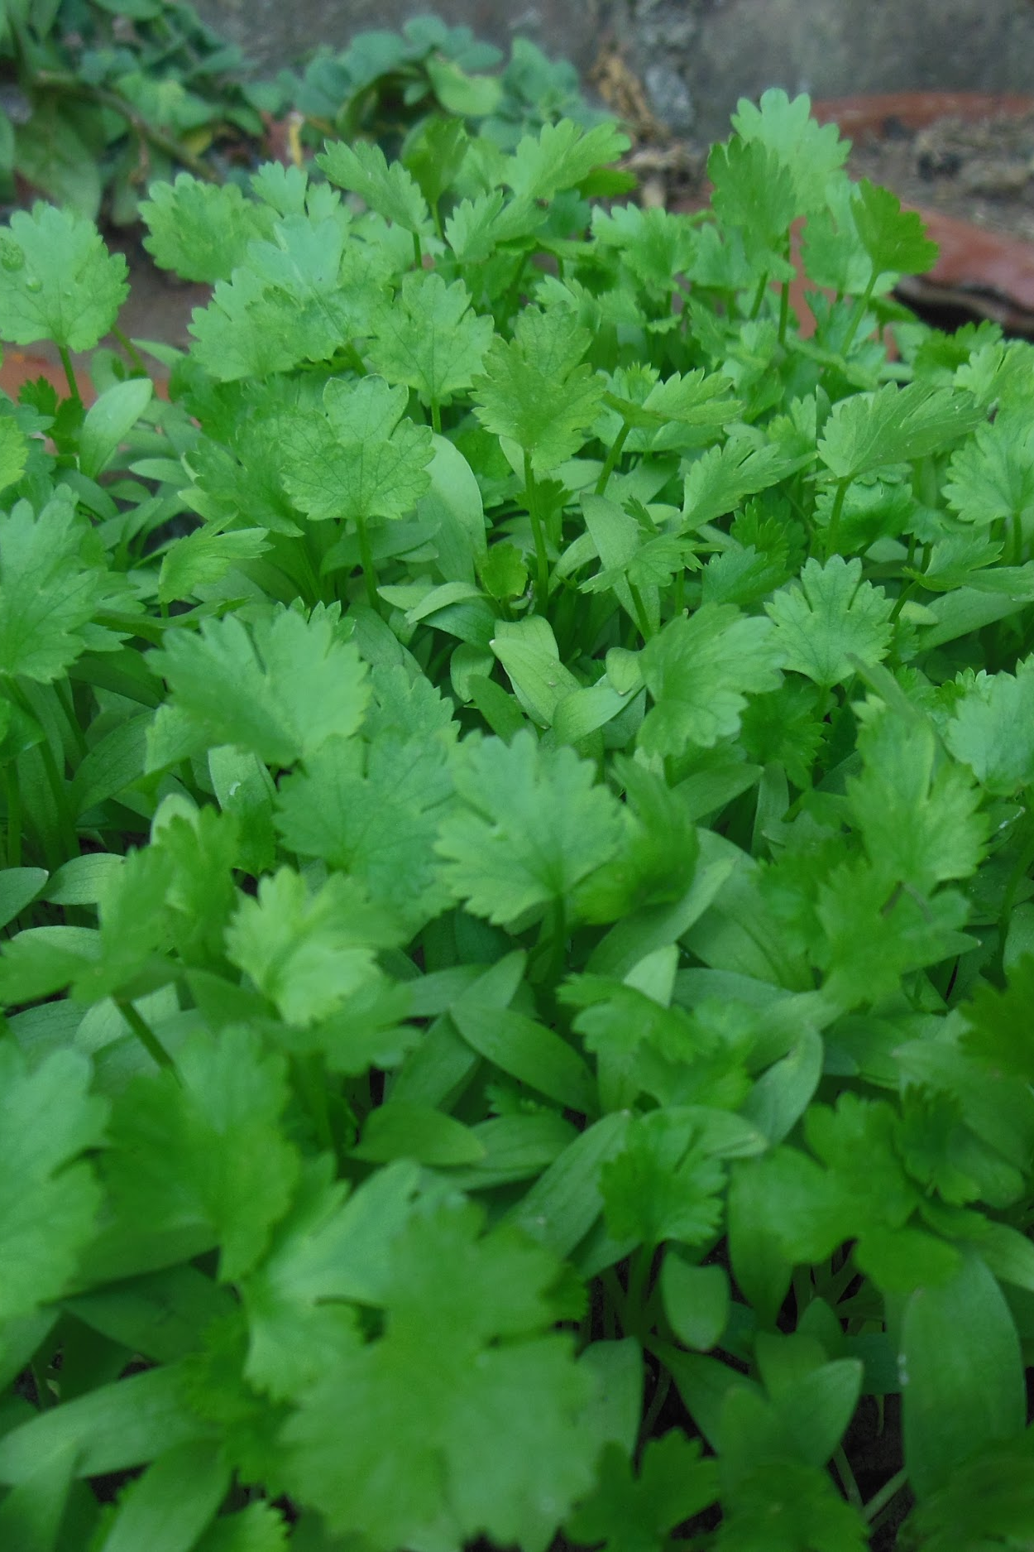
SPOTLIGHT INGREDIENT: CILANTRO
My spotlight ingredient is the cilantro.The cilantro adds the color and the taste of the pasta.The color of the cilantro is green and it tastes like a leaf.The cilantro is a leaf.The cilantro takes up to 3-4 weeks to grow.

Slide 57
RECIPE TITLE
Ferdinand Connolly
main course
garlic 2 cloves
pine nuts 2 handfuls
parmesan cheese
6 servings
INGREDIENTS:
3 tbsp olive oil
1 teaspoon salt
basil 1 full bushel
PROCEDURE:
put all ingredients except the parmesan cheese into a food processor or blender and turn it on till you have a smooth past
then boil some water and add the tortolini to the water and leave it on till the tortolini is soft
later strain the pasta and mix it in a bowl with the pesto.
then you have pesto and tortolini!
INDEX

Slide 58
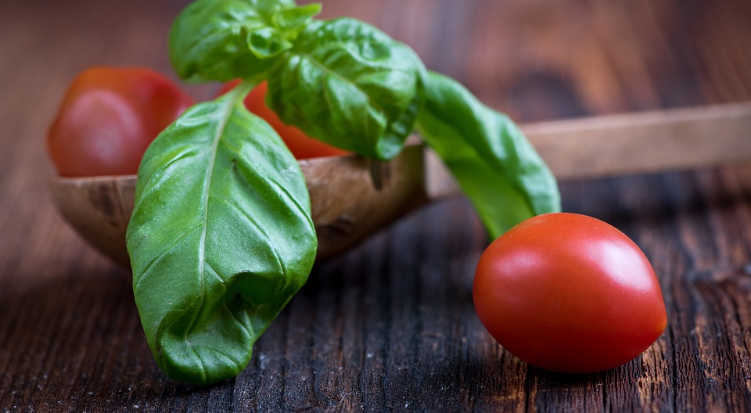
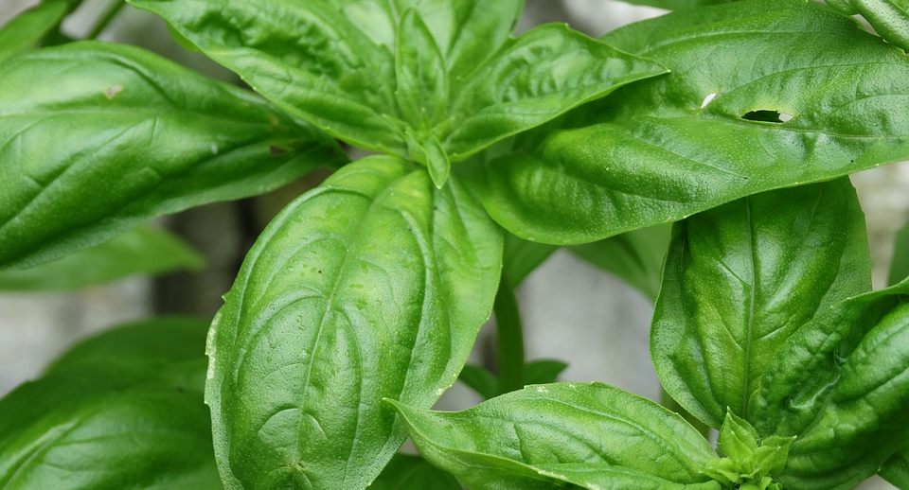
ALL ABOUT MY RECIPE
pesto and tortolini are so amazing it is also very helthy.
SPOTLIGHT INGREDIENT: basil
Basil is a very delicious leaf that grows in a thick stem and has a very strong flavor.

