Slide 1
Introduction to High School Admissions
Star Corvinelli
8th Grade School Counselor
Notes:
Resources to Handout:
HS Fair Flyer
CTE Fair Flyer
Copy of slide #30: What Makes a Balanced Application
Sample of HS Directory
Sample of the Specialized High School Student Handbook
Objective: 1. Support families in becoming familiar with MySchools- new online HS application system
2. Help families to understand the importance of building a balanced application- build an understanding of what it means to have a mixture of Reach, Target and Likely programs
3. Families that need technology support:
Help them create a personal email account
Help them with initial log into MySchools.nyc (parent portal)

Slide 2
How do I participate in High School Admissions?
Required
Two paths for students
Optional
High School Application 700+ Programs at 400+ High Schools
Specialized High Schools 8 Testing Schools 1 Audition School
Early Fall
Access Round 1 Application
Register, then get Test and/or Audition Ticket(s)
Group Three
Complete Application by listing 12 programs in order of preference.
SHSAT
Audition
Late Fall
March
1 Offer
1 Offer*
1-6 Offers*
Round 2 (optional)
*if applicable
Notes:
There are two paths that students may take to receive a high school offer.
The first is the High School Application (point to left of screen), which is used to apply to over 700 programs at over 400 high schools. You can submit your application online in MySchools. You and your child choose 12 programs you’d like to apply to by December 3. I can give you a paper worksheet in early October if you can’t access online. You will give that worksheet back to me by December 3rd. Every eighth-grade student must complete a High School Application.
The optional, second path is for the Specialized High Schools (point to right of screen). There are nine specialized schools: eight of them take top-scoring students on the Specialized High School Admissions Test (called the SHSAT). The ninth, LaGuardia requires an audition and also looks at academics. Last year, over 28,000 students took the SHSAT for around 5,000 seats at the specialized testing schools. [Make mention here of students who at your school who typically receive an offer to a Specialized High School]
If you are interested in any of the specialized schools, please register for the SHSAT or the LaGuardia studio auditions by October 11 in MySchools! If applicable to your student, please review any accommodations. Students receive a test or audition ticket by mid-October. You can print it out online or I can print for you. Your child then takes the SHSAT and/or auditions during the fall. Taking the test or auditioning means your child has applied. On the SHSAT, students rank the testing Specialized Schools in their order of preference.
In March, the DOE will mail home the letters that tells you your offer from the HS Application, maybe an offer from a testing Specialized school, and maybe an offer from any of the six studios at LaGuardia. (Point to bottom row.) If a student has received multiple offers, the student must choose one. Results will also be available in MySchools!
New this year is that every student will receive an offer in Round 1! Selecting your programs continues to be very important because students may receive offers that were not listed on their application. This happens only when the DOE can not match your child to one of their choices. There are many reasons why this may happen, such as less than 12 choices, too many program choices with over 10 applicants per seat, missing your guarantee program.
We will talk about how to build a balanced application today.
If your child did not receive a specialized offer, then your child is expected to attend the school from the High School application unless you opt out. Participating in Round 2 is optional. Note that the only schools open in Round 2 are schools with seats left after Round 1. A Round 2 replaces a Round 1 offer, so only put down schools you prefer over your Round 1 offer. Round 2 results will be available in May.

Slide 3
What are the Specialized High Schools (SHS)?
There are eight testing SHS — apply by taking the Specialized High Schools Admissions Test (SHSAT).
Bronx | The Bronx High School of Science High School of American Studies at Lehman College
Brooklyn | The Brooklyn Latin School Brooklyn Technical High School
Manhattan | Stuyvesant High School High School for Mathematics, Science and Engineering at the City College of NY
Queens | Queens High School for the Sciences at York College
Staten Island | Staten Island Technical High School
There is one audition SHS — apply to dance, instrumental music, fine arts, drama, technical theater, or vocal music by auditioning or submitting a portfolio.
Manhattan | Fiorello H. LaGuardia High School of Music & Art and Performing Arts (LaGuardia High School)
Notes:
These are the Specialized High Schools. You can learn more about them in the Specialized High Schools Student Handbook, NYC High School Directory, MySchools, or meet with school representatives at a high school fair this fall. [Give the fair dates]

Slide 4
What happens after I take the SHSAT or audition?
Taking the SHSAT or auditioning for LaGuardia High School means you have applied to these Specialized High Schools.
SHSAT answer sheets (not test booklets) are scored. Students’ test scores are placed in order from the highest score to the lowest score. Offers are made based on:
Student’s SHSAT score
Student’s priority order of schools as listed on the answer sheet
Seat availability
Testing Specialized High Schools DO NOT review students’ state test scores, grades, or attendance.
Notes:
Read first bullet, then
After the SHSAT, answer sheets (not the test booklets) are then scored.
Students must make sure they indicate their answers on the answer sheet.
Admissions scores for the SHSAT are not published as they differ each year based on the students taking the test and the number of available seats at each school.
To understand how offers to the testing high schools are determined, imagine all the students’ answer sheets are in a big pile, with the student with the highest score on top, and the next highest score after, and so on.
The top student will be offered their first choice school from the list of schools they bubbled on the answer sheet.
Then the next student will receive an offer to their first choice school, if there are seats available.
Let’s say there are no longer seats available in the first choice school, then the student will be offered a seat at their second choice school, if there are seats available.
This continues through the ordered answer sheets until all the seats are filled.
You should list as many testing Specialized High Schools that you can travel to on the answer sheet, in your preferred order.
Read last bullet
Watch this helpful video with your families: How Students Get Offers to New York City Public Schools: https://vimeo.com/288796889

Slide 5
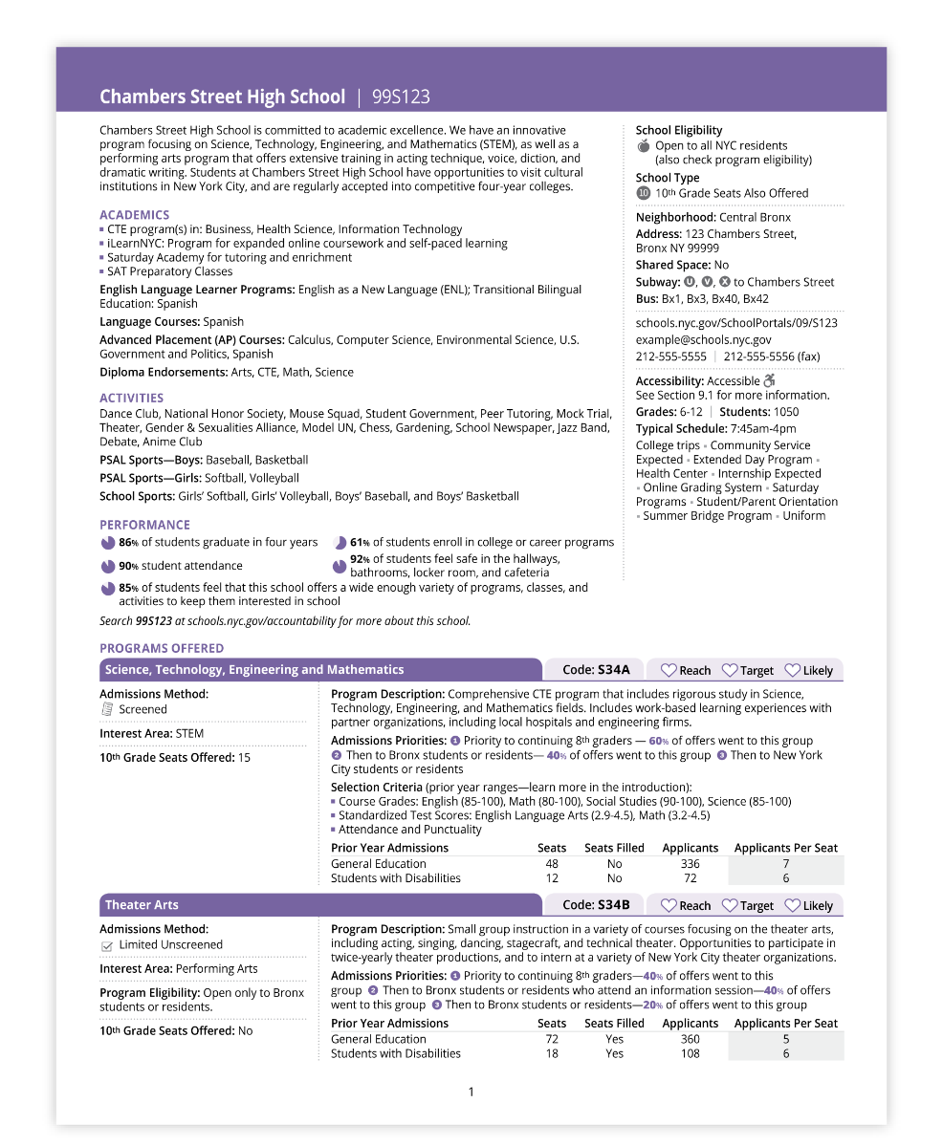
Explore Schools and Programs
Use the High School Directory to create a broad list of choices that interest you.
Location
Academics
Size and Accessibility
Activities
School
Performance
Program Interest
Area
Notes:
Start researching programs by thinking about what matters to you and your child. Keep these in mind as you explore schools and programs.
Students received their High School Directories on _ date__. This book lists every program you may write on your High School Application. Start learning about programs by looking at this book. Then, keep researching and visiting schools to decide which programs to write on your application.
You can also use MySchools to save programs of interest!
Would anyone like to share something they are looking for in their child’s high school??
Allow people to respond.
Thanks for sharing. The High School Directory has lots of information about high schools. We’ll talk more about what we can learn from it.
This is a sample HS Directory school page.
You can use this page to think about what the school has to offer such as courses, activities, and partnerships. It also shows school size, accessibility, performance, and location.
Travel time and distance are also important to many families.
All this information is also in SchoolFinder and MySchools.

Slide 6
Program factor—Admissions Methods
Show how each program selects students for offers.
These programs DO NOT see applicant’s school record
ZONED Based on home address | OPEN Random selection | SCREENED FOR LANGUAGE Based on students’ English language skills and/or years in the country. | TEST Offers are made based on score attained on the Specialized High Schools Admissions Test (SHSAT) only
These programs DO see applicant’s school record
SCREENED Rank students using seventh grade core course grades, attendance, and state test scores. Additional requirements possible, such as portfolios or interviews. | AUDITION Same as Screened, but require an audition. Some auditions require pre-registration. | EDUCATIONAL OPTION Seats reserved for students with high, medium, and low NY State ELA scores. Half of seats filled by students who were ranked by the school. Half of seats filled through random selection.
Notes:
The last factor is Admissions Methods.
Admissions Methods represent how each program selects students, or what you need to do for the program.
These are on page 14 of the High School Directory.
The five admissions methods on the top [point to slide] do not look at an applicant's school record, which is academics and attendance.
The eight testing Specialized High Schools only make offers based on your SHSAT scores.
The three admissions methods on the bottom DO look at an applicant’s school record [point to slide].
Many of these may require you to take additional action, such as auditioning, submitting a portfolio, interviewing, or taking an exam.
Screened and Audition programs indicate which students meet their criteria by ranking them, or assigning a preference number much in the same way you list your high schools in preference order.
Your school record (this is grades, test scores, and attendance) may affect which programs you decide to list on the Application.
A balanced Application has programs with a mix of Admissions Methods.

Slide 7
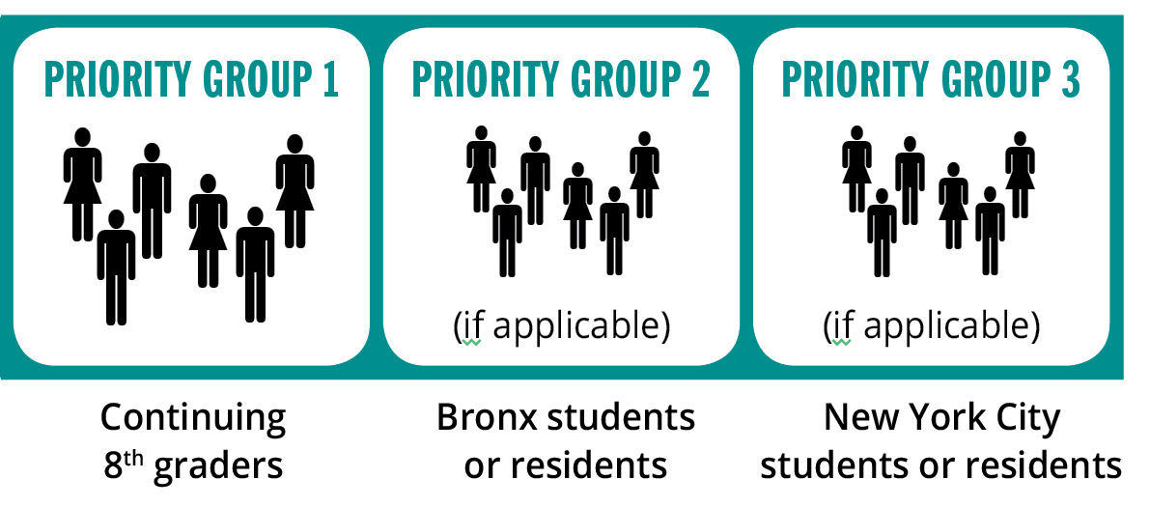
Program Factor—Admissions Priorities
Show the order in which students are considered for offers.
This means
TIP
It is a good strategy to apply to programs where you are in the first priority group.
Notes:
The next factor that affects offers is Admissions Priorities.
Admissions Priorities determine the order in which groups of applicants are considered for placement.
For example, for some programs, your home address and current school may affect the order in which you are considered for offers.
Admissions Priorities can be based on where you live or go to school, if you sign in at a school fair or open house, or if a you attend a continuing 6-12 school.
Here is an example of Admissions Priorities found on page 10 of the 2019 NYC High School Directory.
This means:
The students who receive offers first are continuing 8th grade students (Priority Group 1). If your child is in a program’s first priority group, then that program is a Target or Likely for your child.
The students who receive offers next, if seats are available, are Bronx students or residents (Priority Group 2). If your child is not in a program’s first priority group, then that program is a Reach for your child.
The students who receive offers next, if seats are available, are students or residents outside the Bronx (Priority Group 3). Again, this program is a Reach for students in this priority group.
Finally, the DOE includes in Admissions Priorities the percent of students who received an offer in each priority group. In this example, 60% of offers went to continuing 8th grade student (First Priority Group), 40% of offers went to Bronx students or residents (Second Priority Group), and no offers went to students in the third priority group, which is students or residents outside the Bronx.

Slide 8
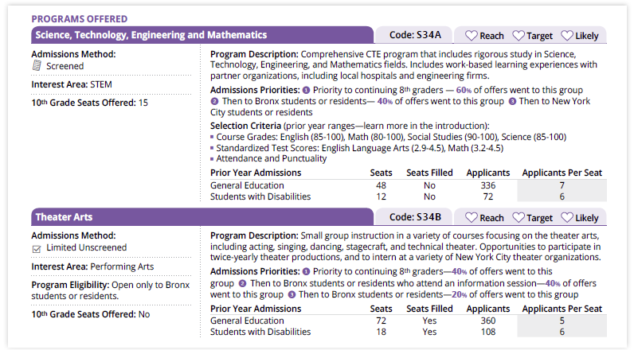
Learn More About Programs
Think of a program as a “doorway” to get into a school
You can apply to more than one program at the same school.
Programs at the same school may make offers based on different factors.
Learn how each program admits students in the High School Directory.
Notes:
When you fill out the online High School Application, you are not applying to schools, you are applying to programs.
Think of a program as a doorway into a school. Many schools have multiple programs, and students may apply to more than one.
Each program at a school is one of the 12 spots on the Application.
Here is a sample of a school page that has two programs with different Admissions Methods.
I’ll talk about Admissions Methods soon.

Slide 9
Students with Disabilities (SWD)
Students with Individualized Education Programs (IEPs) may apply to any high school program in New York City; all high schools must provide services for students.
On each school page, you can find each program’s SWD seat availability last year, and each school’s accessibility category.
For High School Admissions, seats at each high school program are divided into two groups:
General Education (GE) seats | Students with Disabilities (SWD) seats
For students who receive general education instructional programming For students who receive special education instructional programming for 20% or less of their academic program as indicated on their current IEP. | For students who receive special education instructional programming for more than 20% of their academic program as indicated on their current IEP.
Notes:
Read first two bullets, then say
If your child has accessibility needs, I recommend contacting or visiting schools to confirm that each would be a good fit.
Read third bullet and then the table

Slide 10
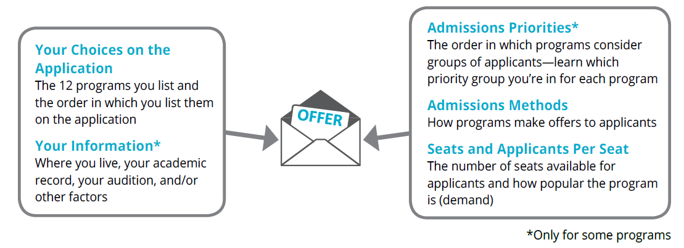
Know your Chances of Getting an Offer
Student factors and program factors determine if a program is a “reach,” “target,” or “likely” for your student.
Lower chance you’ll get an offer | Average chance you’ll get an offer | Higher chance you’ll get an offer
Notes:
How are offers determined or how are students matched with programs?
Students receive one offer from the 12 choices on their online High School Application
These factors affect what offer a student receives, and student’s chances of getting an offer.
point to screen
Read headers of boxes under “Student Factors” and boxes under “Program Factors.”
For the rest of this presentation, I will teach you how to know your chances of getting an offer by categorizing programs as Reach, Target, or Likely.
Reach program means you have a lower chance of getting an offer.
Target program means you have an average chance of getting an offer.
Likely program means you have a higher chance of getting an offer.

Slide 11
Student Factor—Choices on the Application
97% of students who listed 12 programs received an offer in Round 1 last year.
If you list 12 programs, you will have a better chance of getting an offer from one of your choices.
Only 87% of students with 3 programs received an offer
Only 91% of students with 6 programs received an offer
Only 94% of students with 9 programs received an offer
List programs in your true order of preference starting with your top choice.
High schools will not see how you rank them.
High schools should not ask how they’ve been ranked or say you must rank them first.
Notes:
Read bullets

Slide 12
What makes a balanced application?
Aim for a mix of reach, target, and likely programs.
Factors
Seat Availability
Admissions Priorities
Your Academics (selection criteria)
TIP
If you are in a continuing 6–12 program or have a zoned program, you may have a guaranteed match.
High Demand: 10 or more applicants per seat
Low or Average Demand:
4 – 9 applicants per seat
Lower Demand: 3 or fewer applicants per seat
OR
OR
AND
You are not in the first priority group
You are in the first priority group
You are in the first priority group
OR
OR
OR
The admissions method does not use academics, or your academics are on the high ends of the ranges
Your academics are below or on the low ends of the ranges
Your academics are in the middle of the ranges
Notes:
Handout this slide
This is your crib sheet.
A Good Application will lead to an offer at the end of Round 1. This table will help explain what that means.
When you’ve identified a program of interest, then determine if that program is a Reach, Target, or Likely for your child:
A reach program is a lower chance of getting an offer…. [read slide and pay attention to the ORs]
A target program is an average chance of getting an offer… [read slide and pay attention to the ORs]
A likely program is a higher chance of getting an offer…[read slide and pay attention to the AND and OR]
Some students have guaranteed programs! You have to choose your guaranteed programs as one of your 12 choices to be considered!
These programs are continuing 6-12 schools, or zoned guarantee programs that are based on address.
Check the Application to see if you have a guaranteed program.
Remember, your goal is for your child to have an offer in Round 1. If you are going to include “reach” programs on your Application, it’s important that you also include “target” programs and “likely” programs. This is what we mean by a Balanced Application.

Slide 13
My Chances—Reach, target, or likely–match?
Student A Application
Reach | Target
Reach | Likely
Reach | Reach
Target | Target
Likely | Target
Likely | Guarantee
Student A Information
ELA State Test: 4.10 | English Grade: 98
Math State Test: 4.05 | Math Grade: 95
Absence + Lateness: 4 | Science Grade: 94
Guarantee?: Yes, zone | Social Studies Grade: 94
Turn & Talk
Did the student receive an offer in Round 1?
YES!
Application has 12 choices.
Application is a balance of Reach, Target, and Likely-Match.
Student has guarantee, and could have put 11 Reach programs as long as Guarantee program code is on the application.
Notes:
**animation**
Let’s look at an example of a student’s application after the families has evaluated Reach, Target or Likely for all of them. Let’s also look at the student’s academics.
walk them through what’s on the screen
Now, turn and talk and answer the question: Did this student receive an offer of choice in Round 1?
give them time to discuss, then ask them to shout out. Click to bring up the Yes.
Great! Now, clap your hands if you discussed:
Click to animate each one
If you do not put or have a guarantee match, then your last option should be a likely.

Slide 14
My Chances—Reach, target, or likely–match?
Student B Application
Reach | Reach
Reach | --
Reach | --
Reach | --
Reach | --
Reach | --
Student B Information
ELA State Test: 4.10 | English Grade: 98
Math State Test: 4.05 | Math Grade: 95
Absence + Lateness: 4 | Science Grade: 94
Guarantee?: No | Social Studies Grade: 94
Turn & Talk
Did the student receive an offer in Round 1?
NO!
Application has less than 12 choices.
Application is not balanced.
5 missed opportunities on the Round 1 Application that are no longer available in Round 2.
Notes:
**animation**
Let’s look at another example of a student’s application after the family has evaluated Reach, Target or Likely for all of them. Let’s also look at the student’s academics.
walk them through what’s on the screen
Now, turn and talk and answer the question: Did this student receive an offer of choice in Round 1?
give them time to discuss, then ask them to shout out. Click to bring up the No.
Great! Now, clap your hands if you discussed:
Click to animate each one

Slide 15
My Chances—Reach, target, or likely–match?
Student B Application
Beacon | Midwood Med Sci
Bard Manhattan | Harvest Collegiate
Bard Queens | --
Millennium BK | --
Nest+m | --
NYC iSchool | --
Student B Information
ELA State Test: 4.10 | English Grade: 98
Math State Test: 4.05 | Math Grade: 95
Absence + Lateness: 4 | Science Grade: 94
Guarantee?: No | Social Studies Grade: 94
Turn & Talk
Did the student receive an offer in Round 1?
NO!
Application has less than 12 choices.
Application is not balanced.
4 missed opportunities on the Round 1 Application that are no longer available in Round 2.
Notes:
**animation**
Let’s look at another example of a student’s application after the family has evaluated Reach, Target or Likely for all of them. Let’s also look at the student’s academics.
walk them through what’s on the screen
Now, turn and talk and answer the question: Did this student receive an offer of choice in Round 1?
give them time to discuss, then ask them to shout out. Click to bring up the No.
Great! Now, clap your hands if you discussed:
Click to animate each one

Slide 16
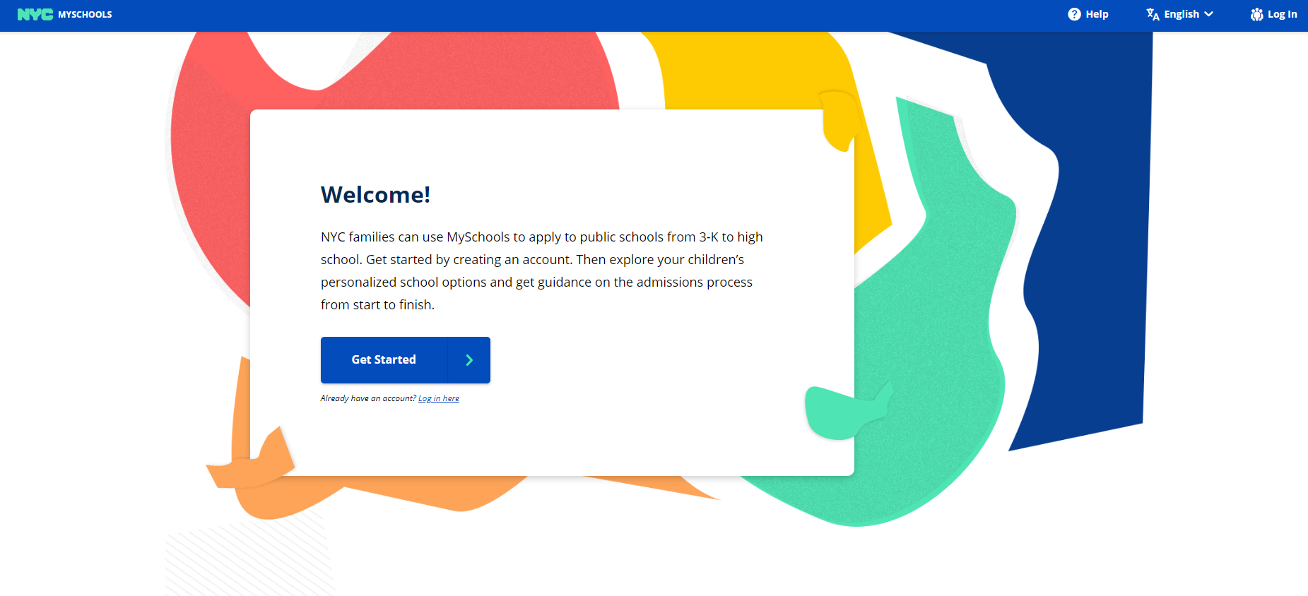
MySchools!
Notes:
This year the NYCDOE has upgraded the admissions system so that parents can register for the Specialized High Schools and submit a High School Application online.
Parents will need their student’s OSIS ID and an Account Creation Code to log in. You will receive the Account Creation Code in the mail. If you don’t receive it, I can get the code for you.
For public schools (DOE and Charter)
When you log-in, you will see your child’s information and 7th grade academic record (grades, test scores, attendance and punctuality). If you don’t see test scores immediately, just wait until they are released later this fall. Grades will be released at that time.
Review that all information is correct. If anything is inaccurate, please tell me immediately.
For non-public schools (private and parochial)
I will have to add your child’s information and 7th grade academic record (grades, test scores, attendance and punctuality) to the system. Once I do that, I can give you the student ID (called an OSIS) and the Account Creation Code so that you can access directly.
For all schools
You will complete the High School Application online by selecting 12 program choices in order of preference starting with your top choice. You’ll submit your completed application online by December 3.
For Families that do not have access to technology, I can provide you with a paper worksheet in early October that you will return to me by December 3.
You can use the High School resources to find schools. These resources include,
The High School Directory
The Specialized High School Admissions Handbook
Me- your School Counselor

Slide 17
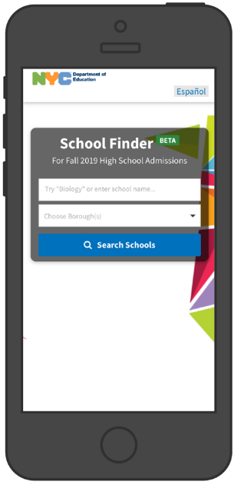
Round 1 Application – Research
Learn about more than 700 programs in the 2019 NYC High School Directory. Explore programs on your mobile or desktop device with NYC School Finder (schoolfinder.nyc.gov) or MySchools (MySchools.nyc).
Attend High School fairs and visit schools.
Choose 20 – 30 programs that interest you.
Narrow your list down to 12 program choices. No Specialized High Schools!
Notes:
You can continue to research with this book, the NYC High School Directory. The school information is also in NYC School Finder. If you haven’t done so already, take out your phone and go to schoolfinder.nyc.gov to have the Directory on your phone!
You can find information on all the DOE high schools in NYC in this book. I will show what information you should be looking at in this book.
You should start learning about programs in the Directory and find 20-30 that interest, then keep exploring and visiting schools to decide which 12 programs to write on the Application. Go to schools.nyc.gov/high and scroll to the bottom of the page to access the calendar.

Slide 18
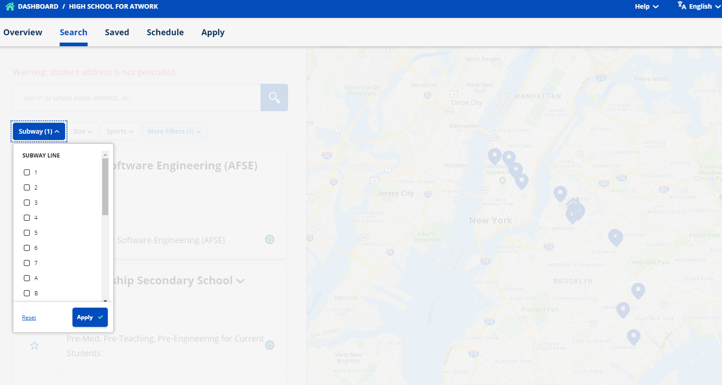
MySchools
Notes:
Screenshot of searching by subway line

Slide 19
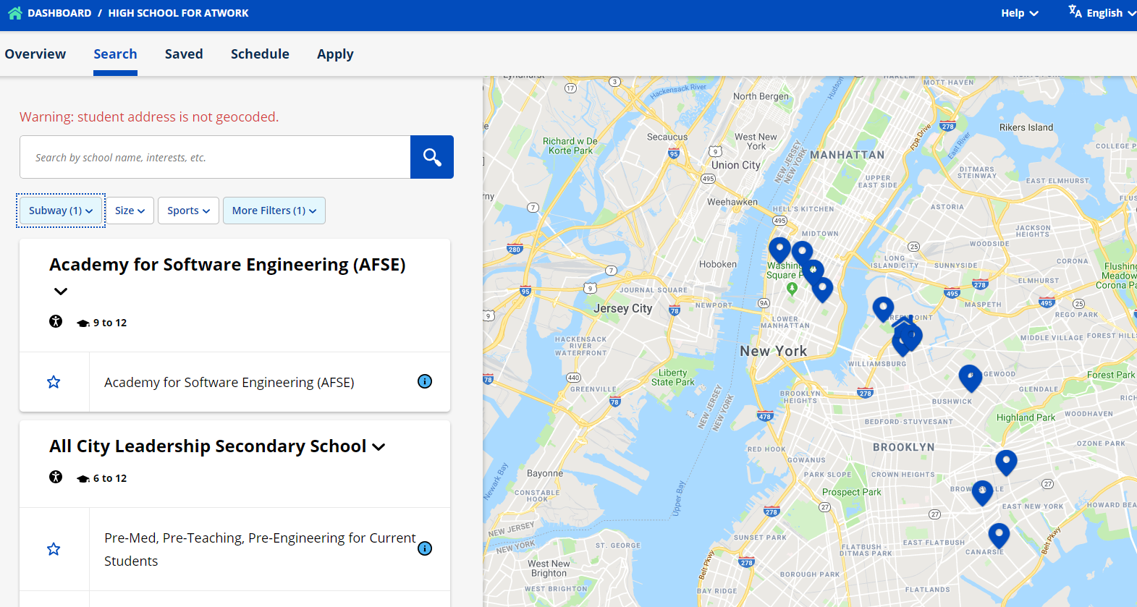
MySchools
Notes:
Screenshot of searching by subway line

Slide 20
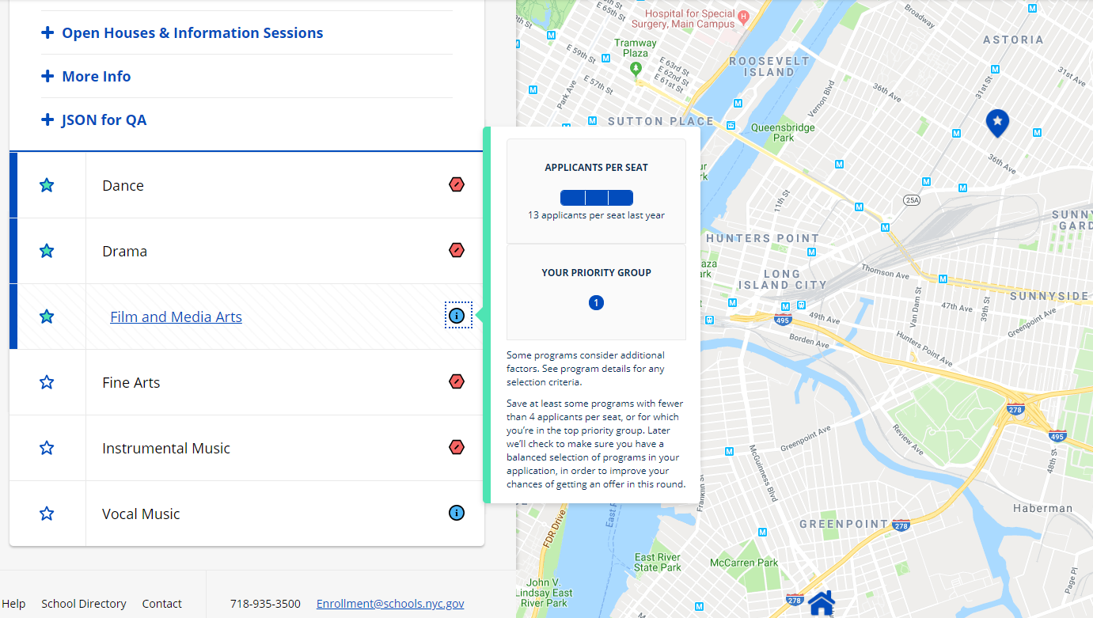
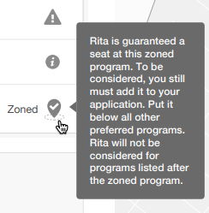
MySchools
+ Programs
Notes:
Screenshot of program information – Please note the applicants per seat and each student’s priority group.
Students are notified of their zoned school, if applicable.

Slide 21
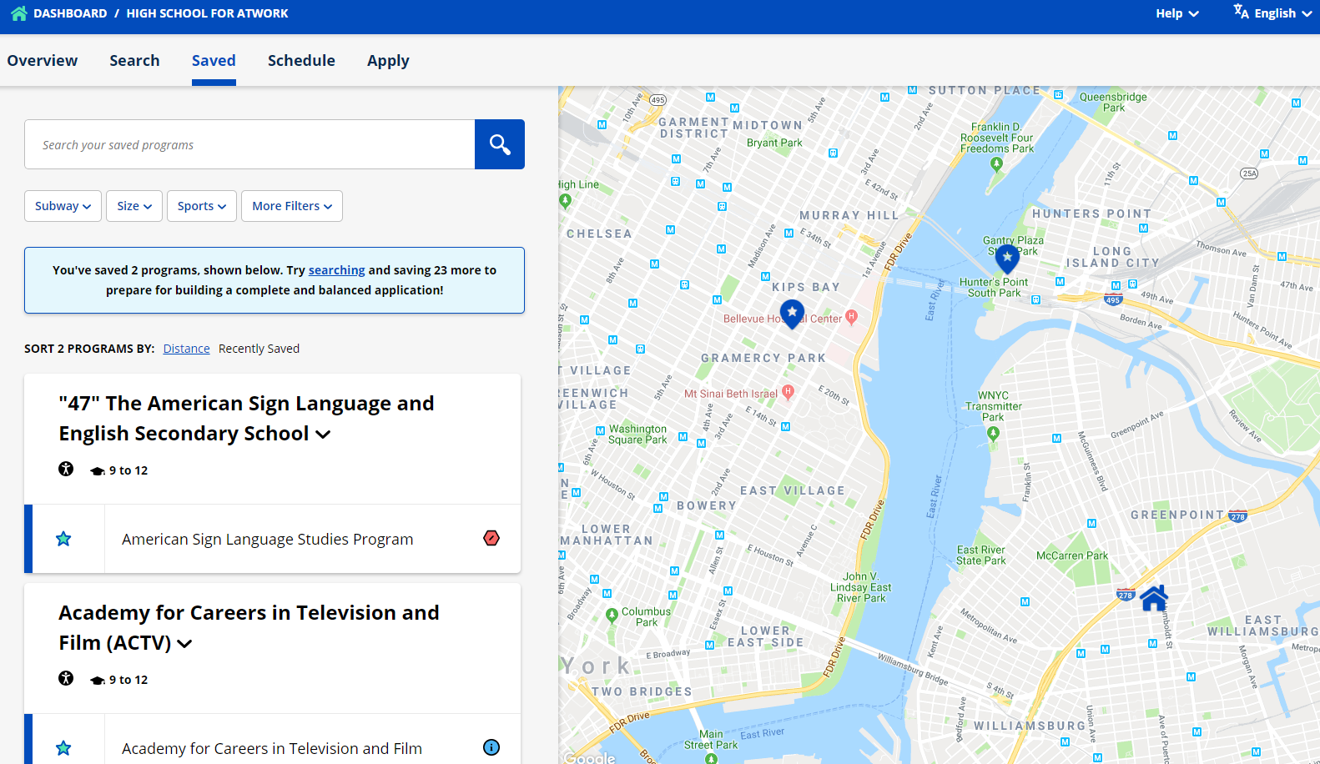
MySchools
Notes:
The map on your saved schools tab shows your home address and the schools you’ve saved!

Slide 22
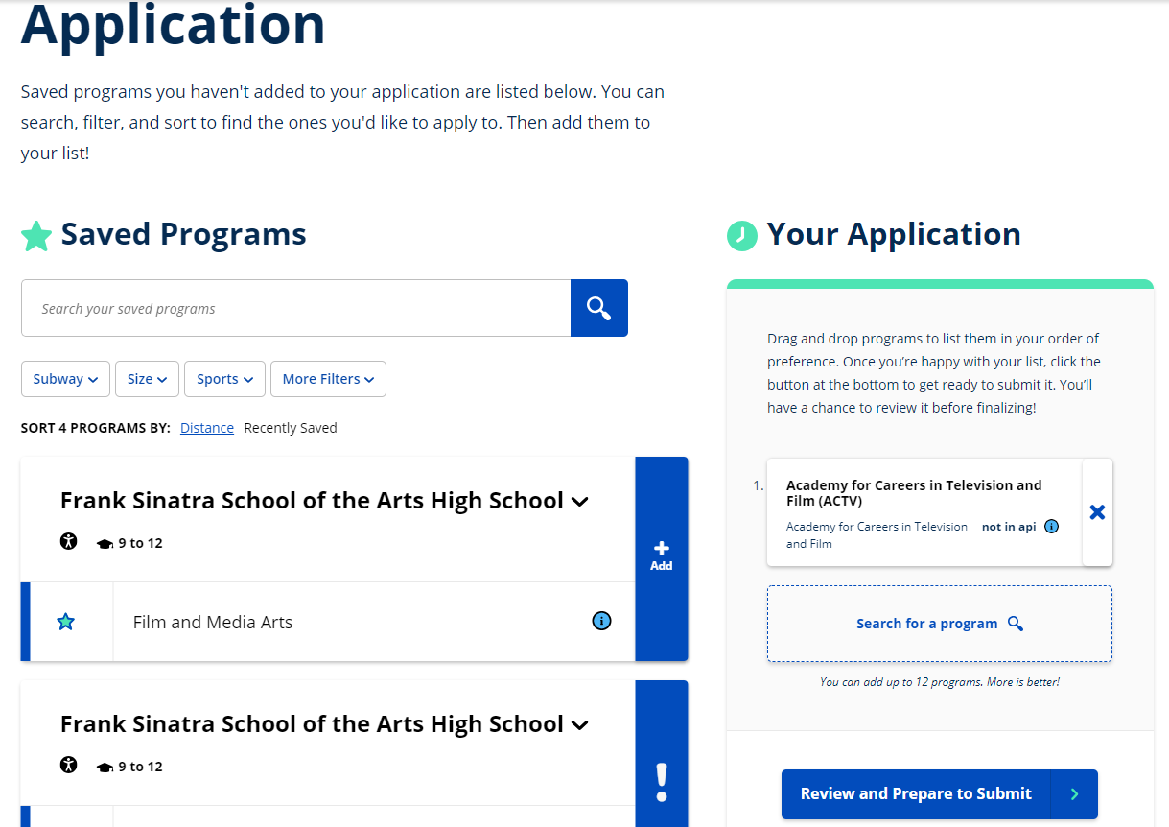
MySchools
Notes:
On the Apply tab, you will see your list of Saved programs
You need only click the Add bar next to the program to add to your application, the program would appear here as well.

Slide 23
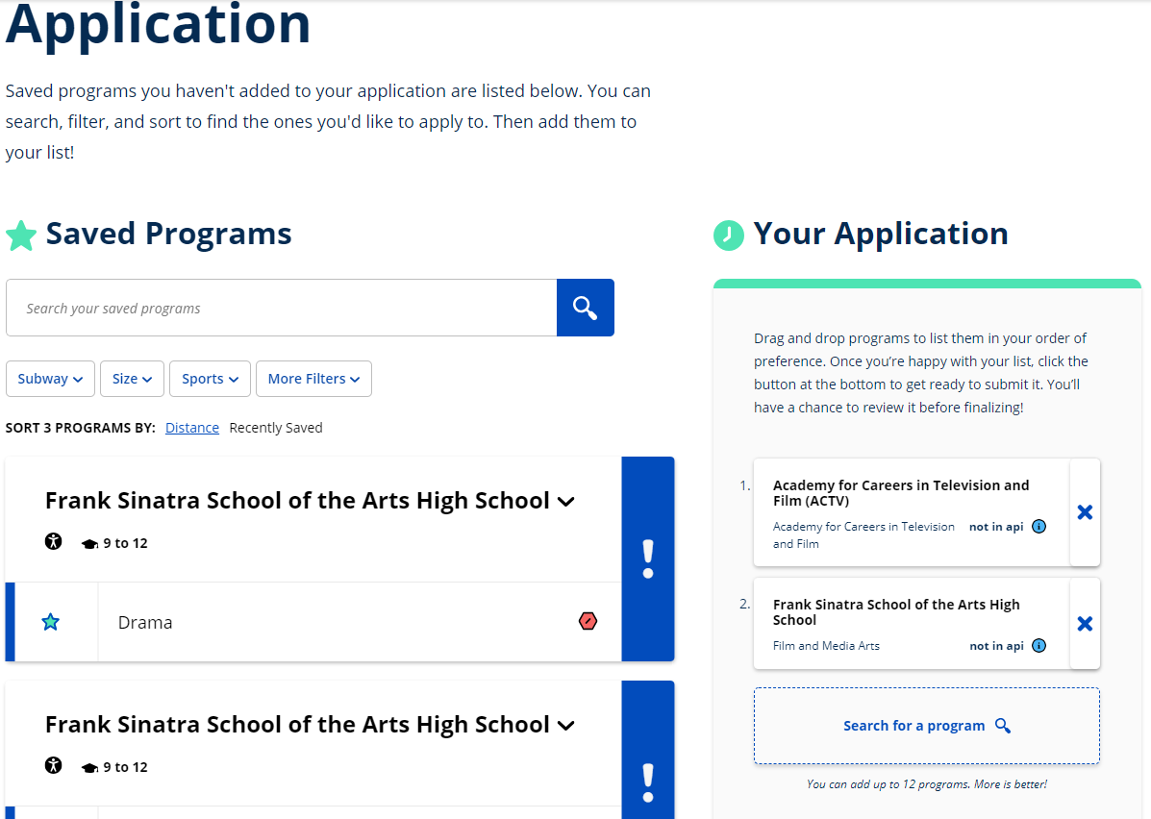
MySchools
Notes:
*Animation
Here’s the program added to the application!
You can easily remove a program from the application by clicking the X next to the program name
You can easily re-order application choices orders by dragging the program boxes
You can also type in a program name here in the “Search for a program” box

Slide 24
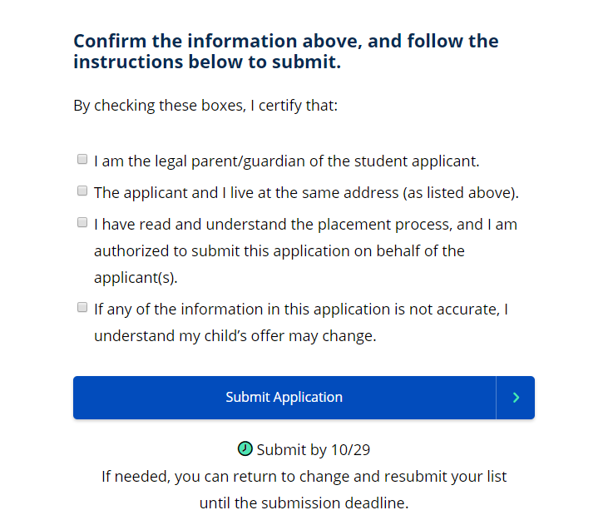
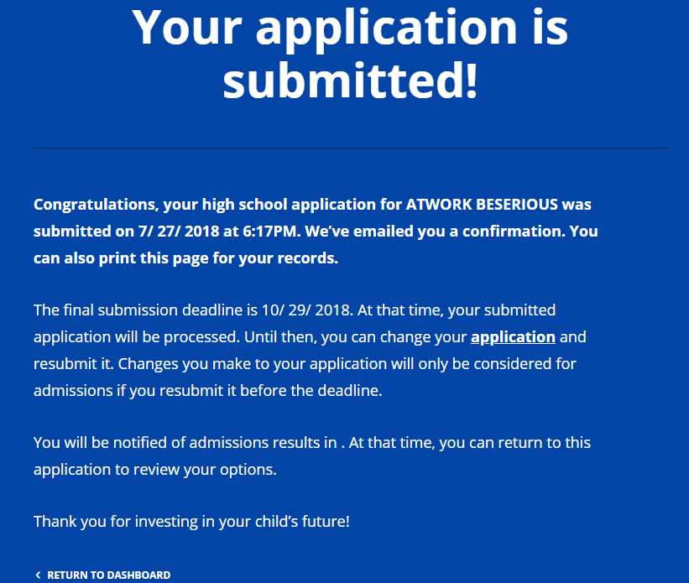
MySchools
12/3
Notes:
Finally, you must confirm this information prior to submitting the application
It is very important to note that the address that is in the system at the point of submission is the address that will be used when determining an offer.

Slide 25
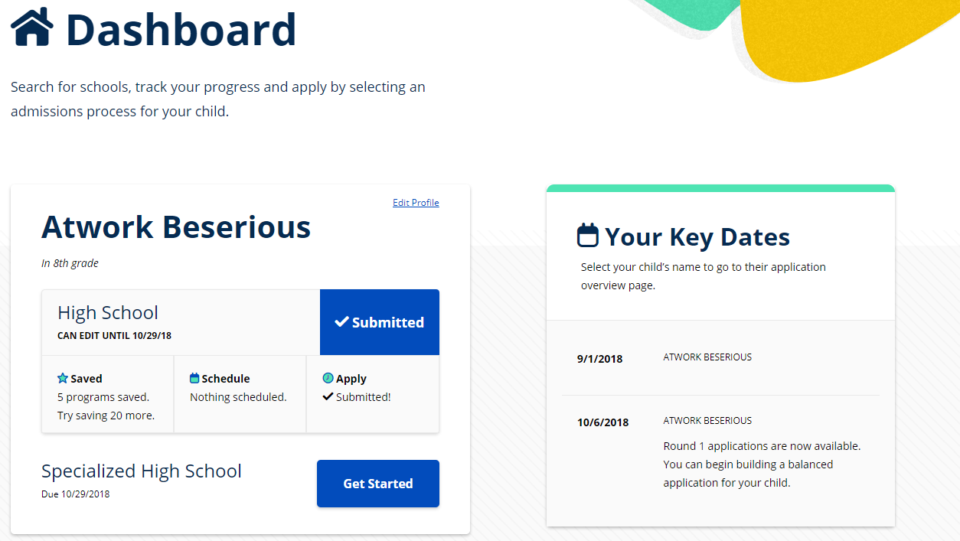
MySchools
12/3/2018
10/11/2018
Notes:
The student Dashboard gives you a summary of where your student is in the process.
If I make a change to your child’s application, I will tell you and you can see that I’ve made a change.

Slide 26
Next Steps
Explore High Schools
Online Application System | MySchools.nyc
2019 NYC High School Directory | schools.nyc.gov/High
NYC School Finder | schoolfinder.nyc.gov
High Schools Email List | schools.nyc.gov/Connect
Attend Events
High School Events Calendar | schools.nyc.gov/High
HS Fairs | September 22 and 23 and October 13 and 14
Tour all schools of interest
Star Corvinelli
scorvinelli@ms447.org | www.ms447.org | 718-330-9328
Notes:
Let me provide you with my contact information. Please feel free to reach out with any questions about your child’s High School Application.
On the High School Admissions Resources website, you can find information about applying to high school (schools.nyc.gov/High). You can also find online copies of the High School Directory and the Specialized High School Handbook.
If you’d like to receive email updates from the Office of Student Enrollment, you can sign up at this website (schools.nyc.gov/Connect).
Thank you for being here today! I look forward to working with you and your child to successfully apply to high school! Please feel free to reach out to me at any time.

Slide 27
Class of 2018 High School Acceptances
Abraham Lincoln | 1 | John Jay School for Law | 2
Art and Design HS | 1 | LaGuardia HS * | 19
Bard HS Early College | 16 | Leon M. Goldstein HS | 1
Bard HS Queens | 7 | Manhattan Hunter Science | 3
Beacon HS | 28 | Midwood HS | 12
Benjamin Banneker Academy | 1 | Millennium Brooklyn | 22
Boerum Hill School for International Studies | 1 | Millennium Manhattan | 1
Bronx Science | 1 | NEST +M | 3
Brooklyn College Academy | 2 | NYC iSchool | 16
Brooklyn Collaborative Studies | 1 | Park Slope Collegiate | 1
Brooklyn Latin * | 11 | Professional Performing Arts | 1
Brooklyn Tech HS * | 34 | Reperatory Company High School | 1
Edward R. Murrow HS | 19 | Science, Tech, and Research Early College HS at Erasmus | 1
Curtis High School | 1 | Special Music School | 1
Essex Street Academy | 4 | Stuyvesant HS * | 3
Fort Hamilton HS | 1 | Telecommunication Arts and Technology | 2
Frank Sinatra School of the Arts | 4 | Urban Assembly Harbor School | 2
HS for Math, Science, and Engineering * | 1 | Urban Assembly Law & Justice | 1
Health Professions | 1 | Urban Assembly Maker Academy | 2
James Madison HS | 3 | Williamsburg Architecture | 1

Slide 28
Private School Forms & Report Card Requests
Private School
Make sure you complete all the steps in the application process. This should include sending the following:
The school application form, test scores, current school record and teacher recommendation forms.
Please note that transcript request forms should be submitted to Star Corvinelli and teacher recommendation forms should be submitted directly to the teachers.
For those forms that must be completed by the School Counselor, please adhere to the following guidelines.
*Please have students bring forms to me at least 2 weeks prior to the date that they must be received by the high school.
*Each form you submit to me must be attached to a pre-addressed stamped envelope.
Recommendation Requests
Due to the overwhelming requests in previous years for recommendation letters, students may only ask for a recommendation if the school requires it (Bard will accept it if the student is granted an interview).
Students who are applying to such schools need to bring in the forms specifically designated for those high schools.
Students must also submit a stamped addressed envelope at least two weeks in advance with any recommendation requests.
Report Card Requests
Students can request an additional copy through Miriam Diaz in the main office.
Notes:
The schedule tab allows you to:
Register for the SHSAT
Register for LaGuardia High School auditions
Express interest in programs that:
Require an audition (other than LaGuardia)
Have an on-site screening assessment (other than the SHSAT, such as Bard)
Have an on-site interview
Student has to submit a portfolio

